Slide 1
Modeling and Simulation Lab# 2: SPICE Simulation
Computer Engineering Department
Faculty of Engineering
Cairo University

Slide 2
Agenda
SPICE Simulator
Modified Nodal analysis

Slide 3
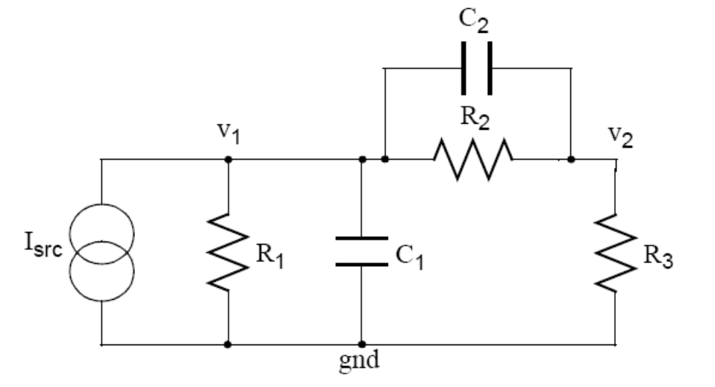
SPICE Simulator
It takes an analog circuit schematic, simulates,
calculates and plots the voltage at each node, and the current produced by each voltage source.

Slide 4
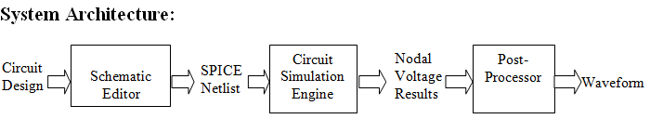
SPICE Simulator

Slide 5
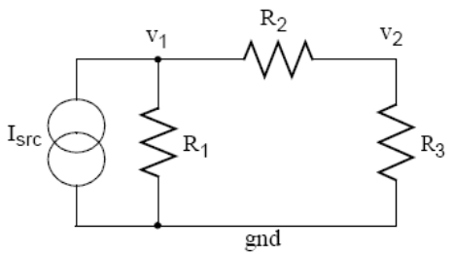
Circuit Simulation Engine
Requirement: Find V1,V2
Simulation solution steps:
1. Find Nodes in the circuit
2 Nodes
1 ground node

Slide 6
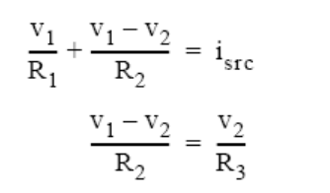
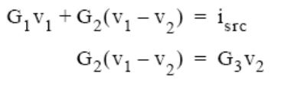
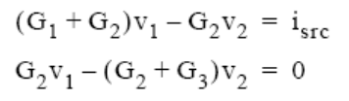
Circuit Simulation Engine
Simulation solution steps[Cont’]:
2. Make KCL at each node.
-> Replace Resistance with conductance G=1/R

Slide 7
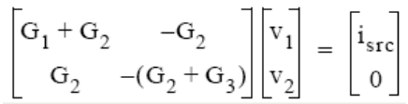
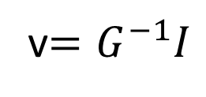
Circuit Simulation Engine
Simulation solution steps[Cont’]:
3. Create conductance matrix.
Gv=I
4.Solve using by a simple matrix manipulation.
v$=G^{−1}I$

Slide 8

Modified Nodal analysis (MNA)
Straightforward analog circuit solver technique based on KCL and KVL.
MNA applied to a circuit with only passive elements (resistors) and independent current and voltage sources results in a matrix equation of the form:
Ax=z
A is a matrix consists only of known quantities.
Z is a vector holds only known quantities
X is a vector holds the unknown quantities (nodal voltages and current sources we want)
The circuit is solved by a simple matrix manipulation:
Notes:
Though this may be difficult by hand, it is straightforward and so is easily done by computer.

Slide 9
SPICE Netlist
1. Find Nodes in the circuit

Slide 10
Netlist Format
------------------------------------------------------------------------
Component_Type | Node1 | Node2 | Value | Initial_Value
------------------------------------------------------------------------
- Component_Type stands for the type of the component. It can be one of the following:
Voltage Source "Vsrc".
Current Source "Isrc".
Resistance "R".
Inductor "I".
Capacitor "C".

Slide 11
Netlist Format[Cont’]
Node1 and Node2 stands for the nodes’ numbers to which the component is connected to. (for uni-polar components as Vsrc, Node1 is the +ve port, Node2 is the –ve port)
Value is the physical value of the component.
Initial_Value is the initial current or voltage that is observed on the component at time=0.
Notes:
Initial_Value has meaning with capacitor and inductor only

Slide 12

Circuit Simulation Engine
Solve Ax=z
The Matrix A
The A matrix will be developed as the combination of 4 smaller matrices, G, B, C, and D.
The A matrix is (m+n)x(m+n) (n is the number of nodes, and m is the number of independent voltage sources).

Slide 13
The G matrix
The G matrix is nxn and is determined by the interconnections between the passive circuit elements (resistors)
The G matrix is an nxn matrix formed in two steps:
1-Each element in the diagonal matrix is equal to the sum of the conductance of each element connected to the corresponding node.
2-The off diagonal elements are the negative conductance of the element connected to the pair of corresponding node.
Notes:
The G matrix is an nxn matrix formed in two steps
Each element in the diagonal matrix is equal to the sum of the conductance (one over the resistance) of each element connected to the corresponding node. So the first diagonal element is the sum of conductances connected to node 1, the second diagonal element is the sum of conductances connected to node 2, and so on.
The off diagonal elements are the negative conductance of the element connected to the pair of corresponding node. Therefore a resistor between nodes 1 and 2 goes into the G matrix at location (1,2) and locations (2,1).

Slide 14
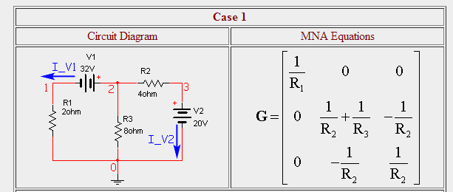
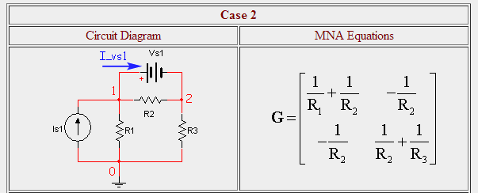
Example:

Slide 15
The B matrix
The B matrix is nxm and is determined by the connection of the voltage sources.
The B matrix is an nxm matrix with only 0, 1 and -1 elements
Each location in the matrix corresponds to a particular voltage source and a node.
If the positive terminal of the ith voltage source is connected to node k, then the element (k,i) in the B matrix is a 1.
If the negative terminal of the ith voltage source is connected to node k, then the element (k,i) in the B matrix is a -1.
Otherwise, elements of the B matrix are zero.
Notes:
The B matrix is an nxm matrix with only 0, 1 and -1 elements. Each location in the matrix corresponds to a particular voltage source (first dimension) or a node (second dimension). If the positive terminal of the ith voltage source is connected to node k, then the element (i,k) in the B matrix is a 1. If the negative terminal of the ith voltage source is connected to node k, then the element (i,k) in the B matrix is a -1. Otherwise, elements of the B matrix are zero.

Slide 16
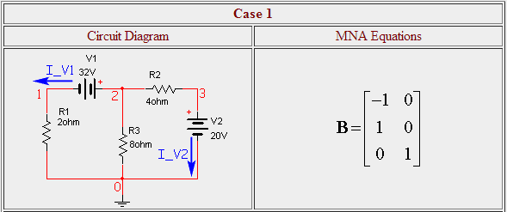
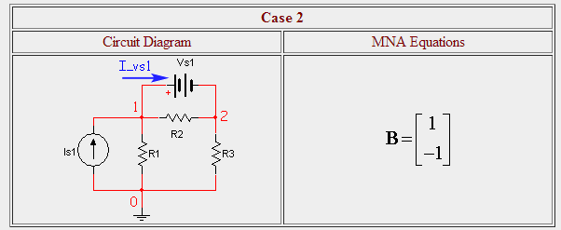
Example

Slide 17
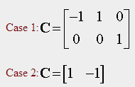
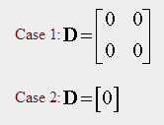
The C & D matrices
the C matrix is mxn and is determined by the connection of the voltage sources.It is the transpose of the B matrix.
The D matrix is mxm and is zero if only independent sources are considered.
These are not the case when dependent sources are present.
Notes:
The C matrix is an mxn matrix with only 0, 1 and -1 elements. Each location in the matrix corresponds to a particular node (first dimension) or voltage source (second dimension). If the positive terminal of the ith voltage source is connected to node k, then the element (k,i) in the C matrix is a 1. If the negative terminal of the ith voltage source is connected to node k, then the element (k,i) in the C matrix is a -1. Otherwise, elements of the C matrix are zero.
In other words, the C matrix is the transpose of the B matrix. (This is not the case when dependent sources are present.)
The D matrix is an mxm matrix that is composed entirely of zeros. (It can be non-zero if dependent sources are considered.)

Slide 18

Circuit Simulation Engine Solve Ax=z The X matrix:
The x matrix holds our unknown quantities and will be developed as the combination of 2 smaller matrices v and j.
The v matrix is nx1 and hold the unknown voltages. Each element in v corresponds to the voltage at the equivalent node in the circuit
The j matrix is mx1 and holds the unknown currents through the voltage sources.

Slide 19
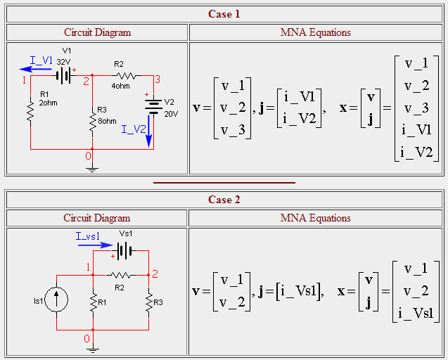
Example
Notes:
The v matrix is an nx1 matrix formed of the node voltages. Each element in v corresponds to the voltage at the equivalent node in the circuit (there is no entry for ground -- node 0).

Slide 20

Circuit Simulation Engine Solve Ax=z The Z matrix:
The z matrix holds our independent voltage and current sources and will be developed as the combination of 2 smaller matrices i and e.
The i matrix is nx1 and contains the sum of the currents through the passive elements into the corresponding node (either zero, or the sum of independent current sources).
The e matrix is mx1 and holds the values of the independent voltage sources.
Notes:
The i matrix is an nx1 matrix with each element of the matrix corresponding to a particular node. The value of each element of i is determined by the sum of current sources into the corresponding node. If there are no current sources connected to the node, the value is zero.
the e matrix is an mx1 matrix with each element of the matrix equal in value to the corresponding independent voltage source.

Slide 21
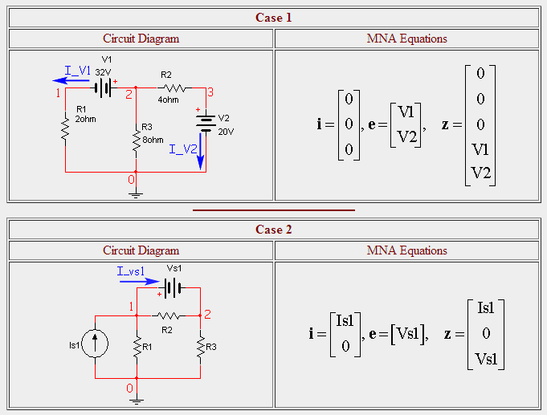
Example

Slide 22
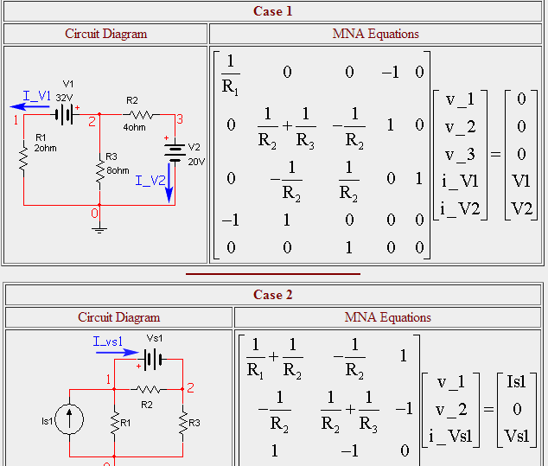
Putting all Together

Slide 23
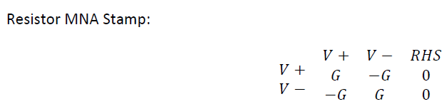
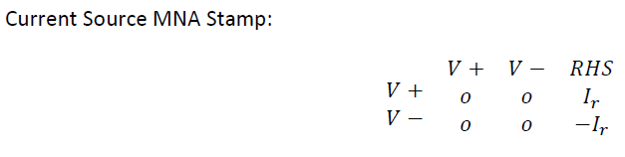
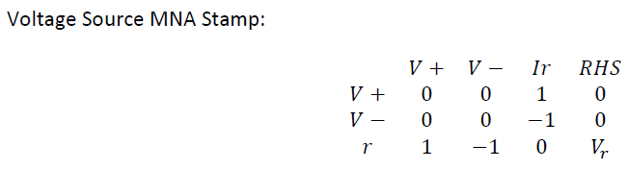
MNA stamp

Slide 24
Recap-System Flow chart
Netlist Parsing
Create matrix A and vectors x, z
Fill A, x, z by the MNA stamps for each component
Solve the algebraic system of equations

Slide 25


