Slide 1
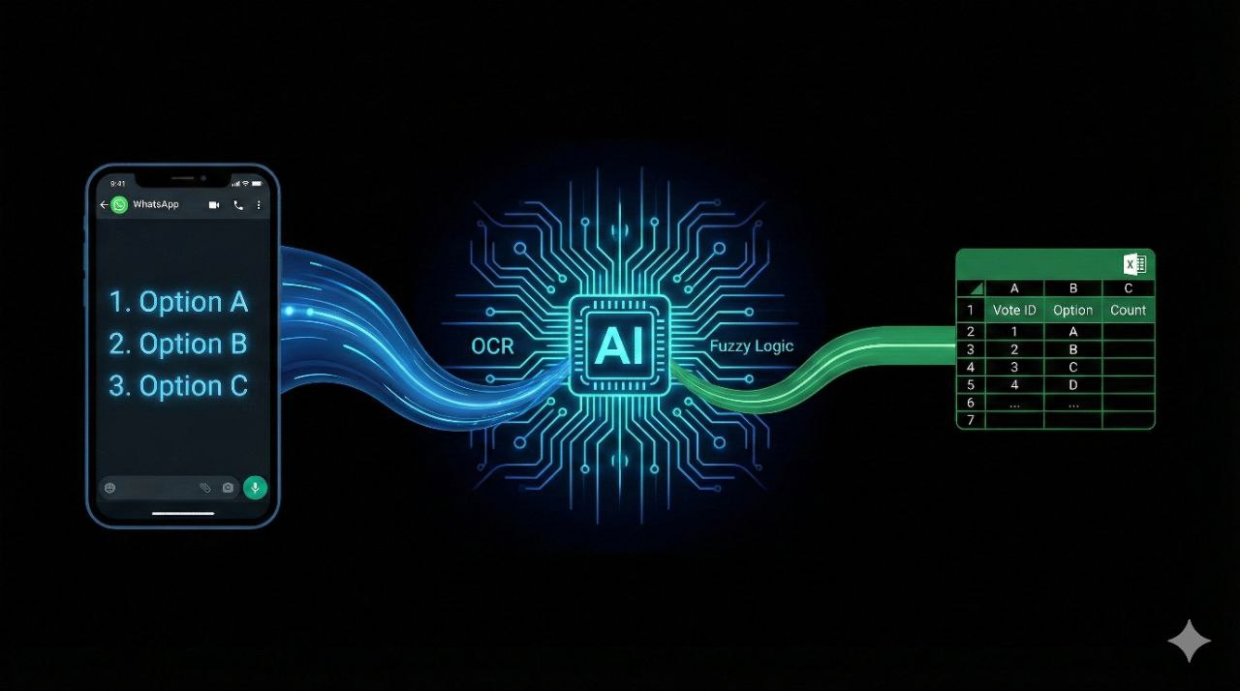
PollToExcel: Automated Vote Extraction System
Leveraging OCR and Fuzzy Logic for Data Automation
Student: Mohammed Hani Abdullah | Course: Artificial Intelligence

Slide 2
The Challenge of Manual Data Entry
Counting votes in WhatsApp groups is a manual, tedious process.
Time-Consuming
Human Error
Scalability
Admins spend hours transcribing lists.
High risk of typos or missing names.
Impossible to manage for groups with hundreds of members.

Slide 3
Automating the Workflow with AI
A Python-based application that converts raw WhatsApp screenshots into structured Excel files.
Automated Text Reading (OCR).
Intelligent Name Classification.
Noise & Timestamp Filtering.
Instant Excel Report Generation.

Slide 4

Technologies Powering the System
OpenCV: For Image Pre-processing (Grayscale & Thresholding).
Tesseract OCR: LSTM Neural Networks for text recognition.
FuzzyWuzzy: Fuzzy Logic algorithm for spelling correction.
Pandas: For data structuring and export.

Slide 5





The Processing Pipeline
Input: Load Screenshot
(Dark Mode).
Pre-processing
Convert to Binary Image (Black/White).
Extraction
Tesseract reads raw text.
Logic Layer
Fuzzy Logic matches text to vote categories (Threshold > 75%).
Output: Clean Excel Sheet.

Slide 6
Beyond Simple OCR: Fuzzy Matching
OCR is imperfect (e.g., reads "Thre" instead of "Three").
We implemented Levenshtein Distance to calculate similarity.
Rule: If Similarity(Extracted_Text, Valid_Option) > 75%, accept the vote.
Outcome: Robustness against spelling errors and noise.

Slide 7

Performance Evaluation
Tested on real-world WhatsApp screenshots.
Metric: Simple Accuracy Classification.
Test Sample:
Correctly Extracted:
14 Voter Names.
10 Names.
Final Accuracy: 71.4%.
Note: Performance correlates heavily with image resolution.

Slide 8
Impact and Next Steps
Conclusion: Successfully demonstrated how Rule-Based AI can solve administrative bottlenecks.
Future Roadmap:
Train a Deep Learning model (YOLO) for better text detection.
Add support for Arabic Language.
Develop a GUI for non-technical users.

