Slide 1

INVESTIGATING THE AUSTRALIAN ROAD TOLL
(1989 – 2021)
CAPSTONE PROJECT
Matt Hacket
Data Scientist
Notes:
Photo by Christian Perner on Unsplash

Slide 2
AGENDA
Biography
01
Introduction to the presenter
Project Context
02
Business Domain
Stakeholders
03
Define
Business question
Related data
04
Deliver
Modelling
Solutions
05
Summarise
Conclusion
Future investigations
Notes:
Photo by Todd Trapani on Unsplash

Slide 3

BIOGRAPHY
Matt Hacket
Postgraduate Diploma of Science (2009)
8 years working in the healthcare industry
Interest in public health and government
Previous data science project investigating Australian motor vehicle accidents:
Mini Project 2 – Investigating the Severity of South Australian MVAs
Notes:
Photo by Aidan Hancock on Unsplash

Slide 4

PROJECT CONTEXT
BUSINESS DOMAIN
Governmental
The recent Federal budget allocated $2.0 billion dollars for the next three years for transport infrastructure improvements
A 2017 study from the Australian Automobile Association has found that:
Total cost of road trauma = $22.2b
The economic cost of each road fatality was $4.34m
Notes:
Photo by Aidan Hancock on Unsplash

Slide 5
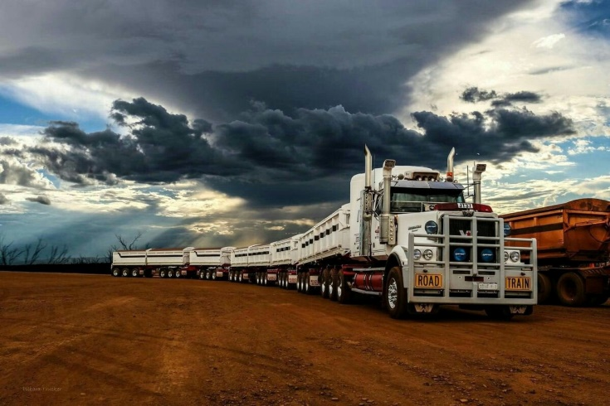
PROJECT CONTEXT
BUSINESS DOMAIN
Transport and Logistics
2018 National Industry Insights Report:
"The Transport and Logistics sector in Australia has an estimated annual revenue of $102.87 billion, with an operating profit of $10.14 billion in 2018.“
Safe Work Australia states that in 2018, 38 workers died in the Transport, Postal and Warehousing industry, with a fatality rate / 100,000 workers of 5.9.
(Second only to Agriculture, Forestry and Fishing – 11.2 / 37 deaths.)
Notes:
Photo by Aidan Hancock on Unsplash

Slide 6

PROJECT AIM
BUSINESS ASPECTS
Who are the key stakeholders?
Governmental, freight industry, families
What is the business question?
Can we predict, based on historical trends, the road toll for the upcoming year? Can we use it to set a target for reducing the road toll?
What is the business value?
A 20% reduction in the road toll for 2020 would have resulted in approximate savings of $3.8b (based on loss of future earnings estimate)
Notes:
Photo by Aidan Hancock on Unsplash

Slide 7

PROJECT AIM
DATA ASPECTS
What is the data question?
Can I source and use available data to accurately predict future road fatalities?
Data required?
Historical data on Australian road toll, including demographic information used to deduce insights
Where was the data sourced?
Data acquired from data.gov.au
Notes:
Photo by Aidan Hancock on Unsplash

Slide 8
PIPELINE
Sourced from Data.gov.au on 15 May – up to April 2021
Visualisation of demographics, factors involved in accidents
Data Acquisition
Cleaning
EDA / Visualisation
Modelling
Interpretation
Deep Learning model used to make predictions.
Replacing null values, feature engineering
Notes:
Photo by Aidan Hancock on Unsplash

Slide 9
DATA
DATA ASPECTS
What is the shape of the raw data?
52,397 observations, 20 features
Visualisation data?
52,397 observations, 17 features
Age, gender, day of week, road user etc.
Modelling data?
388 observations, 1 feature (monthly total)
Notes:
Photo by Aidan Hancock on Unsplash

Slide 10
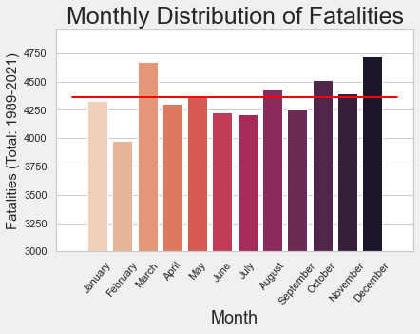
VISUALISATION
March and December feature the most fatalities
February has the least (data has not been scaled to days/month)
Notes:
Photo by Todd Trapani on Unsplash

Slide 11
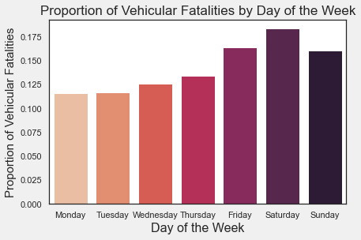
VISUALISATION
Weekends are more conducive to road fatalities
Monday/Tuesday are the least
Notes:
Photo by Todd Trapani on Unsplash

Slide 12
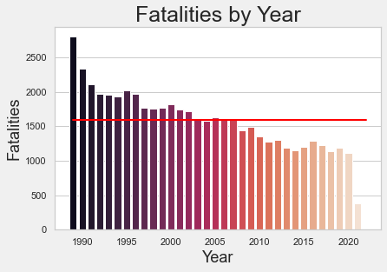
VISUALISATION
1989 had the most fatalities; 2021 data incomplete
General downward trend between 1989-2012, levelling off since
Notes:
Photo by Todd Trapani on Unsplash

Slide 13
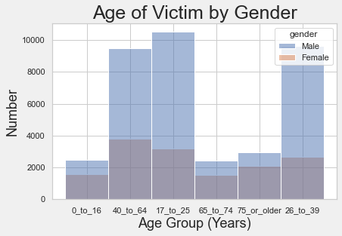
VISUALISATION
Note: Not in age order
Can see that males outnumber females
Largest groups are 17 – 64: most common age of drivers
Notes:
Photo by Todd Trapani on Unsplash

Slide 14
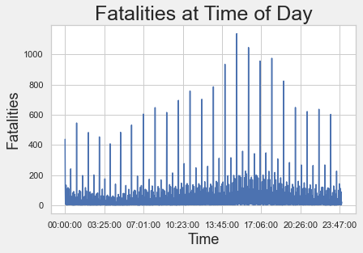
VISUALISATION
Most fatalities occur between 1400 – 1800 (peak)
Schools, tradies, office workers commuting
Notes:
Photo by Todd Trapani on Unsplash

Slide 15
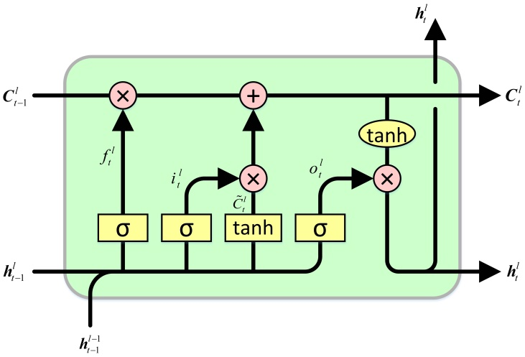
MODELLING
MODEL CHOSEN
LSTM
Long Short Term Memory
Recurrent Neural Network designed to ‘remember’ aspects of previous data – counters the diminishing gradient issue with NN
Modelling data
388 observations, 1 feature (monthly total)
12, 24, 48 month timesteps used for validation (2 Layer LSTM) (100 epochs)
12 month timestep used for prediction (Encoder-Decoder 2 Layer LSTM) (100 epochs)
Notes:
Photo by Aidan Hancock on Unsplash

Slide 16
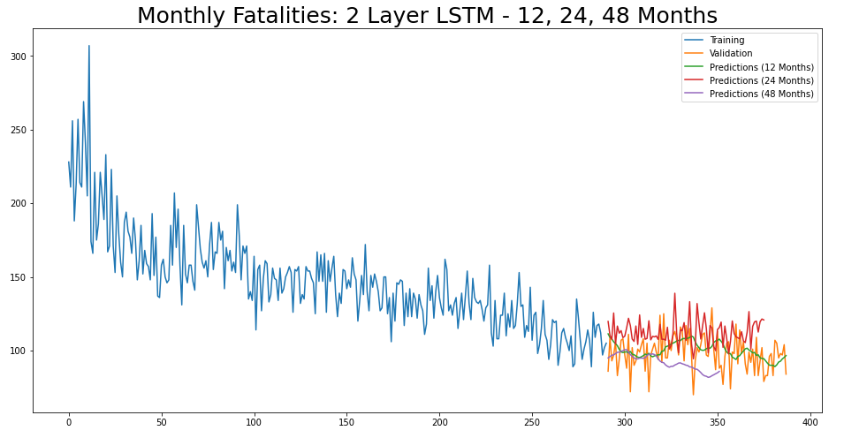
VALIDATION
388 months from 1989 – 2021:
12 month window follows the best
24 and 48 months
Notes:
Photo by Todd Trapani on Unsplash

Slide 17
PREDICTIONS
MONTH | 2020-2021 | 2021-2021 | -20% | TARGET
MAY | 83 | 90 |  | 72
JUNE | 83 | 91 |  | 72
JULY | 96 | 92 |  | 72
AUGUST | 98 | 92 |  | 72
SEPTEMBER | 83 | 92 |  | 72
OCTOBER | 107 | 92 |  | 72
NOVEMBER | 105 | 91 |  | 72
DECEMBER | 95 | 90 |  | 72
JANUARY | 98 | 90 |  | 72
FEBRUARY | 97 | 89 |  | 72
MARCH | 104 | 89 |  | 72
APRIL | 84 | 89 |  | 72
Predictions are smoothed over the 12 months
Targeting a 20% reduction would be large effort but would result in $3.8b in savings
Validation predictions assessed using RMSE ~ 3
Predictions RMSE ~ 12
Notes:
Photo by Aidan Hancock on Unsplash

Slide 18
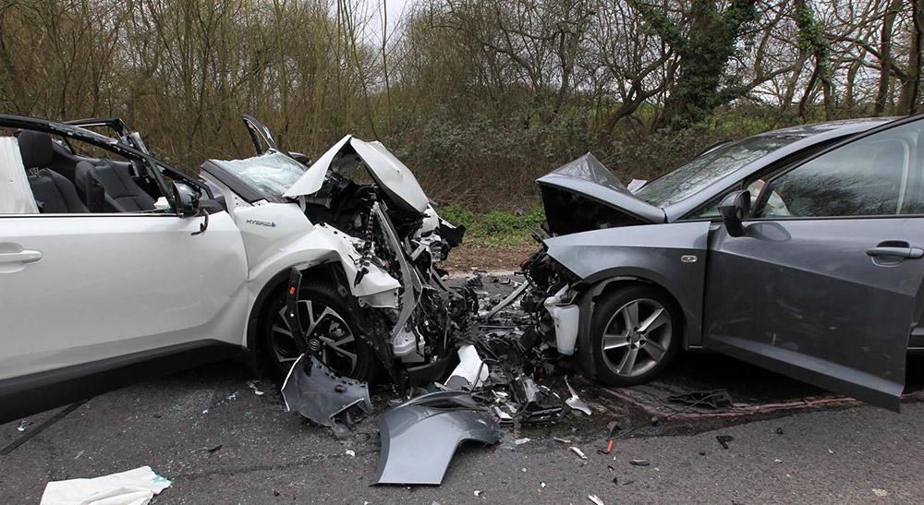
SUMMARY
CONCLUSION
A 20% reduction would be a large effort but would save a large amount of lost potential earnings for the economy and emotional cost for families
SUGGESTION
A driver education campaign would be the suggested modality: focussing on being courteous and cautious around peak traffic times and weekends (potentially targeted towards males)
Notes:
Photo by Aidan Hancock on Unsplash

Slide 19
SUMMARY
LIMITATIONS
LSTM might be too complex for this type of analysis: the predicted output didn’t seem much different from a rolling average (my estimation)
Find a way to include demographic data in the modelling
Use other regression methods to compare outputs
Notes:
Photo by Aidan Hancock on Unsplash

Slide 20
THANK
YOU

Slide 21
APPENDIX
NOTEBOOKS
MVA_Capstone
mva_capstone_pp
mva_lstm
mva_capstone_univariate_lstm_final
DATA
ardd_fatalities_apr_2021.csv
df_pp.csv
df_my.csv
df_lstm.csv
Notes:
Photo by Aidan Hancock on Unsplash

