Slide 1
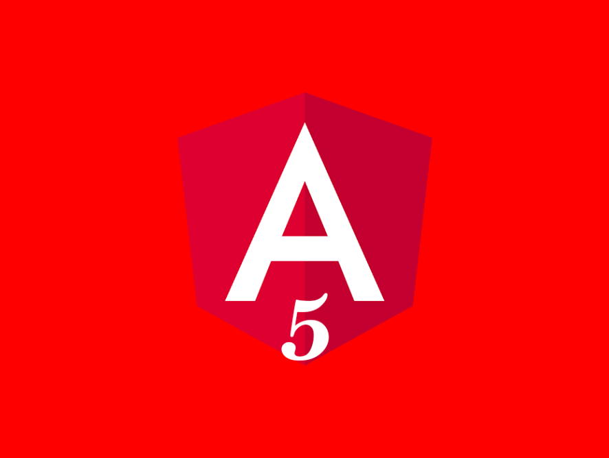
Advanced
State management
in Angular
Angular Oslo meetup
14th, Feb 2018
Majid Hajian

Slide 2

ABOUT ME
Passionate web developer
Angular enthusiast, Over 4+ experiences
Open Source lover and contributor
Public speaker,
Trainer @PacktPub
Majid Hajian
@mhadaily

Slide 3
Redux

Slide 4
THREE PRINCIPLES
Single source of truth
State is read-only
Pure functions update state

Slide 5
SINGLE SOURCE OF TRUTH
One state tree inside Store
Predictability, maintainability
Universal apps (SSR)
Testing and debugging

Slide 6
STATE IS READ-ONLY
Derive specific props from state
Dispatch actions to change the state
Immutable update patterns

Slide 7
PURE FUNCTIONS UPDATE STATE
Pure functions (reducers)
Reducers look for action types
Return new state

Slide 8
CORE CONCEPTS
Single state tree
Actions
Reducers
Store
One-way dataflow

Slide 9
const state = {
products: []
}

Slide 10
const action = {
type: 'ADD_PRODUCT',
payload: {
id: 1,
title: 'Awesome Angular'
}
}

Slide 11
function reducer(state, action) {
switch (action.type) {
case 'ADD_PRODUCT':
{
return {
products: [
...state.products,
action.payload
]
};
}
}
return state;
}

Slide 12
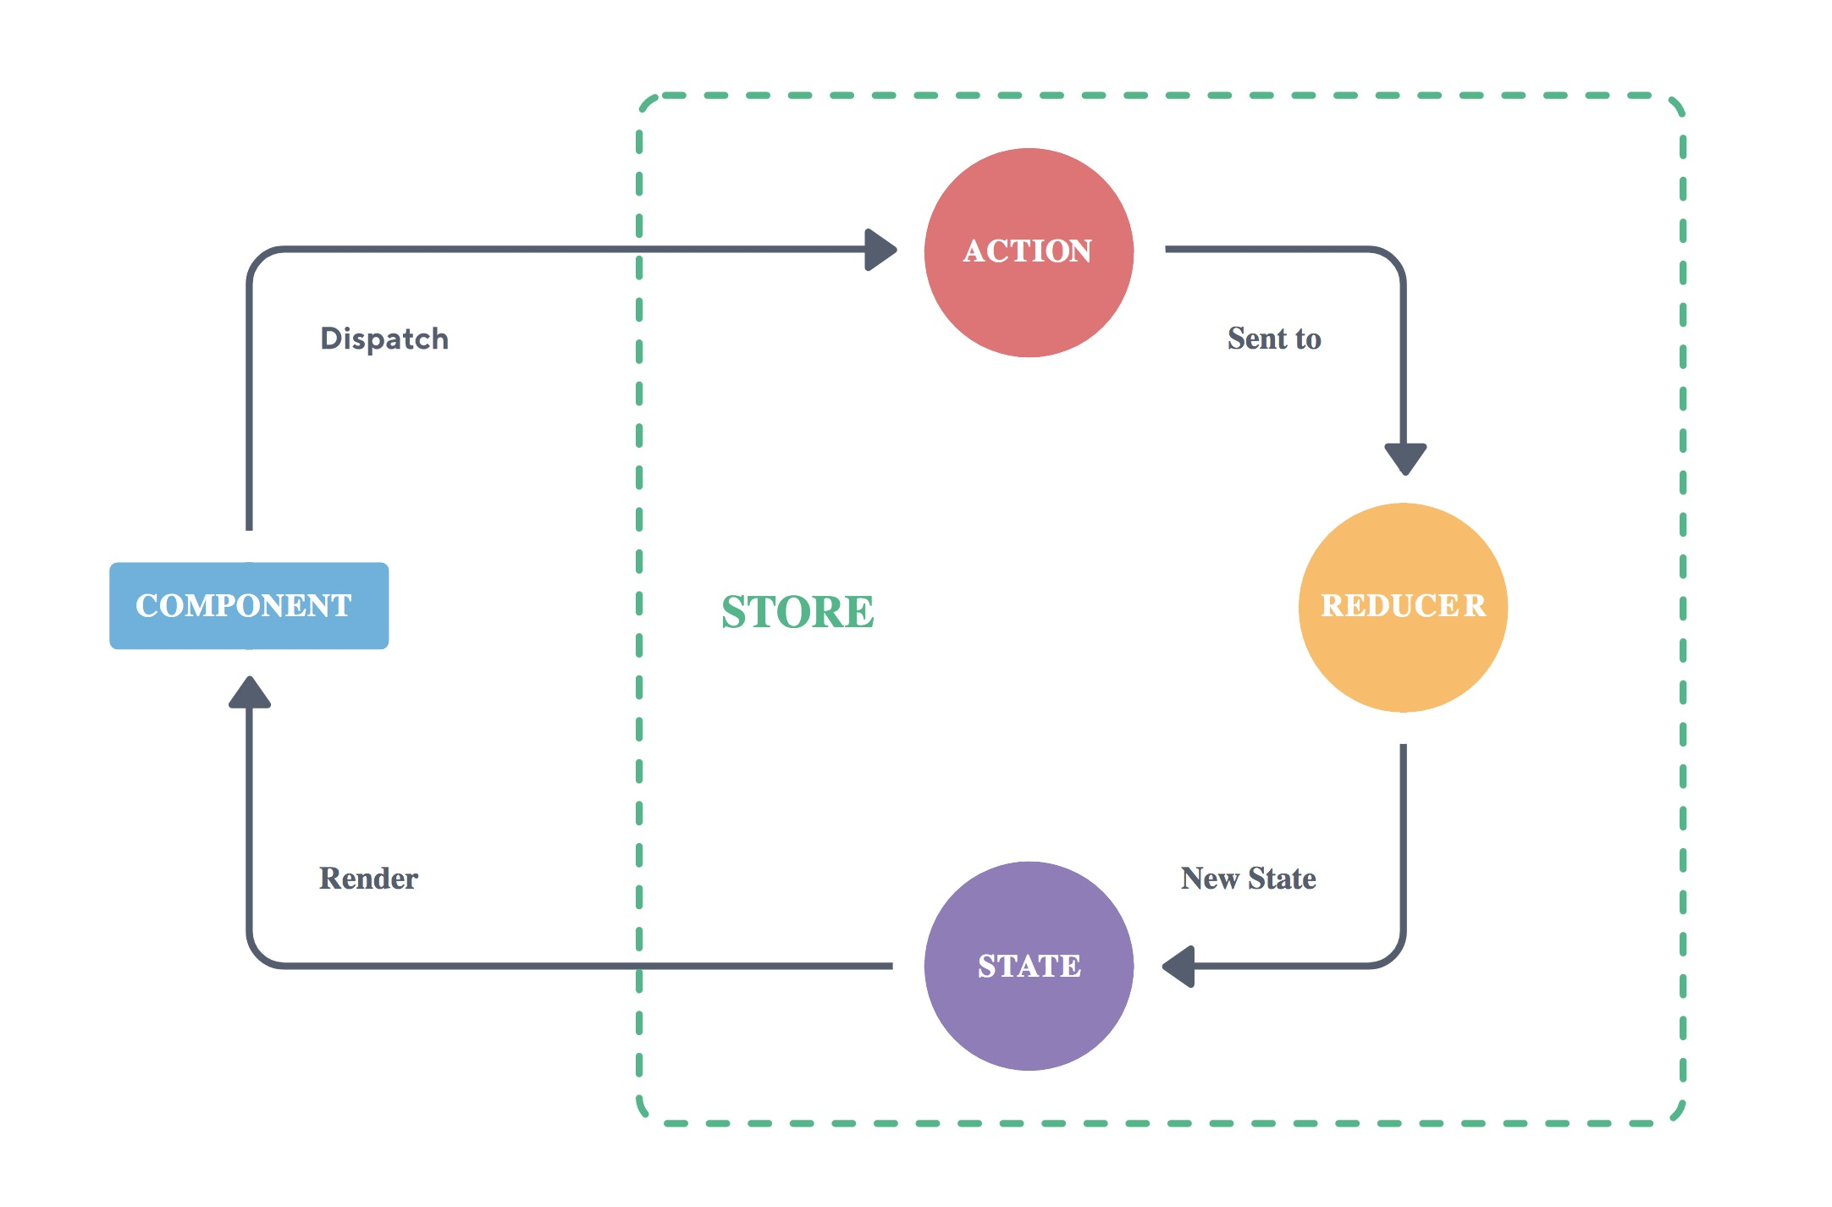

Slide 13

NGRX

Slide 14
@ngrx/store - RxJS powered state management for Angular applications, inspired by Redux
@ngrx/effects - Side Effect model for @ngrx/store to model event sources as actions.
@ngrx/router-store - Bindings to connect the Angular Router to @ngrx/store
@ngrx/store-devtools - Store instrumentation that enables a powerful time-travelling debugger.
@ngrx/entity - Entity State adapter for managing record collections.
@ngrx/schematics - Scaffolding library for Angular applications using NgRx.

Slide 15
NGRX/STORE
Single source of truth
Testability
Performance benefits
ChangeDetectionStrategy.OnPush
Immutable @Inputs
Object reference checks are fast
Root and feature module support
Eagerly loaded modules
Lazily loaded modules

Slide 16
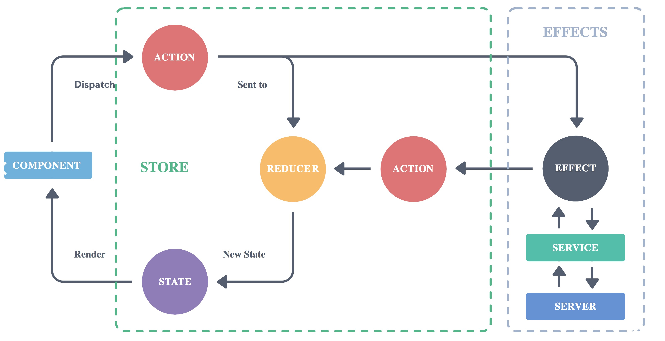

Slide 17
NGRX/EFFECTS
Listen for @ngrx/store actions
Isolate side effects from components
Communicate outside of Angular

Slide 18
NGRX/entity
Reduces boilerplate for creating reducers that manage a collection of models.
Provides performant CRUD operations for managing entity collections.
Extensible type-safe adapters for selecting entity information.

Slide 19
NGRX/SCHEMATICS
generating files when building out feature areas using NgRx. Built on top of Schematics, it integrates with the Angular CLI to make setting up and expanding NgRx in Angular applications easier.

Slide 20
CODE
DEMO TIME

Slide 21
THANK YOU
See You Next Time
MAJID HAJIAN
@mhadaily

