Slide 1

Diphtheria Analysis

Slide 2
Author:
Mohammad Hadi Hossaini
m.hadi.hossaini@gmail.com

Slide 3
Contents:
Background
Objective
Methods
Graphs
Map
Pie chart
Linear chart
Bar chart
Results
Discussion
Conclusion

Slide 4
Background:
Diphtheria is a highly contagious bacterial infection caused by Corynebacterium diphtheriae
Before the introduction of the vaccine
epidemics occurred 1887
outbreak in various states of the United States
More than 100k in many states
The fatality rate exceeded 10% of the reported cases
Objective:
This study investigates the prevalence and distribution of diphtheria cases in different regions and time periods in the United States
the study aims to identify peak years and affected areas
The objective is to gain insights into the patterns and geographical spread of diphtheria

Slide 5
Methods
Dataset:
The data was taken from https://healthdata.gov/dataset/Project-Tycho-Level-2-Data/8ihh-ztee/data
The "Project Tycho Level 2 Data" dataset covers the period from 1887 to 2014.
Project Tycho v2 comprises 5.7 million counts of infectious diseases in the United States
Preprocessing steps were performed to remove irrelevant columns and focus on essential data
The analysis identified peak periods of diphtheria, providing insights into the intensity of the disease during specific years.
By visualizing the data, the states with the highest number of diphtheria cases and deaths were identified, aiding in understanding the geographical distribution and severity of the disease.

Slide 6
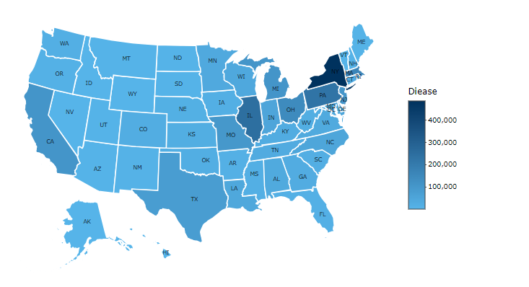
Graphs
Distribution of DIPHETHERIA cases all over US

Slide 7
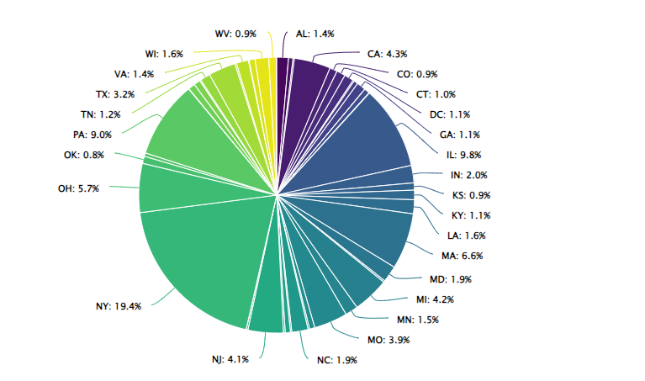
DIPHETHERIA cases by state

Slide 8
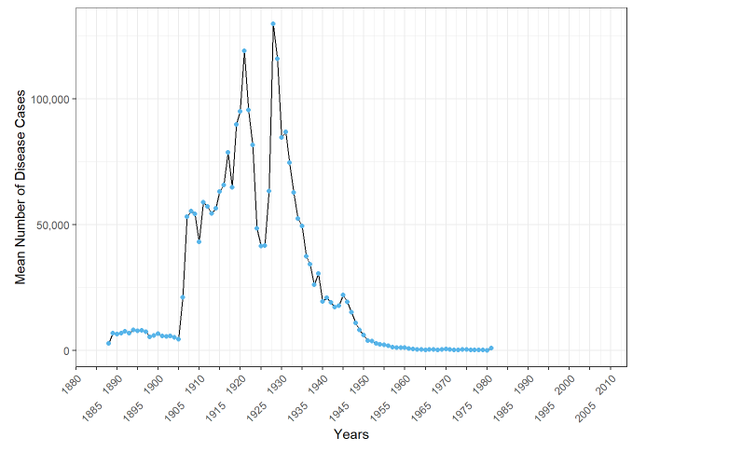
Linear graph DIPHTHERIA from 1880 to 2014

Slide 9
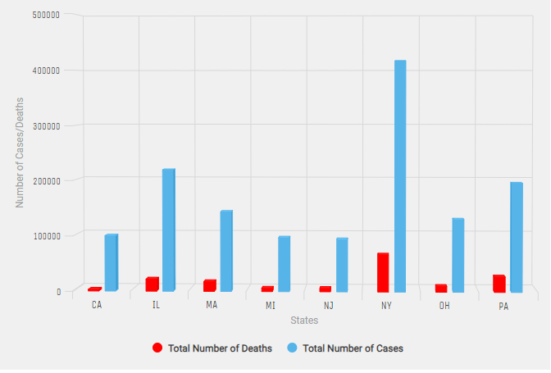
Bar chart of cases and deaths in states with more than 100k cases

Slide 10
Results:
The northeast side of the US, along with Illinois and New York, experienced a higher burden of diphtheria cases, indicating significant impact and distribution of the disease.
NewYork had the highest number of reported cases near to 500k , followed by Illinois in the second place and Pennsylvania third scoring around 200k
A significant increase in diphtheria cases occurred in 1905, with a peak between 1925 and 1930, followed by a gradual decrease and a plateau until 1980, indicating temporal patterns in disease occurrence.
New York had the highest number of deaths, with a death rate of 16% among reported cases, while Illinois had a death rate of 10% and Pennsylvania had a death rate of 14%.
The disease accounted for 8.3% of all reported deaths, emphasizing the severity and impact of diphtheria on public health.

Slide 11
Conclusion:
This study shows that,
The northeast side of the country, particularly Illinois and New York, emerged as the most affected regions with a higher volume of reported cases
Temporal analysis revealed significant fluctuations in diphtheria cases, with a notable increase in 1905 and a peak between 1925 and 1930, followed by a gradual decline until 1980.
Despite Pennsylvania having the second-highest number of cases, New York had the highest proportion of deaths related to diphtheria.

