Slide 1

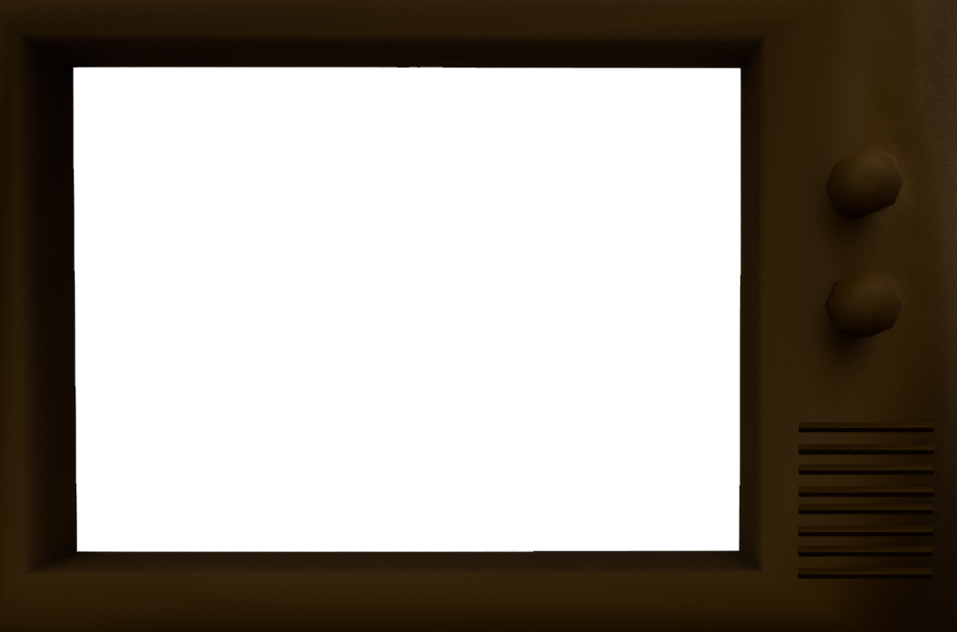
Ascension of Atlas Prototype
Oshawott:
Haydon Derrick
Leon Stone
Matthew Hadley

Slide 2
Game Outline
Ascension of Atlas is an open-world, turn-based strategy game set in the near future
The game consists of exploring an open-world and running into random enemy encounters that take you into a battle scene
In the battle you can use a range of attacks and options unlocked through the progression of the game
The goal is to strengthen your character until you can defeat the boss

Slide 3
Team Breakdown
The development tasks were broken down like this:
Game world, character movement – Haydon
Enemies AI and models, and a save system – Leon
Player combat system UI and code – Matt
Currently, we have achieved the following ->

Slide 4
Haydon

Slide 5
Matt
UI – Created some buttons but currently only flee and attack have any functionality which is listed below; Attack - deals a random amount of damage between editable values and destroys the enemy when it’s out of health
Flee – Flees the scene (literally) by sending the player back to the over world scene.
Battle Scene – The scene that the game moves too when you engage with an enemy in the over world. The camera is positioned to show the player and enemy and the available options the player has.
Problems encountered – due to the way the buttons are set up, the button trigger overlaps meaning it’s harder to press some of the buttons, for now I got around this by simply clicking at the edge of the buttons, but in the future the sizes of the button triggers will be reduced to not overlap

Slide 6
Matt 2

Slide 7
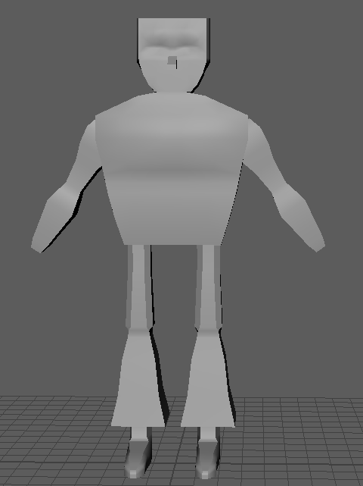
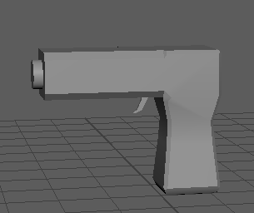
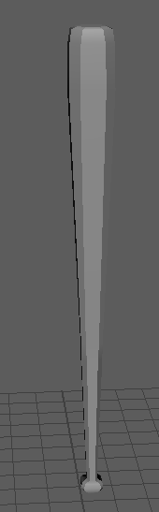
Leon
Saving
Enemy models

Slide 8
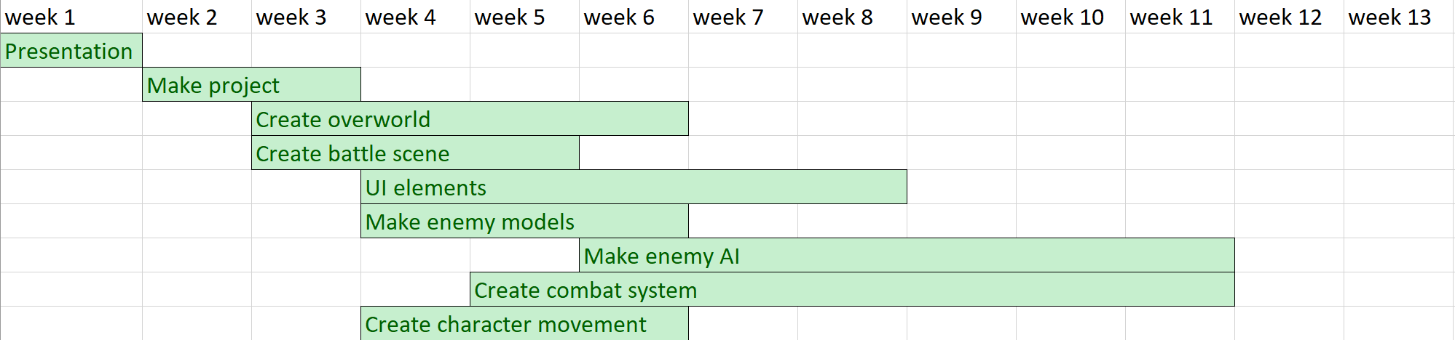
Proposed Timeline

Slide 9
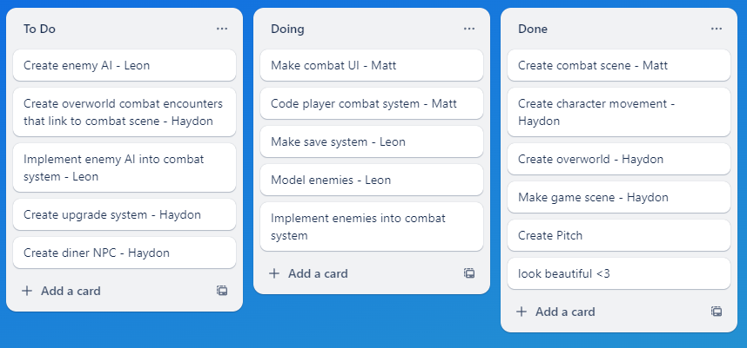
Current Position

Slide 10
Evaluation
The team is on a good trajectory for development
The enemy AI (week 6)hasn’t been started but that timeline was decided upon before the difficulty of saving was known about
If you adjust the timeline gantt chart to include the creation and implementation of the save system, the team is on schedule.

Slide 11
Going Forward
Haydon | Matt | Leon
Create random encounters | Update UI | Texture and implement enemy models
Create diner upgrade system | Create script to make the combat turn-based | Create enemy AI that interacts with turn-based script

