Slide 1
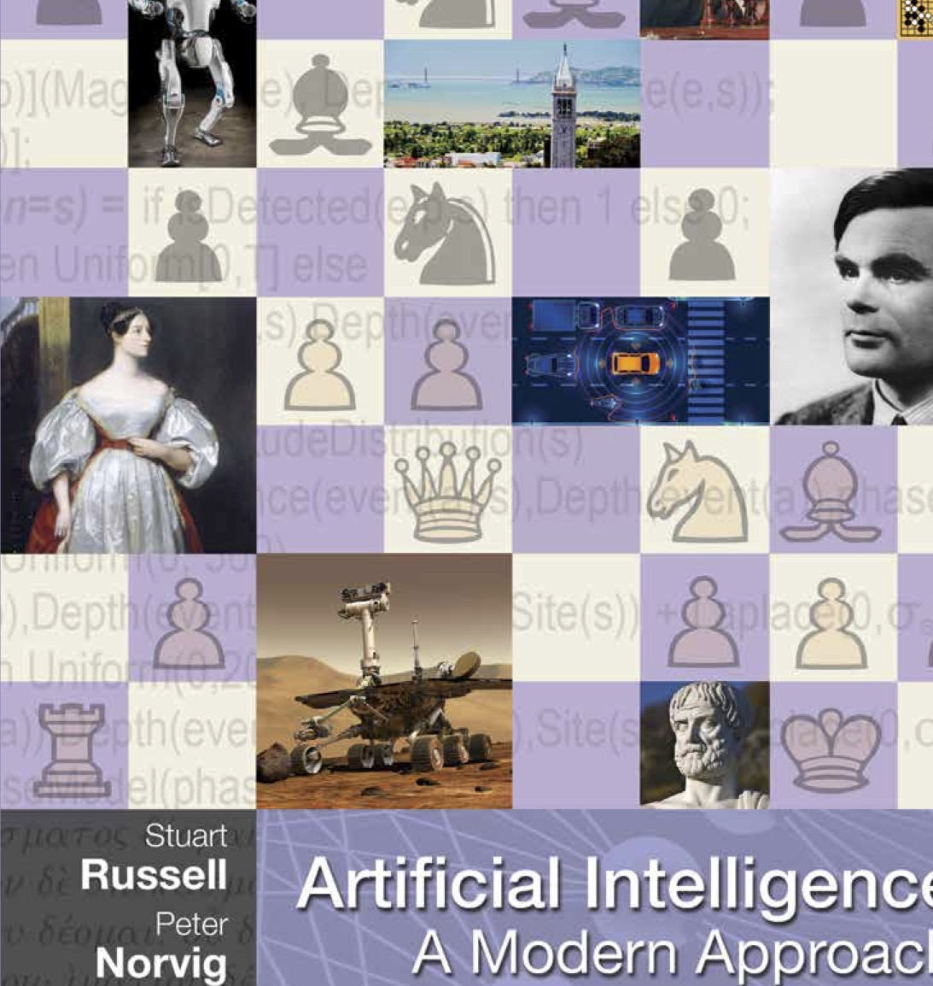
CS 5/7320 Artificial Intelligence Introduction AIMA Chapter 1
Discussion
Slides by Michael Hahsler with figures and cover art from the AIMA textbook.
This work is licensed under a Creative Commons Attribution-ShareAlike 4.0 International License.

Slide 2
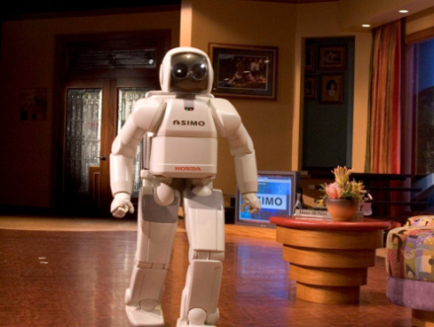
Module Review

Slide 3
The Goal of AI
“Have machines solve problems that are challenging for humans.”
We call such a machine an intelligent agent.
Narrow AI
Artificial General Intelligence (AGI)
Artificial Superintelligence
An intelligent agent that can solve a specific problem. E.g., drive a car or play chess.
A hypothetical intelligent agent which can understand or learn any intellectual task that human beings can. [Wikipedia: AGI]
A hypothetical intelligent agent possessing intelligence surpassing that of the brightest and most gifted human minds. [Wikipedia: Superintelligence]
How can we achieve this? Create an agent that can:
Think like a human?
Act like a human?
Think rationally?
Act rationally?

Slide 4

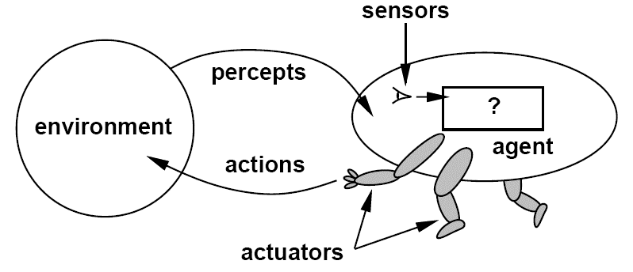
Components of an Intelligent Agent
Intelligent agents act rationally in their environment.
They need to
Communicate with the environment using percepts and actions.
Represent knowledge, reason and plan to achieve a desired outcome.
Optional
Learn from experience to improve performance. This uses Machine Learning (ML)
Developer
Agent interacting with the environment [Artificial Intelligence: A Modern Approach, Editions 1-3]

Slide 5
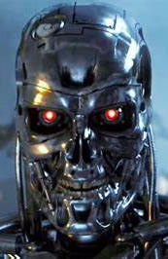

AI Safety and Optimizers
Intelligent Agents are “optimizers!”
Goal/reward alignment: How do we specify a robust objective function? Whose objectives are used?
Reward hacking: The AI learns to exploit unintended side effects to get a high “score” without solving the objective. AI needs to follow social norms.
Instrumental convergence: All intelligent agents will pursue common subgoals like the need for more power to get better at reaching its objectives. How will this need be balanced with human’s needs?
Instrumental convergence
Alignment?
Goals
Objectives and Rules
Reward hacking
Intelligent Agent
User
Side effect
Action
Alignment?
program
train
Goals
select
Data
Developers / Owners
Credit: Terminator 3: Rise of the Machines. Warner Bros.

Slide 6

Case Study: LLMs

Slide 7
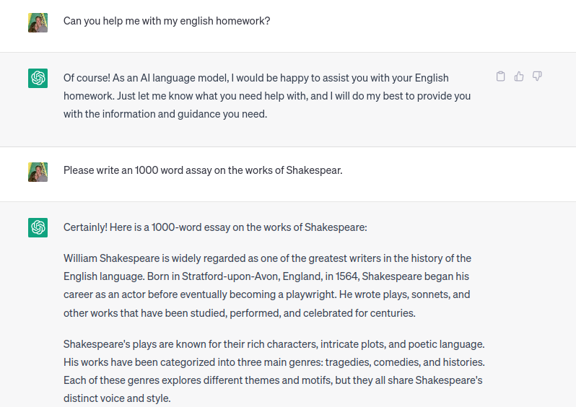
Example Conversation With a Large Language Models (LLMs)
What are the LLMs
Percepts?
Actions?
Objectives?
…
Source: https://chat.openai.com/

Slide 8
Large Language Models (LLMs)
AGI?
“A large language model (LLM) is a computational model notable for its ability to achieve general-purpose language generation and other natural language processing tasks such as classification
…
LLMs acquire these abilities by learning statistical relationships from vast amounts of text during a computationally intensive self-supervised and semi-supervised training process.
LLMs can be used for text generation, a form of generative AI, by taking an input text and repeatedly predicting the next token or word.”
Source: Large language model – Wikipedia https://en.wikipedia.org/wiki/Large_language_model
How?
Is this intelligent?

Slide 9
How do Large Language Models fit into the AI Framework in this Course?
think like a human?
act like a human?
think rationally?
act rationally.
What do LLMs do?
Do LLMs act rationally?
Ask a chatbot if it
acts rational
Is an intelligent agent

Slide 10
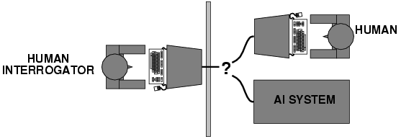
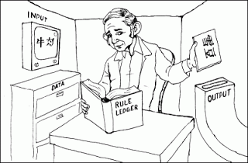
Turing Test: Large Language Models (LLMs)
act like a human?
How do LLMs relate to this:
Chinese Room Argument
Would a modern LLM pass the Turing Test?
Would you be fooled?
Why does it or does it not pass your test?
What does this mean for artificial general intelligence (AGI) or narrow AI?
How do we currently test the performance of LLMs?
See : Open LLM Leaderboard (Hugging Face)
Thought experiment by John Searle (1980): Imitate intelligence using rules.

Slide 11
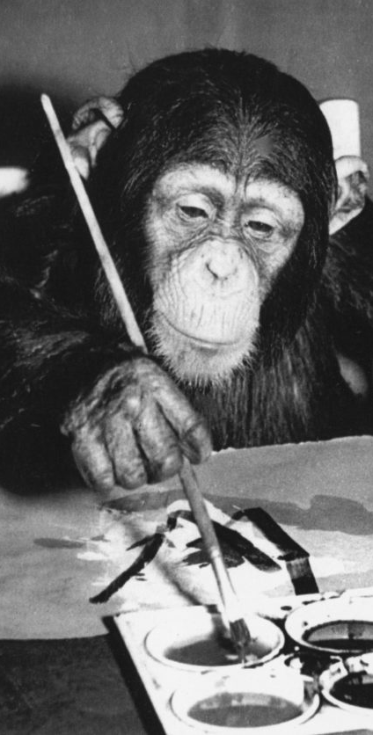
The AI Effect: AI gets no respect?
How do you think LLMs will affect the value of being able to write assays as taught in high school?
LLMs write computer code. What does this mean for the value of learning to code?
When should students be allowed to use the following tools? Give reasons for your decision.
A pocket calculator
LLMs (to answer homework questions and write assays)
LLMs to write or support writing code

Slide 12

AI Safety
Max. probability of next Word
Alignment?
Goals
“Prevent accidents, misuse, or other harmful consequences of AI.”
User
Intelligent Agent: LLM
How are LLMs affected by:
Robustness: Black swan vs. adversarial robustness
Monitoring AI
What about liability?
Goal/reward alignment
Reward hacking
AGI and instrumental convergence
Alignment?
Generated Text
program
train
Goals
select
Data
Developers / owners

Slide 13
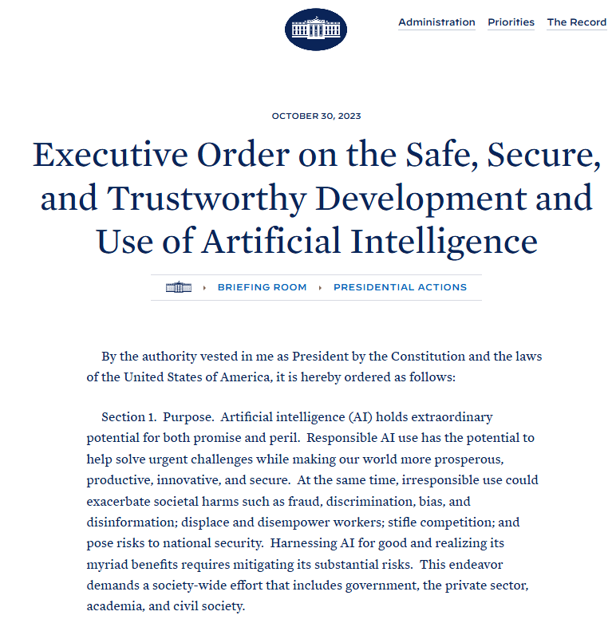
USA: Executive Order on the Safe Use of AI
Some important points:
Artificial Intelligence must be safe and secure.
Promoting responsible innovation, competition, and collaboration
Americans’ privacy and civil liberties must be protected.
Should the use of LLMs be regulated?
How?
What about copyright?

Slide 14

Conclusion
LLMs are a powerful new generative AI technology which many applications.
Unfortunately, there are many open questions. For example:
How do LLMs reason and what are the limits?
How do we make sure that LLMs generate factually correct output?
How do we fairly compensate the people who create the data that is used to train LLMs?
How do we use LLMs in learning, so human learning is not compromised?

