Slide 1
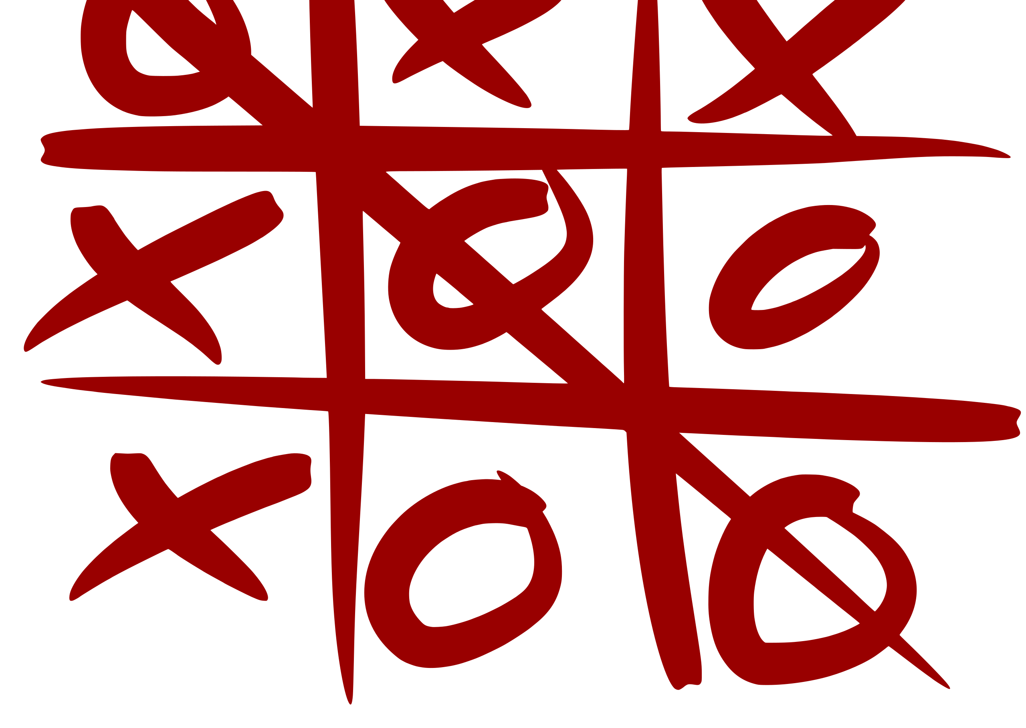
CS 5/7320
Artificial Intelligence
Learning from Examples: Learning to Score a Tic-Tac-Toe board
AIMA Chapter 19
Discussion
Michael Hahsler

Slide 2
Intro: Learning from Examples
What can be learned?

Slide 3

Learning from Examples
Up until now in this course:
  Hand-craft algorithms to make rational/optimal or at least good decisions.
  Examples: Search strategies, heuristics, and constructing Bayesian networks.
Issues
  We may not be able to anticipate all possible future scenarios.
  We may have examples, but we do not know how to implement a solution.
Supervised Machine Learning
  Uses observations: training data with the correct answers.
  Learn a function (model) to map an input (e.g., state) to an output (e.g., action) representing the desired behavior.
  Examples:
    Use a naïve Bayesian classifier to distinguish between spam/non-spam.
    Learn a playout policy to simulate games (current board -> good move)
Data
(behavior)
Algorithm
chooses actions
creates
Data
(observations)
learn
Model
chooses actions

Slide 4
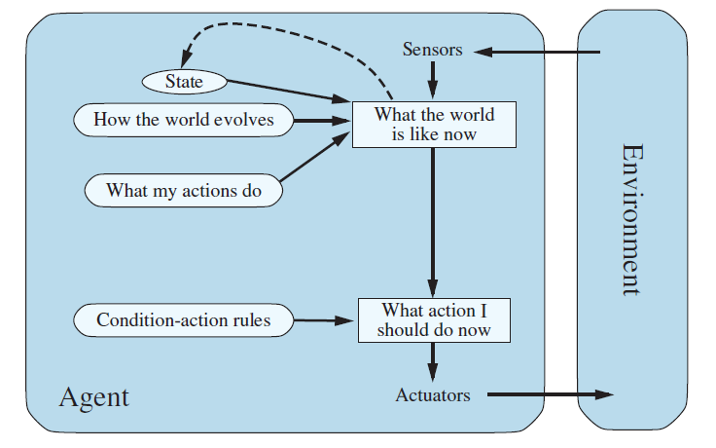




Learning Components of an Agent
We can learn many different components of an agent from examples
Example: Learning components of a model-based reflex agent
Learn the state representation
Learn a utility function
Learn the transition model
$$p$$
$$s^{′}=T(s,a)$$
$$a=f(p,s)$$
$$a$$
Learn rules

Slide 5
Example: Tic-Tac-Toe
Approaches to implement/learn an evaluation function.

Slide 6


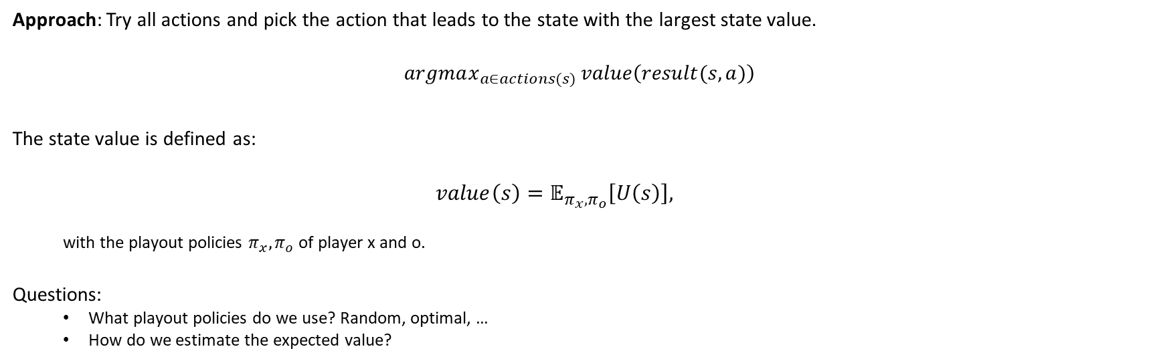
Utility of Being in a State: State Value
State $s$
$$value\left(s\right)$$
Approach: Try all actions and pick the action that leads to the state with the largest state value.
$$argmax_{a∈actions(s)} value\left(result(s, a)\right)$$
The state value is defined as:
  $$value\left(s\right)=𝔼_{π_{x},π_{o}}\left[U\left(s\right)\right],$$
  with the playout policies $π_{x},π_{o}$ of player x and o.
Questions:
  What playout policies do we use? Random, optimal, …
  How do we estimate the expected value?
Expectation is used for stochastic playout strategies!

Slide 7
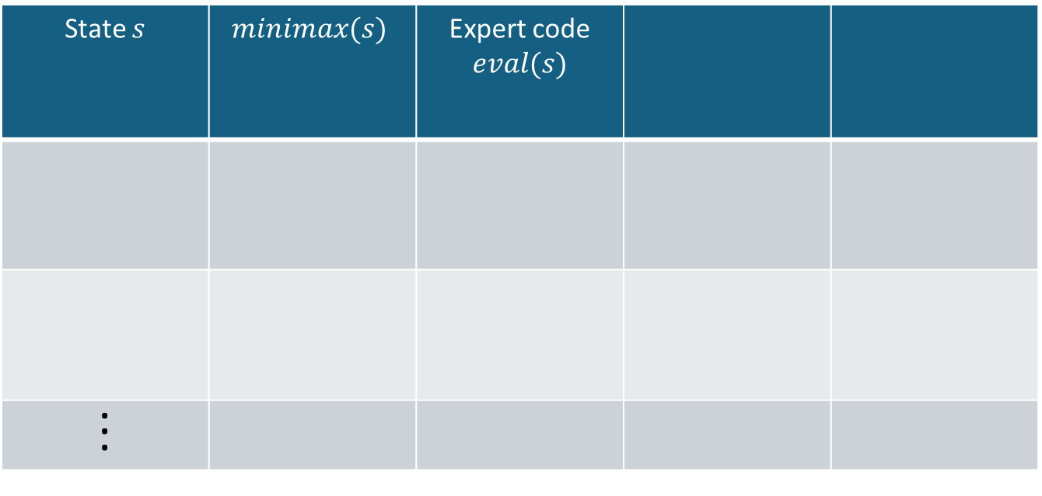


Minimax and Variations
$$value\left(s\right)≈E_{π_{x},π_{o}}[U(s)]$$
State $s$ | $$minimax(s)$$ | Expert code $$eval(s)$$
. . .
1
0
Playout policy
$π_{x},π_{o}$
optimal play
Method
Tree search

Slide 8
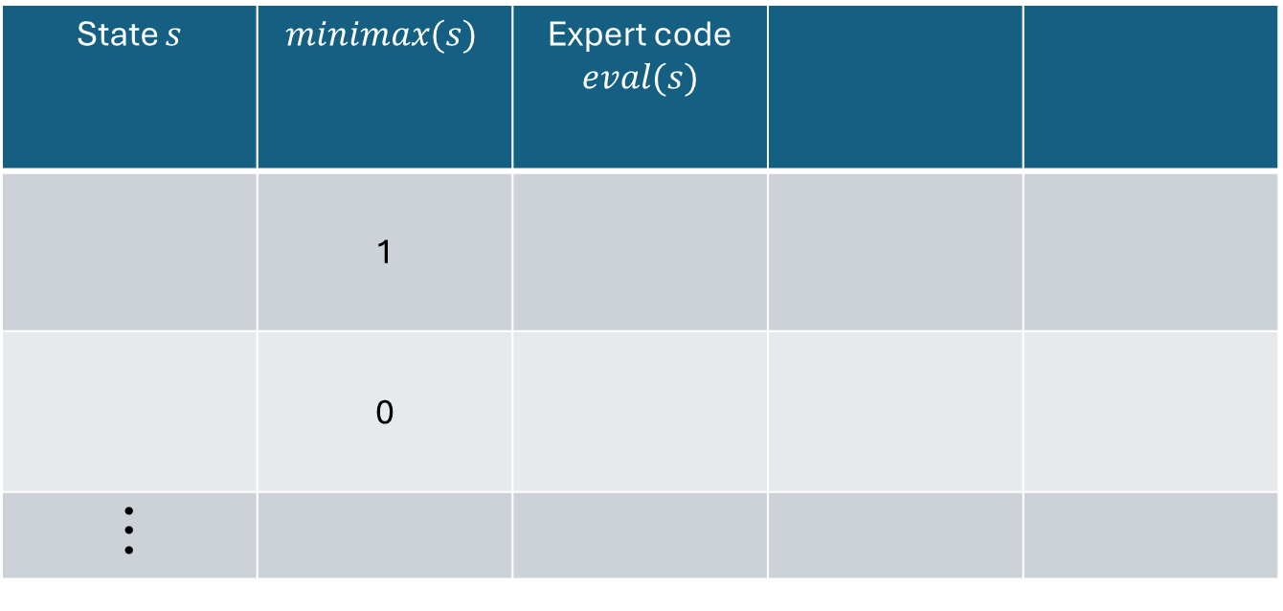
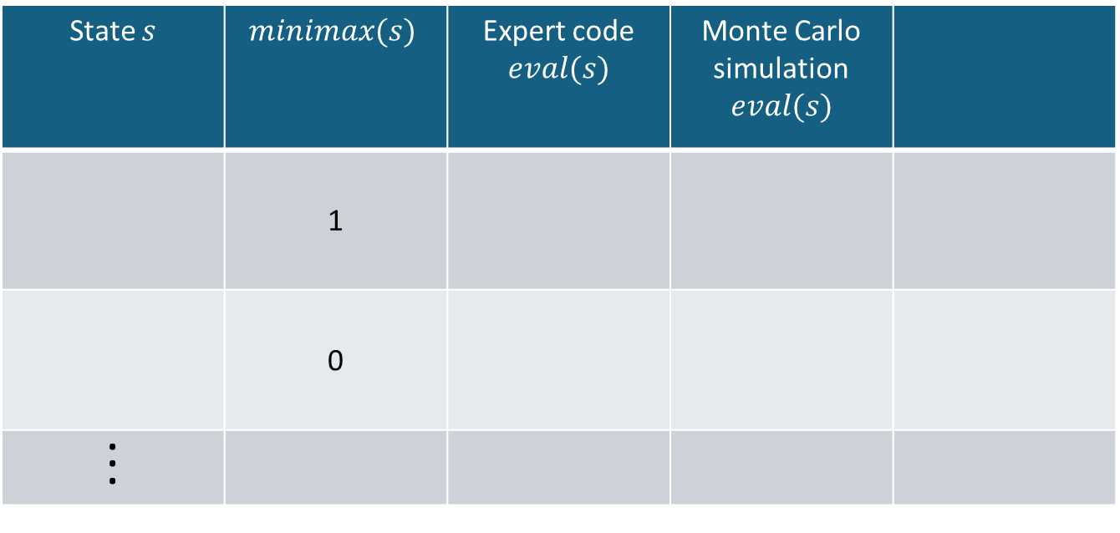
Expert Evaluation Function
$$value\left(s\right)≈E_{π_{x},π_{o}}[U(s)]$$
State $s$ | $$minimax(s)$$ | Expert code $$eval(s)$$
 | 1
 | 0
. . .
State $s$ | $$minimax(s)$$ | Expert code $$eval(s)$$ | Monte Carlo simulation $$eval(s)$$
 | 1
 | 0
. . .
Expert Heuristic
+.4 for each winning opportunity
-.4 for each loosing opportunity
+0.4
-0.4
Playout policy
$π_{x},π_{o}$
optimal play
none
Method
Tree search
Code + cutoff search

Slide 9



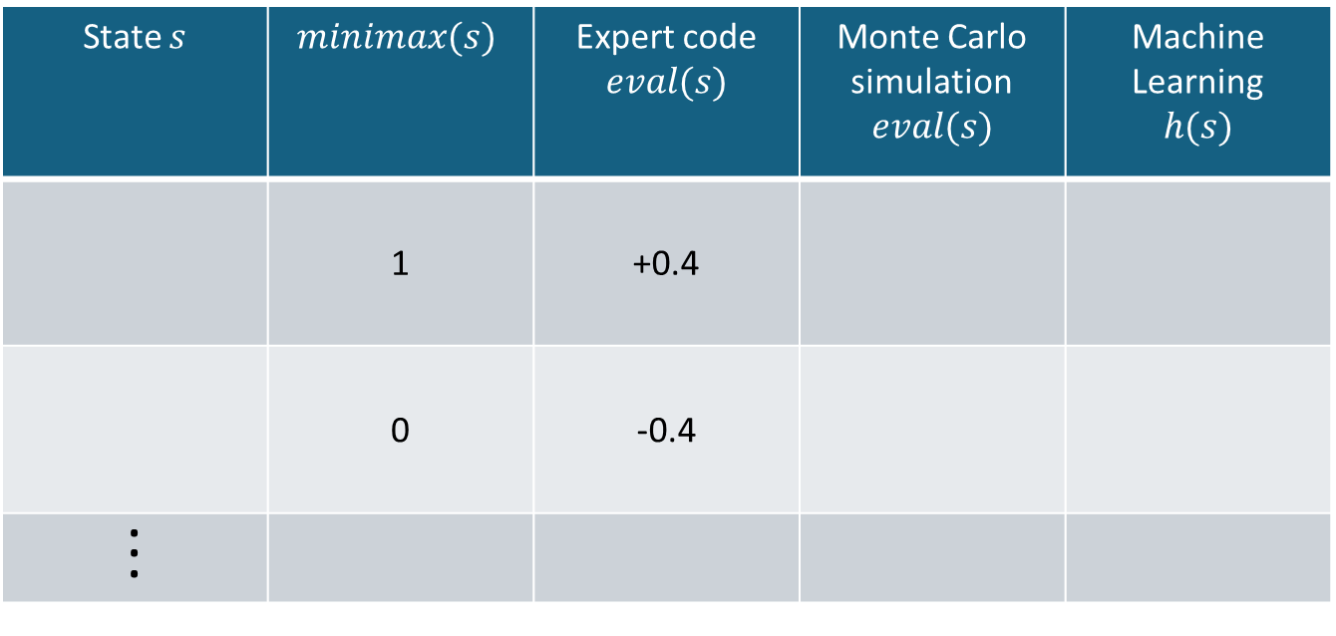
Monte Carlo Simulation
$$value\left(s\right)≈E_{π_{x},π_{o}}[U(s)]$$
State $s$ | $$minimax(s)$$ | Expert code $$eval(s)$$ | Monte Carlo simulation $$eval(s)$$ | Machine Learning $$h(s)$$
 | 1 | +0.4
 | 0 | -0.4
. . .
0.634
-0.021
Playout policy
$π_{x},π_{o}$
optimal play
none
Random or other
Method
Tree search
Code + cutoff search
Simulation

Slide 10
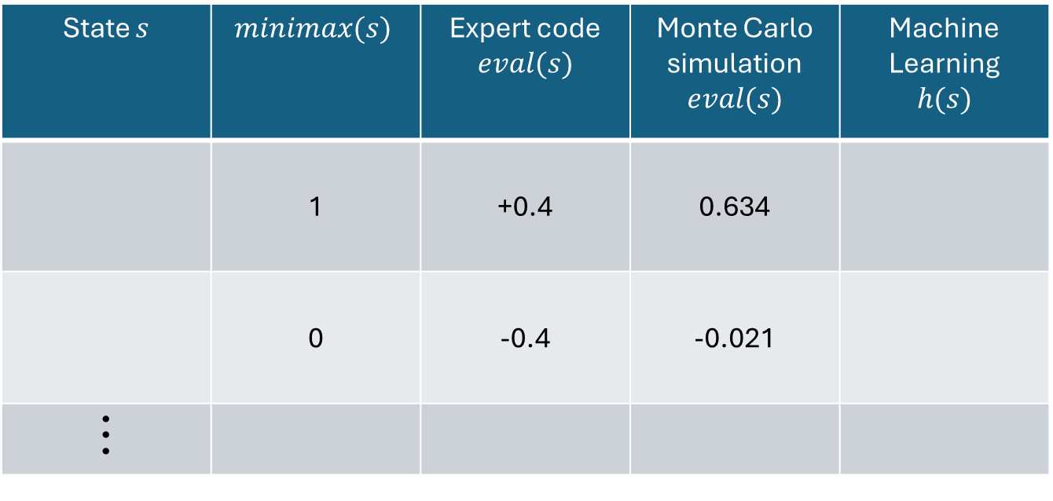
Machine Learning
$$value\left(s\right)≈E_{π_{x},π_{o}}[U(s)]$$
State $s$ | $$minimax(s)$$ | Expert code $$eval(s)$$ | Monte Carlo simulation $$eval(s)$$ | Machine Learning $$h(s)$$
 | 1 | +0.4 | 0.634
 | 0 | -0.4 | -0.021
. . .
Playout policy
$π_{x},π_{o}$
optimal play
none
Random or other
Method
Tree search
Code + cutoff search
Simulation

Slide 11
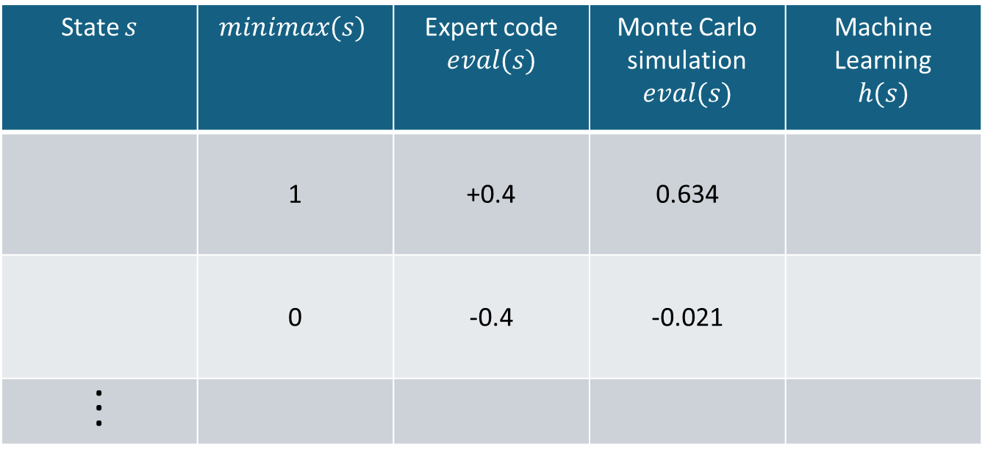

Machine Learning
$$value\left(s\right)≈E_{π_{x},π_{o}}[U(s)]$$
State $s$ | $$minimax(s)$$ | Expert code $$eval(s)$$ | Monte Carlo simulation $$eval(s)$$ | Machine Learning $$h(s)$$
 | 1 | +0.4 | 0.634
 | 0 | -0.4 | -0.021
. . .
0.325
0.042
All methods hopefully produce a consistent state order.
Playout policy
$π_{x},π_{o}$
optimal play
none
Random or other
For training data
Method
Tree search
Code + cutoff search
Simulation
Machine learning

Slide 12
Reinforcement Learning (RL)
Tries to learn state values directly from rewards resulting from
  Model-based RL: Uses a complete probabilistic model of the environment.
  Model-free RL: Learns from interactions with the environment.
    Online learning
    Offline learning (can use supervised learning from a sampled dataset)
Machine learning for an evaluation function can be seen as a special case of model-free offline RL called (neural) fitted Q-learning with replay memory.
We will talk about other RL methods later.

