Slide 1



CS 5/7320 Artificial Intelligence Adversarial Search and Games AIMA Chapter 5
Discussion
Slides by Michael Hahsler with figures from the AIMA textbook
This work is licensed under a Creative Commons Attribution-ShareAlike 4.0 International License.
Image: "Reflected Chess pieces" by Adrian Askew
Online Material

Slide 2

Games
Strategic environment: Games typically feature an environment containing an opponent who wants to win against the agent.
Episodic environment: One game does not affect the next.
We will focus on planning for
two-player zero-sum games with
deterministic game mechanics and
perfect information (i.e., fully observable environment).
We call the two players:
Max tries to maximize its utility.
Min tries to minimize Max’s utility (zero-sum game).

Slide 3

Definition of a Game
Definition:
$s_{0}$ The initial state (position, board, hand).
$Actions(s)$ Legal moves in state $s$.
$Result(s,a)$ Transition model.
$Terminal(s)$ Test for terminal states.
$Utility(s)$ Utility for player Max for terminal states.

Slide 4
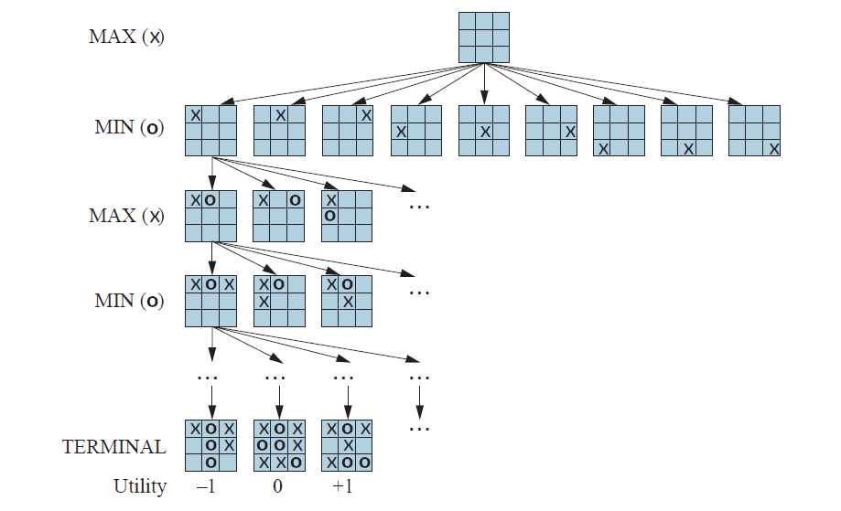


Tic-tac-toe: Partial Game Tree
Note: This game has no cycles!
node / state
# of nodes
action / result()
1
9
redundant path
$$9×8$$
The state space size (number of possible boards) is much smaller than:
$3^{9}=19,683$ states.
However, the complete game tree is much larger because the same state (board) can be reached in different subtrees (redundant paths). The game tree here is a little smaller than:
$$1+\left(9× 8\right)+\left(9×8×7\right)+…\left(9!\right)$$ $=\text{986,409}$ nodes
Terminal states have a known utility

Slide 5
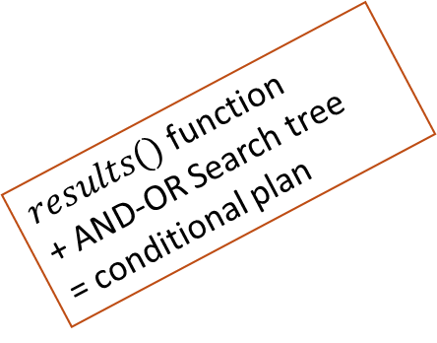
Methods for Adversarial Games
Exact Methods
Model as nondeterministic actions: The opponent is seen as part of an environment with nondeterministic actions. Non-determinism is the result of the unknown moves by the opponent. We consider all possible moves by the opponent.
Find optimal decisions: Minimax search and Alpha-Beta pruning, where each player plays optimally to the end of the game.
Heuristic Methods (game tree is too large)
Heuristic Alpha-Beta Tree Search:
Cut-off game tree and use a heuristic for utility.
Forward Pruning: ignore poor moves.
Monte Carlo Tree search: Estimate the utility of a state by simulating complete games and averaging the utility.
$results()$function
+ AND-OR Search tree
= conditional plan
DFS to calculate the minmax value of each state
+ pick action that leads to the best state

Slide 6












Minmax Exercise: Simple 2-Ply Game
MV
Max
$$a_{1}$$
$$a_{2}$$
$$a_{3}$$
MV
MV
MV
Min
$$a_{1}$$
$$a_{3}$$
$$a_{1}$$
$$a_{3}$$
$$a_{1}$$
$$a_{3}$$
$$a_{2}$$
$$a_{2}$$
$$a_{2}$$
Utility for Max
2
0
5
-5
-2
7
5
-7
4
Compute all MV (minimax values).
What is the optimal action for Max?

Slide 7
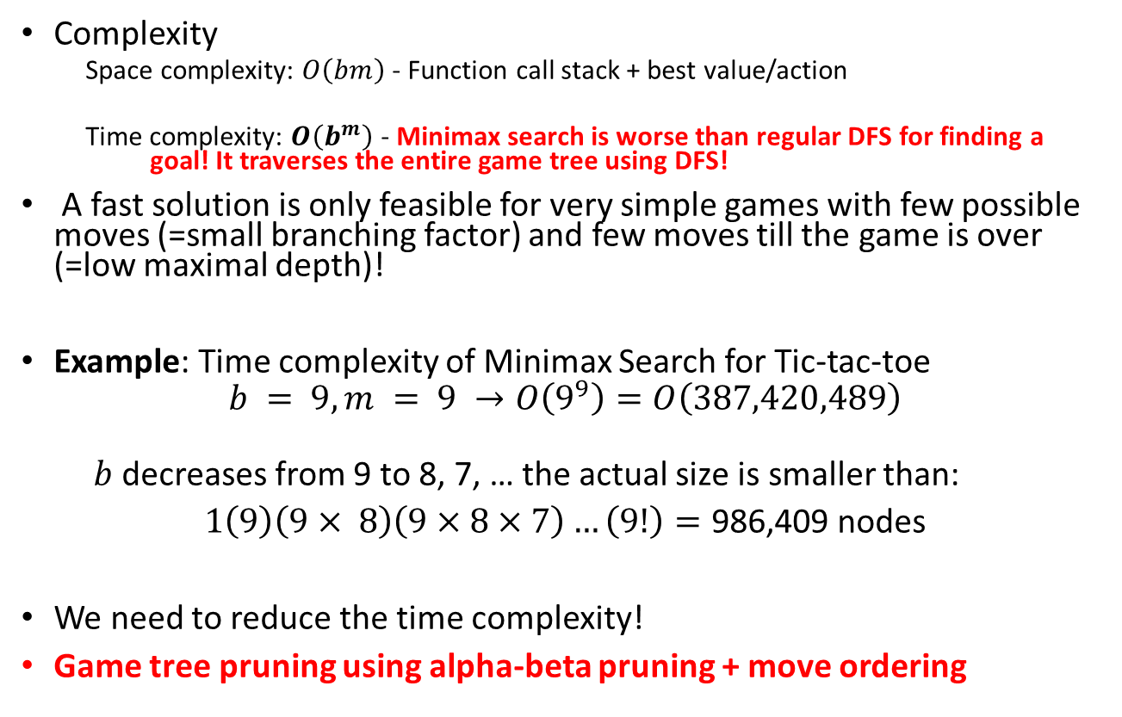
Issue: Search Time
b: max. branching factor
m: max. depth of tree
Complexity
Space complexity: $O\left(bm\right)$ - Function call stack + best value/action
Time complexity: $O\left(b^{m}\right)$ - Minimax search is worse than regular DFS for finding a goal! It traverses the entire game tree using DFS!
A fast solution is only feasible for very simple games with few possible moves (=small branching factor) and few moves till the game is over (=low maximal depth)!
Example: Time complexity of Minimax Search for Tic-tac-toe
$$b = 9, m = 9 →O\left(9^{9}\right)=O\left(387,420,489\right)$$
$b$ decreases from 9 to 8, 7, … the actual size is smaller than:
$1\left(9\right)\left(9× 8\right)\left(9×8×7\right)…\left(9!\right)=\text{986,409}$ nodes
We need to reduce the time complexity!
Game tree pruning using alpha-beta pruning + move ordering

Slide 8
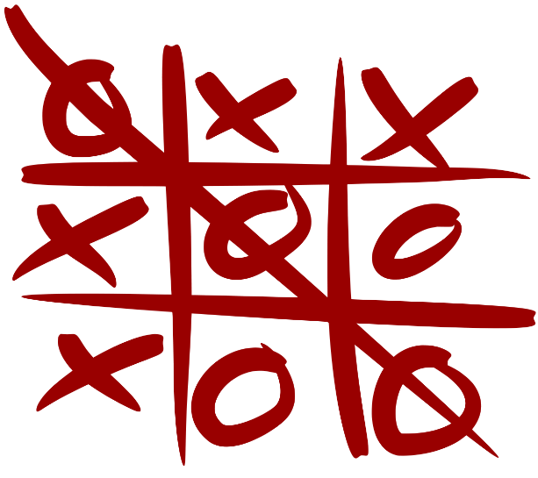
The Effect of Alpha-Beta Pruning
Tic-tac-toe
Method | Searched Nodes | Search Time
Minimax Search | 549,946 | 13 s
+ Alpha-Beta Pruning | 18,297 | 660 ms
+ Move ordering (heuristic: center, corner, rest) | 7,275 | 202 ms

Slide 9
Issue With Minimax Search
Optimal decision-making algorithms scale poorly for large game trees.
Alpha-beta pruning and move ordering are often not sufficient to reduce the search time.
Fast approximate methods are needed. We may lose the optimality guarantee, but we can work with larger problems.

Slide 10

Heuristic Methods
Heuristic Alpha-Beta Tree Search

Slide 11
Heuristic Alpha-Beta Tree Search: Cut Off Search
HMV = heuristic minimax value
Depth (ply)
0
Pick the action with the highest HMV
1
HMV
HMV
HMV
HMV
HMV
HMV
HMV
HMV
HMV
2
Eval
Eval = heuristic to estimate of the minimax value/utility of the state.
Eval
Eval
3
Cut search off at depth =2
This is also called: search with a “look ahead” of 2

Slide 12

Heuristic Methods
Monte Carlo Tree Search (MCTS)

Slide 13
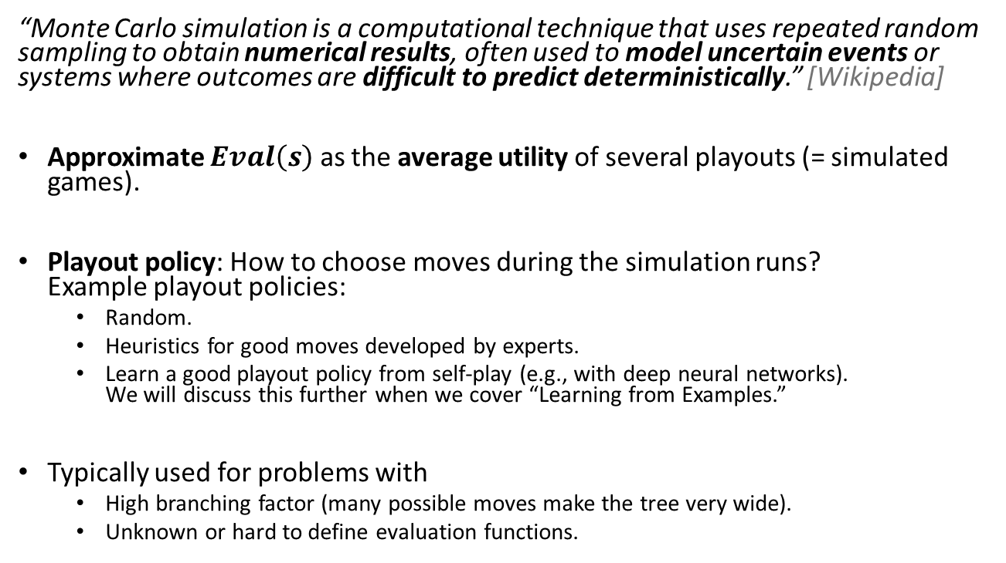
Idea of Monte Carlo Search
“Monte Carlo simulation is a computational technique that uses repeated random sampling to obtain numerical results, often used to model uncertain events or systems where outcomes are difficult to predict deterministically.” [Wikipedia]
Approximate $Eval\left(s\right)$ as the average utility of several playouts (= simulated games).
Playout policy: How to choose moves during the simulation runs? Example playout policies:
Random.
Heuristics for good moves developed by experts.
Learn a good playout policy from self-play (e.g., with deep neural networks). We will discuss this further when we cover “Learning from Examples.”
Typically used for problems with
High branching factor (many possible moves make the tree very wide).
Unknown or hard to define evaluation functions.

Slide 14
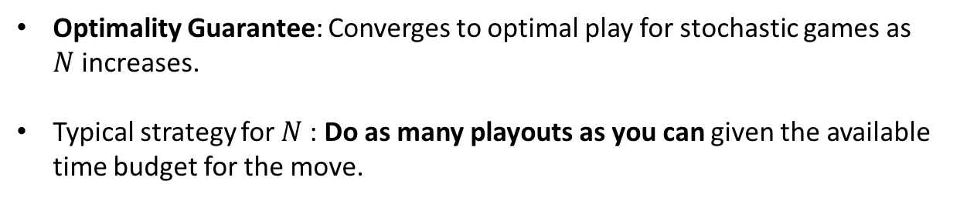
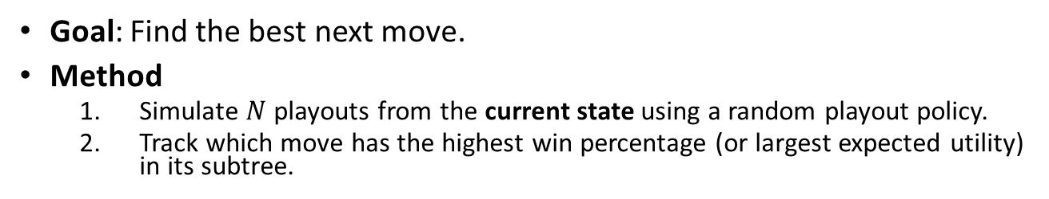
Pure Monte Carlo Search
Goal: Find the best next move.
Method
Simulate $N$ playouts from the current state using a random playout policy.
Track which move has the highest win percentage (or largest expected utility) in its subtree.
Start playouts
0.61
Estimate win probability
#wins/playouts
0.54
0.50
0.62
0.57
0.78
0.52
0.38
0.65
0.14
Optimality Guarantee: Converges to optimal play for stochastic games as $N$increases.
Typical strategy for $N$: Do as many playouts as you can given the available time budget for the move.

Slide 15
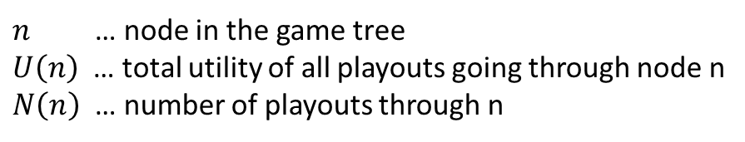
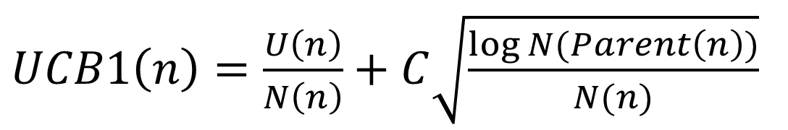
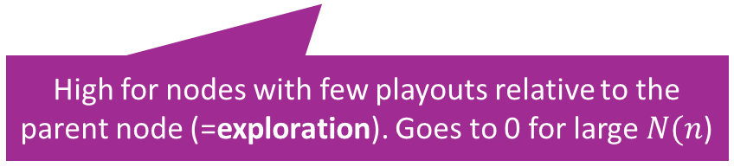
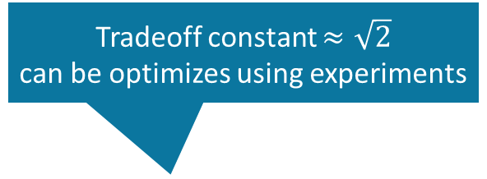
Playout Selection Strategy: Upper Confidence Bound 1 (UCB1) Applied to Trees (UCT)
Tradeoff constant $≈\sqrt{2}$ can be optimizes using experiments
$UCB1\left(n\right)=\frac{U\left(n\right)}{N\left(n\right)}+C\sqrt{\frac{\log{N(Parent\left(n\right))}}{N(n)}}$
Average utility (=exploitation)
High for nodes with few playouts relative to the parent node (=exploration). Goes to 0 for large $N(n$)
$n$ … node in the game tree
$U\left(n\right)$ … total utility of all playouts going through node n
$N\left(n\right)$ … number of playouts through n
Selection strategy: Select node with highest UCB1 score.

Slide 16
Monte Carlo Tree Search (MCTS)
Pure Monte Carlo search always starts playouts from a given state (or its children). Issue: We have to start the simulation for each move from scratch.
Monte Carlo Tree Search builds a partial game tree and can start playouts from any state (node) in that tree. This reduces repeated work.
Important considerations:
We typically can only store a small part of the game tree, so we do not store the complete playout runs.
We can use UCB1 as the selection strategy to decide what part of the tree we should focus on for the next playout. This balances exploration and exploitation.

Slide 17
Some Considerations
Estimating the value of a position using simple playouts is very effective and typically beats many other methods.
Playouts can be done in parallel (multi-core or on multiple machines).
Note: Random playouts may not work well, and a better playout policy can help.
Slow Convergence. Playouts may be wasted on evaluating very bad (random) moves that nobody ever would play.
Random play makes discovering long-term strategies very unlikely.

Slide 18
Conclusion
Nondeterministic actions:
The opponent is seen as part of an environment with nondeterministic actions. Non-determinism is the result of the unknown moves by the opponent. All possible moves are considered.
Optimal decisions:
Minimax search and Alpha-Beta pruning where each player plays optimal to the end of the game.
Choice nodes and Expectiminimax for stochastic games.
Heuristic Alpha-Beta Tree Search:
Cut off game tree and use heuristic evaluation function for utility (based on state features).
Forward Pruning: ignore poor moves.
Learn heuristic from data using MCTS
Monte Carlo Tree search:
Simulate complete games and calculate proportion of wins.
Use modified UCB1 scores to expand the partial game tree.
Learn playout policy using self-play and deep learning.
Scale only for tiny problems!
State of the Art

