Slide 1
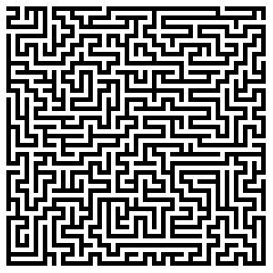
CS 5/7320 Artificial Intelligence Solving problems by searching AIMA Chapter 3
Discussion
Slides by Michael Hahsler based on slides by Svetlana Lazepnik with figures from the AIMA textbook.
This work is licensed under a Creative Commons Attribution-ShareAlike 4.0 International License.

Slide 2
Assignment 1
Discuss:
Robustness (Obstacles)
Noisy sensors

Slide 3
Module Review
Intro and Uninformed Search

Slide 4
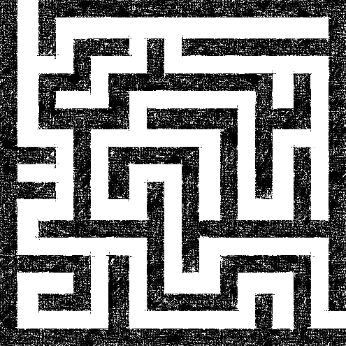
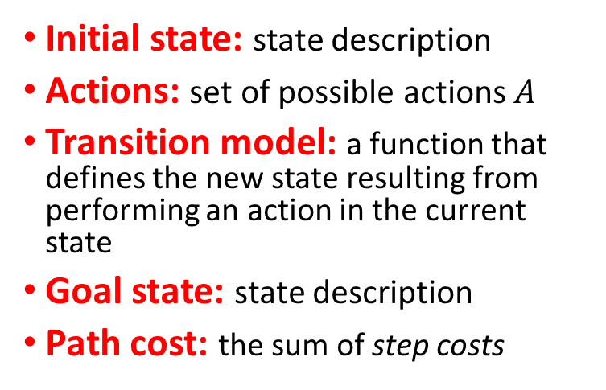
Definition of a Search Problem
Initial state
Actions: {N, E, S, W}
Transitions
Initial state: state description
Actions: set of possible actions $A$
Transition model: a function that defines the new state resulting from performing an action in the current state
Goal state: state description
Path cost: the sum of step costs
1
g
i
4
a
Goal state
z
Discretization grid
Important: The state space is typically too large to be enumerated, or it is continuous. Therefore, the problem is defined by initial state, actions and the transition model and not the set of all possible states.

Slide 5
Complete Planning Agent to Solve a Maze
Map = Transition function + initial and goal state
Environment
Physical Maze
Physical agent
has an event loop:
Read sensors
Call agent function
Execute action in the physical environment
Repeat
Planning function
Sensors
Sensor input
Need to plan or replan
percepts
State
Plan
Agent function
next action
Follow the plan
Current step in plan
Actuators
Execute action in the physical environment
The event loop calls the agent function for the next action.
The agent function follows the plan or calls the planning function if there is no plan yet or it thinks the current plan does not work based on the percepts (replanning).

Slide 6
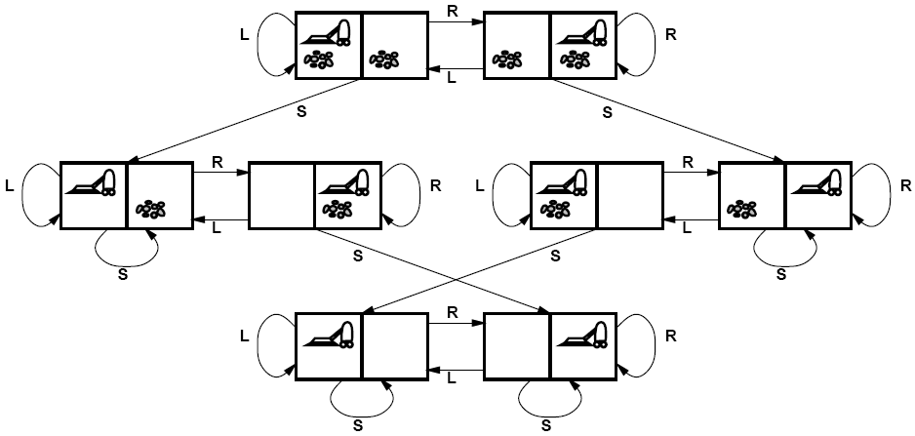
Solving Search Problems
Given a search problem definition
Initial state
Actions
Transition model
Goal state
Path cost
How do we find the optimal solution (sequence of actions/states)?
Construct a search tree for the state space graph!
Initial state
State space
Goal states

Slide 7
Creating a Search Tree
Superimpose a “what if” tree of possible actions and outcomes (states) on the state space graph.
The Root node represents the initial stare.
An action child node is reached by an edge representing an action. The corresponding state is defined by the transition model.
Trees cannot have cycles (loops). Cycles in the search space must be broken to prevent infinite loops.
Trees cannot have multiple paths to the same state. These are called redundant paths. Removing other redundant paths improves search efficiency.
A path through the tree corresponds to a sequence of actions (states).
A solution is a path ending in a node representing a goal state.
Nodes vs. states: Each tree node represents a state of the system. If redundant path cannot be prevented then state can be represented by multiple nodes in the tree.
Root node = Initial state
a
Edge = Action
Child node
Non-cycle redundant
path
b
c
d
e
e
Cycle
…
…
…
b
Solution path
Node representing a Goal state
f

Slide 8
Differences Between Typical Tree Search and AI Search
Typical tree search
Assumes a given tree that fits in memory.
Trees have by construction no cycles or redundant paths.
AI tree/graph search
The search tree is too large to fit into memory.
Builds parts of the tree from the initial state using the transition function representing the graph.
Memory management is very important.
The search space is typically a very large and complicated graph. Memory-efficient cycle checking is very important to avoid infinite loops or minimize searching parts of the search space multiple times.
Checking redundant paths often requires too much memory and we accept searching the same part multiple times.

Slide 9
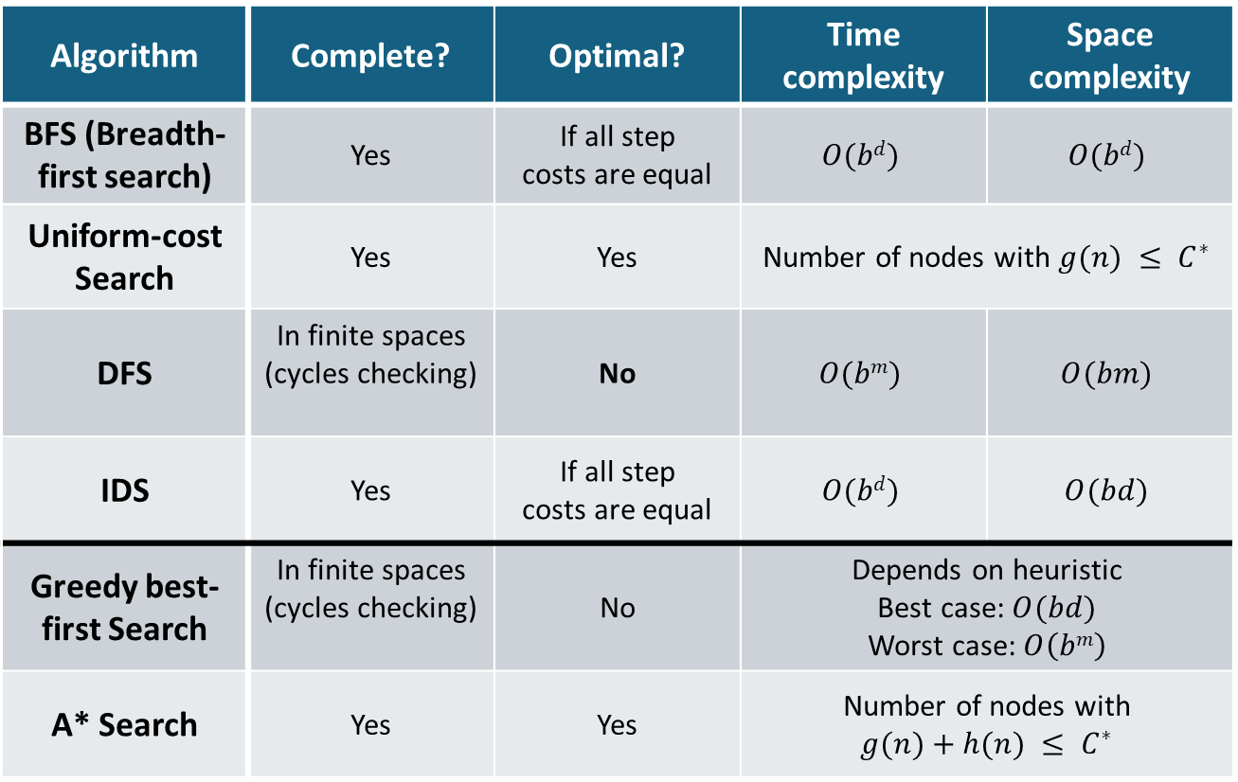
Summary: All Search Strategies
b: maximum branching factor of the search tree
d: depth of the optimal solution
m: maximum length of any path in the state space
C*: cost of optimal solution
Algorithm | Complete? | Optimal? | Time complexity | Space complexity
BFS (Breadth-first search) | Yes | If all step costs are equal | $$O(bd)$$ | $$O(bd)$$
Uniform-cost Search | Yes | Yes | Number of nodes with $g(n) ≤ C^{∗}$
DFS | In finite spaces (cycles checking) | No | $$O(bm)$$ | $$O(bm)$$
IDS | Yes | If all step costs are equal | $$O(bd)$$ | $$O(bd)$$
Greedy best-first Search | In finite spaces (cycles checking) | No | Depends on heuristic $$\text{Best} \text{case}\text{: }O(bd)$$ Worst case: $O\left(bm\right)$
A* Search | Yes | Yes | Number of nodes with $$g(n)+h(n) ≤ C^{∗}$$
Uninformed Search
Informed Search
With a good heuristic

Slide 10
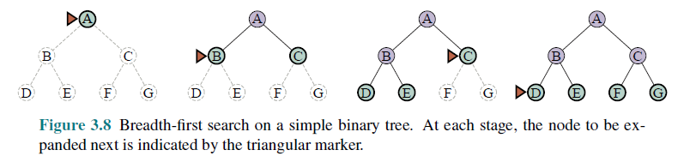
Breadth-First Search (BFS)
All nodes are in memory!
Expansion rule: Expand shallowest unexpanded node in the frontier (=FIFO).
Data Structures
Frontier data structure: holds references to the green nodes (green) and is implemented as a FIFO queue.
Reached data structure: holds references to all visited nodes (gray and green) and is used to prevent visiting nodes more than once (cycle and redundant path checking).
Builds a complete tree with links between parent and child.

Slide 11

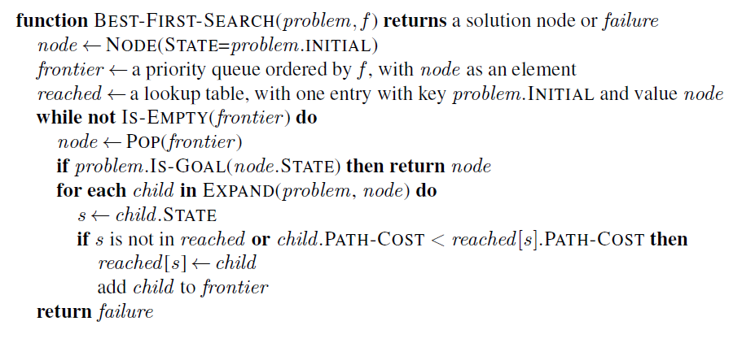
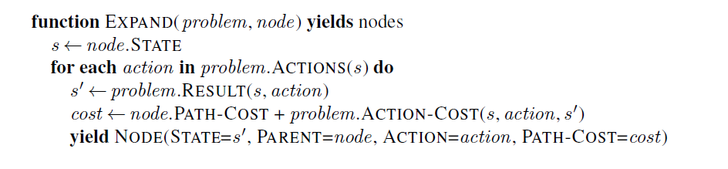
Implementation: Best-First Search Strategy
This is a generalization of Breadth-first search that expands the search based on cost and not on the number of steps.
The order for expanding the frontier is determined by f(n) = path cost from the initial state to node n.
This check is added to BFS! It visits a node again if it can be reached by a better (cheaper) path.

Slide 12
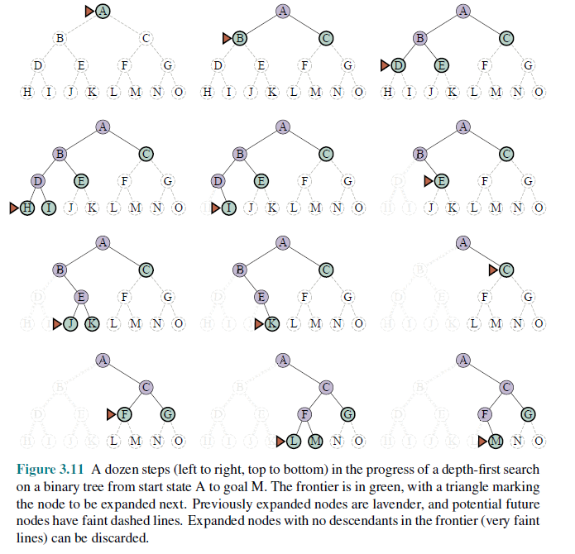
Depth-First Search (DFS)
Expansion rule: Expand deepest unexpanded node in the frontier (last added).
Frontier: stack (LIFO)
No reached data structure! Cycle checking checks only the current path. Redundant paths can not be identified and lead to replicated work.
Memory management: only the current path is in memory!

Slide 13
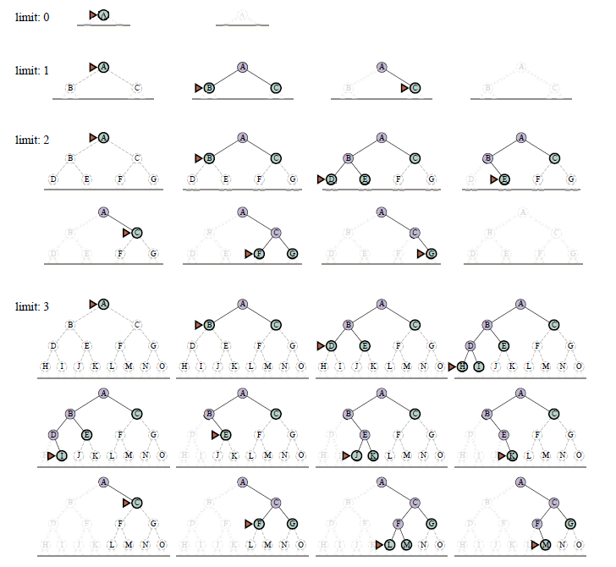
Iterative Deepening Search (IDS)
This is a very important algorithm in AI!

Slide 14
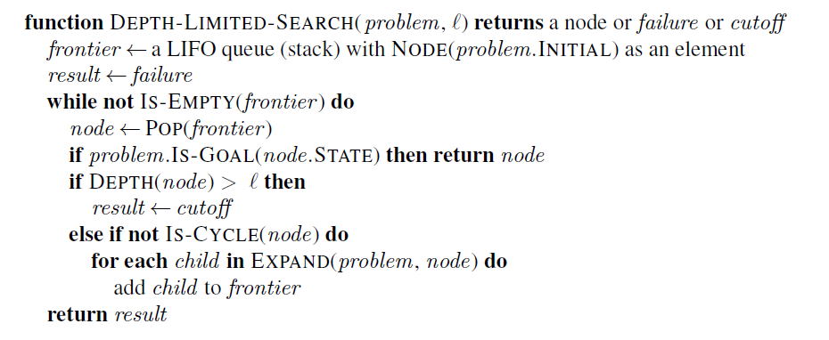
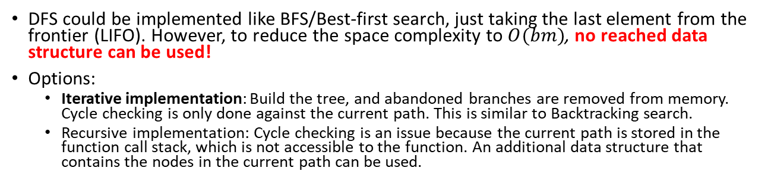

Implementation: DFS
DFS is implemented very differently to BFS!
DFS could be implemented like BFS/Best-first search, just taking the last element from the frontier (LIFO). However, to reduce the space complexity to $O(bm)$, no reached data structure can be used!
Options:
Iterative implementation: Build the tree, and abandoned branches are removed from memory. Cycle checking is only done against the current path. This is similar to Backtracking search.
Recursive implementation: Cycle checking is an issue because the current path is stored in the function call stack, which is not accessible to the function. An additional data structure that contains the nodes in the current path can be used.
DFS uses ℓ $=∞$
Memory management: remove nodes for abandoned branches here!
Cycles: Prevent cycles by checking against the current path. We also need to ensure that the frontier does not contain the same state more than once.
Redundant paths: We cannot prevent other redundant paths.
See BFS for function EXPAND.

Slide 15
Module Review
Statespace and Search Complexity

Slide 16
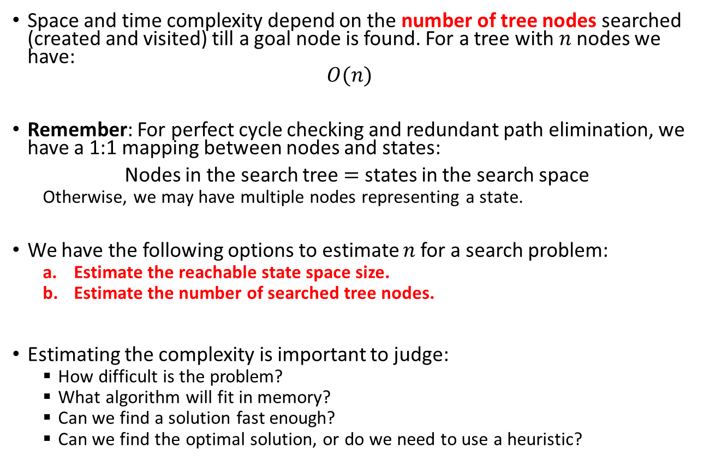
State Space vs. Search Tree Size
Space and time complexity depend on the number of tree nodes searched (created and visited) till a goal node is found. For a tree with $n$ nodes we have: $O(n)$
Remember: For perfect cycle checking and redundant path elimination, we have a 1:1 mapping between nodes and states:
Nodes in the search tree $=$ states in the search space
Otherwise, we may have multiple nodes representing a state.
We have the following options to estimate $n$ for a search problem:
Estimate the reachable state space size.
Estimate the number of searched tree nodes.
Estimating the complexity is important to judge:
How difficult is the problem?
What algorithm will fit in memory?
Can we find a solution fast enough?
Can we find the optimal solution, or do we need to use a heuristic?

Slide 17
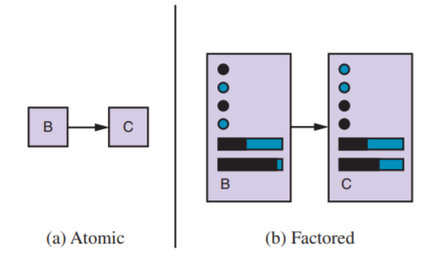
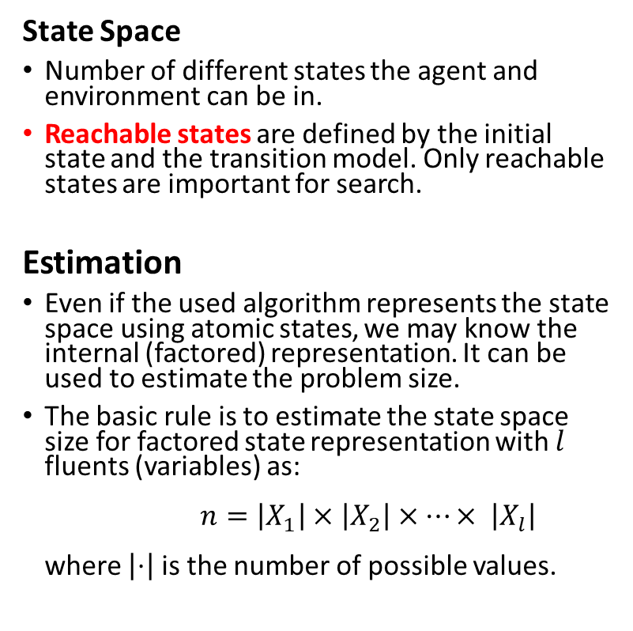


State Space Size Estimation
State Space
Number of different states the agent and environment can be in.
Reachable states are defined by the initial state and the transition model. Only reachable states are important for search.
Estimation
Even if the used algorithm represents the state space using atomic states, we may know the internal (factored) representation. It can be used to estimate the problem size.
The basic rule is to estimate the state space size for factored state representation with $l$ fluents (variables) as: $n=\left|X_{1}\right|×\left|X_{2}\right|×⋯× \left|X_{l}\right|$ where $\left|⋅\right|$ is the number of possible values.
State representation
$$x_{1}$$
$$x_{2}$$
…
The factored state consists of variables called fluents that represent conditions that can change over time.

Slide 18
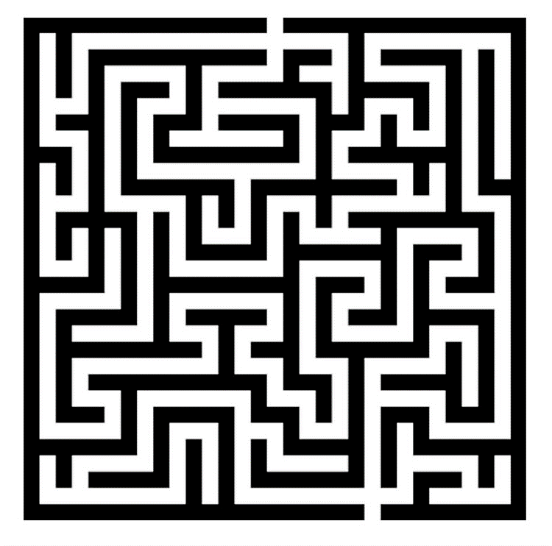
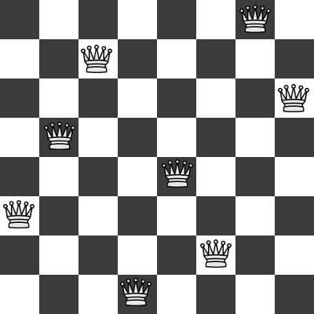
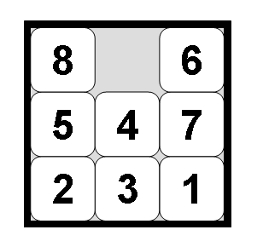
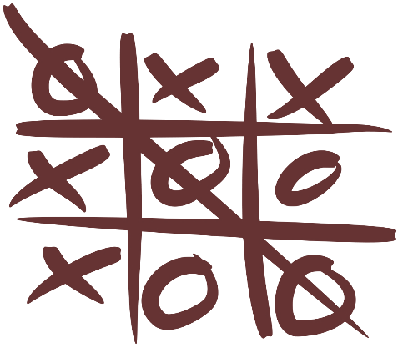
Examples: What is the State Space Size?
Often a rough upper limit is sufficient to determine how hard the search problem is.
Maze
8-queens problem
8-puzzle problem
Tic-tac-toe

Slide 19
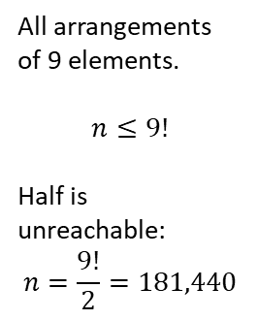
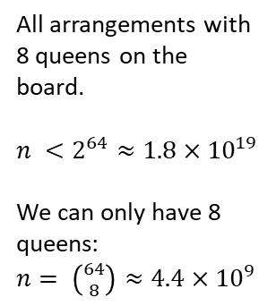
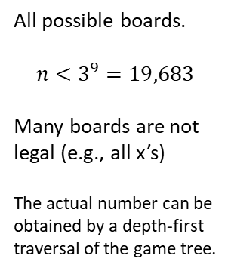
Examples: What is the State Space Size?
Often a rough upper limit is sufficient to determine how hard the search problem is.
Maze
8-queens problem
8-puzzle problem
Tic-tac-toe
Positions the agent can be in.
n = Number of white squares.
All arrangements with 8 queens on the board.
$n <2^{64}≈1.8×{10}^{19}$
We can only have 8 queens: $n= \left({64 \atop 8}\right)≈4.4×{10}^{9}$
All arrangements of 9 elements.
$$n≤9!$$
Half is unreachable: $$n=\frac{9!}{2}=181,440$$
All possible boards.
$$n<3^{9}=19,683$$
Many boards are not legal (e.g., all x’s)
The actual number can be obtained by a depth-first traversal of the game tree.

Slide 20
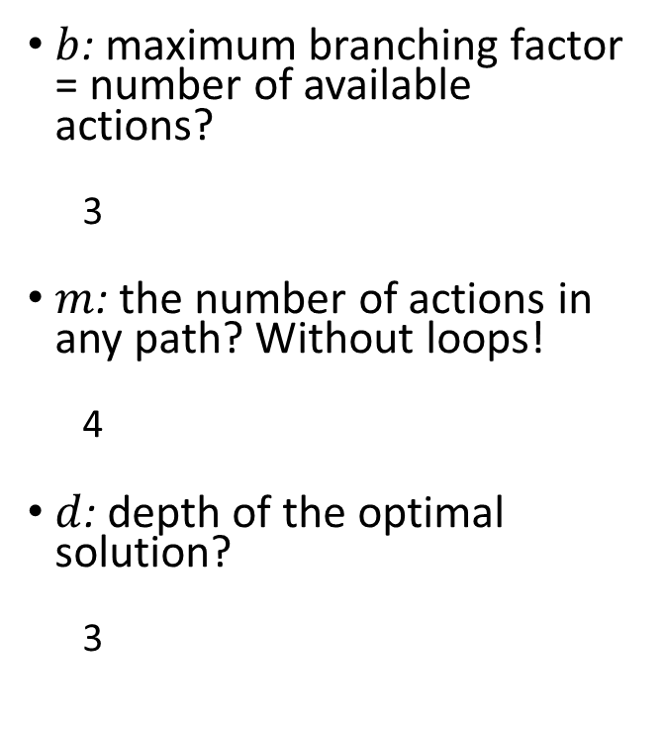
Example: What determines the Search Tree Size?
$b$: maximum branching factor = number of available actions?
3
$m$: the number of actions in any path? Without loops!
4
$d$: depth of the optimal solution?
3
State Space with Transition Model
Initial state
Goal states

Slide 21
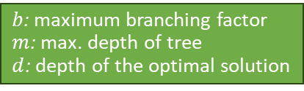
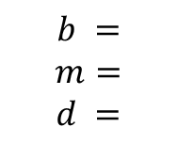
Examples: What determines the Search Tree Size?
$b$: maximum branching factor
$m$: max. depth of tree
$d$: depth of the optimal solution
Often a rough upper limit is sufficient to determine how hard the search problem is.
Maze
8-queens problem
8-puzzle problem
Tic-tac-toe
$$b =$$
$$m=$$
$$d =$$

Slide 22
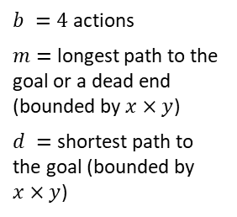
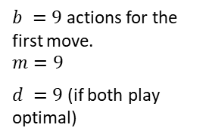
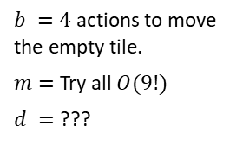
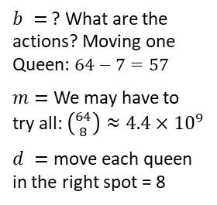
Examples: What determines the Search Tree Size?
$b$: maximum branching factor
$m$: max. depth of tree
$d$: depth of the optimal solution
Often a rough upper limit is sufficient to determine how hard the search problem is.
Maze
8-queens problem
8-puzzle problem
Tic-tac-toe
$b =4$ actions
$m=$ longest path to the goal or a dead end (bounded by $x×y$)
$d =$ shortest path to the goal (bounded by $x×y$)
$b =$ ? What are the actions? Moving one Queen: $64−7=57$
$m=$ We may have to try all: $\left({64 \atop 8}\right)≈4.4×{10}^{9}$
$d =$ move each queen in the right spot = 8
$b =4$ actions to move the empty tile.
$m=$ Try all $O(9!)$
$d =$ ???
$b =9$ actions for the first move.
$$m=9$$
$d =9$ (if both play optimal)

Slide 23
Assignment 2
Introduction

Slide 24
Module Review
Informed Search

Slide 25
Summary: All Search Strategies
b: maximum branching factor of the search tree
d: depth of the optimal solution
m: maximum length of any path in the state space
C*: cost of optimal solution
Algorithm | Complete? | Optimal? | Time complexity | Space complexity
BFS (Breadth-first search) | Yes | If all step costs are equal | $$O(bd)$$ | $$O(bd)$$
Uniform-cost Search | Yes | Yes | Number of nodes with $g(n) ≤ C^{∗}$
DFS | In finite spaces (cycles checking) | No | $$O(bm)$$ | $$O(bm)$$
IDS | Yes | If all step costs are equal | $$O(bd)$$ | $$O(bd)$$
Greedy best-first Search | In finite spaces (cycles checking) | No | Depends on heuristic $$\text{Best} \text{case}\text{: }O(bd)$$ Worst case: $O\left(bm\right)$
A* Search | Yes | Yes | Number of nodes with $$g(n)+h(n) ≤ C^{∗}$$
Uninformed Search
Informed Search
With a good heuristic

Slide 26
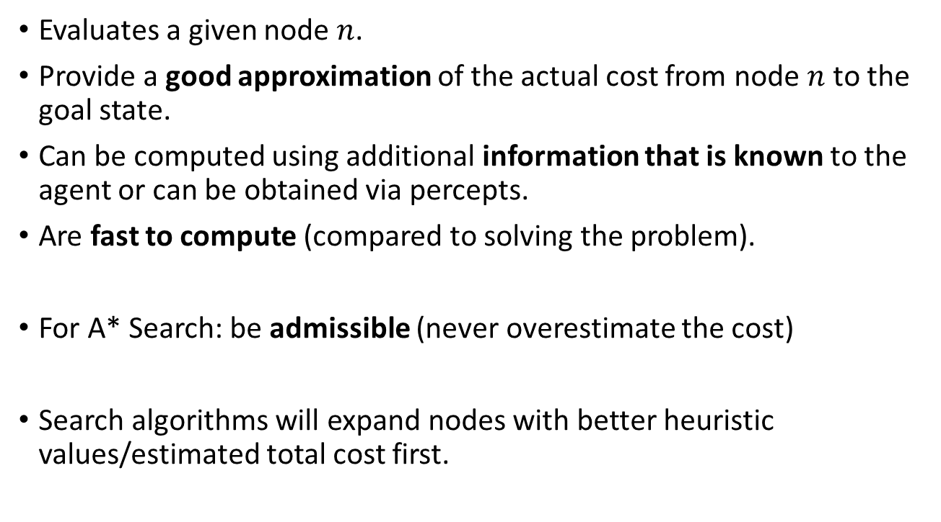
Properties of Heuristic Functions
Evaluates a given node $n$.
Provide a good approximation of the actual cost from node $n$ to the goal state.
Can be computed using additional information that is known to the agent or can be obtained via percepts.
Are fast to compute (compared to solving the problem).
For A* Search: be admissible (never overestimate the cost)
Search algorithms will expand nodes with better heuristic values/estimated total cost first.

Slide 27
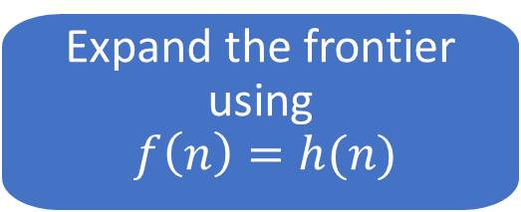
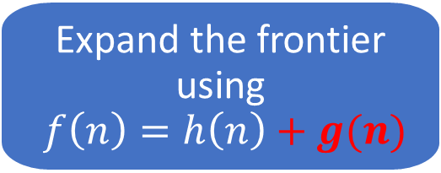
Implementation
Greedy Best-First search
Best-First Search
Expand the frontier using $$f\left(n\right)=h(n)$$
A* Search
Best-First Search
Expand the frontier using $f\left(n\right)=h\left(n\right)+g(n)$

Slide 28
Heuristics from Relaxed Problems
What relaxations are used in these two cases?
Euclidean distance
Manhattan distance
Start state
Start state
Goal state
Goal state
Which heuristic is admissible for A* search?

Slide 29
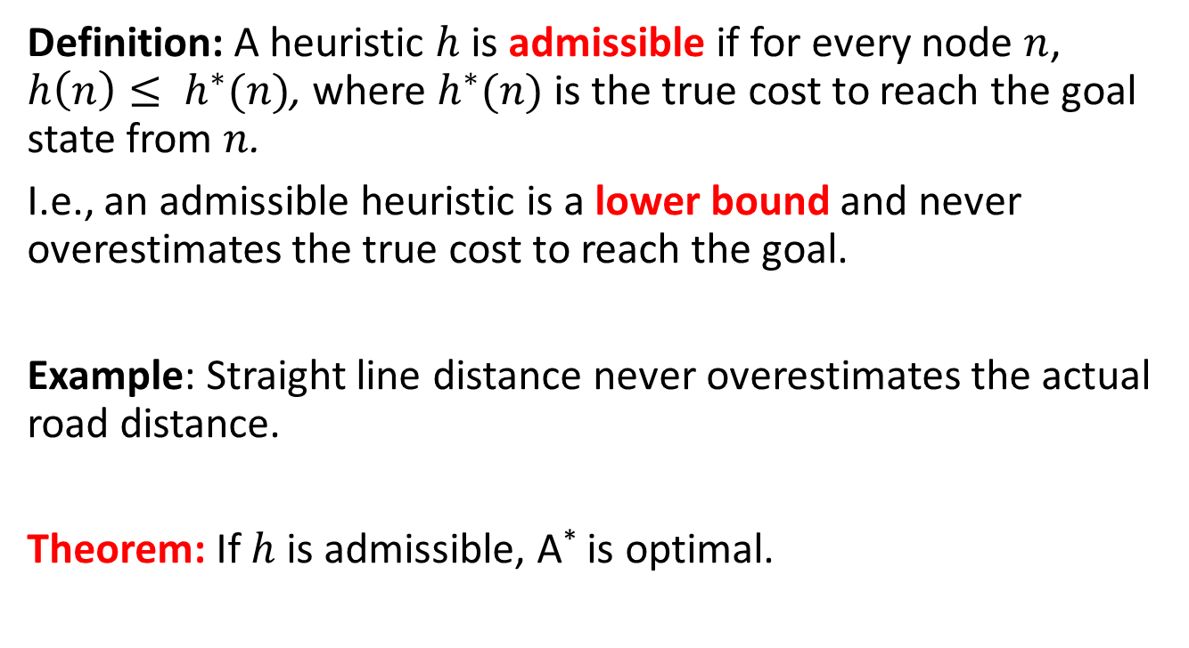
A* Search Optimality: Admissible Heuristics
Definition: A heuristic $h$ is admissible if for every node $n$, $h\left(n\right)≤ h^{∗}(n)$, where $h^{∗}(n)$ is the true cost to reach the goal state from $n$.
I.e., an admissible heuristic is a lower bound and never overestimates the true cost to reach the goal.
Example: Straight line distance never overestimates the actual road distance.
Theorem: If $h$ is admissible, A* is optimal.

Slide 30
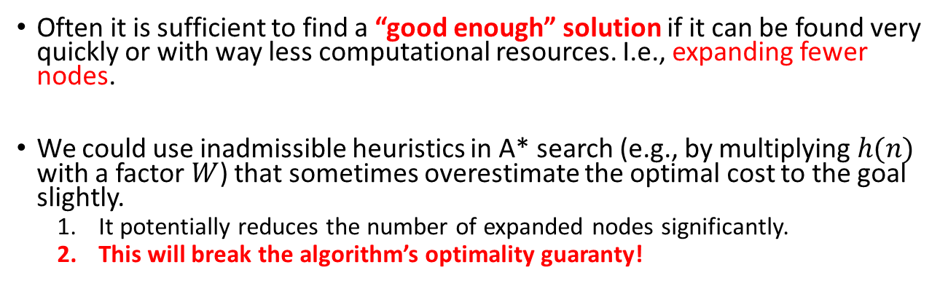
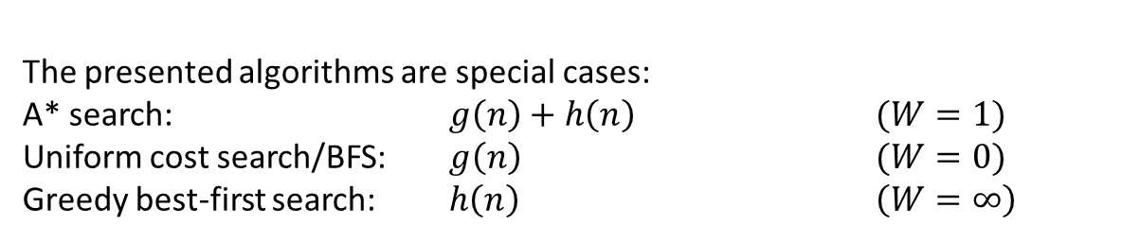
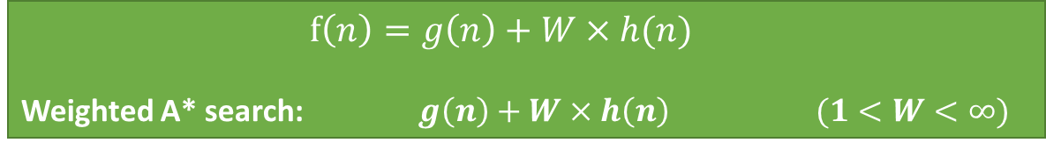
Satisficing Search: Weighted A* Search
Often it is sufficient to find a “good enough” solution if it can be found very quickly or with way less computational resources. I.e., expanding fewer nodes.
We could use inadmissible heuristics in A* search (e.g., by multiplying $h(n)$ with a factor $W$) that sometimes overestimate the optimal cost to the goal slightly.
It potentially reduces the number of expanded nodes significantly.
This will break the algorithm’s optimality guaranty!
$$f\left(n\right)=g\left(n\right)+W×h(n)$$
Weighted A* search: $g\left(n\right)+W×h\left(n\right)$ $(1<W<∞)$
The presented algorithms are special cases:
A* search: $g\left(n\right)+h\left(n\right)$ $(W=1)$
Uniform cost search/BFS: $g\left(n\right)$ $(W=0)$
Greedy best-first search: $h\left(n\right)$ $\left(W=∞\right)$

Slide 31


Case Study: A Heuristic for Tic-Tac-Toe
Define the goal states:
What is the cost that needs to be estimated?
What could be used as a heuristic value for these boards (assume you play x):
How do you calculate the heuristic value?
Is the heuristic admissible?
Does the heuristic use a relaxation?

Slide 32
Assignment 2
Discussion

