Slide 1



CS 5/7320
Artificial Intelligence
Quantifying Uncertainty:
Probabilities & Bayesian Decision Making
AIMA Chapter 12
Discussion
Slides by Michael Hahsler
based on slides by Svetlana Lazepnik
with figures from the AIMA textbook
This work is licensed under a Creative Commons Attribution-ShareAlike 4.0 International License.
Cover image: "Dice"
by Steve A Johnson
Online Material

Slide 2

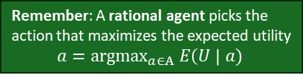
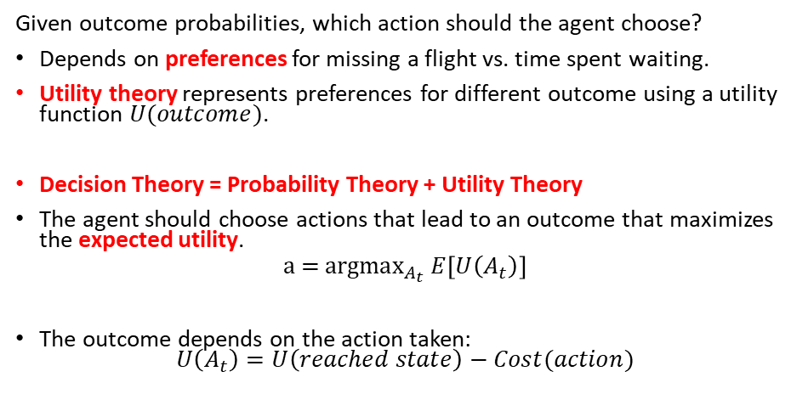
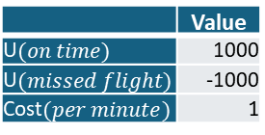
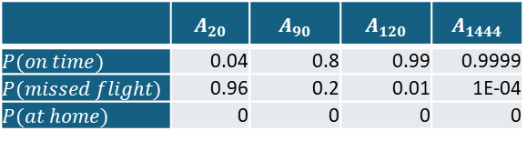
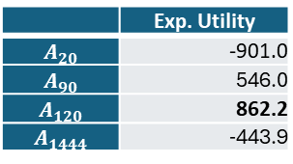
Making a Decision Under Uncertainty
Given outcome probabilities, which action should the agent choose?
Depends on preferences for missing a flight vs. time spent waiting.
Utility theory represents preferences for different outcome using a utility function $U(outcome)$.
Decision Theory = Probability Theory + Utility Theory
The agent should choose actions that lead to an outcome that maximizes the expected utility.
$$\text{a}\text{ = }\text{argma}{\text{x}}_{A_{t}} E\left[U\left(A_{t}\right)\right]$$
The outcome depends on the action taken:
$U\left(A_{t}\right)=U\left(reached state\right)−Cost(action)$
Remember: A rational agent picks the action that maximizes the expected utility
$$a={\text{argmax}}_{a∈A} E\left(U \right| a)$$
Example:
Belief states with probabilities
Utility structure
 | $$A_{20}$$ | $$A_{90}$$ | $$A_{120}$$ | $$A_{1444}$$
$$P(on time)$$ | 0.04 | 0.8 | 0.99 | 0.9999
$$P(missed flight)$$ | 0.96 | 0.2 | 0.01 | 1E-04
$$P(at home)$$ | 0 | 0 | 0 | 0
+
=
 | Exp. Utility
$$A_{20}$$ | -901.0
$$A_{90}$$ | 546.0
$$A_{120}$$ | 862.2
$$A_{1444}$$ | -443.9
 | Value
U$(on time)$ | 1000
U$(missed flight)$ | -1000
Cost$(per minute)$ | 1
$$E\left[U\left(A_{t}\right)\right] =P\left(on time | A_{t}\right) U\left(on time \right| A_{t})+P\left(missed flight | A_{t}\right)U\left(missed flight \right|A_{t})$$
$$E\left[U\left(A_{120}\right)\right]=0.99×\left(1000−120×1\right)+0.01×\left(−1000−120×1\right)=862.4$$

Slide 3
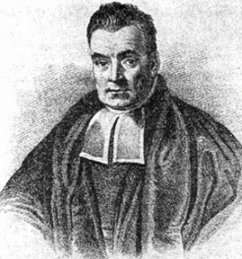
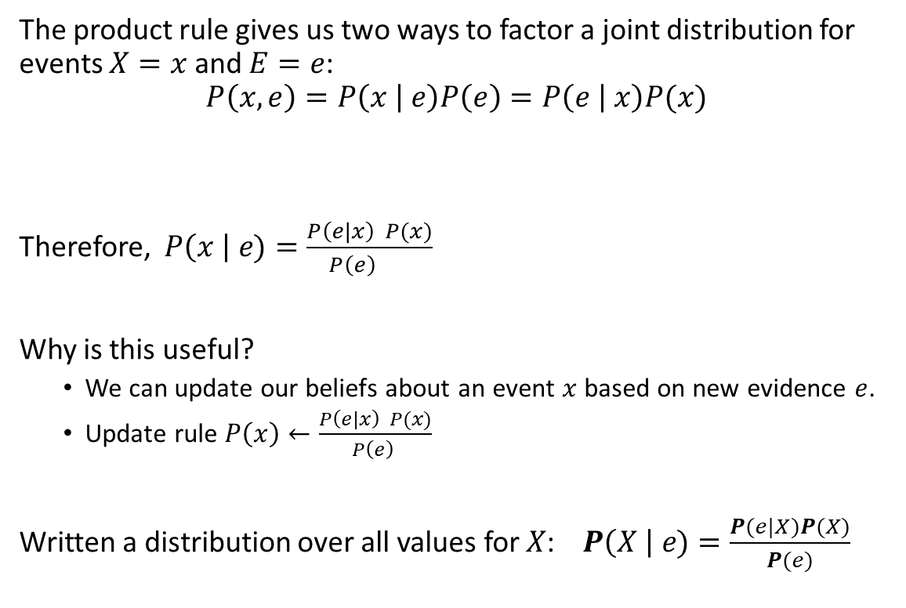
Bayes’ Theorem: The Bayesian Update Rule
The product rule gives us two ways to factor a joint distribution for events $X=x$ and $E=e$:
$$P\left(x,e\right)=P\left(x | e\right)P\left(e\right)=P\left(e | x\right)P(x)$$
Therefore, $P\left(x \right| e)=\frac{P\left(e|x\right) P(x)}{P\left(e\right) }$
Why is this useful?
  We can update our beliefs about an event $x$ based on new evidence $e$.
  Update rule $P\left(x\right)←\frac{P\left(e|x\right) P(x)}{P\left(e\right) }$
Written a distribution over all values for $X$: $P\left(X \right| e)=\frac{P(e|X)P(X)}{P(e)}$
Posterior Prob.
Prior Prob.
Add evidence

Slide 4
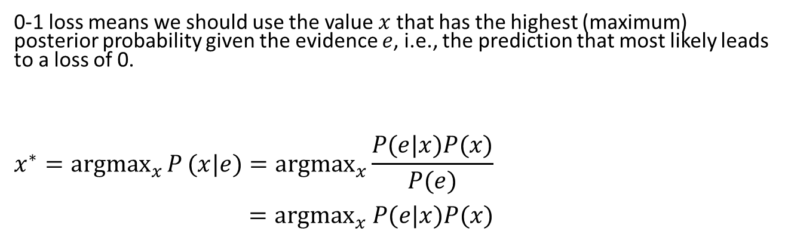

MAP: Maximum A Posteriori Decision
Estimate prior probabilities
+Utility (Loss)
Update belief using Bayes’ rule with new evidence
Decision
Estimate Likelihoods
0-1 loss means we should use the value $x$ that has the highest (maximum) posterior probability given the evidence $e$, i.e., the prediction that most likely leads to a loss of 0.
$$x^{∗}={argmax}_{x}{P}(x|e)={argmax}_{x}\frac{P(e|x)P(x)}{P(e)}$$
$={argmax}_{x} P(e|x)P(x)$
Prior Prob.
Posterior Prob.
$P\left(e\right)$ is fixed for a given evidence.
This is the optimal decision for 0-1 loss.

Slide 5



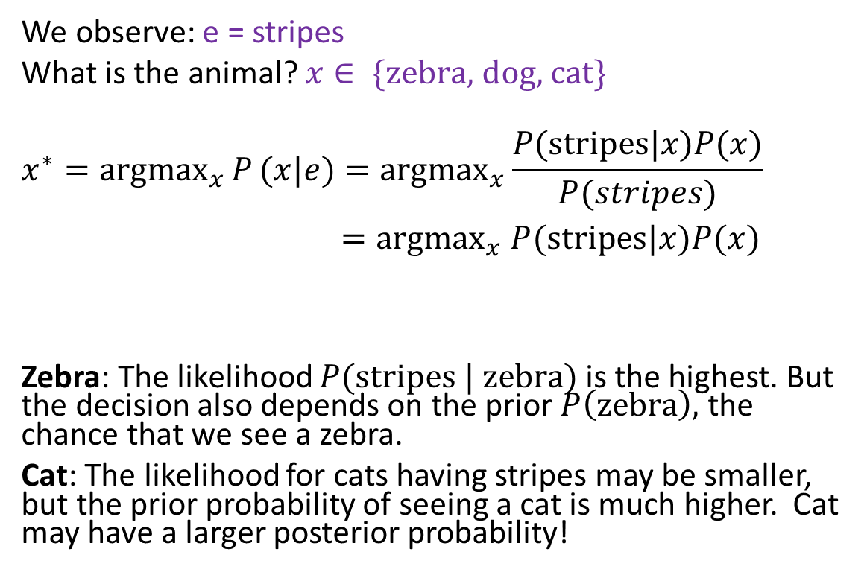
MAP: Example
We observe: e = stripes
What is the animal? $x∈ \{\text{zebra}\text{, }\text{dog}\text{, }\text{cat}\}$
$$x^{∗}={argmax}_{x}{P}(x|e)={argmax}_{x}\frac{P(\text{stripes}|x)P(x)}{P(stripes)}$$
$={argmax}_{x} P(\text{stripes}|x)P(x)$
Zebra: The likelihood $P(\text{stripes} \text{|} \text{zebra})$is the highest. But the decision also depends on the prior $P\left(\text{zebra}\right),$ the chance that we see a zebra.
Cat: The likelihood for cats having stripes may be smaller, but the prior probability of seeing a cat is much higher. Cat may have a larger posterior probability!
Posterior Prob.
likelihood
Prior Prob.

Slide 6
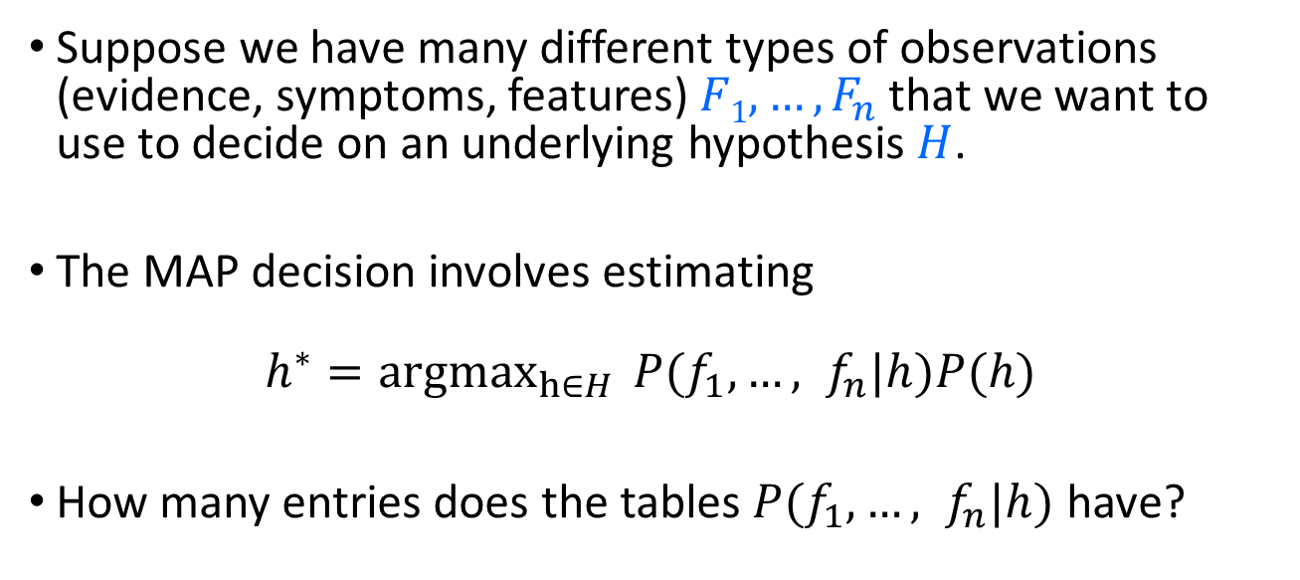
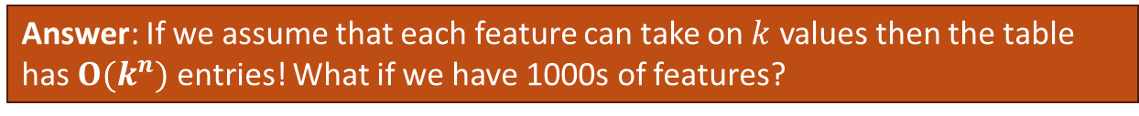
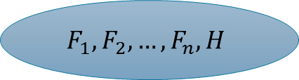
Bayes Classifier
$$F_{1},F_{2},…,F_{n}, H$$
Suppose we have many different types of observations (evidence, symptoms, features) $F1, …, F_{n}$that we want to use to decide on an underlying hypothesis $H$.
The MAP decision involves estimating
$$h^{∗}={argmax}_{h∈H}{P(f_{1},…, f_{n}|h)P(h) }$$
How many entries does the tables $P(f_{1},…, f_{n}|h)$ have?
Answer: If we assume that each feature can take on $k$ values then the table has $O(k^{n})$ entries! What if we have 1000s of features?

Slide 7
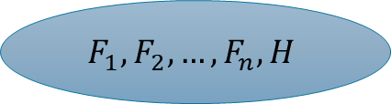
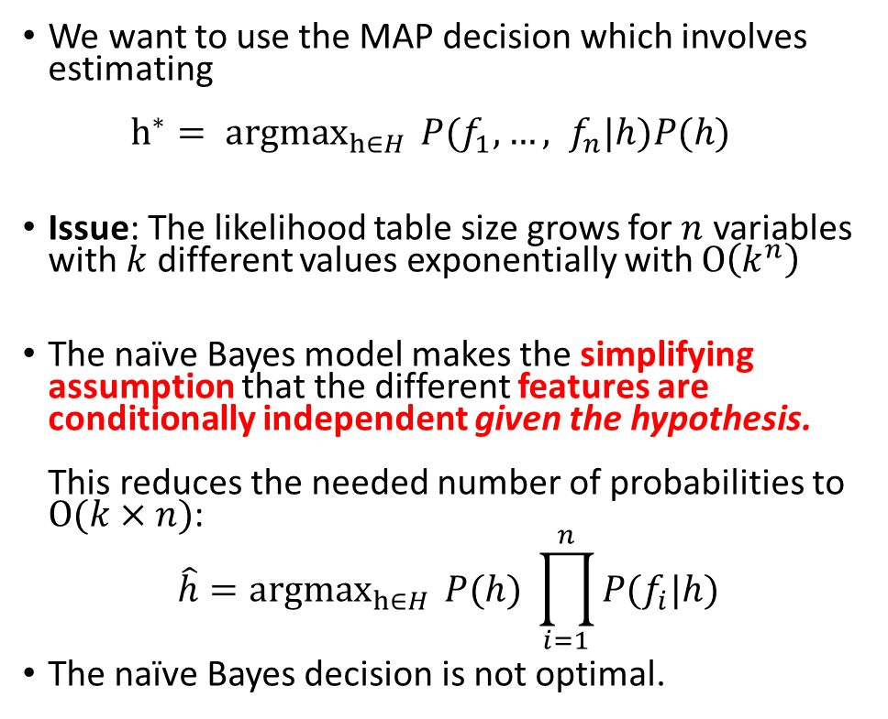






Naïve Bayes Model
We want to use the MAP decision which involves estimating
${h^{∗}= argmax}_{h∈H}{P(f_{1},…, f_{n}|h)P(h) }$
Issue: The likelihood table size grows for $n$ variables with $k$ different values exponentially with $O\left(k^{n}\right)$
The naïve Bayes model makes the simplifying assumption that the different features are conditionally independent given the hypothesis.
This reduces the needed number of probabilities to $O(k×n)$:
$${\hat{h}=argmax}_{h∈H}{P(h) }\prod_{i=1}^{n}{P(f_{i}|h)}$$
The naïve Bayes decision is not optimal.
$$O\left(2^{n}\right)$$
$$F_{1},F_{2},…,F_{n}, H$$
$$H$$
$$O\left(n\right)$$
…
$$F_{1}$$
$$F_{2}$$
$$F_{n}$$

Slide 8
Conclusion
Bayesian Intelligent Agents: This is a type of utility-based agent is also called a decision-theoretic agent.
Approach
Agent function
Estimate prior probabilities
Update belief using Bayes’ rule with new evidence
+Utility
Decision
Estimate Likelihoods
Agent’s knowledge. We typically use frequentist estimates (e.g., counting) and store them as a model.
Predict the belief states given different actions
+
Use utility information to calculate expected utilities.
Choose the action that maximizes the expected utility.
Conditional Independence makes this possible.

