Slide 1
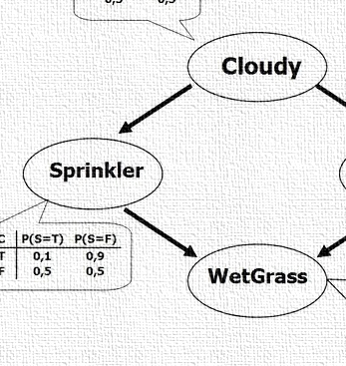


CS 5/7320
Artificial Intelligence
Probabilistic Reasoning:
Bayesian Networks
AIMA Chapter 13
Discussion
Slides by Michael Hahsler
based on slides by Svetlana Lazepnik
with figures from the AIMA textbook
This work is licensed under a Creative Commons Attribution-ShareAlike 4.0 International License.
Online Material

Slide 2
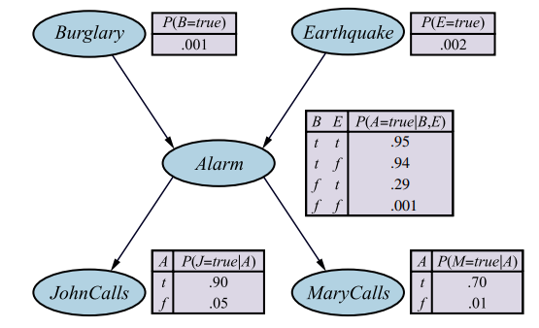
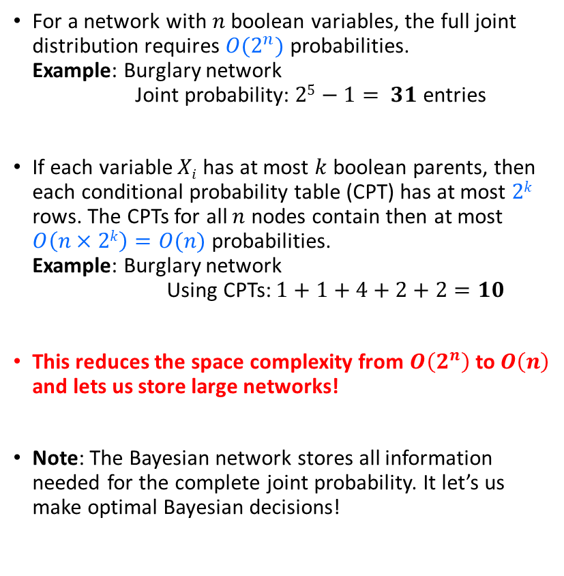
Bayesian Nets
For a network with $n$ boolean variables, the full joint distribution requires $O(2^{n})$probabilities.
Example: Burglary network
Joint probability: $25−1= 31$ entries
If each variable $Xi$ has at most $k$ boolean parents, then each conditional probability table (CPT) has at most $2k$ rows. The CPTs for all $n$ nodes contain then at most $O\left(n×2k\right)=O(n)$ probabilities.
Example: Burglary network
Using CPTs: $1+1+4+2+2=10$
This reduces the space complexity from $O\left(2^{n}\right)$ to $O\left(n\right)$ and lets us store large networks!
Note: The Bayesian network stores all information needed for the complete joint probability. It let’s us make optimal Bayesian decisions!

Slide 3
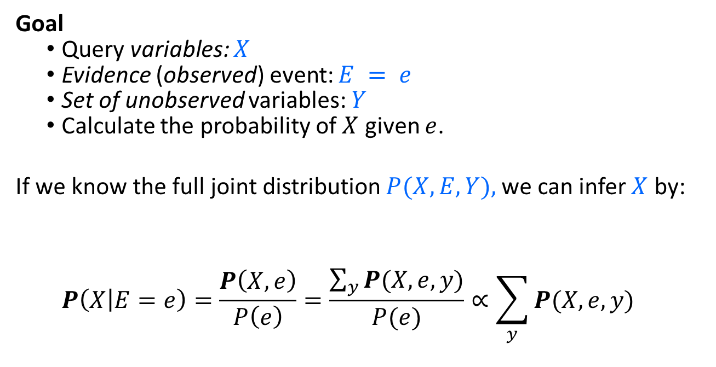
Exact Inference:
Calculating Conditional Distributions
This is too much work for large networks!
Goal
  Query variables: $X$
  Evidence (observed) event: $E = e$
  Set of unobserved variables: $Y$
  Calculate the probability of $X$ given $e$.
If we know the full joint distribution $P(X, E, Y),$we can infer $X$ by:
  $$P\left(X | E=e\right)=\frac{P\left(X,e\right)}{P\left(e\right)}=\frac{\sum_{y}{P(X,e,y)}}{P(e)}∝\sum_{y}{P(X,e,y)}$$
Sum over values of unobservable variables = marginalizing them out.

Slide 4
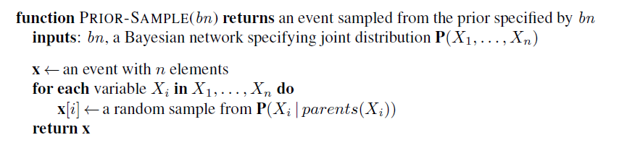
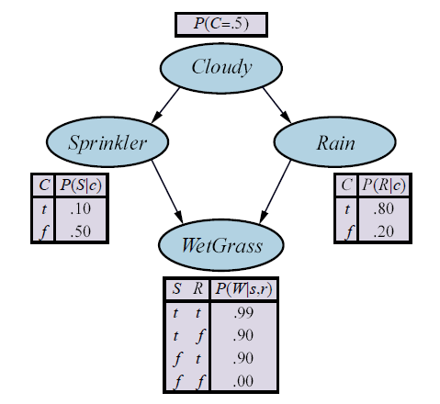
Approximate Inference:
Prior-Sample Algorithm
Order is important! We need to start with the random variables that have no parents.
Variable Order
Note: This looks like playouts in games.

Slide 5
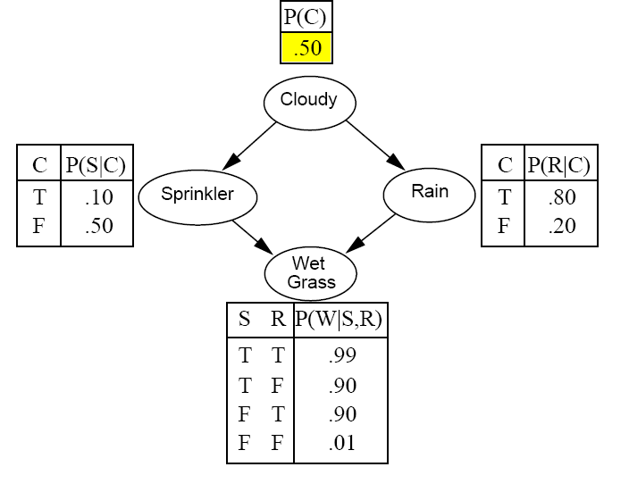
Example: Sampling from a Bayesian Network
Variable order

Slide 6
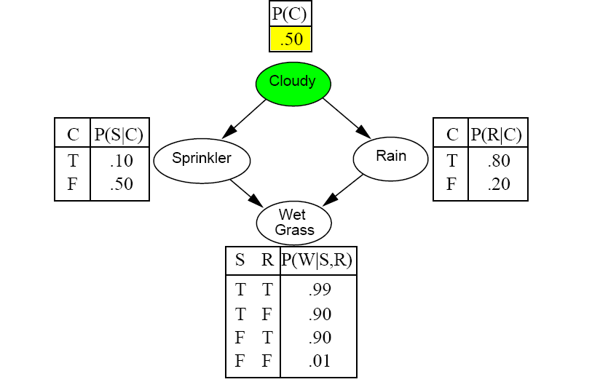
Example: Sampling from a Bayesian Network
Draw a random value
using the probability.

Slide 7
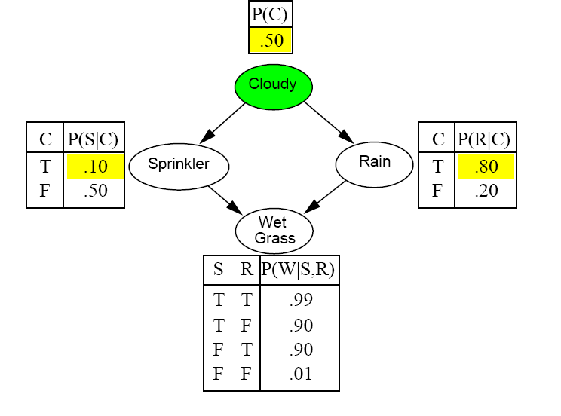
Example: Sampling from a Bayesian Network

Slide 8
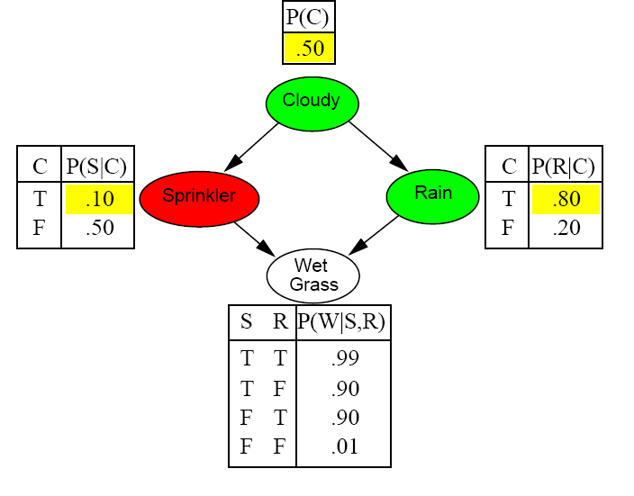
Example: Sampling from a Bayesian Network

Slide 9
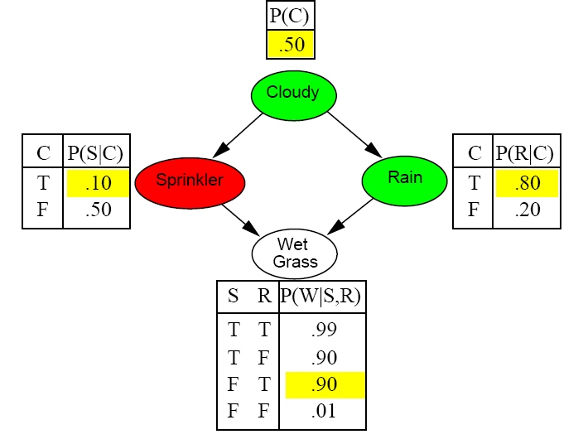
Example: Sampling from a Bayesian Network

Slide 10
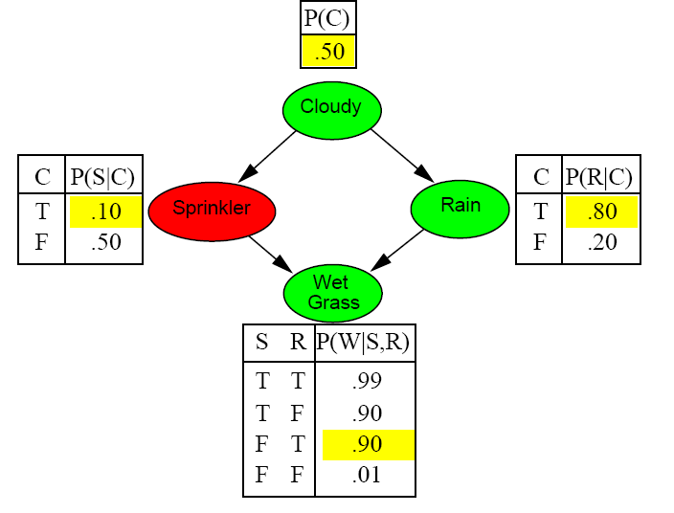
Example: Sampling from a Bayesian Network
Prior Sample returns the event:
[C = True, S = False,
R = True, W = True]

Slide 11
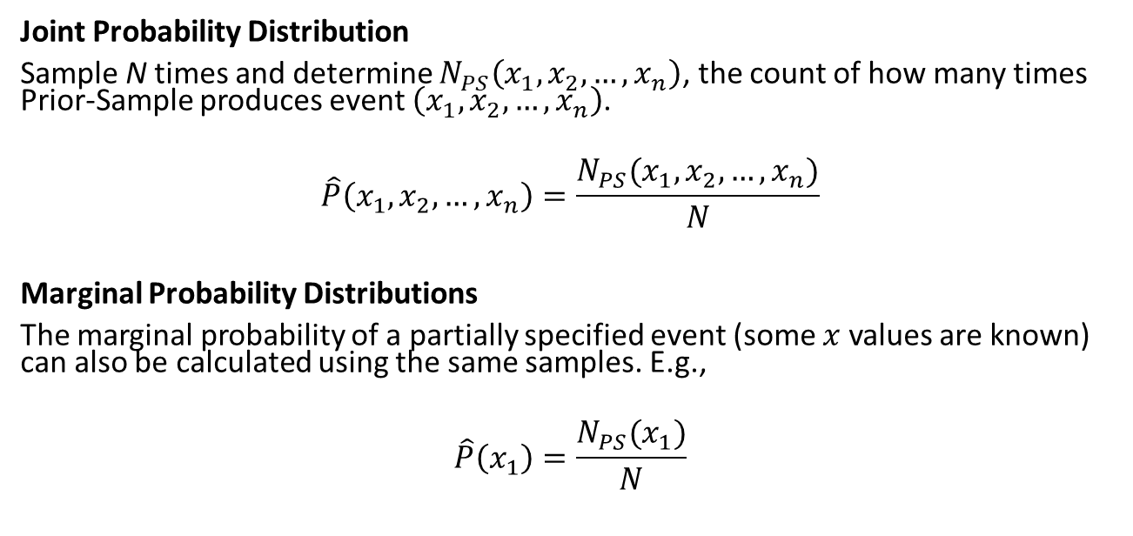
Estimating the Joint and Marginal Probability Distributions from Individual Samples
Joint Probability Distribution
Sample N times and determine $N_{PS}\left(x_{1},x_{2},…,x_{n}\right)$, the count of how many times Prior-Sample produces event $\left(x_{1},x_{2},…,x_{n}\right)$.
$$\hat{P}\left(x_{1},x_{2},…,x_{n}\right)=\frac{N_{PS}(x_{1},x_{2},…,x_{n})}{N}$$
Marginal Probability Distributions
The marginal probability of a partially specified event (some $x$ values are known) can also be calculated using the same samples. E.g.,
$$\hat{P}\left(x_{1}\right)=\frac{N_{PS}(x_{1})}{N}$$

Slide 12
Estimating Conditional Probabilities:
Markov Chain Monte Carlo Sampling (MCMC)
Idea: Instead of creating each sample individually from scratch, generate a sequence of samples.
The next sample in the sequence is created by making random changes to the current sample. Changes are controlled by a Markov Chain (MC) that is specifically created to have the desired probability distribution as its stationary distribution.
The stationary distribution of a MC can be estimated using Monte Carlo simulation by counting how often each state (=sample) is reached in a random walk through the MC.
Algorithms:
  Gibbs sampling works well for BNs since it needs conditional probabilities and we have CPTs.
  Metropolis-Hastings sampling is more general.
Notes:
  MCMC with Gibbs sampling is the most popular inference method.
  Simulated annealing local search is related to MCMC algorithms.

Slide 13

Conclusion
Bayesian networks provide an efficient way to store a complete probabilistic model for an AI problem by exploiting (conditional) independence between variables.
Inference means querying the model for a conditional probability given some evidence.
Exact inference is difficult for all but tiny models.
The state-of-the-art is to use approximate inference by Markov Chain Monte Carlo sampling from the model.
Any software libraries provide general inference engines.

