Slide 1
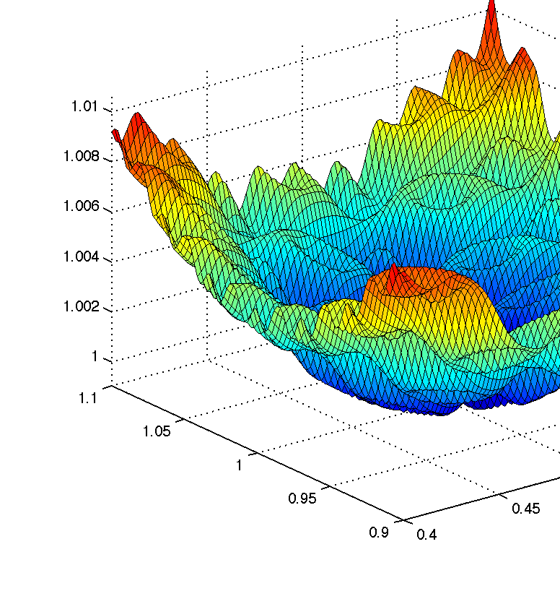


CS 5/7320 Artificial Intelligence Local Search AIMA Chapters 4.1 & 4.2
Discussion
Slides by Michael Hahsler based on slides by Svetlana Lazepnik with figures from the AIMA textbook.
This work is licensed under a Creative Commons Attribution-ShareAlike 4.0 International License.
Online Material

Slide 2
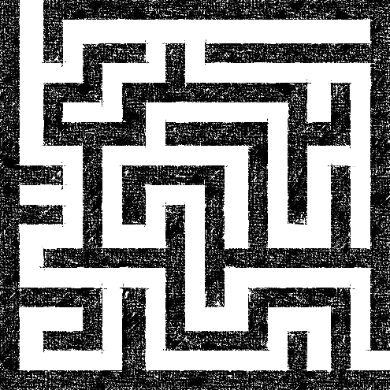
Recap: Uninformed and Informed Search
Tries to plan the
best path
from a
given initial state
to a
given goal state.
Often comes with completeness and optimality guarantees (BFS, A* Search, IDS).
Issue: Typically have to search a large portion of the search space and therefore need a lot of time and memory.
Initial state
Goal state

Slide 3
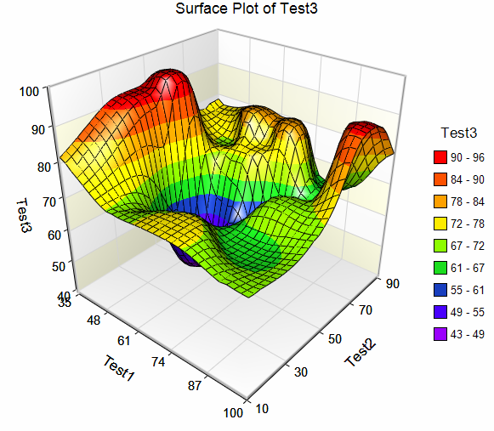
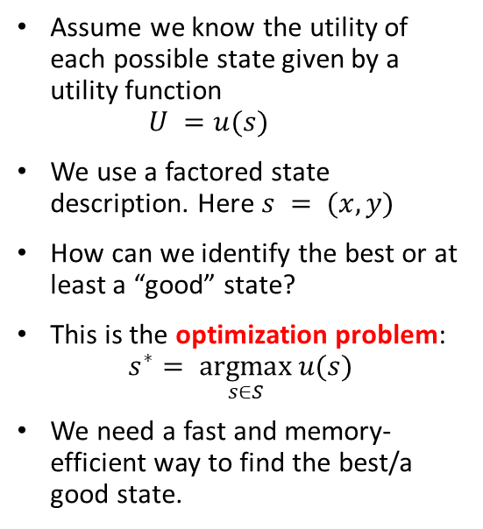
Local Search
Local improvement move from state to state
Assume we know the utility of each possible state given by a utility function $U =u(s)$
We use a factored state description. Here $s = (x, y)$
How can we identify the best or at least a “good” state?
This is the optimization problem: $s^{∗}= \underset{s∈S}{argmax}{u(s)}$
We need a fast and memory-efficient way to find the best/a good state.
x
x
Utility U
y
x
Idea:
Start with a current solution (a state) and improve the solution by moving from the current state to a “neighboring” better state (a.k.a. performing a series of local moves).

Slide 4
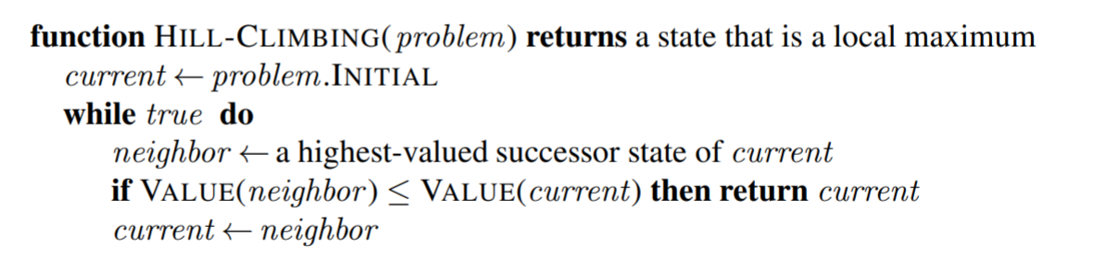
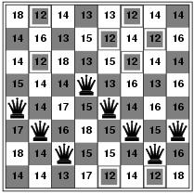


Hill-Climbing Search (Greedy Local Search)
Maximization
We often start with a random state
Use $≥$for minimization
Variants:
Steepest ascent hill climbing: Check all possible successors and choose the highest-valued successor.
Stochastic hill climbing: Choose randomly among all uphill (improvement) moves.
First-choice stochastic hill climbing: Generate randomly one new successor at a time and only move to better ones. This is what people often mean by “stochastic hill climbing.” It is equivalent to a, but computationally much cheaper.
Minimization
$$h = 17$$

Slide 5
Stochastic Hill Climbing
This is what people often mean by “stochastic hill climbing.”
Minimization
First-choice stochastic hill climbing: Generate randomly one new successor at a time and only move to better ones.
Simulate a few steps:
Describe why the result is equivalent to stochastic hill climbing that calculates the heuristic for all moves?
$$h = 17$$

Slide 6
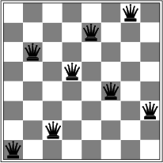

Local Optima
Hill-climbing search is like greedy best-first search with the objective function as a (maybe not admissible) heuristic. It only stores the current state (has no frontier data structure) and just stops at a dead end.
Is it complete/optimal?
No – can get stuck in local optima.
Example: local optimum for the 8-queens problem. No single queen can be moved within its column to improve the objective function.
$$h = 1$$
Simple approach that can help with local optima:
Random-restart hill climbing: Restart hill-climbing many times with random initial states and return the best solution. This strategy can be used for any stochastic (i.e., randomized) algorithm.

Slide 7
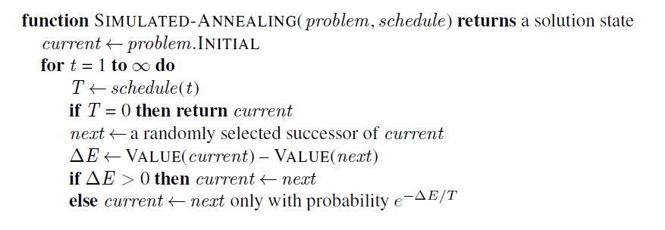
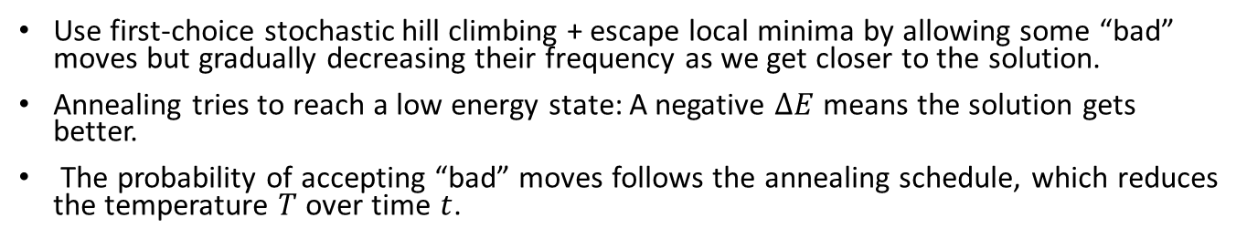

Simulated Annealing Algorithm
Use first-choice stochastic hill climbing + escape local minima by allowing some “bad” moves but gradually decreasing their frequency as we get closer to the solution.
Annealing tries to reach a low energy state: A negative $ΔE$ means the solution gets better.
The probability of accepting “bad” moves follows the annealing schedule, which reduces the temperature $T$ over time $t$.
Maximization
Typically, we start with a random state
Always accept good moves that reduce the energy.
Accept “bad” moves with a probability inspired by the acceptance criterion in the Metropolis–Hastings MCMC algorithm.
if $ΔE≤ 0$ then
Note: Use $VALUE(next) – VALUE(current)$for minimization

Slide 8
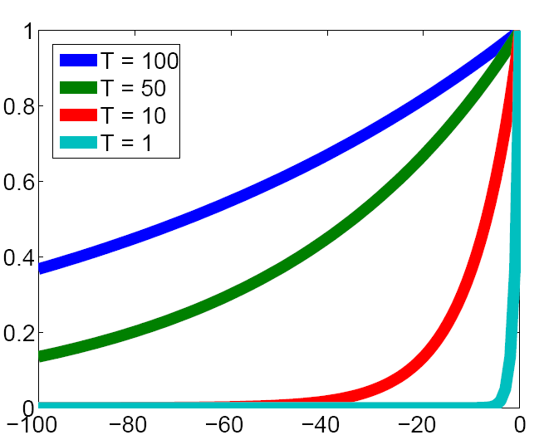
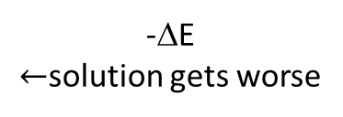
The Effect of Temperature
Convert the changes due to “bad” moves into an acceptance probability depending on the temperature. The criterion uses the negative part of the exponential function.
Prob. of accepting a worse state exp(-ΔE/T)
-ΔE $←$solution gets worse

Slide 9
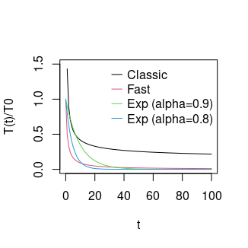
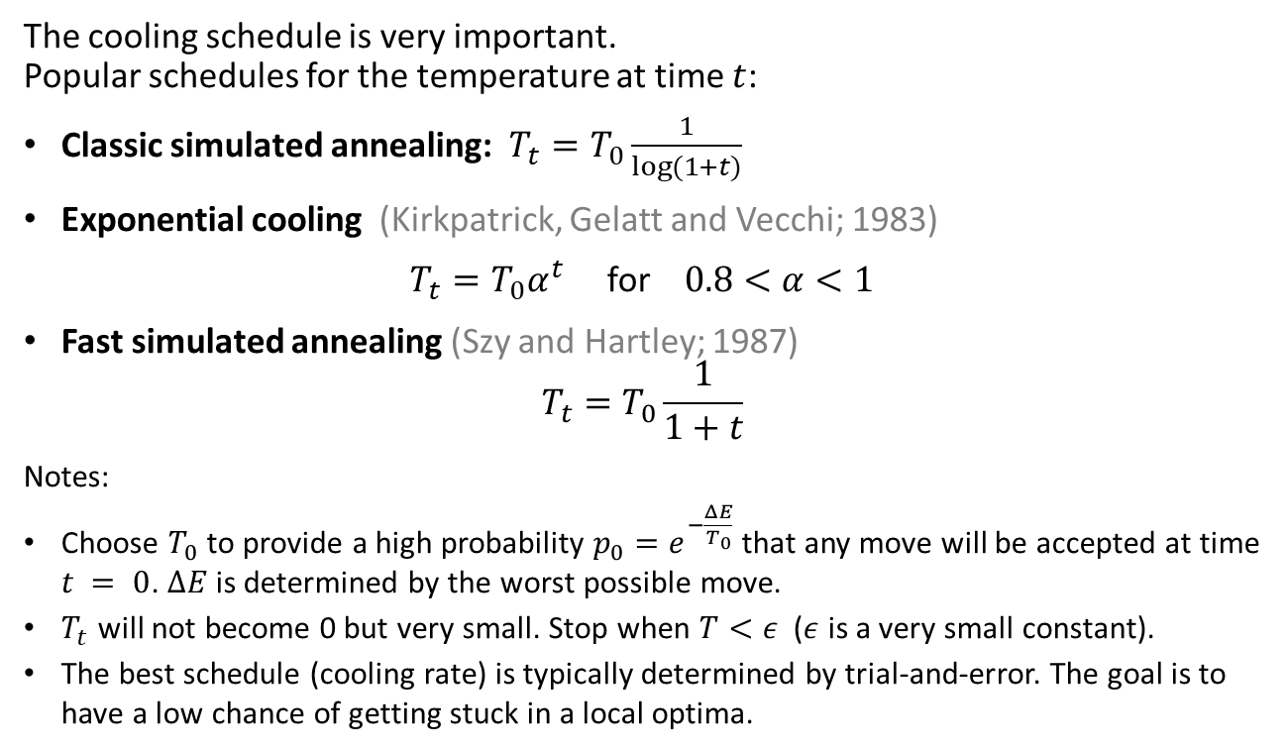
Cooling Schedule
The cooling schedule is very important. Popular schedules for the temperature at time $t$:
Classic simulated annealing: $T_{t}=T_{0}\frac{1}{log⁡(1+t)}$
Exponential cooling (Kirkpatrick, Gelatt and Vecchi; 1983)
$T_{t}=T_{0}α^{t}$ for $0.8<α<1$
Fast simulated annealing (Szy and Hartley; 1987)
$$T_{t}=T_{0}\frac{1}{1+t}$$
Notes:
Choose $T_{0}$ to provide a high probability $p_{0}=e^{−\frac{ΔE}{T_{0}}}$that any move will be accepted at time $t = 0$. $ΔE$is determined by the worst possible move.
$T_{t}$ will not become 0 but very small. Stop when $T<ε$ ($ε$ is a very small constant).
The best schedule (cooling rate) is typically determined by trial-and-error. The goal is to have a low chance of getting stuck in a local optima.

Slide 10
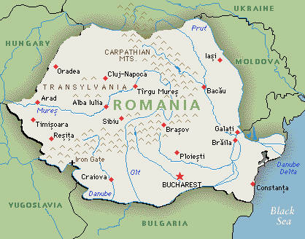
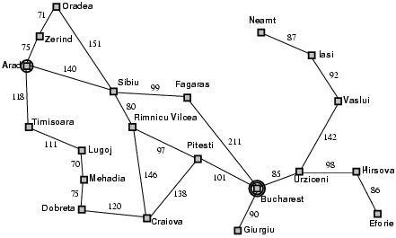


Methods: Discretization of Continuous Space
Use atomic states and create a graph as the transition function.
Use a grid with spacing of size $δ$
Note: You probably need a way finer grid!
$$δ$$
y
x

Slide 11
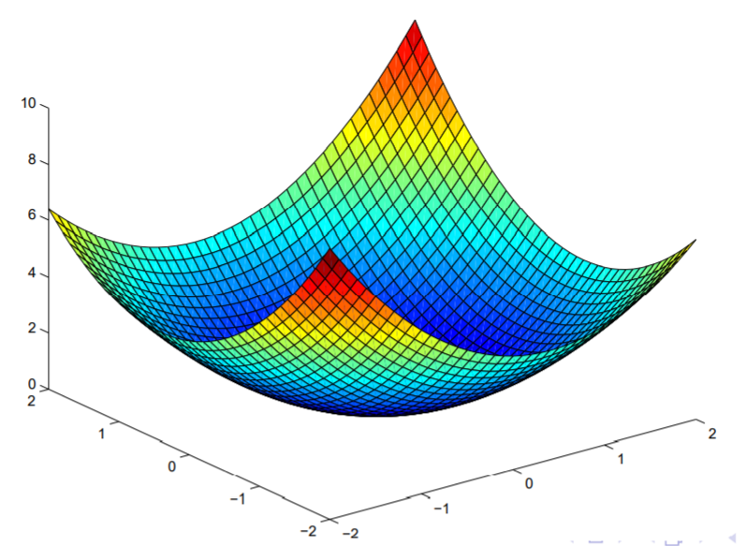
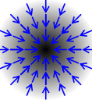





Search in Continuous Spaces: Gradient Descent
$$f(x)$$
State representation: $x= \left(x_{1},x_{2},…,x_{k}\right)$
State space size: infinite
Objective function: min $f\left(x\right)$
Local neighborhood: small changes in $x_{1},x_{2},…,x_{k}$
Gradient at point $x$: $∇f\left(x\right)= \left(\frac{∂f\left(x\right)}{∂x_{1}}, \frac{∂f\left(x\right)}{∂x_{2}}\text{, …, }\frac{∂f\left(x\right)}{∂x_{k}}\right)$ (=evaluation of the Jacobian matrix at $x$)
Find optimum by solving: $∇f\left(x\right)=0$
Gradient descent (= Steepest-ascend hill climbing for minimization) with step size $α$ (typically reduced over time)
Repeat: $x←x−α∇f\left(x\right)$
Newton-Raphson method uses the inverse of the Hessian matrix (second-order partial derivative of $f\left(x\right)$) $H_{ij}=\frac{∂^{2}f}{∂x_{i}∂x_{j}}$ as the optimal step size
Repeat: $x←x−H_{f}^{−1}(x)∇f\left(x\right)$
Note: May get stuck in a local optimum if the search space is non-convex! Use simulated annealing, momentum or other methods to escape local optima.
$$x_{1}$$
$$x_{2}$$
$$∇f\left(x\right)$$

Slide 12
Example
Apply Simple Hill Climbing to the L-Maze

