Slide 1



Large Language Models in AI
A Quick Overview
Michael Hahsler
This work is licensed under a Creative Commons Attribution-ShareAlike 4.0 International License.
Online Material

Slide 2
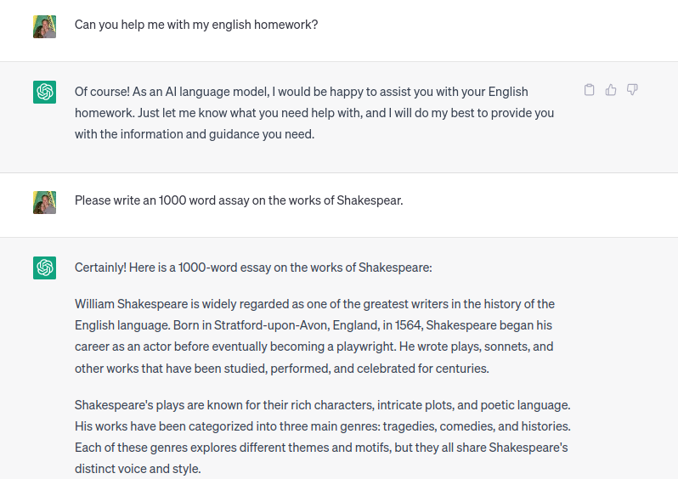
Example Conversation With a
Large Language Model (LLM)
This knowledge has to come from somewhere!
…
Source: https://chat.openai.com/

Slide 3
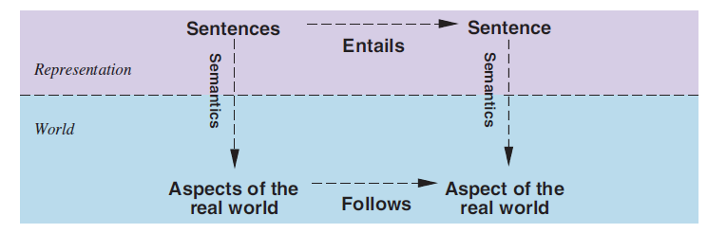
Using Natural Language for Knowledge Representation
Pretrained model knows words relationship, grammar, and facts stored as parameters in a network.
Modified version of knowledge represented using logic.
KB
Generates
Text
Prompts
Useful?
The user formulates a question about the real world as a natural language prompt (a sequence of tokens).
The LLM generates text using a pretrained model that represents its knowledge base.
The text (hopefully) is useful in the real world. The objective function is not clear. Maybe it is implied in the prompt?

Slide 4
What are LLMs
Large language models are knowledge-based agents.
The knowledge base is a large, deep artificial neural network using the transformer architecture.
The model is pretrained for the task of predicting the next word using self-supervised learning on a large text corpus.
The pretrained model is specialized for a specific task using fine-tuning on examples. For chatbots, this includes
  supervised instruction training followed by
  reinforcement learning from human feedback (RLHF).
The model can generate text following a “prompt.”
Learned word relationships, grammar, facts, and how to answer questions.
Knowledge base
Domain-independent content (pre-training)
+
Domain-specific content (fine tuning)
Text Generator
Domain-independent algorithms
LLM as a knowledge-based agent
Pretrained models can be downloaded from
Hugging Face: https://huggingface.co/models

Slide 5
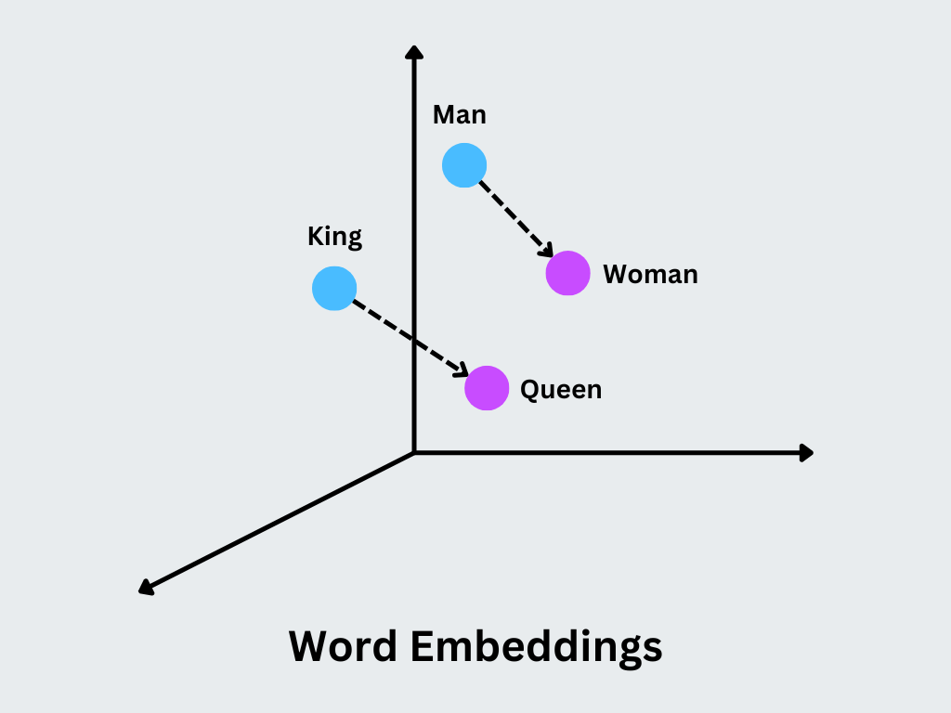
How LLMs Understand Text
LLMs can only compute with numbers!
Prompts are converted into numbers:
  Tokenization:
    Text is converted into a sequence of tokens (ids).
    Tokens represent words, parts of words, parts of numbers, etc.
  Embedding:
    Tokes are converted to large vectors indicating a position in a high-dimensional space called the embedding space.
    Positions in this space have meaning.
Computation is done by calculations (moving around) in the embedding space.
New words are generated from resulting vectors by learning a function that maps vectors back to tokens.
Natural Language Processing (NLP)
Source: https://zilliz.com/glossary/word2vec

Slide 6
Prompts and Generation
System Prompt
Example Context:
LLMs can only perform next-token prediction.
The most likely next word is predicted based on the context, which is the input window (percept) for the LLM.
The context is typically a combination of the
  system prompt (general instructions you often don’t see)
  more context information (documents, additional information)
  the user prompt
The context window size is limited by the model, and the model “forgets” everything that drops out of the window.
The complete response is created token-by-token (autoregessive generation). LLMs may hallucinate by creating low-probability tokens, and autoregression will amplify this issue.
You are a helpful assistant who answers user questions based on the following information.
This week’s schedule:
Monday 10 AM – AI class
Wednesday 12 AM – Data Mining class
When do I need to go to the AI class?
Additional context (e.g., from a database)
User Prompt

Slide 7
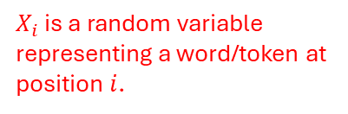


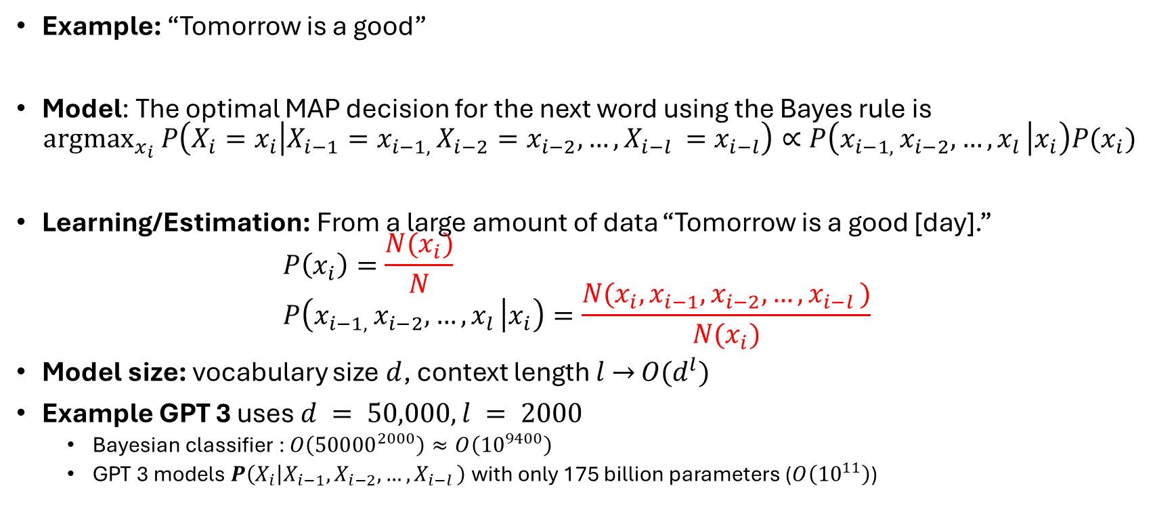






How LLMs Predict the Next Word
Context window
Predict the next word
$X_{i}$ is a random variable representing a word/token at position $i$.
Example: “Tomorrow is a good”
Model: The optimal MAP decision for the next word using the Bayes rule is
${argmax}_{x_{i}} P\left(X_{i}=x_{i} | X_{i−1}=x_{i−1, }X_{i−2}=x_{i−2}, …, X_{i−l }=x_{i−l}\right)∝P\left(x_{i−1, }x_{i−2}, …, x_{l } | x_{i}\right)P(x_{i})$
Learning/Estimation: From a large amount of data “Tomorrow is a good [day].”
$P\left(x_{i}\right)=\frac{N(x_{i})}{N}$
$P\left(x_{i−1, }x_{i−2}, …, x_{l } | x_{i}\right)=\frac{N(x_{i}, x_{i−1}, x_{i−2}, …, x_{i−l })}{N(x_{i})}$
Model size: vocabulary size $d$, context length $l$ $→$ $O(d^{l})$
Example GPT 3 uses $d = 50,000, l = 2000$
  Bayesian classifier : $O\left({50000}^{2000}\right)≈O\left({10}^{9400}\right)$
  GPT 3 models $P\left(X_{i} | X_{i−1}, X_{i−2}, …, X_{i−l }\right)$ with only 175 billion parameters ($O\left({10}^{11}\right)$)
$$x_{i−4}$$
$$x_{i−3}$$
?
$$x_{i−2}$$
$$x_{i−1}$$
$$x_{i}$$
Mask the next word = self-supervised learning
Joint Probability as a table has all the information $P({X_{i}, X}_{i−1}, X_{i−2}, …, X_{i−l })$
$$X_{i−l}$$ | … | $$X_{i−3}$$ | $$X_{i−2}$$ | $$X_{i−1}$$ | $$X_{i}$$ | $$P$$
- | … | is | a | good | day | 0.01
- | … | is | a | good | reason | 1e-12
This does not fit in memory and we cannot estimate that many numbers!
$O(d^{l})$ rows!
Tricks for compression in transformers are positional encoding and the attention mechanism.
With 16-bit floats, this needs > 350 GB RAM

Slide 8
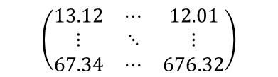




Structure of a GPT-type LLM
Predicted probabilities for next token
Vector (state)
Example
Trainable artificial neural networks
Probability for token “day”
Vectors (embedding as tensor)
classifier
$$(0, …,.63,…, 0)$$
Classifier (a soft-max layer)
$n$ transformer blocks
with self-attention
$$(32432.23, …, 899.12)$$
Single embedding size vector.
Token sequence
$n$ transformer blocks
with self-attention
Prompt (words)
Positional embedding
$$\left(\begin{matrix}13.12 & ⋯ & 12.01 \\ ⋮ & ⋱ & ⋮ \\ 67.34 & ⋯ & 676.32\end{matrix}\right)$$
Token by embedding size matrix
Positional embedding
(a single connected layer)
Tokenizing
[18449, 382, 261, 1899]
Tokenizing
Structure of a GPT-type LLM using a decoder only transformer architecture
Today is a good

Slide 9
Prompt Engineering / Context Engineering
Design effective natural language instructions (prompts) to guide generative AI models toward desired outputs, such as text, images, or code.
  Zero-shot prompt: directly instructs the model to perform a task without any additional examples.
  Few-Shot Prompting: Provide demonstrations in the prompt to steer the model to better performance. This is also called “in-context learning”
  Chain-of-thought: solve a problem as a series of intermediate steps before giving a final answer.
  Note: Many modern chatbots include chain-of-thought into the system prompt and call this reasoning models!
Examples:
6 times 15 minus 3 is
Review: Loved it! Output: Positive
Review: Hated it. Output: Negative
Review: It was good. Output:
How much is 6 times 15 minus 3? Let's think step-by-step.

Slide 10
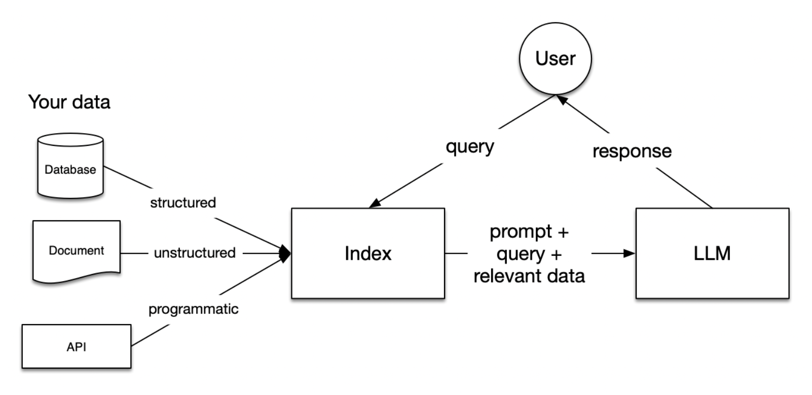
Retrieval Augmented Generation (RAG)
RAG combines an information retrieval component with a text generator model.
Approach:
  RAG takes an input and retrieves a set of relevant/supporting documents given a source (e.g., Wikipedia).
  The documents are concatenated as context with the original input prompt and fed to the text generator LLM.
  The LLM produces the final output.
This approach can reduce issues with hallucination and introduce information that was not in the training data.
Tools: LangChain, LambdaIndex, Flowise,…
Source: https://codingscape.com/blog/rag-101-what-is-rag-and-why-does-it-matter

Slide 11
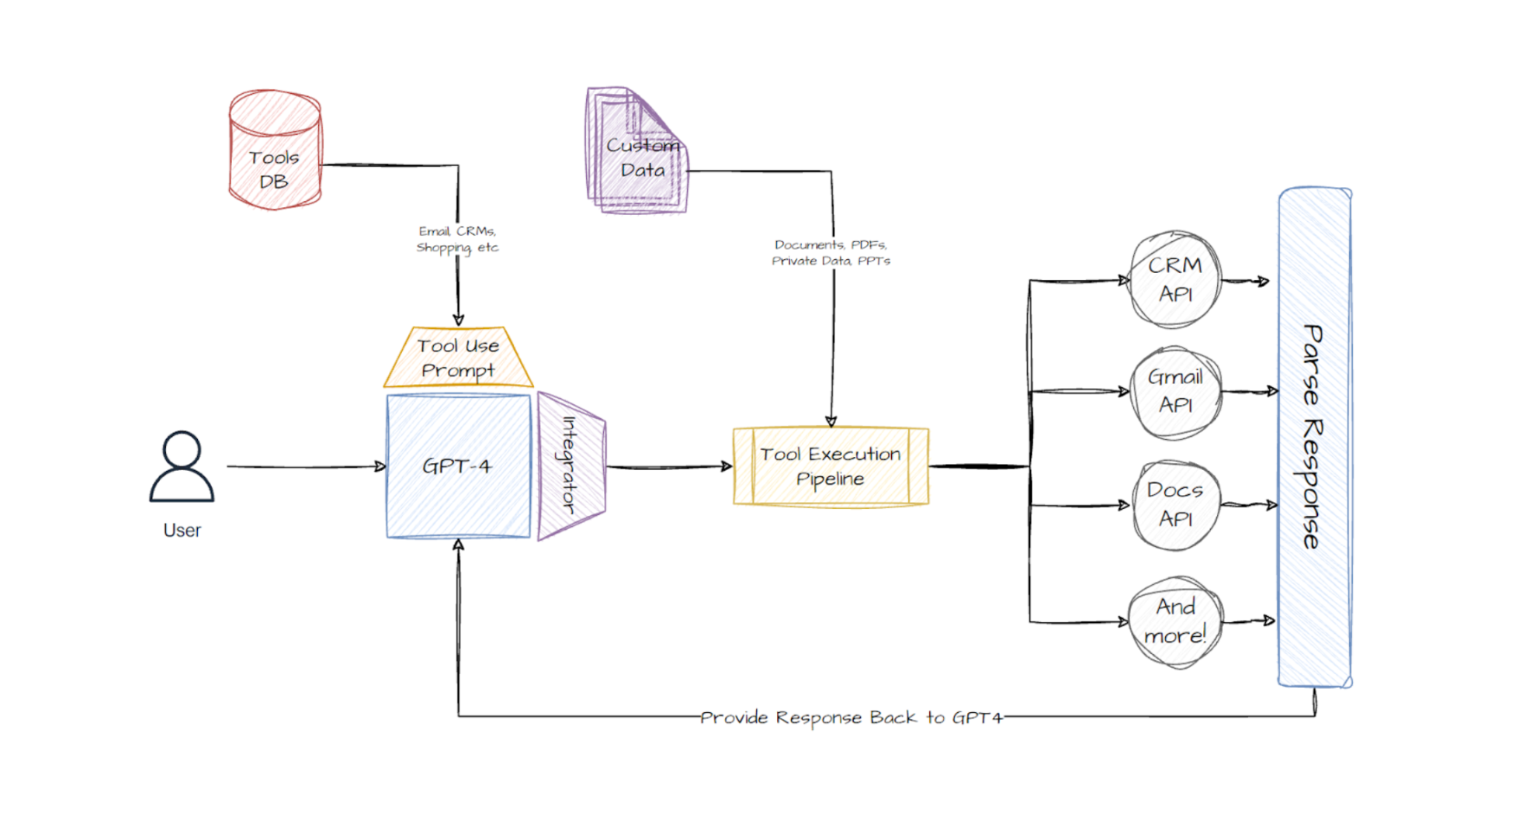
LLMs that use Tools
Enables LLMs to use tools like browsing the web, a calculator, or executing code.
Training: LLMs are finetuned using demonstrations of how the tool is correctly used.
Execution:
The LLM generates a structured output that signals a tool call. E.g.: “browser(http://…”
The tool call is intercepted by the surrounding program, and the tool is executed.
The tool’s result is returned to the LLM to create the final output.
Frameworks: LangChain, LangGraph, OpenAI Agents SDK, …
Source: https://www.mercity.ai/blog-post/guide-to-integrating-tools-and-apis-with-language-models

Slide 12
LLMs and Images
Image interpretation: image as the input
  LLMs convert visual data into locations in the embedding space (using image encoders and multimodal alignment).
  The location in the embedding space connects the image to tokens. This connection enables LLMs to describe the image.
  Training: LLMs that process images are usually trained with multimodal datasets and tasks like image-text matching, predicting missing parts of an image, etc.
Image generation: Image as the output
  LLMs do not directly generate images.
  The LLM is trained to generate a textual description of the desired image and then uses an external tool like a diffusion model (DALL-E, Stable Diffusion, Imagen).

Slide 13
Argentic AI
An AI solution that uses a set of specially prompted LLM calls.
The solution involves any or all of these:
  Multiple LLM calls
  LLMs can use tools (browse the web, access files, etc.) to interact with an environment.
  A planner coordinates the activities of the agents: Can be a developer-defined workflow or use an LLM to plan its own.
Tools: LangChain, LangGraph, CrewAI, …

Slide 14
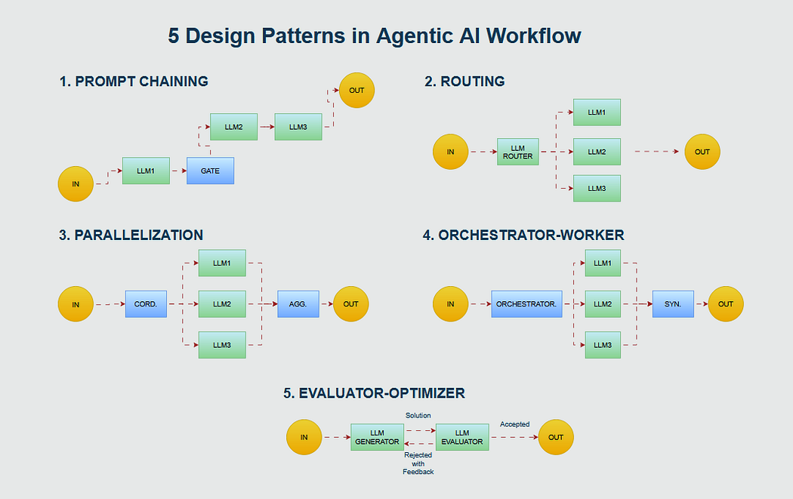
Argentic AI Strategies
Prompt chaining: each step has a focused job, making each LLM query simpler and more accurate.
Routing is about smartly directing inputs to the right handler (e.g., LLMs trained differently).
Parallelization lets the agent do multiple things at the same time.
Orchestration: An agent takes the input, breaks it into sub-tasks on the fly, and then dispatches each subtask to separate “worker” agents.
Evaluator–optimizer is a feedback loop. One agent generates a solution, and another evaluates it and suggests improvements.
Source: https://pub.towardsai.net/5-design-patterns-in-agentic-ai-workflow-c972c83f77e4

Slide 15
Conclusion
LLMs are knowledge-based agents trained for the next-word prediction task.
LLMs can be fine-tuned for specific purposes (e.g., a chatbot), to understand images, and to use tools.
Prompt engineering (context engineering) is important to produce better responses from the LLM.
Retrieval Augmented Generation (RAG) can be used to include information that was not in the training data.
Agentic AI uses multiple LLM calls to deal with more complicated problems.
Some issues:
  Hallucinations; the LLM does not say when it is not sure. RAG can help.
  Privacy and data security when a third party hosts the LLM. Training data can be poisoned.
  Safety: It is easy to avoid guardrails (i.e., jailbreak) leading to unsafe responses.
  LLMs currently have no (or very little) common sense.
  LLMs’ performance is influenced by small prompt changes. The results are not very dependable.
  Reasoning capabilities are very limited. Agentic AI tries to mitigate this issue by focusing on smaller tasks.

