Slide 1
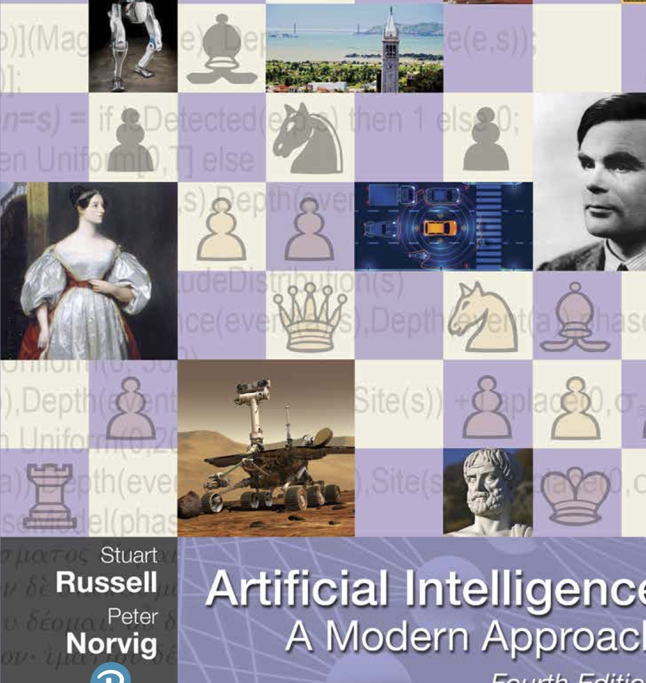

CS 5/7320 Artificial Intelligence Course Introduction
Slides by Michael Hahsler
This work is licensed under a Creative Commons Attribution-ShareAlike 4.0 International License.
Online Material

Slide 2
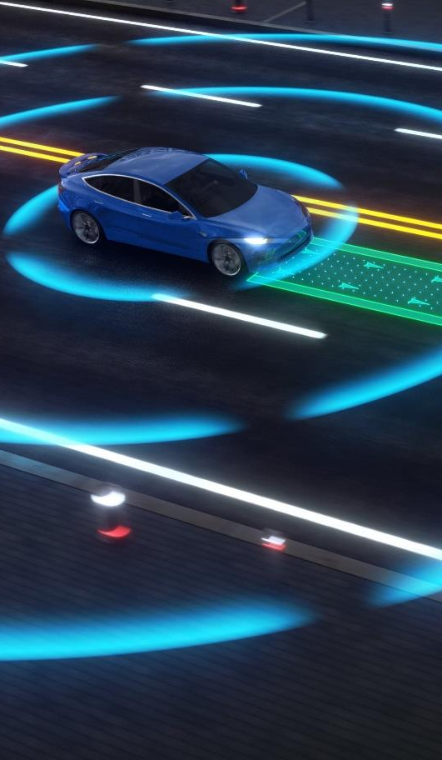
Course Goal
This course will introduce AI from the viewpoint of creating an autonomous intelligent agent that acts rationally in its environment.
For example, a self-driving car is an intelligent agent with the objective of delivering a passenger to a desired destination. The agent needs to make decisions about stopping, turning, and changing lanes by observing its environment, which consists of roads, other cars, pedestrians, and traffic signals.
We will focus on the algorithms used by the agent to make decisions. We will survey the following important topics:
Searching for a solution
Using knowledge for decision making
Decision-making under uncertainty
Learning from examples

Slide 3
Learning Method
Lecture + Problem Sets: We will discuss algorithms appropriate for different tasks and types of environments. Problem sets will improve the understanding.
Projects: You will implement algorithms to solve several tasks and conduct experiments to investigate how well the algorithms work and how they scale with problem size.
Exams: Checks knowledge of AI concepts and the ability to apply them.
Evaluation is based on problem sets, projects, and exams.

Slide 4
Course Learning Outcomes
CLO 1: Define what artificial intelligence (AI) is and explain how it is used.
CLO 2: Identify ethical and security issues with artificial intelligence applications.
CLO 3: Define intelligent agents and explain how they interact with their environment.
CLO 4: Apply search to create agents that can perform simple tasks.
CLO 5: Explain how knowledge-based agents make decisions.
CLO 6: Explain how probabilistic reasoning is used by agents to make decisions under uncertainty.
CLO 7: Apply machine learning to different components of an intelligent agent.

Slide 5
To Be Successful you need…
Course assignments require substantial advanced Python programming.
Students need practical knowledge of how to implement data structures and algorithms (Big-O notation, search trees).
Students must have a working knowledge of probability theory and combinatorics.
Students are expected to obtain any missing knowledge independently.

