Slide 1

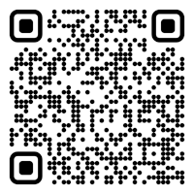

CS 5/7320
Artificial Intelligence
Adversarial Search and Games
AIMA Chapter 5
Slides by Michael Hahsler
with figures from the AIMA textbook
This work is licensed under a Creative Commons Attribution-ShareAlike 4.0 International License.
Image: "Reflected Chess pieces"
by Adrian Askew
Online Material

Slide 2
Contents
Games as
Search Problems
Exact Methods
Non-deterministic Actions
Minimax Search
Heuristic Methods
Heuristic Alpha-Beta Tree Search
Monte Carlo Tree search
Stochastic Games

Slide 3

Games
Strategic environment: Games typically feature an environment containing an opponent who wants to win against the agent.
Episodic environment: One game does not affect the next.
We will focus on planning for
  two-player zero-sum games with
  deterministic game mechanics and
  perfect information (i.e., fully observable environment).
We call the two players:
  Max tries to maximize its utility.
  Min tries to minimize Max’s utility (zero-sum game).

Slide 4
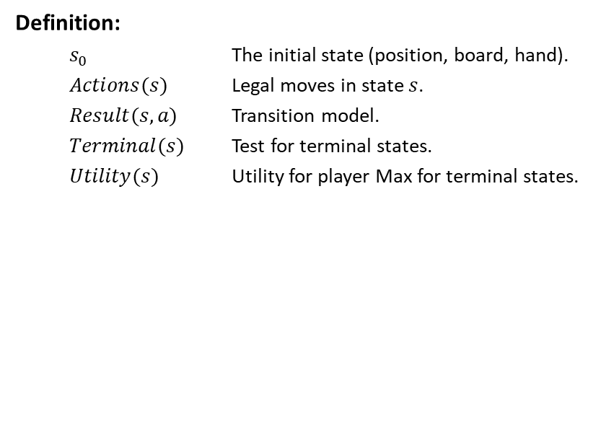
Definition of a Game
Definition:
  $s_{0}$ The initial state (position, board, hand).
  $Actions(s)$ Legal moves in state $s$.
  $Result(s,a)$ Transition model.
  $Terminal(s)$ Test for terminal states.
  $Utility(s)$ Utility for player Max for terminal states.

Slide 5
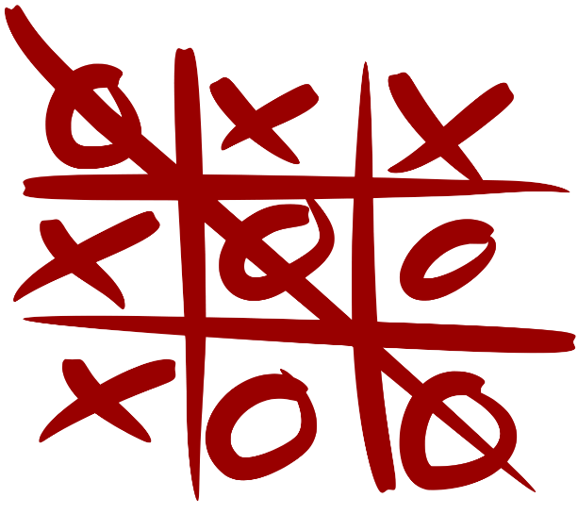
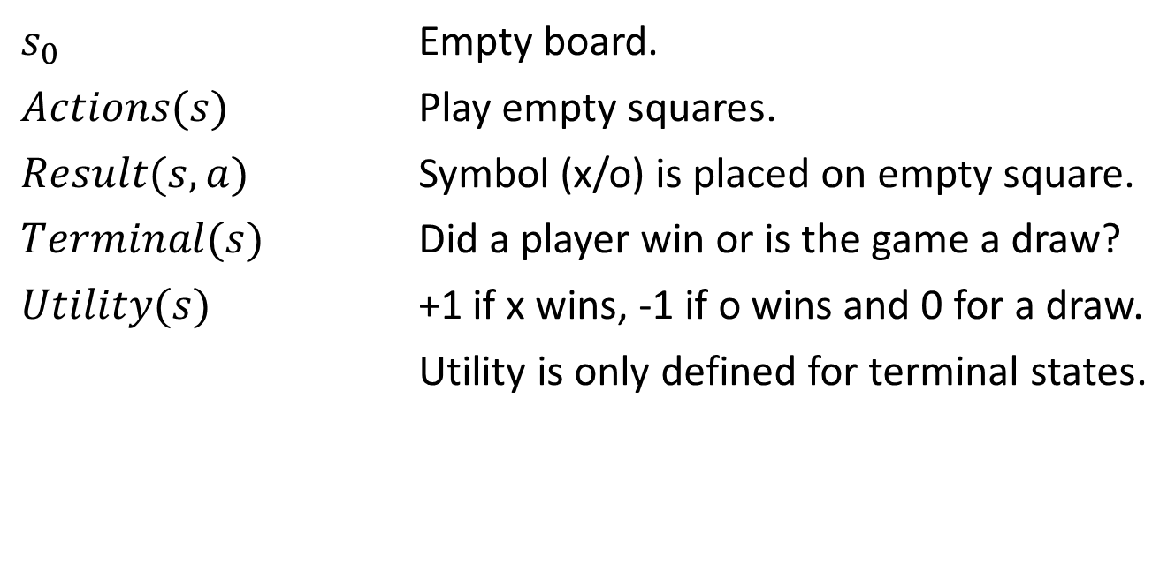
Example: Tic-tac-toe
$s_{0}$ Empty board.
$Actions(s)$ Play empty squares.
$Result(s,a)$ Symbol (x/o) is placed on empty square.
$Terminal(s)$ Did a player win or is the game a draw?
$Utility(s)$ +1 if x wins, -1 if o wins and 0 for a draw.
Utility is only defined for terminal states.
Here player x is Max and player o is Min.
Note: This game still uses a goal-based agent that plans actions to reach a winning terminal state!

Slide 6
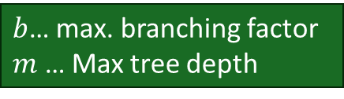
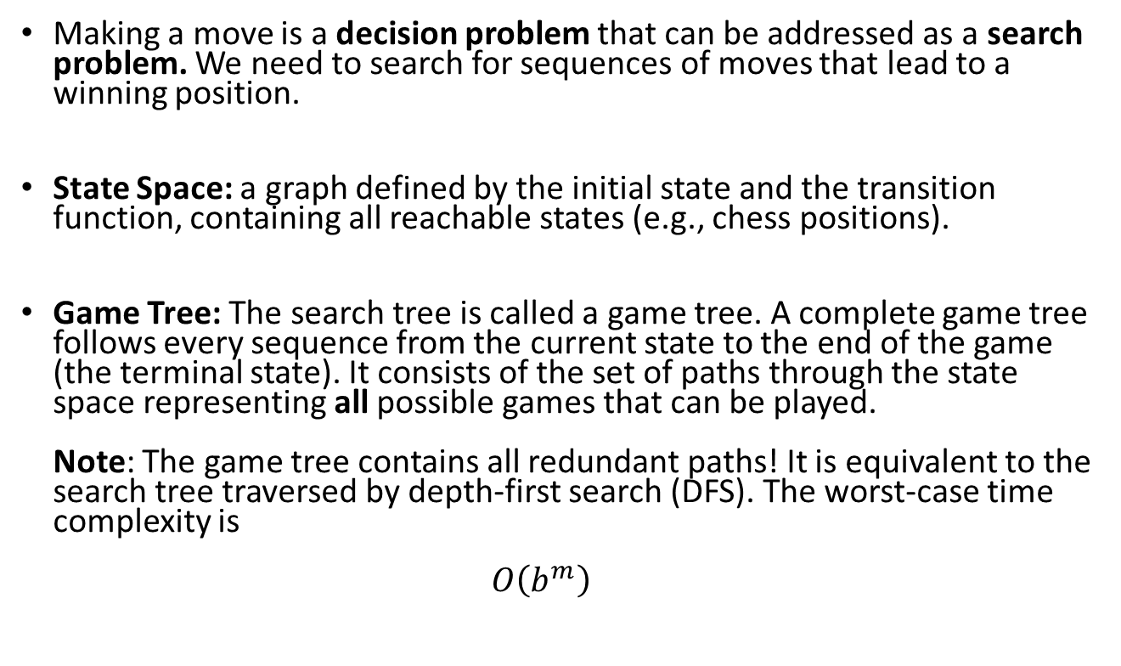
Games as Search Problems
Making a move is a decision problem that can be addressed as a search problem. We need to search for sequences of moves that lead to a winning position.
State Space: a graph defined by the initial state and the transition function, containing all reachable states (e.g., chess positions).
Game Tree: The search tree is called a game tree. A complete game tree follows every sequence from the current state to the end of the game (the terminal state). It consists of the set of paths through the state space representing all possible games that can be played.
Note: The game tree contains all redundant paths! It is equivalent to the search tree traversed by depth-first search (DFS). The worst-case time complexity is
$O\left(b^{m}\right)$
$b$… max. branching factor
$m$ … Max tree depth

Slide 7
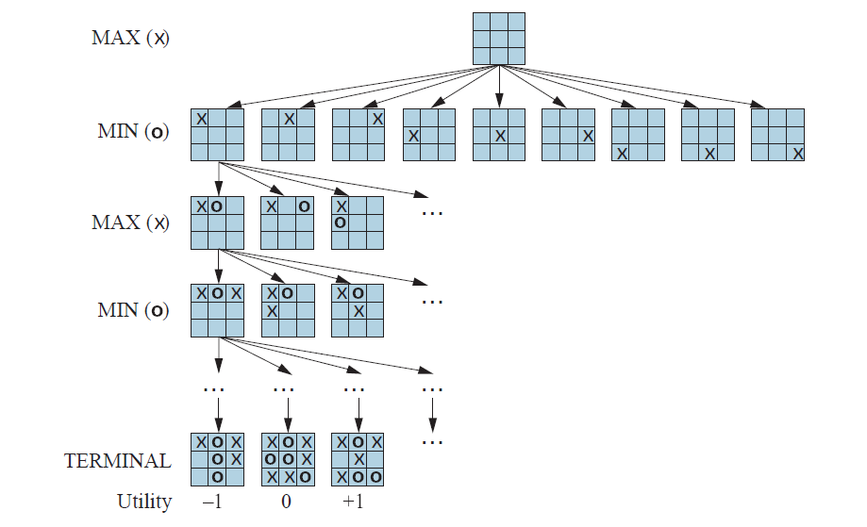
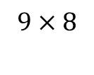
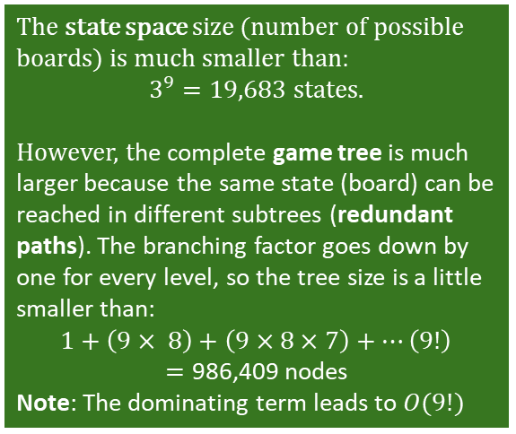
Tic-tac-toe: Partial Game Tree
Note: This game has no cycles!
node / state
# of nodes
action / result()
1
9
redundant path
$$9×8$$
The state space size (number of possible boards) is much smaller than:
$3^{9}=19,683$ states.
However, the complete game tree is much larger because the same state (board) can be reached in different subtrees (redundant paths). The branching factor goes down by one for every level, so the tree size is a little smaller than:
$$1+\left(9× 8\right)+\left(9×8×7\right)+…\left(9!\right)$$
$=\text{986,409}$ nodes
Note: The dominating term leads to $O(9!)$
Terminal states have a known utility

Slide 8
Methods for Adversarial Games
Exact Methods
Model as nondeterministic actions: The opponent is seen as part of an environment with nondeterministic actions. Non-determinism is the result of the unknown moves by the opponent. We consider all possible moves by the opponent.
Find optimal decisions: Minimax search and Alpha-Beta pruning, where each player plays optimally to the end of the game.
Heuristic Methods
(game tree is too large)
Heuristic Alpha-Beta Tree Search:
  Cut-off game tree and use a heuristic for utility.
  Forward Pruning: ignore poor moves.
Monte Carlo Tree search: Estimate the utility of a state by simulating complete games and averaging the utility.

Slide 9
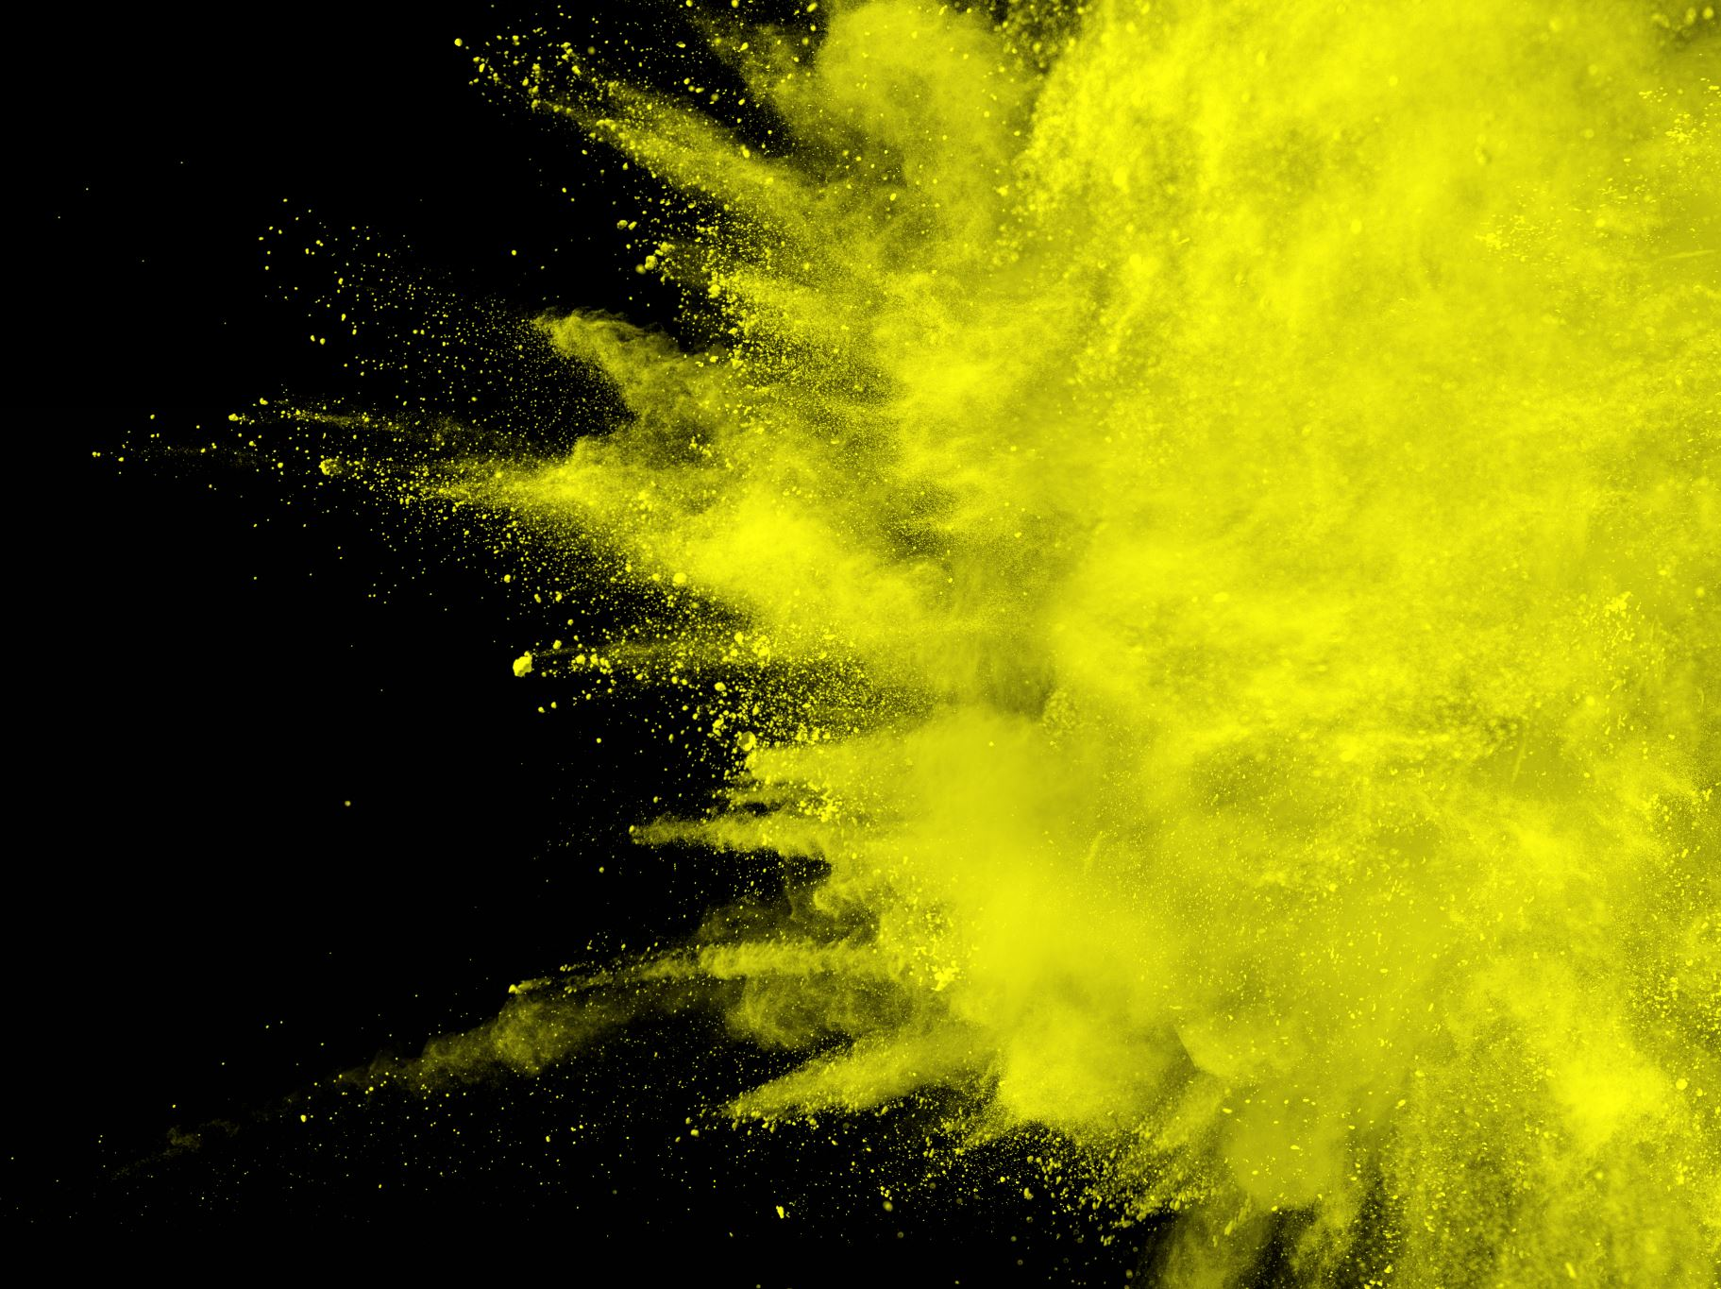
Exact Method:
Nondeterministic Actions

Slide 10
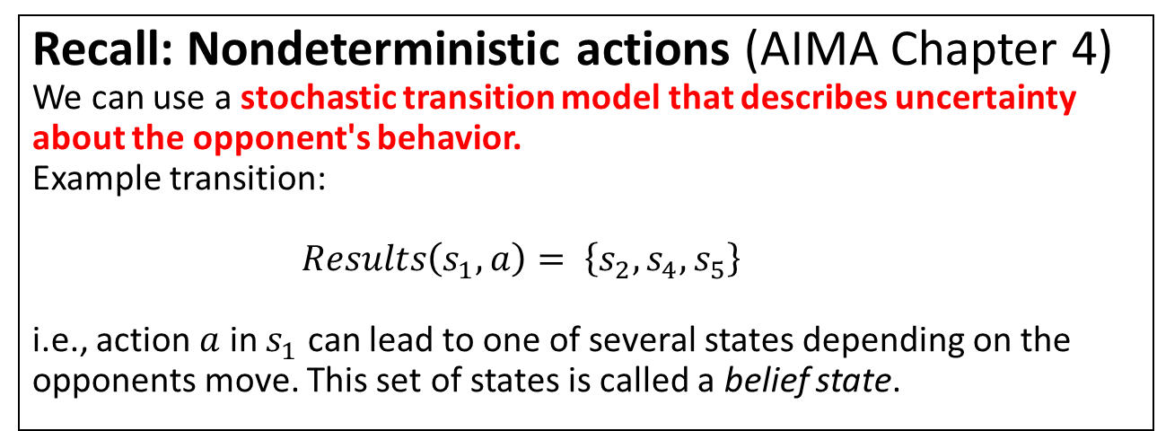
Nondeterministic Actions
The opponent is considered part of the strategic environment.
Each “round” consists of
  the deterministic move by the agent, and
  a non-deterministic response by the opponent (the environment).
Recall: Nondeterministic actions (AIMA Chapter 4)
We can use a stochastic transition model that describes uncertainty about the opponent's behavior.
Example transition:
$Results\left(s_{1},a\right)= \left\{s_{2},s_{4},s_{5}\right\}$
i.e., action $a$ in $s_{1}$ can lead to one of several states depending on the opponents move. This set of states is called a belief state.

Slide 11
Tic-tac-toe: AND-OR Search
We play MAX and decide on our actions (OR).
MIN’s actions introduce non-determinism (AND).
OR (specify 1 action)
AND (consider all outcomes)
Objective: Find a subtree that consists of
one action for OR nodes and
all children for AND nodes that
has only win leaf nodes (utility +1).
Extract a conditional plan from the subtree.
OR
AND
This implies playing optimally.
MAX: We try to find a move that guarantees a win (= optimal).
MIN: We consider all the opponent’s moves in the AND stage. This includes MIN’s best (optimal) move.

Slide 12
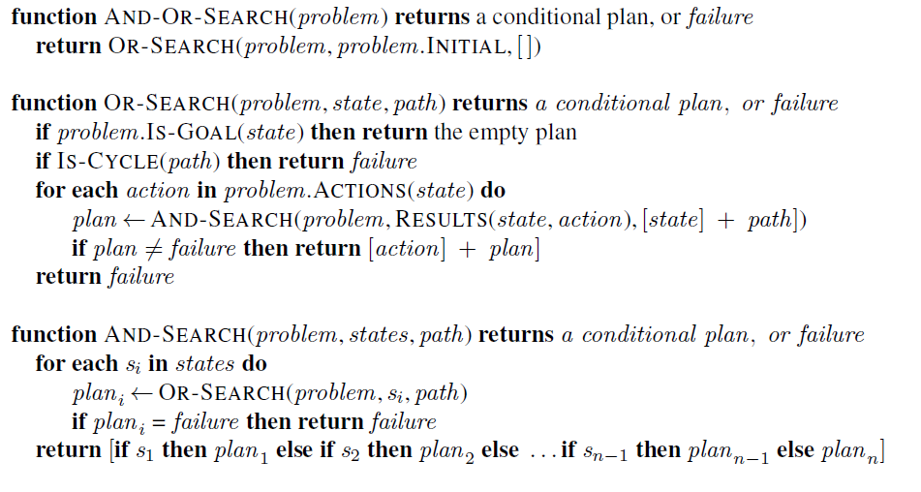
Recall: AND-OR DFS Search Algorithm
= nested If-then-else statements
Try agent’s moves
// don’t follow loops
// check all possible actions
all states that can result from opponent’s moves
// check all possible resulting states
Go through opponent
moves
abandon subtree if a loss is possible
Construct a partial conditional plan for the subtree

Slide 13
Code example: Tic-Tac-Toe with
AND-OR Search Trees
See Code on https://michael.hahsler.net/Introduction_to_Artificial_Intelligence/

Slide 14
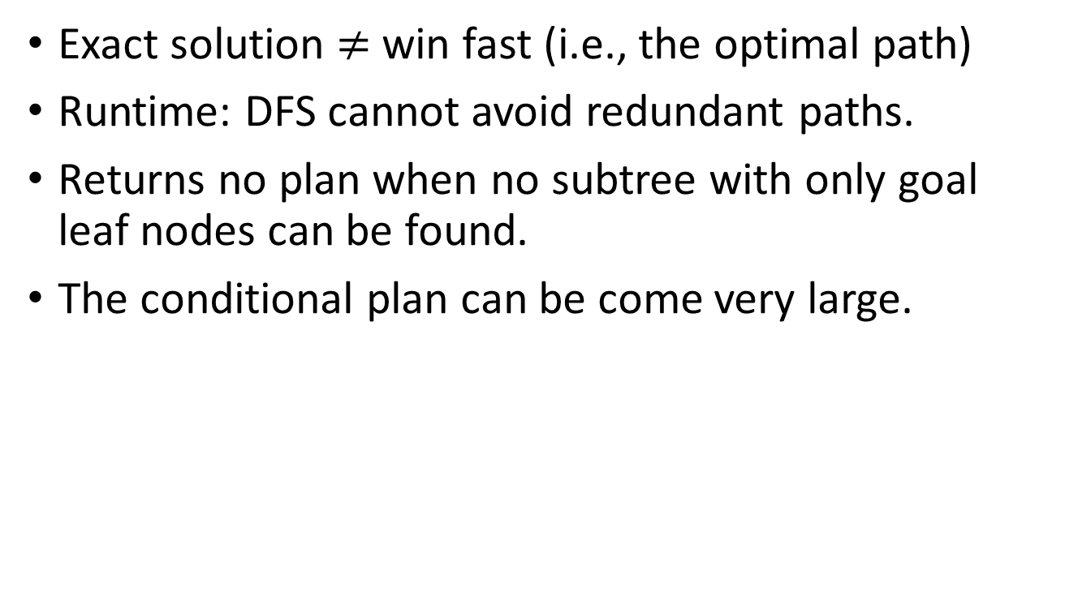
Issues: AND-OR DFS Search
Exact solution $≠$ win fast (i.e., the optimal path)
Runtime: DFS cannot avoid redundant paths.
Returns no plan when no subtree with only goal leaf nodes can be found.
The conditional plan can be come very large.

Slide 15

Optimal Decisions:
Minimax Search

Slide 16
Immediate vs. Long-Term Rewards
?
The immediate reward of a state is the utility that the agent receives for being in/getting to that state.
Terminal states: The immediate reward is the known utility.
Non-terminal states: The immediate reward is 0.
Issue: How good is it to be in a non-terminal state? We need to complete the game and see. This is called the (expected) long-term reward of the state.
The optimal decision is to always choose the action that leads to the highest long-term reward state.

Slide 17
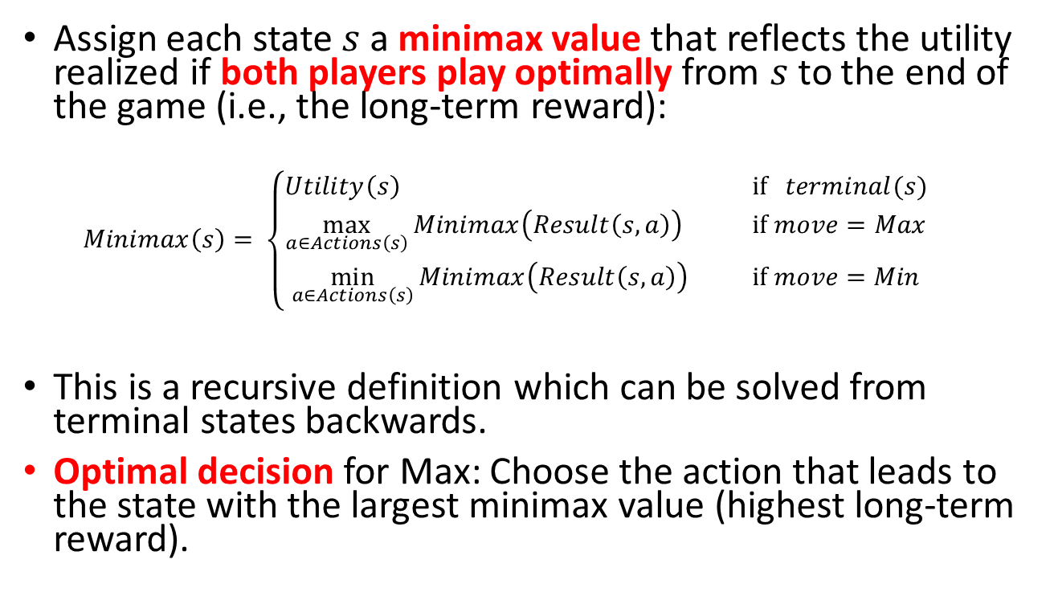
Idea: Minimax Decision
Assign each state $s$ a minimax value that reflects the utility realized if both players play optimally from $s$ to the end of the game (i.e., the long-term reward):
  $$Minimax\left(s\right)= \left\{\begin{aligned}Utility\left(s\right) \text{ if} terminal(s) \\ \max_{a∈Actions\left(s\right)}{Minimax\left(Result\left(s,a\right)\right)}\text{ if} move=Max \\ \min_{a∈Actions\left(s\right)}{Minimax\left(Result\left(s,a\right)\right) } \text{if} move=Min\end{aligned}\right.$$
This is a recursive definition which can be solved from terminal states backwards.
Optimal decision for Max: Choose the action that leads to the state with the largest minimax value (highest long-term reward).

Slide 18
Minimax Search: Back-up Minimax Values
Pick action that leads to the largest MV
MV
MV
MV
MV
MV
MV
MV
MV
MV
min
1
MV
MV
Determine Minmax values (MVs) using a bottom-up strategy
max
0
1
1
Using MVs
MAX always picks the action that leads to the largest value.
MIN always picks the action that leads to the smallest value.
min
…
= minimax value (MV)

Slide 19
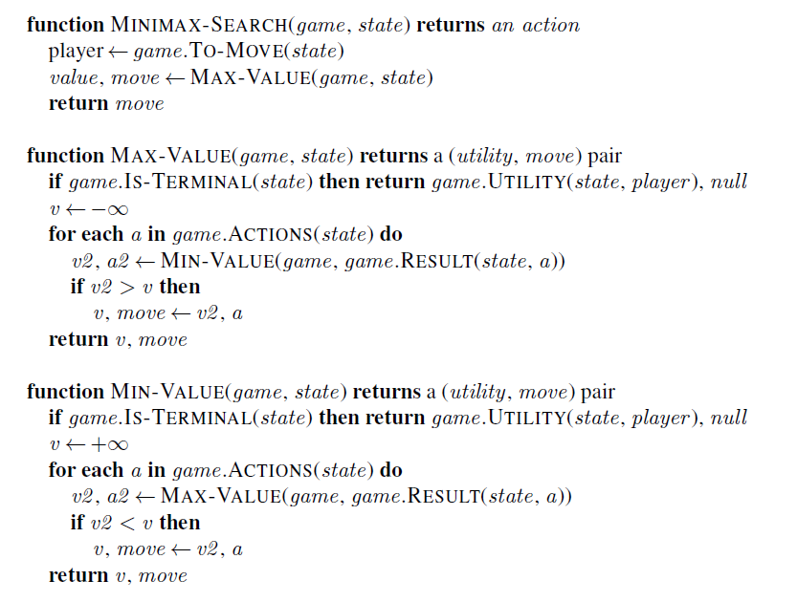
Minimax DFS
Approach: Follow tree to each terminal node and back up minimax value = traverse the complete tree!
Note: This is just a modification of the AND-OR Tree Search and returns the first action of the conditional plan.
Represents OR Search
Find the action that leads to the best value.
Represents AND Search

Slide 20












Exercise: Simple 2-Ply Game
MV
Max
$$a_{1}$$
$$a_{2}$$
$$a_{3}$$
MV
MV
MV
Min
$$a_{1}$$
$$a_{3}$$
$$a_{1}$$
$$a_{3}$$
$$a_{1}$$
$$a_{3}$$
$$a_{2}$$
$$a_{2}$$
$$a_{2}$$
Utility for Max
2
0
5
-5
-2
7
5
-7
4
Compute all MV (minimax values).
What is the optimal action for Max?

Slide 21
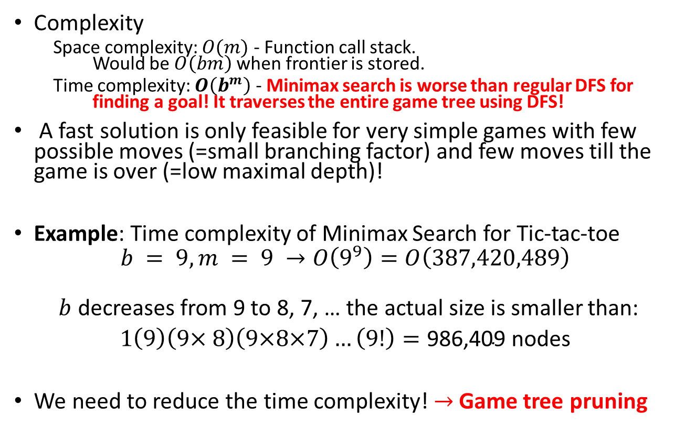
Issue: Minimax Search
b: max. branching factor
m: max. depth of tree
Complexity
    Space complexity: $O(m)$ - Function call stack.
    Would be $O\left(bm\right)$ when frontier is stored.
    Time complexity: $O\left(b^{m}\right)$ - Minimax search is worse than regular DFS for finding a goal! It traverses the entire game tree using DFS!
A fast solution is only feasible for very simple games with few possible moves (=small branching factor) and few moves till the game is over (=low maximal depth)!
Example: Time complexity of Minimax Search for Tic-tac-toe
$$b = 9, m = 9 →O\left(9^{9}\right)=O\left(387,420,489\right)$$
  $b$ decreases from 9 to 8, 7, … the actual size is smaller than:
$1\left(9\right)\left(9× 8\right)\left(9×8×7\right)…\left(9!\right)=\text{986,409}$ nodes
We need to reduce the time complexity! $→$Game tree pruning

Slide 22
Code example: Tic-Tac-Toe with
Minimax Search
See Code on https://michael.hahsler.net/Introduction_to_Artificial_Intelligence/

Slide 23
Improvements for
Minimax Search
Alpha-Beta Pruning Search and Move Ordering

Slide 24
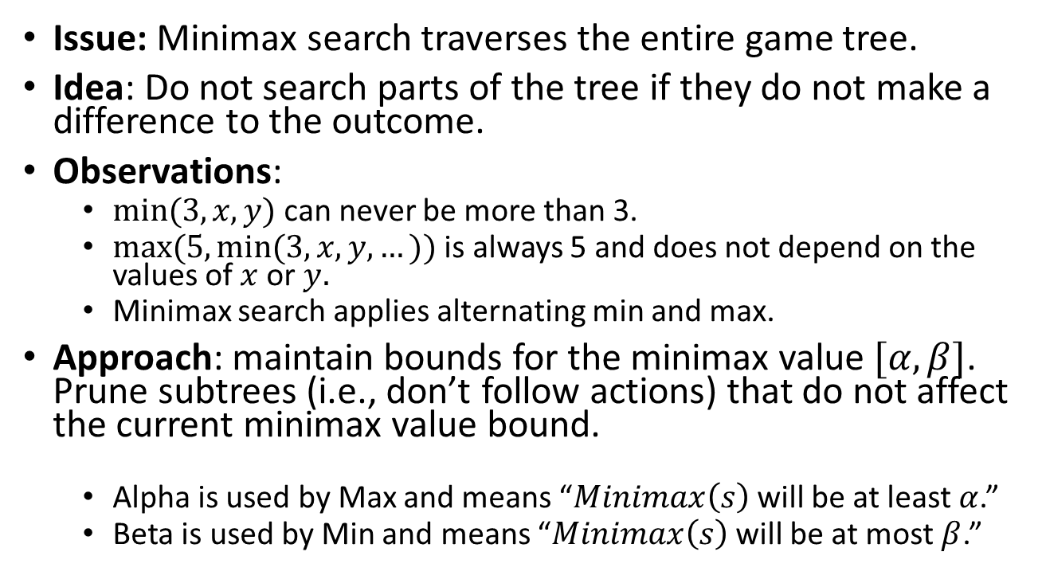
Alpha-Beta Pruning Search
Issue: Minimax search traverses the entire game tree.
Idea: Do not search parts of the tree if they do not make a difference to the outcome.
Observations:
  $min⁡(3, x, y)$can never be more than 3.
  $max⁡(5, min⁡(3, x, y, …))$ is always 5 and does not depend on the values of $x$ or $y.$
  Minimax search applies alternating min and max.
Approach: maintain bounds for the minimax value $[α, β]$.
Prune subtrees (i.e., don’t follow actions) that do not affect the current minimax value bound.
  Alpha is used by Max and means “$Minimax\left(s\right)$ will be at least $α$.”
  Beta is used by Min and means “$Minimax\left(s\right)$ will be at most $β$.”

Slide 25
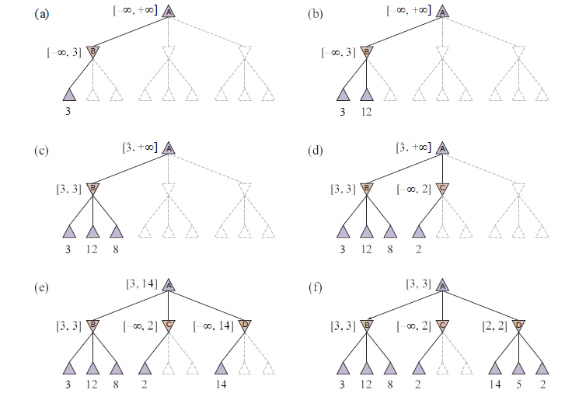

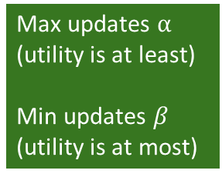



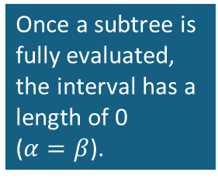

Example: Alpha-Beta Pruning
[$α,β$]
Max updates $α$
(utility is at least)
Min updates $β$
(utility is at most)
Max
Max
Min
Min
Utility cannot be more than 2 in the subtree, but we already can get 3 from the first subtree. Prune the rest.
Max
Max
$$v=3$$
Min
Min
$$v≤2$$
Max
$$v=3$$
Max
Once a subtree is fully evaluated, the interval has a length of 0
($α=β$).
$$v=2$$
Min
Min

Slide 26
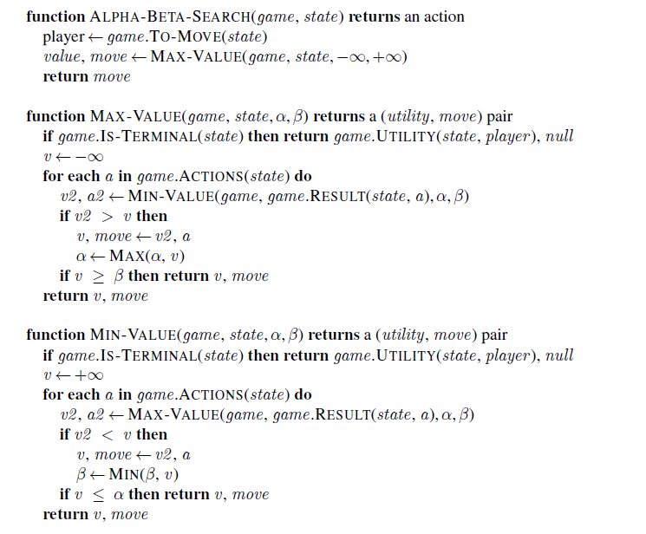
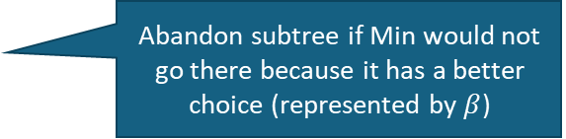
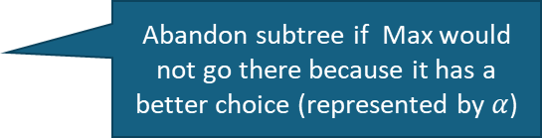
Alpha-Beta-Search Algorithm
= minimax search + pruning
// v is the minimax value
Found a better action?
Abandon subtree if Min would not go there because it has a better choice (represented by $β$)
Found a better action?
Abandon subtree if Max would not go there because it has a better choice (represented by $α$)

Slide 27
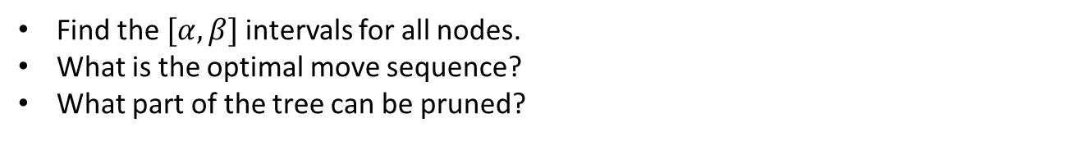

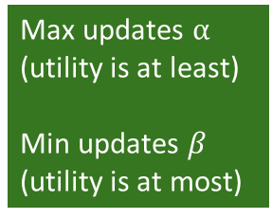



Exercise: Simple 2-Ply Game with Alpha-Beta Pruning
Max updates $α$
(utility is at least)
Min updates $β$
(utility is at most)
$$[α,β]$$
Max
$$a_{1}$$
$$a_{2}$$
$$a_{3}$$
$$[α,β]$$
$$[α,β]$$
$$[α,β]$$
Min
$$a_{1}$$
$$a_{3}$$
$$a_{1}$$
$$a_{3}$$
$$a_{1}$$
$$a_{3}$$
$$a_{2}$$
$$a_{2}$$
$$a_{2}$$
Utility for Max
-5
2
5
7
0
2
5
-7
-4
Find the $[α,β]$ intervals for all nodes.
What is the optimal move sequence?
What part of the tree can be pruned?

Slide 28
Move Ordering for Alpha-Beta Pruning
Idea: Pruning is more effective if good alpha-beta bounds can be found in the first few checked subtrees.
Move ordering for DFS = Check good moves for Min and Max first.
This is very similar to Greedy Best-first Search. We need expert knowledge (a heuristic) to determine what a good move is.

Slide 29



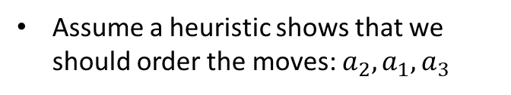







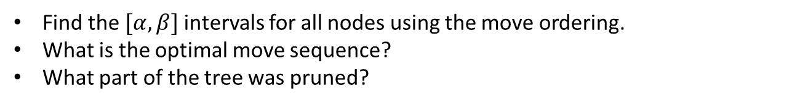






Exercise: Simple 2-Ply Game with Alpha-Beta Pruning and Move Ordering
Max updates $α$
(utility is at least)
Min updates $β$
(utility is at most)
Assume a heuristic shows that we should order the moves: $a_{2}, a_{1},a_{3}$
$$[α,β]$$
Max
$$a_{1}$$
$$a_{2}$$
$$a_{3}$$
$$[α,β]$$
$$[α,β]$$
$$[α,β]$$
Min
$$a_{1}$$
$$a_{1}$$
$$a_{1}$$
$$a_{3}$$
$$a_{3}$$
$$a_{3}$$
$$a_{2}$$
$$a_{2}$$
$$a_{2}$$
Utility for Max
-5
2
5
7
0
2
5
-7
-4
Find the $[α,β]$ intervals for all nodes using the move ordering.
What is the optimal move sequence?
What part of the tree was pruned?

Slide 30
Code example: Tic-Tac-Toe with
Minimax Search with Alpha-Beta Pruning
See Code on https://michael.hahsler.net/Introduction_to_Artificial_Intelligence/

Slide 31
The Effect of
Alpha-Beta Pruning
Tic-tac-toe
Method | Searched Nodes | Search Time
Minimax Search | 549,946 | 13 s
+ Alpha-Beta Pruning | 18,297 | 660 ms
+ Move ordering (heuristic: center, corner, rest) | 7,275 | 202 ms

Slide 32
Issue With Minimax Search
Optimal decision-making algorithms scale poorly for large game trees.
Alpha-beta pruning and move ordering are often not sufficient to reduce the search time.
Fast approximate methods are needed.
We may lose the optimality guarantee, but we can work with larger problems.

Slide 33

Heuristic Methods
Heuristic Alpha-Beta
Tree Search

Slide 34
Heuristic Alpha-Beta Tree Search
Issue: The game tree is too large to use optimal Alpha-Beta Search.
Approach: Search only part of the tree by replacing missing information using a heuristic evaluation function.
Options:
  Cut off game tree and use a heuristic for utility.
  Forward Pruning: ignore poor moves.

Slide 35
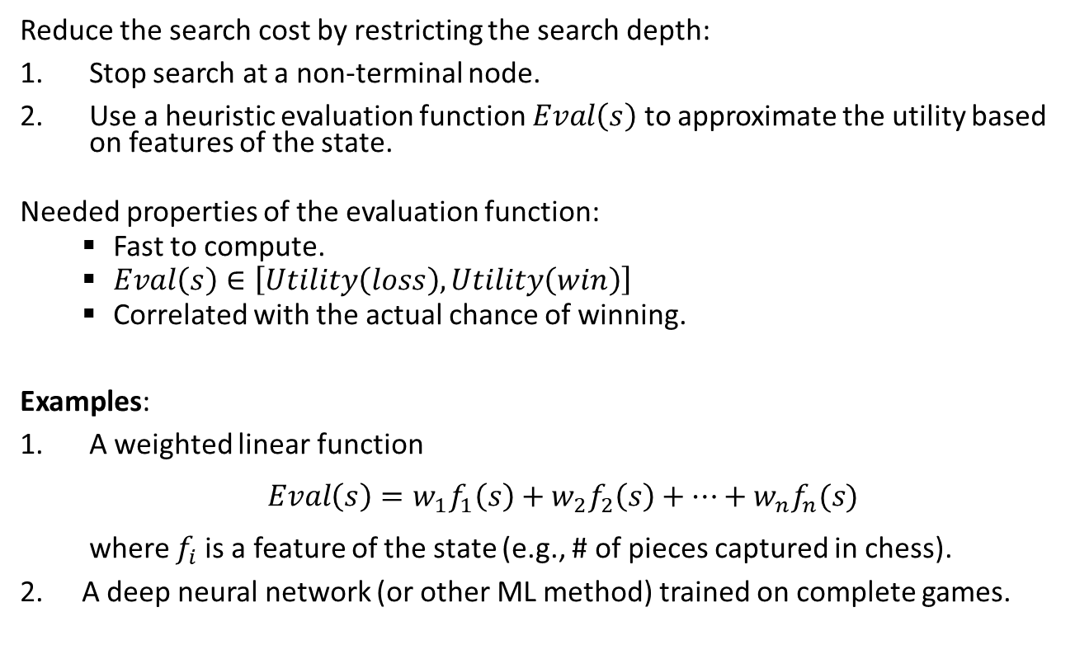
Option A: Heuristic Cut Off Search
Reduce the search cost by restricting the search depth:
Stop search at a non-terminal node.
Use a heuristic evaluation function $Eval\left(s\right)$ to approximate the utility based on features of the state.
Needed properties of the evaluation function:
  Fast to compute.
  $Eval\left(s\right)∈\left[Utility\left(loss\right),Utility\left(win\right)\right]$
  Correlated with the actual chance of winning.
Examples:
A weighted linear function
$Eval\left(s\right)=w_{1}f_{1}\left(s\right)+w_{2}f_{2}\left(s\right)+⋯+w_{n}f_{n}(s)$
where $f_{i}$is a feature of the state (e.g., # of pieces captured in chess).
A deep neural network (or other ML method) trained on complete games.

Slide 36
Heuristic Alpha-Beta Tree Search:
Cut Off Search
HMV = heuristic minimax value
Depth (ply)
0
Pick the action with
the highest HMV
1
HMV
HMV
HMV
HMV
HMV
HMV
HMV
HMV
HMV
2
Eval
Eval = heuristic to estimate of the minimax value/utility of the state.
Eval
Eval
3
Cut search off at depth =2
This is also called: search with a “look ahead” of 2

Slide 37
Code example: Tic-Tac-Toe with
Heuristic Alpha-Beta Tree Search
See Code on https://michael.hahsler.net/Introduction_to_Artificial_Intelligence/

Slide 38
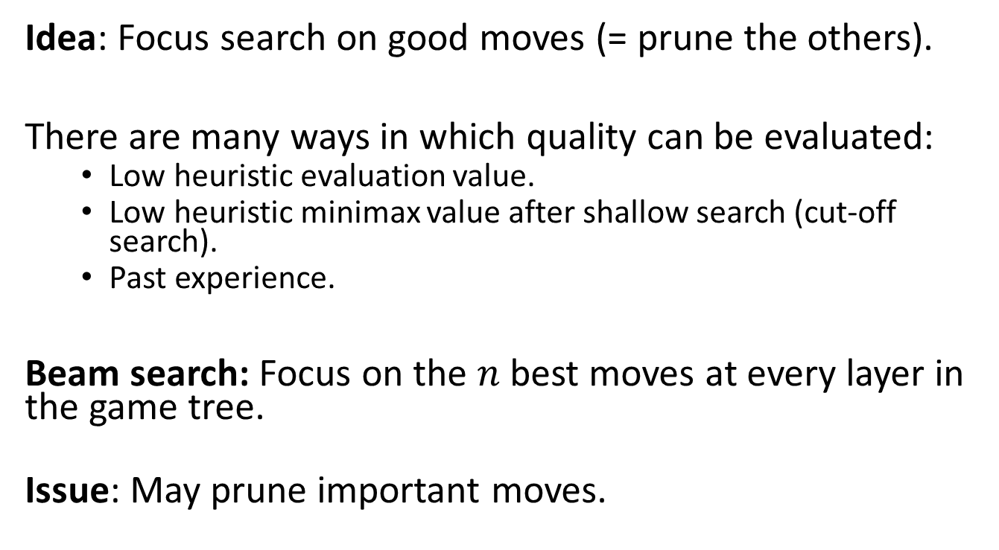
Option B: Heuristic Forward Pruning
Idea: Focus search on good moves (= prune the others).
There are many ways in which quality can be evaluated:
  Low heuristic evaluation value.
  Low heuristic minimax value after shallow search (cut-off search).
  Past experience.
Beam search: Focus on the $n$ best moves at every layer in the game tree.
Issue: May prune important moves.

Slide 39
Heuristic Alpha-Beta Tree Search:
Example for Forward Pruning
x … prune low HMV actions
x
x
x
x
x
x
HMV
HMV
HMV
HMV
HMV
HMV
HMV
HMV
HMV
Continue alpha-beta search on these.
Eval
Eval
Eval
Perform Cut-off search.
Choose the n best actions using the heuristic minimax value and prune the rest.
Explore the chosen actions using heuristic Alpha-Beta Tree search.
Cut search off at depth =2

Slide 40
Important Considerations
Designing a good evaluation heuristic can be difficult.
  We need expert knowledge.
  Experimentation may be needed to choose the best heuristic.
The cutoff depth affects the runtime and the quality of the found move.
  Low cutoff: Fast, but the approximation of the evaluation function will be poor.
  Intermediate cutoff: Slower because a larger tree needs to be searched, but the evaluation function will work better.
  Infinity (= no cutoff): The algorithm reverts to complete minimax search and optimal decisions.

Slide 41
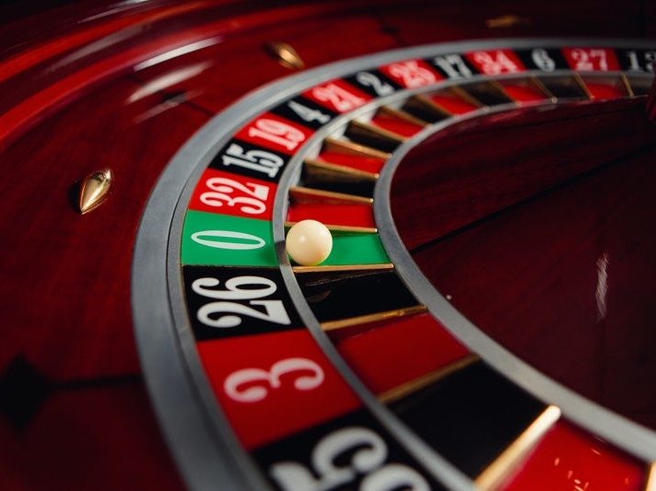
Heuristic Methods
Monte Carlo Tree Search (MCTS)

Slide 42
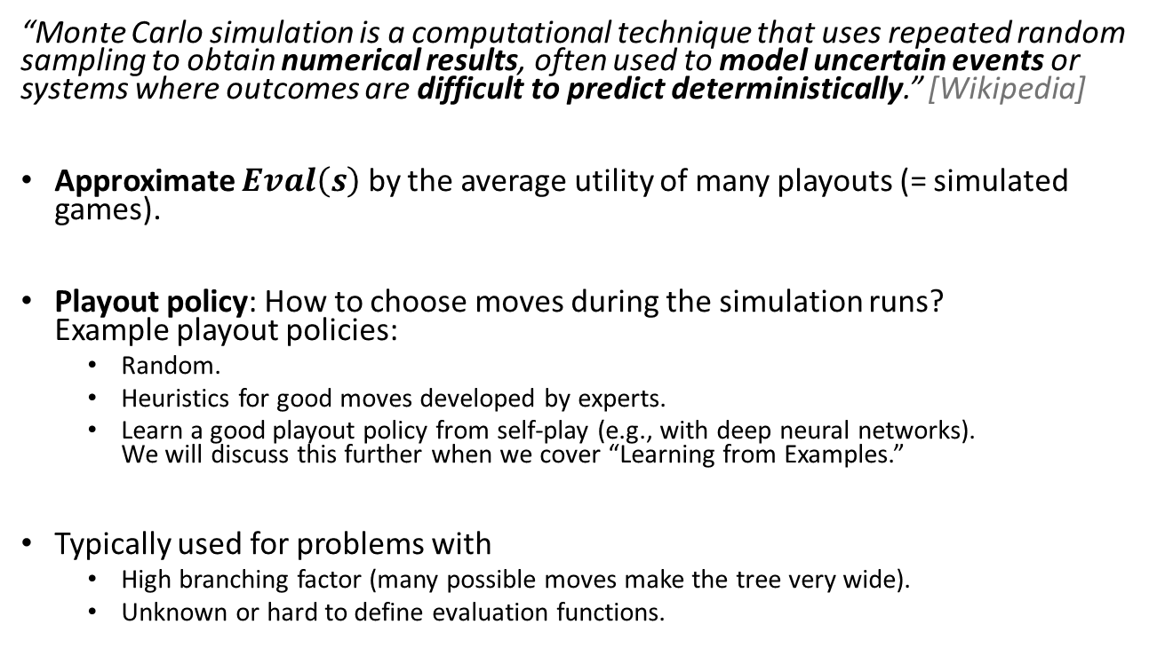
Idea of Monte Carlo Search
“Monte Carlo simulation is a computational technique that uses repeated random sampling to obtain numerical results, often used to model uncertain events or systems where outcomes are difficult to predict deterministically.” [Wikipedia]
Approximate $Eval\left(s\right)$ by the average utility of many playouts (= simulated games).
Playout policy: How to choose moves during the simulation runs?
Example playout policies:
  Random.
  Heuristics for good moves developed by experts.
  Learn a good playout policy from self-play (e.g., with deep neural networks).
  We will discuss this further when we cover “Learning from Examples.”
Typically used for problems with
  High branching factor (many possible moves make the tree very wide).
  Unknown or hard to define evaluation functions.

Slide 43
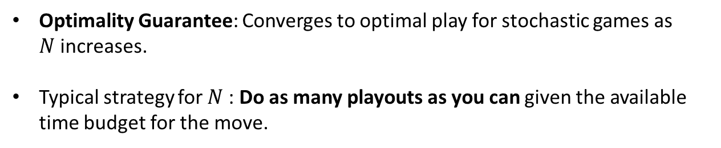
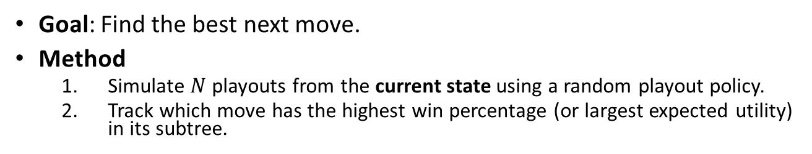
Pure Monte Carlo Search
Goal: Find the best next move.
Method
  Simulate $N$ playouts from the current state using a random playout policy.
  Track which move has the highest win percentage (or largest expected utility) in its subtree.
Start playouts
Estimate expected utility
Avg. utility of playouts
0.32
0.20
0.33
0.16
0.49
0.23
0.35
0.19
0.36
Optimality Guarantee: Converges to optimal play for stochastic games as $N$increases.
Typical strategy for $N$: Do as many playouts as you can given the available time budget for the move.

Slide 44
Code example: Tic-Tac-Toe with
Pure Monte Carlo Search
See Code on https://michael.hahsler.net/Introduction_to_Artificial_Intelligence/

Slide 45
Monte Carlo Tree Search (MCTS)
Pure Monte Carlo search always starts playouts from a given state (or randomly from its children).
Issue: Many playouts are performed for very bad moves. This is especially a problem for random playout policies.
Idea:
Create a depth-limited game tree.
Start the next (random) playout at the best leaf-node using the UCB1 selection criterion.
We will start with discussion step 2.

Slide 46
Playout Selection Strategy
For the empty board, Max can start a playout at any of these states. Which one should it choose?
Issue: Pure Monte Carlo Search with a random playout policy will explore all moves equally and spend a lot of time to create playouts for bad move.
Better: Select the starting state for playouts to focus on important parts of the game tree (i.e., good moves).
This presents the following tradeoff:
Exploration: perform more playouts from states that currently have no or few playouts.
Exploitation: more playouts for states that have done well to get more accurate estimates.

Slide 47
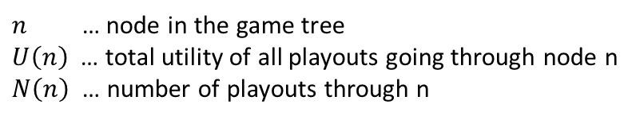
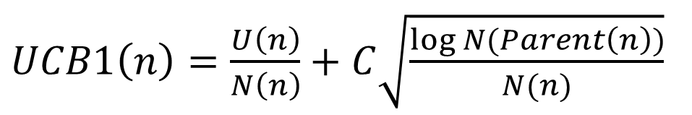
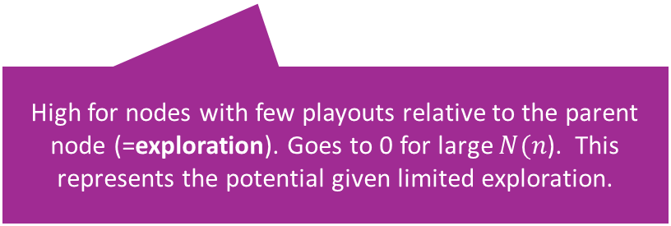
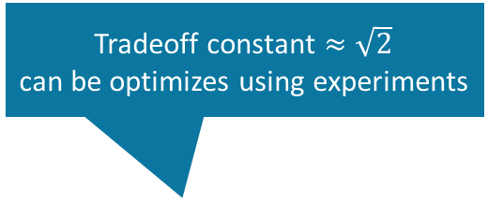
Upper Confidence Bound 1 (UCB1)
Tradeoff constant $≈\sqrt{2}$
can be optimizes using experiments
$UCB1\left(n\right)=\frac{U\left(n\right)}{N\left(n\right)}+C\sqrt{\frac{\log{N(Parent\left(n\right))}}{N(n)}}$
Average utility
(=exploitation)
High for nodes with few playouts relative to the parent node (=exploration). Goes to 0 for large $N(n$). This represents the potential given limited exploration.
$n$ … node in the game tree
$U\left(n\right)$ … total utility of all playouts going through node n
$N\left(n\right)$ … number of playouts through n
Selection strategy: Select node with highest UCB1 score.

Slide 48
Code example:
Tic-Tac-Toe with Monte Carlo Tree Search
+ UCB1 Selection Policy
See Code on https://michael.hahsler.net/Introduction_to_Artificial_Intelligence/

Slide 49
Trees in MCTS
Monte Carlo Tree Search builds a partial game tree representing short sequences of the next few moves.
(Random) playouts can start from any state (leaf node) in that tree. This means the first few moves are not random and algorithm can focus on a good sequence of moves.
Important considerations:
We typically can only store a small part of the game tree, so we do not store the complete playout runs.
We can use UCB1 as the selection strategy to decide what part of the tree we should focus on for the next playout. This balances exploration and exploitation.

Slide 50
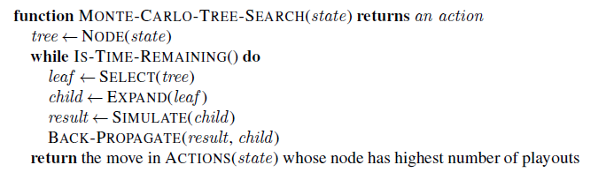
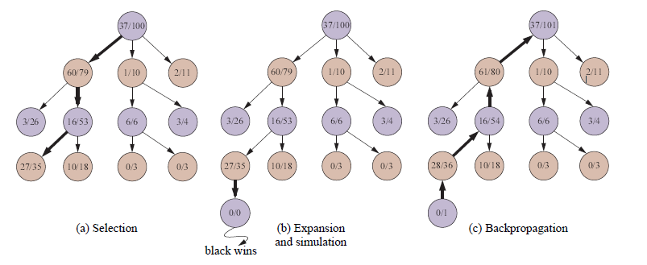
Monte-Carlo-Tree-Search Algorithm
Highest UCB1 score
UCB1 selection favors win percentage more and more.
White
Wins/Playouts
Black
First few levels
White
Black
White
(update counts)
Select leaf with highest UCB1 score
Advantage over pure MCS: Selection strategically focuses search.
Expand and Simulate: the simulation path is not recorded to preserve memory!

Slide 51
Some Considerations
Estimating the value of a position using simple playouts is very effective and typically beats many other methods.
Playouts can be done in parallel (multi-core or on multiple machines).
MCTS selects playouts strategically by using UCB1 playout selection and looking several moves ahead.
Note: Random playouts may not work well, and a better playout policy can help.
  Slow Convergence. Playouts may be wasted on playing very bad (random) moves that nobody would ever play.
  Random play makes discovering long-term strategies very unlikely.

Slide 52

Stochastic Games
Games With Random Events

Slide 53
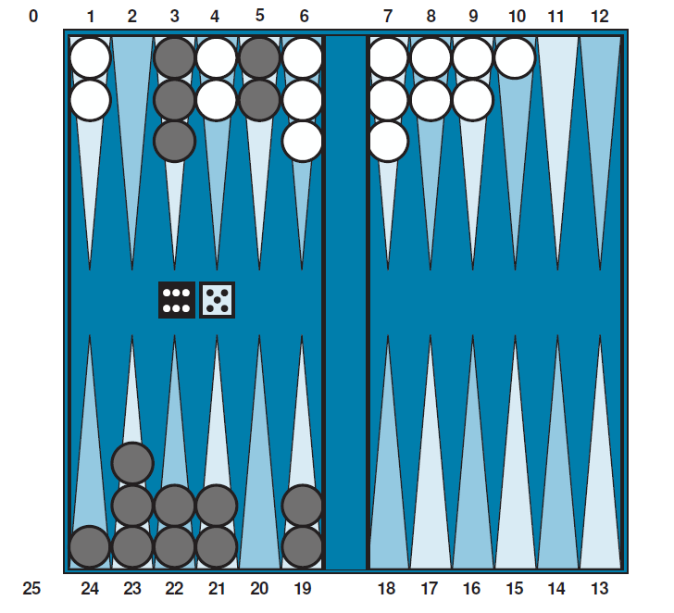
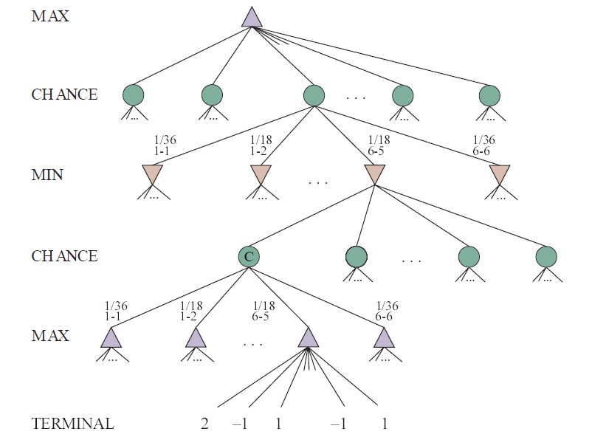
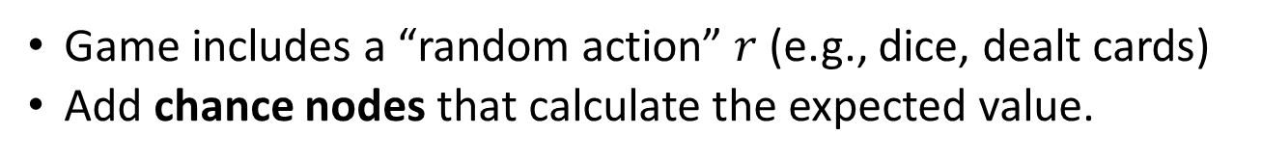
Stochastic Games
Game includes a “random action” $r$ (e.g., dice, dealt cards)
Add chance nodes that calculate the expected value.
MAX has just rolled 6 + 5
move
Backgammon: Move checker pieces according to the dice.

Slide 54
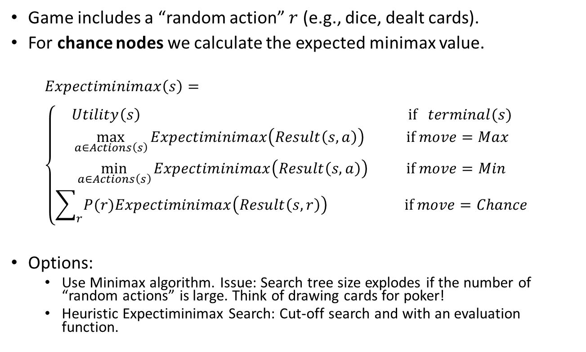
Expectiminimax
Game includes a “random action” $r$ (e.g., dice, dealt cards).
For chance nodes we calculate the expected minimax value.
  $$Expectiminimax\left(s\right)= \\ \left\{\begin{aligned}Utility\left(s\right) \text{if} terminal(s) \\ \max_{a∈Actions\left(s\right)}{Expectiminimax\left(Result\left(s,a\right)\right)}{} \text{ if} move=Max \\ \min_{a∈Actions\left(s\right)}{Expectiminimax\left(Result\left(s,a\right)\right) } \text{if} move=Min \\ \sum_{r}{P(r)Expectiminimax\left(Result\left(s,r\right)\right) }\text{ if }move=Chance\end{aligned}\right.$$
Options:
  Use Minimax algorithm. Issue: Search tree size explodes if the number of “random actions” is large. Think of drawing cards for poker!
  Heuristic Expectiminimax Search: Cut-off search and with an evaluation function.

Slide 55
MCTS for Stochastic Games
Monte Carlo Tree Search can be directly applied to stochastic games: Random actions can be easily added to playouts.
Issue: Random actions result in a significantly larger game tree.
  Requires a much larger number of playouts to converge to good solutions.
  The tree cannot be very deep because the random actions make it very wide.

Slide 56
Conclusion
Nondeterministic actions:
  The opponent is seen as part of an environment with nondeterministic actions. Non-determinism is the result of the unknown moves by the opponent. All possible moves are considered.
Optimal decisions:
  Minimax search and Alpha-Beta pruning where each player plays optimal to the end of the game.
  Choice nodes and Expectiminimax for stochastic games.
Heuristic Alpha-Beta Tree Search:
  Cut off game tree and use heuristic evaluation function for utility (based on state features).
  Forward Pruning: ignore poor moves.
  Learn heuristic from data using MCTS
Monte Carlo Tree search:
  Simulate complete games and calculate proportion of wins.
  Use modified UCB1 scores to expand the partial game tree.
  Learn playout policy using self-play and deep learning.
Scale only for tiny problems!
State of the Art

