Slide 1

Introduction to Data Mining Web Chapter Exploring Data
by Michael Hahsler
Based in Slides by Tan, Steinbach, Karpatne, Kumar
This work is licensed under a Creative Commons Attribution-ShareAlike 4.0 International License.

Slide 2


R Code Examples
Available R Code examples are indicated on slides by the R logo
The Examples are available at https://mhahsler.github.io/Introduction_to_Data_Mining_R_Examples/

Slide 3
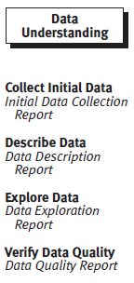
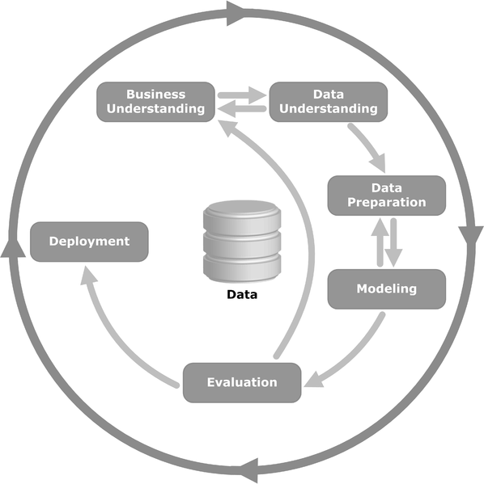
Exploring Data in the Data Mining Process

Slide 4
Topics
Exploratory Data Analysis
Summary Statistics
Visualization

Slide 5
What is Data Exploration?
“A preliminary exploration of the data to better understand its characteristics.”
Key motivations of data exploration include
Helping to select the right tool for preprocessing or analysis
Making use of humans’ abilities to recognize patterns. People can recognize patterns not captured by data analysis tools
Related to the area of Exploratory Data Analysis (EDA)
Created by statistician John Tukey
Seminal book is "Exploratory Data Analysis" by Tukey
A nice online introduction can be found in Chapter 1 of the NIST Engineering Statistics Handbook
http://www.itl.nist.gov/div898/handbook/index.htm

Slide 6
Techniques Used In Data Exploration
In EDA, as originally defined by Tukey
The focus was on visualization
Clustering and anomaly detection were viewed as exploratory techniques
In data mining, clustering and anomaly detection are major areas of interest, and not thought of as just exploratory
In our discussion of data exploration, we focus on
Summary statistics
Visualization

Slide 7
Topics
Exploratory Data Analysis
Summary Statistics
Visualization

Slide 8
Summary Statistics
Summary statistics are numbers that summarize properties of the data
Summarized properties include location and spread for continuous data Examples: location - mean spread - standard deviation
Most summary statistics can be calculated in a single pass through the data

Slide 9
Categorical Features: Frequency and Mode
The frequency of an attribute value is the percentage of time the value occurs in the data set
For example, given the attribute ‘gender’ and a representative population of people, the gender ‘female’ occurs about 60% of the time.
The mode of an attribute is the most frequent attribute value

Slide 10
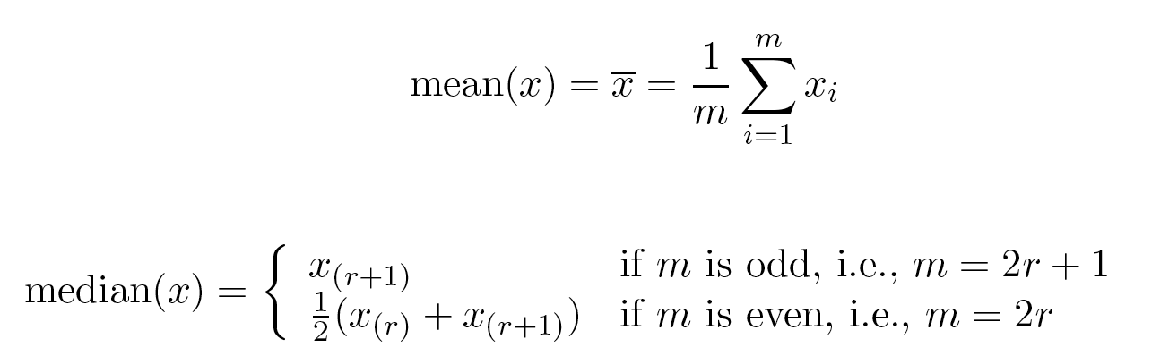
Continuous/Ordinal Features: Measures of Location - Mean and Median
The mean is the most common measure of the location of a set of points.
However, the mean is very sensitive to outliers.
Thus, the median or a trimmed mean is also commonly used.
Robust against outliers

Slide 11
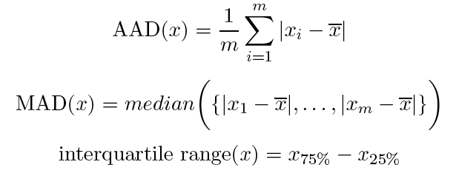
Measures of Spread: Range and Variance
Range is the difference between the max and min
The variance or standard deviation is the most common measure of the spread of a set of points.
Other measures are often used.
Robust against outliers
IQR

Slide 12
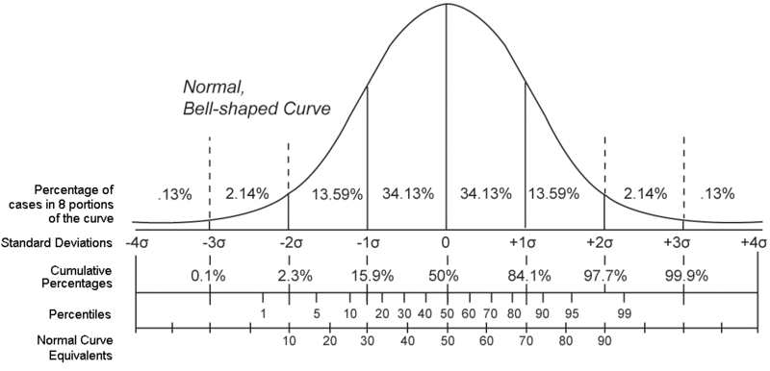



Percentiles of a Distribution
Given an ordinal or continuous attribute x and a number p between 0 and 100, the $p^{th}$percentile is a value $x_{p\%}$ of x such that p% of the observed values of x are less than $x_{p\%}$.
99% of the observations
Median – 50% of the cases has a smaller value & 50% are larger
$$Q_{1}$$
$$Q_{3}$$
IQR spans 50%

Slide 13

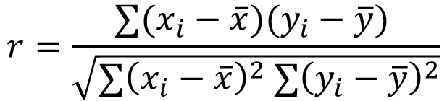
Pearson Correlation
The Pearson correlation coefficient measures the (linear) relationship between two variables.
To compute Pearson correlation (Pearson's Product Moment Correlation), we standardize data objects, p and q, and then take their dot product
Estimation:
Correlation is often used as a measure of similarity.
$$ρ=\frac{\text{cov}(X,Y)}{\text{sd}\left(X\right) \text{sd}(Y)}$$
$$r=\frac{∑(x_{i}−\overline{x})(y_{i}−\overline{y}) }{\sqrt{∑{\left(x_{i}−\overline{x}\right)}^{2} ∑{\left(y_{i}−\overline{y}\right)}^{2}}}$$

Slide 14
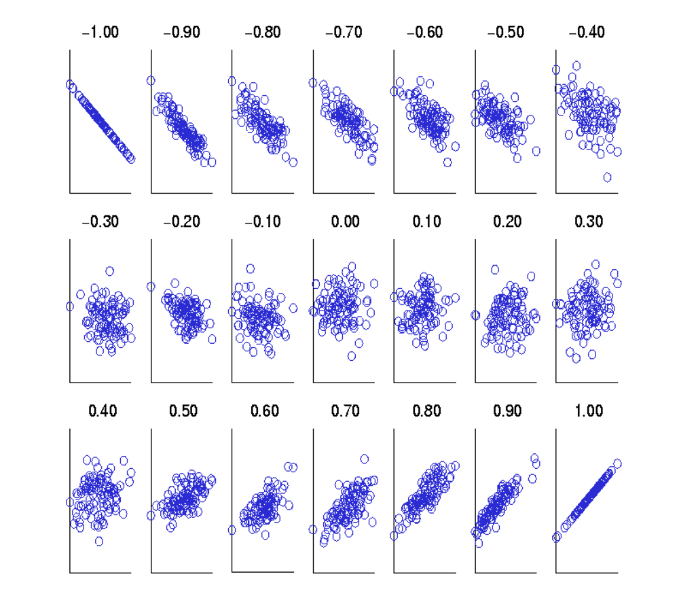
Visually Evaluating Correlation
Scatter plots showing data with correlation from –1 to 1.

Slide 15
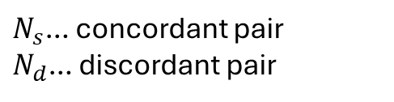


Rank Correlation
Measure the degree of similarity between two ratings (e.g., ordinal data).
Is more robust against outliers and does not assume normality of data or linear relationship like Pearson Correlation.
Measures (all are between -1 and 1)
Spearman's Rho: Pearson correlation between ranked variables.
Kendall's Tau
Goodman and Kruskal's Gamma
$$τ=\frac{N_{s}−N_{d}}{\frac{1}{2}n(n−1)}$$
$N_{s}$… concordant pair $N_{d}$… discordant pair
$$γ=\frac{N_{s}−N_{d}}{N_{s}+N_{d}}$$

Slide 16
Topics
Exploratory Data Analysis
Summary Statistics
Visualization

Slide 17
Visualization
Visualization is the conversion of data into a visual or tabular format so that the characteristics of the data and the relationships among data items or attributes can be analyzed or reported.
Visualization of data is one of the most powerful and appealing techniques for data exploration.
Humans have a well-developed ability to analyze large amounts of information that is presented visually
- Can detect general patterns and trends
- Can detect outliers and unusual patterns

Slide 18
Representation
Is the mapping of information to a visual format
Data objects, their attributes, and the relationships among data objects are translated into graphical elements such as points, lines, shapes, and colors.
Examples:
Objects are often represented as points.
Their attribute values can be represented as the position of the points or the characteristics of the points, e.g., color, size, and shape.
If position is used, then the relationships of points, i.e., whether they form groups or a point is an outlier, is easily perceived.

Slide 19
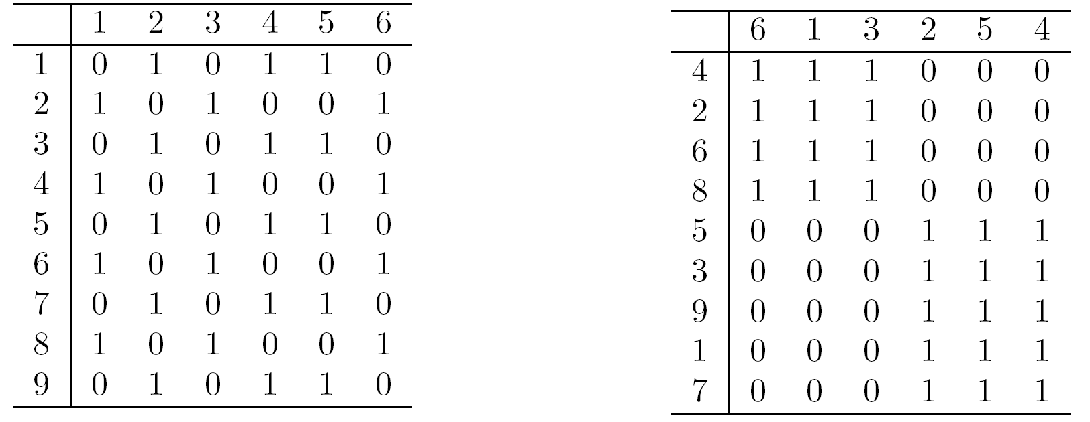
Arrangement
Is the placement of visual elements within a display
Can make a large difference in how easy it is to understand the data
Example:

Slide 20
Selection
Is the elimination or the deemphasis of certain objects and attributes
Selection may involve the choosing a subset of attributes
Dimensionality reduction is often used to reduce the number of dimensions to two or three
Alternatively, pairs of attributes can be considered
Selection may also involve choosing a subset of objects
A region of the screen can only show so many points
Can sample, but want to preserve points in sparse areas

Slide 21


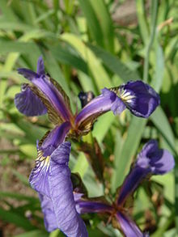
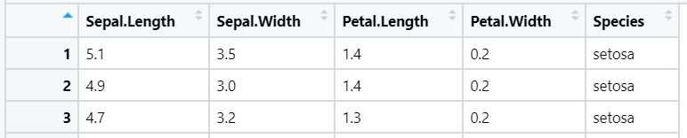
The Iris Dataset
Iris Versicolor
Iris Virginica
Many of the exploratory data techniques are illustrated with the Iris Plant data set.
Included as a demo datasert in many tools (R, scikit-learn, Rapidminer, …).
Can be obtained from the UCI Machine Learning Repository http://www.ics.uci.edu/~mlearn/MLRepository.html
From the statistician R.A. Fisher
150 flowers, three types (classes).
Four (non-class) attributes
Iris Setosa
…

Slide 22
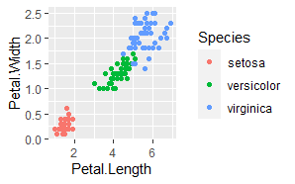
Scatter Plots
Attributes values determine the position
Two-dimensional scatter plots most common, but can have three-dimensional scatter plots
Often additional attributes can be displayed by using the size, shape, and color of the markers that represent the objects

Slide 23
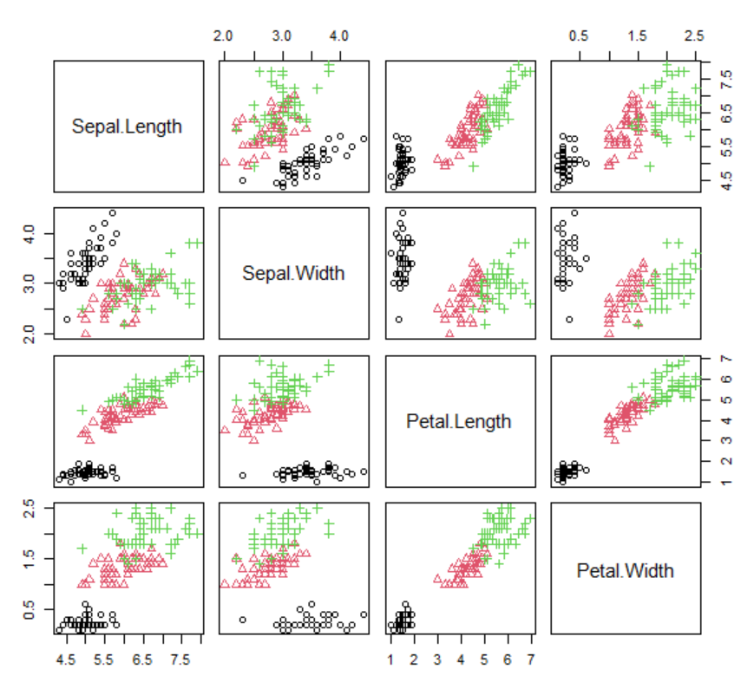
Scatter Plot Array of Iris Attributes

Slide 24
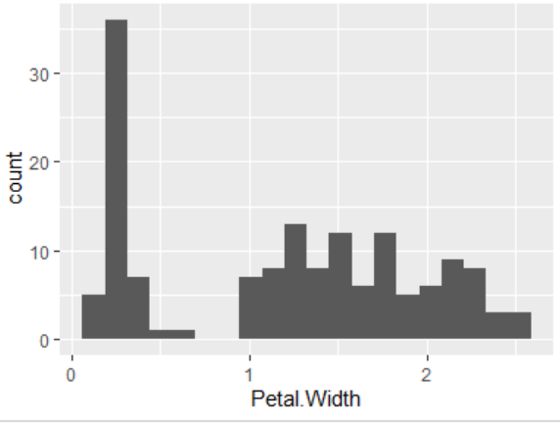
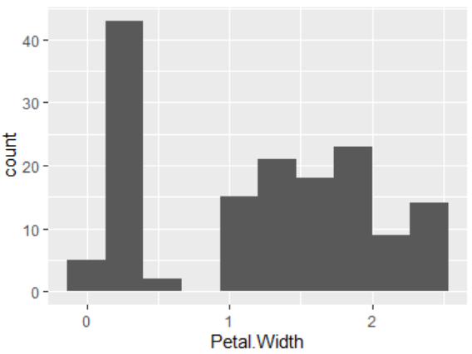
Distribution: Histograms
Usually shows the distribution of values of a single variable
Divide the values into bins and show a bar plot of the number of objects in each bin.
The height of each bar indicates the number of objects
Shape of histogram depends on the number of bins
Kernel-based density estimation (KDE) can be used to smooth histograms.
Example: Petal Width (10 and 20 bins, respectively)

Slide 25
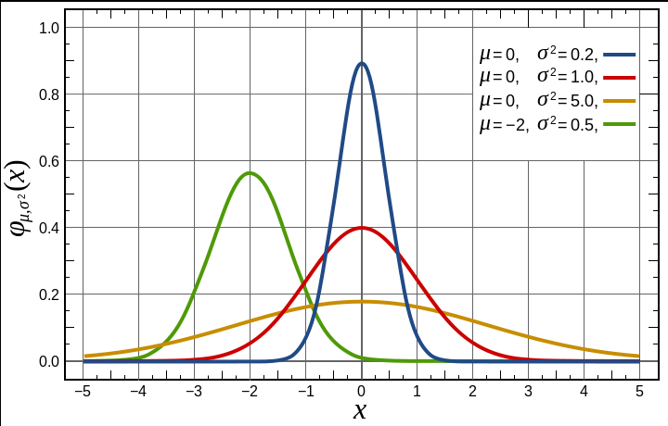
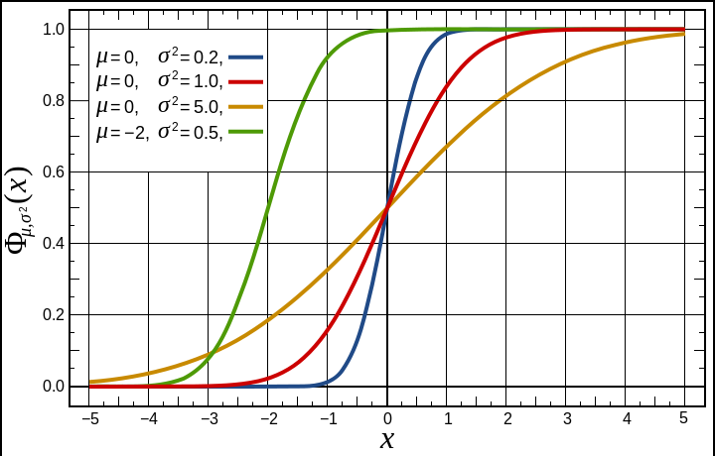
Empirical Cumulative Distribution Function (ECDF)
Probability Density Function (PDF): describes the relative likelihood for this random variable to take on a given value. Histogram shows an empirical PDF.
Cumulative Distribution Function (CDF): Shows the distribution of data as the fraction of points that are less than this value.
PDF
CDF

Slide 26
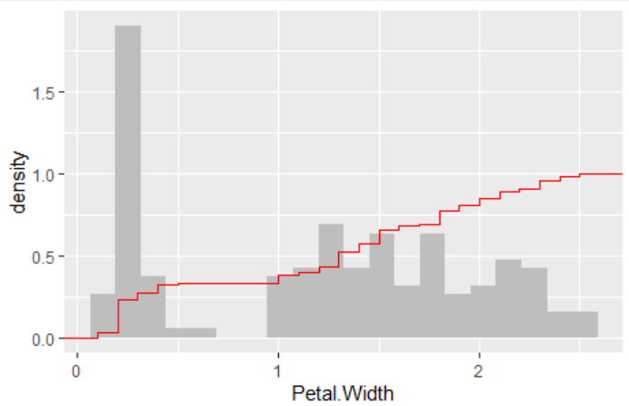
Example: ECDF

Slide 27
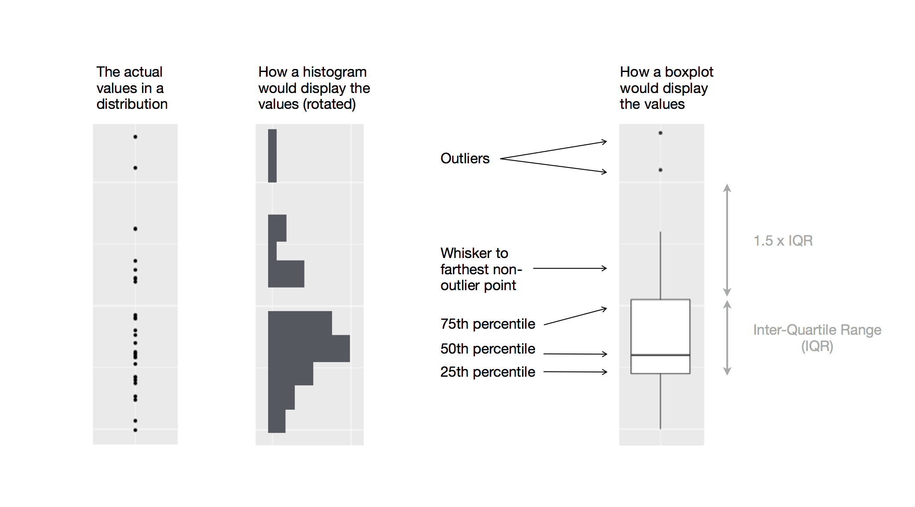
Distribution Box Plots
Invented by J. Tukey as a simplified version of a PDF/histogram that is robust against outliers.
Used to compare distributions.
feature
Figure source: Data visualization – R for Data Science (2e)

Slide 28
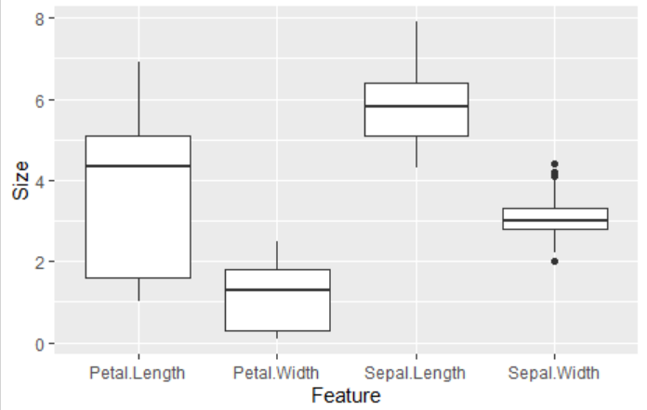
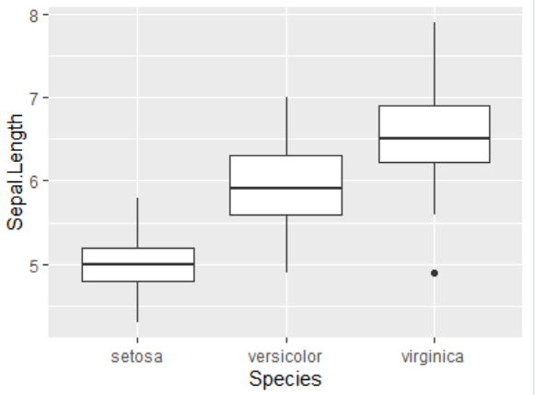
Examples of Box Plots
Box plots can be used to compare the distribution of attributes or subgroups.

Slide 29
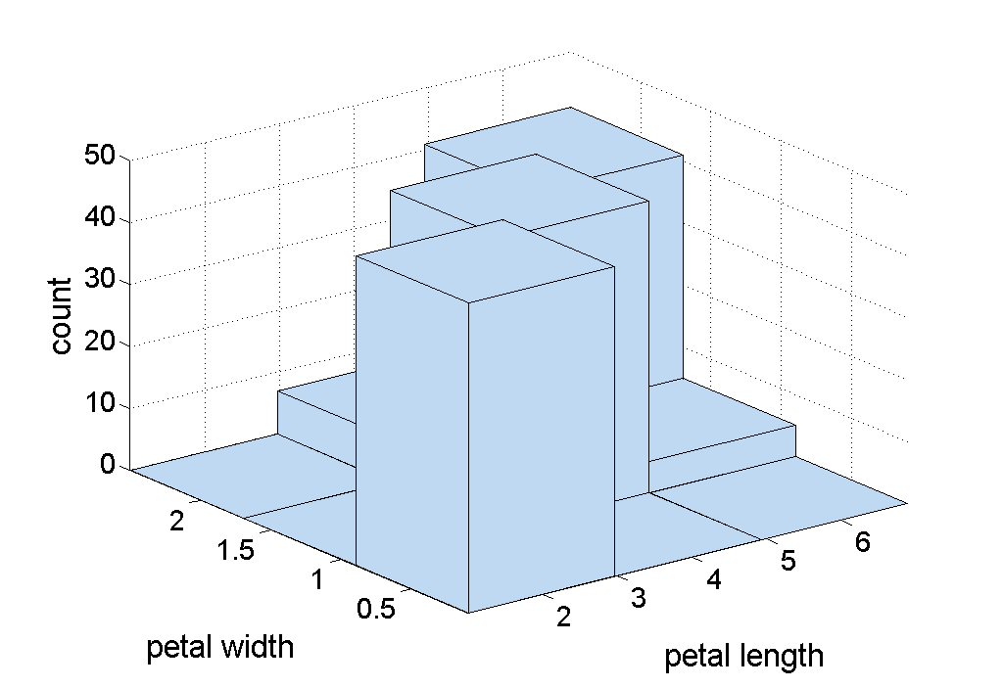
Two-Dimensional Histograms
Show the joint distribution of the values of two attributes
Example: petal width and petal length. What does this tell us?
Note: Matrix visualizations are often preferred.

Slide 30
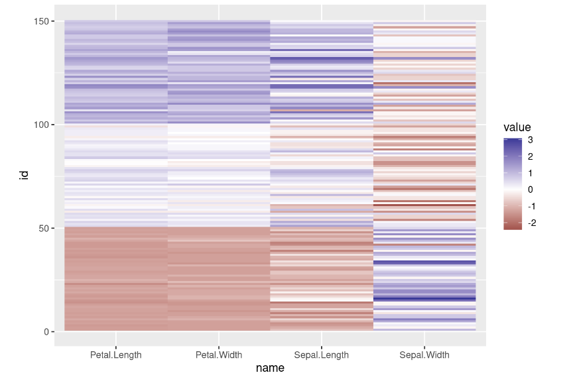
Matrix Plots
Can plot a data matrix
Can be useful when objects are sorted according to class
Typically, the attributes are normalized to prevent one attribute from dominating the plot
Plots of similarity or distance matrices can also be useful for visualizing the relationships between objects
Example: The Iris Data Matrix
Value
Z-score

Slide 31
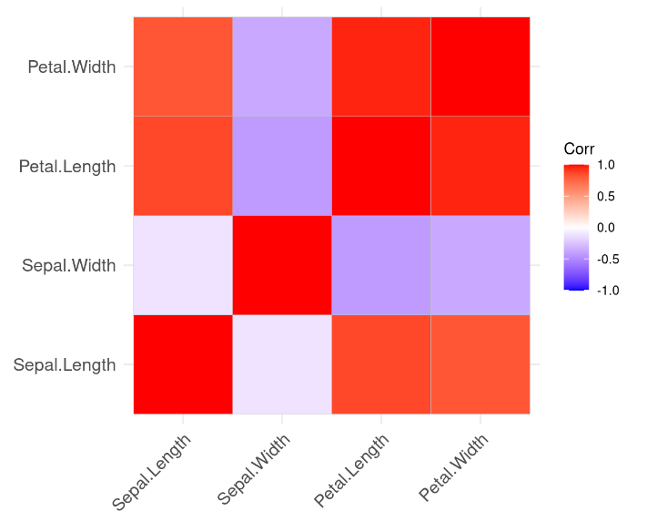
Matrix plot example: The Iris Correlation Matrix

Slide 32
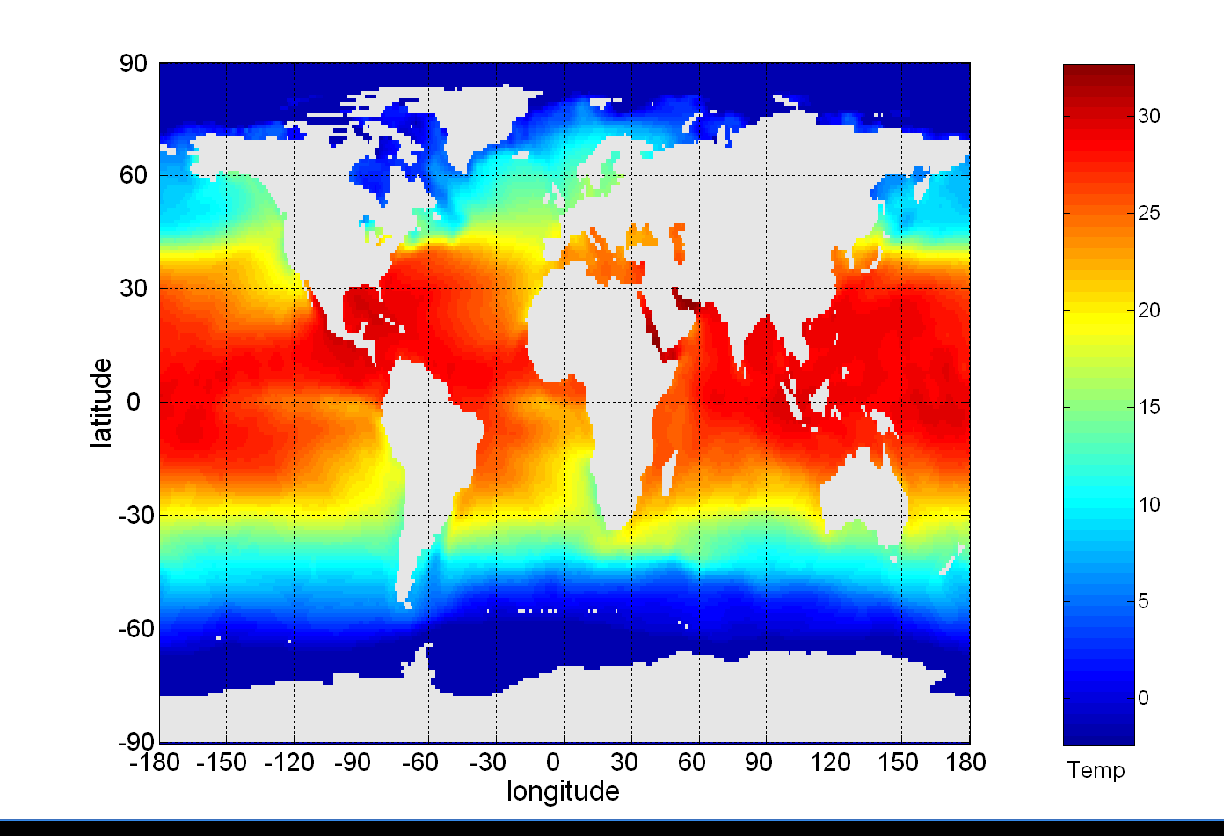
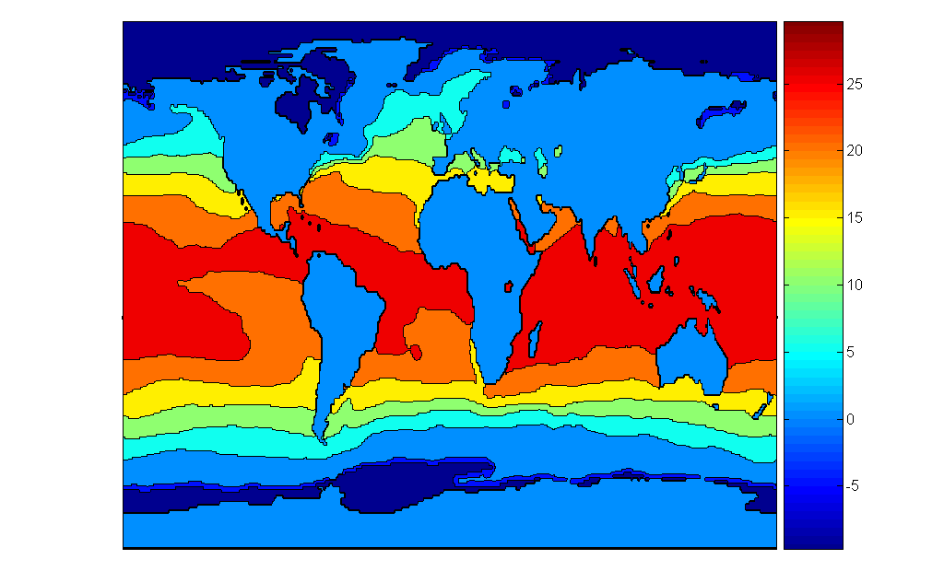
Contour Plots
Sea Surface Temperature (SST) for July 1982
Ocean Temp.
in ⁰C
Useful when a continuous attribute is measured on a spatial grid
They partition the plane into regions of similar values
The contour lines that form the boundaries of these regions connect points with equal values
The most common example is contour maps of elevation
Can also display temperature, rainfall, air pressure, etc.
Ocean Temp.
in ⁰C

Slide 33
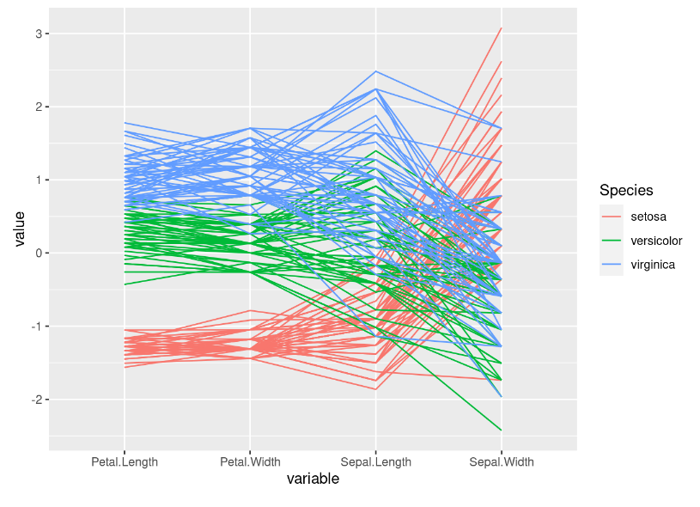
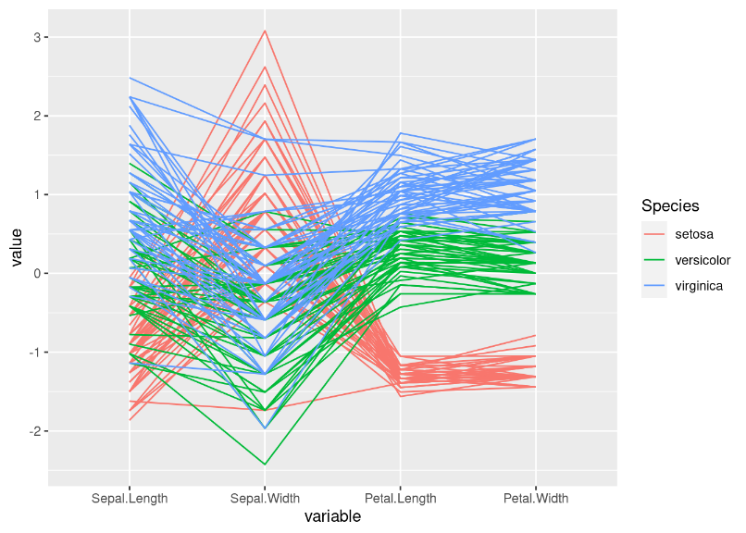
Parallel Coordinates
Used to plot the attribute values of high-dimensional data
Instead of using perpendicular axes, use a set of parallel axes
The attribute values of each object are plotted as a point on each corresponding coordinate axis and the points are connected by a line
Thus, each object is represented as a line
Often, the lines representing a distinct class of objects group together, at least for some attributes
Ordering of attributes is important in seeing such groupings
+ Reordered features
(z-score)
(z-score)

Slide 34
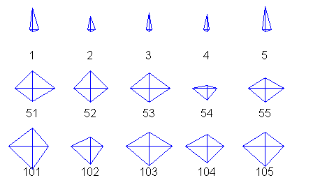
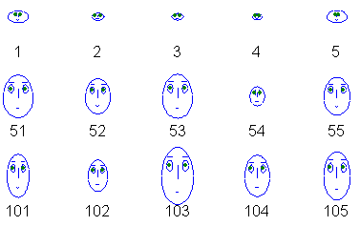
Other Visualization Techniques
Translate each feature to a feature (a length or size) of a glyph.
Star Plots
Chernoff Faces
Setosa
Versicolor
Virginica
Also called radar charts

Slide 35
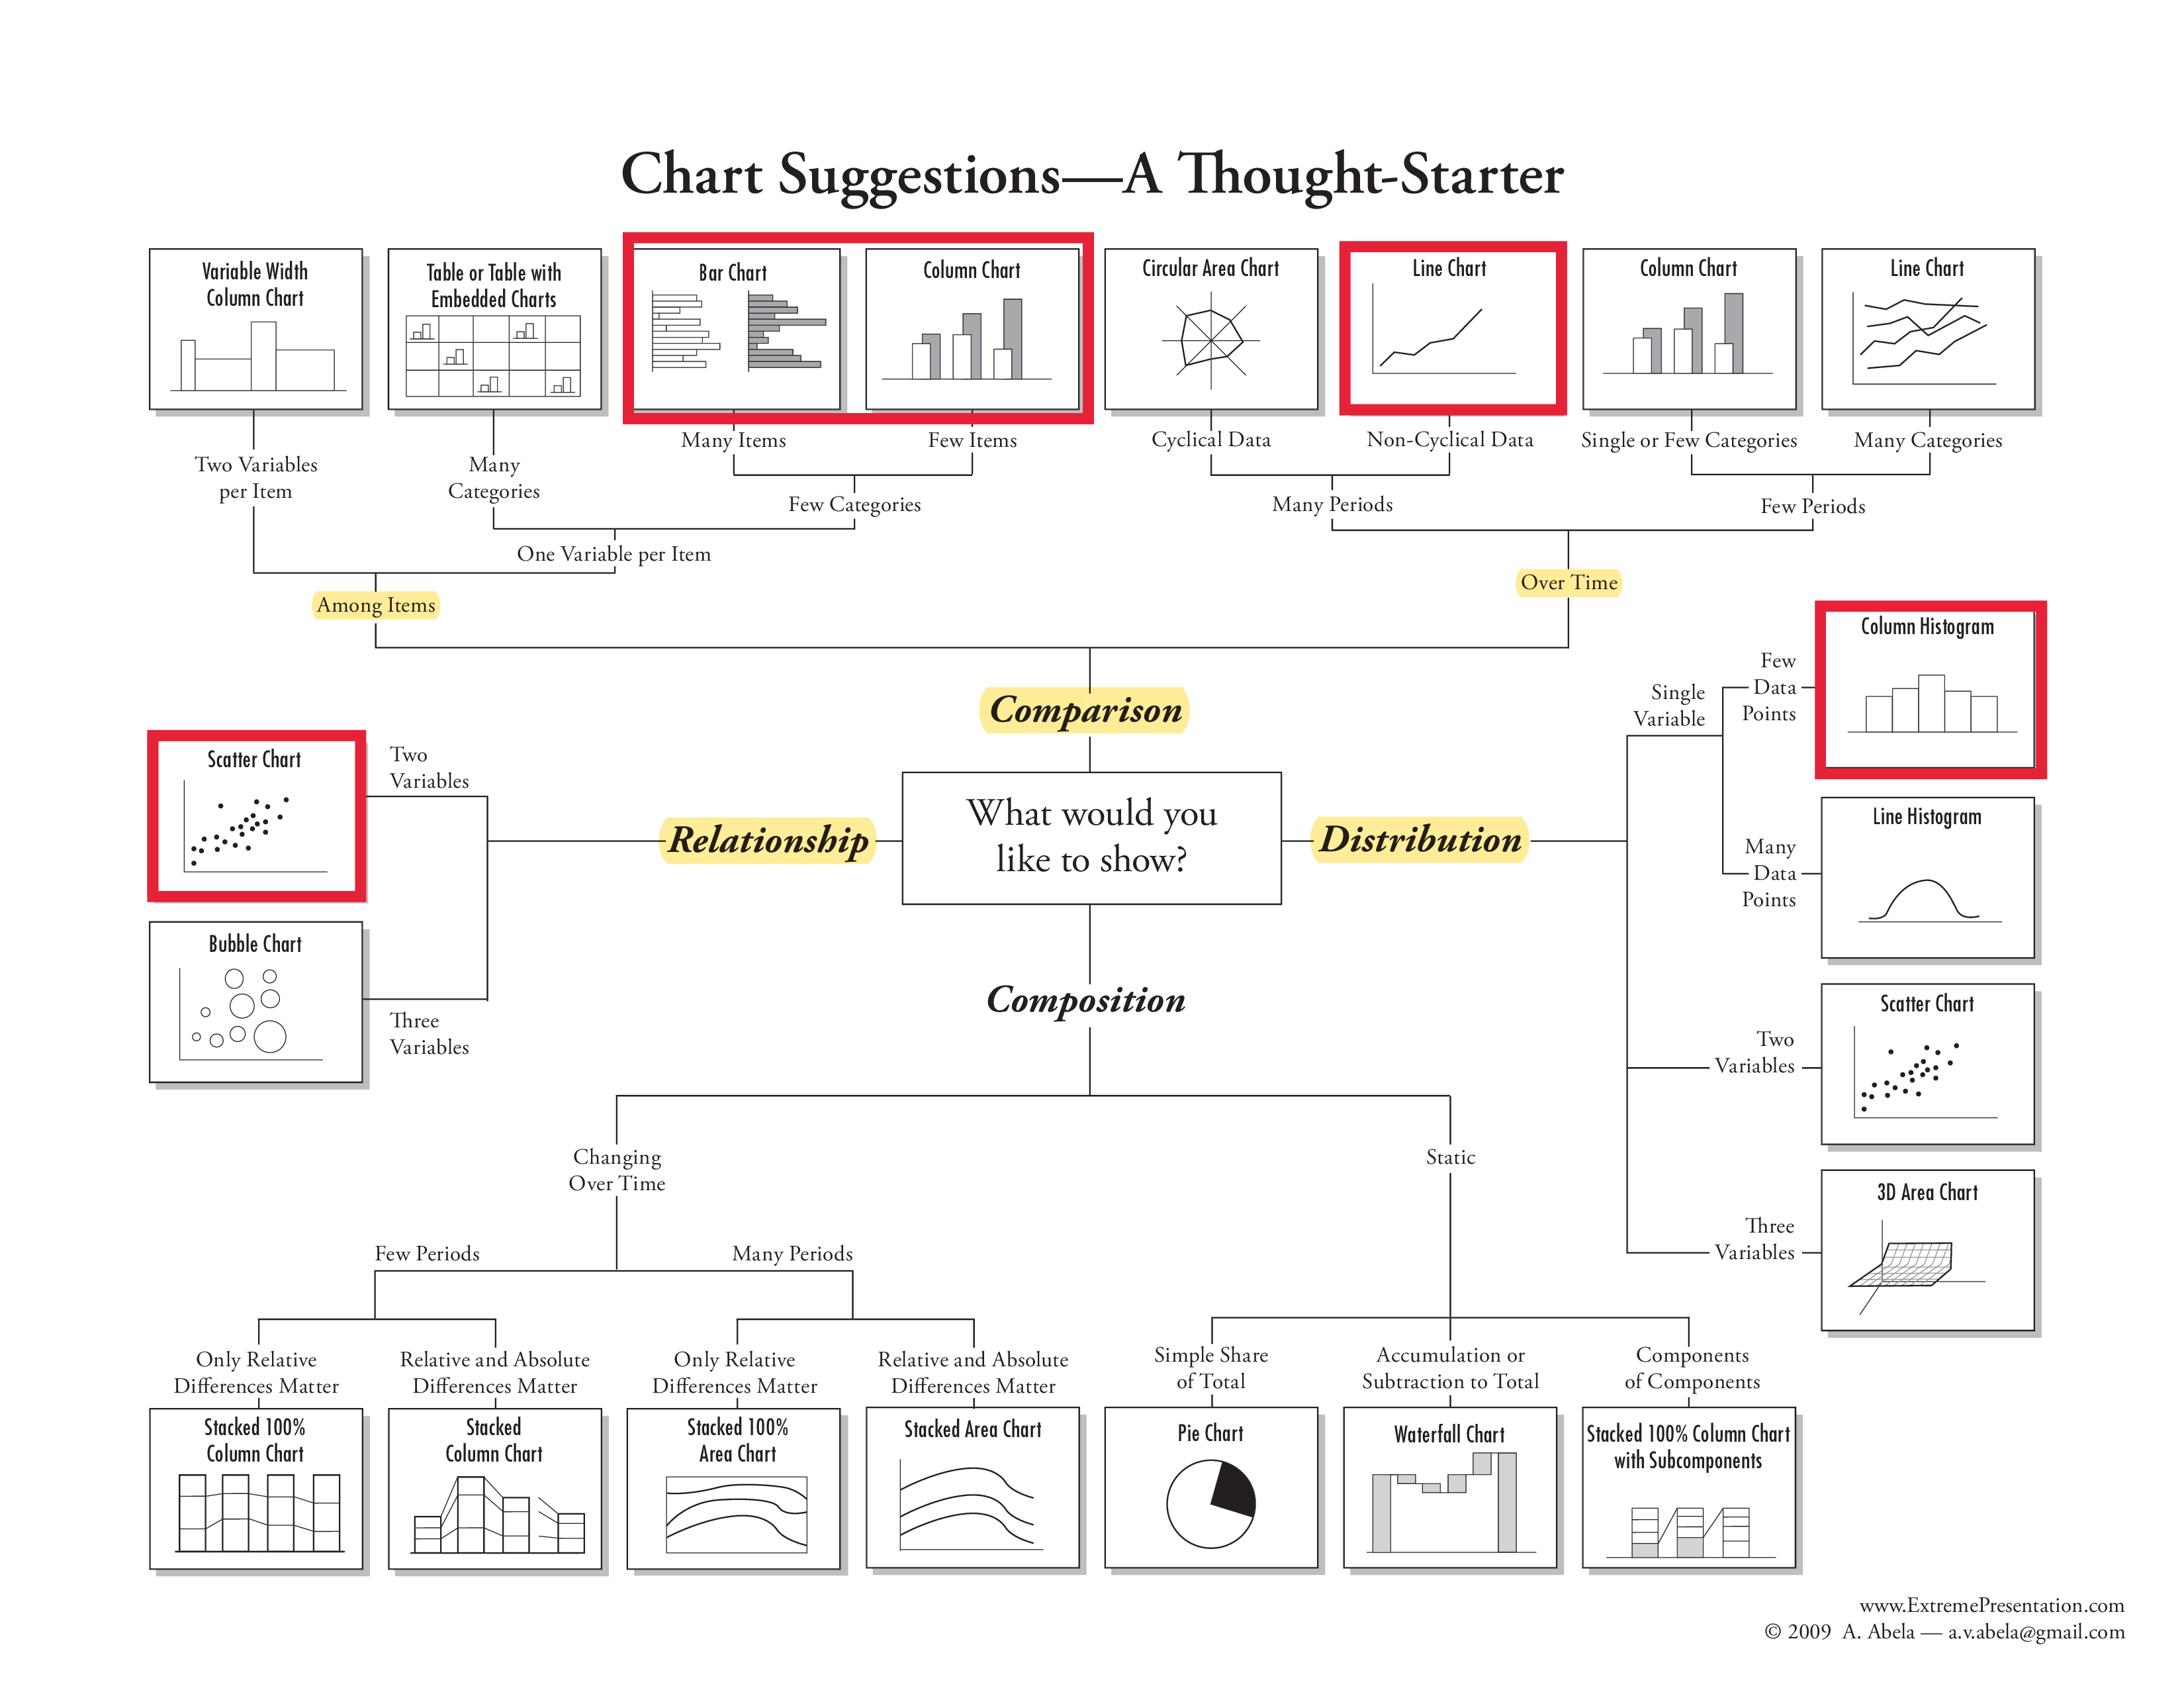

Slide 36

Conclusion
Exploring data is the first step when working with data.
The goal is to:
Understand what data is available.
Assess data distributions and how variables relate to each other.
Assess data quality.
Understanding the data is necessary to decide on data preparation and modeling.

