Slide 1

Introduction to Data Mining Chapter 4 Classification – Alternative Techniques
by Michael Hahsler
Based in Slides by Tan, Steinbach, Karpatne, Kumar

Slide 2


R Code Examples
Available R Code examples are indicated on slides by the R logo
The Examples are available at https://mhahsler.github.io/Introduction_to_Data_Mining_R_Examples/

Slide 3
Topics
Other Classification Methods
Rule-Based Classifier
Nearest Neighbor Classifier
Naive Bayes Classifier
Artificial Neural Networks
Support Vector Machines
Ensemble Methods
Class Imbalance Problem

Slide 4
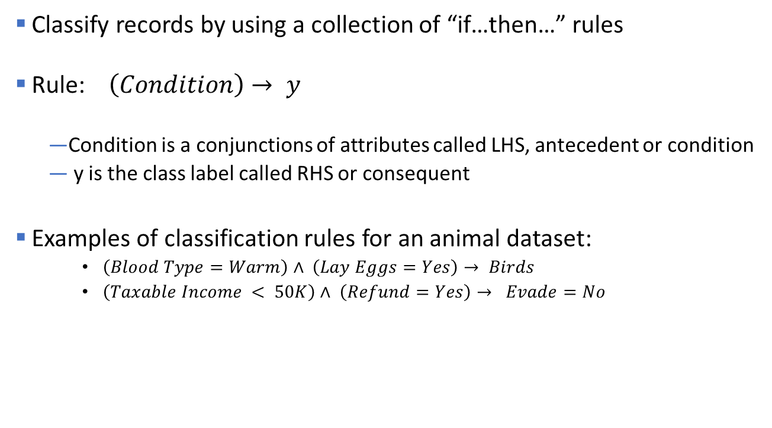
Rule-Based Classifier
Classify records by using a collection of “if…then…” rules
Rule: $\left(Condition\right)→ y$
Condition is a conjunctions of attributes called LHS, antecedent or condition
y is the class label called RHS or consequent
Examples of classification rules for an animal dataset:
$\left(Blood Type=Warm\right)∧ \left(Lay Eggs=Yes\right)→ Birds$
$\left(Taxable Income < 50K\right)∧ \left(Refund=Yes\right)→ Evade=No$

Slide 5

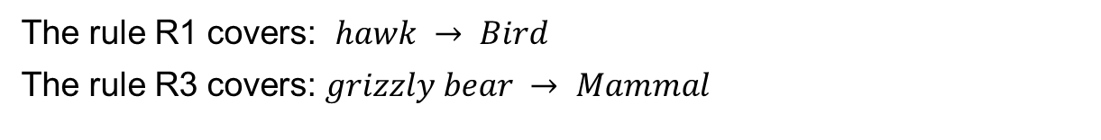
Using a Rule-Based Classifier
A rule $R$ covers an instance x if the attributes of the instance satisfy the condition of the rule. Such a rule can be used for classification.
R1: (Give Birth = no) ∧ (Can Fly = yes) → Birds
R2: (Give Birth = no) ∧ (Live in Water = yes) → Fishes
R3: (Give Birth = yes) ∧ (Blood Type = warm) → Mammals
R4: (Give Birth = no) ∧ (Can Fly = no) → Reptiles
R5: (Live in Water = sometimes) → Amphibians
Rule base
The rule R1 covers: $hawk → Bird$
The rule R3 covers: $grizzly bear → Mammal$

Slide 6
Ordered Rule Set vs. Voting
Rules are rank ordered according to their priority
An ordered rule set is known as a decision list
When a test record is presented to the classifier
It is assigned to the class label of the highest ranked rule it has triggered (R3 is selected below -> Amphibians)
If none of the rules fired, it is assigned to the default class
Alternative: (weighted) voting by all matching rules (-> Amphibians)
R1: (Give Birth = no) ∧ (Can Fly = yes) → Birds
R2: (Give Birth = yes) ∧ (Blood Type = warm) → Mammals
R3: (Live in Water = sometimes) → Amphibians
R4: (Give Birth = no) ∧ (Can Fly = no) → Reptiles
R5: (Give Birth = no) → Amphibians
Rule base
R3, 4 and 5 cover the observation

Slide 7
Rule Ordering Schemes
Rule-based ordering
Individual rules are ranked based on their quality
Class-based ordering
Rules that belong to the same class appear together

Slide 8
Rule Coverage and Accuracy
Coverage of a rule:
Fraction of records that satisfy the antecedent of a rule
Accuracy of a rule:
Fraction of records that satisfy both the antecedent and consequent of a rule
(Status=Single) → No
Coverage = 40%, Accuracy = 50%

Slide 9
How does Rule-based Classifier Work?
R1: (Give Birth = no) ∧ (Can Fly = yes) → Birds
R2: (Give Birth = no) ∧ (Live in Water = yes) → Fishes
R3: (Give Birth = yes) ∧ (Blood Type = warm) → Mammals
R4: (Give Birth = no) ∧ (Can Fly = no) → Reptiles
R5: (Live in Water = sometimes) → Amphibians
A lemur triggers rule R3, so it is classified as a mammal
A turtle triggers both R4 and R5
A dogfish shark triggers none of the rules

Slide 10
Characteristics of Rule-Based Classifier
Mutually exclusive rules
Classifier contains mutually exclusive rules if the rules are independent of each other
Every record is covered by at most one rule
Exhaustive rules
Classifier has exhaustive coverage if it accounts for every possible combination of attribute values
Each record is covered by at least one rule

Slide 11
Rules From Decision Trees
Rules are created by reading the decisions in tree branches from the root to a final node.
Rule set contains as much information as the tree.
Rules can be simplified (similar to pruning of the tree).
Example: C4.5rules

Slide 12
Effect of Rule Simplification
Rules are no longer mutually exclusive
A record may trigger more than one rule
Solution?
Ordered rule set
Unordered rule set – use voting schemes
Rules are no longer exhaustive
A record may not trigger any rules
Solution?
Use a default class

Slide 13
Direct Methods of Rule Generation
Extract rules directly from the data
Sequential Covering (Example: try to cover class +)
d
c
...
a
b
x
R1: a>x>b ∧ c>y>d ⟶ class +

Slide 14
Rule Growing
What attributes should be used in the rule?

Slide 15
Rule Growing (Examples)
CN2 Algorithm:
Start from an empty conjunct: {}
Add conjuncts that minimizes the entropy measure: {A}, {A,B}, …
Determine the rule consequent by taking majority class of instances covered by the rule
RIPPER Algorithm:
Start from an empty rule: {} => class
Add conjuncts that maximizes FOIL’s information gain measure:
R0: {} => class (initial rule)
R1: {A} => class (rule after adding conjunct)
Gain(R0, R1) = t [ log (p1/(p1+n1)) – log (p0/(p0 + n0)) ]
where t: number of positive instances covered by both R0 and R1
p0: number of positive instances covered by R0
n0: number of negative instances covered by R0
p1: number of positive instances covered by R1
n1: number of negative instances covered by R1

Slide 16
Instance Elimination
Why do we need to eliminate instances?
Otherwise, the next rule is identical to previous rule
Why do we remove positive instances?
Ensure that the next rule is different
Why do we remove negative instances?
Prevent underestimating accuracy of rule
Compare rules R2 and R3 in the diagram

Slide 17
Rule Evaluation
n : Number of instances covered by rule
n_{c} : Number of times the rule is correct
k : Number of classes
p : Prior probability
Metrics:
Accuracy
Laplace
M-estimate
Deal with low counts
(potentially 0)

Slide 18
Stopping Criterion and Rule Pruning
Stopping criterion
Compute the gain
If gain is not significant, discard the new rule
Rule Pruning
Similar to post-pruning of decision trees
Reduced Error Pruning:
Remove one of the conjuncts in the rule
Compare error rate on validation set before and after pruning
If error improves, prune the conjunct

Slide 19
Direct Method: RIPPER
For 2-class problem, choose one of the classes as positive class, and the other as negative class
Learn rules for positive class
Negative class will be default class
For multi-class problem
Order the classes according to increasing class prevalence (fraction of instances that belong to a particular class)
Learn the rule set for smallest class first, treat the rest as negative class
Repeat with next smallest class as positive class

Slide 20
Direct Method: RIPPER
Growing a rule:
Start from empty rule
Add conjuncts as long as they improve FOIL’s information gain
Stop when rule no longer covers negative examples
Prune the rule immediately using incremental reduced error pruning
Measure for pruning: v = (p-n)/(p+n)
p: number of positive examples covered by the rule in the validation set
n: number of negative examples covered by the rule in the validation set
Pruning method: delete any final sequence of conditions that maximizes v

Slide 21
Direct Method: RIPPER
Building a Rule Set:
Use sequential covering algorithm
Finds the best rule that covers the current set of positive examples
Eliminate both positive and negative examples covered by the rule
Each time a rule is added to the rule set, compute the new description length
stop adding new rules when the new description length is d bits longer than the smallest description length obtained so far

Slide 22
Direct Method: RIPPER
Optimize the rule set:
For each rule r in the rule set R
Consider 2 alternative rules:
Replacement rule (r*): grow new rule from scratch
Revised rule(r’): add conjuncts to extend the rule r
Compare the rule set for r against the rule set for r* and r’
Choose rule set that minimizes MDL principle
Repeat rule generation and rule optimization for the remaining positive examples

Slide 23
Indirect Methods

Slide 24
Indirect Method: C4.5rules
Extract rules from an unpruned decision tree
For each rule, r: A → y,
consider an alternative rule r’: A’ → y where A’ is obtained by removing one of the conjuncts in A
Compare the pessimistic error rate for r against all r’s
Prune if one of the r’s has lower pessimistic error rate
Repeat until we can no longer improve generalization error

Slide 25
Indirect Method: C4.5rules
Instead of ordering the rules, order subsets of rules (class ordering)
Each subset is a collection of rules with the same rule consequent (class)
Compute description length of each subset
Description length = L(error) + g L(model)
g is a parameter that takes into account the presence of redundant attributes in a rule set (default value = 0.5)

Slide 26
Example

Slide 27
C4.5 versus C4.5rules versus RIPPER
C4.5rules:
(Give Birth=No, Can Fly=Yes) → Birds
(Give Birth=No, Live in Water=Yes) → Fishes
(Give Birth=Yes) → Mammals
(Give Birth=No, Can Fly=No, Live in Water=No) → Reptiles
( ) → Amphibians
RIPPER:
(Live in Water=Yes) → Fishes
(Have Legs=No) → Reptiles
(Give Birth=No, Can Fly=No, Live In Water=No) → Reptiles
(Can Fly=Yes,Give Birth=No) → Birds
() → Mammals

Slide 28
C4.5 versus C4.5rules versus RIPPER
C4.5 and C4.5rules:
RIPPER:

Slide 29
Advantages of Rule-Based Classifiers
As expressive as decision trees
Easy to interpret
Easy to generate
Can classify new instances rapidly
Performance comparable to decision trees

Slide 30
Topics
Rule-Based Classifier
Nearest Neighbor Classifier
Naive Bayes Classifier
Artificial Neural Networks
Support Vector Machines
Ensemble Methods

Slide 31
Nearest Neighbor Classifiers
Basic idea:
If it walks like a duck, quacks like a duck, then it’s probably a duck
Compute Distance
Test Record
Training Records
Choose k of the “nearest” records

Slide 32
Nearest-Neighbor Classifiers
Unknown record
Requires three things
The set of stored records
Distance Metric to compute distance between records
The value of k, the number of nearest neighbors to retrieve
To classify an unknown record:
Compute distance to other training records
Identify k nearest neighbors
Use class labels of nearest neighbors to determine the class label of unknown record (e.g., by taking majority vote)
y
k=3
–
+
–
–
+
+
–
–
+
–
+
–
–
–
–
–
–
–
–
–
–
–
–
–
+
+
+
–
+
+
–
+
+
–
+
x

Slide 33
Definition of Nearest Neighbor
k-nearest neighbors of a record x are data points that have the k smallest distance to x. k is a hyperparameter.

Slide 34
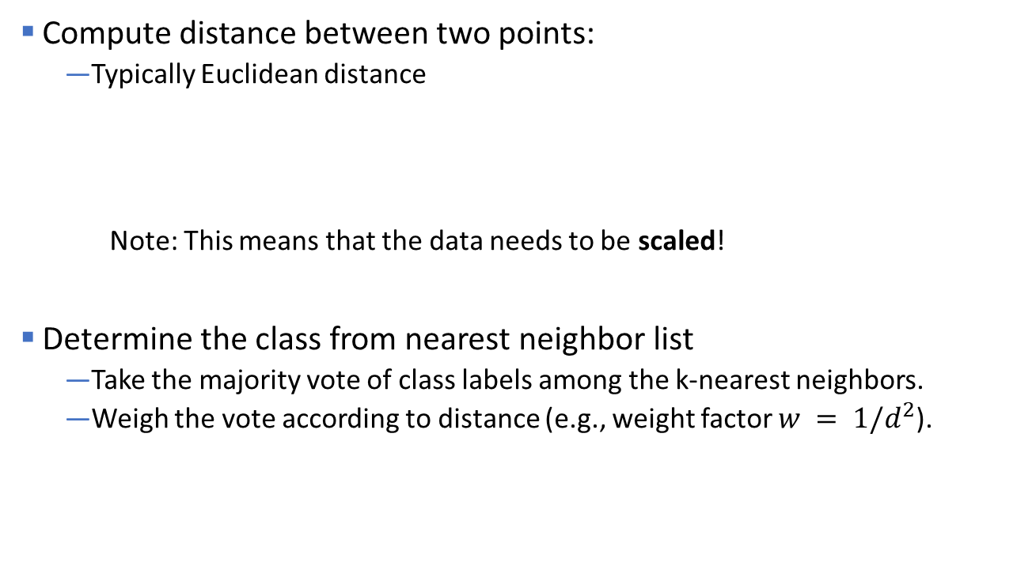

Nearest Neighbor Classification
Compute distance between two points:
Typically Euclidean distance
Note: This means that the data needs to be scaled!
Determine the class from nearest neighbor list
Take the majority vote of class labels among the k-nearest neighbors.
Weigh the vote according to distance (e.g., weight factor $w = 1/d^{2}$).
$d\left(p,q\right)= \sqrt{\sum_{i}{{\left({p_{i}−q}_{i}\right)}^{2}}}$

Slide 35
Nearest Neighbor Classification
y
–
Choosing the value of k:
If k is too small, sensitive to noise points
If k is too large, neighborhood may include points from other classes
–
–
–
–
+
–
–
–
–
–
–
–
+
–
–
–
+
–
+
–
+
–
–
–
–
–
–
+
+
+
–
+
+
–
+
+
–
+
x
k is too large!

Slide 36

Scaling issues
Attributes may have to be scaled to prevent distance measures from being dominated by one of the attributes
Example:
height of a person may vary from 1.5m to 1.8m
weight of a person may vary from 90lb to 300lb
income of a person may vary from $10K to $1M
Income will dominate Euclidean distance!
Solution: scaling/standardization (Z-Score)
$$z= \frac{x−\overline{x}}{sd(x)}$$

Slide 37
Nearest neighbor Classification…
k-NN classifiers are lazy learners
It does not build models explicitly (unlike eager learners such as decision trees).
Needs to store all the training data.
Classifying unknown records are relatively expensive (find the k-nearest neighbors). Space partitioning data structures like k-d trees can help.
Advantage: Can create arbitrary non-linear decision boundaries.
y
–
+
–
–
–
–
–
–
–
+
+
–
–
+
–
–
–
–
+
+
–
+
–
–
–
+
+
k=1
x

Slide 38
Topics
Rule-Based Classifier
Nearest Neighbor Classifier
Naive Bayes Classifier
Artificial Neural Networks
Support Vector Machines
Ensemble Methods

Slide 39
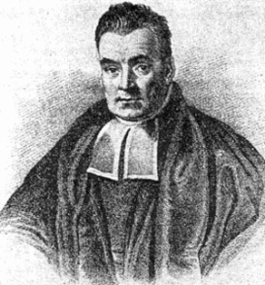
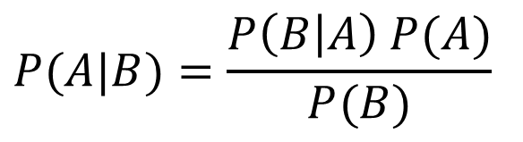

Bayes’ Rule
The product rule gives us two ways to factor a joint distribution:
Therefore,
Why is this useful?
Can get diagnostic probability $P(\text{cavity} | \text{toothache})$from causal probability $P(\text{toothache} | \text{cavity})$
We can update our beliefs based on evidence.
Important tool for probabilistic inference .
$$P\left(A,B\right)=P\left(A | B\right)P\left(B\right)=P\left(B | A\right)P(A)$$
Posterior Prob.
Prior Prob.
$$P(A|B)=\frac{P\left(B | A\right) P(A)}{P(B)}$$
Rev. Thomas Bayes (1702-1761)

Slide 40
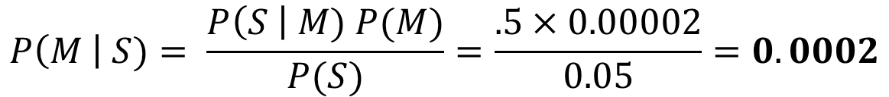
Example of Bayes Theorem
A doctor knows that meningitis causes stiff neck 50% of the time → P(S|M)=.5
Prior probability of any patient having meningitis is P(M) = 1/50,000 = 0.00002
Prior probability of any patient having stiff neck is P(S) = 1/20=0.05
If a patient has stiff neck, what’s the probability he/she has meningitis?
$$P\left(M \right| S)= \frac{P\left(S \right| M) P(M)}{P(S)}=\frac{.5×0.00002}{0.05}=0.0002$$
Increases the probability by x10!

Slide 41
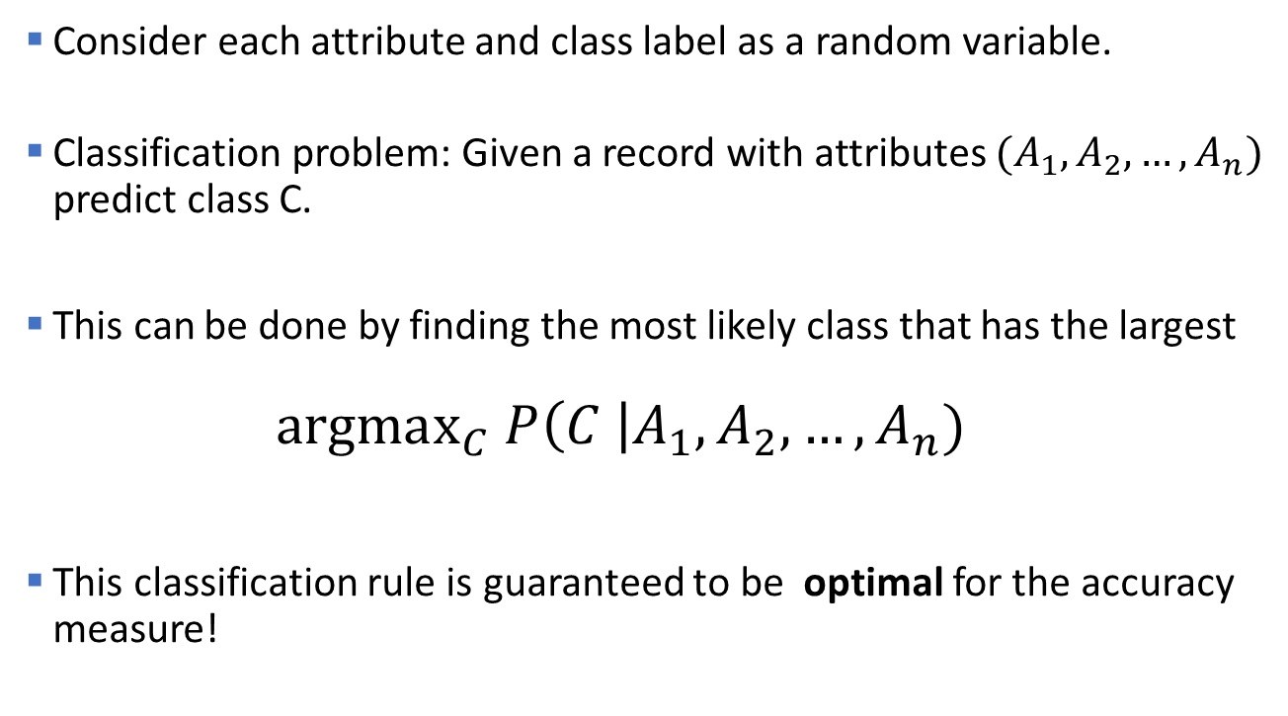
Bayesian Classifiers
Consider each attribute and class label as a random variable.
Classification problem: Given a record with attributes $(A_{1}, A_{2},…,A_{n})$ predict class C.
This can be done by finding the most likely class that has the largest
$$\text{argma}{\text{x}}_{C} P\left(C \right|A_{1}, A_{2},…,A_{n})$$
This classification rule is guaranteed to be optimal for the accuracy measure!

Slide 42
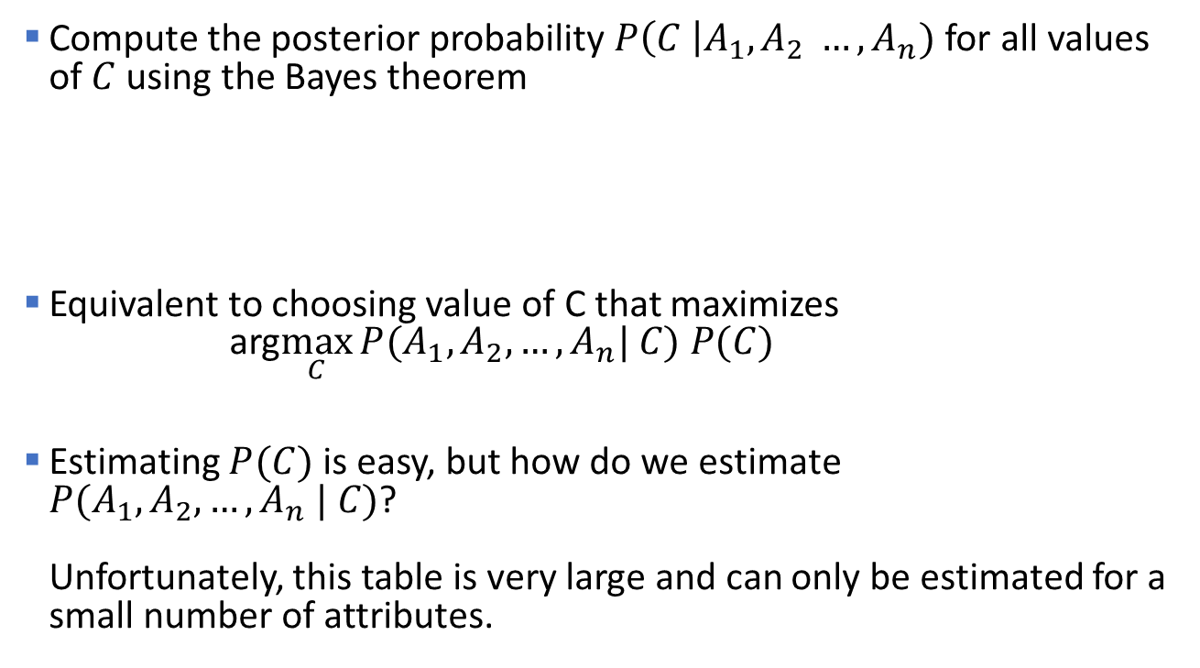
Bayesian Classifiers
Compute the posterior probability $P\left(C \right|A_{1}, A_{2} …, A_{n})$ for all values of $C$ using the Bayes theorem
Equivalent to choosing value of C that maximizes arg$\max_{C}{P(A_{1}, A_{2}, …, A_{n}| C) P(C) }$
Estimating $P(C)$ is easy, but how do we estimate $P(A_{1}, A_{2}, …, A_{n} | C)$? Unfortunately, this table is very large and can only be estimated for a small number of attributes.
$$\underset{C}{argmax}{P\left(C \right|A_{1}, A_{2}, …, A_{n})}=\text{argma}{\text{x}}_{C}\frac{P(A_{1}, A_{2}, …, A_{n}| C) P(C)}{P(A_{1}, A_{2}, …, A_{n})}$$
This is a constant! We don’t need it for the max.

Slide 43
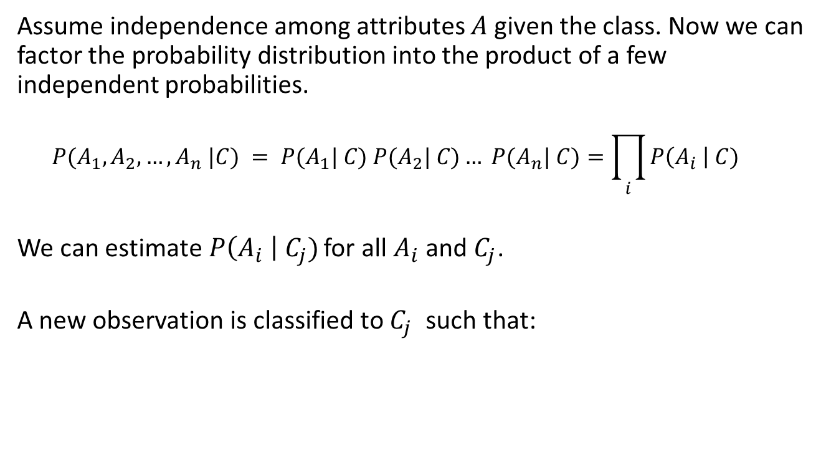
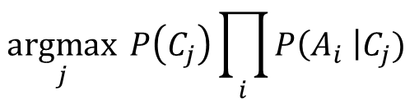
Naïve Bayes Classifier
Assume independence among attributes $A$ given the class. Now we can factor the probability distribution into the product of a few independent probabilities.
$$P(A_{1}, A_{2}, …, A_{n} |C) = P(A_{1}| C) P(A_{2}| C)… P(A_{n}| C)=\prod_{i}{P\left(A_{i} \right| C)}$$
We can estimate$P\left(A_{i} \right| C_{j})$ for all $A_{i}$ and $C_{j}$.
A new observation is classified to $C_{j}$ such that:
$$\underset{j}{argmax}{ P\left(C_{j}\right)\prod_{i}{P\left(A_{i} \right|C_{j}) }}$$

Slide 44
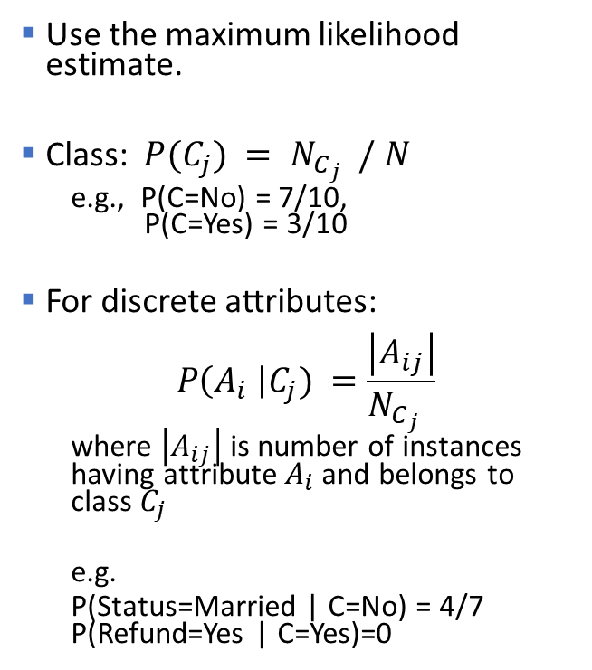
How to Estimate Probabilities from Data?
Use the maximum likelihood estimate.
Class: $P(C_{j}) = N_{C_{j}} / N$
e.g., P(C=No) = 7/10, P(C=Yes) = 3/10
For discrete attributes: $P\left(A_{i} \right|C_{j}) =\frac{\left|A_{ij}\right|}{N_{C_{j}} }$
where $\left|A_{ij}\right|$ is number of instances having attribute$A_{i}$and belongs to class $C_{j}$
e.g.
P(Status=Married | C=No) = 4/7 P(Refund=Yes | C=Yes)=0

Slide 45
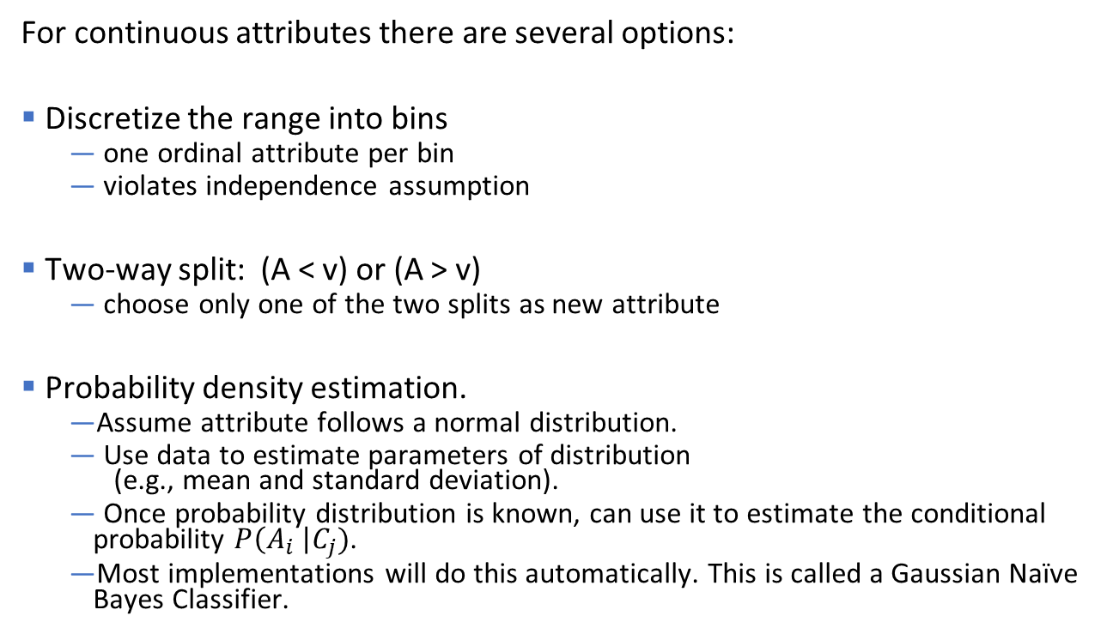
How to Estimate Probabilities from Data?
For continuous attributes there are several options:
Discretize the range into bins
one ordinal attribute per bin
violates independence assumption
Two-way split: (A < v) or (A > v)
choose only one of the two splits as new attribute
Probability density estimation.
Assume attribute follows a normal distribution.
Use data to estimate parameters of distribution (e.g., mean and standard deviation).
Once probability distribution is known, can use it to estimate the conditional probability $P\left(A_{i} \right|C_{j})$.
Most implementations will do this automatically. This is called a Gaussian Naïve Bayes Classifier.

Slide 46
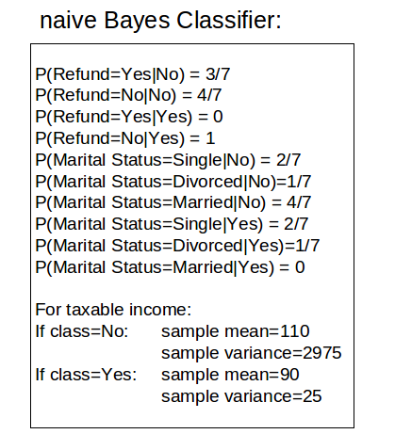
Example of Naïve Bayes Classifier
Given a Test Record what is the most likely class?
$$X=(Refund=No, Married, Income=120K)$$
P(X|Class=No) = P(Refund=No|Class=No) * P(Married| Class=No) * P(Income=120K| Class=No) = 4/7 * 4/7 * 0.0072 = 0.0024
P(X|Class=Yes) = P(Refund=No| Class=Yes) * P(Married| Class=Yes) * P(Income=120K| Class=Yes) = 1 * 0 * 1.2 * 10⁻⁹ = 0
Since P(X|No)P(No) > P(X|Yes)P(Yes)
Therefore P(No|X) > P(Yes|X) => Class = No
0 are an issue!

Slide 47
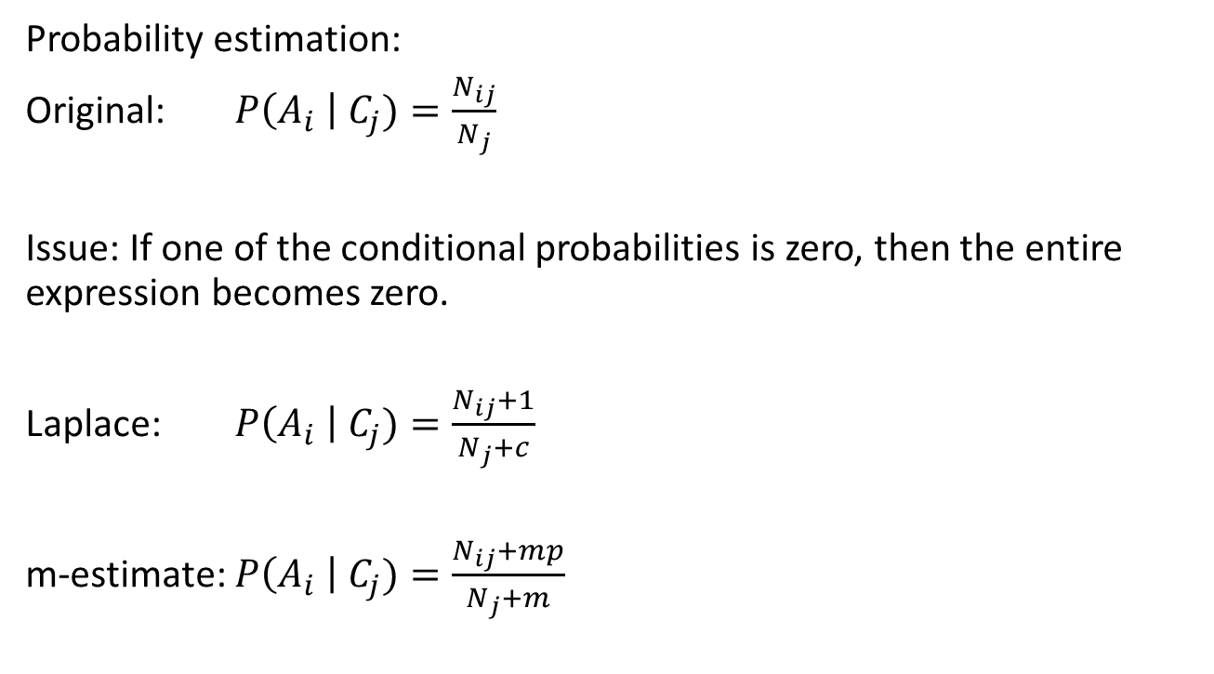
Naïve Bayes Classifier: Dealing With Low Counts
Probability estimation:
Original: $P\left(A_{i} \right| C_{j})=\frac{N_{ij}}{N_{j}}$
Issue: If one of the conditional probabilities is zero, then the entire expression becomes zero.
Laplace: $P\left(A_{i} \right| C_{j})=\frac{N_{ij}+1}{N_{j}+c}$
m-estimate: $P\left(A_{i} \right| C_{j})=\frac{N_{ij}+mp}{N_{j}+m}$
c: number of classes
p: prior probability
m: parameter

Slide 48
Example of Naïve Bayes Classifier
A: attributes
M: mammals
N: non-mammals
P(A|M)P(M) > P(A|N)P(N)
=> Mammals

Slide 49
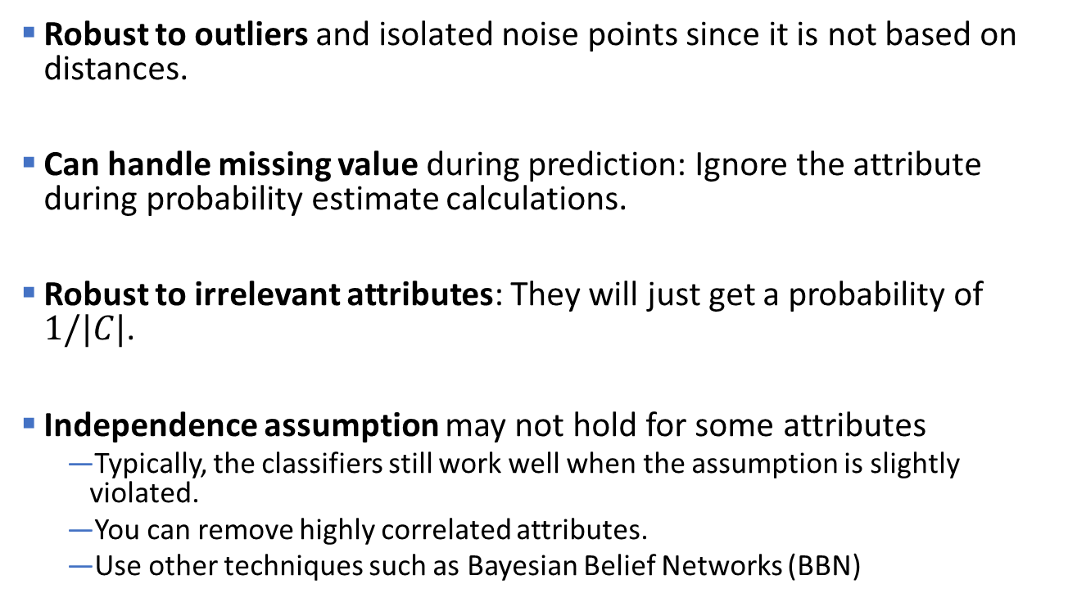
Naïve Bayes (Summary)
Robust to outliers and isolated noise points since it is not based on distances.
Can handle missing value during prediction: Ignore the attribute during probability estimate calculations.
Robust to irrelevant attributes: They will just get a probability of $1/|C|$.
Independence assumption may not hold for some attributes
Typically, the classifiers still work well when the assumption is slightly violated.
You can remove highly correlated attributes.
Use other techniques such as Bayesian Belief Networks (BBN)

Slide 50
Topics
Rule-Based Classifier
Nearest Neighbor Classifier
Naive Bayes Classifier
Artificial Neural Networks
Support Vector Machines
Ensemble Methods

Slide 51
Artificial Neural Networks (ANN)
Output Y is 1 if at least two of the three inputs are equal to 1.

Slide 52
Artificial Neural Networks (ANN)
Model is an assembly of inter-connected nodes and weighted links
Output node sums up each of its input value according to the weights of its links
Compare output node against some threshold t
Perceptron Model
or

Slide 53
Artificial Neural Networks (ANN)

Slide 54
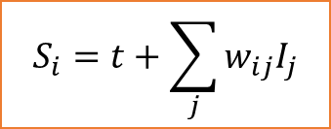

General Structure of ANN
$$S_{i}=t+\sum_{j}{w_{ij}I_{j}}$$
$$\hat{y}$$
Training: Find the weights $w_{i}$’s that minimize the above loss function $L(y, f(x_{1},x_{2},…, x_{n})).$
Methods: backpropagation algorithm, gradient descend

Slide 55
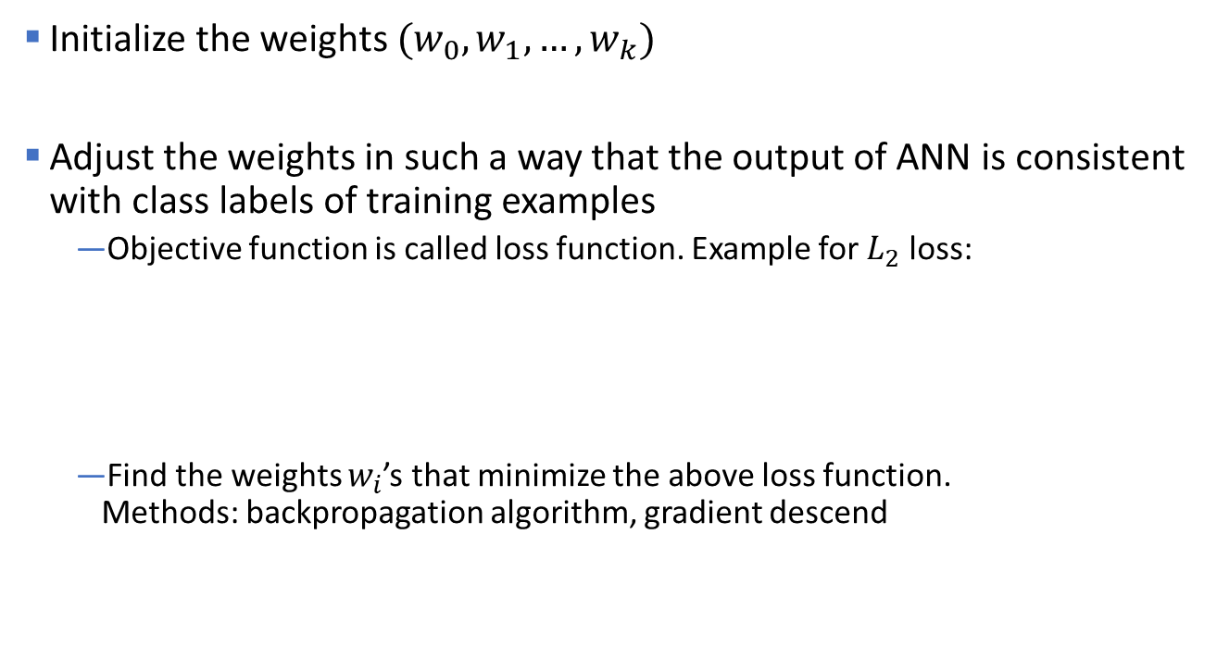
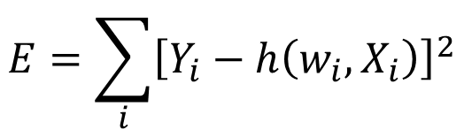
Algorithm for learning ANN
Initialize the weights $(w_{0}, w_{1}, …, w_{k})$
Adjust the weights in such a way that the output of ANN is consistent with class labels of training examples
Objective function is called loss function. Example for $L_{2}$ loss:
Find the weights $w_{i}$’s that minimize the above loss function. Methods: backpropagation algorithm, gradient descend
$$E=\sum_{i}{{\left[Y_{i}−h\left(w_{i},X_{i}\right)\right]}^{2}}$$

Slide 56
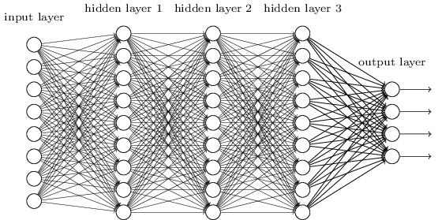
Deep Learning / Deep Neural Networks
Can make training more efficient. Pretrained layers may be used (i.e., transfer learning).
Needs lots of data + computation (GPU).
Applications: computer vision, speech recognition, natural language processing, audio recognition, machine translation, bioinformatics, …
Tools: Keras, Tensorflow and many others.
Related: Deep belief networks, recurrent neural networks (RNN), convolutional neural network (CNN), …

Slide 57
Topics
Rule-Based Classifier
Nearest Neighbor Classifier
Naive Bayes Classifier
Artificial Neural Networks
Support Vector Machines
Ensemble Methods

Slide 58
Support Vector Machines
Goal: Find a linear hyperplane (decision boundary) that will separate the data.

Slide 59
Support Vector Machines
Many possible solutions

Slide 60
Support Vector Machines
B1
B2
Which one is better? B1 or B2?
How do you define better?

Slide 61
Support Vector Machines
B1
B2
margin
Find the hyperplane with the maximal margin => B1 is better than B2
Larger margin = more robust = less expected generalization error

Slide 62
Support Vector Machines
What if the problem is not linearly separable?
Use slack variables to account for violations.
Use hyperplane that minimizes the total slack.
Solution:
The optimization problem can be written as a quadratic optimization problem with linear constraints that only depends on a few close data points called the support vectors.
slack

Slide 63
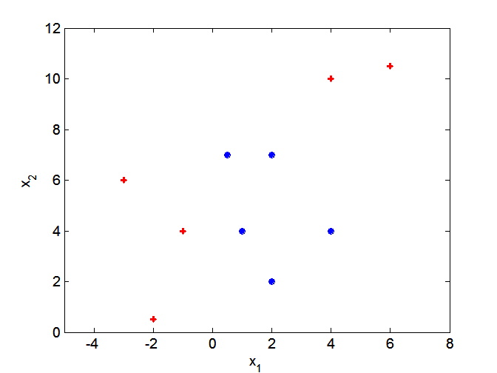
Nonlinear Support Vector Machines
SVMs look for linear decision boundaries. What if decision boundary is not linear?

Slide 64
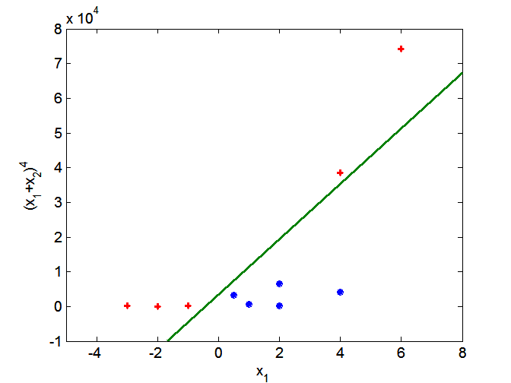
Nonlinear Support Vector Machines
projection
Project data into a higher dimensional space where the classes are linearly separable.
Projection is expensive! Kernel trick: Compute the similarity (inner product) in the projected space directly from the original data. This trick can be used with other method like clustering as well.

Slide 65
Topics
Rule-Based Classifier
Nearest Neighbor Classifier
Naive Bayes Classifier
Artificial Neural Networks
Support Vector Machines
Ensemble Methods

Slide 66
Ensemble Methods
Method
Construct a set of (possibly weak) classifiers from the training data.
Predict class label of previously unseen records by aggregating predictions made by multiple classifiers.
Advantages
Improve the stability and often also the accuracy of classifiers.
Reduces variance in the prediction.
Reduces overfitting.

Slide 67
General Idea
sampling
weak learners
voting
prediction

Slide 68

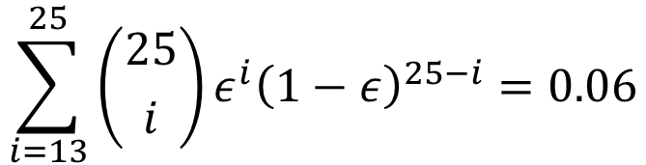
Why does it work?
Suppose there are 25 base classifiers.
Each classifier has error rate $ε = 0.35$
Assume classifiers are independent (different features and/or training data).
Probability that the ensemble classifier makes a wrong prediction:
$$\sum_{i=13}^{25}{\left({25 \atop i}\right)ε^{i}{\left(1−ε\right)}^{25−i}=0.06}$$
= Probability that the majority (13 or more classifiers) make the wrong decision.
Note
The binomial coefficient gives the number of ways you can choose i out of 25.

Slide 69
Examples of Ensemble Methods
How to generate an ensemble of independent classifiers?
Bagging
Use several samples
Boosting
Increase the weight for misclassified data points
Random Features
Use different features

Slide 70
Bagging (Bootstrap Aggregation)
1. Sampling with replacement (bootstrap sampling)
Note: some objects are chosen multiple times in a bootstrap sample while others are not chosen! A typical bootstrap sample contains about 63% of the objects in the original data.
2. Build classifiers, one for each bootstrap sample (classifiers are hopefully independent since they are learned from different subsets of the data)
3. Aggregate the classifiers' results by averaging or voting

Slide 71
Boosting
Records that are incorrectly classified in one round will have their weights increased in the next
Example 4 is hard to classify. Its weight is increased so it is more likely to be chosen again in subsequent rounds. This creates a larger error, and the classifier will try harder to predict it correctly.
Popular algorithm: AdaBoost (Adaptive Boosting) typically uses decision trees as the weak learner.

Slide 72
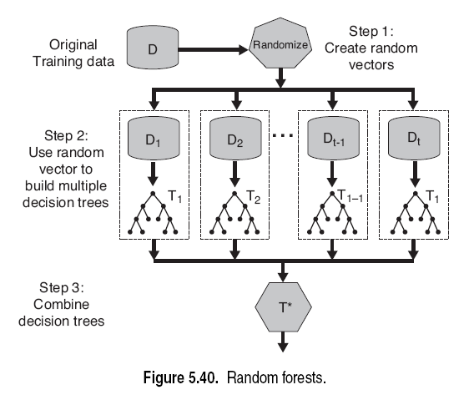
Random Forests
Introduce two sources of randomness: “Bagging” and “Random input vectors”
Bagging method: each tree is grown using a bootstrap sample of training data
Random vector method: At each node, the best split is chosen only from a random sample of the m possible attributes.

Slide 73
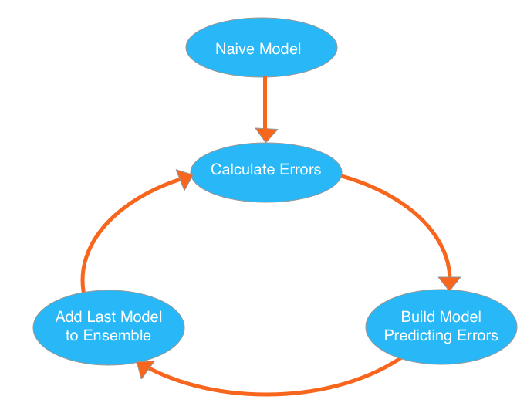
Gradient Boosted Decision Trees (XGBoost)
Idea: build models to predict (correct) errors (= boosting).
Approach:
Start with a naive (weak) model
Calculate errors for each observation in the dataset.
Build a new model to predict these errors and add to the ensemble.
Go to 2.
Error should decrease

Slide 74
Other Popular Approaches
Logistic Regression (Generalized linear models).
Linear Discriminant Analysis (LDA).
Regularized Models (Shrinkage).
Stacking.

Slide 75

Topics
Other Classification Methods
Rule-Based Classifier
Nearest Neighbor Classifier
Naive Bayes Classifier
Artificial Neural Networks
Support Vector Machines
Ensemble Methods
Class Imbalance Problem

Slide 76
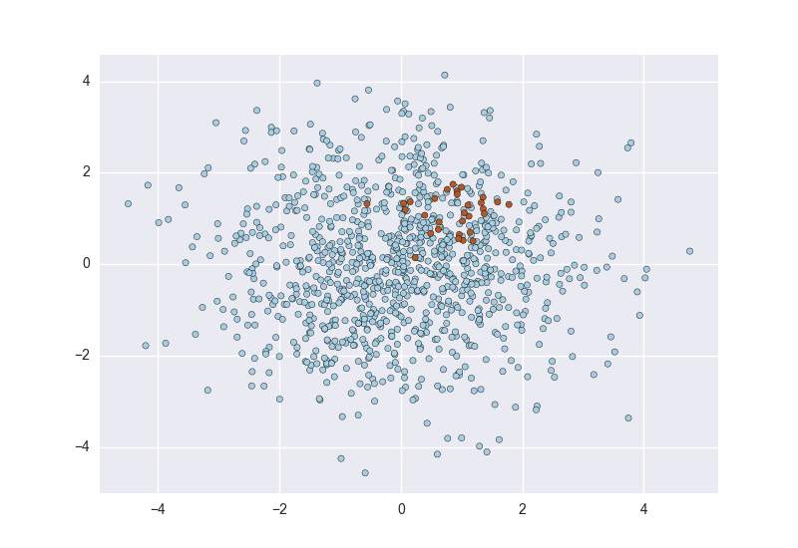
Class Imbalance Problem
Consider a 2-class problem
Number of Class 0 examples = 9990
Number of Class 1 examples = 10
A simple model:
Always predict Class 0
accuracy = 9990/10000 = 99.9 %
error = 0.1%
Issues:
Evaluation: accuracy is misleading.
Learning: Most classifiers try to optimize accuracy/error. These classifiers will not learn how to find examples of Class 1!

Slide 77
Class Imbalance Problem: Evaluation
Do not use accuracy to evaluate problems with strong class imbalance!
Use instead:
ROC curves and AUC (area under the curve) for binary classifiers.
Cohen's Kappa which corrects for random accuracy.
Misclassification cost.
Precision/Recall plots or the F1 Score.

Slide 78
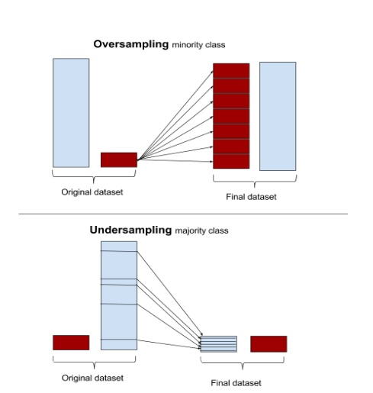
Class Imbalance Problem: Learning
Do nothing. Sometimes you get lucky!
Balance the data set: Down-sample the majority class and/or up-sample the minority class (use sampling with replacement). Synthesize new examples with SMOTE. This will artificially increase the error for a mistake in the minority class.
Use algorithms that can deal with class imbalance (see next slide).
Throw away minority examples and switch to an anomaly detection framework.

Slide 79
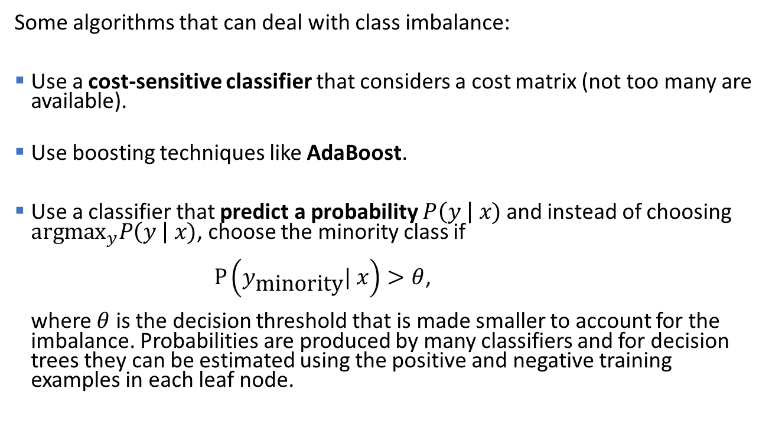
Class Imbalance Problem: Learning
Some algorithms that can deal with class imbalance:
Use a cost-sensitive classifier that considers a cost matrix (not too many are available).
Use boosting techniques like AdaBoost.
Use a classifier that predict a probability $P\left(y \right| x)$ and instead of choosing $\text{argma}{\text{x}}_{y}P\left(y \right| x)$, choose the minority class if $P\left(y_{\text{minority}}| x\right)>θ$, where $θ$ is the decision threshold that is made smaller to account for the imbalance. Probabilities are produced by many classifiers and for decision trees they can be estimated using the positive and negative training examples in each leaf node.

Slide 80

Conclusion
Bias: There are many ways to implement the classification function. Each of them has a different inductive bias.
Feature extraction and feature creation is important (e.g., interaction effects in linear models). Deep learning can also learn to create features.
Overfitting and model variability are issues. Appropriate validation and test data needs to be used to produce and evaluate models that generalize well.
Accuracy is problematic for imbalanced data sets. Rebalancing the data may be necessity.
Model explainability is often important. Rules and trees may be easier to explain than other models.
(Deep) artificial neural networks are a very powerful method but other methods may be preferable since ANNs:
Have no or very low bias and need lots of training data.
Have many hyperparameters which need to be tuned experimentally.
Model represents a black box and it is hard to explain why it makes decisions.

