Slide 1

Introduction to Data Mining Chapter 5 Association Analysis – Basic Concepts and Algorithms
by Michael Hahsler
Based in Slides by by Tan, Steinbach, Karpatne, Kumar

Slide 2


R Code Examples
Available R Code examples are indicated on slides by the R logo
The Examples are available at https://mhahsler.github.io/Introduction_to_Data_Mining_R_Examples/

Slide 3
Topics
Definition
Mining Frequent Itemsets (APRIORI)
Concise Itemset Representation
Alternative Methods to Find Frequent Itemsets
Association Rule Generation
Support Distribution
Pattern Evaluation

Slide 4
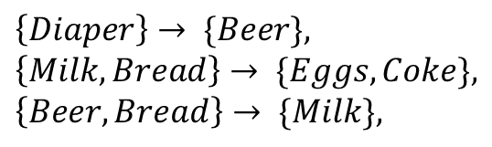
Association Rule Mining
Given a set of transactions, find rules that will predict the occurrence of an item based on the occurrences of other items in the transaction
Market-Basket transactions
Example of Association Rules
TID | Items
1 | Bread, Milk
2 | Bread, Diaper, Beer, Eggs
3 | Milk, Diaper, Beer, Coke
4 | Bread, Milk, Diaper, Beer
5 | Bread, Milk, Diaper, Coke
$$\left\{Diaper\right\}→ \{Beer\}, \\ \left\{Milk, Bread\right\}→ \{Eggs,Coke\}, \\ \left\{Beer, Bread\right\}→ \{Milk\},$$
Implication means co-occurrence, not causality!

Slide 5

Definition: Frequent Itemset
Itemset
A collection of one or more items
Example: {Milk, Bread, Diaper}
k-itemset
An itemset that contains k items
Support count (σ)
Frequency of occurrence of an itemset
E.g. σ({Milk, Bread, Diaper}) = 2
Support
Fraction of transactions that contain an itemset
E.g. s({Milk, Bread, Diaper}) = σ({Milk, Bread, Diaper}) / |T| = 2/5
Frequent Itemset
An itemset whose support is greater than or equal to a minsup threshold
TID | Items
1 | Bread, Milk
2 | Bread, Diaper, Beer, Eggs
3 | Milk, Diaper, Beer, Coke
4 | Bread, Milk, Diaper, Beer
5 | Bread, Milk, Diaper, Coke
s$\left(X\right)=\frac{σ(X)}{|T|}$

Slide 6

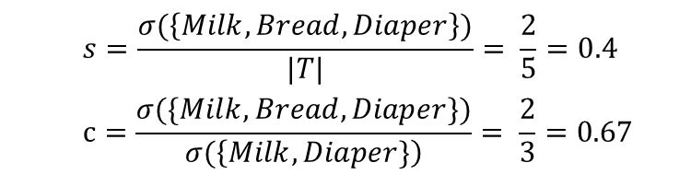
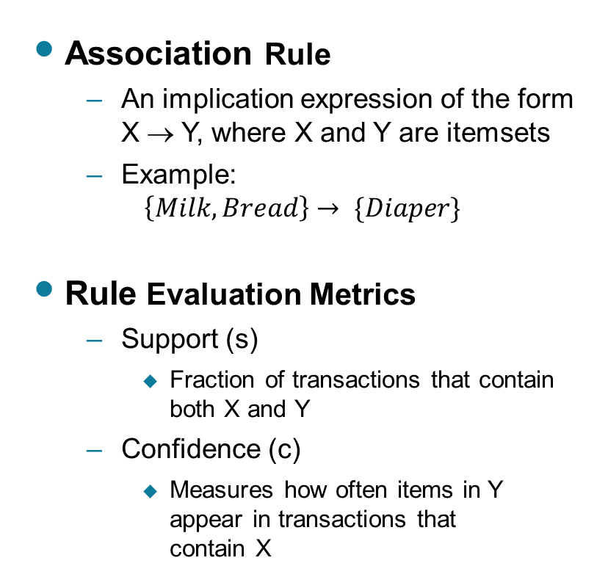
Definition: Association Rule
Association Rule
An implication expression of the form X → Y, where X and Y are itemsets
Example: $\left\{Milk, Bread\right\}→ \{Diaper\}$
Rule Evaluation Metrics
Support (s)
Fraction of transactions that contain both X and Y
Confidence (c)
Measures how often items in Y appear in transactions that contain X
TID | Items
1 | Bread, Milk
2 | Bread, Diaper, Beer, Eggs
3 | Milk, Diaper, Beer, Coke
4 | Bread, Milk, Diaper, Beer
5 | Bread, Milk, Diaper, Coke
Example:
$$\left\{Milk, Bread\right\}→ \left\{Diaper\right\}$$
$$s=\frac{σ(\left\{Milk, Bread, Diaper\right\})}{|T|}= \frac{2}{5}=0.4$$
$$c=\frac{σ(\{Milk, Bread, Diaper\})}{σ(\left\{Milk, Diaper\}\right)}= \frac{2}{3}=0.67$$

Slide 7
Topics
Definition
Mining Frequent Itemsets (APRIORI)
Concise Itemset Representation
Alternative Methods to Find Frequent Itemsets
Association Rule Generation
Support Distribution
Pattern Evaluation

Slide 8
Association Rule Mining Task
Given a set of transactions T, the goal of association rule mining is to find all rules having
support ≥ minsup threshold
confidence ≥ minconf threshold
Brute-force approach:
List all possible association rules
Compute the support and confidence for each rule
Prune rules that fail the minsup and minconf thresholds
⇒ Computationally prohibitive!

Slide 9
Mining Association Rules
Example of Rules:
{Milk,Diaper} → {Beer} (s=0.4, c=0.67) {Milk,Beer} → {Diaper} (s=0.4, c=1.0)
{Diaper,Beer} → {Milk} (s=0.4, c=0.67)
{Beer} → {Milk,Diaper} (s=0.4, c=0.67) {Diaper} → {Milk,Beer} (s=0.4, c=0.5)
{Milk} → {Diaper,Beer} (s=0.4, c=0.5)
TID | Items
1 | Bread, Milk
2 | Bread, Diaper, Beer, Eggs
3 | Milk, Diaper, Beer, Coke
4 | Bread, Milk, Diaper, Beer
5 | Bread, Milk, Diaper, Coke
Observations:
All the above rules are binary partitions of the same itemset: {Milk, Diaper, Beer}
Rules originating from the same itemset have identical support but can have different confidence
Thus, we may decouple the support and confidence requirements

Slide 10
Mining Association Rules
Two-step approach:
Frequent Itemset Generation
Generate all itemsets whose support ≥ minsup
Rule Generation
Generate high confidence rules from each frequent itemset, where each rule is a binary partitioning of a frequent itemset
Frequent itemset generation is still computationally expensive

Slide 11
Frequent Itemset Generation
Given d items, there are 2^{d} possible candidate itemsets

Slide 12
Frequent Itemset Generation
Brute-force approach:
Each itemset in the lattice is a candidate frequent itemset
Count the support of each candidate by scanning the database
Match each transaction against every candidate
Complexity ~ O(NM) => Expensive since M = 2^{d} !!!

Slide 13
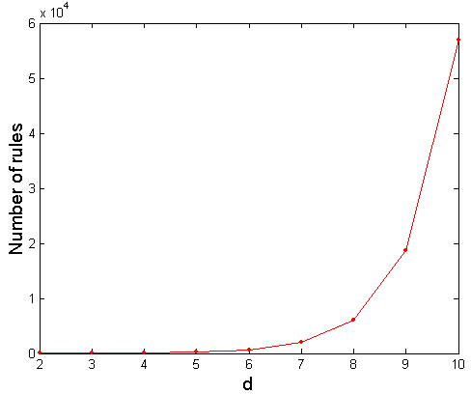
Computational Complexity
Given d unique items:
Total number of itemsets = 2^{d}
Total number of possible association rules:
If d=6, R = 602 rules

Slide 14
Frequent Itemset Generation Strategies
Reduce the number of candidates (M)
Complete search: M=2^{d}
Use pruning techniques to reduce M
Reduce the number of transactions (N)
Reduce size of N as the size of itemset increases
Used by DHP and vertical-based mining algorithms
Reduce the number of comparisons (NM)
Use efficient data structures to store the candidates or transactions
No need to match every candidate against every transaction

Slide 15
Reducing Number of Candidates
Apriori principle:
If an itemset is frequent, then all of its subsets must also be frequent
Apriori principle holds due to the following property of the support measure:
Support of an itemset never exceeds the support of its subsets
This is known as the anti-monotone property of support
$$∀ X,Y :\left(X ⊆Y\right)⇒s\left(X\right)≥s(Y)$$

Slide 16
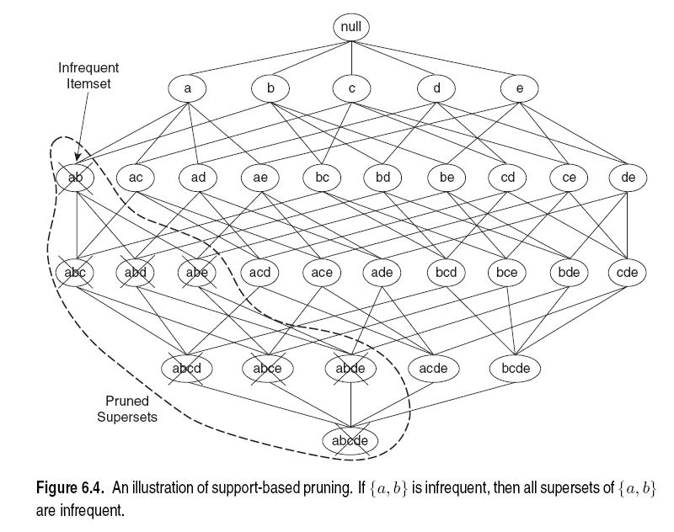
Illustrating Apriori Principle

Slide 17
Illustrating Apriori Principle
Items (1-itemsets)
Pairs (2-itemsets)
(No need to generate candidates involving Coke or Eggs)
Minimum Support = 3
Triplets (3-itemsets)
If every subset is considered,
⁶C₁ + ⁶C₂ + ⁶C₃ = 41
With support-based pruning,
6 + 6 + 1 = 13

Slide 18
Apriori Algorithm
Method:
Let k=1
Generate frequent itemsets of length 1
Repeat until no new frequent itemsets are identified
Generate length (k+1) candidate itemsets from length k frequent itemsets
Prune candidate itemsets containing subsets of length k that are infrequent
Count the support of each candidate by scanning the DB
Eliminate candidates that are infrequent, leaving only those that are frequent

Slide 19
Reducing Number of Comparisons
Candidate counting:
Scan the database of transactions to determine the support of each candidate itemset
To reduce the number of comparisons, store the candidates in a hash structure
Instead of matching each transaction against every candidate, match it against candidates contained in the hashed buckets

Slide 20
Generate Hash Tree
Suppose you have 15 candidate itemsets of length 3:
{1 4 5}, {1 2 4}, {4 5 7}, {1 2 5}, {4 5 8}, {1 5 9}, {1 3 6}, {2 3 4}, {5 6 7}, {3 4 5}, {3 5 6}, {3 5 7}, {6 8 9}, {3 6 7}, {3 6 8}
You need:
Hash function
Max leaf size: max number of itemsets stored in a leaf node (if number of candidate itemsets exceeds max leaf size, split the node)
Hash function
2 3 4
5 6 7
3,6,9
1,4,7
1 4 5
3 4 5
3 5 6
3 5 7
6 8 9
3 6 7
3 6 8
1 3 6
2,5,8
1 2 4
4 5 7
1 2 5
4 5 8
1 5 9

Slide 21
Association Rule Discovery: Hash tree
Hash Function
Candidate Hash Tree
1,4,7
3,6,9
2,5,8
2 3 4
5 6 7
1 4 5
1 3 6
3 4 5
3 5 6
3 6 7
Hash on 1, 4 or 7
3 5 7
3 6 8
1 2 4
1 5 9
6 8 9
1 2 5
4 5 7
4 5 8

Slide 22
Association Rule Discovery: Hash tree
Hash Function
Candidate Hash Tree
1,4,7
3,6,9
2,5,8
2 3 4
5 6 7
1 4 5
1 3 6
3 4 5
3 5 6
3 6 7
Hash on 2, 5 or 8
3 5 7
3 6 8
1 2 4
1 5 9
6 8 9
1 2 5
4 5 7
4 5 8

Slide 23
Association Rule Discovery: Hash tree
Hash Function
Candidate Hash Tree
1,4,7
3,6,9
2,5,8
2 3 4
5 6 7
1 4 5
1 3 6
3 4 5
3 5 6
3 6 7
Hash on 3, 6 or 9
3 5 7
3 6 8
1 2 4
1 5 9
6 8 9
1 2 5
4 5 7
4 5 8

Slide 24
Subset Operation
Given a transaction t, what are the possible subsets of size 3?

Slide 25
Subset Operation Using Hash Tree
1 2 3 5 6
transaction
Hash Function
1 +
2 3 5 6
2 +
3 5 6
1,4,7
3,6,9
3 +
5 6
2,5,8
2 3 4
5 6 7
1 4 5
1 3 6
3 4 5
3 5 6
3 6 7
3 5 7
3 6 8
1 2 4
1 2 5
1 5 9
6 8 9
4 5 7
4 5 8

Slide 26
Subset Operation Using Hash Tree
1 2 3 5 6
transaction
Hash Function
1 +
2 3 5 6
2 +
3 5 6
1,4,7
3,6,9
1 2 +
3 5 6
3 +
5 6
2,5,8
1 3 +
5 6
2 3 4
1 5 +
6
5 6 7
1 4 5
1 3 6
3 4 5
3 5 6
3 6 7
3 5 7
3 6 8
1 2 4
1 2 5
1 5 9
6 8 9
4 5 7
4 5 8

Slide 27
Subset Operation Using Hash Tree
1 2 3 5 6
transaction
Hash Function
1 +
2 3 5 6
2 +
3 5 6
1,4,7
3,6,9
1 2 +
3 5 6
3 +
5 6
2,5,8
1 3 +
5 6
2 3 4
1 5 +
6
5 6 7
1 4 5
1 3 6
3 4 5
3 5 6
3 6 7
3 5 7
3 6 8
1 2 4
1 2 5
1 5 9
6 8 9
4 5 7
4 5 8
Match transaction against 11 out of 15 candidates

Slide 28
Factors Affecting Complexity
Choice of minimum support threshold
lowering support threshold results in more frequent itemsets
this may increase number of candidates and max length of frequent itemsets
Dimensionality (number of items) of the data set
more space is needed to store support count of each item
if number of frequent items also increases, both computation and I/O costs may also increase
Size of database
since Apriori makes multiple passes, run time of algorithm may increase with number of transactions
Average transaction width
transaction width increases with denser data sets
This may increase max length of frequent itemsets and traversals of hash tree (number of subsets in a transaction increases with its width)

Slide 29
Topics
Definition
Mining Frequent Itemsets (APRIORI)
Concise Itemset Representation
Alternative Methods to Find Frequent Itemsets
Association Rule Generation
Support Distribution
Pattern Evaluation

Slide 30
Compact Representation of Frequent Itemsets
Some itemsets are redundant because they have identical support as their supersets
Number of frequent itemsets
Need a compact representation

Slide 31
Maximal Frequent Itemset
An itemset is maximal frequent if none of its immediate supersets is frequent

Slide 32
Closed Itemset
An itemset is closed if none of its immediate supersets has the same support as the itemset (can only have smaller support -> see APRIORI principle)

Slide 33
Maximal vs Closed Itemsets
Transaction Ids
Not supported by any transactions

Slide 34
Maximal vs Closed Frequent Itemsets
Minimum support = 2
Closed but not maximal
Closed and maximal
# Closed = 9
# Maximal = 4

Slide 35
Maximal vs Closed Itemsets

Slide 36
Topics
Definition
Mining Frequent Itemsets (APRIORI)
Concise Itemset Representation
Alternative Methods to Find Frequent Itemsets
Association Rule Generation
Support Distribution
Pattern Evaluation

Slide 37
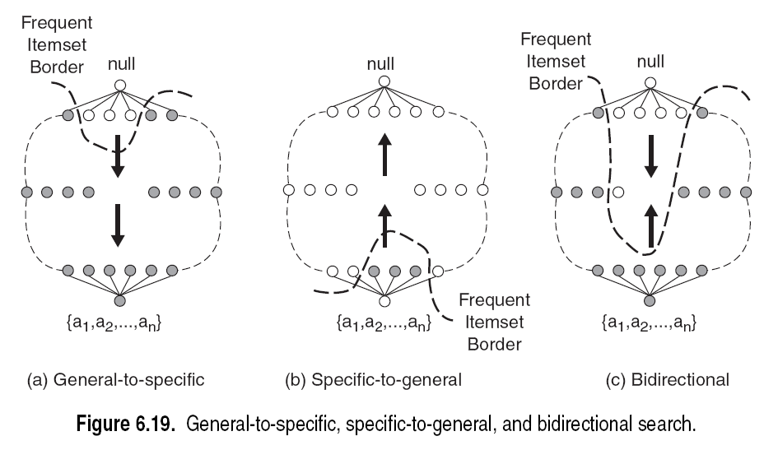
Alternative Methods for Frequent Itemset Generation
Traversal of Itemset Lattice
General-to-specific vs Specific-to-general

Slide 38
Alternative Methods for Frequent Itemset Generation
Traversal of Itemset Lattice
Equivalent Classes

Slide 39
Alternative Methods for Frequent Itemset Generation
Traversal of Itemset Lattice
Breadth-first vs Depth-first

Slide 40
Alternative Methods for Frequent Itemset Generation
Representation of Database: horizontal vs vertical data layout

Slide 41
Alternative Algorithms
FP-growth
Use a compressed representation of the database using an FP-tree
Once an FP-tree has been constructed, it uses a recursive divide-and-conquer approach to mine the frequent itemsets
ECLAT
Store transaction id-lists (vertical data layout).
Performs fast tid-list intersection (bit-wise XOR) to count itemset frequencies

Slide 42
FP-tree construction
null
After reading TID=1:
A:1
B:1
After reading TID=2:
null
A:1
B:1
B:1
C:1
D:1

Slide 43
FP-Tree Construction
Transaction Database
null
A:7
B:3
B:5
C:3
C:1
D:1
Header table
D:1
C:3
E:1
D:1
E:1
D:1
E:1
D:1
Pointers are used to assist frequent itemset generation

Slide 44
FP-growth
null
Conditional Pattern base for D: P = {(A:1,B:1,C:1), (A:1,B:1), (A:1,C:1), (A:1), (B:1,C:1)}
Recursively apply FP-growth on P
Frequent Itemsets found (with sup > 1): AD, BD, CD, ACD, BCD
A:7
B:1
B:5
C:1
C:1
D:1
C:3
D:1
D:1
D:1
D:1

Slide 45
Tree Projection
Set enumeration tree:
Possible Extension: E(A) = {B,C,D,E}
Possible Extension: E(ABC) = {D,E}

Slide 46
Tree Projection
Items are listed in lexicographic order
Each node P stores the following information:
Itemset for node P
List of possible lexicographic extensions of P: E(P)
Pointer to projected database of its ancestor node
Bitvector containing information about which transactions in the projected database contain the itemset

Slide 47
Projected Database
Projected Database for node A:
Original Database:
For each transaction T, projected transaction at node A is T ∩ E(A)

Slide 48
ECLAT
For each item, store a list of transaction ids (tids)
TID-list

Slide 49
ECLAT
Determine support of any k-itemset by intersecting tid-lists of two of its (k-1) subsets.
3 traversal approaches:
top-down, bottom-up and hybrid
Advantage: very fast support counting
Disadvantage: intermediate tid-lists may become too large for memory
∧
→

Slide 50
Topics
Definition
Mining Frequent Itemsets (APRIORI)
Concise Itemset Representation
Alternative Methods to Find Frequent Itemsets
Association Rule Generation
Support Distribution
Pattern Evaluation

Slide 51
Rule Generation
Given a frequent itemset L, find all non-empty subsets X=f ⊂ L and Y=L – f such that X → Y satisfies the minimum confidence requirement
If {A,B,C,D} is a frequent itemset, candidate rules:
ABC →D, ABD →C, ACD →B, BCD →A, A →BCD, B →ACD, C →ABD, D →ABC AB →CD, AC → BD, AD → BC, BC →AD, BD →AC, CD →AB,
If |L| = k, then there are 2^{k} – 2 candidate association rules (ignoring L → ∅ and ∅ → L)

Slide 52
Rule Generation
How to efficiently generate rules from frequent itemsets?
In general, confidence does not have an anti-monotone property
c(ABC →D) can be larger or smaller than c(AB →D)
But confidence of rules generated from the same itemset has an anti-monotone property
e.g., L = {A,B,C,D}: c(ABC → D) ≥ c(AB → CD) ≥ c(A → BCD)
Confidence is anti-monotone w.r.t. number of items on the RHS of the rule

Slide 53
Rule Generation for Apriori Algorithm

Slide 54
Rule Generation for Apriori Algorithm
Candidate rule is generated by merging two rules that share the same prefix in the rule consequent
join(CD=>AB,BD=>AC) would produce the candidate rule D => ABC
Prune rule D=>ABC if its subset AD=>BC does not have high confidence

Slide 55
Topics
Definition
Mining Frequent Itemsets (APRIORI)
Concise Itemset Representation
Alternative Methods to Find Frequent Itemsets
Association Rule Generation
Support Distribution
Pattern Evaluation

Slide 56
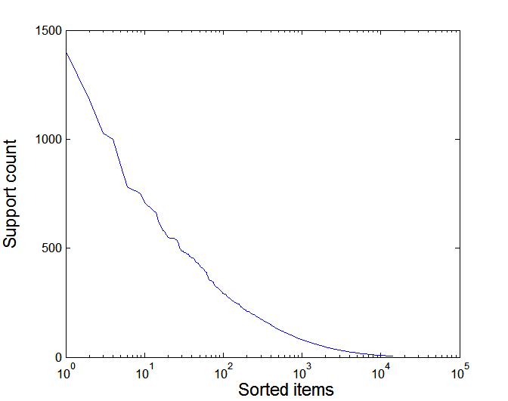
Effect of Support Distribution
Many real data sets have skewed support distribution
Support distribution of a retail data set

Slide 57
Effect of Support Distribution
How to set the appropriate minsup threshold?
If minsup is set too high, we could miss itemsets involving interesting rare items (e.g., expensive products)
If minsup is set too low, it is computationally expensive and the number of itemsets is very large
Using a single minimum support threshold may not be effective

Slide 58
Multiple Minimum Support
How to apply multiple minimum supports?
MS(i): minimum support for item i
e.g.: MS(Milk)=5%, MS(Coke) = 3%, MS(Broccoli)=0.1%, MS(Salmon)=0.5%
MS({Milk, Broccoli}) = min (MS(Milk), MS(Broccoli)) = 0.1%
Challenge: Support is no longer anti-monotone
Suppose: Support(Milk, Coke) = 1.5% and Support(Milk, Coke, Broccoli) = 0.5%
{Milk,Coke} is infrequent but {Milk,Coke,Broccoli} is frequent

Slide 59
Multiple Minimum Support

Slide 60
Multiple Minimum Support

Slide 61
Multiple Minimum Support (Liu 1999)
Order the items according to their minimum support (in ascending order)
e.g.: MS(Milk)=5%, MS(Coke) = 3%, MS(Broccoli)=0.1%, MS(Salmon)=0.5%
Ordering: Broccoli, Salmon, Coke, Milk
Need to modify Apriori such that:
L₁ : set of frequent items
F₁ : set of items whose support is ≥ MS(1) where MS(1) is min_{i}( MS(i) )
C₂ : candidate itemsets of size 2 is generated from F₁ instead of L₁

Slide 62
Multiple Minimum Support (Liu 1999)
Modifications to Apriori:
In traditional Apriori,
A candidate (k+1)-itemset is generated by merging two frequent itemsets of size k
The candidate is pruned if it contains any infrequent subsets of size k
Pruning step has to be modified:
Prune only if subset contains the first item
e.g.: Candidate={Broccoli, Coke, Milk} (ordered according to minimum support)
{Broccoli, Coke} and {Broccoli, Milk} are frequent but {Coke, Milk} is infrequent
Candidate is not pruned because {Coke,Milk} does not contain the first item, i.e., Broccoli.

Slide 63
Topics
Definition
Mining Frequent Itemsets (APRIORI)
Concise Itemset Representation
Alternative Methods to Find Frequent Itemsets
Association Rule Generation
Support Distribution
Pattern Evaluation

Slide 64
Pattern Evaluation
Association rule algorithms tend to produce too many rules. Many of them are
uninteresting or
redundant
Interestingness measures can be used to prune/rank the derived patterns
A rule {A,B,C} → {D} can be considered redundant if {A,B} → {D} has the same or higher confidence.

Slide 65
Application of Interestingness Measure
Interestingness Measures

Slide 66
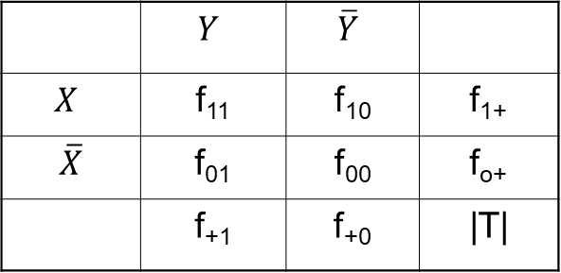
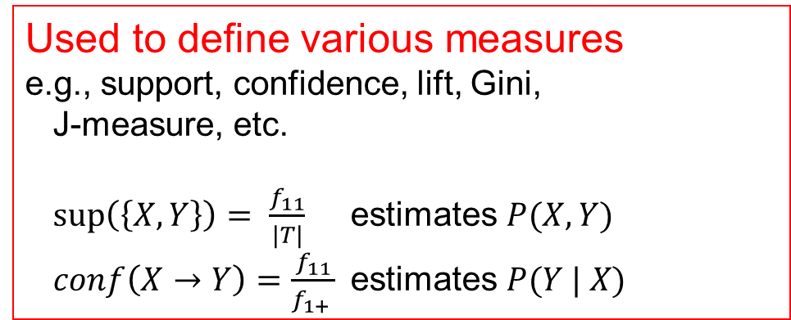
Computing Interestingness Measure
Given a rule X → Y, information needed to compute rule interestingness can be obtained from a contingency table
error
Contingency table for X → Y
 | $$Y$$ | $$\overline{Y}$$
$$X$$ | f₁₁ | f₁₀ | f₁₊
$\overline{X}$ | f₀₁ | f₀₀ | f_{o+}
 | f₊₁ | f₊₀ | |T|
f₁₁: support of X and Y f₁₀: support of X and not Y f₀₁: support of not X and Y f₀₀: support of not X and not Y
Used to define various measures e.g., support, confidence, lift, Gini, J-measure, etc.
$\sup\left(\left\{X, Y\right\}\right)= \frac{f_{11}}{|T|}$ estimates $P(X, Y)$
$conf\left(X→Y\right)=\frac{f_{11}}{f_{1+} }$estimates $P(Y | X)$

Slide 67
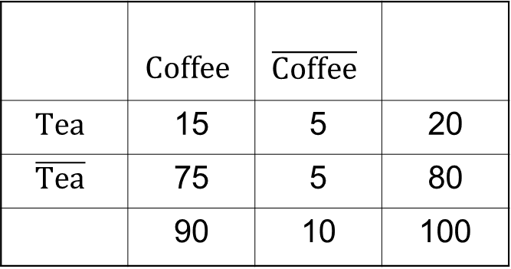
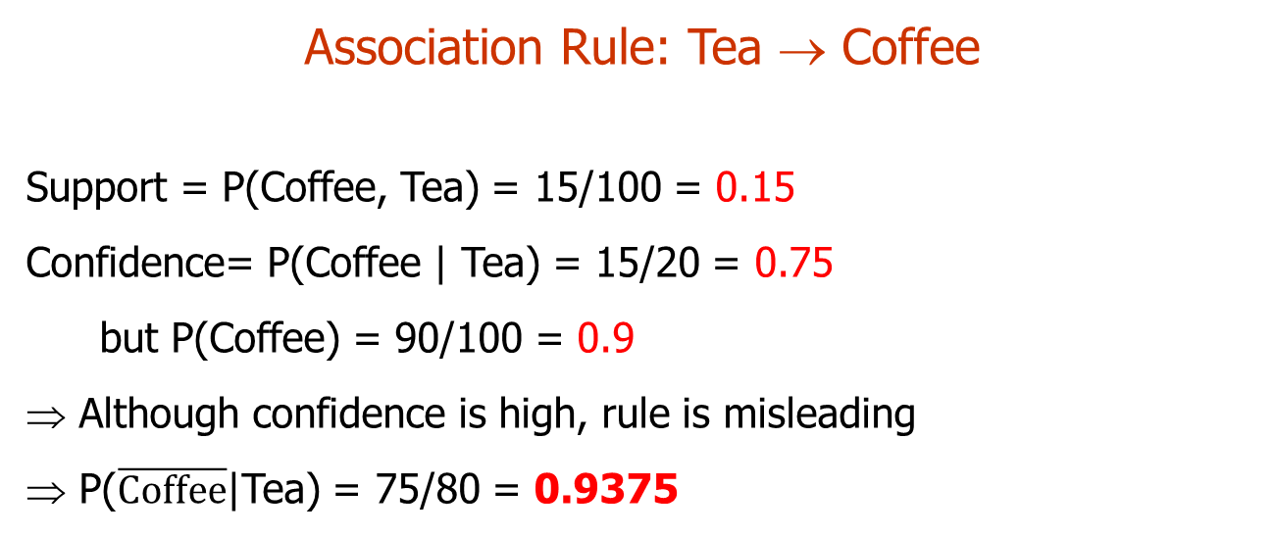
Drawback of Confidence
 | $$\text{Coffee}$$ | $$\overline{\text{Coffee}}$$
$$\text{Tea}$$ | 15 | 5 | 20
$$\overline{\text{Tea}}$$ | 75 | 5 | 80
 | 90 | 10 | 100
Association Rule: Tea → Coffee
Support = P(Coffee, Tea) = 15/100 = 0.15
Confidence= P(Coffee | Tea) = 15/20 = 0.75
but P(Coffee) = 90/100 = 0.9
Although confidence is high, rule is misleading
P($\overline{\text{Coffee}}$|Tea) = 75/80 = 0.9375

Slide 68
Statistical Independence
Population of 1000 students
600 students know how to swim (S)
700 students know how to bike (B)
450 students know how to swim and bike (S,B)
P(S,B) = 450/1000 = 0.45 (observed joint prob.)
P(S) × P(B) = 0.6 × 0.7 = 0.42 (expected under indep.)
P(S,B) = P(S) × P(B) => Statistical independence
P(S,B) > P(S) × P(B) => Positively correlated
P(S,B) < P(S) × P(B) => Negatively correlated

Slide 69

Statistical-based Measures
Measures that take statistical dependence into account for rule:
X → Y
$$Lift=Interest= \frac{P(Y|X)}{P(Y)}=\frac{P(X,Y)}{P\left(X\right)P(Y)}$$
$$PS=P\left(X,Y\right)−P\left(X\right)P\left(Y\right)$$
$$Φ= \frac{P\left(X,Y\right)−P\left(X\right)P(Y)}{\sqrt{P\left(X\right)\left[1−P\left(X\right)\right]P\left(Y\right)[1−P\left(Y\right)]}}$$
Deviation from independence
Correlation

Slide 70
Example: Lift/Interest
 | $$\text{Coffee}$$ | $$\overline{\text{Coffee}}$$
$$\text{Tea}$$ | 15 | 5 | 20
$$\overline{\text{Tea}}$$ | 75 | 5 | 80
 | 90 | 10 | 100
Association Rule: Tea → Coffee
Conf(Tea → Coffee)= P(Coffee|Tea) = P(Coffee,Tea)/P(Tea) = .15/.2 = 0.75
but P(Coffee) = 0.9
Lift(Tea → Coffee) = P(Coffee,Tee)/(P(Coffee)P(Tee)) = .15/(.9 x .2) = 0.8333 Note: Lift < 1, therefore Coffee and Tea are negatively associated

Slide 71
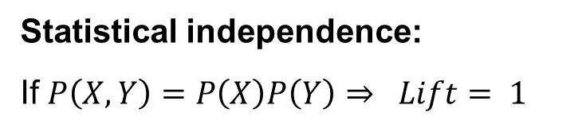
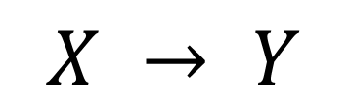
Drawback of Lift/Interest
$$X → Y$$
 | Y | Y
X | 10 | 0 | 10
X | 0 | 90 | 90
 | 10 | 90 | 100
 | Y | Y
X | 90 | 0 | 90
X | 0 | 10 | 10
 | 90 | 10 | 100
Statistical independence:
If $P\left(X,Y\right)=P\left(X\right)P\left(Y\right)⇒ Lift= 1$
It is more likely that this
happens by chance!

Slide 72
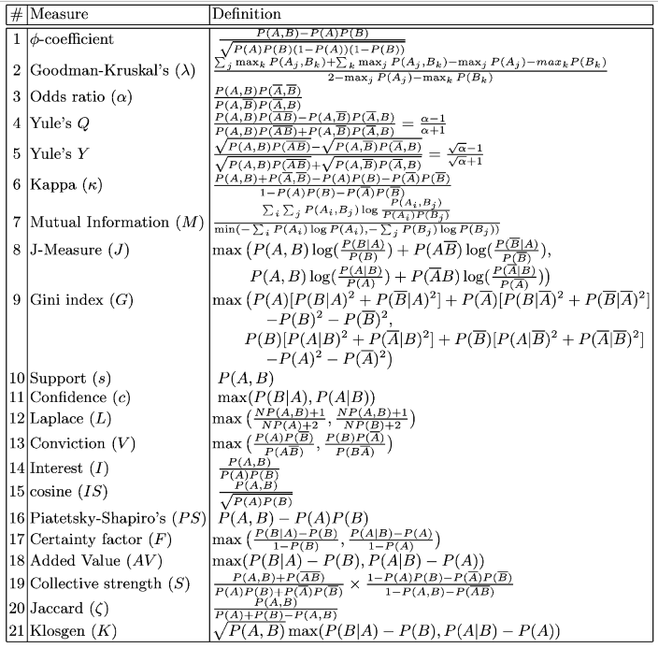
Many measures have been proposed in the literature
Some measures are good for certain applications, but not for others
What criteria should we use to determine whether a measure is good or bad?
What about Apriori-style support-based pruning? How does it affect these measures?
Source: The list is from Pang-Ning Tan, Vipin Kumar, and Jaideep Srivastava. Selecting the right objective measure for association analysis. Information Systems, 29(4):293--313, 2004.
A larger list of measures is available at: A Probabilistic Comparison of Commonly Used Interest Measures for Association Rules

Slide 73
Properties of A Good Measure
Example: Lift
Piatetsky-Shapiro: 3 properties a good measure M must satisfy:
M(A,B) = 0 if A and B are statistically independent
M(A,B) increase monotonically with P(A,B) when P(A) and P(B) remain unchanged
M(A,B) decreases monotonically with P(A) [or P(B)] when P(A,B) and P(B) [or P(A)] remain unchanged
No
Yes
Yes

Slide 74
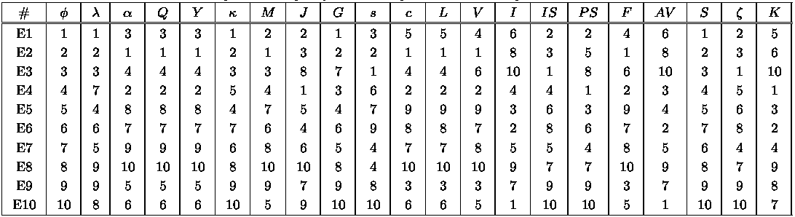
Comparing Different Measures
10 examples of contingency tables:
Rankings of contingency tables using various measures:
support & confidence
lift

Slide 75
Property under Variable Permutation
Does M(A,B) = M(B,A)?
Symmetric measures:
support, lift, collective strength, cosine, Jaccard, etc
Asymmetric measures:
confidence, conviction, Laplace, J-measure, etc

Slide 76
Property under Row/Column Scaling
Grade-Gender Example (Mosteller, 1968):
 | Male | Female
High | 2 | 3 | 5
Low | 1 | 4 | 5
 | 3 | 7 | 10
 | Male | Female
High | 4 | 30 | 34
Low | 2 | 40 | 42
 | 6 | 70 | 76
2x
10x
Mosteller: Underlying association should be independent of the relative number of male and female students in the samples

Slide 77
Property under Inversion Operation
Transaction 1
.
.
.
.
.
Transaction N

Slide 78
Example: φ-Coefficient
φ-coefficient is analogous to correlation coefficient for continuous variables
 | Y | Y
X | 60 | 10 | 70
X | 10 | 20 | 30
 | 70 | 30 | 100
 | Y | Y
X | 20 | 10 | 30
X | 10 | 60 | 70
 | 30 | 70 | 100
φ Coefficient is the same for both tables

Slide 79
Property under Null Addition
Invariant measures:
support, cosine, Jaccard, etc
Non-invariant measures:
correlation, Gini, mutual information, odds ratio, etc

Slide 80
Different Measures have Different Properties

Slide 81
Support-based Pruning
Most of the association rule mining algorithms use support measure to prune rules and itemsets
Study effect of support pruning on correlation of itemsets
Generate 10,000 random contingency tables
Compute support and pairwise correlation for each table
Apply support-based pruning and examine the tables that are removed

Slide 82
Effect of Support-based Pruning

Slide 83
Effect of Support-based Pruning
Support-based pruning eliminates mostly negatively correlated itemsets

Slide 84
Effect of Support-based Pruning
Investigate how support-based pruning affects other measures
Steps:
Generate 10,000 contingency tables
Rank each table according to the different measures
Compute the pair-wise correlation between the measures

Slide 85
Effect of Support-based Pruning
Without Support Pruning (All Pairs)
Scatter Plot between Correlation & Jaccard Measure
Red cells indicate correlation between the pair of measures > 0.85
40.14% pairs have correlation > 0.85

Slide 86
Effect of Support-based Pruning
0.5% ≤ support ≤ 50%
Scatter Plot between Correlation & Jaccard Measure:
61.45% pairs have correlation > 0.85

Slide 87
Effect of Support-based Pruning
0.5% ≤ support ≤ 30%
Scatter Plot between Correlation & Jaccard Measure
76.42% pairs have correlation > 0.85

Slide 88
Subjective Interestingness Measure
Objective measure:
Rank patterns based on statistics computed from data
e.g., 21 measures of association (support, confidence, Laplace, Gini, mutual information, Jaccard, etc).
Subjective measure:
Rank patterns according to user’s interpretation
A pattern is subjectively interesting if it contradicts the expectation of a user (Silberschatz & Tuzhilin)
A pattern is subjectively interesting if it is actionable (Silberschatz & Tuzhilin)

Slide 89
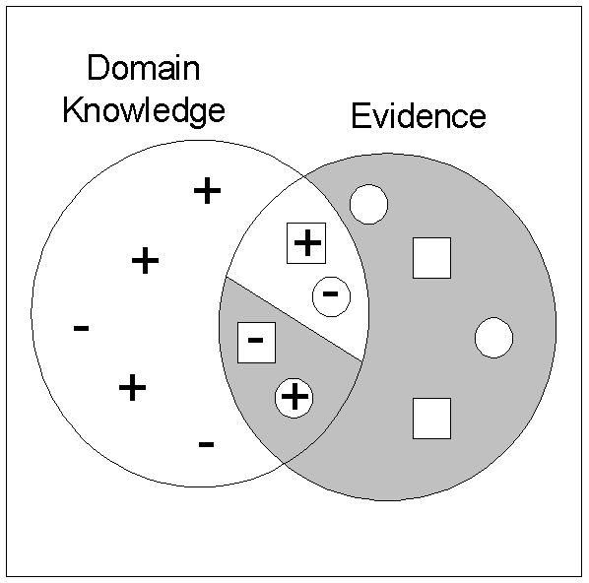
Interestingness via Unexpectedness
Need to model expectation of users (domain knowledge)
Need to combine expectation of users with evidence from data (i.e., extracted patterns)
+
Pattern expected to be frequent
-
Pattern expected to be infrequent
Pattern found to be frequent
Pattern found to be infrequent
+
-
Expected Patterns
-
+
Unexpected Patterns

Slide 90
Interestingness via Unexpectedness
Web Data (Cooley et al 2001)
Domain knowledge in the form of site structure
Given an itemset F = {X₁, X₂, …, X_{k}} (X_{i} : Web pages)
L: number of links connecting the pages
lfactor = L / (k × k-1)
cfactor = 1 (if graph is connected), 0 (disconnected graph)
Structure evidence = cfactor × lfactor
Usage evidence
Use Dempster-Shafer theory to combine domain knowledge and evidence from data

Slide 91

Conclusion
Association rule mining has many applications where data can be seen as large transaction data sets.
Market Basket Analysis Marketing & Retail. E.g., frequent itemsets give information about "other customer who bought this item also bought X"
Exploratory Data Analysis Find correlation in very large (= many transactions), high-dimensional (= many items) data
Intrusion Detection Rules with low support but very high lift
Build Rule-based Classifiers Class association rules (CARs)

