Slide 1

Introduction to Data Mining Chapter 5 Association Analysis – Basic Concepts and Algorithms
by Michael Hahsler
Based in Slides by Tan, Steinbach, Karpatne, Kumar

Slide 2


R Code Examples
Available R Code examples are indicated on slides by the R logo
The Examples are available at https://mhahsler.github.io/Introduction_to_Data_Mining_R_Examples/

Slide 3
Topics
Definition
Mining Frequent Itemsets (APRIORI)
Concise Itemset Representation
Alternative Methods to Find Frequent Itemsets
Association Rule Generation
Support Distribution
Pattern Evaluation

Slide 4
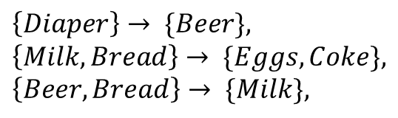
Association Rule Mining
Given a set of transactions, find rules that will predict the occurrence of an item based on the occurrences of other items in the transaction.
Market-Basket transactions
Example of Association Rules
TID | Items
1 | Bread, Milk
2 | Bread, Diaper, Beer, Eggs
3 | Milk, Diaper, Beer, Coke
4 | Bread, Milk, Diaper, Beer
5 | Bread, Milk, Diaper, Coke
$$\left\{Diaper\right\}→ \{Beer\}, \\ \left\{Milk, Bread\right\}→ \{Eggs,Coke\}, \\ \left\{Beer, Bread\right\}→ \{Milk\},$$
Meaning: A customer who buys Diapers is also very likely to buy Beer.
TID | Bread | Beer | Eggs | …
1 | 1 | 0 | 0 | …
2 | 1 | 1 | 1 | …
3 | 0 | 1 | 0 | …
4 | 0 | 1 | 0 | …
5 | 1 | 0 | 0 | …
Representation of transactions as a large, sparse 0-1 matrix. Columns (variables) are the items. Sparse means most entries are 0.

Slide 5
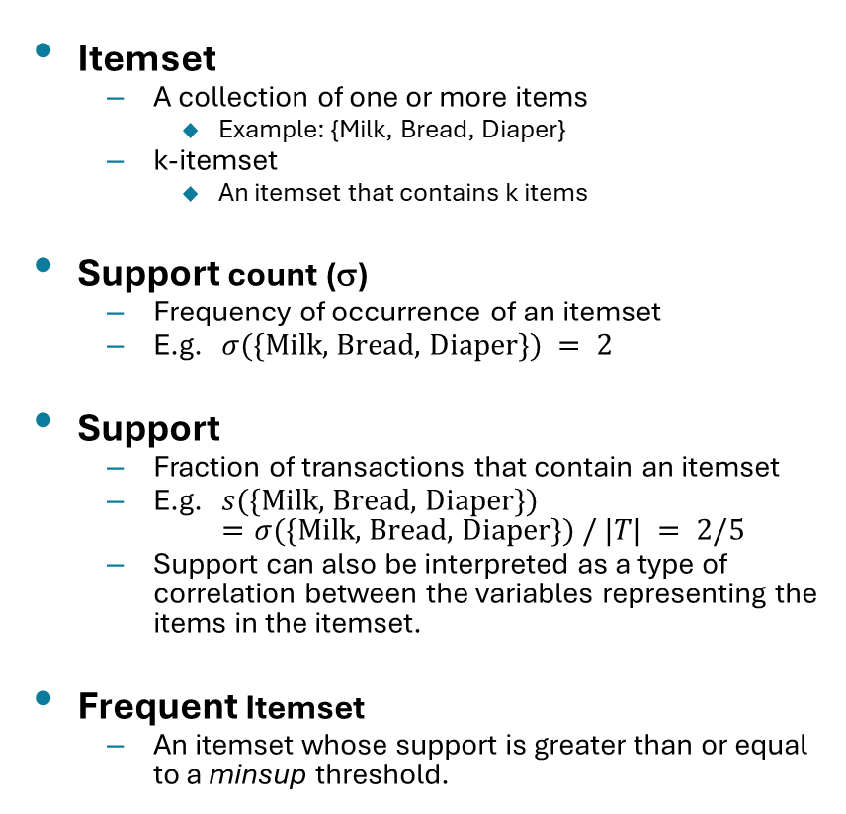

Definition: Frequent Itemset
Itemset
A collection of one or more items
Example: {Milk, Bread, Diaper}
k-itemset
An itemset that contains k items
Support count (σ)
Frequency of occurrence of an itemset
E.g. $σ(\{\text{Milk}\text{, }\text{Bread}\text{, }\text{Diaper}\}) = 2$
Support
Fraction of transactions that contain an itemset
E.g. $s(\{\text{Milk}\text{, }\text{Bread}\text{, }\text{Diaper}\})$ $=σ(\{\text{Milk}\text{, }\text{Bread}\text{, }\text{Diaper}\}) / |T| = 2/5$
Support can also be interpreted as a type of correlation between the variables representing the items in the itemset.
Frequent Itemset
An itemset whose support is greater than or equal to a minsup threshold.
TID | Items
1 | Bread, Milk
2 | Bread, Diaper, Beer, Eggs
3 | Milk, Diaper, Beer, Coke
4 | Bread, Milk, Diaper, Beer
5 | Bread, Milk, Diaper, Coke
$$s\left(X\right)=\frac{σ(X)}{|T|}$$

Slide 6
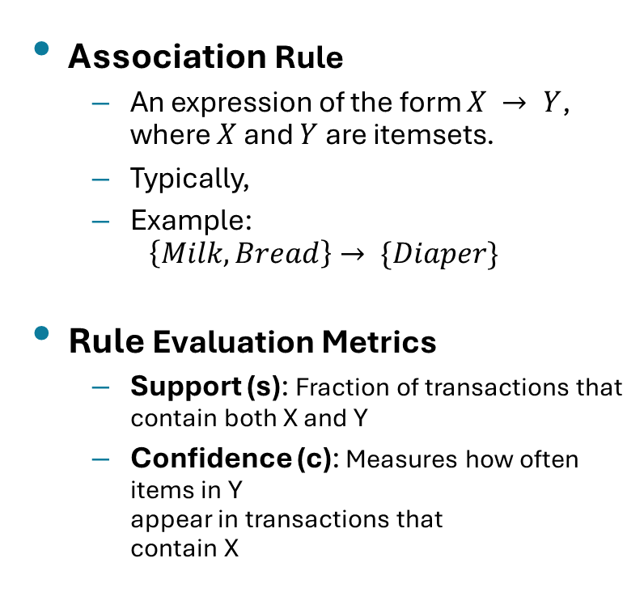
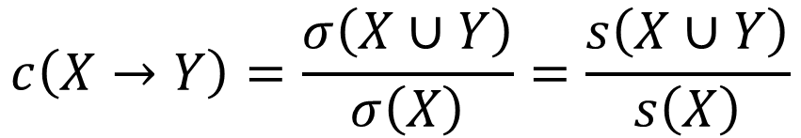

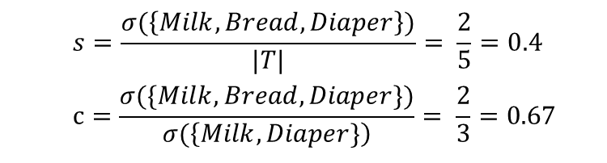
Definition: Association Rule
Association Rule
An expression of the form $X → Y$, where $X$ and $Y$ are itemsets.
Typically,
Example: $\left\{Milk, Bread\right\}→ \{Diaper\}$
Rule Evaluation Metrics
Support (s): Fraction of transactions that contain both X and Y
Confidence (c): Measures how often items in Y appear in transactions that contain X
TID | Items
1 | Bread, Milk
2 | Bread, Diaper, Beer, Eggs
3 | Milk, Diaper, Beer, Coke
4 | Bread, Milk, Diaper, Beer
5 | Bread, Milk, Diaper, Coke
Example:
$$\left\{Milk, Bread\right\}→ \left\{Diaper\right\}$$
$$s=\frac{σ(\left\{Milk, Bread, Diaper\right\})}{|T|}= \frac{2}{5}=0.4$$
$$c=\frac{σ(\{Milk, Bread, Diaper\})}{σ(\left\{Milk, Diaper\}\right)}= \frac{2}{3}=0.67$$
$$c\left(X→Y\right)=\frac{σ\left(X∪Y\right)}{σ\left(X\right)}=\frac{s\left(X∪Y\right)}{s\left(X\right)}$$

Slide 7
Topics
Definition
Mining Frequent Itemsets (APRIORI)
Concise Itemset Representation
Alternative Methods to Find Frequent Itemsets
Association Rule Generation
Support Distribution
Pattern Evaluation

Slide 8
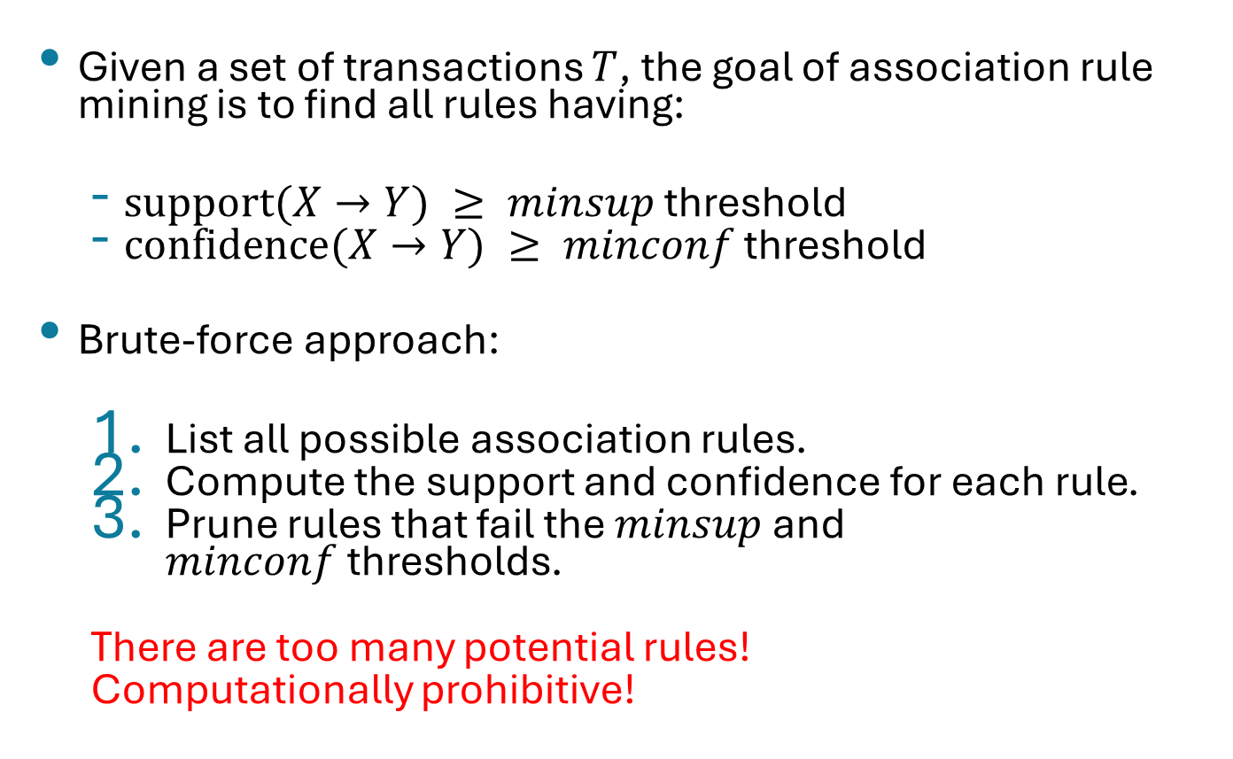
Association Rule Mining Task
Given a set of transactions $T$, the goal of association rule mining is to find all rules having:
$\text{support}(X→Y) ≥ minsup$threshold
$\text{confidence}(X→Y) ≥ minconf$threshold
Brute-force approach:
List all possible association rules.
Compute the support and confidence for each rule.
Prune rules that fail the $minsup$ and $minconf$thresholds.
There are too many potential rules!
Computationally prohibitive!

Slide 9
Mining Association Rules
Example of Rules:
{Milk,Diaper} → {Beer} (s=0.4, c=0.67) {Milk,Beer} → {Diaper} (s=0.4, c=1.0)
{Diaper,Beer} → {Milk} (s=0.4, c=0.67)
{Beer} → {Milk,Diaper} (s=0.4, c=0.67) {Diaper} → {Milk,Beer} (s=0.4, c=0.5)
{Milk} → {Diaper,Beer} (s=0.4, c=0.5)
TID | Items
1 | Bread, Milk
2 | Bread, Diaper, Beer, Eggs
3 | Milk, Diaper, Beer, Coke
4 | Bread, Milk, Diaper, Beer
5 | Bread, Milk, Diaper, Coke
Observations:
All the above rules are binary partitions of the same itemset: {Milk, Diaper, Beer}
Rules originating from the same itemset have identical support but can have different confidence.
Thus, we may decouple the support and confidence requirements.

Slide 10
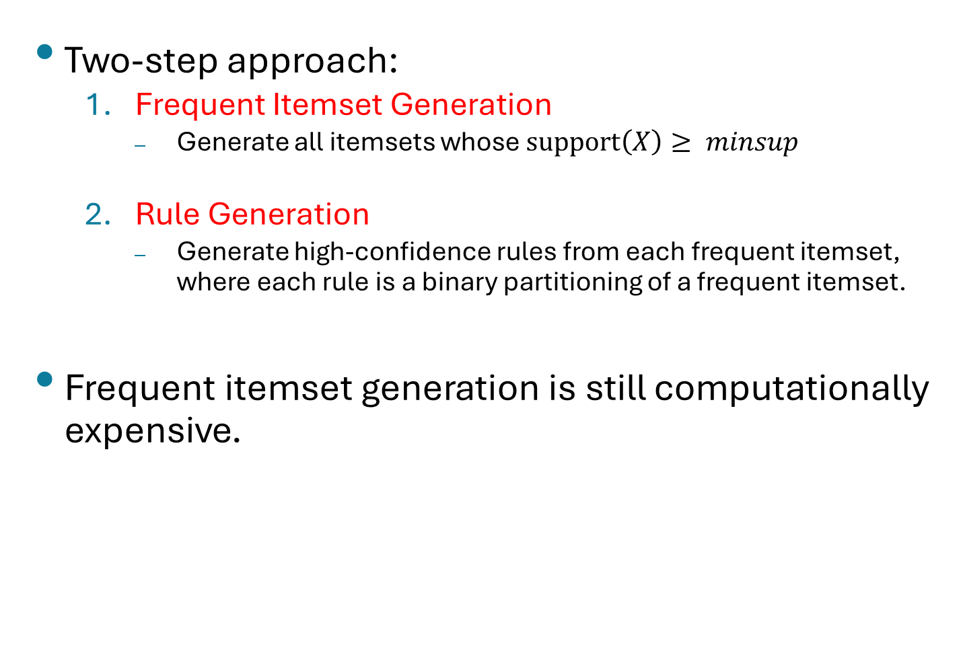
Mining Association Rules
Two-step approach:
Frequent Itemset Generation
Generate all itemsets whose $\text{support}\left(X\right)≥ minsup$
Rule Generation
Generate high-confidence rules from each frequent itemset, where each rule is a binary partitioning of a frequent itemset.
Frequent itemset generation is still computationally expensive.

Slide 11
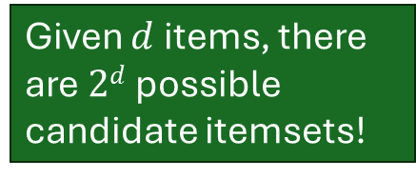
Frequent Itemset Generation
Given $d$ items, there are $2d$ possible candidate itemsets!

Slide 12
Reducing Number of Candidates
The Apriori Principle:
If an itemset is frequent, then all of its subsets must also be frequent.
The apriori principle holds due to the following property of the support measure:
Support of an itemset can never exceed the support of its subsets.
This is also known as the anti-monotone property of support.
$$∀ X,Y :\left(X⊆Y\right)⇒s\left(X\right)≥s(Y)$$

Slide 13
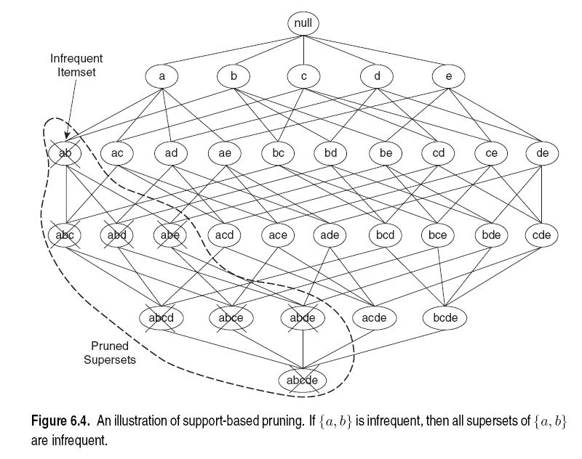
Illustrating the Apriori Principle

Slide 14
Illustrating the Apriori Principle
Items (1-itemsets)
Pairs (2-itemsets)
(No need to generate candidates involving Coke or Eggs)
Minimum Support = 3
Triplets (3-itemsets)
If every subset is considered,
⁶C₁ + ⁶C₂ + ⁶C₃ = 41
With support-based pruning,
6 + 6 + 1 = 13

Slide 15
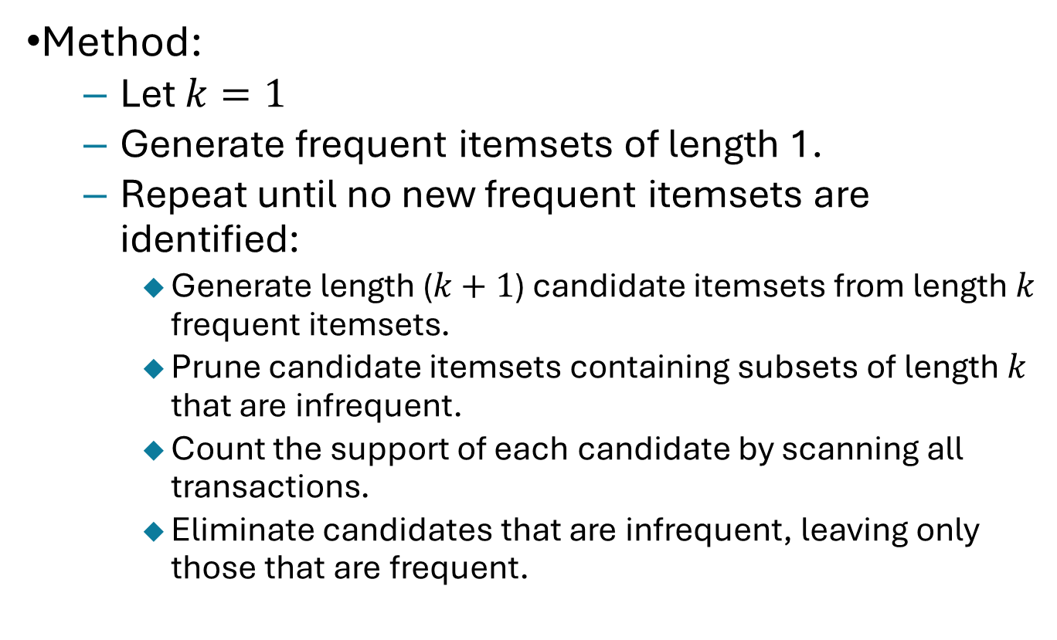
Apriori Algorithm
Method:
Let $k=1$
Generate frequent itemsets of length 1.
Repeat until no new frequent itemsets are identified:
Generate length ($k+1$) candidate itemsets from length $k$ frequent itemsets.
Prune candidate itemsets containing subsets of length $k$ that are infrequent.
Count the support of each candidate by scanning all transactions.
Eliminate candidates that are infrequent, leaving only those that are frequent.

Slide 16
Factors Affecting Complexity
Choice of minimum support threshold
Lowering the support threshold results in more frequent itemsets.
This may increase number of candidates and max. length of frequent itemsets.
Dimensionality (number of items) of the data set
More space is needed to store support count of each item.
If the number of frequent items also increases, both computation and I/O costs may also increase.
Size of database
Since the Apriori algorithm makes multiple passes, run time of algorithm may increase with number of transactions.
Number of items per transaction
Transaction width increases with denser data sets.
This may increase max. length of frequent itemsets and thus run time.

Slide 17
Topics
Definition
Mining Frequent Itemsets (APRIORI)
Concise Itemset Representation
Alternative Methods to Find Frequent Itemsets
Association Rule Generation
Support Distribution
Pattern Evaluation

Slide 18
Maximal Frequent Itemset
An itemset is maximal frequent if none of its immediate supersets is frequent

Slide 19
Closed Itemset
An itemset is closed if none of its immediate supersets has the same support as the itemset (can only have smaller support -> see APRIORI principle)

Slide 20
Maximal vs. Closed Itemsets
Transaction Ids
Not supported by any transactions

Slide 21
Maximal vs Closed Frequent Itemsets
Minimum support = 2
Closed but not maximal
Closed and maximal
# Closed = 9
# Maximal = 4

Slide 22
Maximal vs Closed Itemsets

Slide 23
Topics
Definition
Mining Frequent Itemsets (APRIORI)
Concise Itemset Representation
Alternative Methods to Find Frequent Itemsets
Association Rule Generation
Support Distribution
Pattern Evaluation

Slide 24
Alternative Methods for Frequent Itemset Generation
Traversal of Itemset Lattice
Equivalent Classes

Slide 25
Alternative Methods for Frequent Itemset Generation
Representation of Database: horizontal vs vertical data layout

Slide 26
Alternative Algorithms
FP-growth
Use a compressed representation of the database using an FP-tree
Once an FP-tree has been constructed, it uses a recursive divide-and-conquer approach to mine the frequent itemsets
ECLAT
Store transaction id-lists (vertical data layout).
Performs fast tid-list intersection (bit-wise XOR) to count itemset frequencies

Slide 27
Topics
Definition
Mining Frequent Itemsets (APRIORI)
Concise Itemset Representation
Alternative Methods to Find Frequent Itemsets
Association Rule Generation
Support Distribution
Pattern Evaluation

Slide 28
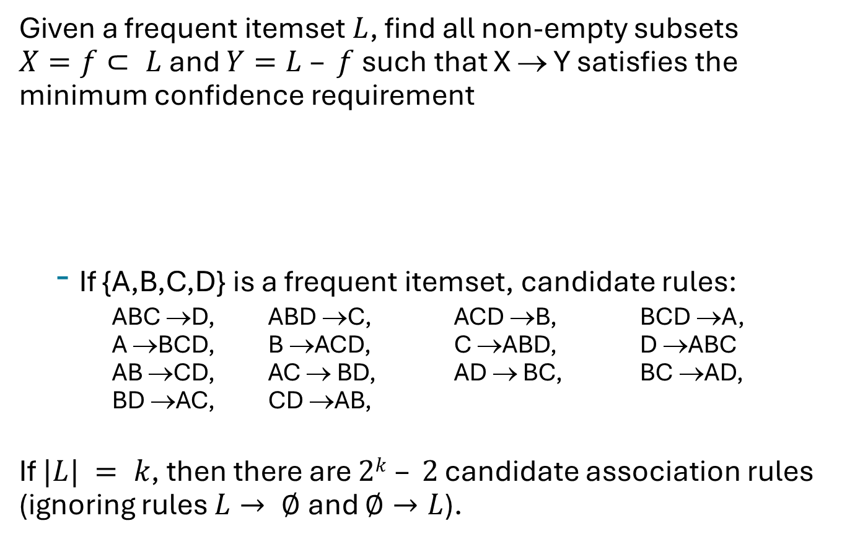
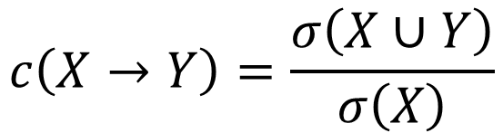
Rule Generation
Given a frequent itemset $L$, find all non-empty subsets $X=f⊂ L$and $Y=L – f$such that X → Y satisfies the minimum confidence requirement
If {A,B,C,D} is a frequent itemset, candidate rules:
ABC →D, ABD →C, ACD →B, BCD →A, A →BCD, B →ACD, C →ABD, D →ABC AB →CD, AC → BD, AD → BC, BC →AD, BD →AC, CD →AB,
If $|L| = k$, then there are $2k – 2$ candidate association rules (ignoring rules $L→ ∅$and $∅→L$).
$$c\left(X→Y\right)=\frac{σ\left(X∪Y\right)}{σ\left(X\right)}$$

Slide 29
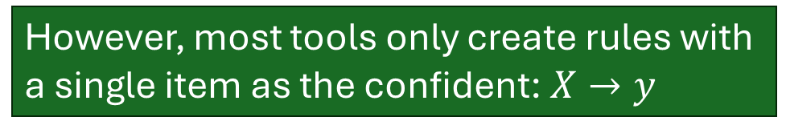
Rule Generation
How do we efficiently generate rules from frequent itemsets?
In general, confidence does not have an anti-monotone property
c(ABC →D) can be larger or smaller than c(AB →D)
But confidence of rules generated from the same itemset has an anti-monotone property
e.g., L = {A,B,C,D}: c(ABC → D) ≥ c(AB → CD) ≥ c(A → BCD)
Confidence is anti-monotone w.r.t. number of items on the RHS of the rule.
However, most tools only create rules with a single item as the confident: $X→y$

Slide 30
Topics
Definition
Mining Frequent Itemsets (APRIORI)
Concise Itemset Representation
Alternative Methods to Find Frequent Itemsets
Association Rule Generation
Support Distribution
Pattern Evaluation

Slide 31
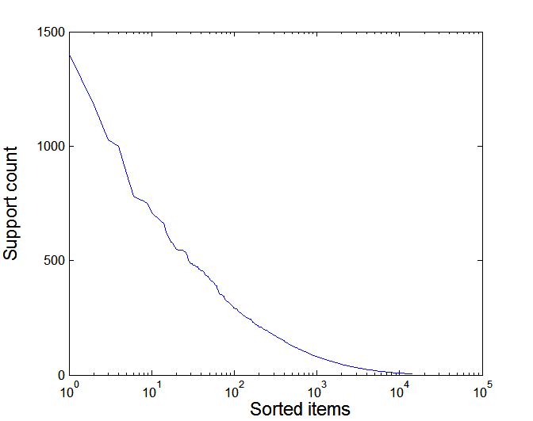
Effect of Support Distribution
Many real data sets have skewed support distribution.
Example: Support distribution of a retail data set

Slide 32
Effect of Support Distribution
How do we set the appropriate minsup threshold?
If minsup is set too high, we could miss itemsets involving interesting rare items (e.g., expensive products).
If minsup is set too low, it is computationally expensive and the number of itemsets is very large.
Note: Using a single minimum support threshold may not be effective. Algorithms with multiple support thresholds exist.

Slide 33
Topics
Definition
Mining Frequent Itemsets (APRIORI)
Concise Itemset Representation
Alternative Methods to Find Frequent Itemsets
Association Rule Generation
Support Distribution
Pattern Evaluation

Slide 34
Pattern Evaluation
Association rule algorithms tend to produce too many rules. Many of them are
Uninteresting, or
Redundant.
Interestingness measures can be used to prune/rank the derived patterns.
A rule {A,B,C} → {D} can be considered redundant if the more general rule {A,B} → {D} has the same or higher confidence.

Slide 35
Application of Interestingness Measure
Interestingness Measures

Slide 36
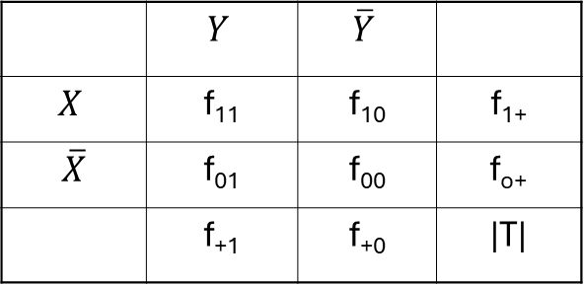
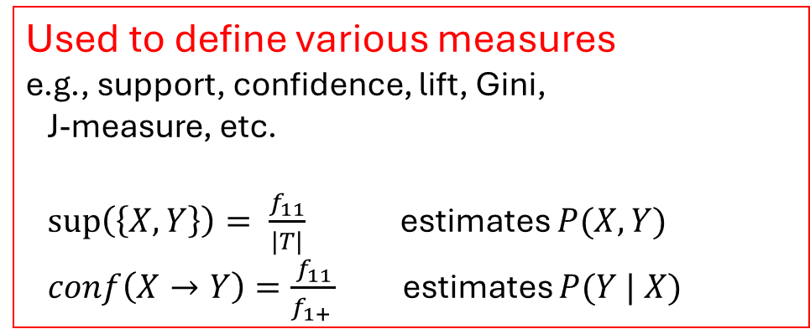
Computing Interestingness Measure
Given a rule X → Y, information needed to compute rule interestingness can be obtained from a contingency table (a count table).
error
Contingency table for X → Y
 | $$Y$$ | $$\overline{Y}$$
$$X$$ | f₁₁ | f₁₀ | f₁₊
$\overline{X}$ | f₀₁ | f₀₀ | f_{o+}
 | f₊₁ | f₊₀ | |T|
f₁₁: support count of X and Y f₁₀: support count of X and not Y f₀₁: support count of not X and Y f₀₀: support count of not X and not Y
Used to define various measures e.g., support, confidence, lift, Gini, J-measure, etc.
$\sup\left(\left\{X, Y\right\}\right)= \frac{f_{11}}{|T|}$ estimates $P(X, Y)$
$conf\left(X→Y\right)=\frac{f_{11}}{f_{1+} }$ estimates $P(Y | X)$

Slide 37
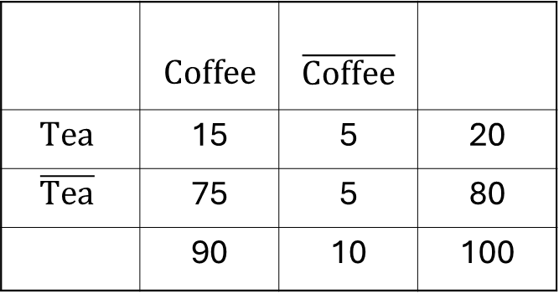
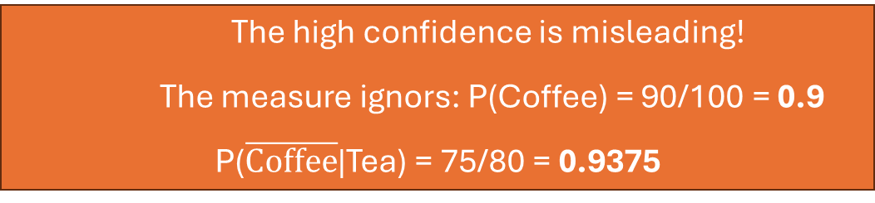
Drawback of Confidence
 | $$\text{Coffee}$$ | $$\overline{\text{Coffee}}$$
$$\text{Tea}$$ | 15 | 5 | 20
$$\overline{\text{Tea}}$$ | 75 | 5 | 80
 | 90 | 10 | 100
Association Rule: Tea → Coffee
Support = P(Coffee, Tea) = 15/100 = 0.15
Confidence= P(Coffee | Tea) = 15/20 = 0.75
The high confidence is misleading!
The measure ignors: P(Coffee) = 90/100 = 0.9
P($\overline{\text{Coffee}}$|Tea) = 75/80 = 0.9375

Slide 38
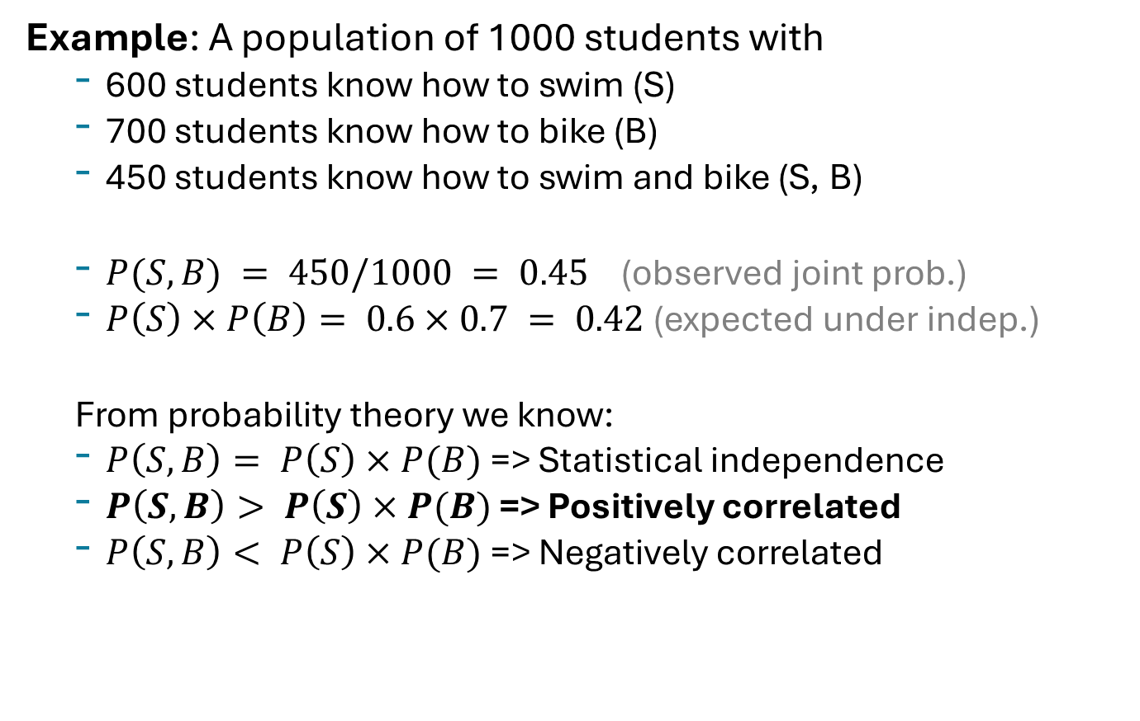
Statistical Independence
Example: A population of 1000 students with
600 students know how to swim (S)
700 students know how to bike (B)
450 students know how to swim and bike (S, B)
$P(S, B) = 450/1000 = 0.45$ (observed joint prob.)
$P\left(S\right)×P\left(B\right)= 0.6×0.7 = 0.42$(expected under indep.)
From probability theory we know:
$P\left(S,B\right)= P\left(S\right)×P(B)$=> Statistical independence
$P\left(S,B\right)> P\left(S\right)×P(B)$=> Positively correlated
$P\left(S,B\right)< P\left(S\right)×P(B)$=> Negatively correlated

Slide 39

Statistical-based Measures
Measures that take statistical dependence into account for rule:
X → Y
$$Lift=Interest= \frac{P(Y|X)}{P(Y)}=\frac{P(X,Y)}{P\left(X\right)P(Y)}$$
$$PS=P\left(X,Y\right)−P\left(X\right)P\left(Y\right)$$
$$Φ= \frac{P\left(X,Y\right)−P\left(X\right)P(Y)}{\sqrt{P\left(X\right)\left[1−P\left(X\right)\right]P\left(Y\right)[1−P\left(Y\right)]}}$$
Deviation from independence
Phi correlation (= correlation between 0-1 vectors)

Slide 40
Example: Lift/Interest
 | $$\text{Coffee}$$ | $$\overline{\text{Coffee}}$$
$$\text{Tea}$$ | 15 | 5 | 20
$$\overline{\text{Tea}}$$ | 75 | 5 | 80
 | 90 | 10 | 100
Association Rule: Tea → Coffee
Conf(Tea → Coffee)= P(Coffee|Tea) = P(Coffee,Tea)/P(Tea) = .15/.2 = 0.75
but P(Coffee) = 0.9
Lift(Tea → Coffee) = P(Coffee,Tee)/(P(Coffee)P(Tee)) = .15/(.9 x .2) = 0.8333 Note: Lift < 1, therefore Coffee and Tea are negatively associated

Slide 41
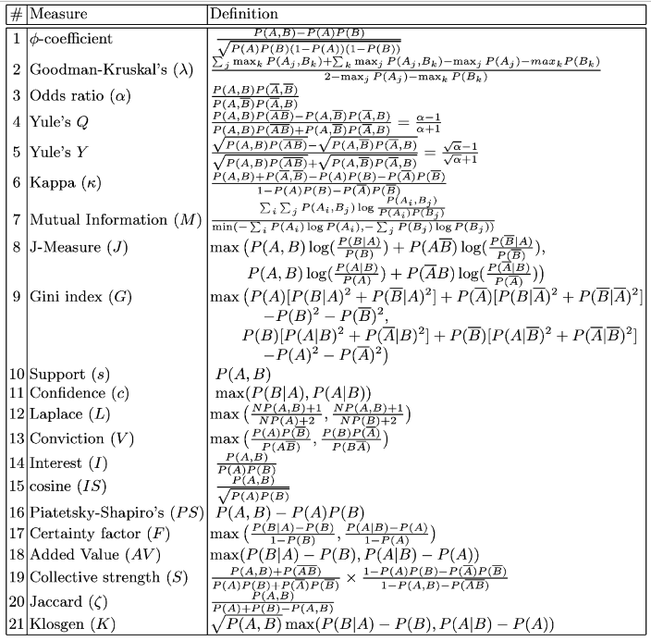
Many measures have been proposed in the literature
Some measures are good for certain applications, but not for others
What criteria should we use to determine whether a measure is good or bad?
What about Apriori-style support-based pruning? How does it affect these measures?
Source: The list is from Pang-Ning Tan, Vipin Kumar, and Jaideep Srivastava. Selecting the right objective measure for association analysis. Information Systems, 29(4):293--313, 2004.
A larger list of measures is available at: A Probabilistic Comparison of Commonly Used Interest Measures for Association Rules

Slide 42
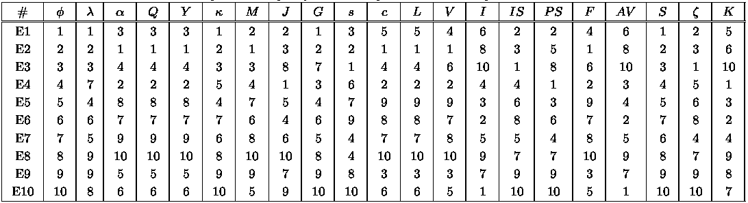
Comparing Different Measures
Experiment: 10 examples of contingency tables.
Rankings of contingency tables using various measures:
support & confidence
lift

Slide 43
Support-based Pruning
Most of the association rule mining algorithms use support measure to prune rules and itemsets.
Study effect of support pruning on correlation of itemsets:
Generate 10,000 random contingency tables.
Compute support and pairwise correlation for each table.
Apply support-based pruning and examine the tables that are removed.

Slide 44
The Effect of Support-based Pruning
Support-based pruning eliminates mostly negatively correlated itemsets!

Slide 45
Subjective Interestingness Measure
Objective measures
Rank patterns based on statistics computed from data.
e.g., 21 measures of association (support, confidence, Laplace, Gini, mutual information, Jaccard, etc).
Subjective measures
Rank patterns according to user’s interpretation.
A pattern is subjectively interesting if it contradicts the expectation of a user (Silberschatz & Tuzhilin)
A pattern is subjectively interesting if it is actionable (Silberschatz & Tuzhilin)

Slide 46
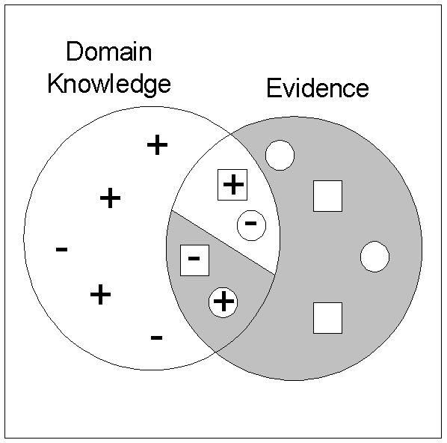
Interestingness via Unexpectedness
Need to model the expectation of users (domain knowledge)
+
Pattern expected to be frequent
-
Pattern expected to be infrequent
Pattern found to be frequent
Pattern found to be infrequent
+
-
Expected Patterns
-
+
Unexpected Patterns
Need to combine the expectation of users with evidence from data (i.e., extracted patterns)

Slide 47

Conclusion
Association rule mining has many applications where data can be seen as large transaction data sets.
Market Basket Analysis Marketing & Retail. E.g., frequent itemsets give information about "other customer who bought this item also bought X"
Exploratory Data Analysis Find correlation in very large (= many transactions), high-dimensional (= many items) data
Intrusion Detection Rules with low support but very high lift
Build Rule-based Classifiers Class association rules (CARs)

