Slide 1
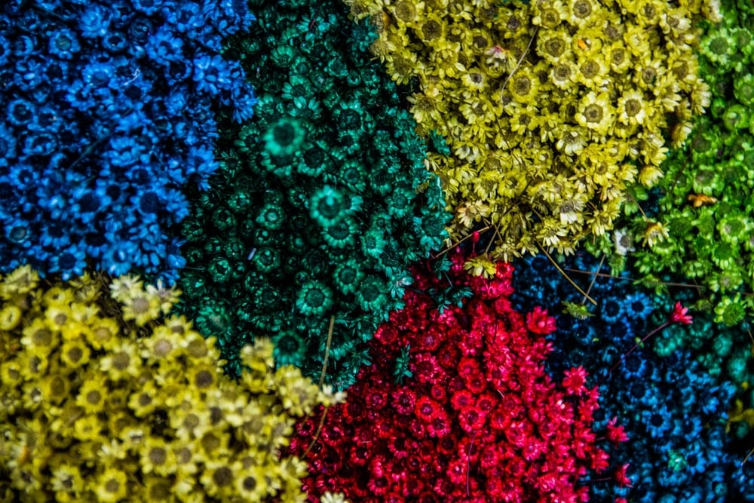
Introduction to Data Mining Chapter 7 Cluster Analysis
by Michael Hahsler
Based in Slides by Tan, Steinbach, Karpatne, Kumar
This work is licensed under a Creative Commons Attribution-ShareAlike 4.0 International License.

Slide 2


R Code Examples
Available R Code examples are indicated on slides by the R logo
The Examples are available at https://mhahsler.github.io/Introduction_to_Data_Mining_R_Examples/

Slide 3
Topics
Introduction
Types of Clustering
Types of Clusters
Clustering Algorithms
K-Means Clustering
Hierarchical Clustering
Density-based Clustering
Cluster Evaluation
Unsupervised Evaluation
Supervised Evaluation
Outliers and Scaling Issues

Slide 4
What is Cluster Analysis?
Finding groups of objects such that the objects in a group will be similar (or related) to one another and different from (or unrelated to) the objects in other groups.
A clustering is a set of clusters. Each cluster contains a set of points.
Inter-cluster distances are maximized
Intra-cluster distances are minimized

Slide 5
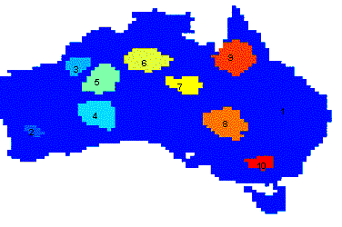
Applications of Cluster Analysis
Understanding
Group related documents for browsing, group genes and proteins that have similar functionality, or group stocks with similar price fluctuations
Summarization
Reduce the size of large data sets to a small number of groups.
Clustering precipitation in Australia

Slide 6
Measuring Similarity/Distances
How do we measure similarity/dissimilarity/distance/proximity?
Examples
Minkovsky distance: Manhattan distance, Euclidean Distance, etc.
Jaccard index for binary data.
Cosine similarity for word counts.
Gower's distance for mixed data (ratio/interval and nominal).
Correlation coefficient as similarity between variables.
See Chapter 2 on Data.

Slide 7
What is not Cluster Analysis?
→ Clustering organizes observations by descriptive features
Supervised classification
Uses correct class label information to learn how to predict the class label.
Simple segmentation
E.g., Dividing students into different registration groups alphabetically, by last name.
Results of a query
Groupings are a result of an external query specification.

Slide 8

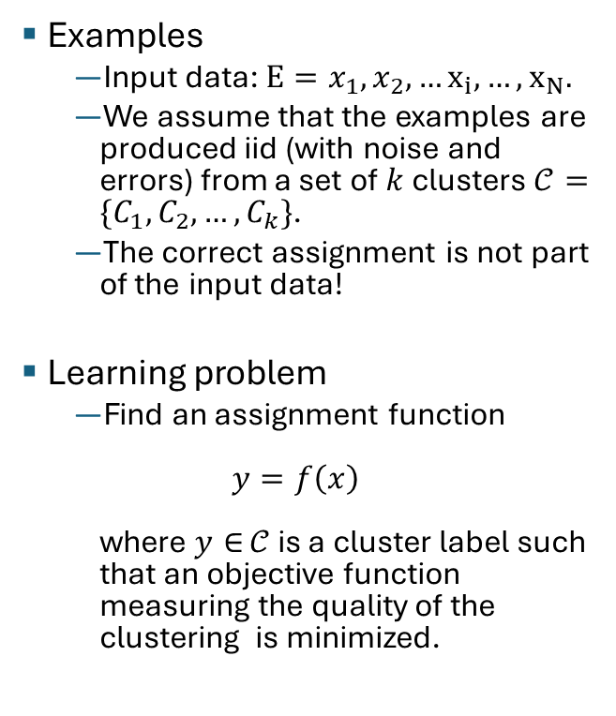



Clustering as Unsupervised Learning
Examples
Input data: $E=x_{1},x_{2},…x_{i}, …, x_{N}.$
We assume that the examples are produced iid (with noise and errors) from a set of $k$ clusters $𝒞=\{C_{1},C_{2},…, C_{k}\}$.
The correct assignment is not part of the input data!
Learning problem
Find an assignment function $y=f\left(x\right)$ where $y∈$ $𝒞$ is a cluster label such that an objective function measuring the quality of the clustering is minimized.
Example
$$k = 3$$
$$C_{1}$$
$$C_{2}$$
$$C_{3}$$

Slide 9
Notion of a Cluster can be Ambiguous
How many clusters?

Slide 10
Notion of a Cluster can be Ambiguous
How many clusters?
Six Clusters
Two Clusters
Four Clusters

Slide 11
Topics
Introduction
Types of Clustering
Types of Clusters
Clustering Algorithms
K-Means Clustering
Hierarchical Clustering
Density-based Clustering
Cluster Evaluation
Unsupervised Evaluation
Supervised Evaluation
Outliers and Scaling Issues

Slide 12
Types of Clusterings
Partitional Clustering
A division data objects into non-overlapping subsets (clusters) such that each data object is in exactly one subset
Hierarchical clustering
A set of nested clusters organized as a hierarchical tree

Slide 13
Partitional Clustering
Original Points
A Partitional Clustering

Slide 14
Hierarchical Clustering

Slide 15
Other Distinctions Between Sets of Clusters
Exclusive versus non-exclusive
In non-exclusive clusterings, points may belong to multiple clusters.
Fuzzy versus non-fuzzy
In fuzzy clustering, a point belongs to every cluster with some membership weight between 0 and 1.
Membership weights must sum to 1.
Partial versus complete
In some cases, we only want to cluster some of the data.
E.g. don’t cluster outliers or noise data points.
Heterogeneous versus homogeneous
Cluster of widely different sizes, shapes, and densities
Typical clustering is: exclusive, crisp (non-fuzzy), complete, and homogeneous.

Slide 16
Topics
Introduction
Types of Clustering
Types of Clusters
Clustering Algorithms
K-Means Clustering
Hierarchical Clustering
Density-based Clustering
Cluster Evaluation
Unsupervised Evaluation
Supervised Evaluation
Outliers and Scaling Issues

Slide 17
Types of Clusters
Center-based clusters
Contiguous clusters
Density-based clusters
Conceptual clusters

Slide 18
Center-based Clusters
Not well separated (overlapping)
Well separated
Cluster centers
A cluster is a set of objects such that an object in a cluster is closer (more similar) to the “center” of a cluster, than to the center of any other cluster
The center of a cluster is often a centroid, the average of all the points in the cluster, or a medoid, the most “representative” point of a cluster

Slide 19
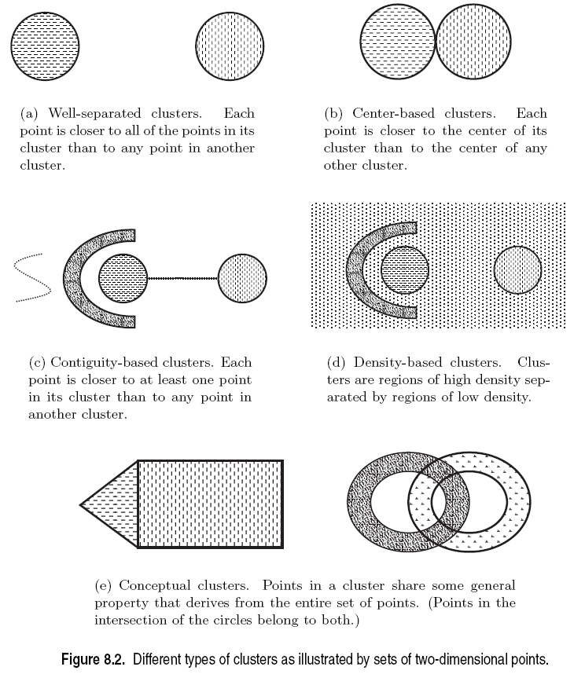
Contiguous and Density-based Clusters
High density
Connected

Slide 20
Conceptual Clusters
Conceptual clusters are hard to detect since they are often not:
Center-based
Contiguity-based
Density-based

Slide 21
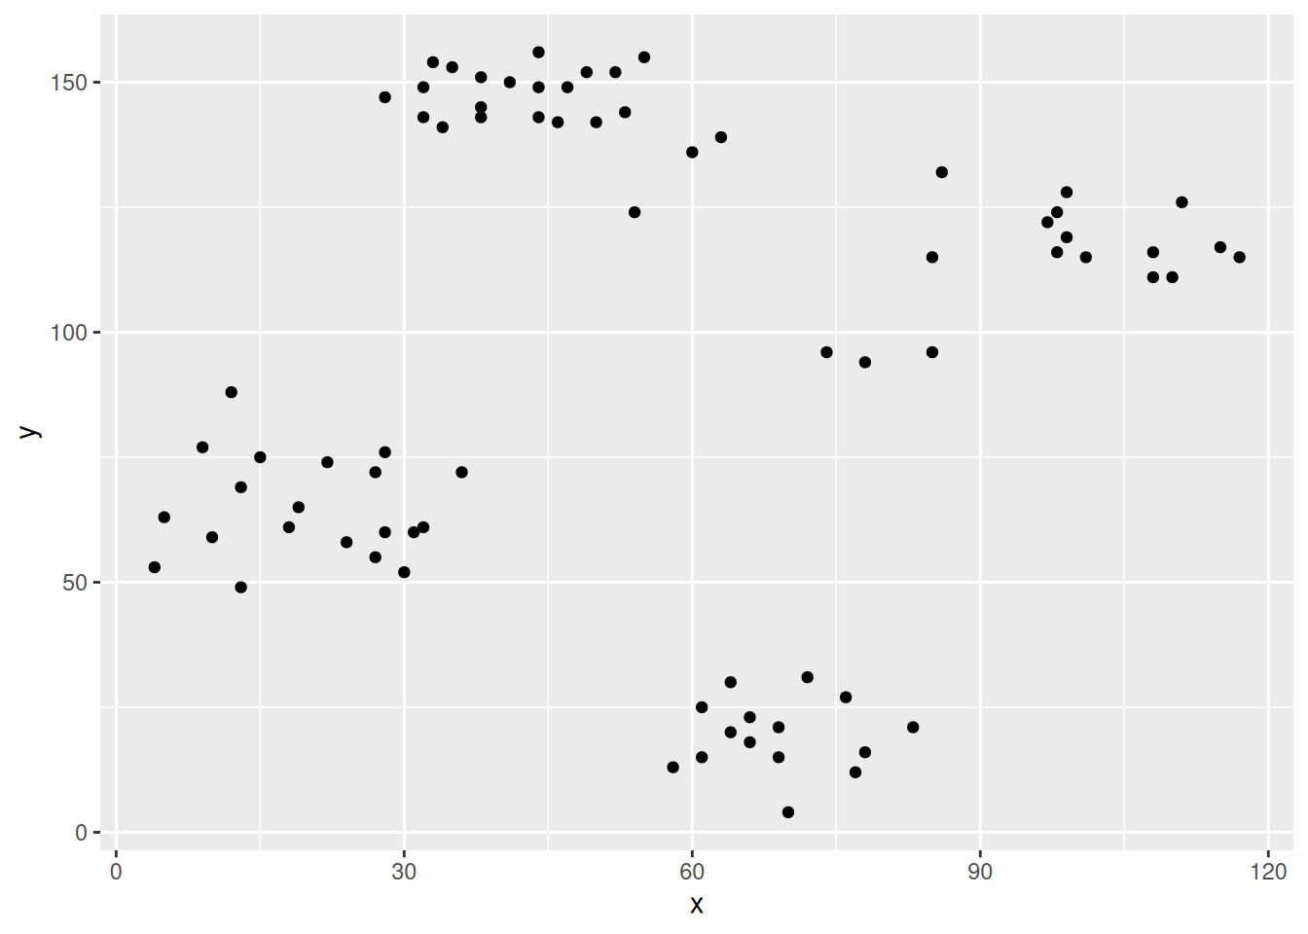
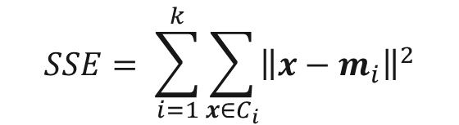





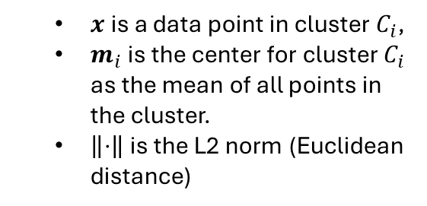
Clustering is an Optimization Problem
The best clustering minimizes or maximizes an objective function.
Example: Minimize the “Sum of Squared Errors” for centroid-based algorithms.
+
$$SSE= \sum_{i=1}^{k}{\sum_{x∈C_{i}}{{\left\|x−m_{i}\right\|}^{2}}}$$
$$m_{2}$$
+
$$m_{4}$$
$x$is a data point in cluster $C_{i}$,
$m_{i}$ is the center for cluster $C_{i}$ as the mean of all points in the cluster.
$\left\|⋅\right\|$ is the L2 norm (Euclidean distance)
$$\left\|x−m_{1}\right\|$$
+
$$m_{1}$$
$$m_{3}$$
+

Slide 22
Objective Functions
Global objective function
Typically used in partitional clustering. k-means uses SSE.
Mixture Models assume that the data is a ‘mixture' of a number of parametric statistical distributions (e.g., a mixture of Gaussians). Maximize log-likelihood of the model.
Local objective function
Hierarchical clustering algorithms typically have local objectives.
Density-based clustering is based on local density estimates.
Graph based approaches. Graph partitioning (e.g., min-cut) and shared nearest neighbors.
We will talk about the objective functions more when we talk about individual clustering algorithms.

Slide 23
Topics
Introduction
Types of Clustering
Types of Clusters
Clustering Algorithms
K-Means Clustering
Hierarchical Clustering
Density-based Clustering
Cluster Evaluation
Unsupervised Evaluation
Supervised Evaluation
Outliers and Scaling Issues

Slide 24
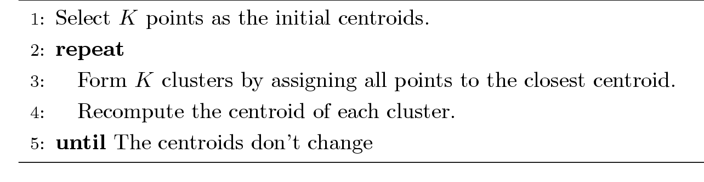
K-means Clustering
Partitional clustering approach
Each cluster is associated with a centroid (center point)
Each point is assigned to the cluster with the closest centroid
Number of clusters, K, must be specified
Lloyd’s algorithm (Voronoi iteration):

Slide 25
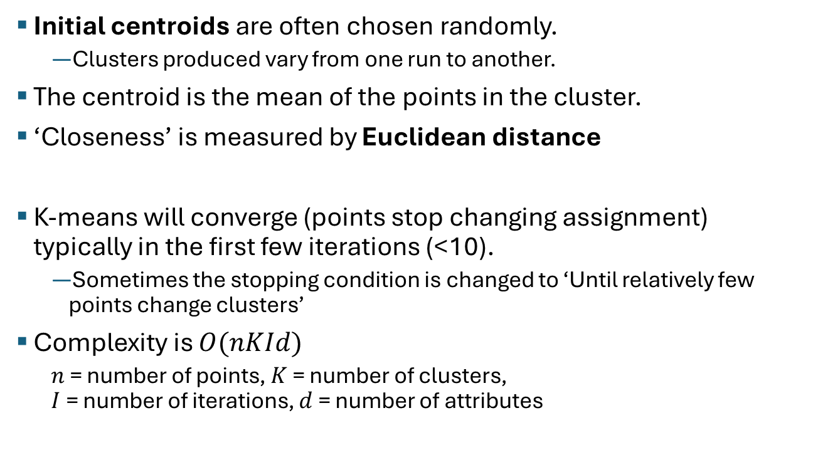
K-means Clustering – Details
Initial centroids are often chosen randomly.
Clusters produced vary from one run to another.
The centroid is the mean of the points in the cluster.
‘Closeness’ is measured by Euclidean distance
K-means will converge (points stop changing assignment) typically in the first few iterations (<10).
Sometimes the stopping condition is changed to ‘Until relatively few points change clusters’
Complexity is $O(nKId)$
$n$ = number of points, $K$ = number of clusters, $I$ = number of iterations, $d$ = number of attributes

Slide 26
K-Means Example
See visualization

Slide 27
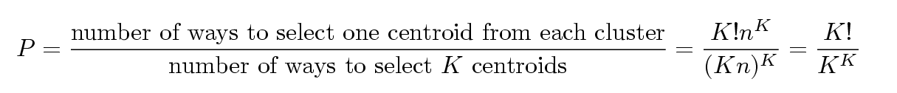
Problems with Selecting Initial Points
If there are K ‘real’ clusters then the chance of selecting one centroid from each cluster is small.
Chance is relatively small when K is large
If clusters are the same size, n, then
For example, if K = 10, then probability = 10!/1010 = 0.00036
Sometimes the initial centroids will readjust themselves in ‘right’ way, and sometimes they don’t
Consider an example of five pairs of clusters

Slide 28
Importance of Choosing Initial Centroids …
Gets stuck in a local optimum!

Slide 29
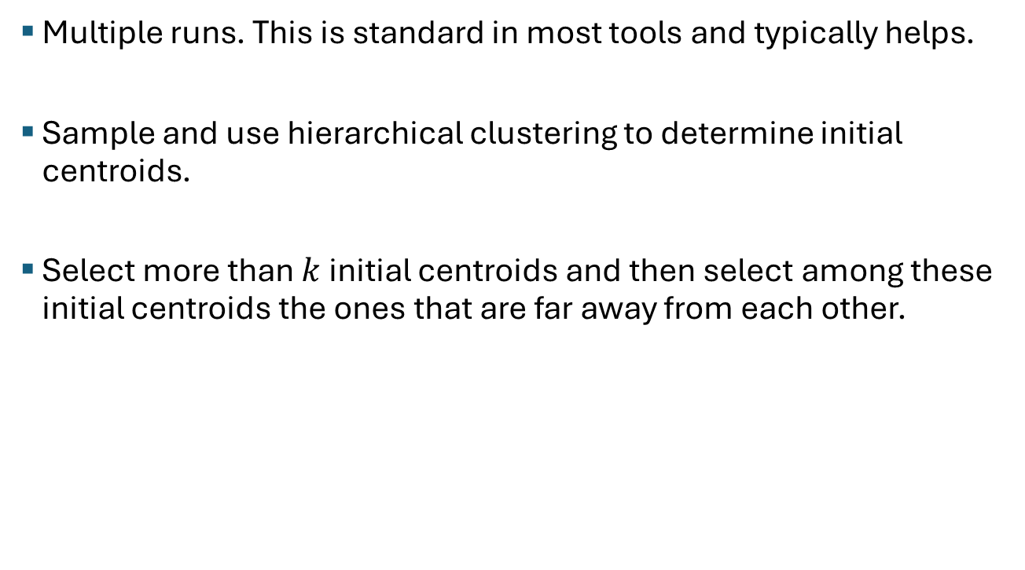
Solutions to the Initial Centroids Problem
Multiple runs. This is standard in most tools and typically helps.
Sample and use hierarchical clustering to determine initial centroids.
Select more than $k$ initial centroids and then select among these initial centroids the ones that are far away from each other.

Slide 30
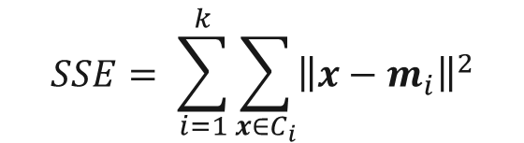



Evaluating k-means Clusters
Most common measure is Sum of Squared Error (SSE)
For each point, the error is the distance to the nearest cluster center
k-means uses a simple heuristic to minimizing the SSE.
$$SSE= \sum_{i=1}^{k}{\sum_{x∈C_{i}}{{\left\|x−m_{i}\right\|}^{2}}}$$
+
$$m_{2}$$
+
$$m_{4}$$
Given two clusterings, we can choose the one with the smallest $SSE$.
Only compare clusterings with the same number of clusters $k$!$SSE$ automatically decreases with $k$.
$SSE$ is also called the $WCSS$ or $WSS$.
+
$$m_{1}$$
$$m_{3}$$
+

Slide 31
Pre-processing and Post-processing
Pre-processing
Normalize the data (e.g., scale to unit standard deviation)
Eliminate outliers
Post-processing
Eliminate small clusters that may represent outliers
Split ‘loose’ clusters, i.e., clusters with relatively high SSE
Merge clusters that are ‘close’ and that have relatively low SSE

Slide 32
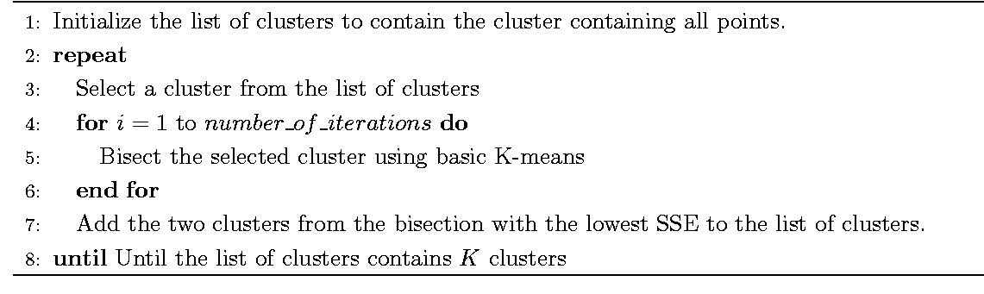
Bisecting K-means
Variant of K-means that can produce a partitional or a hierarchical clustering

Slide 33
Limitations of K-means
K-means has problems when clusters are of differing
Sizes
Densities
Non-globular shapes
K-means has problems when the data contains outliers.

Slide 34
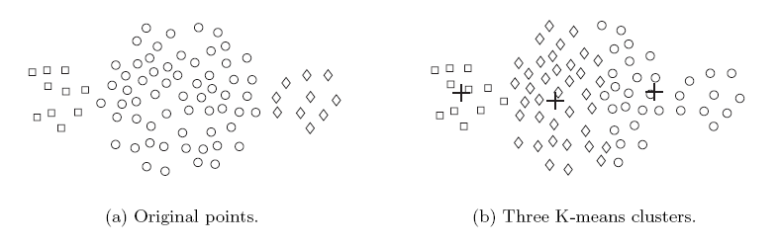
Limitations of K-means: Differing Sizes

Slide 35
Limitations of K-means: Differing Density

Slide 36
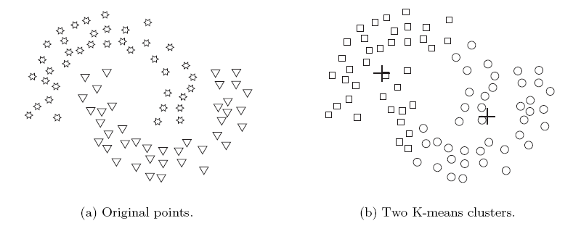
Limitations of K-means: Non-globular Shapes

Slide 37
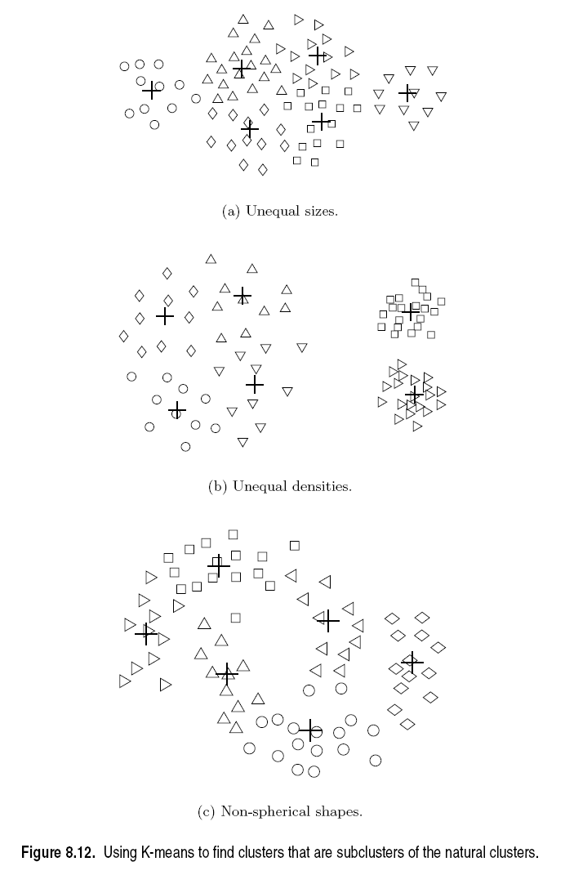
Overcoming K-means Limitations
Use a larger number of clusters
Several clusters
represent a true
Cluster and need to be merged.

Slide 38
Overcoming K-means Limitations
Use a larger number of clusters
Several clusters
represent a true
cluster

Slide 39
Topics
Introduction
Types of Clustering
Types of Clusters
Clustering Algorithms
K-Means Clustering
Hierarchical Clustering
Density-based Clustering
Cluster Evaluation
Unsupervised Evaluation
Supervised Evaluation
Outliers and Scaling Issues

Slide 40
Hierarchical Clustering
Produces a set of nested clusters organized as a hierarchical tree called a dendrogram. The dendrogram shows at what distance points join into a cluster.
Dendrogram
distance
0.2
0.15
0.1
0.05
0
1
3
2
5
4
6
Data points

Slide 41
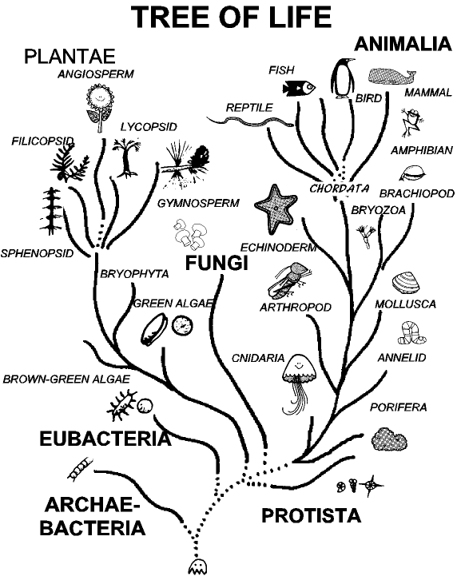
Strengths of Hierarchical Clustering
You do not have to assume any particular number of clusters
Any desired number of clusters can be obtained by ‘cutting’ the dendogram at the proper level.
They may correspond to meaningful taxonomies
Example in biological sciences (e.g., animal kingdom, phylogeny reconstruction, …)

Slide 42
Hierarchical Clustering
Two main types of hierarchical clustering
Agglomerative:
Start with the points as individual clusters
At each step, merge the closest pair of clusters until only one cluster (or k clusters) left
Divisive:
Start with one, all-inclusive cluster
At each step, split a cluster until each cluster contains a point (or there are k clusters)
Traditional hierarchical algorithms
Use a similarity or distance matrix
Agglomerative: merge one cluster at a time
Dendrogram
distance
Divisive
Agglomerative
0.2
0.15
0.1
0.05
0
1
3
2
5
4
6
Data points

Slide 43
Agglomerative Clustering Algorithm
The basic algorithm is straightforward
Compute the proximity matrix
Let each data point be a cluster
Repeat
Merge the two closest clusters
Update the proximity matrix
Until only a single cluster remains
The key operation is merging the two closest clusters which requires the computation of the proximity between two clusters.

Slide 44
Starting Situation
Start with clusters of individual points and a proximity matrix
p1
p2
p3
p4
p5
. . .
p1
y
p2
p3
p4
p5
.
.
.
Proximity Matrix
...
Dendrogram
x

Slide 45
Intermediate Situation
C1
C2
C3
C4
C5
After some merging steps, we have some clusters
C1
y
C2
C3
C3
C4
C4
C5
Proximity Matrix
C1
C2
C5
...
C2 C5 C3
x
Dendrogram

Slide 46
Intermediate Situation
We want to merge the two closest clusters (C2 and C5) and update the proximity matrix.
C1
C2
C3
C4
C5
C1
y
C2
C3
C3
C4
C4
C5
Proximity Matrix
C1
C2
C5
...
...
x
C2 C5 C3
Dendrogram

Slide 47
After Merging
C2 U C5
The question is “How do we update the proximity matrix?”
C1
C3
C4
y
C1
?
? ? ?
C2 U C5
?
?
?
C3
C3
?
C4
C4
?
Proximity Matrix
C1
C2 U C5
...
...
x
C2 C5 C3
Dendrogram

Slide 48
How to Define Inter-Cluster Similarity
p1
p2
p3
p4
p5
. . .
Similarity or Distance?
p1
p2
p3
p4
p5
.
.
.
MIN
MAX
Group Average
Distance Between Centroids
Other methods driven by an objective function
Ward’s Method uses squared error
Proximity Matrix

Slide 49
How to Define Inter-Cluster Similarity
p1
p2
p3
p4
p5
. . .
p1
p2
p3
p4
p5
MIN (Single Link)
MAX (Complete Link)
Group Average
Distance Between Centroids
Other methods driven by an objective function
Ward’s Method uses squared error
.
.
.
Proximity Matrix

Slide 50
How to Define Inter-Cluster Similarity
p1
p2
p3
p4
p5
. . .
p1
p2
p3
p4
p5
MIN (Single Link)
MAX (Complete Link)
Group Average
Distance Between Centroids
Other methods driven by an objective function
Ward’s Method uses squared error
.
.
.
Proximity Matrix

Slide 51
How to Define Inter-Cluster Similarity
p1
p2
p3
p4
p5
. . .
p1
p2
p3
p4
p5
MIN (Single Link)
MAX (Complete Link)
Group Average (Average Link)
Distance Between Centroids
Other methods driven by an objective function
Ward’s Method uses squared error
.
.
.
Proximity Matrix

Slide 52
How to Define Inter-Cluster Similarity
p1
p2
p3
p4
p5
. . .
p1
×
×
p2
p3
p4
p5
.
.
.
MIN (Single Link)
MAX (Complete Link)
Group Average
Distance Between Centroids
Other methods driven by an objective function
Ward’s Method uses squared error
Proximity Matrix

Slide 53
Single Link
Advantage: Non-spherical, non-convex clusters
Problem: Chaining

Slide 54
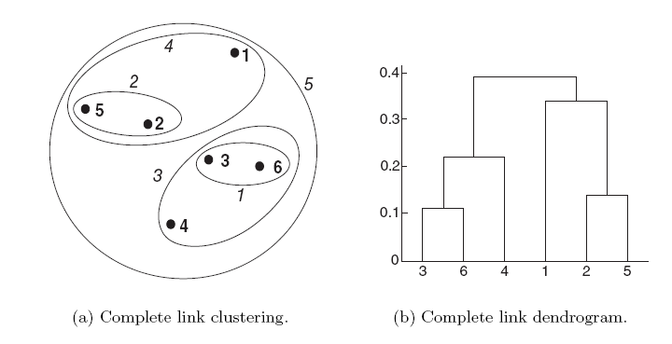
Complete Link
Advantage: more robust against noise (no chaining)
Problem: Tends to break large clusters, Biased towards globular clusters

Slide 55
Average Link
A compromise between Single and Complete Link

Slide 56

Ward’s Method
Hierarchical analogue of K-means.
Similarity of two clusters is based on the increase in $SSE$ when two clusters are merged.
Less susceptible to noise and outliers.
Biased towards globular clusters.

Slide 57
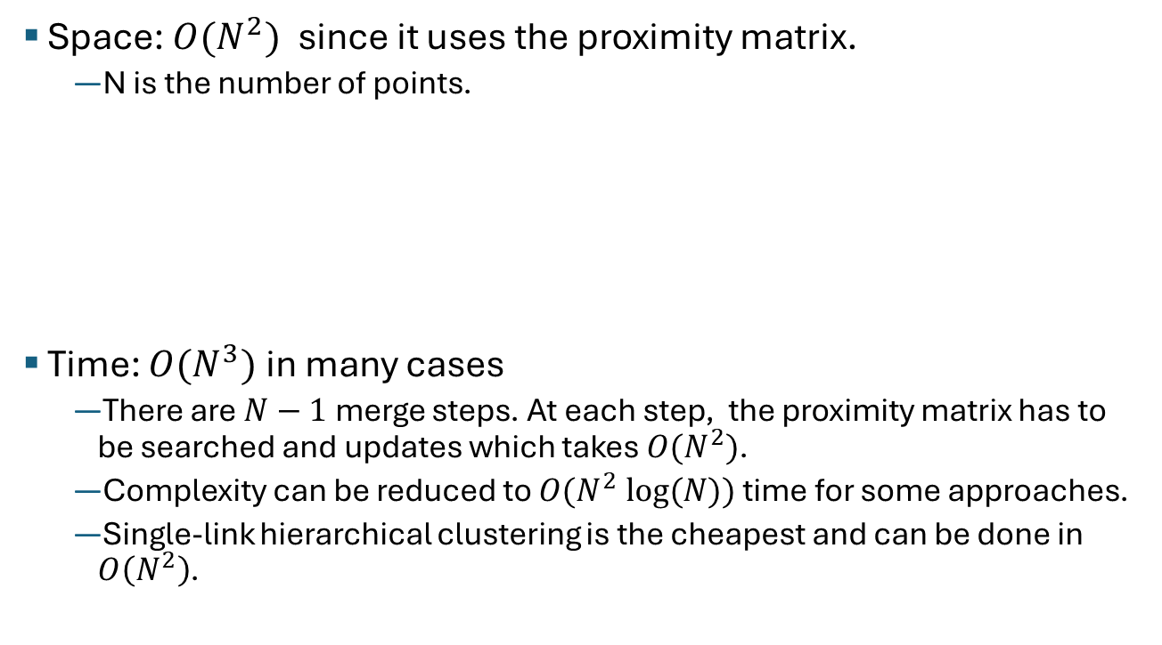
Hierarchical Clustering: Complexity
Space: $O(N^{2})$ since it uses the proximity matrix.
N is the number of points.
Time: $O(N^{3})$in many cases
There are$N−1$merge steps. At each step, the proximity matrix has to be searched and updates which takes ${O(N}^{2})$.
Complexity can be reduced to $O(N^{2} log⁡(N))$time for some approaches.
Single-link hierarchical clustering is the cheapest and can be done in $O\left(N^{2}\right)$.
This restricts the number of points that can be clustered!

Slide 58
Hierarchical Clustering: Limitations
Greedy: Once a decision is made to combine two clusters, it cannot be undone.
No global objective function, just local merge decisions.
Different schemes have problems with one or more of the following:
General: Sensitivity to noise and outliers (uses a complete clustering approach).
Complete –link: Difficulty handling different sized clusters (e.g., breaking large clusters apart) and convex shapes.
Single-link: Chaining.

Slide 59
Topics
Introduction
Types of Clustering
Types of Clusters
Clustering Algorithms
K-Means Clustering
Hierarchical Clustering
Density-based Clustering
Cluster Evaluation
Unsupervised Evaluation
Supervised Evaluation
Outliers and Scaling Issues

Slide 60
Density-Based Spatial Clustering of Applications with Noise (DBSCAN)
Measures density around a point as the number of points within a specified radius Eps called the eps-neighborhood.
density = 7 points

Slide 61
DBSCAN
Classifies points by the density of their eps-neighborhood:
point is a core point if it has more than a specified number of points (MinPts) within Eps. These are points that form the interior of a cluster.
A border point has fewer than MinPts within Eps, but is in the neighborhood of a core point
A noise point is any point that is not a core point or a border point.
MinPts = 5

Slide 62
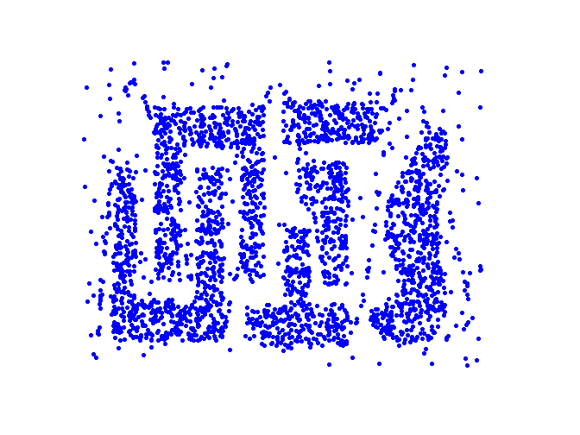
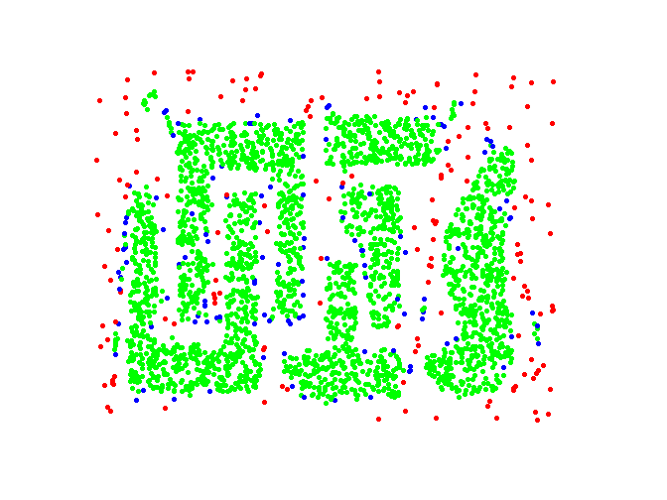
DBSCAN: Core, Border and Noise Points
Eps = 10 MinPts = 4
Original Points
Point types: core, border and noise

Slide 63
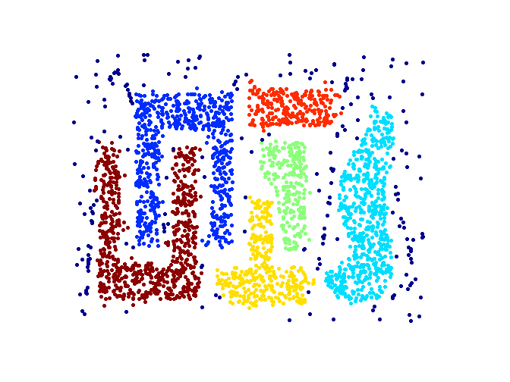
DBSCAN: Determine Clusters
‘density connected’ components
Point types: core, border and noise
Clusters
Properties of DBSCAN
Resistant to noise and outliers.
Can handle clusters of different shapes and sizes.
Eps and MinPts depend on each other and can be hard to specify.

Slide 64
DBSCAN Algorithm
DBSCAN(D, eps, MinPts)
C = 0
for each unvisited point P in dataset D
mark P as visited
NeighborPts = regionQuery(P, eps)
if sizeof(NeighborPts) < MinPts
mark P as NOISE
else
C = next cluster
expandCluster(P, NeighborPts, C, eps, MinPts)
expandCluster(P, NeighborPts, C, eps, MinPts)
add P to cluster C
for each point P' in NeighborPts
if P' is not visited
mark P' as visited
NeighborPts' = regionQuery(P', eps)
if sizeof(NeighborPts') >= MinPts
NeighborPts = NeighborPts joined with NeighborPts'
if P' is not yet member of any cluster
add P' to cluster C
Note: Finding neighbors using region queries is the most expensive operation.

Slide 65
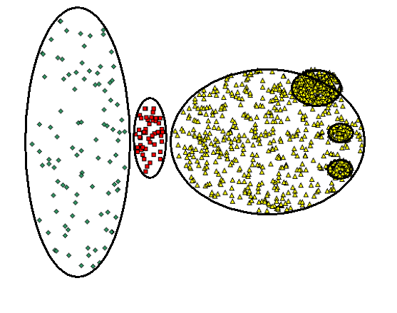
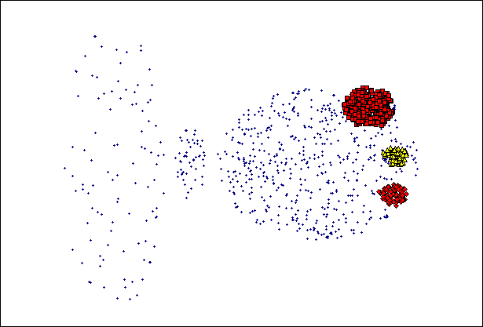
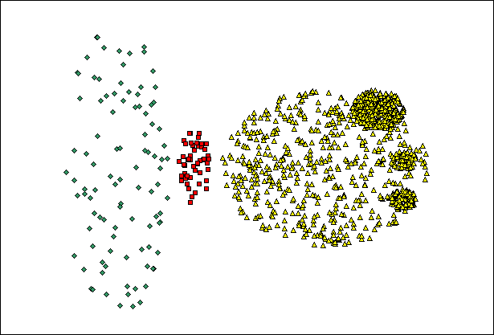
When DBSCAN Does NOT Work Well
(MinPts=4, Eps=9.75).
Original Points
Varying densities
High-dimensional data
(MinPts=4, Eps=9.92)

Slide 66
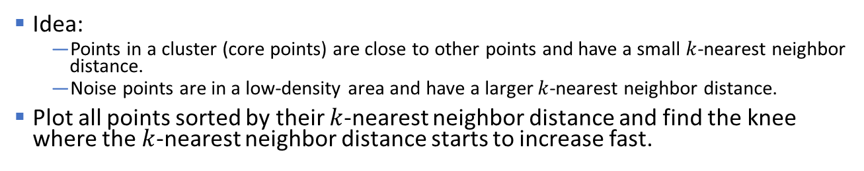


DBSCAN: Determining EPS and MinPts
Idea:
Points in a cluster (core points) are close to other points and have a small $k$-nearest neighbor distance.
Noise points are in a low-density area and have a larger $k$-nearest neighbor distance.
Plot all points sorted by their $k$-nearest neighbor distance and find the knee where the $k$-nearest neighbor distance starts to increase fast.
$$k=MinPts −1$$
$$Eps$$
Core Points

Slide 67
Topics
Introduction
Types of Clustering
Types of Clusters
Clustering Algorithms
K-Means Clustering
Hierarchical Clustering
Density-based Clustering
Other Methods
Cluster Evaluation
Unsupervised Evaluation
Supervised Evaluation
Outliers and Scaling Issues

Slide 68
Some Other Clustering Algorithms
Center-based Clustering
Fuzzy c-means
PAM (Partitioning Around Medoids)
Mixture Models
Expectation-maximization (EM) algorithm
Hierarchical
CURE (Clustering Using Representatives): shrinks points toward center
BIRCH (balanced iterative reducing and clustering using hierarchies)
Graph-based Clustering
Graph partitioning on a sparsified proximity graph
Shared nearest-neighbor (SNN graph)
Spectral Clustering
Reduce the dimensionality using the spectrum of the similarity, and cluster in this space.
Subspace Clustering
Data Stream Clustering

Slide 69
Topics
Introduction
Types of Clustering
Types of Clusters
Clustering Algorithms
K-Means Clustering
Hierarchical Clustering
Density-based Clustering
Cluster Evaluation
Unsupervised Evaluation
Supervised Evaluation
Outliers and Scaling Issues

Slide 70
Cluster Evaluation
For supervised classification (= we have a class label) we have a variety of measures to evaluate how good our model is: Accuracy, error rate, loss, precision, recall,…
For cluster analysis (=unsupervised learning), the analogous question is:
How to evaluate the “goodness” of the resulting clusters?

Slide 71
Clusters found in Random Data (Overfitting)
Random Points
DBSCAN
K-means
k=3
Complete Link + cut into 3 clusters
If you tell a clustering algorithm to find clusters then it will!

Slide 72
Different Aspects of Cluster Evaluation
Unsupervised Cluster Evaluation: Evaluate how well the results of a cluster analysis fit the data without reference to external group information.
Determining the clustering tendency of a set of data, i.e., distinguishing whether a non-random structure exists in the data (e.g., to avoid overfitting).
Determining the ‘correct’ number of clusters.
Supervised Cluster Evaluation: Compare the results of a cluster analysis to externally known group labels (ground truth).
Compare different clusterings to determine which one is better or more useful.

Slide 73
Measures for Cluster Evaluation
Numerical measures that are applied to judge various aspects of cluster quality are classified into the following three types.
Internal Index (unsupervised cluster evaluation): Used to measure the goodness of a clustering structure without respect to external information.
E.g.: Sum of Squared Error (SSE), Silhouette coefficient, Correlation between proximity and incidence matrix
External Index (supervised cluster evaluation): Used to measure the extent to which cluster labels match externally supplied group labels.
E.g., Entropy, Purity, Rand index, …
Relative Index: Used to compare two different clusterings or clusters.
Often an external or internal index is used for this function, e.g., the difference of SSE or entropy

Slide 74
Topics
Introduction
Types of Clustering
Types of Clusters
Clustering Algorithms
K-Means Clustering
Hierarchical Clustering
Density-based Clustering
Cluster Evaluation
Unsupervised Evaluation
Supervised Evaluation
Outliers and Scaling Issues

Slide 75
Measures for Cluster Evaluation
Numerical measures that are applied to judge various aspects of cluster quality, are classified into the following three types.
Internal Index (unsupervised cluster evaluation): Used to measure the goodness of a clustering structure without respect to external information.
E.g.: Sum of Squared Error (SSE), Silhouette coefficient
External Index (supervised cluster evaluation): Used to measure the extent to which cluster labels match externally supplied group labels.
E.g., Entropy, Purity, Rand index, …
Relative Index: Used to compare two different clusterings or clusters.
Often an external or internal index is used for this function, e.g., difference of SSE or entropy

Slide 76
Visual Method: Similarity Matrix Visualization
Order the similarity matrix with respect to cluster labels and inspect visually.
Clustered Data
Reordered Similarity Matrix
Clusters appear as crisp squares

Slide 77
Visual Method: Similarity Matrix Visualization
Random data
DBSCAN
No crisp clusters!
k-means
Complete L. HC

Slide 78
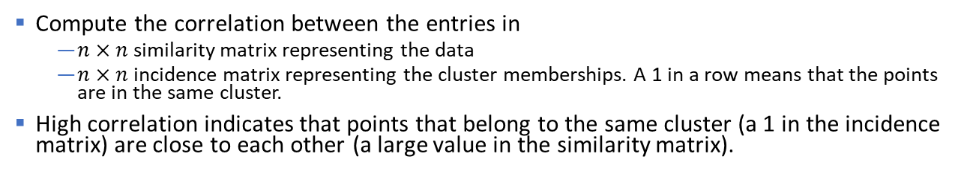
Correlation between Distances and Incidence Matrix
Compute the correlation between the entries in
$n×n$ similarity matrix representing the data
$n×n$ incidence matrix representing the cluster memberships. A 1 in a row means that the points are in the same cluster.
High correlation indicates that points that belong to the same cluster (a 1 in the incidence matrix) are close to each other (a large value in the similarity matrix).
Good Cluster Structure
Random Data
Corr = 0.9235
Corr = 0.5810

Slide 79
Internal Index: Cohesion and Separation
Several indices are based on the concept of cohesion and separation.
Cluster Cohesion: Measures how closely related objects in a cluster are.
Cluster Separation: Measure how distinct or well-separated a cluster is from other clusters.
cohesion
separation

Slide 80


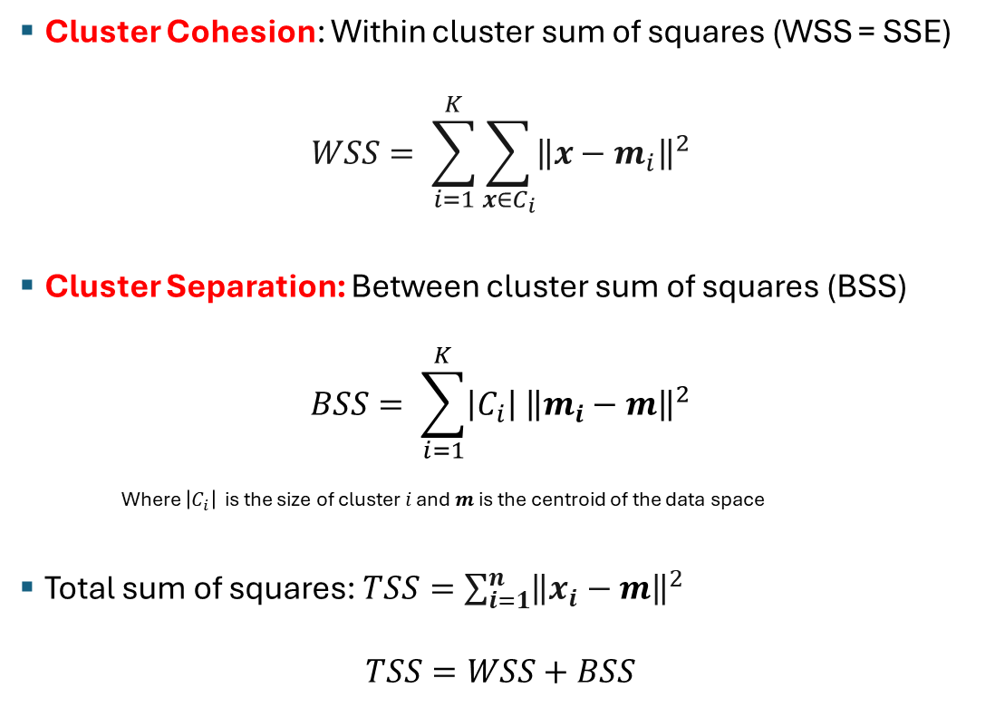








Internal Index: Sum of Squared Errors
$$C_{i}$$
Cluster Cohesion: Within cluster sum of squares (WSS = SSE)
$$WSS= \sum_{i=1}^{K}{\sum_{x∈C_{i}}{{\left\|x−m_{i}\right\|}^{2}}}$$
Cluster Separation: Between cluster sum of squares (BSS)
$$BSS= \sum_{i=1}^{K}{\left|C_{i}\right|{ \left\|m_{i}−m\right\|}^{2}}$$
Where $\left|C_{i}\right|$ is the size of cluster $i$ and $m$is the centroid of the data space
Total sum of squares: $TSS=\sum_{i=1}^{n}{{\left\|x_{i}−m\right\|}^{2}}$
$$TSS=WSS+BSS$$
$$m_{i}$$
$$C_{2}$$
$$m_{2}$$
$$C_{1}$$
$$m$$
+
$$m_{1}$$
$$C_{3}$$
$$m_{3}$$
$$m$$
+

Slide 81
Internal Index: Sum of Squared Errors
TSS = BSS + WSS = constant for a given data set
m=m₁
×
K=1 cluster:
1
2
3
4
5
K=2 clusters:
×
m
×
1
m₁
2
3
4
m₂
5

Slide 82
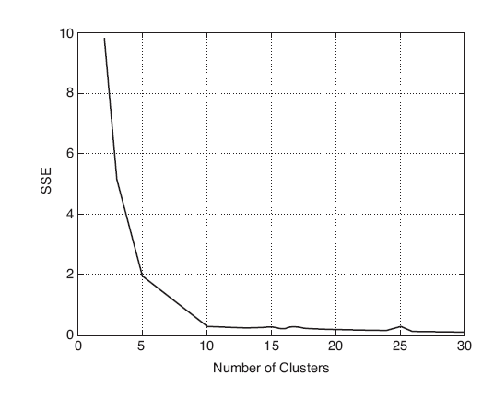
Choosing k with the Sum of Squared Errors
The SSE is good for comparing two different clusterings with the same number of clusters. E.g., several random restarts of k-means.
We cannot directly compare the SSE between clusterings with different k. As k goes up, SSE tends to go down.
We can also be used to estimate the number of clusters using the “knee” method.
Used data has 10 clusters
Look for the knee
y
x

Slide 83
Similarity-Graph Based Internal Index
A proximity graph-based approach can also be used for cohesion and separation. The edges in the graph represent similarities.
Cluster cohesion is the sum of the similarities of all links within a cluster.
Cluster separation is the sum of the similarities between nodes in the cluster and nodes outside the cluster.
cohesion
separation

Slide 84
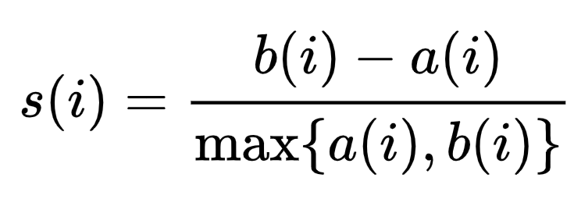
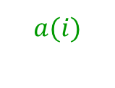


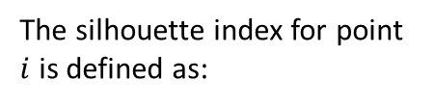


Internal Index: Silhouette Coefficient
The silhouette applies the similarity-graph based index to individual points. For an individual point $i$:
Calculate $a(i)$= average distance of $i$ to all other points in its cluster
Calculate $b(i)$ = average distance from $i$ to all points in the nearest cluster
The closer to 1, the better.
We can calculate the Average Silhouette Width (ASW) for a cluster or a clustering.
The silhouette index for point $i$ is defined as:
$$a(i)$$
i
Nearest cluster to $i$
$$b(i)$$
Range: $−1≤s\left(i\right)≤1$
Cohersion
Separation

Slide 85
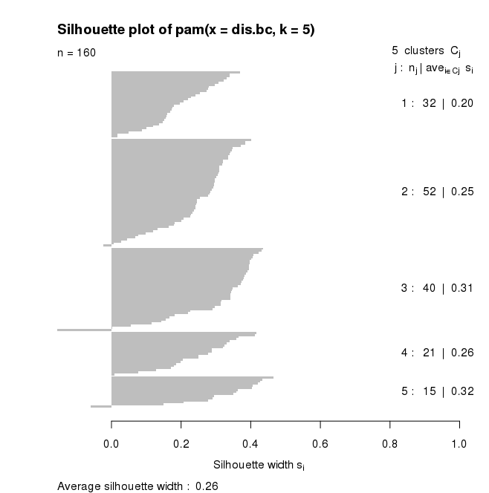
Internal Index: Silhouette Plot
Large, positive silhouettes represent good clusters

Slide 86
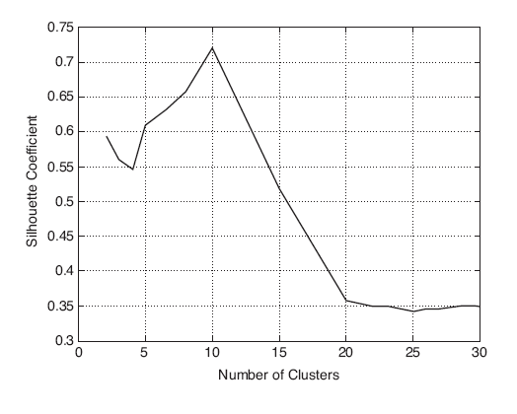
Choosing k using the Average Silhouette Width
Calculate the ASW for different values of k and choose the k with the maximum ASW (also called silhouette coefficient).
Used data has 10 clusters
y
x

Slide 87
Topics
Introduction
Types of Clustering
Types of Clusters
Clustering Algorithms
K-Means Clustering
Hierarchical Clustering
Density-based Clustering
Cluster Evaluation
Unsupervised Evaluation
Supervised Evaluation
Outliers and Scaling Issues

Slide 88
Measures for Cluster Evaluation
Numerical measures that are applied to judge various aspects of cluster quality are classified into the following three types.
Internal Index (unsupervised custer evaluation): Used to measure the goodness of a clustering structure without respect to external information.
E.g.: Sum of Squared Error (SSE), Silhouette coefficient, Correlation between proximity and incidence matrix
External Index (supervised cluster evaluation): Used to measure the extent to which cluster labels match externally supplied group labels.
E.g., Entropy, Purity, Rand index, …
Relative Index: Used to compare two different clusterings or clusters.
Often an external or internal index is used for this function, e.g., the difference of SSE or entropy

Slide 89
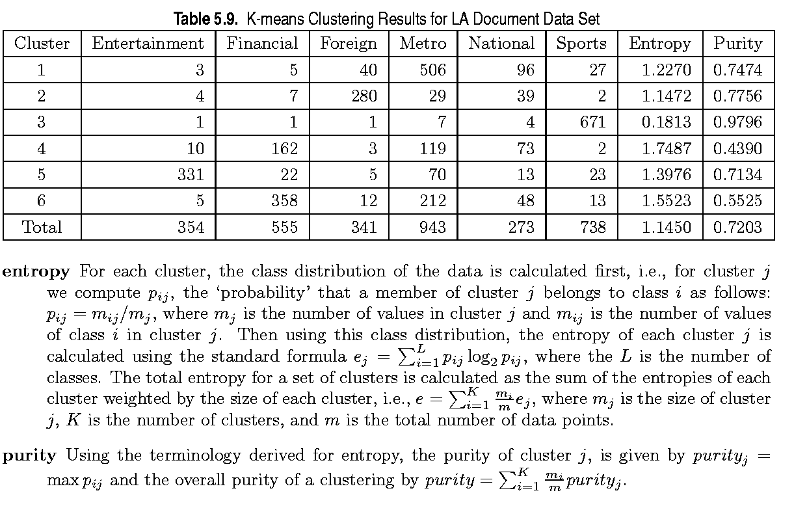
External Measures of Cluster Validity: Entropy and Purity
Other measures: Rand index/ARI, variation of information (VI) index

Slide 90





Supervised Index: Purity
Purity is a measure of the extent to which clusters contain a single class.
For each cluster, count the number of data points from the majority class.
Sum the count over all clusters and divide by the total number of data points.
Example
$$purity= \frac{\# majority}{\# total}$$
$$y$$
$$C_{2}$$
male
female
 | # male | # female | # total | # majority | Purity
Cluster 1
Cluster 2
Total
$$C_{1}$$
$$x$$

Slide 91
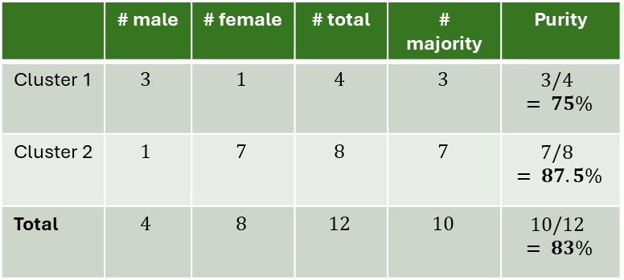
Supervised Index: Purity
Purity is a measure of the extent to which clusters contain a single class.
For each cluster, count the number of data points from the majority class.
Sum the count over all clusters and divide by the total number of data points.
Example
$$purity= \frac{\# majority}{\# total}$$
$$y$$
$$C_{2}$$
male
female
 | # male | # female | # total | # majority | Purity
Cluster 1 | $$3$$ | $$1$$ | $$4$$ | $$3$$ | $$3/4 = 75\%$$
Cluster 2 | $$1$$ | $$7$$ | $$8$$ | $$7$$ | $$7/8 = 87.5\%$$
Total | $$4$$ | $$8$$ | $$12$$ | $$10$$ | $$10/12 = 83\%$$
$$C_{1}$$
$$x$$
Note: Purity automatically increases when the number of clusters increases.

Slide 92
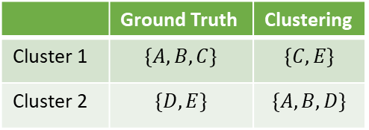
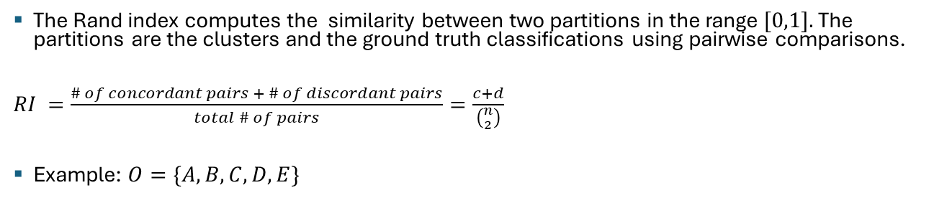


Supervised Index: Rand Index
The Rand index computes the similarity between two partitions in the range $[0,1].$The partitions are the clusters and the ground truth classifications using pairwise comparisons.
$RI =\frac{\# of concordant pairs + \# of discordant pairs}{total \# of pairs}=\frac{c+d}{\left({n \atop 2}\right)}$
Example: $O=\{A,B,C,D,E\}$
Concordant = objects are in both in the same cluster Discordant = objects are in a different cluster
Pairs:
$$c = ?$$
$d = ?$
 | Ground Truth | Clustering
Cluster 1 | $$\{A,B,C\}$$ | $$\{C,E\}$$
Cluster 2 | $$\{D, E\}$$ | $$\{A,B,D\}$$
$$RI = ?$$
Adjusted Rand: corrected for agreement by chance.

Slide 93



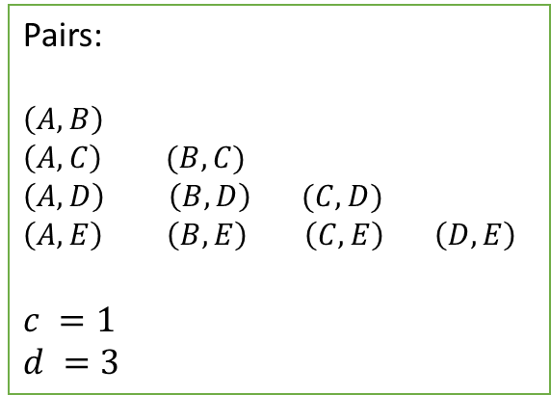
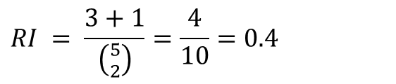

Supervised Index: Rand Index
The Rand index computes the similarity between two partitions in the range $[0,1].$The partitions are the clusters and the ground truth classifications using pairwise comparisons.
$RI =\frac{\# of concordant pairs + \# of discordant pairs}{total \# of pairs}=\frac{c+d}{\left({n \atop 2}\right)}$
Example: $O=\{A,B,C,D,E\}$
Concordant = objects are in both in the same cluster Discordant = objects are in a different cluster
Pairs:
$$\left(A,B\right)$$
$$\left(A,C\right) (B,C)$$
$$\left(A,D\right) \left(B,D\right) (C,D)$$
$$\left(A,E\right) \left(B,E\right) \left(C,E\right) \left(D,E\right)$$
$$c =1$$
$d =3$
 | Ground Truth | Clustering
Cluster 1 | $$\{A,B,C\}$$ | $$\{C,E\}$$
Cluster 2 | $$\{D, E\}$$ | $$\{A,B,D\}$$
$$c$$
$$d$$
$$d$$
$$d$$
$$RI = \frac{3+1}{\left({5 \atop 2}\right)}=\frac{4}{10}=0.4$$
Adjusted Rand: corrected for agreement by chance.

Slide 94
Final Comment on Cluster Evaluation
“The validation of clustering structures is the most difficult and frustrating part of cluster analysis.
Without a strong effort in this direction, cluster analysis will remain a black art accessible only to those true believers who have experience and great courage.”
Jain and Dubes , Algorithms for Clustering Data, 1988

Slide 95
Topics
Introduction
Types of Clustering
Types of Clusters
Clustering Algorithms
K-Means Clustering
Hierarchical Clustering
Density-based Clustering
Cluster Evaluation
Unsupervised Evaluation
Supervised Evaluation
Outliers and Scaling Issues

Slide 96
Outliers and Scaling Issues
Clustering is based on similarities/density and therefore:
The features in your data need to be scaled to similar ranges.
For distance calculation: the feature with the largest range will dominate the distance.
For densities: a large range means that the densities will be artificially low.
Note that scatter plots scale the x and y-axis so the distances/densities you see are not what the algorithm calculates!
Outliers affect complete clustering algorithms. Outlier points may use their own cluster.
You need to identify and remove outliers before scaling the data.

Slide 97
Conclusion
Clustering is an important method to organize large data sets into a small number of clusters. Cluster labels can be used as features in other data mining algorithms.
Meaning is given to clusters by an expert by looking at the characteristics of the cluster (cluster profile). E.g., customers who live in urban areas and spend lots of money on Starbucks coffee.
Clustering is based on similarities/density and therefore:
The features in your data need to be scaled to similar ranges!
Outliers affect scaling and complete clustering algorithms.
Euclidean distance may not always be the right way to measure similarity.
Deciding on the number of clusters and cluster evaluation is tricky!
Data may not have a clustering tendency, but most algorithms will still return a clustering with the specified number of clusters. Note: This may be a partition of the data space that can be useful.

