Slide 1

Introduction to Data Mining Chapter 4 Classification – Alternative Techniques
by Michael Hahsler
Based on Slides by Tan, Steinbach, Karpatne, Kumar

Slide 2


R Code Examples
Available R Code examples are indicated on slides by the R logo
The Examples are available at https://mhahsler.github.io/Introduction_to_Data_Mining_R_Examples/

Slide 3
Topics
Other Classification Methods
Rule-Based Classifier
Nearest Neighbor Classifier
Naive Bayes Classifier
Logistic Regression
Artificial Neural Networks
Support Vector Machines
Ensemble Methods
Class Imbalance Problem

Slide 4
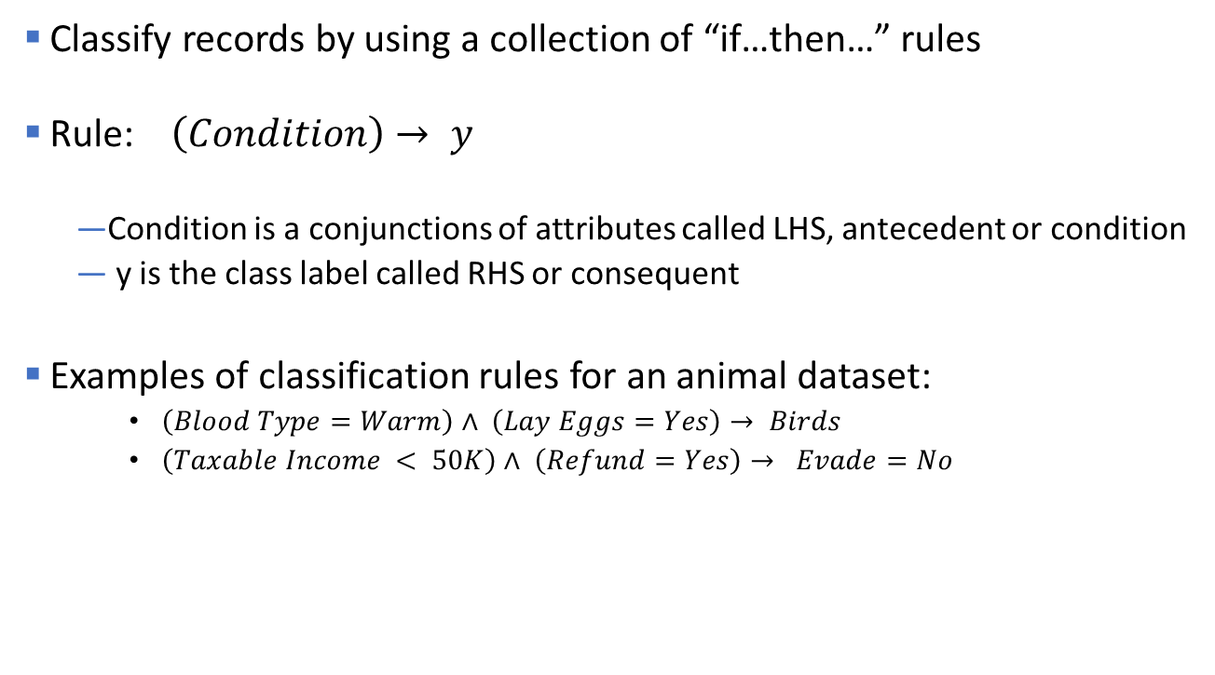
Rule-Based Classifier
Classify records by using a collection of “if…then…” rules
Rule: $\left(Condition\right)→ y$
Condition is a conjunctions of attributes called LHS, antecedent or condition
y is the class label called RHS or consequent
Examples of classification rules for an animal dataset:
$\left(Blood Type=Warm\right)∧ \left(Lay Eggs=Yes\right)→ Birds$
$\left(Taxable Income < 50K\right)∧ \left(Refund=Yes\right)→ Evade=No$

Slide 5

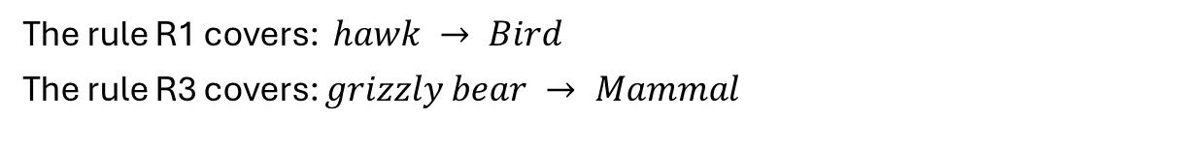
Using a Rule-Based Classifier
A rule $R$ covers an instance x if the attributes of the instance satisfy the condition of the rule. Such a rule can be used for classification.
R1: (Give Birth = no) ∧ (Can Fly = yes) → Birds
R2: (Give Birth = no) ∧ (Live in Water = yes) → Fishes
R3: (Give Birth = yes) ∧ (Blood Type = warm) → Mammals
R4: (Give Birth = no) ∧ (Can Fly = no) → Reptiles
R5: (Live in Water = sometimes) → Amphibians
Rule base
The rule R1 covers: $hawk → Bird$
The rule R3 covers: $grizzly bear → Mammal$

Slide 6
Ordered Rule Set vs. Voting
Rules are rank ordered according to their priority
An ordered rule set is known as a decision list
When a test record is presented to the classifier
It is assigned to the class label of the highest ranked rule it has triggered (R3 is selected below -> Amphibians)
If none of the rules fired, it is assigned to the default class
Alternative: (weighted) voting by all matching rules (-> Amphibians)
R1: (Give Birth = no) ∧ (Can Fly = yes) → Birds
R2: (Give Birth = yes) ∧ (Blood Type = warm) → Mammals
R3: (Live in Water = sometimes) → Amphibians
R4: (Give Birth = no) ∧ (Can Fly = no) → Reptiles
R5: (Give Birth = no) → Amphibians
Rule base
R3, 4 and 5 cover the observation

Slide 7
Rules From Decision Trees
Rules are created by reading the decisions in tree branches from the root to a final node.
Rule set contains as much information as the tree.
Rules can be simplified (similar to pruning of the tree).
Example: C4.5rules

Slide 8
Direct Methods of Rule Generation
Extract rules directly from the data.
Sequential Covering (Example: try to cover class +)
y
y
y
d
c
...
a
b
x
x
x
R1: a>x>b ∧ c>y>d ⟶ class +

Slide 9
Advantages of Rule-Based Classifiers
As expressive as decision trees
Easy to interpret
Easy to generate
Can classify new instances rapidly
Performance comparable to decision trees

Slide 10
Topics
Rule-Based Classifier
Nearest Neighbor Classifier
Naive Bayes Classifier
Logistic Regression
Artificial Neural Networks
Support Vector Machines
Ensemble Methods

Slide 11
Nearest-Neighbor Classifiers
Basic idea:
If it walks like a duck, quacks like a duck, then it’s probably a duck
Compute Distance
Test Record
Training Records
Choose k of the “nearest” records

Slide 12
Nearest-Neighbor Classifiers
Unknown record
Requires three things
The set of stored records.
Distance Metric to compute the distance between records.
The value of k, the number of nearest neighbors to retrieve.
To classify an unknown record:
Compute distance to other training records.
Identify k nearest neighbors.
Use class labels of nearest neighbors to determine the class label of an unknown record (e.g., by taking majority vote).
y
k=3
–
+
–
–
+
+
–
–
+
–
+
–
–
–
–
–
–
–
–
–
–
–
–
–
+
+
+
–
+
+
–
+
+
–
+
x

Slide 13
Definition of Nearest Neighbor
k-nearest neighbors of a record x are data points with the k smallest distances to x.
k is a hyperparameter.
Odd numbers are preferable for k.

Slide 14
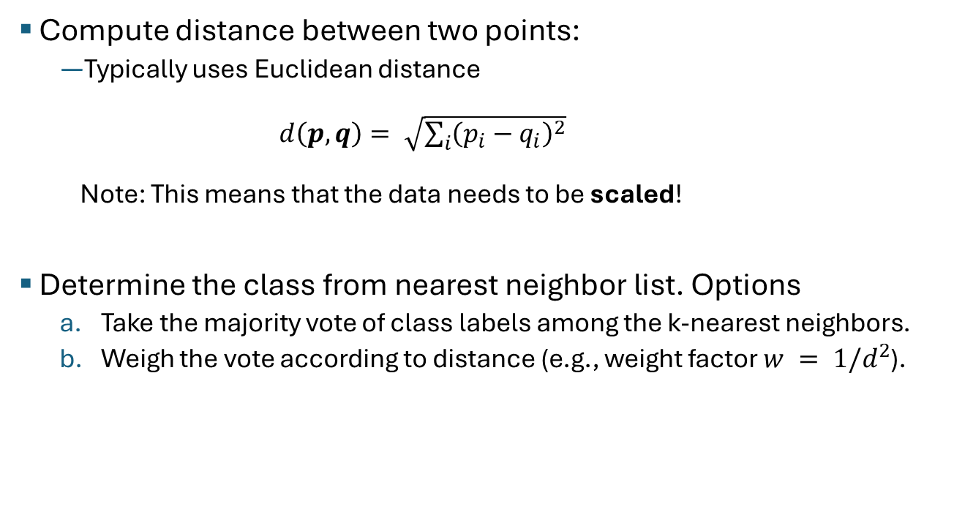
Distance Computation for Nearest-Neighbor Classification
Compute distance between two points:
Typically uses Euclidean distance $d\left(p,q\right)= \sqrt{\sum_{i}{{\left({p_{i}−q}_{i}\right)}^{2}}}$ Note: This means that the data needs to be scaled!
Determine the class from nearest neighbor list. Options
Take the majority vote of class labels among the k-nearest neighbors.
Weigh the vote according to distance (e.g., weight factor $w = 1/d^{2}$).

Slide 15
Choosing k
y
–
If k is too small, sensitive to noise points
If k is too large, neighborhood may include points from other classes
–
–
–
–
+
–
–
–
–
–
–
–
+
–
–
–
+
–
+
–
+
–
–
–
–
–
–
+
+
+
–
+
+
+
+
–
+
–
x
k is too large!

Slide 16
Advantages and Disadvantages
Advantage: Can create arbitrary non-linear decision boundaries.
Disadvantages: k-NN classifiers are lazy learners
It does not build models explicitly (unlike eager learners such as decision trees).
Needs to store all the training data.
Classifying unknown records are relatively expensive (find the k-nearest neighbors). Space partitioning data structures like k-d trees can help.
y
–
+
–
–
–
–
–
–
+
+
–
–
–
+
–
–
–
–
+
+
–
+
–
–
–
+
+
k=1
x

Slide 17
Topics
Rule-Based Classifier
Nearest Neighbor Classifier
Naive Bayes Classifier
Logistic Regression
Artificial Neural Networks
Support Vector Machines
Ensemble Methods

Slide 18
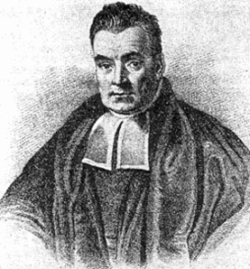
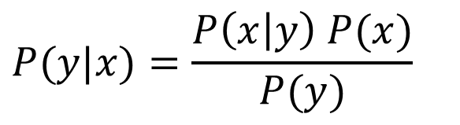

Bayes’ Rule
The product rule gives us two ways to factor a joint distribution:
Therefore,
Why is this useful?
Can get diagnostic probability $P(\text{cavity} | \text{toothache})$from causal probability $P(\text{toothache} | \text{cavity})$
We can update our beliefs based on evidence.
Important tool for probabilistic inference .
$$P\left(x,y\right)=P\left(x | y\right)P\left(y\right)=P\left(y | x\right)P(x)$$
Posterior Prob.
Prior Prob.
$$P(y|x)=\frac{P\left(x | y\right) P(x)}{P(y)}$$
Rev. Thomas Bayes (1702-1761)

Slide 19
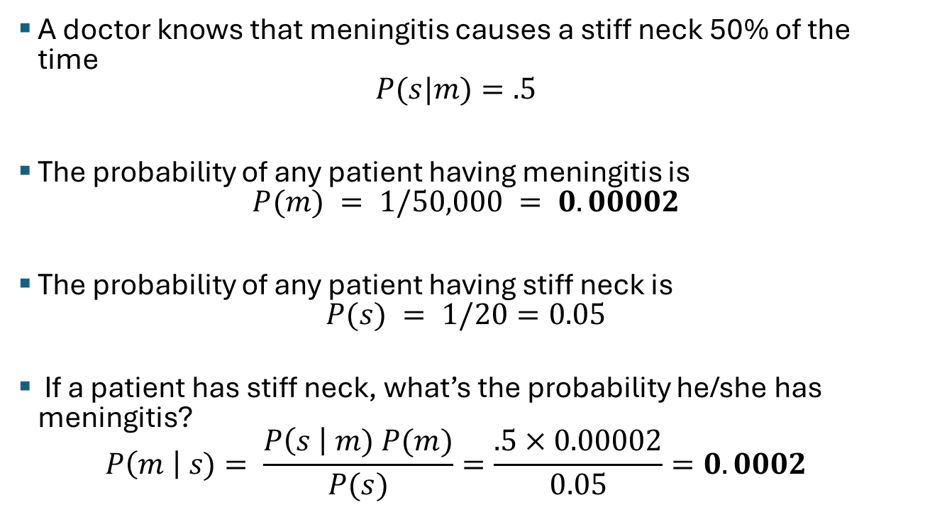
Example of Bayes Theorem
A doctor knows that meningitis causes a stiff neck 50% of the time $P(s|m)=.5$
The probability of any patient having meningitis is $P(m) = 1/50,000 = 0.00002$
The probability of any patient having stiff neck is $P(s) = 1/20=0.05$
If a patient has stiff neck, what’s the probability he/she has meningitis? $P\left(m \right| s)= \frac{P\left(s \right| m) P(m)}{P(s)}=\frac{.5×0.00002}{0.05}=0.0002$
Increases the probability by x10!

Slide 20
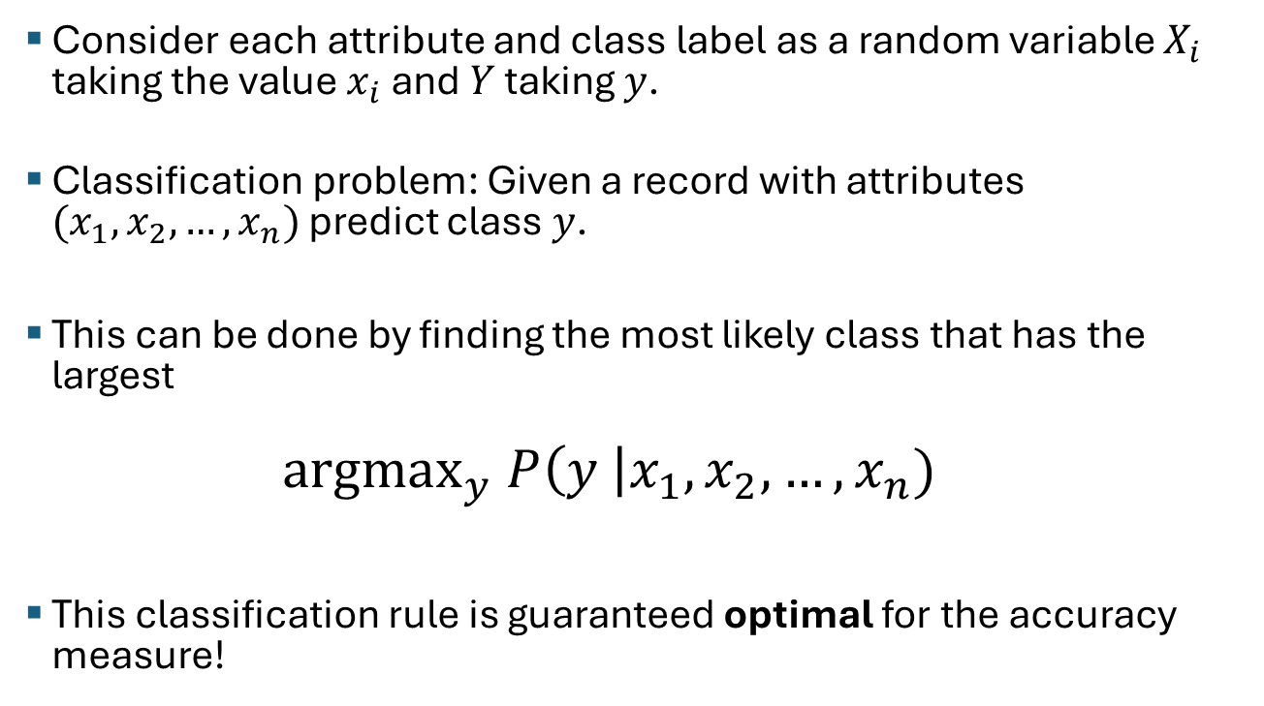
Bayesian Classification Rule
Consider each attribute and class label as a random variable $X_{i}$ taking the value $x_{i}$ and $Y$ taking $y$.
Classification problem: Given a record with attributes $(x_{1}, x_{2},…,x_{n})$ predict class $y$.
This can be done by finding the most likely class that has the largest
$$\text{argma}{\text{x}}_{y} P\left(y \right|x_{1}, x_{2},…,x_{n})$$
This classification rule is guaranteed optimal for the accuracy measure!

Slide 21
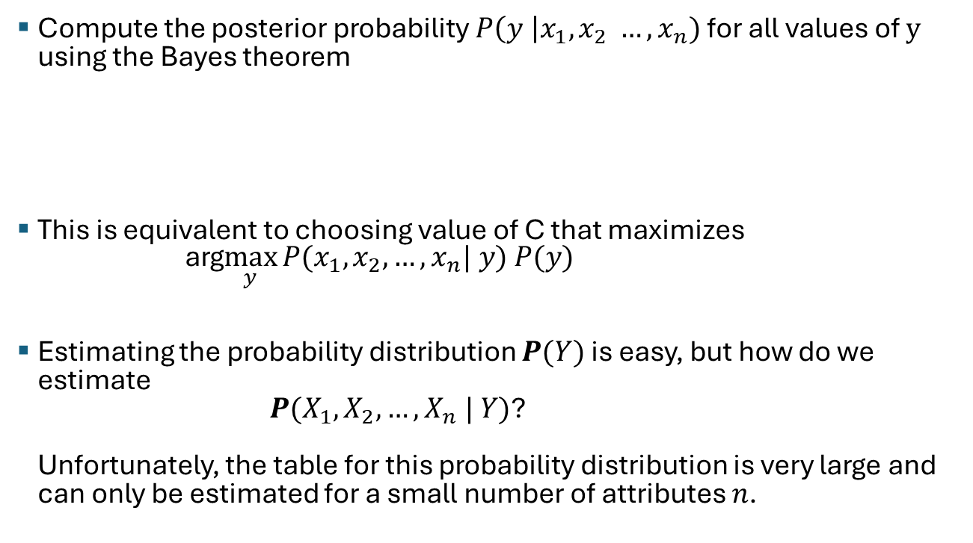
Bayesian Classifiers
Compute the posterior probability $P\left(y \right|x_{1}, x_{2} …, x_{n})$ for all values of $y$ using the Bayes theorem
This is equivalent to choosing value of C that maximizes arg$\max_{y}{P(x_{1}, x_{2}, …, x_{n}| y) P(y) }$
Estimating the probability distribution $P(Y)$ is easy, but how do we estimate $P(X_{1}, X_{2}, …, X_{n} | Y)$? Unfortunately, the table for this probability distribution is very large and can only be estimated for a small number of attributes $n$.
$$\underset{y}{argmax}{P\left(y \right|x_{1}, x_{2}, …, x_{n})}=\text{argma}{\text{x}}_{C}\frac{P(x_{1}, x_{2}, …, x_{n}| y) P(y)}{P(x_{1}, x_{2}, …, x_{n})}$$
This is a constant! We don’t need it for the max.

Slide 22
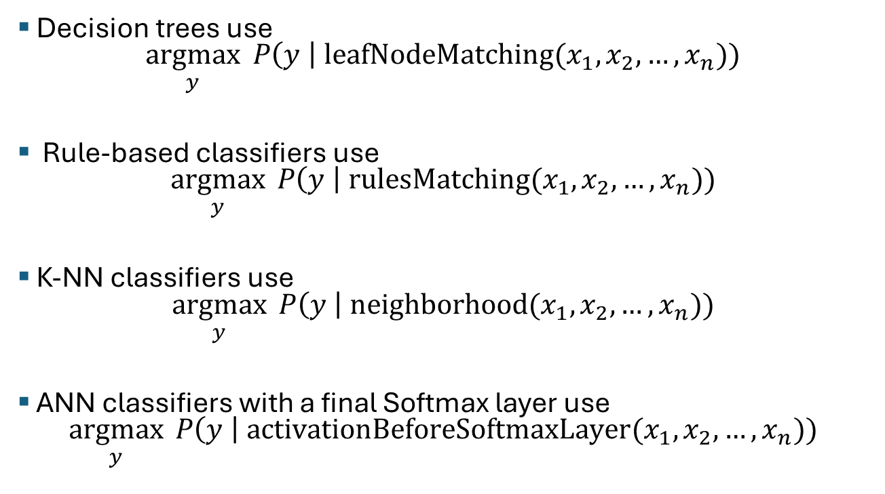
Approximation of Bayesian Classifiers
Decision trees use $\underset{y}{argmax}{ P\left(y \right| \text{leafNodeMatching}(x_{1}, x_{2},…, x_{n})) }$
Rule-based classifiers use $\underset{y}{argmax}{ P\left(y \right| \text{rulesMatching}(x_{1}, x_{2},…, x_{n})) }$
K-NN classifiers use $\underset{y}{argmax}{ P\left(y \right| \text{neighborhood}(x_{1}, x_{2},…, x_{n})) }$
ANN classifiers with a final Softmax layer use $\underset{y}{argmax}{ P\left(y \right| \text{activationBeforeSoftmaxLayer}(x_{1}, x_{2},…, x_{n})) }$

Slide 23
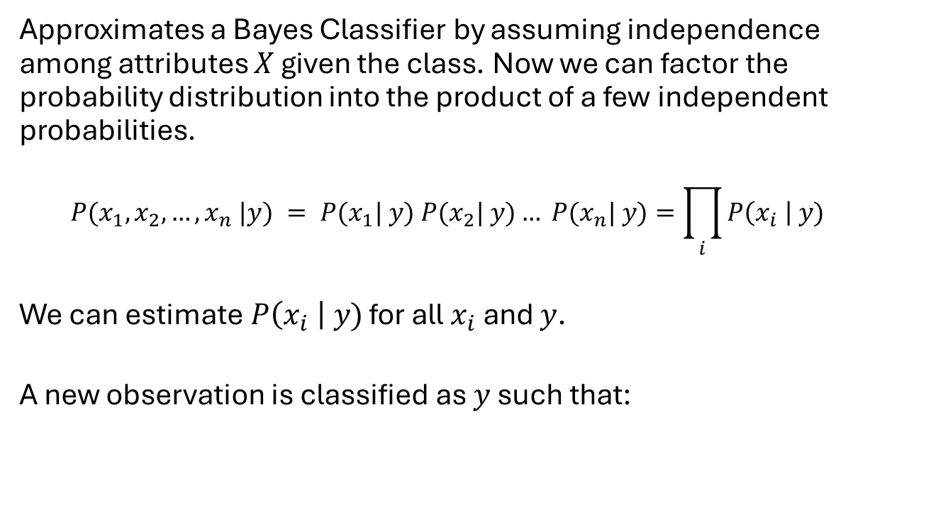
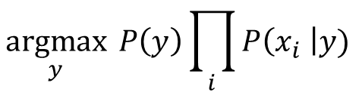
Naïve Bayes Classifier
Approximates a Bayes Classifier by assuming independence among attributes $X$ given the class. Now we can factor the probability distribution into the product of a few independent probabilities.
$$P(x_{1}, x_{2}, …, x_{n} |y) = P(x_{1}| y) P(x_{2}| y)… P(x_{n}| y)=\prod_{i}{P\left(x_{i} \right| y)}$$
We can estimate$P\left(x_{i} \right| y)$ for all $x_{i}$ and $y$.
A new observation is classified as $y$ such that:
$$\underset{y}{argmax}{ P\left(y\right)\prod_{i}{P\left(x_{i} \right|y) }}$$

Slide 24
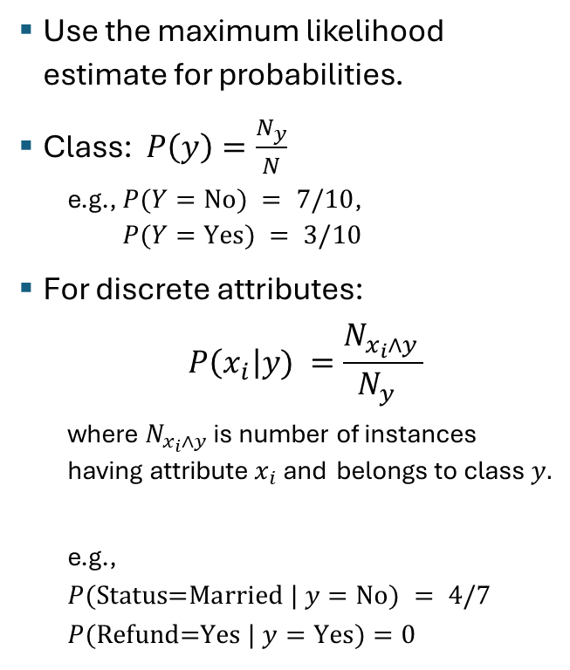
How to Estimate Probabilities from Data? Nominal Features
Use the maximum likelihood estimate for probabilities.
Class: $P\left(y\right)=\frac{N_{y}}{N}$
e.g., $P(Y=\text{No}) = 7/10$, $P(Y=\text{Yes}) = 3/10$
For discrete attributes: $P\left(x_{i}\right|y) =\frac{N_{x_{i}∧y }}{N_{y} }$
where $N_{x_{i}∧y}$ is number of instances having attribute$x_{i}$and belongs to class $y.$
e.g.,
$$P(\text{S}\text{tatus}\text{=}\text{Married} | y=\text{No}) = 4/7 \\ P(\text{Refund}\text{=}\text{Yes} | y=\text{Yes})=0$$

Slide 25
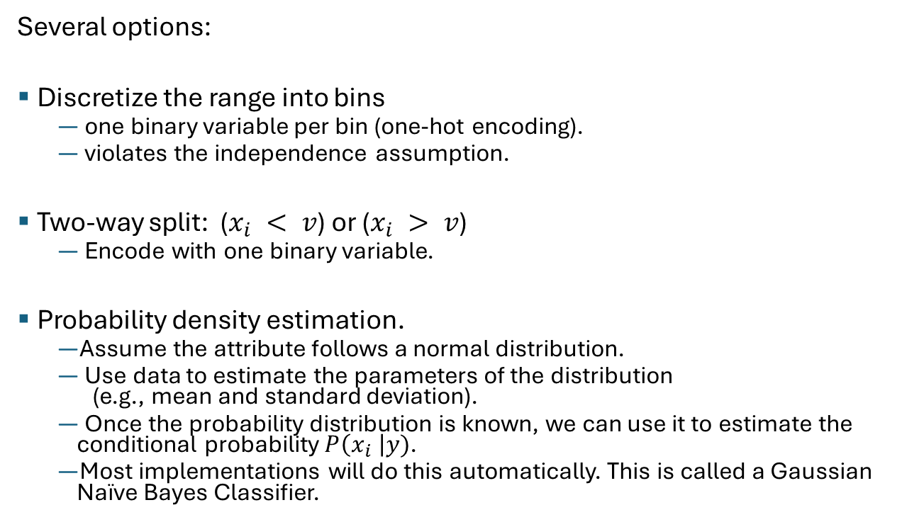
How to Estimate Probabilities from Data? Continuous Features
Several options:
Discretize the range into bins
one binary variable per bin (one-hot encoding).
violates the independence assumption.
Two-way split: ($x_{i} < v$) or ($x_{i} > v$)
Encode with one binary variable.
Probability density estimation.
Assume the attribute follows a normal distribution.
Use data to estimate the parameters of the distribution (e.g., mean and standard deviation).
Once the probability distribution is known, we can use it to estimate the conditional probability $P\left(x_{i} \right|y)$.
Most implementations will do this automatically. This is called a Gaussian Naïve Bayes Classifier.

Slide 26
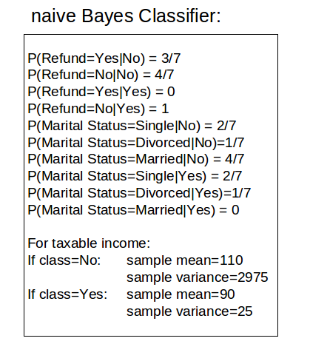
Example of Naïve Bayes Classifier
Given a Test Record what is the most likely class?
$$x=(\text{Refund}\text{=}\text{No}\text{, }\text{Married}\text{, }\text{Income}=120K)$$
P(x|Class=No) = P(Refund=No|Class=No) * P(Married|Class=No) * P(Income=120K|Class=No) = 4/7 * 4/7 * 0.0072 = 0.0024
P(x|Class=Yes) = P(Refund=No|Class=Yes) * P(Married|Class=Yes) * P(Income=120K|Class=Yes) = 1 * 0 * 1.2 * 10⁻⁹ = 0
P(No|x) = P(x|No)P(No) > P(Yes|x) = P(x|Yes)P(Yes)
Predicted Class is No
0s are an issue!

Slide 27
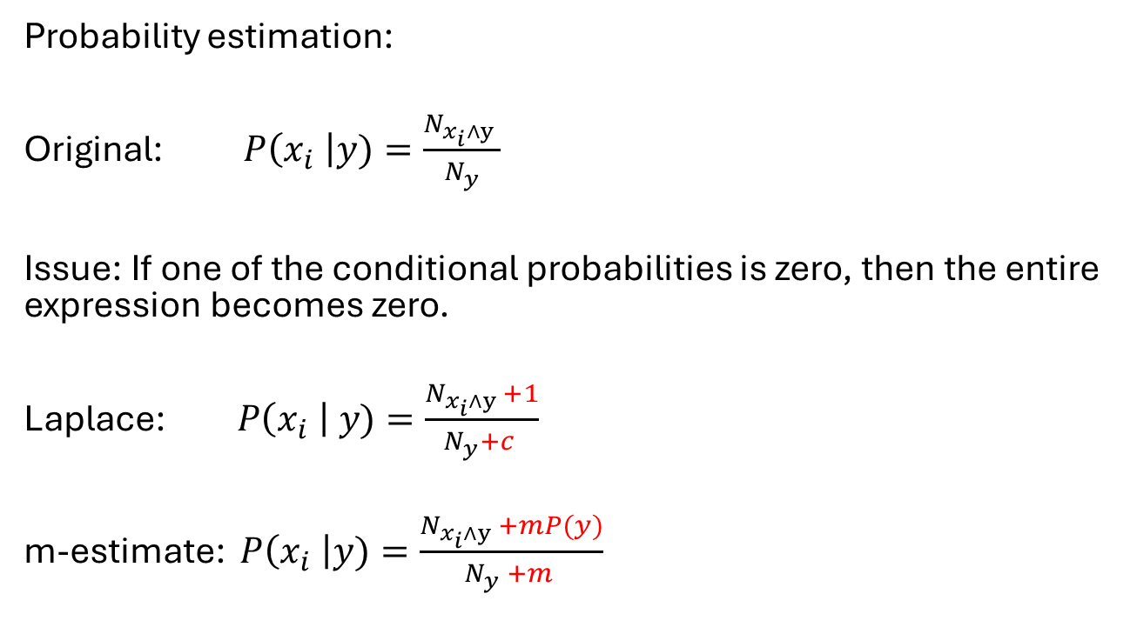
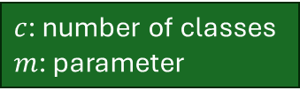
Naïve Bayes Classifier: Dealing With Low Counts
Probability estimation:
Original: $P\left(x_{i} \right|y)=\frac{N_{x_{i}∧y }}{N_{y}}$
Issue: If one of the conditional probabilities is zero, then the entire expression becomes zero.
Laplace: $P\left(x_{i} \right| y)=\frac{N_{x_{i}∧y }+1}{N_{y}+c }$
m-estimate: $P\left(x_{i} \right|y)=\frac{N_{x_{i}∧y }+mP(y)}{N_{y} +m }$
$c$: number of classes $m$: parameter

Slide 28
Summary of Naïve Bayes Classifiers
Robust to outliers and isolated noise points since it is not based on distances.
Can handle missing value during prediction: Ignore the attribute during probability estimate calculations.
Robust to irrelevant attributes: Features are estimated independently. Irrelevant features will produce a likelihood that is a uniform distribution given the class.
Independence assumption may not hold for some attributes
Typically, the classifiers still work well when the assumption is slightly violated.
You can remove highly correlated attributes.
Use other techniques such as Bayesian Belief Networks (BBN) that explicitly model dependence.

Slide 29
Topics
Rule-Based Classifier
Nearest Neighbor Classifier
Naive Bayes Classifier
Logistic Regression
Artificial Neural Networks
Support Vector Machines
Ensemble Methods

Slide 30
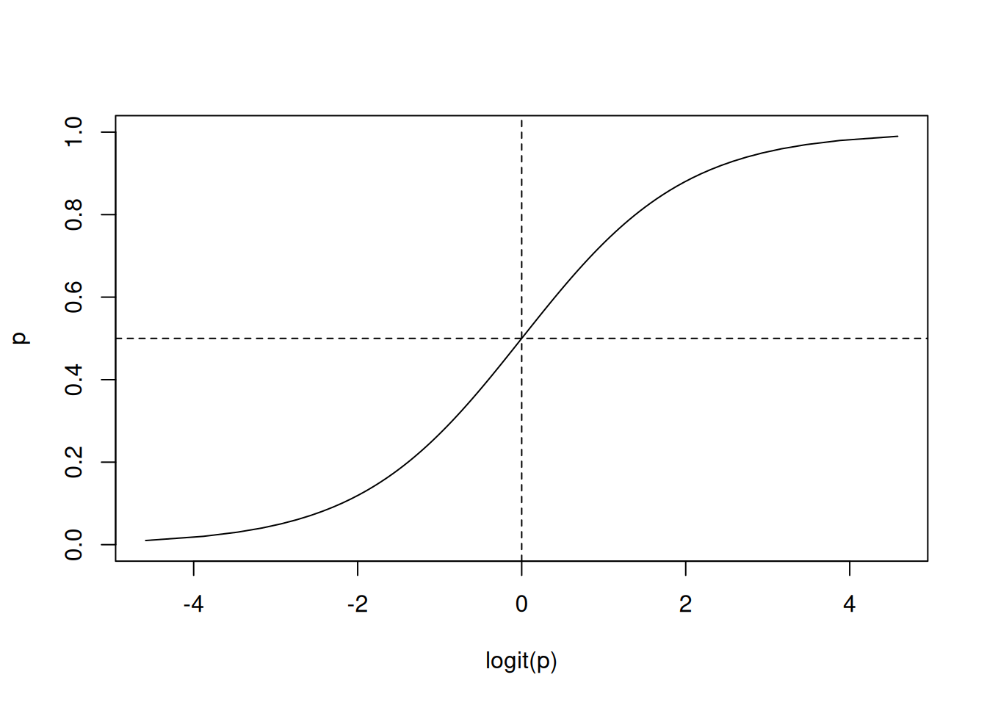




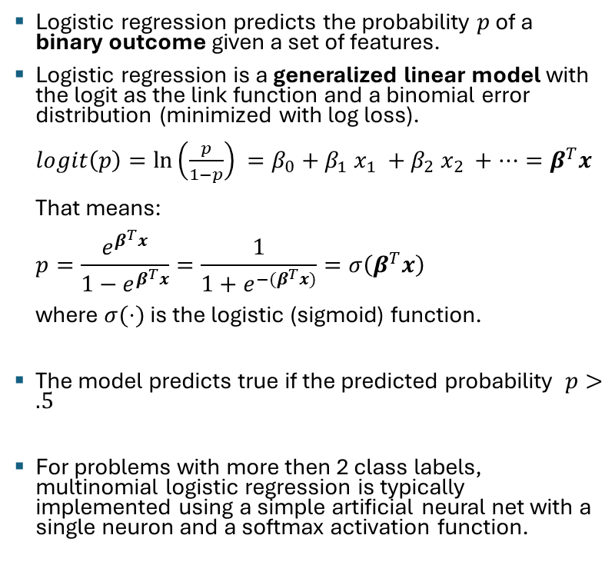








Logistic Regression
Logistic (sigmoid) Function $σ$
Logistic regression predicts the probability $p$ of a binary outcome given a set of features.
Logistic regression is a generalized linear model with the logit as the link function and a binomial error distribution (minimized with log loss). $logit\left(p\right)=\ln\left(\frac{p}{1−p}\right) =β_{0}+β_{1} x_{1} +β_{2} x_{2} +…=β^{T}x$ That means: $p=\frac{e^{β^{T}x}}{1−e^{β^{T}x}}=\frac{1}{1+e^{−(β^{T}x)}}=σ\left(β^{T}x\right)$ where $σ(⋅)$ is the logistic (sigmoid) function.
The model predicts true if the predicted probability $p>.5$
For problems with more then 2 class labels, multinomial logistic regression is typically implemented using a simple artificial neural net with a single neuron and a softmax activation function.
$$x_{1}$$
$$β_{1}$$
$$x_{2}$$
$$β_{2}$$
$$∑$$
$$σ$$
$$β_{m}$$
$$p$$
…
$$x_{m}$$
$$β_{0}$$
$1$ (bias)

Slide 31
Topics
Rule-Based Classifier
Nearest Neighbor Classifier
Naive Bayes Classifier
Logistic Regression
Artificial Neural Networks
Support Vector Machines
Ensemble Methods

Slide 32
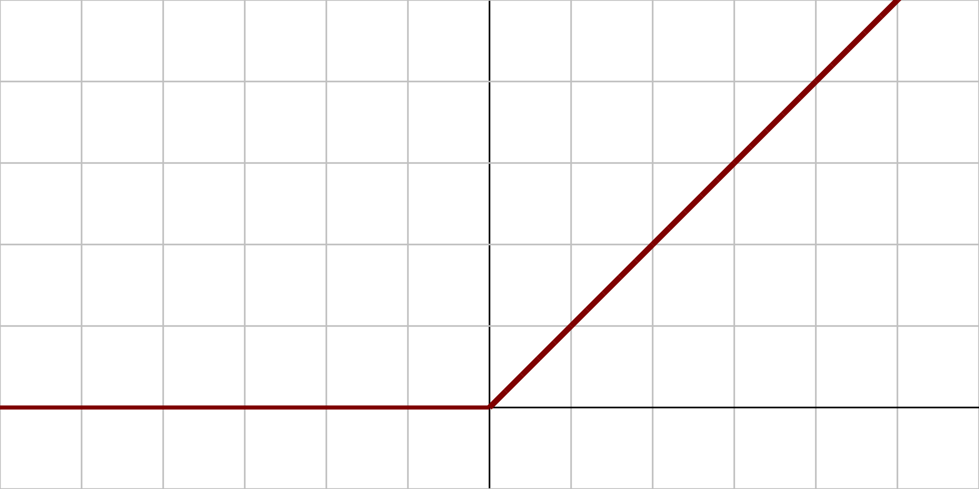
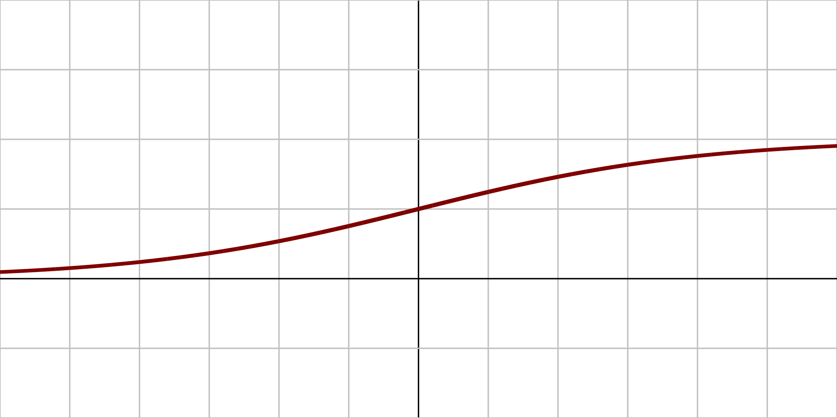



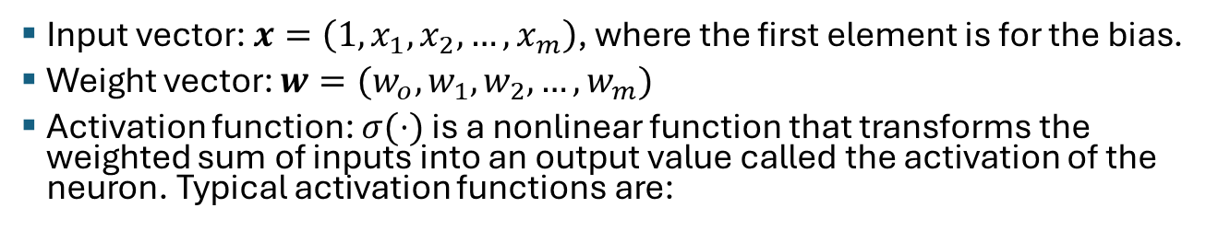
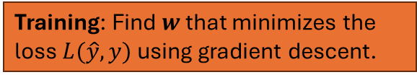





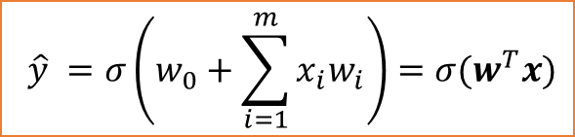


The Artificial Neuron
$$x_{1}$$
$$w_{1}$$
$$\hat{y} =σ\left(w_{0}+\sum_{i=1}^{m}{x_{i}w_{i}}\right)=σ(w^{T}x)$$
$$x_{2}$$
$$w_{2}$$
$$∑$$
$$σ$$
$$w_{m}$$
$$\hat{y}$$
…
$$x_{m}$$
$$w_{0}$$
$1$ (bias)
Input vector: $x=\left(1, x_{1},x_{2}, …, x_{m}\right)$, where the first element is for the bias.
Weight vector: $w=(w_{o},w_{1},w_{2},…,w_{m})$
Activation function: $σ(⋅)$ is a nonlinear function that transforms the weighted sum of inputs into an output value called the activation of the neuron. Typical activation functions are:
Rectified linear unit (ReLU)
Sigmoid (logistic function)
Training: Find $w$ that minimizes the loss $L(\hat{y},y)$ using gradient descent.
$$σ(x)$$
$$σ(x)$$
$$1$$
Relationship to Logistic regression to predict a binary outcome probability: Log. Regression is a single artificial neuron with a logistic activation function and trained using binary cross-entropy loss (log loss).
$$0$$
$$0$$
$$x$$
$$x$$
Bias shifts this point

Slide 33








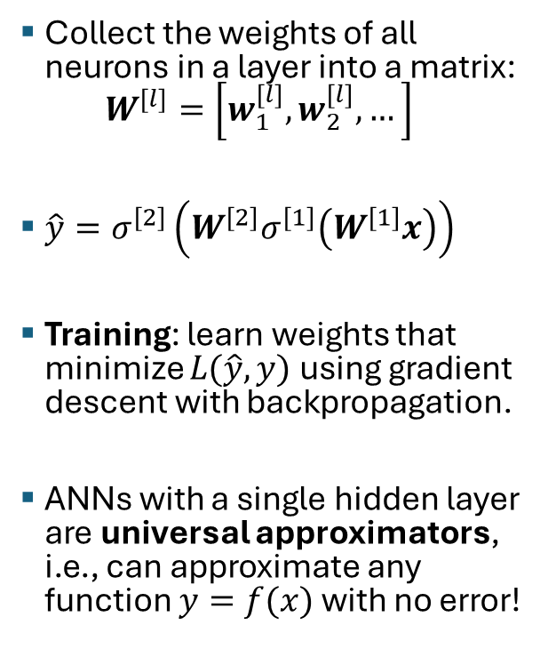










General Structure of an ANN
$$x_{1}$$
$$w_{1}$$
$$∑$$
$$w_{2}$$
$$σ$$
$$\hat{y}$$
$$x_{2}$$
…
$$w_{0}$$
$1$ (bias)
Collect the weights of all neurons in a layer into a matrix: $W^{\left[l\right]}=\left[w_{1}^{\left[l\right]},w_{2}^{\left[l\right]}, …\right]$
$\hat{y}=σ^{[2]}\left(W^{\left[2\right]}σ^{[1]}\left(W^{\left[1\right]}x\right)\right)$
Training: learn weights that minimize $L(\hat{y},y)$ using gradient descent with backpropagation.
ANNs with a single hidden layer are universal approximators, i.e., can approximate any function $y=f(x)$ with no error!
$$y, x=$$
$$x_{1}$$
$$x_{2}$$
$$x_{m}$$
Input Layer
…
$$W^{\left[1\right]}$$
Hidden Layer
$$σ^{\left[1\right]}$$
$$W^{\left[2\right]}$$
Output Layer
$$σ^{\left[2\right]}$$
$$L(\hat{y},y)$$
$$\hat{y}$$

Slide 34
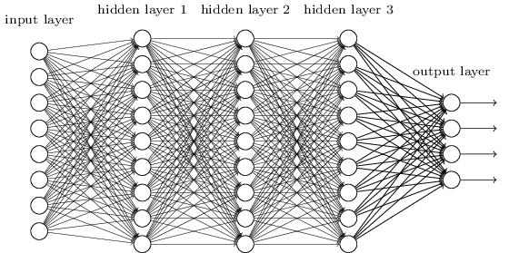







Deep Learning / Deep Neural Networks
$$x_{1}$$
Estimated class probabilities
$$x_{2}$$
$$\hat{P}(Y=y_{1})$$
$$\hat{P}(Y=y_{2})$$
$$…$$
$$\hat{P}(Y=y_{3})$$
$$\hat{P}(Y=y_{4})$$
$$x_{m}$$
End-to-end machine learning: The hidden layers can provide automatic feature engineering for the output layer.
Transfer learning: Pretrained layers may be reused.
Issues: Deciding on the network topology. Many hyperparameters. Needs lots of data + computation (GPU).
Applications: computer vision, speech recognition, natural language processing, audio recognition, machine translation, bioinformatics, …
Tools: Keras, Tensorflow, and many others.
Related: Deep belief networks, recurrent neural networks (RNN), convolutional neural network (CNN), …

Slide 35
Topics
Rule-Based Classifier
Nearest Neighbor Classifier
Naive Bayes Classifier
Logistic Regression
Artificial Neural Networks
Support Vector Machines
Ensemble Methods

Slide 36
Support Vector Machines
Goal: Find a linear hyperplane (decision boundary) that will separate the data.

Slide 37
Support Vector Machines
Many possible solutions

Slide 38
Support Vector Machines
B1
B2
Which one is better? B1 or B2?
How do you define better?

Slide 39
Support Vector Machines
B1
B2
margin
Find the hyperplane with the maximal margin => B1 is better than B2
Larger margin = more robust = less expected generalization error

Slide 40
Support Vector Machines
What if the problem is not linearly separable?
Use slack variables to account for violations.
Use hyperplane that minimizes the total slack.
Solution:
The optimization problem can be written as a quadratic optimization problem with linear constraints that only depends on a few close data points called the support vectors.
slack

Slide 41
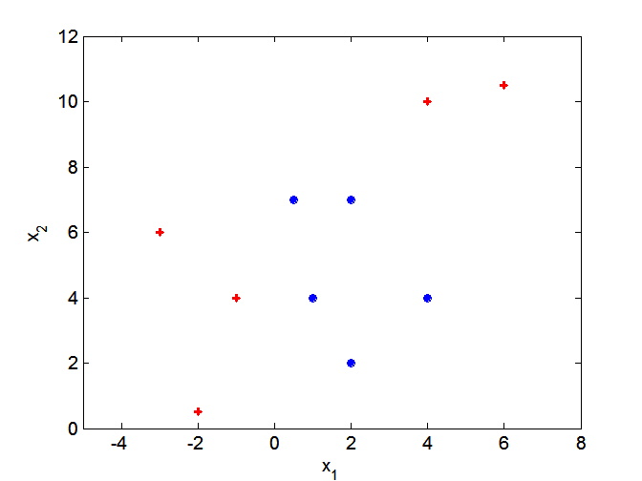
Nonlinear Support Vector Machines
SVMs look for linear decision boundaries. What if decision boundary is not linear?

Slide 42
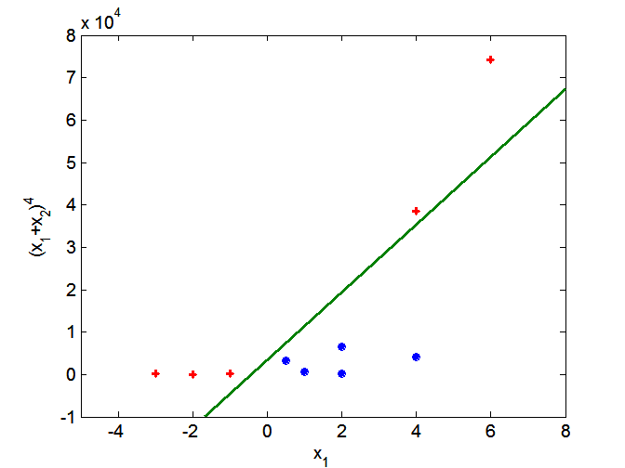
Nonlinear Support Vector Machines
projection
Project data into a higher dimensional space where the classes are linearly separable.
Projection is expensive! Kernel trick: Compute the similarity (inner product) in the projected space directly from the original data. This trick can be used with other method like clustering as well.

Slide 43
Topics
Rule-Based Classifier
Nearest Neighbor Classifier
Naive Bayes Classifier
Logistic Regression
Artificial Neural Networks
Support Vector Machines
Ensemble Methods

Slide 44
Ensemble Methods
Method
Construct a set of (possibly weak) classifiers from the training data.
Predict class label of previously unseen records by aggregating predictions made by multiple classifiers.
Advantages
Improve the stability and often also the accuracy of classifiers.
Reduces variance in the prediction.
Reduces overfitting.

Slide 45
General Idea
sampling
weak learners
voting
prediction

Slide 46

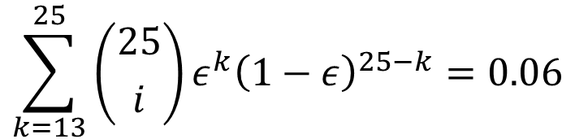
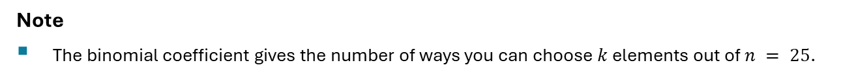
Why does it work?
Suppose there are 25 base classifiers.
Each classifier has error rate $ε = 0.35$
Assume classifiers are independent (different features and/or training data).
Probability that the ensemble classifier makes a wrong prediction:
$$\sum_{k=13}^{25}{\left({25 \atop i}\right)ε^{k}{\left(1−ε\right)}^{25−k}=0.06}$$
= Probability that the majority (13 or more classifiers) make the wrong decision.
Note
The binomial coefficient gives the number of ways you can choose $k$ elements out of $n = 25$.

Slide 47
Examples of Ensemble Methods
How to generate an ensemble of independent classifiers?
Bagging
Use several samples
Boosting
Increase the weight for misclassified data points
Random Features
Use different features

Slide 48
Bagging (Bootstrap Aggregation)
1. Sampling with replacement (bootstrap sampling)
Note: some objects are chosen multiple times in a bootstrap sample while others are not chosen! A typical bootstrap sample contains about 63% of the objects in the original data.
2. Build classifiers, one for each bootstrap sample (classifiers are hopefully independent since they are learned from different subsets of the data)
3. Aggregate the classifiers' results by averaging or voting

Slide 49
Boosting
Records that are incorrectly classified in one round will have their weights increased in the next
Example 4 is hard to classify. Its weight is increased so it is more likely to be chosen again in subsequent rounds. This creates a larger error, and the classifier will try harder to predict it correctly.
Popular algorithm: AdaBoost (Adaptive Boosting) typically uses decision trees as the weak learner.

Slide 50
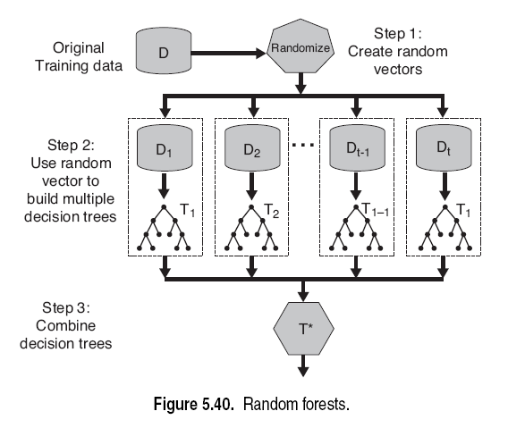
Random Forests
Introduce two sources of randomness: “Bagging” and “Random input vectors”
Bagging method: each tree is grown using a bootstrap sample of training data
Random vector method: At each node, the best split is chosen only from a random sample of the m possible attributes.

Slide 51
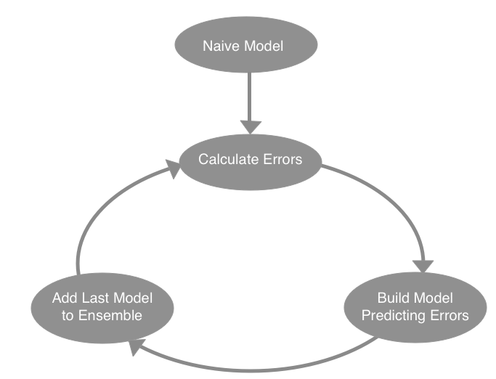
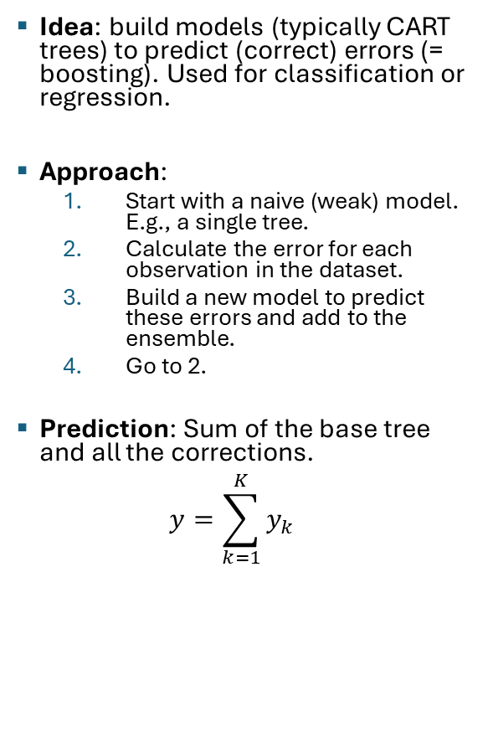
Gradient Boosted Decision Trees (XGBoost)
Idea: build models (typically CART trees) to predict (correct) errors (= boosting). Used for classification or regression.
Approach:
Start with a naive (weak) model. E.g., a single tree.
Calculate the error for each observation in the dataset.
Build a new model to predict these errors and add to the ensemble.
Go to 2.
Prediction: Sum of the base tree and all the corrections. $y=\sum_{k=1}^{K}{y_{k}}$
Error should decrease
Other names: Gradient Boosting Machine (GBM), Multiple Additive Regression Trees (MART), Boosted Regression Trees (BRT), TreeNet

Slide 52

Topics
Other Classification Methods
Rule-Based Classifier
Nearest Neighbor Classifier
Naive Bayes Classifier
Logistic Regression
Artificial Neural Networks
Support Vector Machines
Ensemble Methods
Class Imbalance Problem

Slide 53
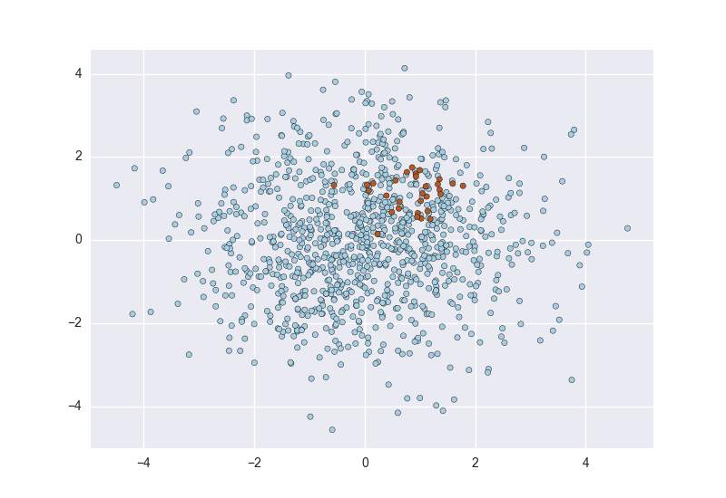
Class Imbalance Problem
Consider a 2-class problem
Number of Class 0 examples = 9990
Number of Class 1 examples = 10
A simple model:
Always predict Class 0
accuracy = 9990/10000 = 99.9 %
error = 0.1%
Issues:
Evaluation: accuracy is misleading.
Learning: Most classifiers try to optimize accuracy/error. These classifiers will not learn how to find examples of Class 1!

Slide 54
Class Imbalance Problem: Evaluation
Do not use accuracy to evaluate problems with strong class imbalance!
Use instead:
ROC curves and AUC (area under the curve) for binary classifiers.
Cohen's Kappa which corrects for random accuracy.
Misclassification cost.
Precision/Recall plots or the F1 Score.

Slide 55
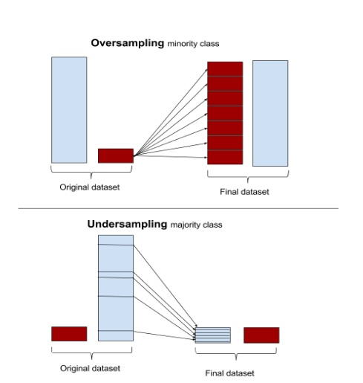
Class Imbalance Problem: Learning
Do nothing. Sometimes you get lucky!
Balance the data set: Down-sample the majority class and/or up-sample the minority class (use sampling with replacement). Synthesize new examples with SMOTE. This will artificially increase the error for a mistake in the minority class.
Use algorithms that can deal with class imbalance (see next slide).
Throw away minority examples and switch to an anomaly detection framework.

Slide 56
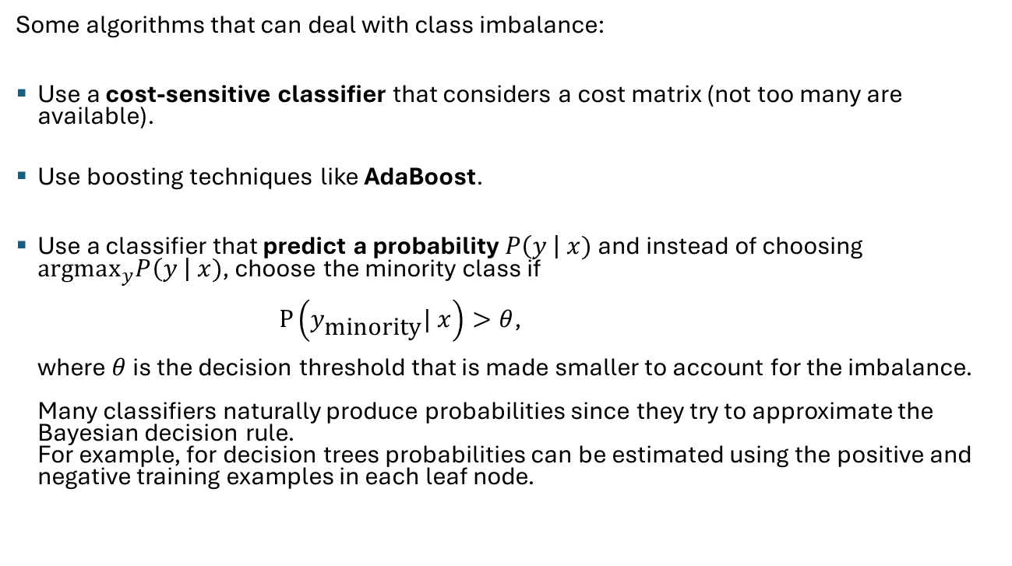
Class Imbalance Problem: Learning
Some algorithms that can deal with class imbalance:
Use a cost-sensitive classifier that considers a cost matrix (not too many are available).
Use boosting techniques like AdaBoost.
Use a classifier that predict a probability $P\left(y \right| x)$ and instead of choosing $\text{argma}{\text{x}}_{y}P\left(y \right| x)$, choose the minority class if $P\left(y_{\text{minority}}| x\right)>θ$, where $θ$ is the decision threshold that is made smaller to account for the imbalance. Many classifiers naturally produce probabilities since they try to approximate the Bayesian decision rule. For example, for decision trees probabilities can be estimated using the positive and negative training examples in each leaf node.

Slide 57

Conclusion
Bias: There are many ways to implement the classification function. Each of them has a different inductive bias.
Feature extraction and feature creation are important (e.g., interaction effects in linear models). Deep learning can also learn to create features.
Overfitting and model variability are issues. Appropriate validation and test data need to be used to produce and evaluate models that generalize well.
Accuracy is problematic for imbalanced data sets. Rebalancing the data may be a necessity.
Model explainability is often important. Rules and trees may be easier to explain than other models.
(Deep) artificial neural networks are a very powerful method, but other methods may be preferable since ANNs:
Have no or very low bias and need lots of training data.
Have many hyperparameters that need to be tuned experimentally.
The model represents a black box, and it is hard to explain why it makes decisions.

