Slide 1



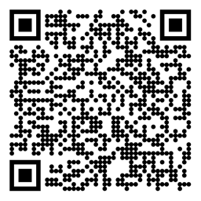

Reinforcement Learning Introduction Textbook Chapter 1
Michael Hahsler, SMU
Some slides are based on material by Oliver Wallscheid (Paderborn University) and by David Silver (University College London)

Slide 2
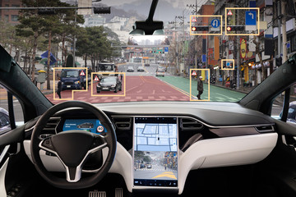
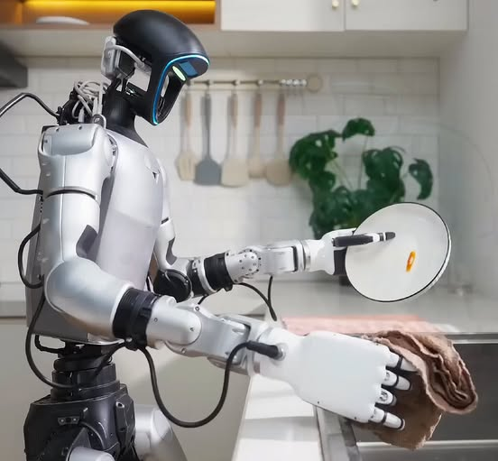
How Do We Build Intelligent Systems?
Options:
Explicitly program behavior: Rule-based agent, planning
Learn behavior from labeled data offline: Supervised learning
Learn behavior using feedback from interacting with the environment (online): Reinforcement Learning

Slide 3
Topics of this Course
Introduction to reinforcement learning
Markov decision processes
Part I: Tabular Methods
Dynamic programming
Monte Carlo methods
Temporal-difference learning
Multi-step bootstrapping
Planning and learning with tabular methods
Part II: Approximate Solution Methods
Prediction and Control using Approximation
Eligibility Traces
Policy Gradient Methods
Part III: Modern RL Methods
Deep Reinforcement Learning
Current Applications

Slide 4
Recommended Readings
Richard S. Sutton, Andrew G. Barto, Reinforcement Learning: An Introduction, 2nd edition, MIT Press, Cambridge, MA, 2018.
Vincent François-Lavet, Peter Henderson, Riashat Islam, Marc G. Bellemare and Joelle Pineau, An Introduction to Deep Reinforcement Learning, Foundations and Trends in Machine Learning, 11:3-4, pp 219-354, 2018.

Slide 5
Table of Contents
What is RL?
Elements of RL
A Small Example
Important Issues in RL
RL and Planning

Slide 6
What is RL?

Slide 7
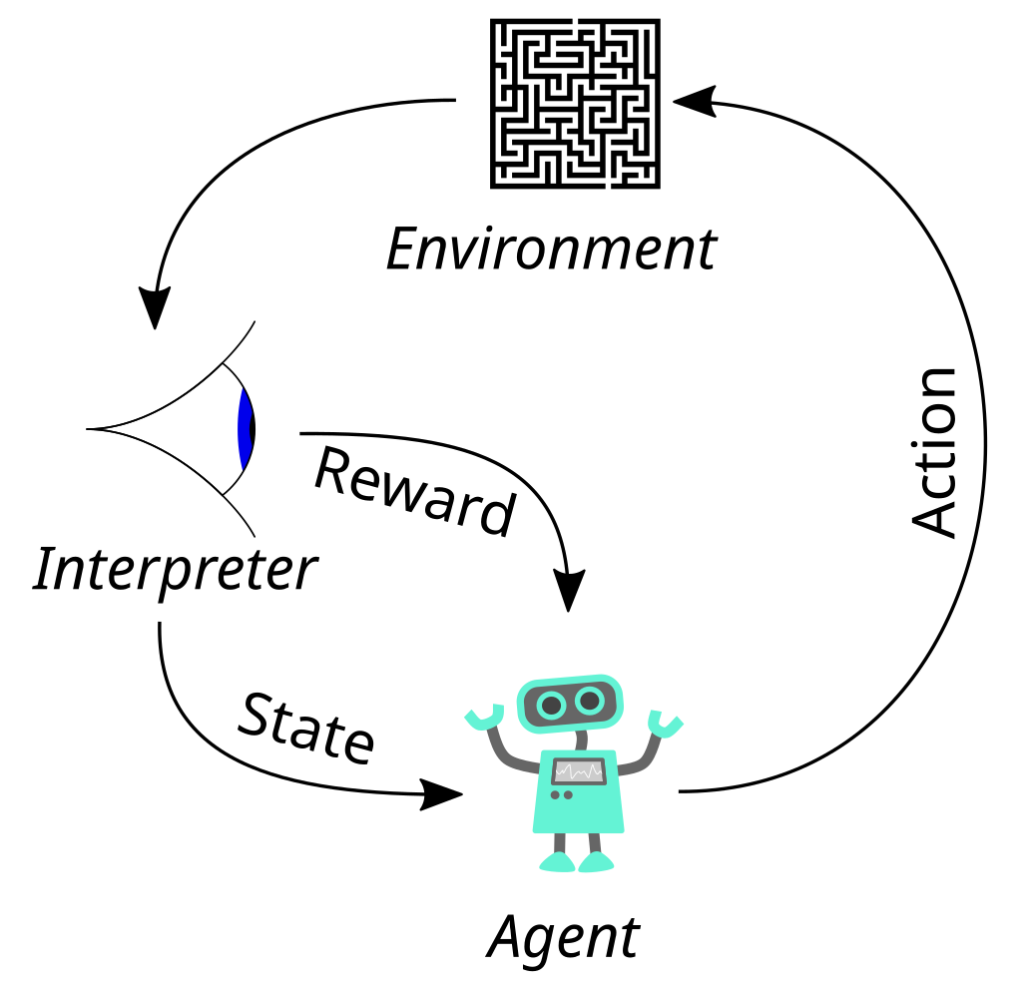



The Basic Reinforcement Learning Structure
$$a_{t}$$
Goal: Map a situation to an action to maximize the reward
Key characteristics:
Uncertainty about the environment leads to a need for sensing.
No supervisor: no training data, discover actions by trying them.
Sequential decision making: Agent actions affect subsequent data. Agent maximizes over future (delayed) rewards which need to be estimated!
Action discovery and maximization lead to a tradeoff: exploit vs. explore
Observation
$$r_{t}$$
$$s_{t}$$
The basic RL operation principle (derivative of www.wikipedia.org, CC0 1.0)

Slide 8
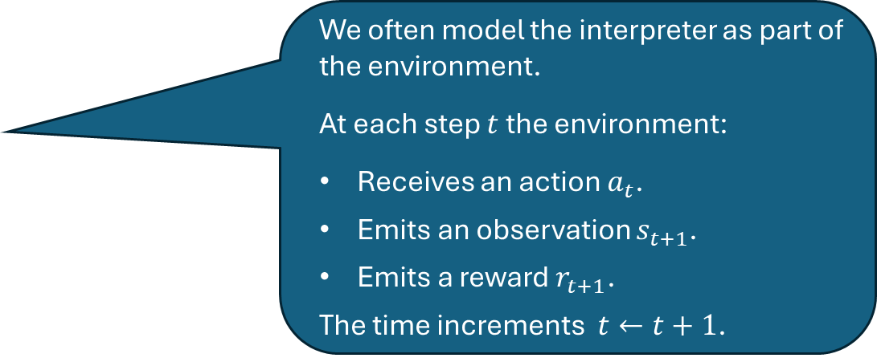
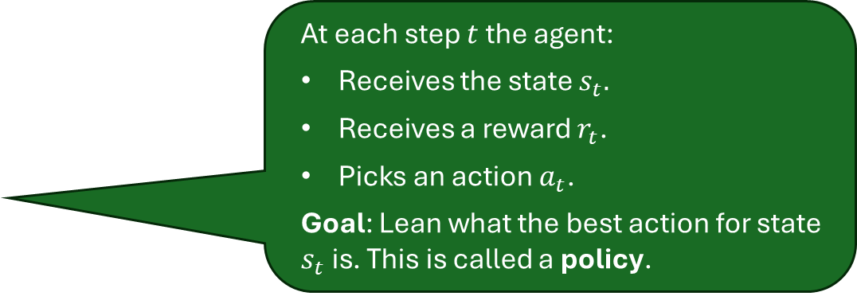
Agent and Environment
We often model the interpreter as part of the environment.
At each step $t$ the environment:
Receives an action $a_{t}$.
Emits an observation $s_{t+1}$.
Emits a reward $r_{t+1}$.
The time increments $t←t+1$.
Observation
$$a_{t}$$
$$r_{t}$$
At each step $t$ the agent:
Receives the state $s_{t}.$
Receives a reward $r_{t}$.
Picks an action $a_{t}$.
Goal: Lean what the best action for state $s_{t}$ is. This is called a policy.
$$s_{t}$$
Remark on time: In AI, we often assume a time delay of one unit between executing the action and receiving the next state as well as the reward. This is called a discrete-time process (vs. a continuous-time process).

Slide 9
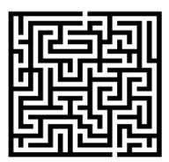








RL and Machine Learning
Machine learning is a field of AI that learns from examples.
RL is a 3rd type of machine learning
Unsupervised Learning
Process and interpret data based only
on the input
Clustering
Dimension Reduction
Environment $f(x)$
Minimize the error.
Fixed Training Data
Supervised Learning
Develop models to map input and output data
Regression
Machine Learning
Classification
ML Model approx. $f(x)$
Reinforcement Learning
Learn optimal control actions to maximize long-term reward
Single-Agent
Observation
What should I do to maximize long-term rewards?
Multi-Agent

Slide 10
When to Use RL vs Supervised Learning
Sequential problems
Actions now affect future outcomes
Delayed feedback (e.g., a good chess move leads to a win later)
Instead of minimizing prediction error, RL optimizes a long-term objective (cumulative reward over time).
Learning through interaction with an environment
No labeled training data
Rewards are produced from interacting with the environment
Dynamic, uncertain, and potentially changing environment. RL explicitly models
exploration (trying new actions) vs exploitation (using known good actions).
Observation
Do not use RL if
You already have high-quality labeled training data.
The task is static (e.g., image classification, spam detection).
Decisions do not influence future states.

Slide 11

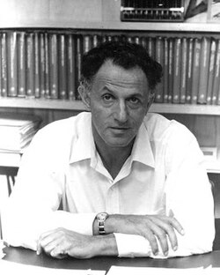






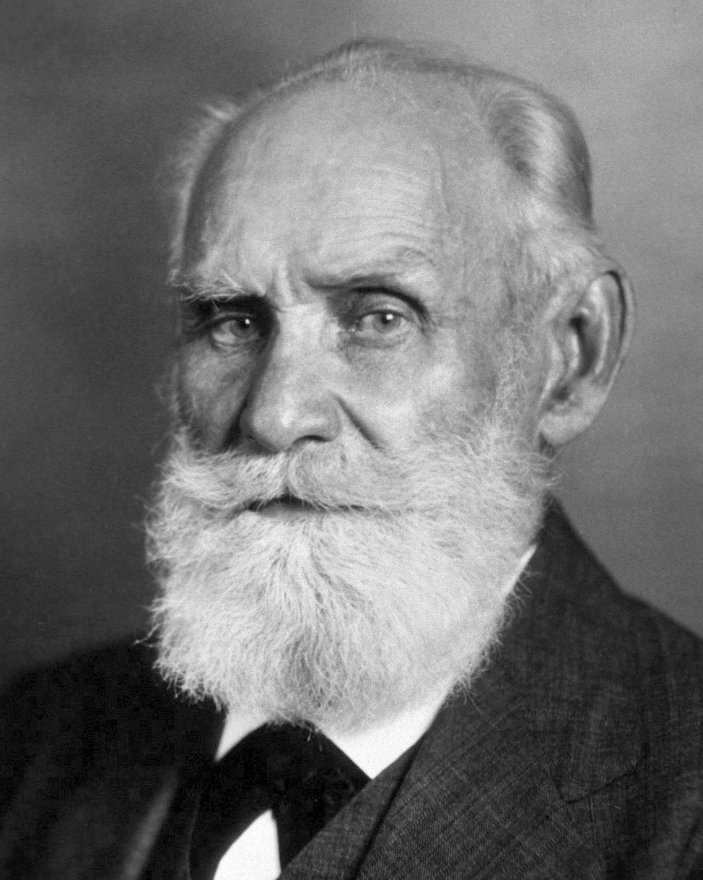
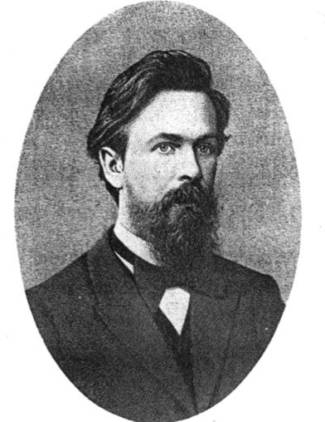
Many Faces of Reinforcement Learning
Optimal sequential decision making
Richard E. Bellman (1920-1984)
American applied mathematician, who introduced dynamic programming and the Bellman equation. Foundation of optimal control theory.
Computer Science
Engineering
Machine Learning
Neuroscience
Optimal Control
Reward System
Classical conditioning
Reinforcement Learning
Operations Classical/Operant Research Conditioning
Bounded Rationality
Stochastic process formalism
Mathematics
Psychology
Ivan Pavlov (1849-1936)
Russian physiologist and Nobel laureate who discovered classical conditioning through his experiments with dogs.
Economics
Andrei Markov (1856-1922)
Russian mathematician developed the groundwork for Markov chains to model dynamical systems.
RL and its neighboring domains
(source: D. Silver, “Reinforcement learning”, 2015. CC BY-NC 4.0)

Slide 12
Contemporary application examples
RL has led to superhuman performance for many games and simple toy examples
Playing Atari Breakout
Play strategy board game Go at super-human performance
Simulated classic control problems
Swinging-up and balance a cart-pole / an inverted pendulum
Using RL for real applications is promising, but much more difficult. Here are some examples:
Controlling electric drive systems
Flipping pancakes with a roboter arm
Drifting with a RC-car
Driving an autonomous car
Nuclear fusion reactor plasma control
Training chat bots (like chatGPT)
...
Reasons for difficulty:
Real environments are complicated.
Sensors (observations) are noisy.
We often have partial observability.
The number of different actions can be large.
Measuring reward can be difficult.
No access to a fast, perfect simulation environment.

Slide 13
Elements of RL

Slide 14
Elements of RL
Observation
We will discuss:
State, Interpreter, Observations and Reward
Actions and Policy

Slide 15


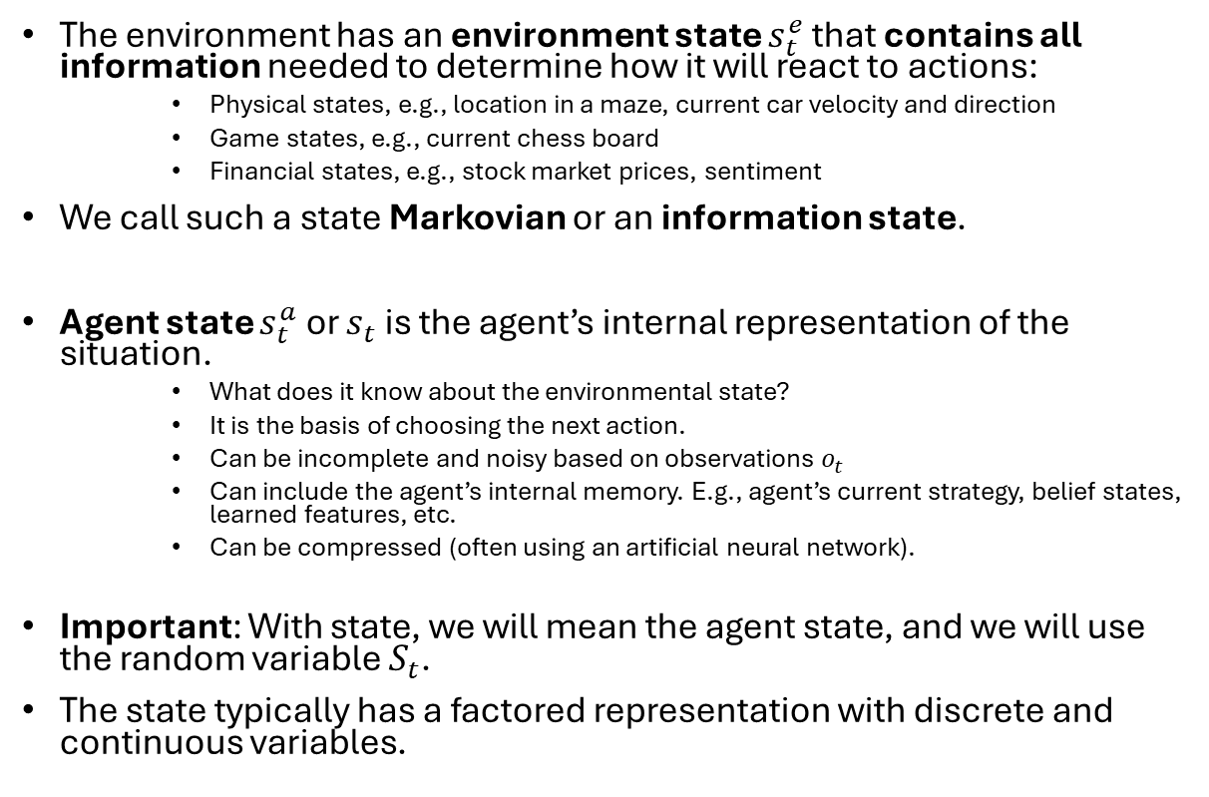


State
$s_{t}^{e}$
The environment has an environment state $s_{t}^{e}$ that contains all information needed to determine how it will react to actions:
Physical states, e.g., location in a maze, current car velocity and direction
Game states, e.g., current chess board
Financial states, e.g., stock market prices, sentiment
We call such a state Markovian or an information state.
Agent state $s_{t}^{a}$ or $s_{t}$ is the agent’s internal representation of the situation.
What does it know about the environmental state?
It is the basis of choosing the next action.
Can be incomplete and noisy based on observations $o_{t}$
Can include the agent’s internal memory. E.g., agent’s current strategy, belief states, learned features, etc.
Can be compressed (often using an artificial neural network).
Important: With state, we will mean the agent state, and we will use the random variable $S_{t}$.
The state typically has a factored representation with discrete and continuous variables.
$$a_{t}$$
Observation
$$o_{t}$$
$$r_{t}$$
$$s_{t}$$

Slide 16
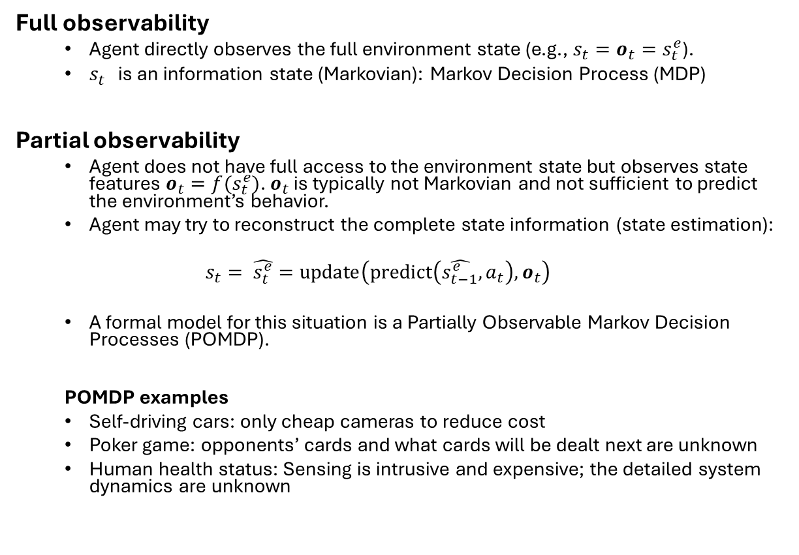
Degree of Observability
$s_{t}^{e}$
Full observability
Agent directly observes the full environment state (e.g., $s_{t}=o_{t}=s_{t}^{e}$).
$s_{t}^{}$ is an information state (Markovian): Markov Decision Process (MDP)
Partial observability
Agent does not have full access to the environment state but observes state features $o_{t}=f(s_{t}^{e})$. $o_{t}$ is typically not Markovian and not sufficient to predict the environment’s behavior.
Agent may try to reconstruct the complete state information (state estimation):
$$s_{t}= \hat{s_{t}^{e}}=\text{update}\left(\text{predict}\left(\hat{s_{t−1}^{e}},a_{t}\right), o_{t}\right)$$
A formal model for this situation is a Partially Observable Markov Decision Processes (POMDP).
POMDP examples
Self-driving cars: only cheap cameras to reduce cost
Poker game: opponents’ cards and what cards will be dealt next are unknown
Human health status: Sensing is intrusive and expensive; the detailed system dynamics are unknown
$$a_{t}$$
Observation
$$o_{t}$$
$$r_{t}$$
$$s_{t}$$
The agent design often includes designing the interpreter’s state estimation.

Slide 17

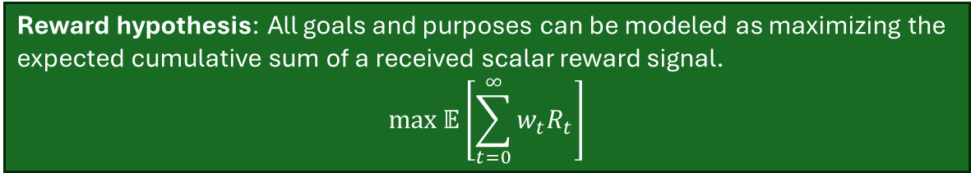

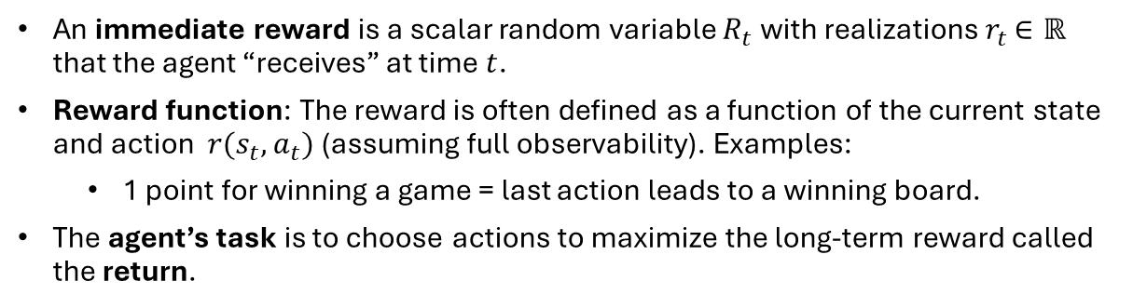



Reward
$s_{t}^{e}$
An immediate reward is a scalar random variable $R_{t}$ with realizations $r_{t}$ $∈ℝ$ that the agent “receives” at time $t$.
Reward function: The reward is often defined as a function of the current state and action $r(s_{t},a_{t})$ (assuming full observability). Examples:
1 point for winning a game = last action leads to a winning board.
The agent’s task is to choose actions to maximize the long-term reward called the return.
$$a_{t}$$
Observation
$$o_{t}$$
$$r_{t}$$
Reward hypothesis: All goals and purposes can be modeled as maximizing the expected cumulative sum of a received scalar reward signal. $$\max{𝔼\left[\sum_{t=0}^{∞}{{w_{t}R}_{t}}\right]}$$
$$s_{t}$$
The reward hypothesis is a foundational assumption of RL! This means that the reward structure fully determines the goal.
The designer’s task is to design the reward signal so the agent can learn how to achieve the goal. This is called reward engineering or reward shaping. E.g., add a reward for intermediate goals, such as achieving 3 in a row in Connect-4.
The agent design often includes designing the reward structure
Note: $w_{t}$ is just a weight that depends only on $t$.

Slide 18
Reward Characteristics
Rewards are highly dependent on the given problem:
Actions may have short and long-term consequences.
The reward for a certain action may be delayed, leading to the credit assignment problem.
Examples: Stock trading, strategic board games,…
Rewards can be positive and negative values.
Certain situations (e.g., car hits a wall) might lead to a negative reward (= a cost).
Exogenous impacts might introduce stochastic reward components.
Example: A wind gust pushes an autonomous helicopter into a tree.

Slide 19
Reward Examples
Flipping a pancake:
Pos. reward: catching the flipped pancake
Neg. reward: dropping the pancake on the floor
Stock trading:
Trading portfolio monetary value
Playing Atari games:
Highscore value at the end of a game episode
Driving an autonomous car:
Pos. reward: getting safely from A to B without crashing
Neg. reward: hitting another car, pedestrian, bicycle,...
Classical control task (e.g., electric drive, inverted pendulum,...):
Pos. reward: following a given reference trajectory precisely
Neg. reward: violating a system constraint or producing a large control error

Slide 20
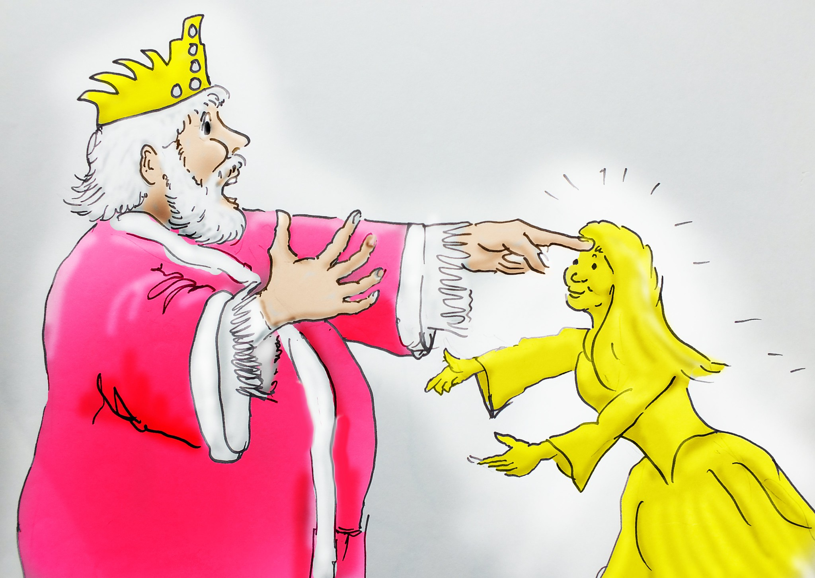
Issues With the Reward Function
“Be careful what you wish for - you might get it” (proverb)
“...it grants what you ask for, not what you should have asked for or what you intend.” (Norbert Wiener, American mathematician)
Reward engineering: Designing an effective reward function is crucial for successful RL applications!
Issues:
Learning: The RL agent’s learning process heavily depends on the reward distribution over time.
Alignment: The reward structure needs to represent the designer’s goals.
Reward hacking: The agent exploits mistakes in the reward structure or model to maximize reward without solving the problem.
Midas and daughter (good as gold) (source: www.flickr.com, by Robin Hutton CC BY-NC-ND 2.0)

Slide 21
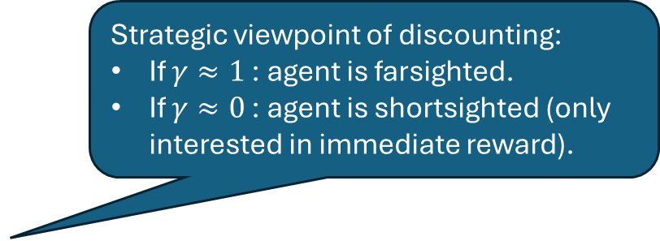
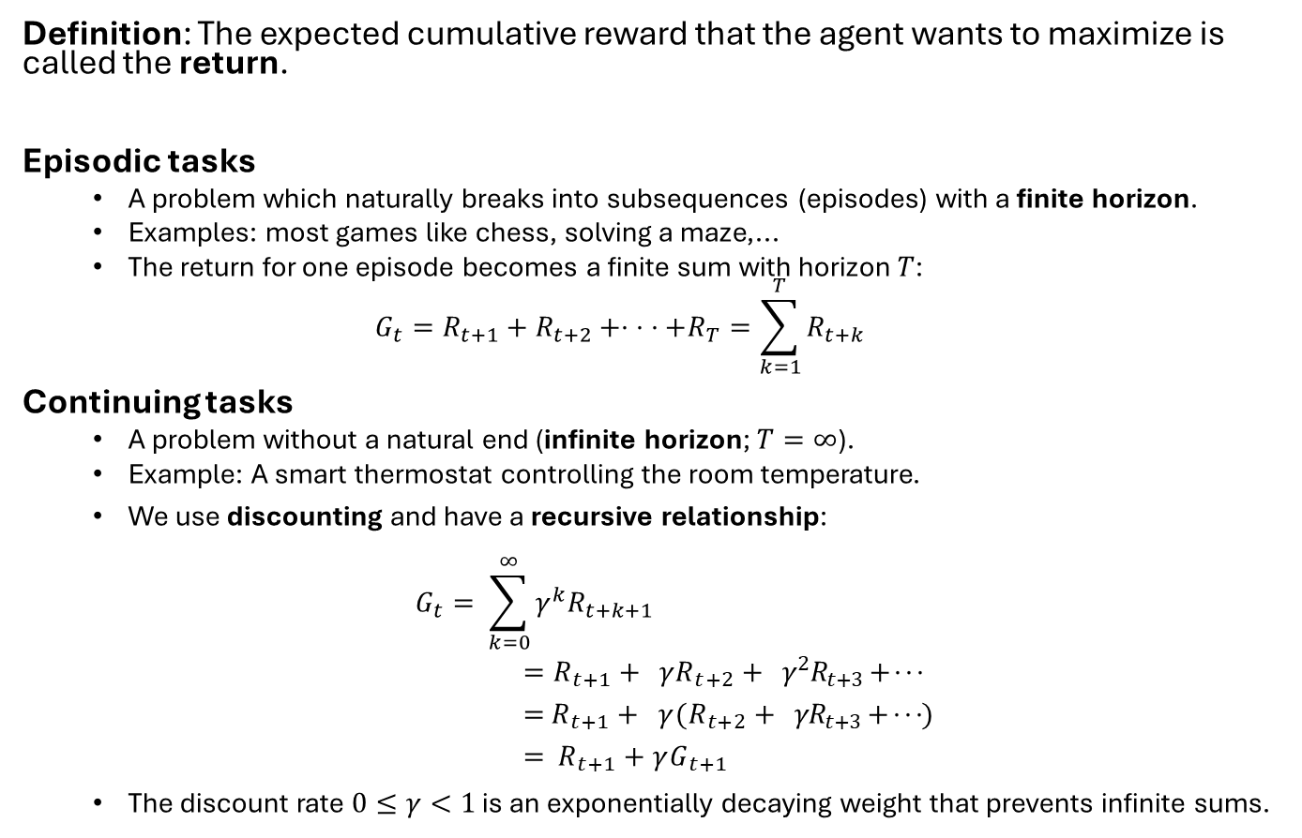
Episodic and Continuing Tasks
Definition: The expected cumulative reward that the agent wants to maximize is called the return.
Episodic tasks
A problem which naturally breaks into subsequences (episodes) with a finite horizon.
Examples: most games like chess, solving a maze,...
The return for one episode becomes a finite sum with horizon $T$:
$$G_{t}=R_{t+1}+R_{t+2}+⋅ ⋅ ⋅+R_{T}=\sum_{k=1}^{T}{R_{t+k}}$$
Continuing tasks
A problem without a natural end (infinite horizon; $T=∞$).
Example: A smart thermostat controlling the room temperature.
We use discounting and have a recursive relationship:
$$G_{t}= \sum_{k=0}^{∞}{γ^{k}R_{t+k+1}} \\ =R_{t+1}+{γR}_{t+2}+γ^{2}R_{t+3}+ ⋅ ⋅ ⋅ \\ =R_{t+1}+{γ(R}_{t+2}+γR_{t+3}+ ⋅ ⋅ ⋅) \\ = R_{t+1}+γG_{t+1}$$
The discount rate $0≤γ<1$ is an exponentially decaying weight that prevents infinite sums.
Strategic viewpoint of discounting:
If $γ≈1$: agent is farsighted.
If $γ≈0$: agent is shortsighted (only interested in immediate reward).

Slide 22
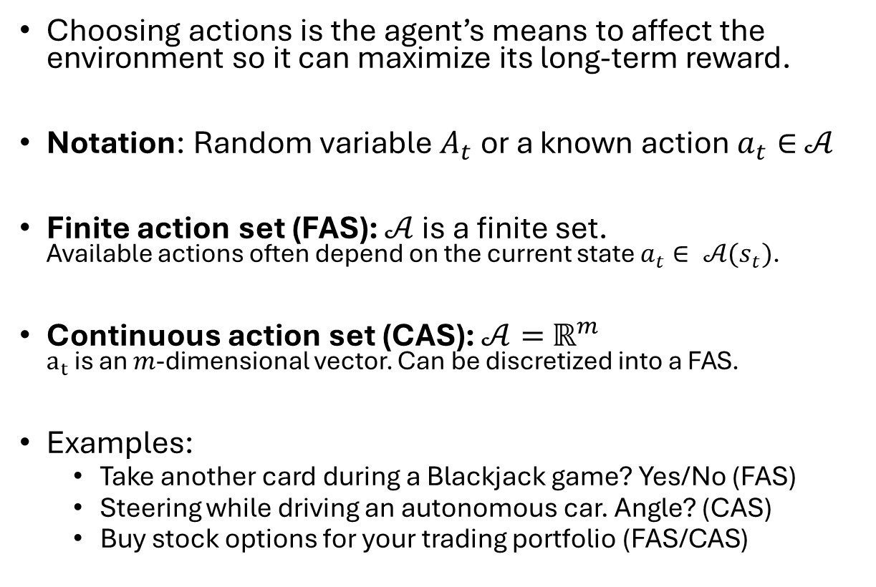


Actions
$s_{t}^{e}$
Choosing actions is the agent’s means to affect the environment so it can maximize its long-term reward.
Notation: Random variable $A_{t}$ or a known action $a_{t}∈$ $𝒜$
Finite action set (FAS): $𝒜$ is a finite set. Available actions often depend on the current state $a_{t}∈ 𝒜(s_{t})$.
Continuous action set (CAS): $𝒜=$ $ℝ^{m}$ $a_{t}$ is an $m$-dimensional vector. Can be discretized into a FAS.
Examples:
Take another card during a Blackjack game? Yes/No (FAS)
Steering while driving an autonomous car. Angle? (CAS)
Buy stock options for your trading portfolio (FAS/CAS)
$$a_{t}$$
Observation
$$o_{t}$$
$$r_{t}$$
$$s_{t}$$

Slide 23
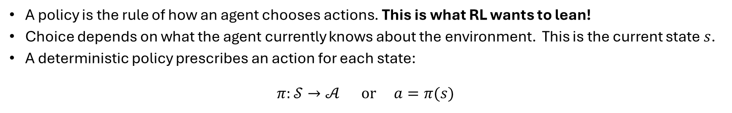
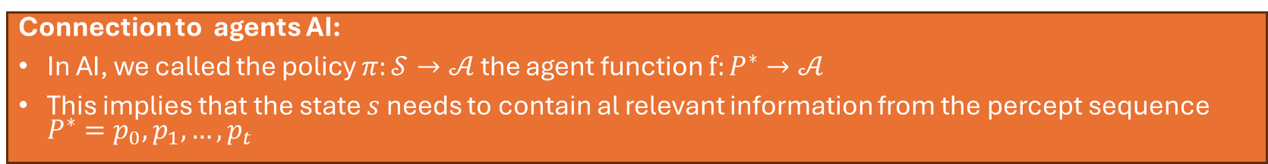
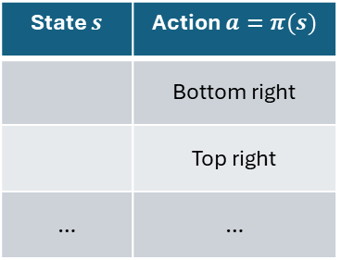
Deterministic Policy
A policy is the rule of how an agent chooses actions. This is what RL wants to lean!
Choice depends on what the agent currently knows about the environment. This is the current state $s$.
A deterministic policy prescribes an action for each state:
$$π:𝒮→𝒜 \text{or} a=π(s)$$
Example:
State: $s=$ Policy shown as a table: x plays bottom right corner for the board.
x
State $s$ | Action $a=π(s)$
 | Bottom right
 | Top right
… | …
x
x
x
o
o
o
x
o
o
Connection to agents AI:
In AI, we called the policy $π:𝒮→𝒜$ the agent function $f:P^{∗}→𝒜$
This implies that the state $s$ needs to contain al relevant information from the percept sequence $P^{∗}=p_{0},p_{1},…,p_{t}$

Slide 24
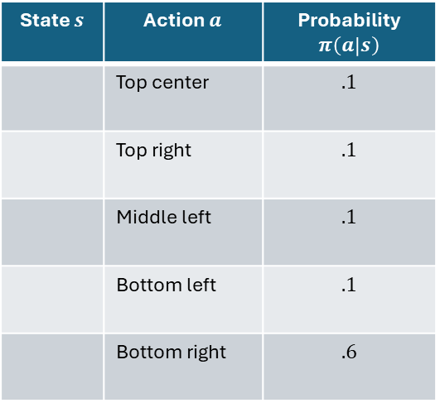
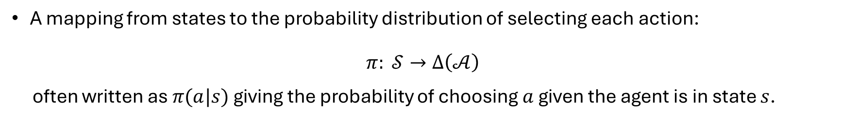
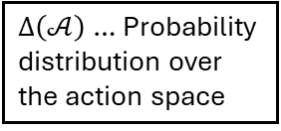
Stochastic Policy
$∆\left(𝒜\right)$… Probability distribution over the action space
A mapping from states to the probability distribution of selecting each action:
$$π: 𝒮→∆\left(𝒜\right)$$ often written as $π(a|s)$ giving the probability of choosing $a$given the agent is in state $s$.
Example: Probability distribution indicating to play bottom right 60% of the time.
State $s$ | Action $a$ | Probability $π\left(a | s\right)$
 | Top center | $$.1$$
 | Top right | $$.1$$
 | Middle left | $$.1$$
 | Bottom left | $$.1$$
 | Bottom right | $$.6$$
x
x
o
o
x
x
o
o
Note: The deterministic policy is just a special case with 1 for the chosen action and 0 for all others.
x
x
o
o
x
x
o
o
x
x
o
o

Slide 25
A Small Example
Simple Maze

Slide 26





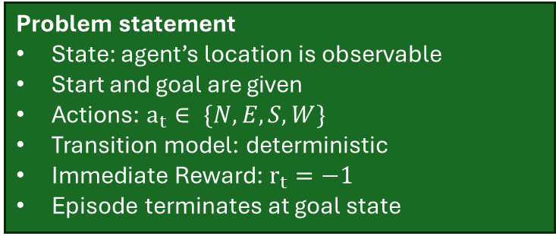

Maze Example
$s_{t}^{e}$
Observation
$$a_{t}$$
$$o_{t}$$
$$r_{t}$$
Start
$$s_{t}$$
Problem statement
State: agent’s location is observable
Start and goal are given
Actions: $a_{t}∈ \{N,E,S,W\}$
Transition model: deterministic
Immediate Reward: $r_{t}=−1$
Episode terminates at goal state
Goal
Maze setup (source: D. Silver, “Reinforcement learning”, 2015. CC BY-NC 4.0)
Episodic problem! To maximize the return, it needs to minimize the number of steps to get to the goal!

Slide 27

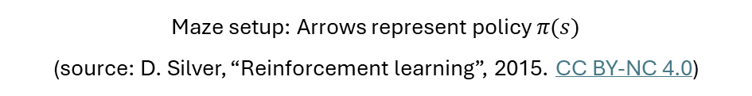
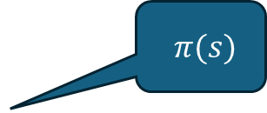
Maze Example: RL-Solution as a Policy
$$π(s)$$
Key characteristics of the policy:
Specify an action (direction) for each state (position in the maze).
Policy can be explicitly stored as a table.
Start
Goal
Maze setup: Arrows represent policy $π(s)$ (source: D. Silver, “Reinforcement learning”, 2015. CC BY-NC 4.0)

Slide 28

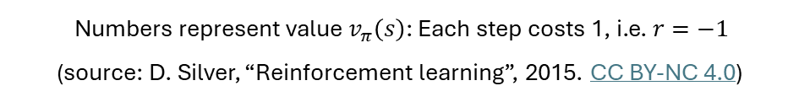
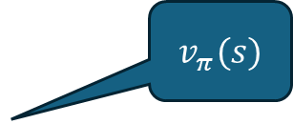
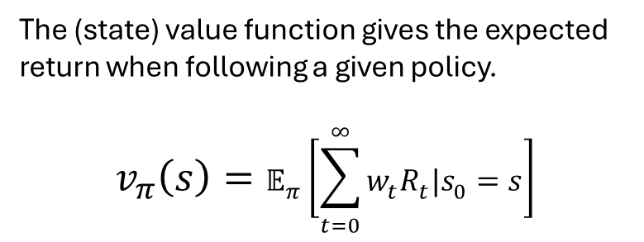
Maze Example: RL-Solution as a Value Function
$$v_{π}(s)$$
The (state) value function gives the expected return when following a given policy.
$$v_{π}\left(s\right)=𝔼_{π}\left[\sum_{t=0}^{∞}{{w_{t}R}_{t}|s_{0}=s}\right]$$
-14 -13 -12 -11 -10 -9
Start
-16 -15
-12
-8
-16 -17
-6
-7
-18 -19
-5
Key characteristics
The policy is implicitly defined by the state values: The agent always chooses actions to move to states with better state values. This is called a “greedy” policy.
-24
-20
-4
-3
-23 -22 -21 -22
-2
-1
Goal
Numbers represent value $v_{π}\left(s\right)$: Each step costs 1, i.e. $r=−1$ (source: D. Silver, “Reinforcement learning”, 2015. CC BY-NC 4.0)

Slide 29
Important Issues in RL

Slide 30
Important Issues
Sparse and Delayed Rewards
Exploration vs. Exploitation
Scalability
Convergence and Optimality
Sample Efficiency

Slide 31
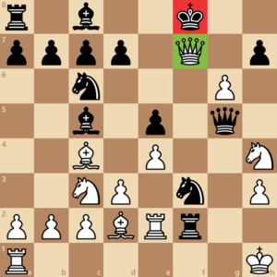
Credit Assignment Problem: Sparse and Delayed Rewards
Credit assignment problem: Delayed rewards make it hard to figure out which actions caused the reward.
Example:
What were the moves in a chess game that led to winning the game?
How much did getting the Bishop in the right position contribute?
To address this issue, we will learn methods like:
Temporal differencing
Eligibility traces
Reward shaping

Slide 32

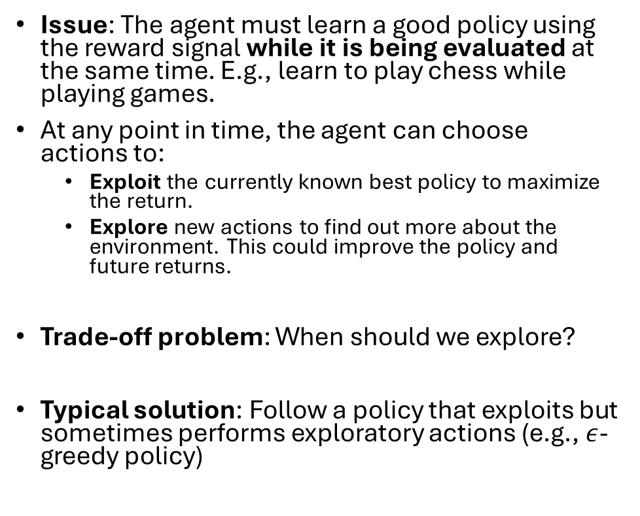
Exploration vs. Exploitation
Issue: The agent must learn a good policy using the reward signal while it is being evaluated at the same time. E.g., learn to play chess while playing games.
At any point in time, the agent can choose actions to:
Exploit the currently known best policy to maximize the return.
Explore new actions to find out more about the environment. This could improve the policy and future returns.
Trade-off problem: When should we explore?
Typical solution: Follow a policy that exploits but sometimes performs exploratory actions (e.g., $ε$-greedy policy)
Exploitation: Eat more of my current favorites
Exploration: Try something new
Figure: The exploration-exploitation dilemma

Slide 33
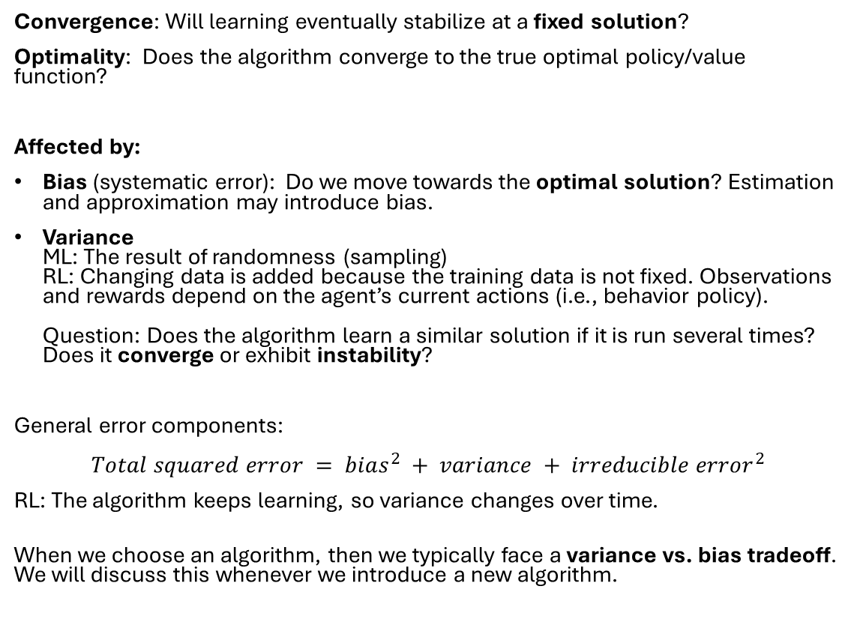
Convergence and Optimality
Optimal solution
Algorithm’s solution
Algorithm bias
Convergence: Will learning eventually stabilize at a fixed solution?
Optimality: Does the algorithm converge to the true optimal policy/value function?
Affected by:
Bias (systematic error): Do we move towards the optimal solution? Estimation and approximation may introduce bias.
Variance ML: The result of randomness (sampling) RL: Changing data is added because the training data is not fixed. Observations and rewards depend on the agent’s current actions (i.e., behavior policy). Question: Does the algorithm learn a similar solution if it is run several times? Does it converge or exhibit instability?
General error components: $$Total squared error = bias^{2} + variance + irreducible error^{2}$$
RL: The algorithm keeps learning, so variance changes over time.
When we choose an algorithm, then we typically face a variance vs. bias tradeoff. We will discuss this whenever we introduce a new algorithm.
Variance
=
Sample randomness
+
Changing data
+
Irreducible error (stochastic environment)
After Convergence
Optimal solution
Algorithm’s solution
Algorithm bias
Variance
=
0 + 0
Sample randomness
Fixed Policy
Changing data
+
Irreducible error (stochastic environment)

Slide 34
Sample Efficiency
Issue: Real-world environments are expensive and slow (robots, healthcare, etc.)
Sample efficiency: How many interactions does an algorithm need to learn a good policy?
High sample efficiency: Learns quickly with few interactions.
Low sample efficiency: Requires a lot of data to perform well.
RL often has low sample efficiency (needs millions of interactions).
We will cover key approaches to improve sample efficiency:
Model-based RL (planning with dynamic programming)
Learning and planning (e.g., Dyna)
Experience replay
Offline RL on a prerecorded data set

Slide 35
Scalability
Issue: Interesting problems are very large with many or continuous states and actions.
Solution: Linear function approximation
enables generalization (we can predict a value for a state we have not seen before),
but it can affect stability.
Non-linear function approximation (neural networks in DRL) together with bootstrapping lead to:
Divergence
Oscillations
Overestimation bias
We will cover these issues and potential fixes when we talk about approximation and DRL.

Slide 36
RL and Planning
Model-based vs. Model-free Methods

Slide 37
Model-based vs. Model-free RL
Model-based RL
Model-free RL
Known Environment: The agent has a complete model of the environment.
Transition model
Reward model
The agent does not need to interact with the environment: The agent can use the model to plan offline and find the optimal policy.
Important issues:
Computational complexity (time and space)
Model errors compound
Unknown environment: Model is unknown.
Data-driven approach: The agent interacts with the environment via trial & error by trying actions and updating its policy based on the received reward.
Important issues:
Sample efficiency (how fast can we learn)
Exploitation vs. exploration

Slide 38
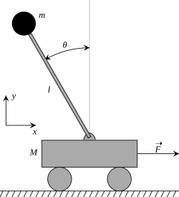
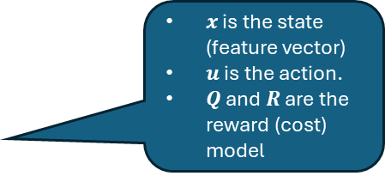
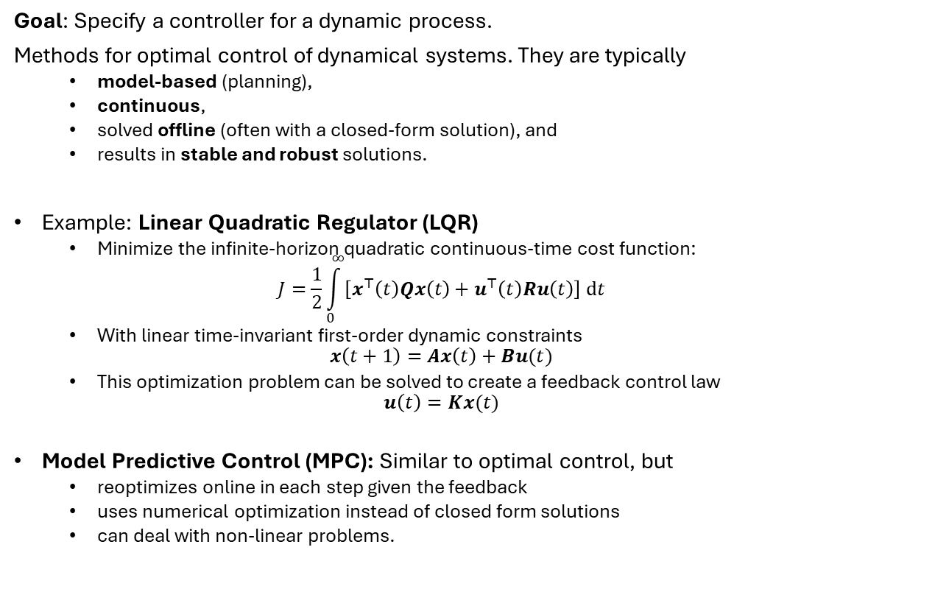
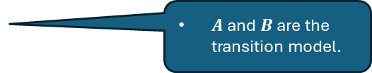
RL vs Optimal Control Theory
State:
cart velocity
Pole angle
Pole angular velocity
Action: Force
Goal: Specify a controller for a dynamic process.
Methods for optimal control of dynamical systems. They are typically
model-based (planning),
continuous,
solved offline (often with a closed-form solution), and
results in stable and robust solutions.
Example: Linear Quadratic Regulator (LQR)
Minimize the infinite-horizon quadratic continuous-time cost function:
$$J=\frac{1}{2}\int_{0}^{∞}{\left[x^{⊤}\left(t\right)Qx\left(t\right)+u^{⊤}\left(t\right)Ru\left(t\right)\right] dt}$$
With linear time-invariant first-order dynamic constraints
$$x\left(t+1\right)=Ax\left(t\right)+Bu(t)$$
This optimization problem can be solved to create a feedback control law
$$u\left(t\right)=Kx(t)$$
Model Predictive Control (MPC): Similar to optimal control, but
reoptimizes online in each step given the feedback
uses numerical optimization instead of closed form solutions
can deal with non-linear problems.
$x$ is the state (feature vector)
$u$ is the action.
$Q$ and $R$ are the reward (cost) model
Example: Cart Pole Balancing Balance the weight by moving forth and back.
$A$ and $B$ are the transition model.
This course will focus on RL and not Optimal Control Theory or MPC.

Slide 39
What You Should Know
Understand the basic RL interaction loop: agent, environment, and the role of the interpreter.
Basic RL vocabulary: state, action, immediate reward, return, policy, value function.
Appreciate the significance of proper reward formulation.
The important RL issues of:
Credit assignment problem
Exploitation vs exploration
Sample efficiency
Variance vs bias
Approximation and generalization
Differentiate between model-based (planning) and model-free reinforcement learning methods.

