Slide 1



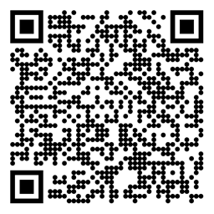

Reinforcement Learning Markov Decision Processes (MDP) Sutton/Barto* Chapter 3
Michael Hahsler, SMU
With figures from Sutton/Barto*
*Sutton and Barto, Reinforcement Learning: An Introduction, 2nd edition, MIT Press, Cambridge, MA, 2018

Slide 2
Topics of this Course
Introduction to reinforcement learning
Markov decision processes
Part I: Tabular Methods
Dynamic programming
Monte Carlo methods
Temporal-difference learning
Multi-step bootstrapping
Planning and learning with tabular methods
Part II: Approximate Solution Methods
Prediction and Control using Approximation
Eligibility Traces
Policy Gradient Methods
Part III: Modern RL Methods
Deep Reinforcement Learning
Current Applications

Slide 3
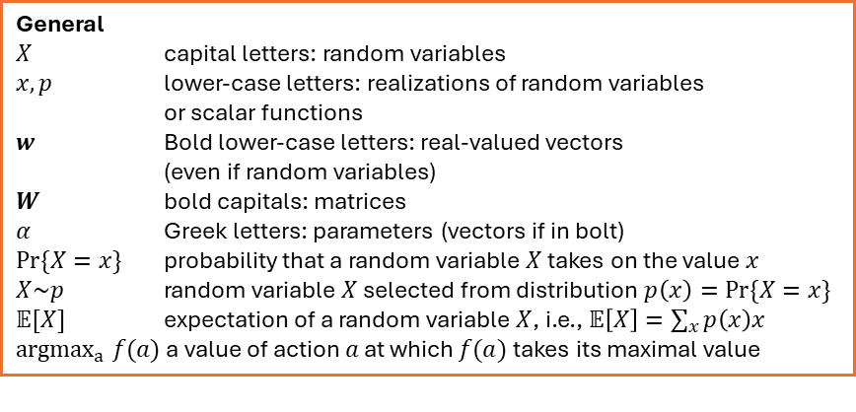
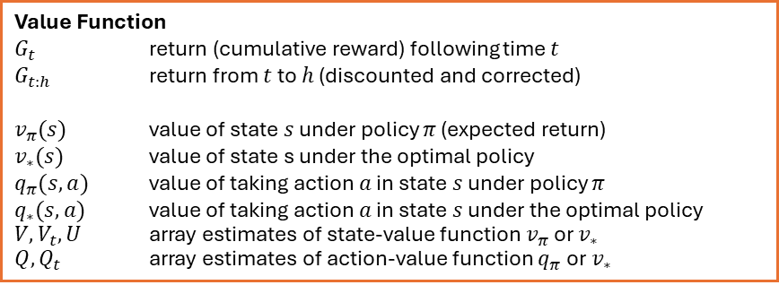
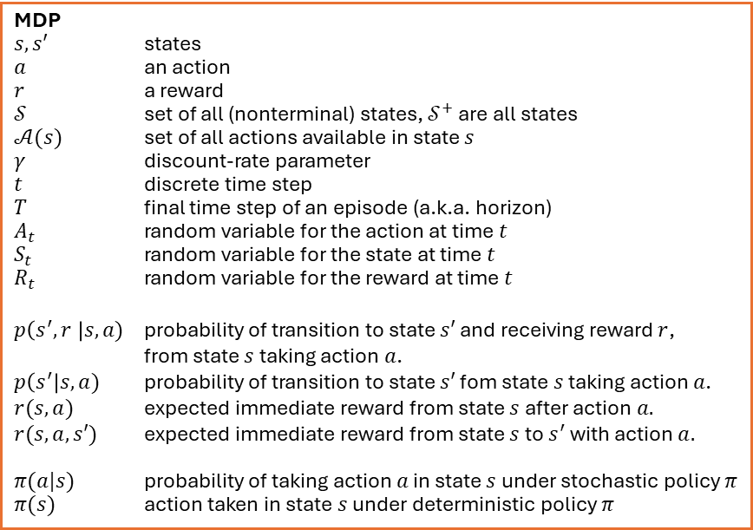
Summary of Notation
General
$X$ capital letters: random variables $x, p$ lower-case letters: realizations of random variables or scalar functions
$w$ Bold lower-case letters: real-valued vectors (even if random variables)
$W$ bold capitals: matrices
$α$ Greek letters: parameters (vectors if in bolt)
$Pr⁡\{X=x\}$ probability that a random variable $X$ takes on the value $x$
$X\sim p$ random variable $X$ selected from distribution $p\left(x\right)=Pr⁡\{X=x\}$
$𝔼[X]$ expectation of a random variable $X$, i.e., $𝔼\left[X\right]=\sum_{x}{p\left(x\right)x}$
${argmax}_{a} f(a)$ a value of action $a$ at which $f(a)$ takes its maximal value
MDP
$s, s′$ states
$a$ an action
$r$ a reward
$𝒮$ set of all (nonterminal) states, $𝒮^{+}$ are all states
$𝒜(s)$ set of all actions available in state $s$
$γ$ discount-rate parameter
$t$ discrete time step
$T$ final time step of an episode (a.k.a. horizon)
$A_{t}$ random variable for the action at time $t$
$S_{t}$ random variable for the state at time $t$
$R_{t}$ random variable for the reward at time $t$
$p\left(s^{′},r \right|s, a)$ probability of transition to state $s′$ and receiving reward $r$, from state $s$ taking action $a$.
$p\left(s^{′}\right|s, a)$ probability of transition to state $s′$ fom state $s$ taking action $a$.
$r(s,a)$ expected immediate reward from state $s$ after action $a.$
$r(s,a,s′)$ expected immediate reward from state $s$ to $s^{′}$ with action $a.$
$π(a|s)$ probability of taking action $a$ in state $s$ under stochastic policy $π$
$π(s)$ action taken in state $s$ under deterministic policy $π$
Value Function
$G_{t}$ return (cumulative reward) following time $t$
$G_{t:h}$ return from $t$ to $h$ (discounted and corrected)
$v_{π}(s)$ value of state $s$ under policy $π$ (expected return)
$v_{∗}(s)$ value of state s under the optimal policy
$q_{π}(s,a)$ value of taking action $a$ in state $s$ under policy $π$
$q_{∗}(s,a)$ value of taking action $a$ in state $s$ under the optimal policy
$V, V_{t},U$ array estimates of state-value function $v_{π}$or $v_{∗}$
$Q,Q_{t}$ array estimates of action-value function $q_{π}$or $v_{∗}$

Slide 4
Finite Markov Decision Processes
The foundation of RL

Slide 5
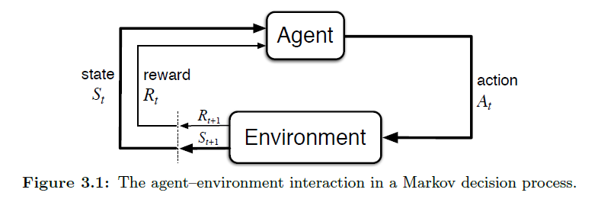
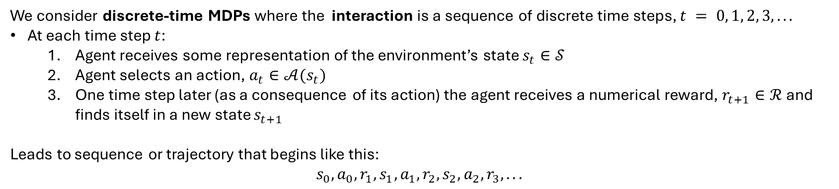
The Agent–Environment Interface
Fully observable means the interpreter is part of the environment
Markov decision process (MDP) is a mathematical model for sequential decision making when outcomes are uncertain.
The MDP represents a fully observable, stochastic, and known environment.
The goal is specified via rewards.
Actions influence the future rewards by leading to different states.
MDP
We consider discrete-time MDPs where the interaction is a sequence of discrete time steps, $t = 0, 1, 2, 3, . . .$
At each time step $t$:
Agent receives some representation of the environment’s state $s_{t}∈𝒮$
Agent selects an action, $a_{t}∈𝒜(s_{t})$
One time step later (as a consequence of its action) the agent receives a numerical reward, $r_{t+1}∈ℛ$and finds itself in a new state $s_{t+1}$
Leads to sequence or trajectory that begins like this:
$$s_{0},a_{0},r_{1}, s_{1},a_{1},r_{2}, s_{2},a_{2},r_{3}, . . .$$

Slide 6

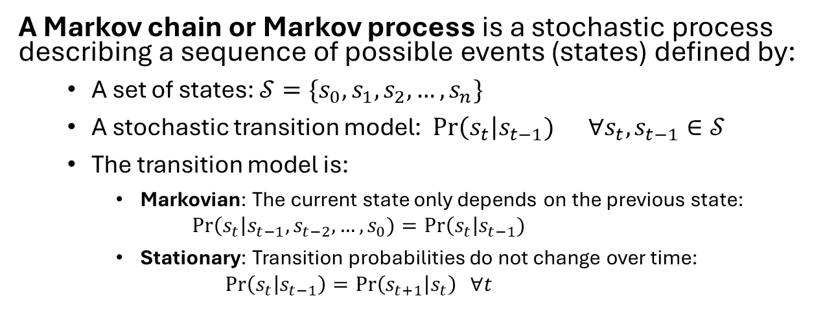
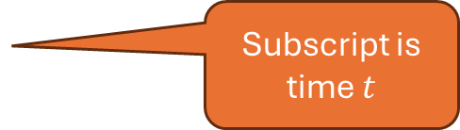






State Sequences: The Markov Process
A Markov chain or Markov process is a stochastic process describing a sequence of possible events (states) defined by:
A set of states: $𝒮=\{s_{0}, s_{1},s_{2}, …,s_{n}\}$
A stochastic transition model: Pr$\left(s_{t}\right|s_{t−1}) ∀s_{t},s_{t−1}∈𝒮$
The transition model is:
Markovian: The current state only depends on the previous state: $Pr\left(s_{t}\right|s_{t−1}, s_{t−2},…,s_{0})=Pr\left(s_{t}\right|s_{t−1})$
Stationary: Transition probabilities do not change over time: $\operatorname{Pr}\left(s_{t} | s_{t−1}\right)=\operatorname{Pr}\left(s_{t+1} | s_{t}\right) ∀t$
Markov model as a graph
$$s_{1}$$
$$s_{0}$$
$$s_{2}$$
$$s_{3}$$
Episode is a trajectory: Markov process “unrolled” over time: $s_{0},s_{1},s_{2},…$
Subscript is the state ID
$$s_{0}$$
$$s_{1}$$
$$s_{2}$$
…
Subscript is time $t$
Note: This is called a discrete-time, stationary, 1st –order Markov process with finite state space.

Slide 7

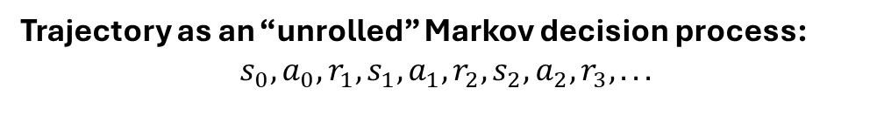

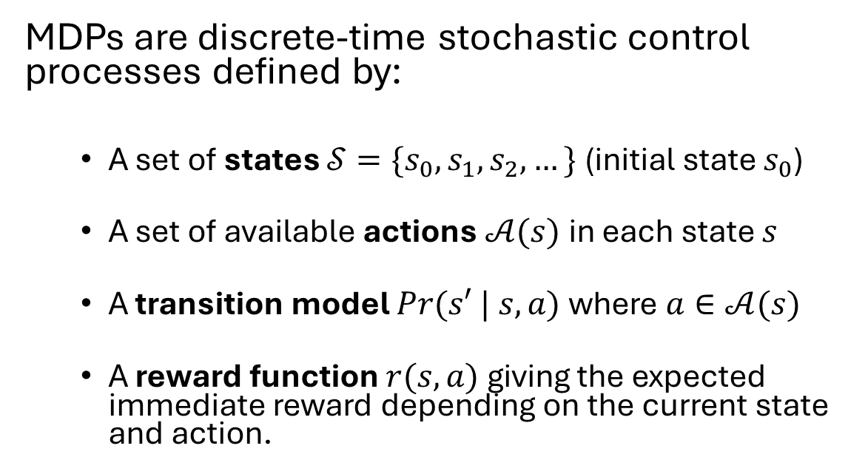


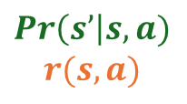














Markov Decision Process (MDP)
MDPs are discrete-time stochastic control processes defined by:
A set of states $𝒮=\{s_{0}, s_{1},s_{2}, …\}$ (initial state $s_{0}$)
A set of available actions $𝒜(s)$ in each state $s$
A transition model $Pr(s′ | s, a)$ where $a∈𝒜(s)$
A reward function $r(s,a)$ giving the expected immediate reward depending on the current state and action.
Example MDP as a Graph
1
$$a_{1}$$
.5
10
$$s_{0}$$
$$s_{1}$$
$$a_{2}$$
-5
10
$$a_{2}$$
.5
1
$$a_{1}$$
100
$$Pr\left(s’\right|s,a)$$
$$r(s,a)$$
$$s_{2}$$
$$a_{1},a_{2}$$
0
Trajectory as an “unrolled” Markov decision process:
$$s_{0},a_{0},r_{1}, s_{1},a_{1},r_{2}, s_{2},a_{2},r_{3}, . . .$$
$$a_{o}$$
$$a_{1}$$
$$a_{2}$$
$$s_{0}$$
$$s_{1}$$
$$s_{2}$$
…
Subscript is time $t$!
$$r_{1}$$
$$r_{2}$$
$$r_{3}$$

Slide 8
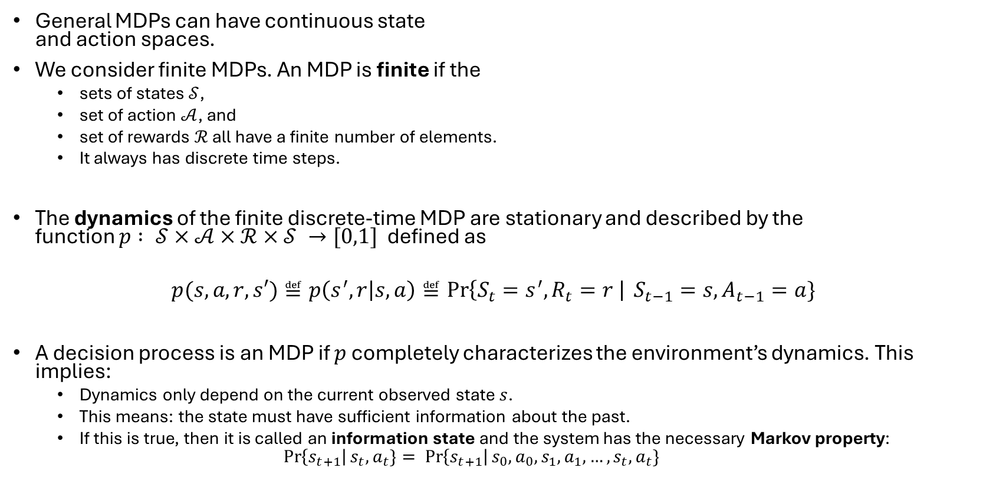
Finite MDP
General MDPs can have continuous state and action spaces.
We consider finite MDPs. An MDP is finite if the
sets of states $𝒮$,
set of action $𝒜$, and
set of rewards $ℛ$ all have a finite number of elements.
It always has discrete time steps.
The dynamics of the finite discrete-time MDP are stationary and described by the function $p : 𝒮×𝒜×ℛ×𝒮 →[0,1]$defined as
$$p(s,a,r,s′)≝p\left(s^{′},r | s,a\right)≝\operatorname{Pr}\left\{S_{t}=s^{′}, R_{t}=r \right| S_{t−1}=s, A_{t−1}=a\}$$
A decision process is an MDP if $p$ completely characterizes the environment’s dynamics. This implies:
Dynamics only depend on the current observed state $s$.
This means: the state must have sufficient information about the past.
If this is true, then it is called an information state and the system has the necessary Markov property:
$$\operatorname{Pr}\left\{s_{t+1}\right|s_{t}, a_{t}\}= \operatorname{Pr}\left\{s_{t+1}\right|s_{0}, a_{0},s_{1}, a_{1}, …,s_{t}, a_{t}\}$$
MDP
Note: When we say MDP in this class, we will always mean a finite discrete-time MDP.

Slide 9
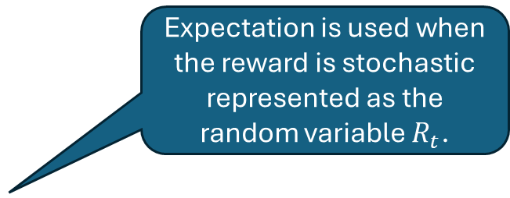
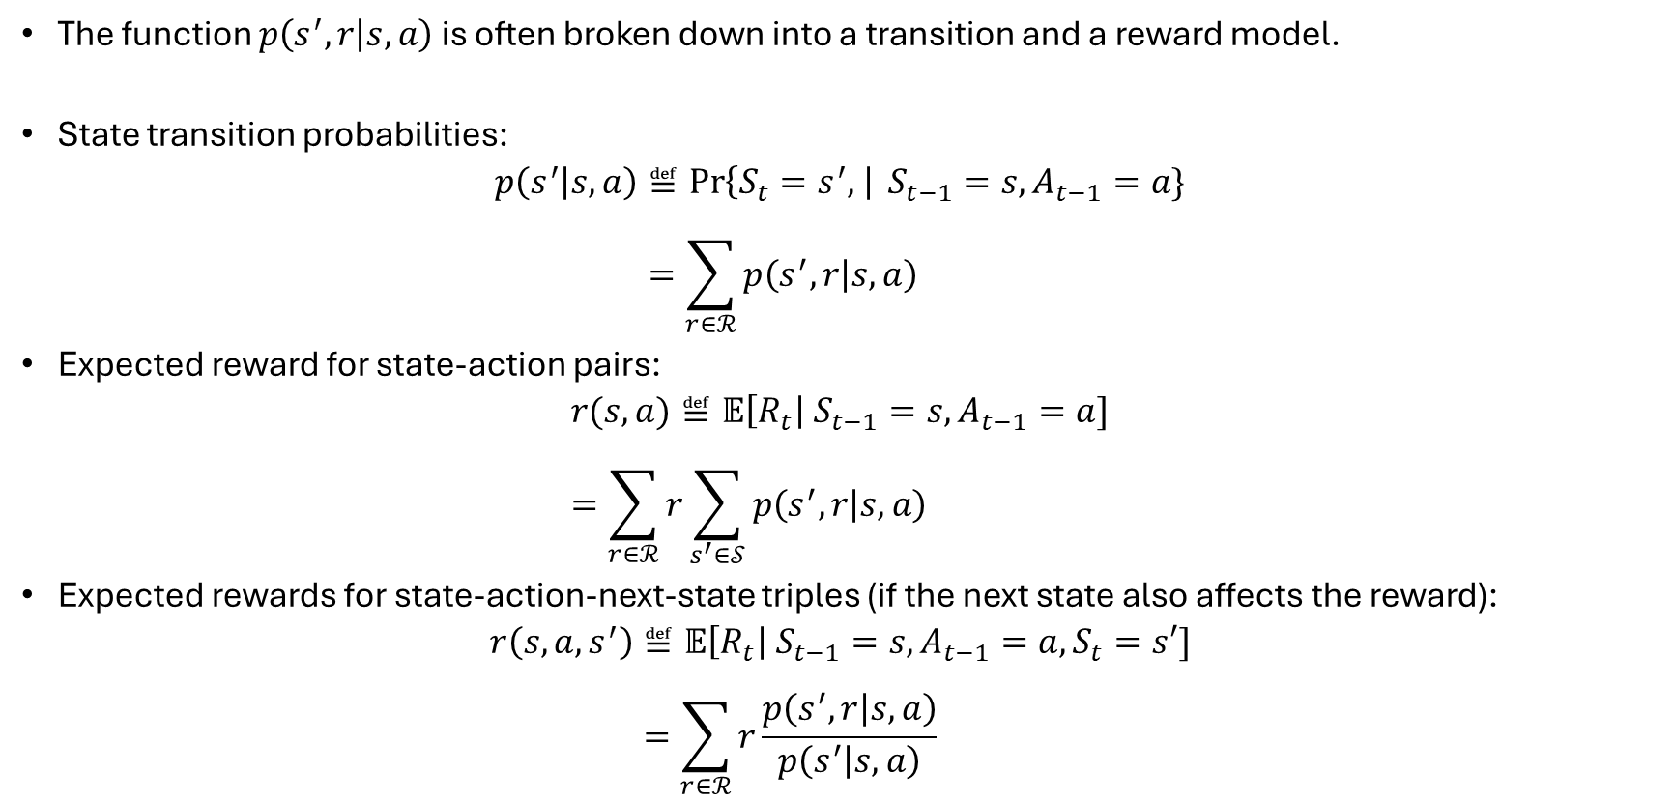
Transition and Reward Functions
The function $p\left(s^{′},r | s,a\right)$ is often broken down into a transition and a reward model.
State transition probabilities:
$$p\left(s^{′} | s,a\right)≝\operatorname{Pr}\left\{S_{t}=s^{′}, \right| S_{t−1}=s, A_{t−1}=a\} \\ =\sum_{r∈ℛ}{p\left(s^{′},r | s,a\right)}$$
Expected reward for state-action pairs:
$$r(s,a)≝𝔼\left[R_{t}\right| S_{t−1}=s, A_{t−1}=a] \\ =\sum_{r∈ℛ}{r\sum_{s^{′}∈𝒮}{p\left(s^{′},r | s,a\right)}}$$
Expected rewards for state-action-next-state triples (if the next state also affects the reward):
$$r\left(s,a,s^{′}\right)≝𝔼\left[R_{t}\right| S_{t−1}=s, A_{t−1}=a,S_{t}=s′] \\ =\sum_{r∈ℛ}{r\frac{p\left(s^{′},r | s,a\right)}{p\left(s^{′} | s,a\right)}}$$
Expectation is used when the reward is stochastic represented as the random variable $R_{t}$.

Slide 10



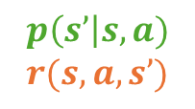
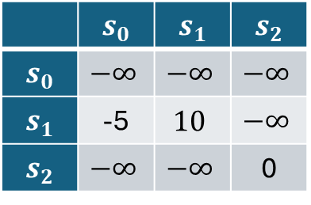
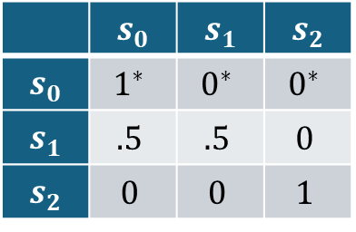

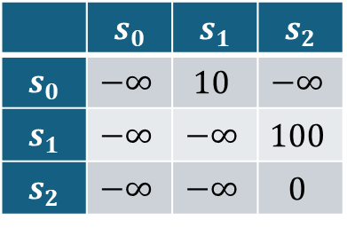


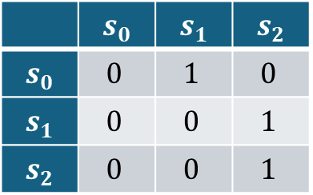
Alternative Representations of a Finite MDP
Graph Representation
Matrix Representation
1
$$a_{1}$$
.5
Transition matrices
10
$$a_{1}$$
$$a_{2}$$
$$s_{0}$$
$$s_{1}$$
$$a_{2}$$
-5
 | $$s_{0}$$ | $$s_{1}$$ | $$s_{2}$$
$$s_{0}$$ | $$0$$ | $$1$$ | $$0$$
$$s_{1}$$ | $$0$$ | $$0$$ | $$1$$
$$s_{2}$$ | $$0$$ | $$0$$ | $$1$$
 | $$s_{0}$$ | $$s_{1}$$ | $$s_{2}$$
$$s_{0}$$ | $$1^{∗}$$ | $$0^{∗}$$ | $$0^{∗}$$
$$s_{1}$$ | $$.5$$ | $$.5$$ | $$0$$
$$s_{2}$$ | $$0$$ | $$0$$ | $$1$$
10
$$a_{2}$$
.5
1
$$a_{1}$$
100
$$p\left(s’\right|s,a)$$
$$r(s,a,s’)$$
$$s_{2}$$
$$a_{1},a_{2}$$
0
Reward matrices
Equivalent
$$a_{1}$$
$$a_{2}$$
$p$-Function Table Representation
 | $$s_{0}$$ | $$s_{1}$$ | $$s_{2}$$
$$s_{0}$$ | $$−∞$$ | $$10$$ | $$−∞$$
$$s_{1}$$ | $$−∞$$ | $$−∞$$ | $$100$$
$$s_{2}$$ | $$−∞$$ | $$−∞$$ | $$0$$
 | $$s_{0}$$ | $$s_{1}$$ | $$s_{2}$$
$$s_{0}$$ | $$−∞$$ | $$−∞$$ | $$−∞$$
$$s_{1}$$ | -5 | $$10$$ | $$−∞$$
$$s_{2}$$ | $$−∞$$ | $$−∞$$ | 0
$$s$$ | $$a$$ | $$s′$$ | $$p(s^{′}|s,a)$$ | $$r(s,a,s^{′})$$
$$s_{0}$$ | $$a_{1}$$ | $$s_{1}$$ | $$1$$ | $$10$$
$$s_{1}$$ | $$a_{2}$$ | $$s_{0}$$ | $$.5$$ | $$−5$$
$$s_{1}$$ | $$a_{2}$$ | $$s_{1}$$ | $$.5$$ | $$10$$
$$s_{1}$$ | $$a_{1}$$ | $$s_{2}$$ | $$1$$ | $$100$$
$$s_{2}$$ | $$a_{1}$$ | $s_{2}$ | $$1$$ | $$0$$
$$s_{2}$$ | $$a_{2}$$ | $s_{2}$ | $$1$$ | $$0$$
* illegal actions, but the rows in the transition matrices need to add up to 1!
$−∞$ represents illegal actions and transitions in the reward matrices!

Slide 11
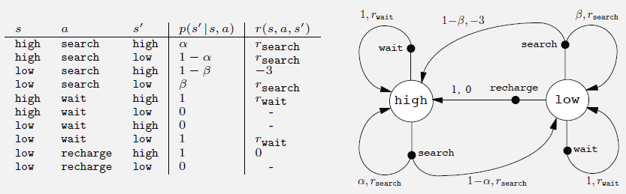
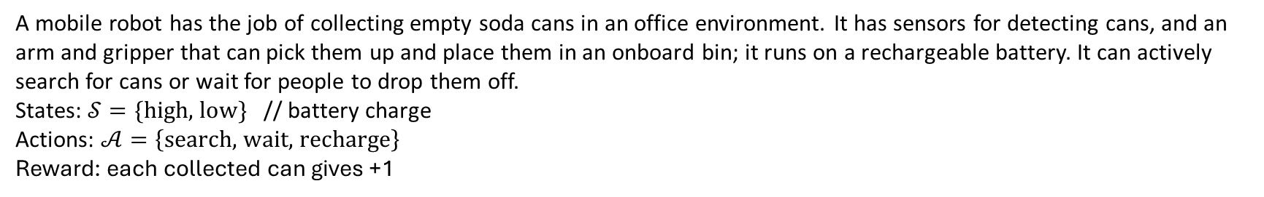
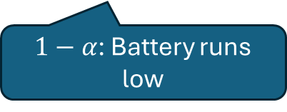
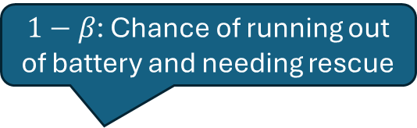
Example: Mobile Robot MDP
A mobile robot has the job of collecting empty soda cans in an office environment. It has sensors for detecting cans, and an arm and gripper that can pick them up and place them in an onboard bin; it runs on a rechargeable battery. It can actively search for cans or wait for people to drop them off.
States: $𝒮=\{\text{high, low}\}$ // battery charge
Actions: $𝒜=\left\{\text{search, wait, recharge}\right\}$
Reward: each collected can gives +1
$1−β$: Chance of running out of battery and needing rescue
Expected number of cans collected.
$1−α$: Battery runs low

Slide 12
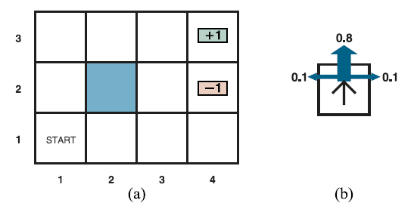
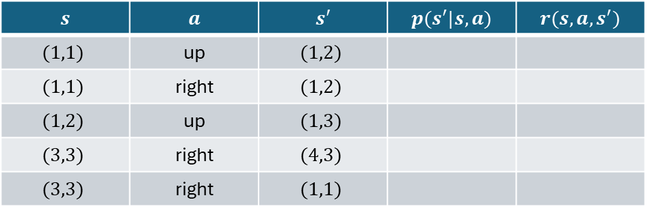

Exercise: 3x4 Grid World
1. Draw MDP model as a graph.
2. Complete the following entries in the model as a table
$$s$$ | $$a$$ | $$s′$$ | $$p(s^{′}|s,a)$$ | $$r(s,a,s^{′})$$
$$(1,1)$$ | up | $$(1,2)$$
$$(1,1)$$ | right | $$(1,2)$$
$$(1,2)$$ | up | $$(1,3)$$
$$(3,3)$$ | right | $$(4,3)$$
$$(3,3)$$ | right | $$(1,1)$$
AIMA Figure 17.1: (a) A simple, stochastic environment. (b) Illustration of the transition model of the environment: the “intended” outcome occurs with probability 0.8, but with probability 0.2 the agent moves at right angles to the intended direction. A collision with a wall results in no movement. Transitions into the two terminal states have reward +1 and -1, respectively, and all other transitions have a reward of -0.04.
State representation: $(x,y)$

Slide 13
Rewards and Returns
What is the agent’s goal?

Slide 14
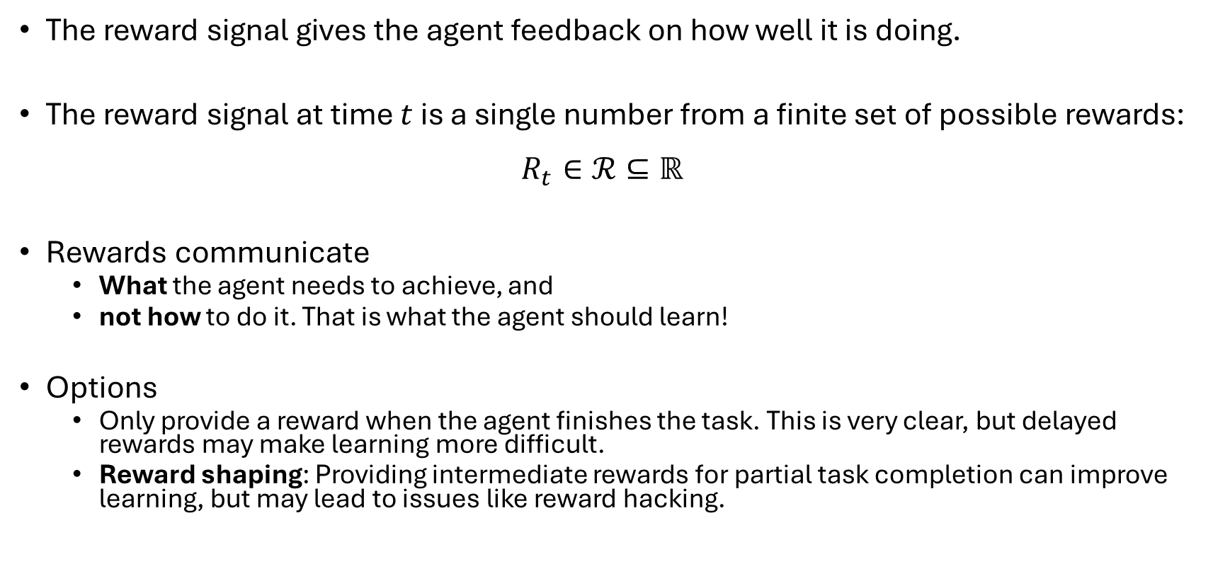
Reward Signals
The reward signal gives the agent feedback on how well it is doing.
The reward signal at time $t$ is a single number from a finite set of possible rewards: $R_{t}∈ℛ⊆ℝ$
Rewards communicate
What the agent needs to achieve, and
not how to do it. That is what the agent should learn!
Options
Only provide a reward when the agent finishes the task. This is very clear, but delayed rewards may make learning more difficult.
Reward shaping: Providing intermediate rewards for partial task completion can improve learning, but may lead to issues like reward hacking.

Slide 15
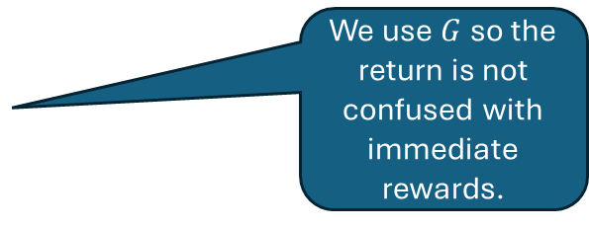
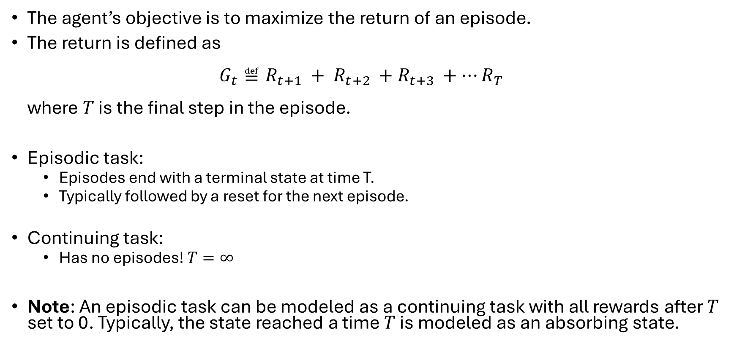
Return and Episodes
The agent’s objective is to maximize the return of an episode.
The return is defined as $G_{t}≝R_{t+1 }+ R_{t+2 }+R_{t+3 }+…R_{T}$ where $T$ is the final step in the episode.
Episodic task:
Episodes end with a terminal state at time T.
Typically followed by a reset for the next episode.
Continuing task:
Has no episodes! $T=∞$
Note: An episodic task can be modeled as a continuing task with all rewards after $T$ set to 0. Typically, the state reached a time $T$ is modeled as an absorbing state.
We use $G$ so the return is not confused with immediate rewards.

Slide 16
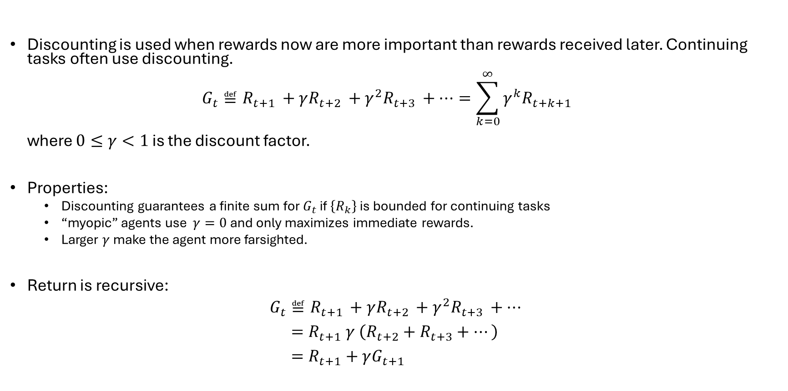
Reward Discounting
Discounting is used when rewards now are more important than rewards received later. Continuing tasks often use discounting. $G_{t}≝R_{t+1 }+γR_{t+2 }+{γ^{2}R}_{t+3 }+…=\sum_{k=0}^{∞}{γ^{k}R_{t+k+1}}$ where $0≤γ<1$ is the discount factor.
Properties:
Discounting guarantees a finite sum for $G_{t}$ if $\left\{R_{k}\right\}$ is bounded for continuing tasks
“myopic” agents use $γ=0$ and only maximizes immediate rewards.
Larger $γ$ make the agent more farsighted.
Return is recursive:
$$G_{t}≝R_{t+1 }+γR_{t+2 }+{γ^{2}R}_{t+3 }+… \\ =R_{t+1} γ \left(R_{t+2}+R_{t+3}+…\right) \\ =R_{t+1}+γG_{t+1}$$

Slide 17
Policy and Value Functions
How should an agent act?

Slide 18
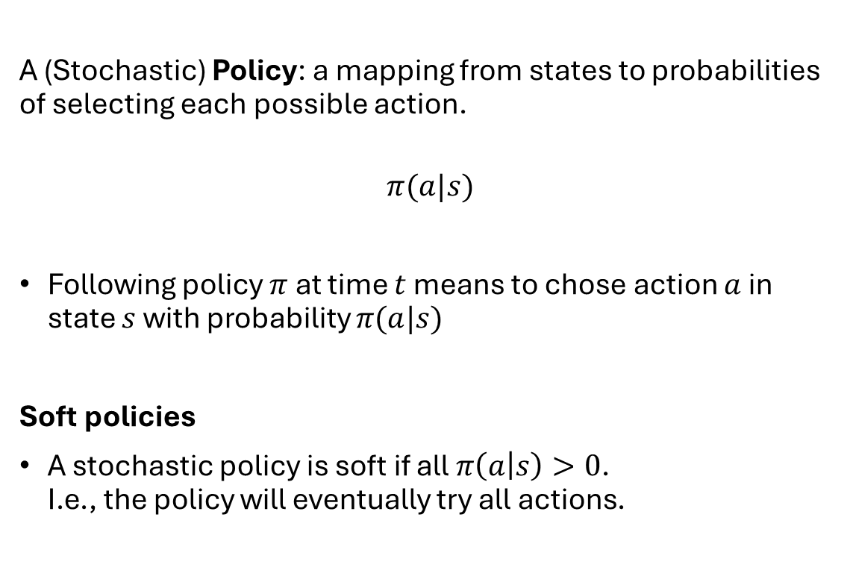
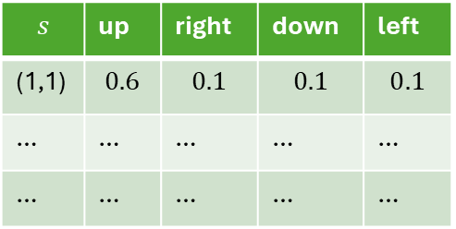
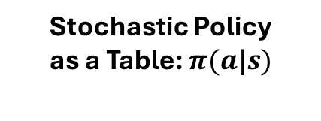
Policy
A (Stochastic) Policy: a mapping from states to probabilities of selecting each possible action.
$$π(a|s)$$
Following policy $π$ at time $t$ means to chose action $a$ in state $s$ with probability $π(a|s)$
Soft policies
A stochastic policy is soft if all $π\left(a | s\right)>0$. I.e., the policy will eventually try all actions.
Stochastic Policy as a Table: $π(a|s)$
$$s$$ | up | right | down | left
(1,1) | $$0.6$$ | $$0.1$$ | $$0.1$$ | $$0.1$$
… | … | … | … | …
… | … | … | … | …

Slide 19
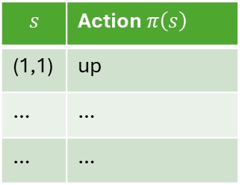
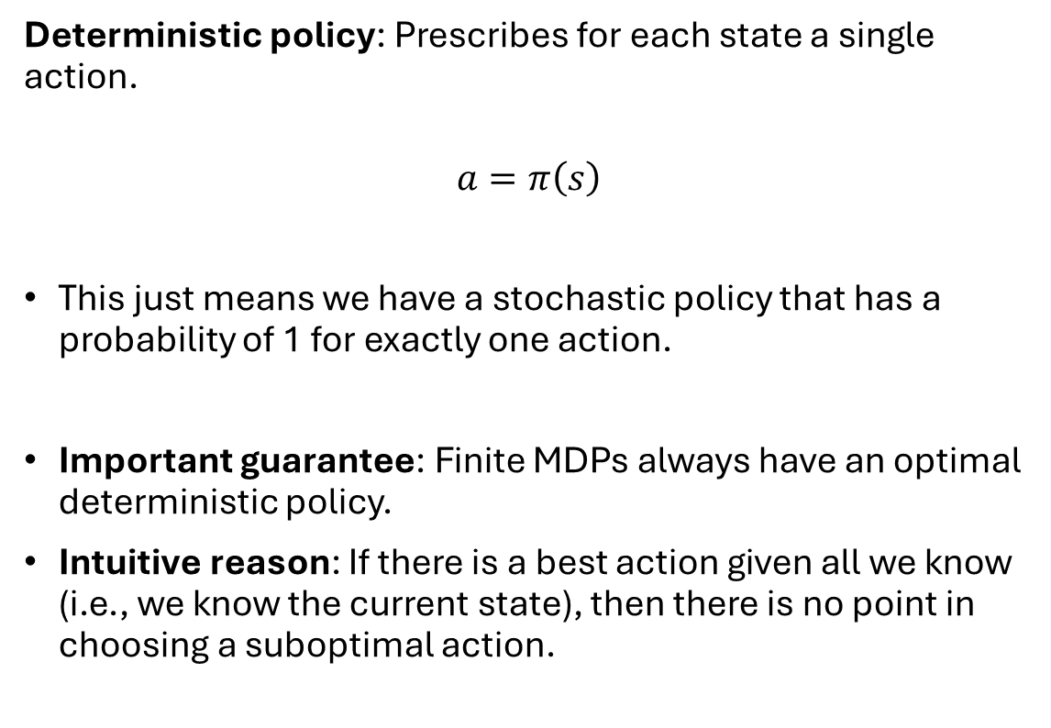
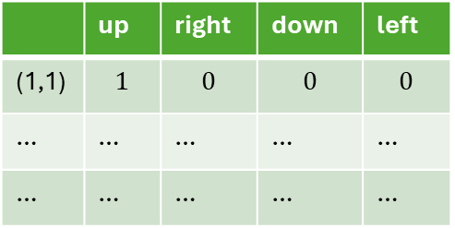
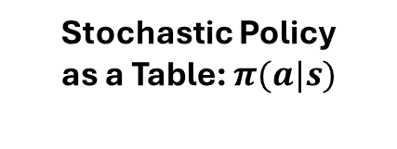
Deterministic Policy
Deterministic Policy as a Table
Deterministic policy: Prescribes for each state a single action.
$$a=π\left(s\right)$$
This just means we have a stochastic policy that has a probability of 1 for exactly one action.
Important guarantee: Finite MDPs always have an optimal deterministic policy.
Intuitive reason: If there is a best action given all we know (i.e., we know the current state), then there is no point in choosing a suboptimal action.
$$s$$ | Action $π\left(s\right)$
(1,1) | up
… | …
… | …
equivalent
Stochastic Policy as a Table: $π(a|s)$
 | up | right | down | left
(1,1) | $$1$$ | $$0$$ | $$0$$ | $$0$$
… | … | … | … | …
… | … | … | … | …

Slide 20
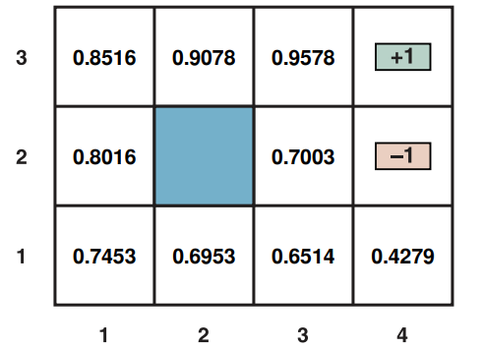
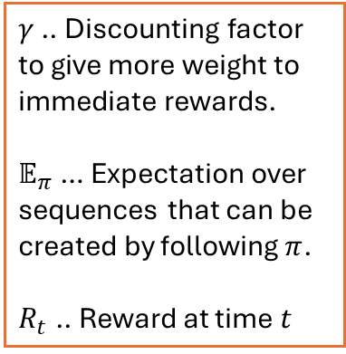
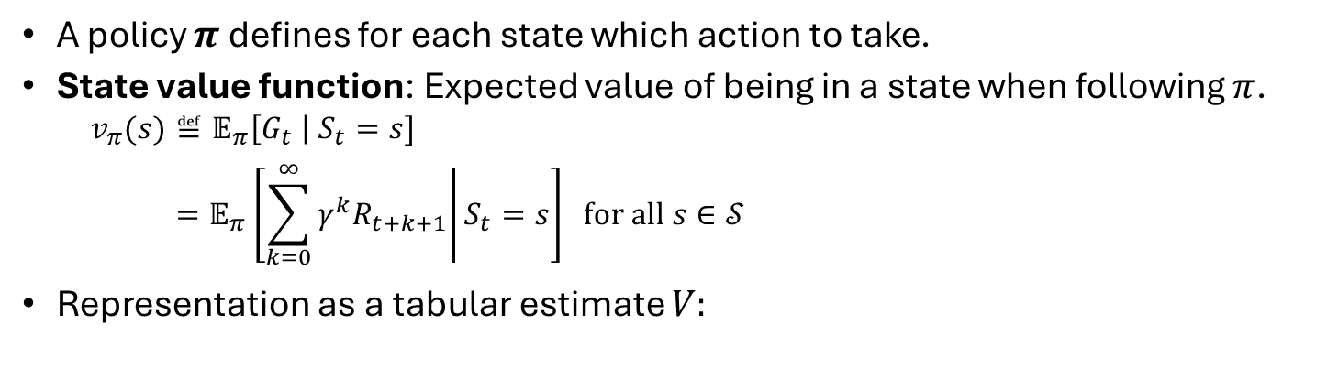
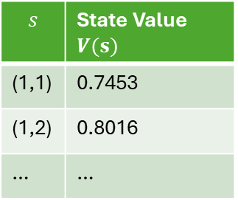
Value Function
A policy $π$ defines for each state which action to take.
State value function: Expected value of being in a state when following $π$.
$$v_{π}(s)≝𝔼_{π}\left[G_{t} \right| S_{t}=s] \\ =𝔼_{π}\left[\left.\sum_{k=0}^{∞}{γ^{k}R_{t+k+1}}\right|S_{t}=s\right] \text{for all }s∈𝒮$$
Representation as a tabular estimate $V:$
$γ$ .. Discounting factor to give more weight to immediate rewards.
$𝔼_{π}$ … Expectation over sequences that can be created by following $π$.
$R_{t}$ .. Reward at time $t$
Value Function for the 3x4 Grid World
Value Function
$$s$$ | State Value $V(s)$
(1,1) | 0.7453
(1,2) | 0.8016
… | …

Slide 21
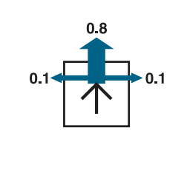
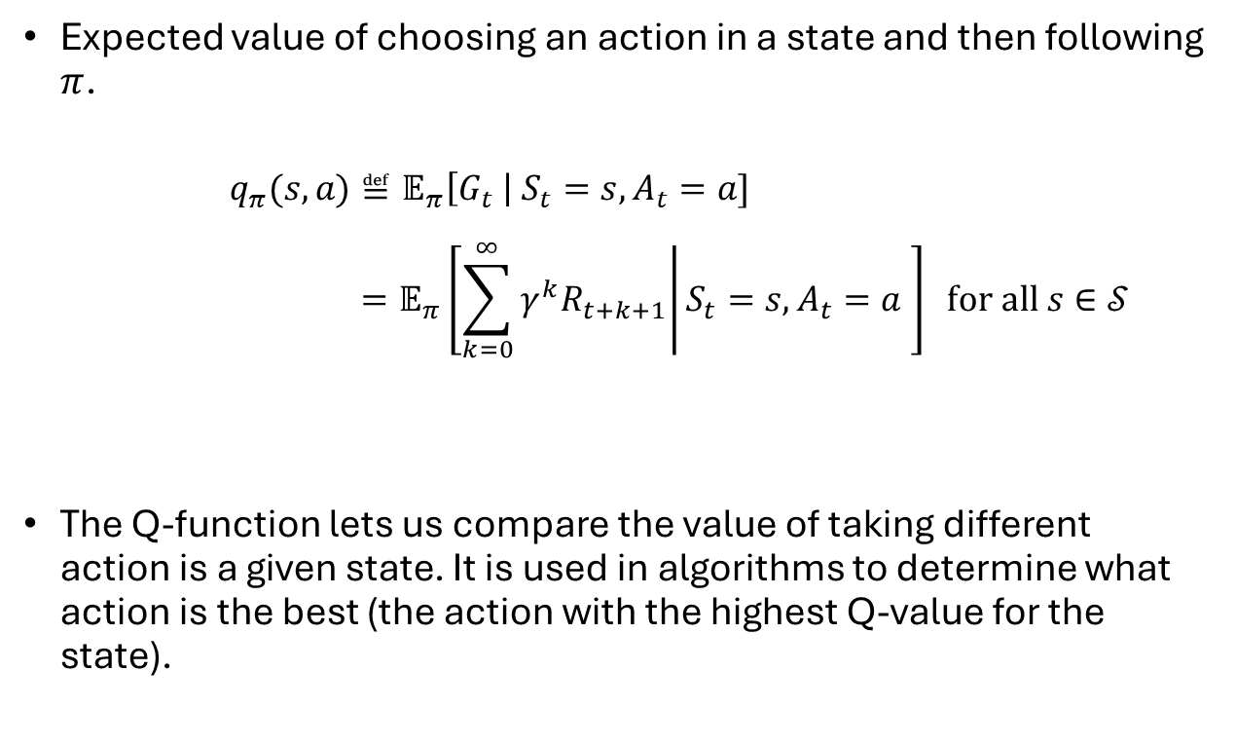
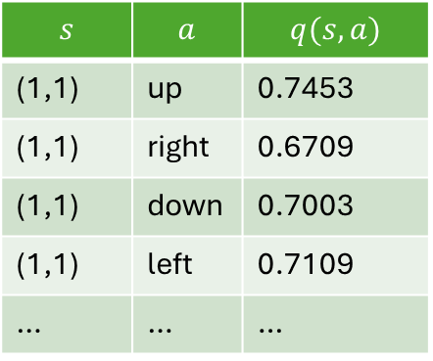
Action-value Function: Q-function
Value Function
Expected value of choosing an action in a state and then following $π$.
$$q_{π}(s,a)≝𝔼_{π}\left[G_{t} \right| S_{t}=s,A_{t}=a] \\ =𝔼_{π}\left[\left.\sum_{k=0}^{∞}{γ^{k}R_{t+k+1}}\right|S_{t}=s,A_{t}=a \right] \text{for all }s∈𝒮$$
The Q-function lets us compare the value of taking different action is a given state. It is used in algorithms to determine what action is the best (the action with the highest Q-value for the state).
Q-Table
$$s$$ | $$a$$ | $$q(s,a)$$
(1,1) | up | 0.7453
(1,1) | right | 0.6709
(1,1) | down | 0.7003
(1,1) | left | 0.7109
… | … | …

Slide 22
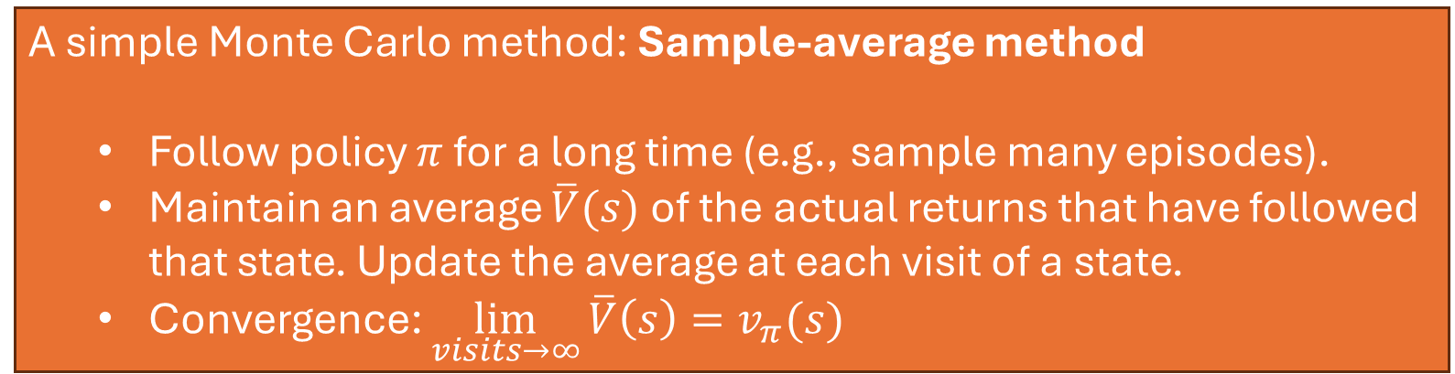
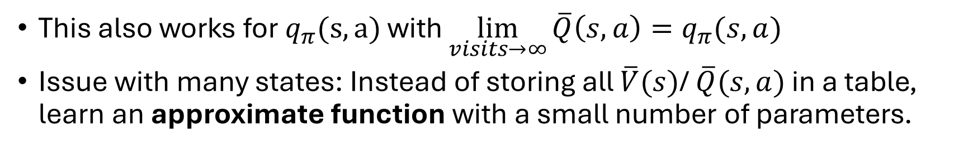
Value Function Estimation using Monte Carlo Methods
The value functions $v_{π}$ and $q_{π}$ can be estimated from experience. This is called policy evaluation.
A simple Monte Carlo method: Sample-average method
Follow policy $π$ for a long time (e.g., sample many episodes).
Maintain an average $\overline{V}(s)$ of the actual returns that have followed that state. Update the average at each visit of a state.
Convergence: $\lim_{visits→∞}{\overline{V}\left(s\right)=v_{π}(s)}$
This also works for $q_{π}(s,a)$ with $\lim_{visits→∞}{\overline{Q}\left(s,a\right)=q_{π}(s,a)}$
Issue with many states: Instead of storing all $\overline{V}(s)$/ $\overline{Q}(s,a)$ in a table, learn an approximate function with a small number of parameters.

Slide 23
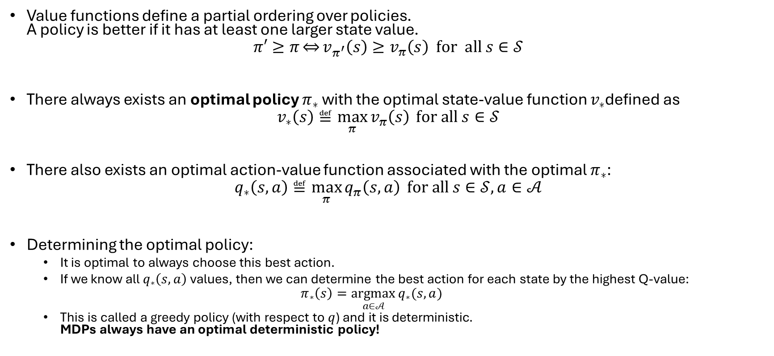
The Optimal Policy
Value functions define a partial ordering over policies. A policy is better if it has at least one larger state value.
$$π′≥π\overset{⇔}{}v_{π^{′}}\left(s\right)≥v_{π}\left(s\right)\text{ for all} s∈𝒮$$
There always exists an optimal policy $π_{∗}$ with the optimal state-value function $v_{∗}$defined as
$$v_{∗}\left(s\right)≝\max_{π}{v_{π}\left(s\right)} \text{for all }s∈𝒮$$
There also exists an optimal action-value function associated with the optimal $π_{∗}$:
$$q_{∗}\left(s,a\right)≝\max_{π}{q_{π}\left(s,a\right)} \text{for all }s∈𝒮,a∈𝒜$$
Determining the optimal policy:
It is optimal to always choose this best action.
If we know all $q_{∗}\left(s,a\right)$ values, then we can determine the best action for each state by the highest Q-value:
$$π_{∗}\left(s\right)=\underset{a∈𝒜}{argmax}{q_{∗}(s,a)}$$
This is called a greedy policy (with respect to $q$) and it is deterministic. MDPs always have an optimal deterministic policy!

Slide 24
Code…

Slide 25
The Bellman Equations
Bellman’s recursive formulation of value functions.

Slide 26

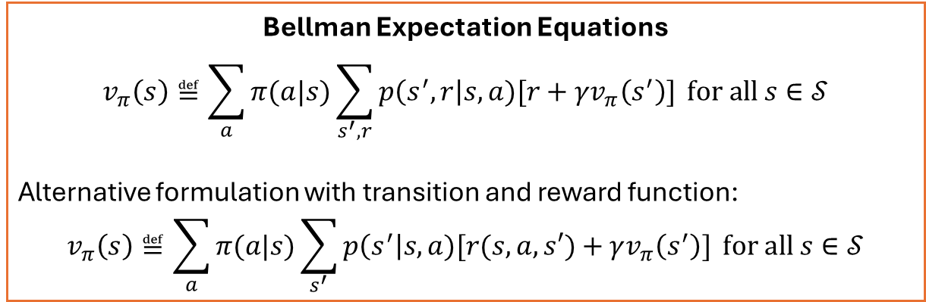

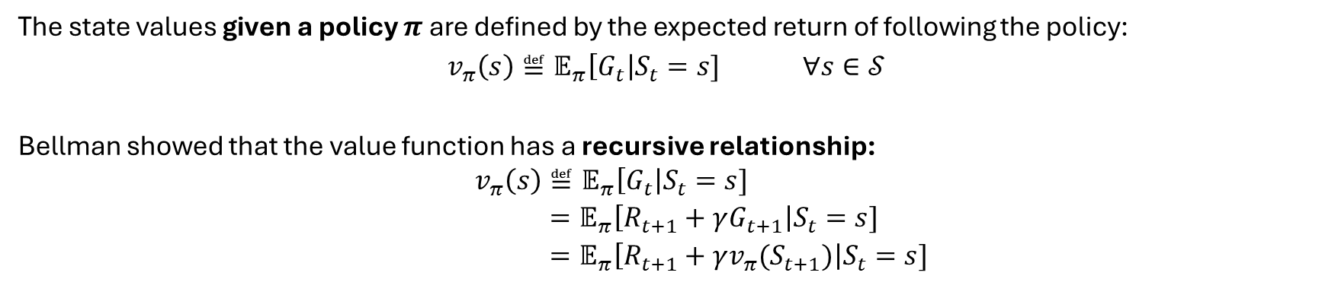
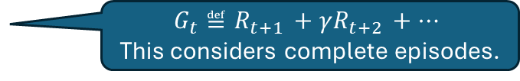

Bellman Expectation Equations
The state values given a policy $π$ are defined by the expected return of following the policy:
$v_{π}\left(s\right)≝𝔼_{π}\left[G_{t}\right|S_{t}=s] ∀s∈𝒮$
Bellman showed that the value function has a recursive relationship:
$$v_{π}\left(s\right)≝𝔼_{π}\left[G_{t}\right|S_{t}=s] \\ =𝔼_{π}\left[R_{t+1}+γG_{t+1}\right|S_{t}=s] \\ =𝔼_{π}\left[R_{t+1}+γv_{π}(S_{t+1})\right|S_{t}=s]$$
$G_{t}≝R_{t+1 }+γR_{t+2 }+…$ This considers complete episodes.
$$v_{π}(s_{t+1})$$
Bellman Expectation Equations
$$v_{π}\left(s\right)≝\sum_{a}{π(a|s)}\sum_{s^{′},r}{p\left(s^{′},r\right|s,a)[r+γv_{π}\left(s^{′}\right)]} \text{for all }s∈𝒮$$
Alternative formulation with transition and reward function:
$$v_{π}\left(s\right)≝\sum_{a}{π(a|s)}\sum_{s^{′}}{p\left(s^{′}\right|s,a)[r(s,a,s′)+γv_{π}\left(s^{′}\right)]} \text{for all }s∈𝒮$$
$$v_{π}(s_{t+1})$$
$$v_{π}(s_{t})$$
Transforms the problem of finding returns into a problem of finding local consistency between state values.

Slide 27












Backup Diagrams: Notation
Symbols
… $v\left(s\right)$
…$q(s,a)$
The relationship between state values, action probabilities, state-action values and expected rewards can be visualized as a tree.
Choosing an action in a state (= calculate the expectation over actions)
$$a_{1}$$
$$a_{3}$$
$$v_{π}\left(s\right)=\sum_{a}{π\left(a | s\right) q_{π}(s,a)}$$
$$a_{2}$$
$$s, a_{1}$$
$$s, a_{2}$$
$$s, a_{3}$$
Calculate the expected state-action value
expectation using $p(s^{′},r|s,a)$
$$q_{π}\left(s,a\right)=\sum_{s^{′},r}{p\left(s^{′},r\right|s,a)[r+γv_{π}\left(s^{′}\right)]}$$

Slide 28




Bellman Equation as a Backup Diagram
Symbols
… $v\left(s\right)$
…$q(s,a)$
Expectation
$$v_{π}\left(s\right)≝\sum_{a}{π(a|s)}\sum_{s^{′},r}{p\left(s^{′},r\right|s,a)[r+γv_{π}\left(s^{′}\right)]} \text{for all }s∈𝒮$$
Choose action
Expectation for transition and reward
Value of next state
Reward
Backup diagram for $v_{π}(s)$ shows all possible paths for the expectation.
All paths are of the form:
$$s,a,r,s’$$
Bellman Backup

Slide 29




Bellman Optimality Equations
Symbols
The optimal value function is defined the value function of the optimal policy:
$$v_{∗}\left(s\right)≝\max_{π}{v_{π}\left(s\right)} \text{for all }s∈𝒮$$
We can express the optimal policy by the greedy actions that it chooses and then apply Bellman’s recursive relation between state values:
$$v_{∗}\left(s\right)=\max_{a}{q_{∗}}\left(s,a\right) \\ {=\max_{a} 𝔼}_{π_{∗}}\left[G_{t}\right|S_{t}=s, A_{t}=a] \\ {=\max_{a} 𝔼}_{π_{∗}}\left[R_{t+1}+γG_{t+1}\right|S_{t}=s, A_{t}=a] \\ {=\max_{a} 𝔼}_{π_{∗}}\left[R_{t+1}+γv_{∗}\left(S_{t+1}\right)\right|S_{t}=s, A_{t}=a]$$
… $v\left(s\right)$
…$q(s,a)$
Backup diagram with max operator
Bellman Optimality Equations
$$v_{∗}\left(s\right)=\max_{a} \sum_{s^{′},r}{p\left(s^{′},r \right|s,a)[r+γv_{∗}\left(s^{′}\right)]} \text{for all }s∈𝒮$$
Backup
Advantage: Expresses optimality as local consistency between state values without:
A need for complete episodes
An explicit policy in the equation
Pick the expected value for the best action

Slide 30


Solving the Bellman Optimality Equations
The Bellman optimality equations form a system of $\left|𝒮\right|$ non-linear equations of the from:
$$v_{∗}\left(s\right)=\max_{a∈𝒜\left(s\right)}{q_{∗}}\left(s,a\right) \text{for all }s∈𝒮$$
Issues with solving the system:
The Markov property for states has to be satisfied.
The transition and reward model (function $p$) needs to be completely known.
Computational resources for solving a large system of non-linear equations.
This is rarely possible in real applications and we need approximate methods.
$max⁡()$is a non-linear operator.

Slide 31


Relationship between Value Functions and Policies
For a given policy $π$: The value functions are defined as expected returns following actions given by the policy:
$$v_{π}\left(s\right)≝𝔼_{π}\left[G_{t}\right|S_{t}=s]$$
$$q_{π}\left(s,a\right)≝𝔼_{π}\left[G_{t}\right|S_{t}=s, A_{t}=a]$$
For the optimal policy: Always the optimal action is chosen and we have:
$$q_{∗}\left(s,a\right)≝𝔼_{π^{∗} }\left[G_{t}\right|S_{t}=s, A_{t}=a]$$
$$v_{∗}\left(s\right)= \max_{a∈𝒜}{q_{∗}(s,a)}$$
$$π^{∗}\left(s\right)= \underset{a∈𝒜}{argmax}{q_{∗}(s,a)}$$
Recursively defining $G_{t}$ as $R_{t+1}+γv(S_{t+1})$ leads to:
Bellman Expectation Equations
$$v_{π}\left(s\right)=𝔼_{π}\left[R_{t+1}+γv_{π}(S_{t+1})\right|S_{t}=s]$$
Bellman Optimality Equations
$$v_{∗}\left(s\right){=\max_{a} 𝔼}_{π_{∗}}\left[R_{t+1}+γv_{∗}\left(S_{t+1}\right)\right|S_{t}=s, A_{t}=a]$$

Slide 32
Related Models
Goal-based Agents, Simplifications, and Extensions

Slide 33
Learning With an MDP vs. Goal-based Agent
MDP
Goal-based Agent
Objective: Maximize the expected episode return.
Goal states do not exist.
The “goal” is defined by the reward structure.
Absorbing (terminal) states mean that no more reward can be accumulated.
Solution method: learn a policy that maximizes the expected return.
Objective: reach a goal state.
Solution method: searches for the shortest path.
Create goal-based behavior using an MDP:
Making the “goal state” a terminal state.
Only awarding a reward when the agent enters that state.
MDPs are much more general and can easily incorporate “goal states” with different values and stochastic environments (transition models).

Slide 34

Related Models
MDP simplifications:
Multi-armed bandits (Chapter 2 in Sutton/Barto)
You repeatedly choose an arm (action).
You immediately get a reward and start over.
There is no state evolution.
Examples: flipping a coin repeatedly, playing multiple slot machines
Markov Reward Process: A Markov chain with rewards (no actions).
MDP extension:
Partially Observable Decision Process (POMDP): a MDP for partially observable problems. It adds:
Observations $O$
Observation probabilities $Z(o|s,a)$
Many other related models were developed: Semi-Markov decision processes, contextual bandits, Markov games, constrained MDPs, multi-objective MDPs, Dynamic Bayesian Networks

Slide 35










Partially Observable Markov Decision Process (POMDP)
MDPs assume full observability, which is a very unrealistic assumption! MDPs can be extended for partially observable environments. The agent observes part of the environment state as an observation $o_{t}$ ($x_{t}$ is also commonly used).
State Estimation: The agent tries to reconstruct the complete state information using all available information (actions and observations):
$$\hat{s_{t}^{e}}=\text{update}\left(\text{predict}\left(\hat{s_{t−1}^{e}},a_{t}\right), o_{t}\right)$$
Prediction is done using the MPD’s transition model, the update (filtering) is performed using an additionally known sensor model specifying $P\left(o | s\right)$, the probability for receiving observation $o$ given being in state $s$.
Belief states: The estimate is a belief state expressed as a distribution over all states. It updated using the Bayesian rule when new observations become available. Example: For a problem with three states, the belief state $b =\left(.2, .8, 0\right)$ means the agent believes that it is with 20% in state 1 and 80% in state 2, but not in state 3. If it observes something that indicates that it is more likely in state 1 then it may update the believe state to $b =\left(.3, .7, 0\right)$.
Belief MDP: A POMDP can be converted into a MDP that uses belief states instead of system states. Issue: The probabilities in belief states are continuous, leading to a continuous (infinite) state space. The belief MDP is not a finite MDP!
Policy: The solution of a belief MDP/POMDP is a policy with the optimal actions for sets of belief states (i.e., ranges of belief).
Complexity: For all but tiny problems, POMDPs can only be solved approximately (e.g., by grid-based methods).
$${ o}_{1}$$
$${ o}_{2}$$
$${ o}_{3}$$
+ Sensor model: $P\left(o\right|s)$
$$a_{1}$$
1
10
.5
10
$$s_{0}$$
$$s_{1}$$
$$a_{2}$$
-5
$$a_{2}$$
.5
The agent knows the transition model and the sensor model, but is cannot observe what stat it the environment is in.

Slide 36

Summary: What You Should Know
Terms
Actions are the agent’s choices
States are the basis for the choices
Reward is used to evaluate choices
Objective: maximize expected return
Policy: a stochastic rule to select actions as a function of the state
Information state = Markov property for states
Backup Diagrams to represent the calculation of expected values.
Bellman optimality Equations
Recursive relationship between state values.
MDPs always have an optimal deterministic policy.
Tasks we will talk in the next sessions:
Policy evaluation (prediction): estimate $v_{π}$ or $q_{π}$ for a given fixed $π$.
Control: find optimal $π_{∗}$

