Slide 1



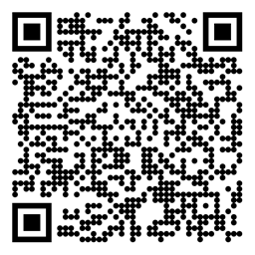


Reinforcement Learning $n$-step Bootstrapping Sutton/Barto* Chapter 7
Michael Hahsler, SMU
With figures from Sutton/Barto*
*Sutton and Barto, Reinforcement Learning: An Introduction, 2nd edition, MIT Press, Cambridge, MA, 2018

Slide 2
Topics of this Course
Introduction to reinforcement learning
Markov decision processes
Part I: Tabular Methods
Dynamic programming
Monte Carlo methods
Temporal-difference learning
Multi-step bootstrapping
Planning and learning with tabular methods
Part II: Approximate Solution Methods
Prediction and Control using Approximation
Eligibility Traces
Policy Gradient Methods
Part III: Modern RL Methods
Deep Reinforcement Learning
Current Applications

Slide 3
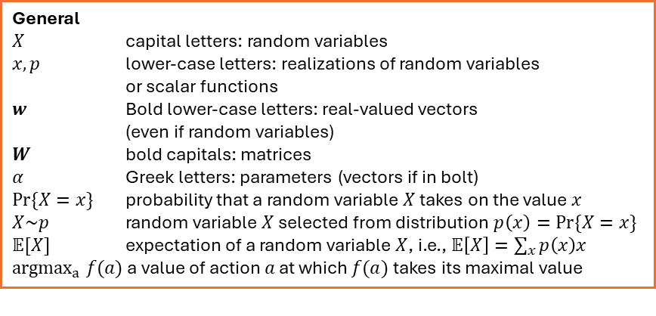
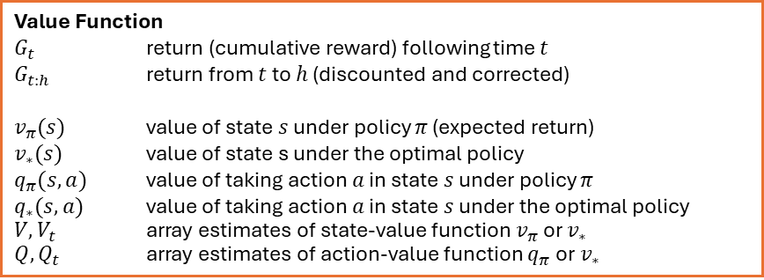
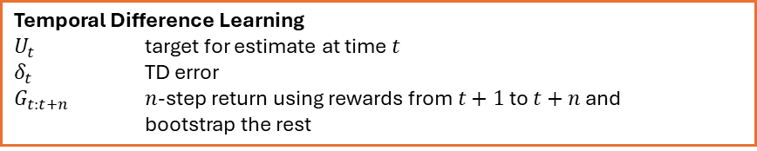
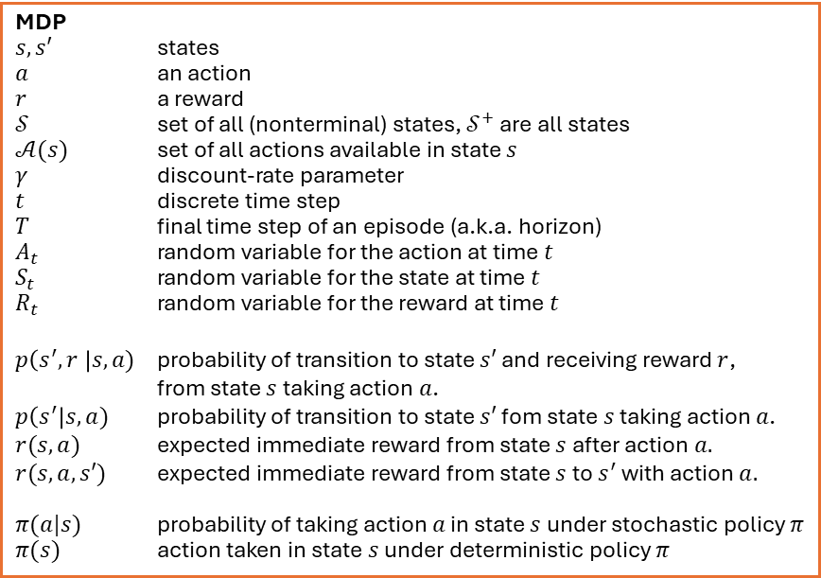
Summary of Notation
General
$X$ capital letters: random variables $x, p$ lower-case letters: realizations of random variables or scalar functions
$w$ Bold lower-case letters: real-valued vectors (even if random variables)
$W$ bold capitals: matrices
$α$ Greek letters: parameters (vectors if in bolt)
$Pr⁡\{X=x\}$ probability that a random variable $X$ takes on the value $x$
$X\sim p$ random variable $X$ selected from distribution $p\left(x\right)=Pr⁡\{X=x\}$
$𝔼[X]$ expectation of a random variable $X$, i.e., $𝔼\left[X\right]=\sum_{x}{p\left(x\right)x}$
${argmax}_{a} f(a)$ a value of action $a$ at which $f(a)$ takes its maximal value
MDP
$s, s′$ states
$a$ an action
$r$ a reward
$𝒮$ set of all (nonterminal) states, $𝒮^{+}$ are all states
$𝒜(s)$ set of all actions available in state $s$
$γ$ discount-rate parameter
$t$ discrete time step
$T$ final time step of an episode (a.k.a. horizon)
$A_{t}$ random variable for the action at time $t$
$S_{t}$ random variable for the state at time $t$
$R_{t}$ random variable for the reward at time $t$
$p\left(s^{′},r \right|s, a)$ probability of transition to state $s′$ and receiving reward $r$, from state $s$ taking action $a$.
$p\left(s^{′}\right|s, a)$ probability of transition to state $s′$ fom state $s$ taking action $a$.
$r(s,a)$ expected immediate reward from state $s$ after action $a.$
$r(s,a,s′)$ expected immediate reward from state $s$ to $s^{′}$ with action $a.$
$π(a|s)$ probability of taking action $a$ in state $s$ under stochastic policy $π$
$π(s)$ action taken in state $s$ under deterministic policy $π$
Value Function
$G_{t}$ return (cumulative reward) following time $t$
$G_{t:h}$ return from $t$ to $h$ (discounted and corrected)
$v_{π}(s)$ value of state $s$ under policy $π$ (expected return)
$v_{∗}(s)$ value of state s under the optimal policy
$q_{π}(s,a)$ value of taking action $a$ in state $s$ under policy $π$
$q_{∗}(s,a)$ value of taking action $a$ in state $s$ under the optimal policy
$V, V_{t}$ array estimates of state-value function $v_{π}$or $v_{∗}$
$Q,Q_{t}$ array estimates of action-value function $q_{π}$or $v_{∗}$
Temporal Difference Learning
$U_{t}$ target for estimate at time$t$
$δ_{t}$ TD error
$G_{t:t+n}$ $n$-step return using rewards from$t+1$to $t+n$ and bootstrap the rest

Slide 4

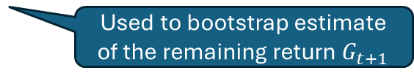
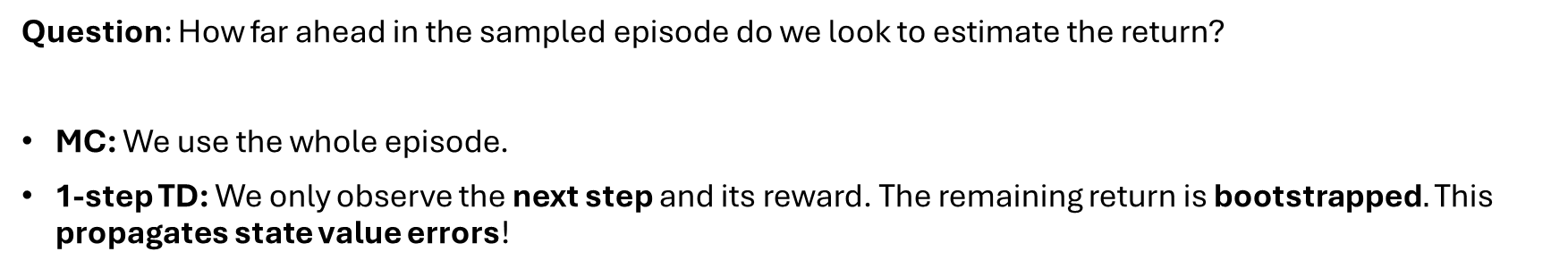


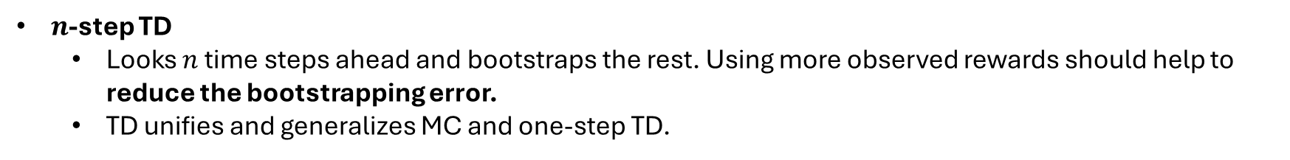

Policy Evaluation: 1-step TD vs. $n$-step TD vs. MC
Question: How far ahead in the sampled episode do we look to estimate the return?
MC: We use the whole episode.
1-step TD: We only observe the next step and its reward. The remaining return is bootstrapped$.$ This propagates state value errors!
1-step
$$V(S_{t})$$
$$V(S_{t+1})$$
Used to bootstrap estimate of the remaining return $G_{t+1}$
update
$n$-step TD
Looks $n$ time steps ahead and bootstraps the rest. Using more observed rewards should help to reduce the bootstrapping error.
TD unifies and generalizes MC and one-step TD.
1-step TD
$n$-step TD
MC
(whole episode)

Slide 5
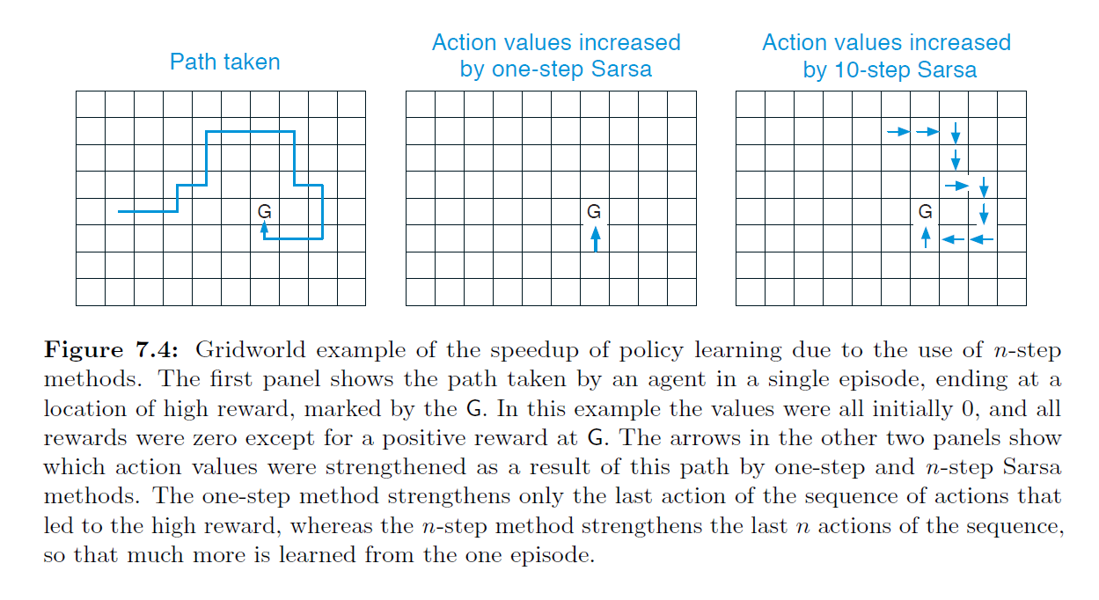
Why is a Longer Look-ahead Useful?
Example: Maze with only one final reward for reaching the goal. We learn from the first episode.
Episode (MC)
1-step look ahead
10-step look ahead
S
Updates in reverse order all state values on the path using the goal reward.
Can only update one state value with the goal reward.
State value can be updated with the goal reward even if it is up to 10 steps away. Learns faster than 1-step TD.

Slide 6
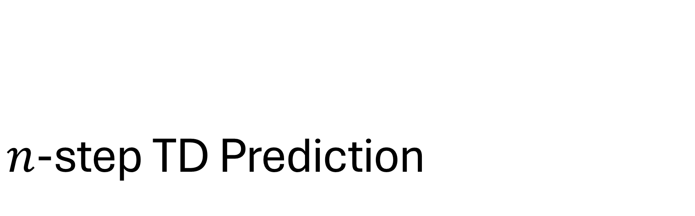
$n$-step TD Prediction
Estimate the value function for a given policy.

Slide 7
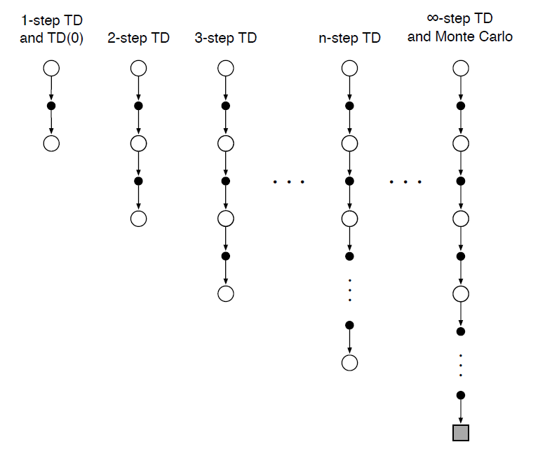
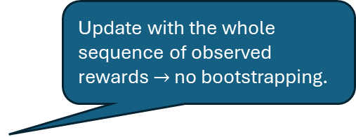

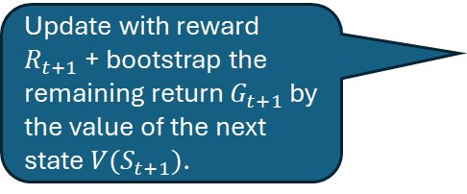
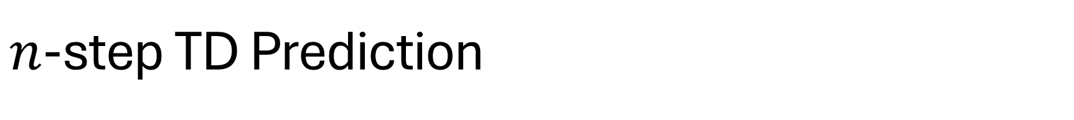


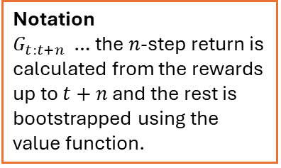

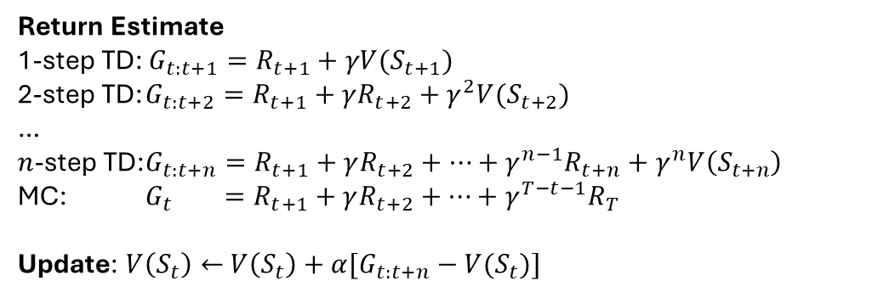
$n$-step TD Prediction
$$V(S_{t})$$
Update with reward $R_{t+1}$ + bootstrap the remaining return $G_{t+1}$ by the value of the next state $V(S_{t+1})$.
$$R_{t+1}$$
$$V(S_{t+1})$$
Update with the whole sequence of observed rewards $→$ no bootstrapping.
Return Estimate
1-step TD: $G_{t:t+1}=R_{t+1}+γV(S_{t+1})$
2-step TD: $G_{t:t+2}=R_{t+1}+γR_{t+2}+γ^{2}V(S_{t+2})$
…
$n$-step TD: $G_{t:t+n}=R_{t+1}+γR_{t+2}+…+γ^{n−1}R_{t+n}+γ^{n}V\left(S_{t+n}\right)$
MC: $G_{t} =R_{t+1}+γR_{t+2}+…+γ^{T−t−1}R_{T}$
Update: $V\left(S_{t}\right)←$ $V\left(S_{t}\right)+α[G_{t:t+n}−V(S_{t})]$
Notation
$G_{t:t+n}$ … the $n$-step return is calculated from the rewards up to $t+n$ and the rest is bootstrapped using the value function.
The update needs $G_{t:t+n}$ and is $n$ steps delayed!

Slide 8
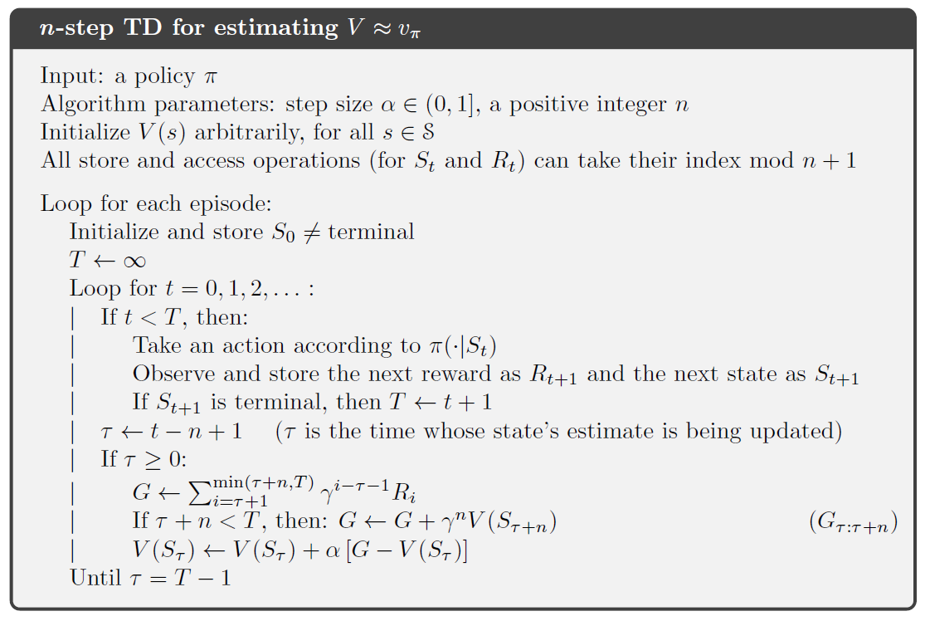


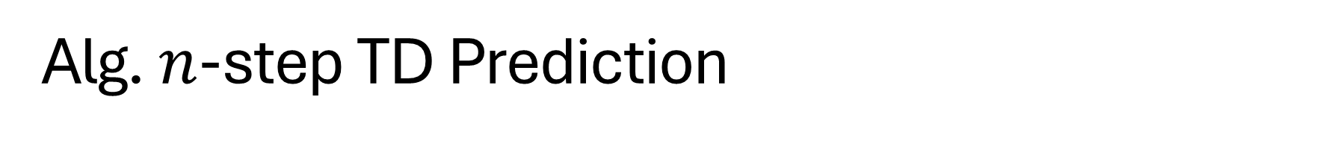
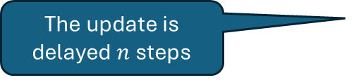
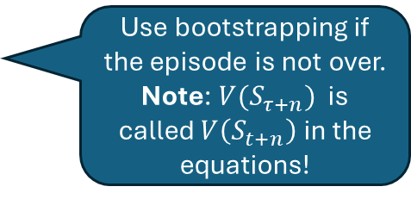

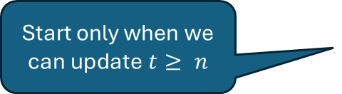

Alg. $n$-step TD Prediction
Detect the end of the episode
$n$ steps
Start only when we can update $t≥ n$
$$τ$$
$$t$$
()
Use bootstrapping if the episode is not over. Note: $V(S_{τ+n})$ is called $V\left(S_{t+n}\right)$ in the equations!
Observed $Rs+V(S_{t})$
The update is delayed $n$ steps

Slide 9
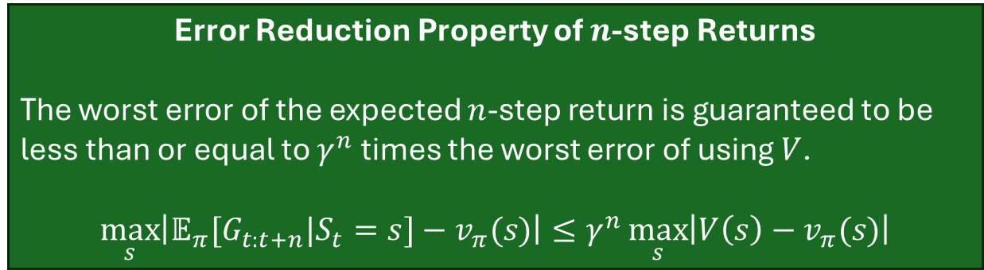
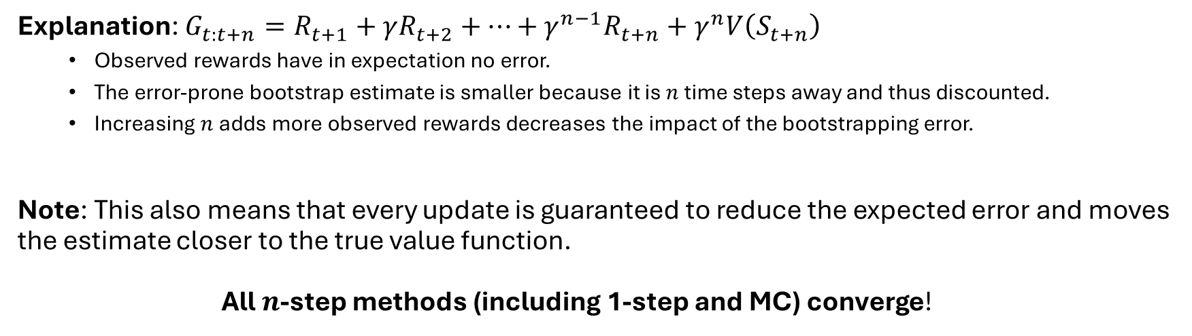
Convergence Guarantee
Error Reduction Property of $n$-step Returns
The worst error of the expected $n$-step return is guaranteed to be less than or equal to $γ^{n}$ times the worst error of using $V$.
$$\max_{s}\left|𝔼_{π}[G_{t:t+n}|S_{t}=s]−v_{π}(s)\right|≤γ^{n}\max_{s}\left|V\left(s\right)−v_{π}(s)\right|$$
Explanation: $G_{t:t+n}=R_{t+1}+γR_{t+2}+…+γ^{n−1}R_{t+n}+γ^{n}V\left(S_{t+n}\right)$
Observed rewards have in expectation no error.
The error-prone bootstrap estimate is smaller because it is $n$ time steps away and thus discounted.
Increasing $n$ adds more observed rewards decreases the impact of the bootstrapping error.
Note: This also means that every update is guaranteed to reduce the expected error and moves the estimate closer to the true value function. All $n$-step methods (including 1-step and MC) converge!

Slide 10
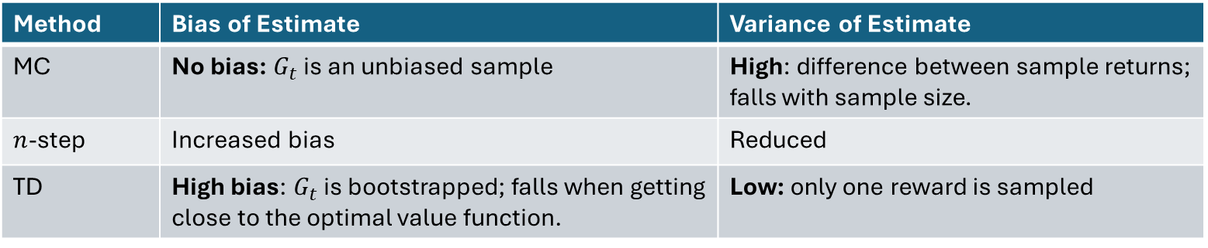
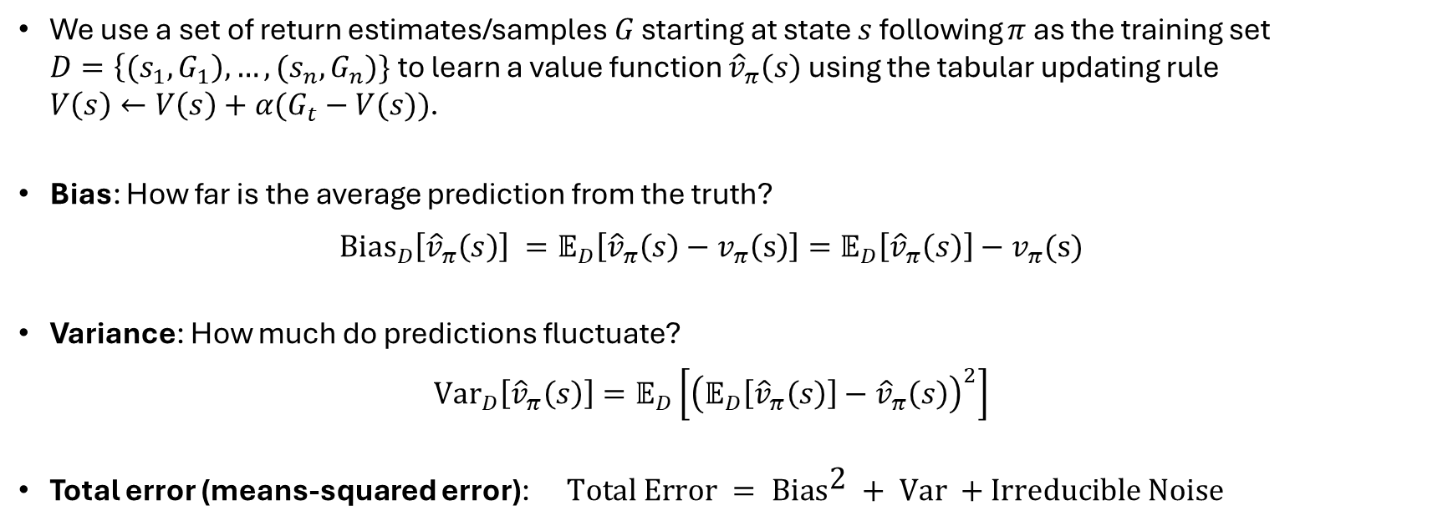
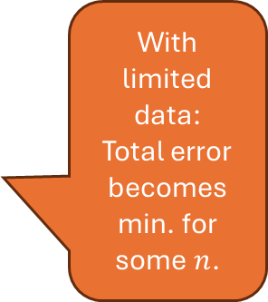
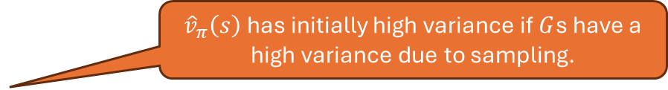
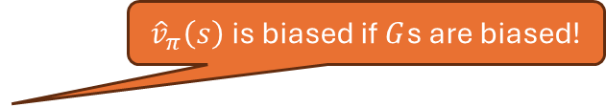
Bias-Variance Tradeoff in RL
We use a set of return estimates/samples $G$ starting at state $s$ following $π$ as the training set $D=\left\{{(s}_{1},G_{1}\right), …,(s_{n},G_{n})\}$to learn a value function ${\hat{v}}_{π}\left(s\right)$ using the tabular updating rule $V\left(s\right)←V\left(s\right)+α(G_{t}−V(s))$.
Bias: How far is the average prediction from the truth? ${\text{Bias}}_{D}\left[{\hat{v}}_{π}\left(s\right)\right] =𝔼_{D}\left[{\hat{v}}_{π}\left(s\right)−v_{π}\left(s\right)\right]=𝔼_{D}\left[{\hat{v}}_{π}\left(s\right)\right]−v_{π}(s)$
Variance: How much do predictions fluctuate? ${Var}_{D}\left[{\hat{v}}_{π}\left(s\right)\right]=𝔼_{D}\left[{\left(𝔼_{D}\left[{\hat{v}}_{π}\left(s\right)\right]−{\hat{v}}_{π}\left(s\right)\right)}^{2}\right]$
Total error (means-squared error): $\text{Total} \text{E}\text{rror} = \text{B}\text{ia}{\text{s}}^{\text{2}} + \text{V}\text{ar} +\text{I}\text{rreducible} \text{N}\text{oise}$
${\hat{v}}_{π}\left(s\right)$ is biased if $G$s are biased!
${\hat{v}}_{π}\left(s\right)$ has initially high variance if $G$s have a high variance due to sampling.
With limited data:
Total error becomes min. for some $n$.
Method | Bias of Estimate | Variance of Estimate
MC | No bias: $G_{t}$ is an unbiased sample | High: difference between sample returns; falls with sample size.
$n$-step | Increased bias | Reduced
TD | High bias: $G_{t}$ is bootstrapped; falls when getting close to the optimal value function. | Low: only one reward is sampled

Slide 11
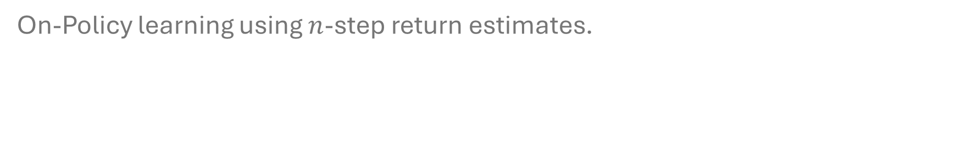
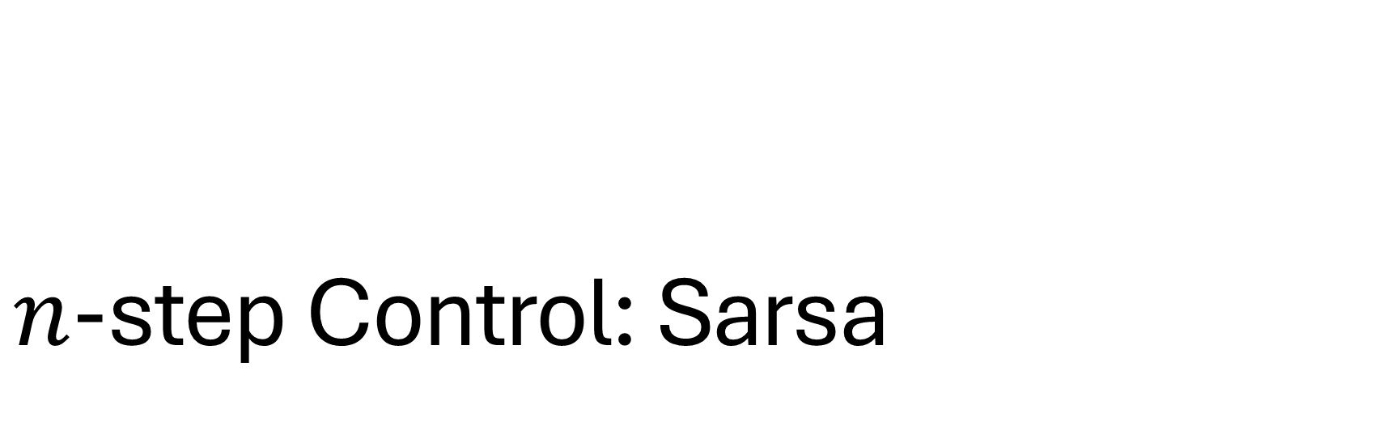
$n$-step Control: Sarsa
On-Policy learning using $n$-step return estimates.

Slide 12
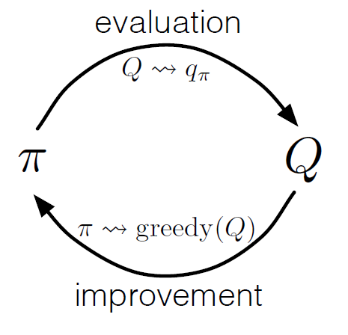
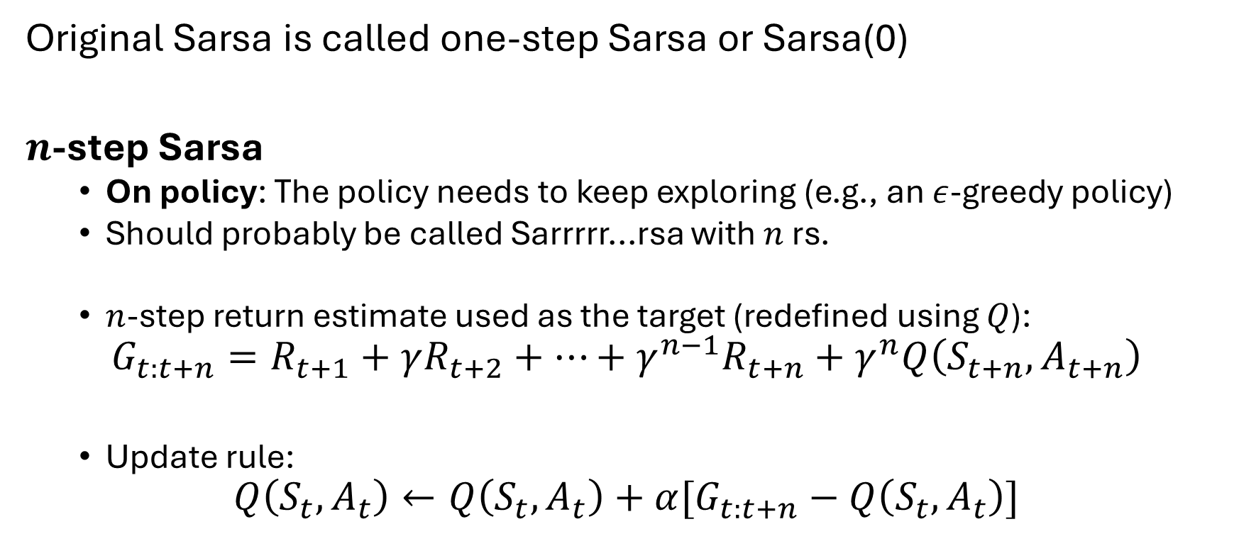

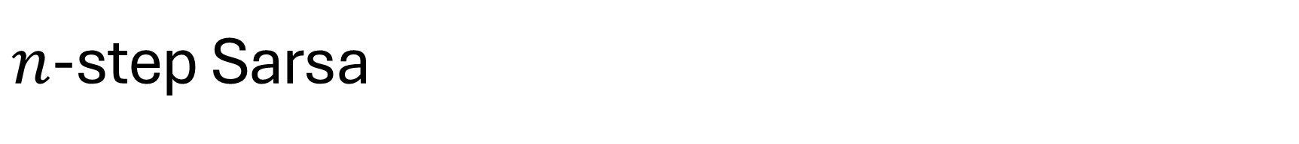

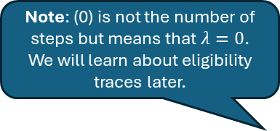
$n$-step Sarsa
$n$-step TD prediction
Note: (0) is not the number of steps but means that $λ=0$. We will learn about eligibility traces later.
GPI
$$π⇝ϵ\text{−}\text{greedy}(Q)$$
Original Sarsa is called one-step Sarsa or Sarsa(0)
$n$-step Sarsa
On policy: The policy needs to keep exploring (e.g., an $ε$-greedy policy)
Should probably be called Sarrrrr...rsa with $n$ rs.
$n$-step return estimate used as the target (redefined using $Q$):
$$G_{t:t+n}=R_{t+1}+γR_{t+2}+…+γ^{n−1}R_{t+n}+γ^{n}Q\left(S_{t+n},A_{t+n}\right)$$
Update rule:
$$Q\left(S_{t},A_{t}\right)←Q\left(S_{t},A_{t}\right)+α[G_{t:t+n}−Q\left(S_{t},A_{t}\right)]$$
This is the extra action Sarsa need.

Slide 13
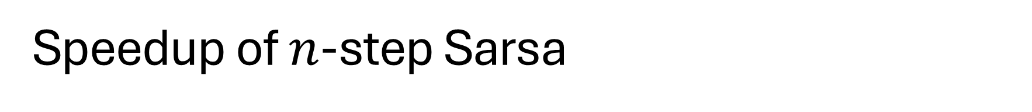

Speedup of $n$-step Sarsa
$Q$-values updated during one episode

Slide 14
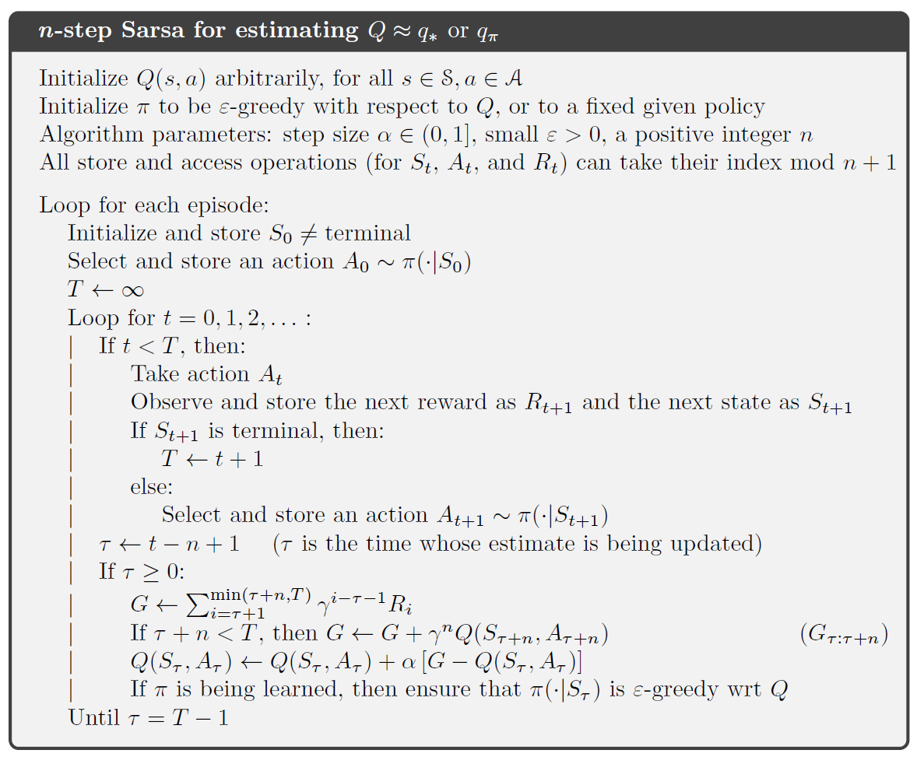
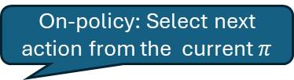
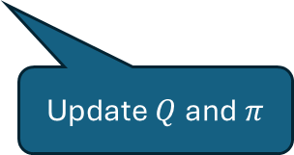
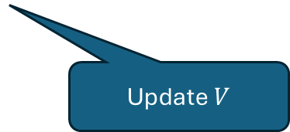
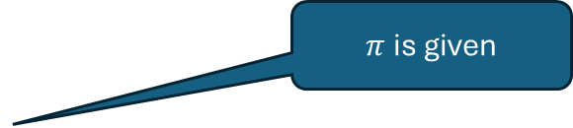
Alg. From DT prediction to $n$-step Sarsa Control
$π$ is given
On-policy: Select next action from the current $π$
Update $V$
Update $Q$ and $π$

Slide 15
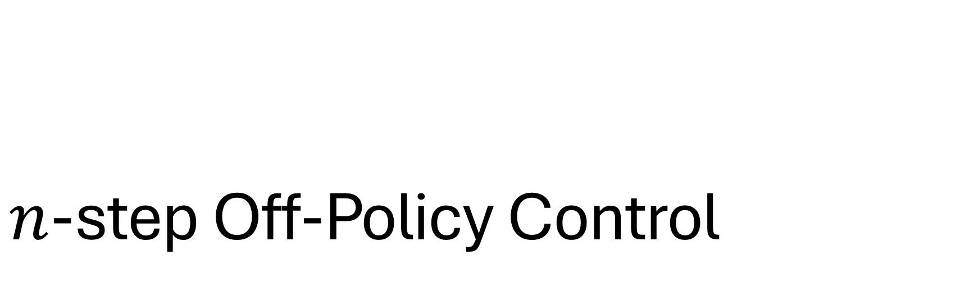
$n$-step Off-Policy Control
Add importance sampling ratios to prediction and control.

Slide 16
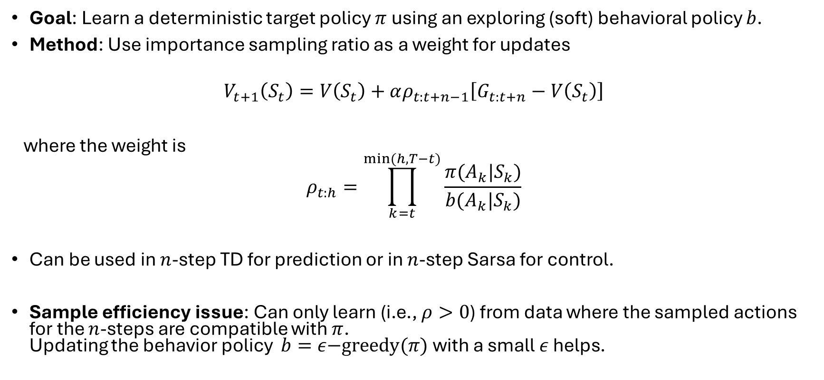
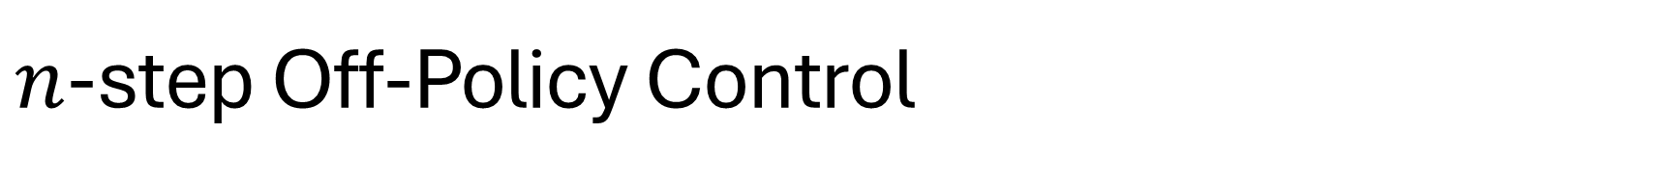
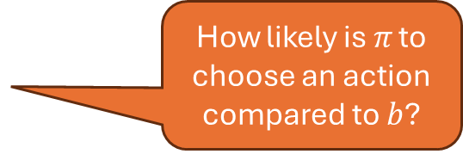
$n$-step Off-Policy Control
Goal: Learn a deterministic target policy $π$ using an exploring (soft) behavioral policy $b$.
Method: Use importance sampling ratio as a weight for updates
$$V_{t+1}\left(S_{t}\right)=V\left(S_{t}\right)+αρ_{t:t+n−1}\left[G_{t:t+n}−V\left(S_{t}\right)\right]$$
where the weight is
$$ρ_{t:h}=\prod_{k=t}^{min⁡(h,T−t)}{\frac{π(A_{k}|S_{k})}{b(A_{k}|S_{k})}}$$
Can be used in $n$-step TD for prediction or in $n$-step Sarsa for control.
Sample efficiency issue: Can only learn (i.e., $ρ>0$) from data where the sampled actions for the $n$-steps are compatible with $π$. Updating the behavior policy $b=ε\text{−}\text{greedy}(π)$ with a small $ε$ helps.
How likely is 𝜋 to choose an action compared to $b$?

Slide 17
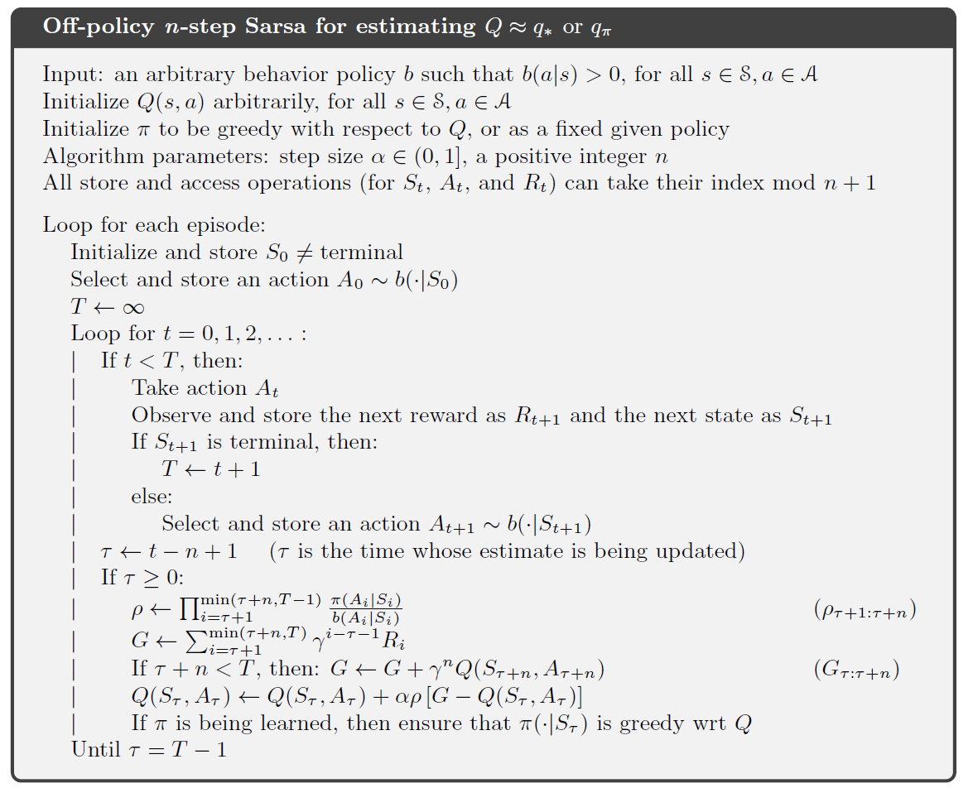
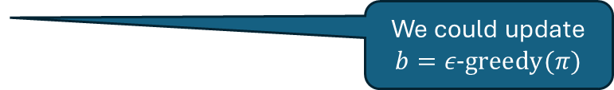
Alg. Comparing On-Policy with Off-Policy
Add behavior policy
Greedy target policy
We could update $b=ε\text{−}\text{greedy}(π)$
On-Policy
Use importance sampling ratio

Slide 18
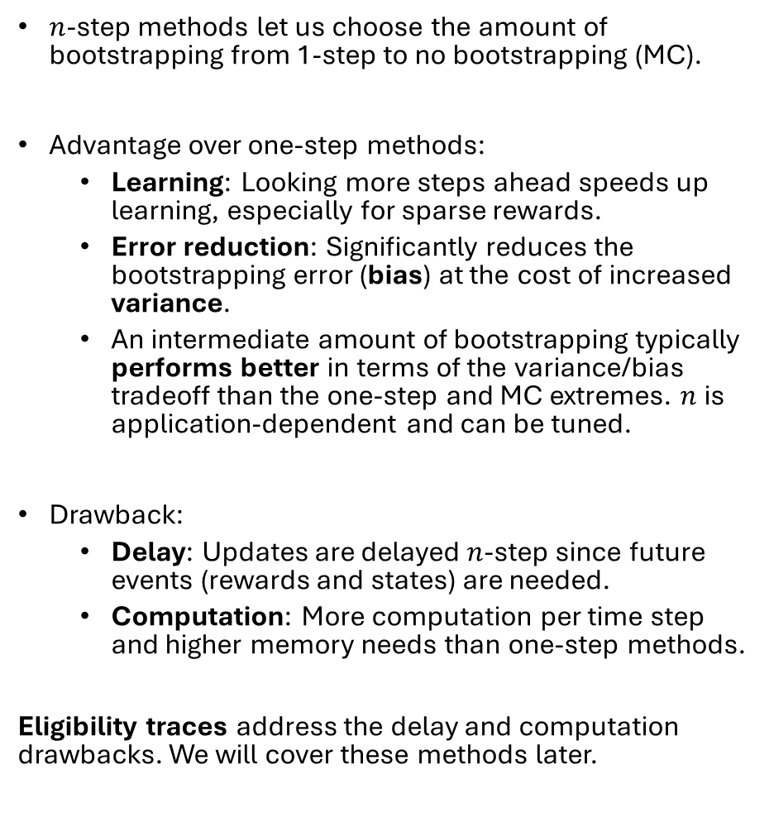
What you Need to Know
$n$-step methods let us choose the amount of bootstrapping from 1-step to no bootstrapping (MC).
Advantage over one-step methods:
Learning: Looking more steps ahead speeds up learning, especially for sparse rewards.
Error reduction: Significantly reduces the bootstrapping error (bias) at the cost of increased variance.
An intermediate amount of bootstrapping typically performs better in terms of the variance/bias tradeoff than the one-step and MC extremes. $n$ is application-dependent and can be tuned.
Drawback:
Delay: Updates are delayed $n$-step since future events (rewards and states) are needed.
Computation: More computation per time step and higher memory needs than one-step methods.
Eligibility traces address the delay and computation drawbacks. We will cover these methods later.

