Slide 1



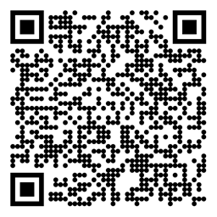

Reinforcement Learning Planning and Learning with Tabular Methods Sutton/Barto* Chapter 8
Michael Hahsler, SMU
With figures from Sutton/Barto*
*Sutton and Barto, Reinforcement Learning: An Introduction, 2nd edition, MIT Press, Cambridge, MA, 2018

Slide 2
Topics of this Course
Introduction to reinforcement learning
Markov decision processes
Part I: Tabular Methods
Dynamic programming
Monte Carlo methods
Temporal-difference learning
Multi-step bootstrapping
Planning and learning with tabular methods
Part II: Approximate Solution Methods
Prediction and Control using Approximation
Eligibility Traces
Policy Gradient Methods
Part III: Modern RL Methods
Deep Reinforcement Learning
Current Applications

Slide 3
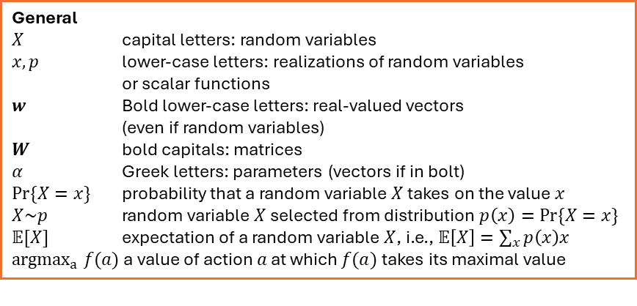
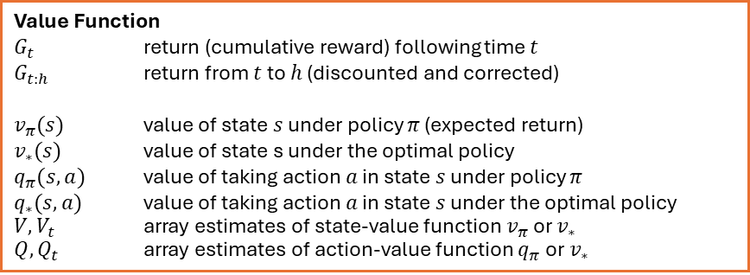
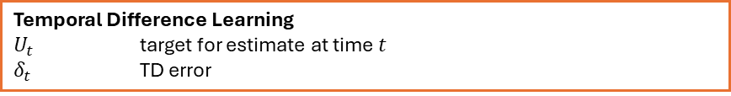
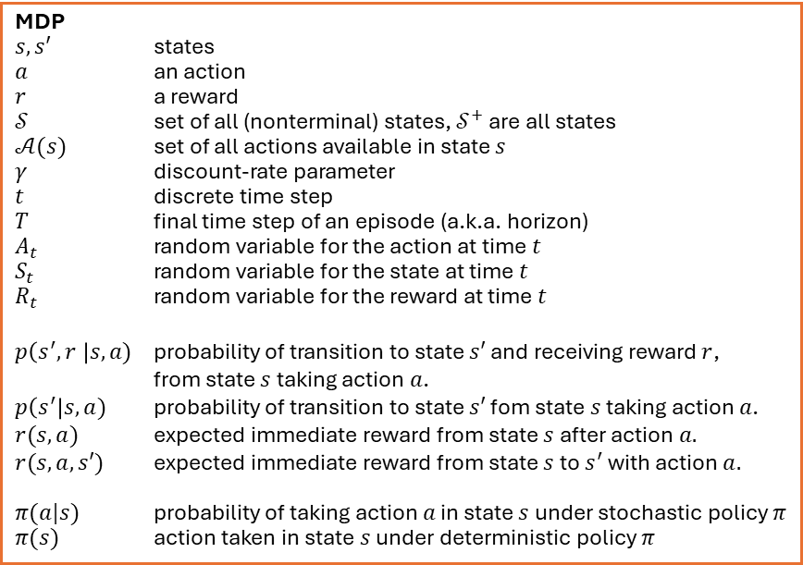
Summary of Notation
General
$X$ capital letters: random variables $x, p$ lower-case letters: realizations of random variables or scalar functions
$w$ Bold lower-case letters: real-valued vectors (even if random variables)
$W$ bold capitals: matrices
$α$ Greek letters: parameters (vectors if in bolt)
$Pr⁡\{X=x\}$ probability that a random variable $X$ takes on the value $x$
$X\sim p$ random variable $X$ selected from distribution $p\left(x\right)=Pr⁡\{X=x\}$
$𝔼[X]$ expectation of a random variable $X$, i.e., $𝔼\left[X\right]=\sum_{x}{p\left(x\right)x}$
${argmax}_{a} f(a)$ a value of action $a$ at which $f(a)$ takes its maximal value
MDP
$s, s′$ states
$a$ an action
$r$ a reward
$𝒮$ set of all (nonterminal) states, $𝒮^{+}$ are all states
$𝒜(s)$ set of all actions available in state $s$
$γ$ discount-rate parameter
$t$ discrete time step
$T$ final time step of an episode (a.k.a. horizon)
$A_{t}$ random variable for the action at time $t$
$S_{t}$ random variable for the state at time $t$
$R_{t}$ random variable for the reward at time $t$
$p\left(s^{′},r \right|s, a)$ probability of transition to state $s′$ and receiving reward $r$, from state $s$ taking action $a$.
$p\left(s^{′}\right|s, a)$ probability of transition to state $s′$ fom state $s$ taking action $a$.
$r(s,a)$ expected immediate reward from state $s$ after action $a.$
$r(s,a,s′)$ expected immediate reward from state $s$ to $s^{′}$ with action $a.$
$π(a|s)$ probability of taking action $a$ in state $s$ under stochastic policy $π$
$π(s)$ action taken in state $s$ under deterministic policy $π$
Value Function
$G_{t}$ return (cumulative reward) following time $t$
$G_{t:h}$ return from $t$ to $h$ (discounted and corrected)
$v_{π}(s)$ value of state $s$ under policy $π$ (expected return)
$v_{∗}(s)$ value of state s under the optimal policy
$q_{π}(s,a)$ value of taking action $a$ in state $s$ under policy $π$
$q_{∗}(s,a)$ value of taking action $a$ in state $s$ under the optimal policy
$V, V_{t}$ array estimates of state-value function $v_{π}$or $v_{∗}$
$Q,Q_{t}$ array estimates of action-value function $q_{π}$or $v_{∗}$
Temporal Difference Learning
$U_{t}$ target for estimate at time$t$
$δ_{t}$ TD error

Slide 4
Planning vs. Learning

Slide 5
Planning vs. Learning
Model-based RL
Model-free RL
Requires knowledge of the MDP model.
Methods: Dynamic Programming, heuristic search
Use the known model to plan
Model is unknown.
Methods: MC, TD
Learn from interactions with the environment (sampling).
+ use the MDP as a simulation model for Model-free RL
All methods do the following:
Policy evaluation (prediction): Compute a value function/policy.
Look ahead to future events (rewards, states, actions) and compute a backed-up value to update an approximate value function.

Slide 6
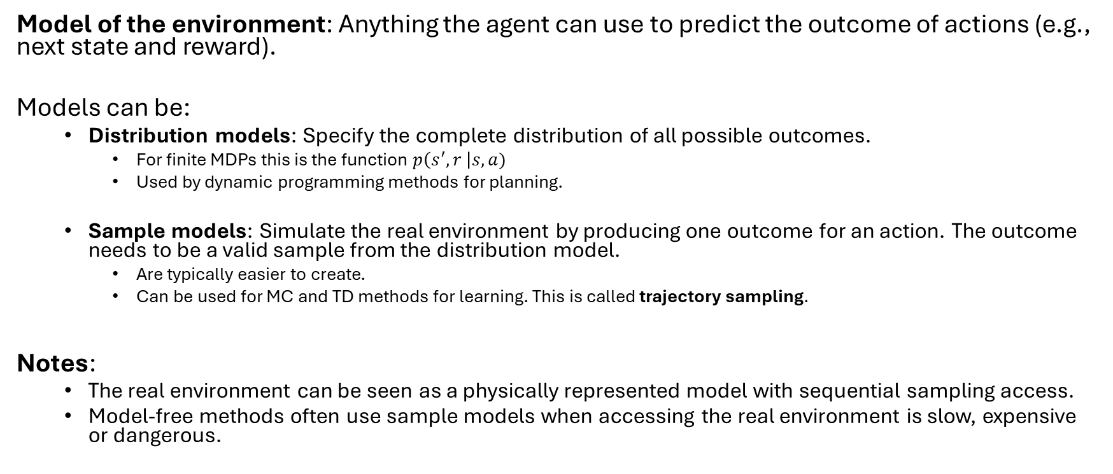
What is a Model
Model of the environment: Anything the agent can use to predict the outcome of actions (e.g., next state and reward).
Models can be:
Distribution models: Specify the complete distribution of all possible outcomes.
For finite MDPs this is the function $p\left(s^{′},r \right|s,a)$
Used by dynamic programming methods for planning.
Sample models: Simulate the real environment by producing one outcome for an action. The outcome needs to be a valid sample from the distribution model.
Are typically easier to create.
Can be used for MC and TD methods for learning. This is called trajectory sampling.
Notes:
The real environment can be seen as a physically represented model with sequential sampling access.
Model-free methods often use sample models when accessing the real environment is slow, expensive or dangerous.
Can we integrate learning and planning?

Slide 7
Dyna
Integrating Planning, Acting, and Learning

Slide 8
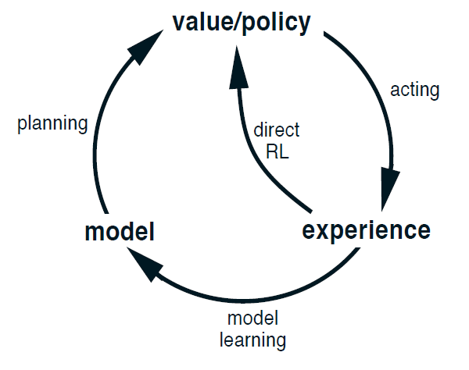
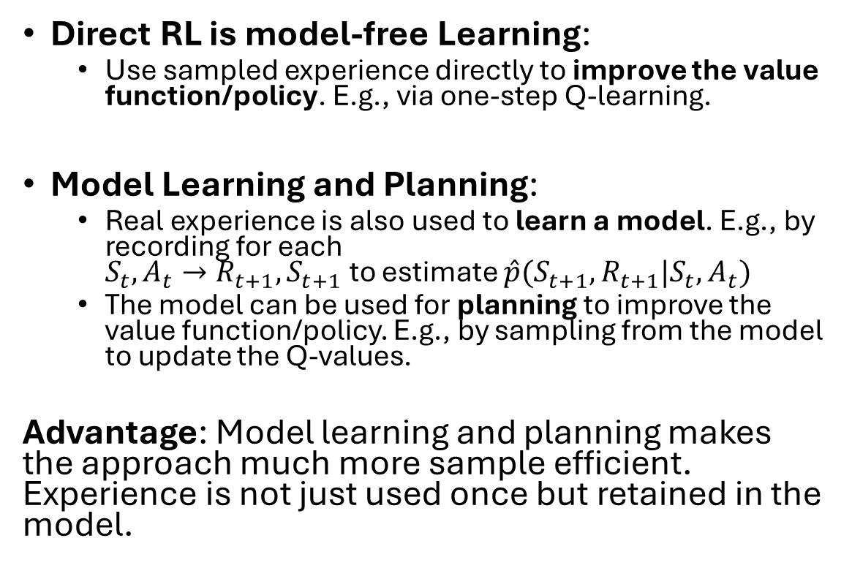
Integrating Planning, Acting, and Learning
Direct RL is model-free Learning:
Use sampled experience directly to improve the value function/policy. E.g., via one-step Q-learning.
Model Learning and Planning:
Real experience is also used to learn a model. E.g., by recording for each $S_{t},A_{t}→R_{t+1}, S_{t+1}$ to estimate $\hat{p}(S_{t+1},R_{t+1}|S_{t},A_{t})$
The model can be used for planning to improve the value function/policy. E.g., by sampling from the model to update the Q-values.
Advantage: Model learning and planning makes the approach much more sample efficient. Experience is not just used once but retained in the model.

Slide 9
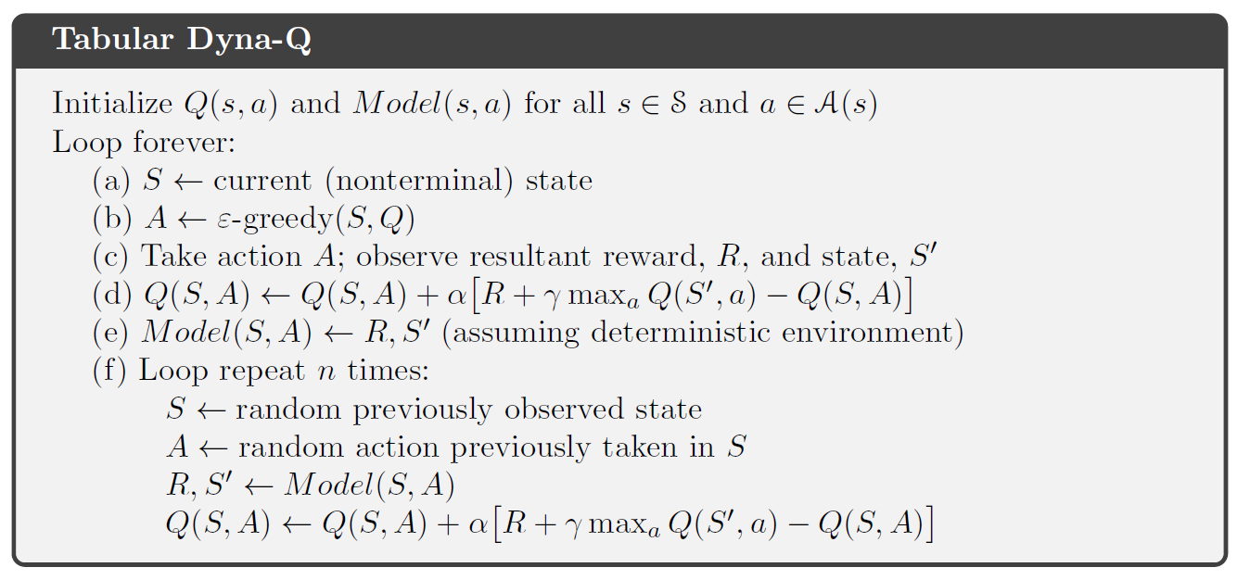

Alg. Tabular Dyna-Q
Direct RL: Q-Learning
Model learning: learn $p(s^{′},r|s,a)$
Improve Q using the model (Planning)

Slide 10
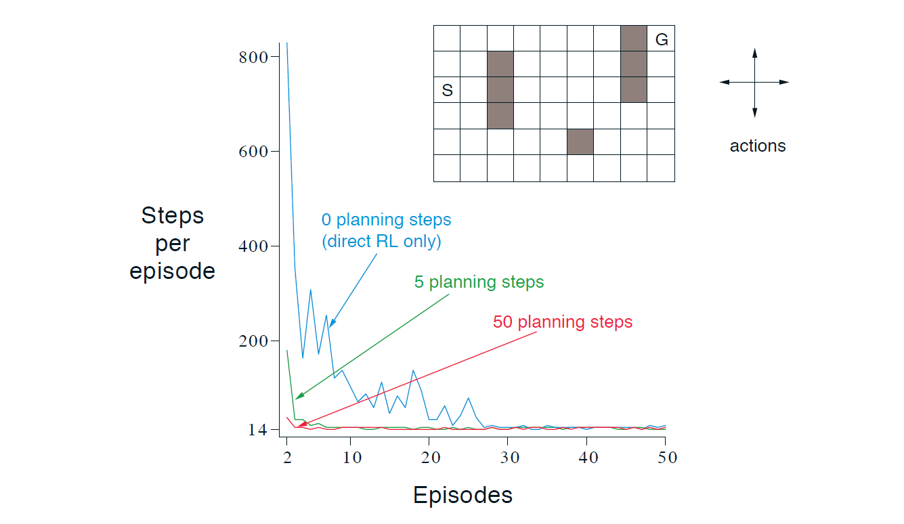
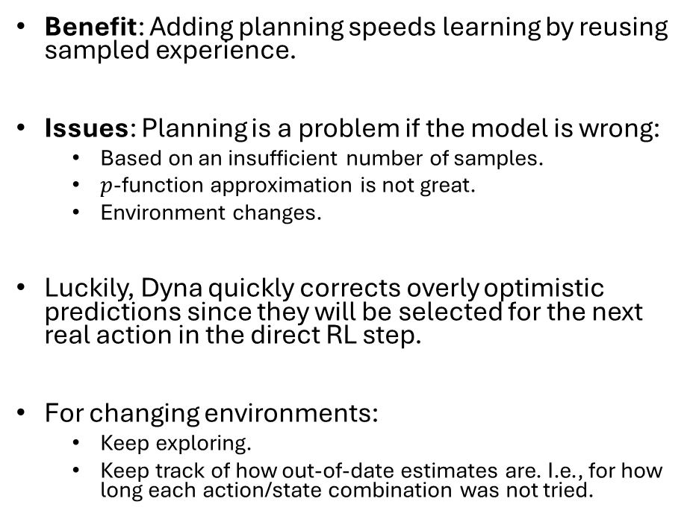
The Effect of Planning
Benefit: Adding planning speeds learning by reusing sampled experience.
Issues: Planning is a problem if the model is wrong:
Based on an insufficient number of samples.
$p$-function approximation is not great.
Environment changes.
Luckily, Dyna quickly corrects overly optimistic predictions since they will be selected for the next real action in the direct RL step.
For changing environments:
Keep exploring.
Keep track of how out-of-date estimates are. I.e., for how long each action/state combination was not tried.

Slide 11
Sampling
Base updates on sampled experience

Slide 12
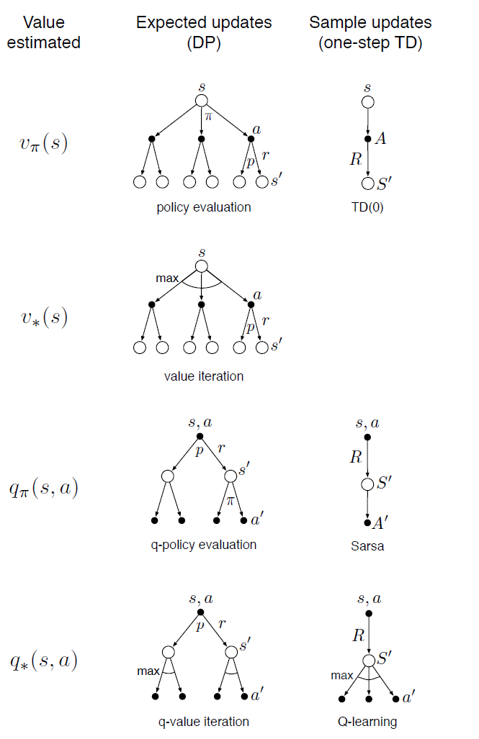
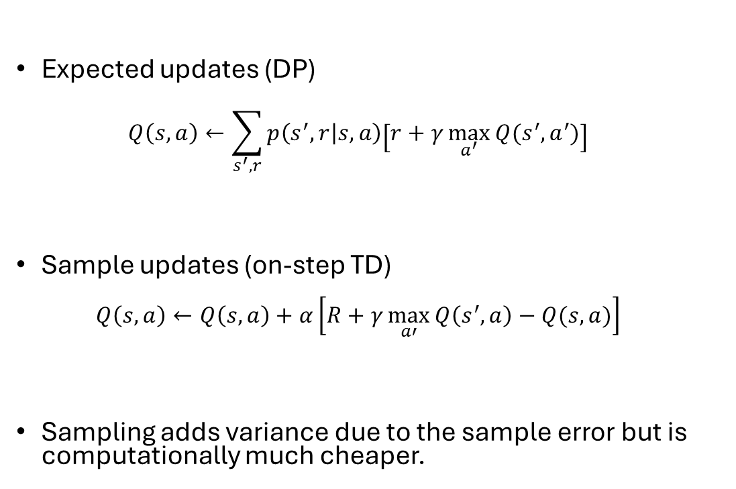
Expected vs. Sample Updates
Expected updates (DP) $Q\left(s,a\right)←\sum_{s^{′},r}{p\left(s^{′},r | s,a\right)\left[r+γ\max_{a^{′}}{Q(s^{′},a^{′})}\right]}$
Sample updates (on-step TD) $Q\left(s,a\right)←Q\left(s,a\right)+α\left[R+γ\max_{a′}{Q\left(s^{′},a\right)−Q(s,a)}\right]$
Sampling adds variance due to the sample error but is computationally much cheaper.

Slide 13
Heuristic Search and Rollout Algorithms
Decision-time planning

Slide 14
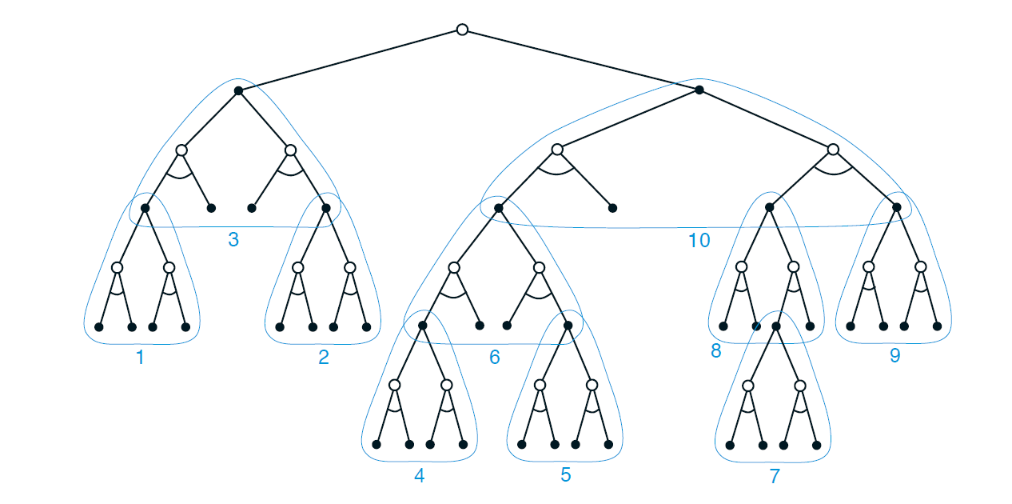

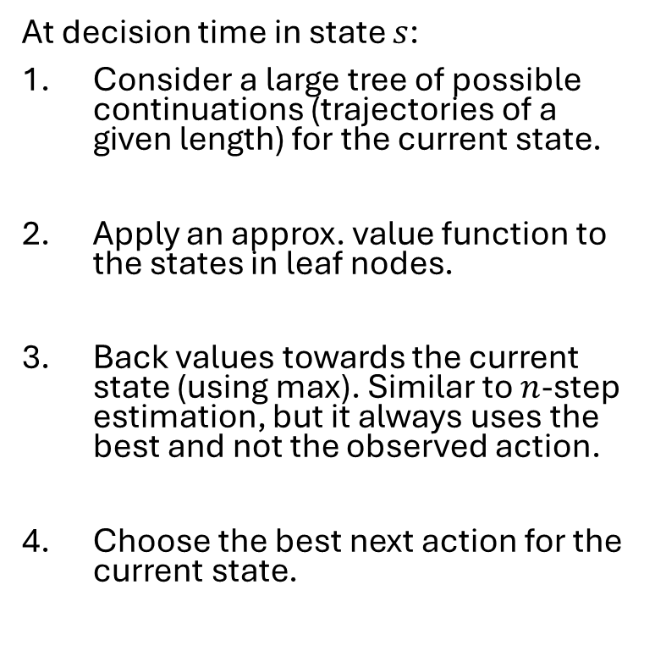




Option 1: Heuristic Search
4. Pick best action leasing to largest Q-value
At decision time in state $s$:
Consider a large tree of possible continuations (trajectories of a given length) for the current state.
Apply an approx. value function to the states in leaf nodes.
Back values towards the current state (using max). Similar to $n$-step estimation, but it always uses the best and not the observed action.
Choose the best next action for the current state.
$$R$$
3. backup
$$R$$
$$R$$
$$R$$
$$Q$$
2. Estimate leaf node values
Note: This is like heuristic (cut-off) min-max search for games.

Slide 15
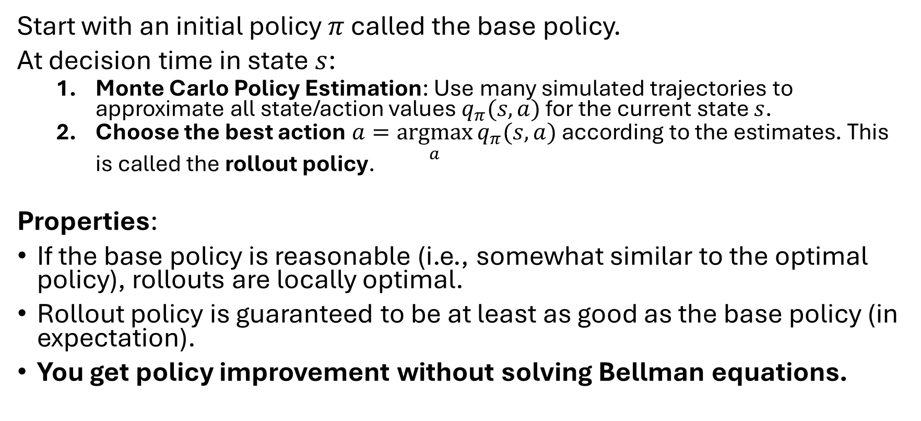
Option 2: Rollout Algorithms
Start with an initial policy $π$ called the base policy.
At decision time in state $s$:
Monte Carlo Policy Estimation: Use many simulated trajectories to approximate all state/action values $q_{π}(s,a)$ for the current state $s$.
Choose the best action $a=\underset{a}{argmax}{q_{π}(s,a)}$ according to the estimates. This is called the rollout policy.
Properties:
If the base policy is reasonable (i.e., somewhat similar to the optimal policy), rollouts are locally optimal.
Rollout policy is guaranteed to be at least as good as the base policy (in expectation).
You get policy improvement without solving Bellman equations.

Slide 16
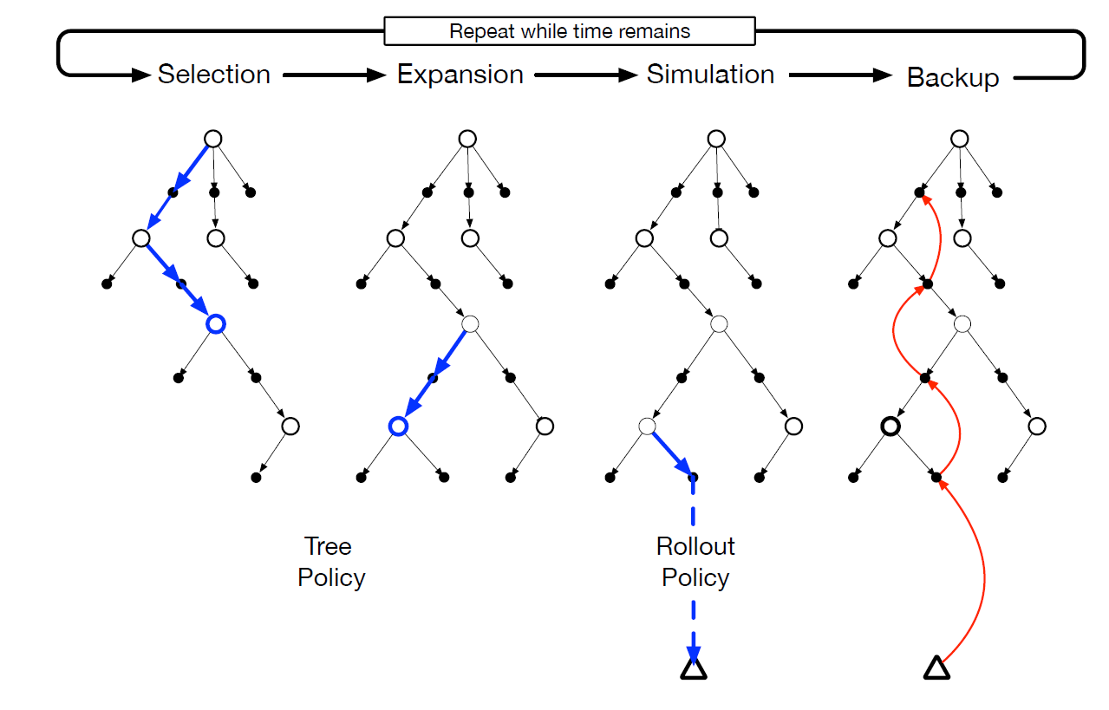
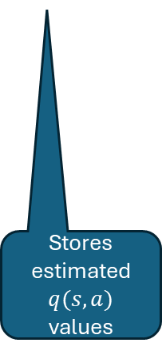
Rollout Algorithm: Monte Carlo Tree Search
MCTS is a rollout algorithm that stores some intermediate estimates in a depth-limited tree structure.
Selection: Pick the currently best leaf node (e.g., greedy, UCB).
Expansion: Add new nodes, but keep the tree small enough.
Simulation: From a selected node, simulate complete episode(s).
Backup: update the tree with the result of the playout.
Advantage: selection steers the simulation towards better trajectories. This avoids approximating the full value function.
Stores estimated $q(s,a)$ values
MTCS can be seen as an RL method that selectively approximates q-values useful for choosing good actions.

Slide 17
What you Should Know
We can have different models of the environment.
A full distribution model
A sample model
DP (planning) requires a distribution model because it uses expected updates.
Model-free RL, like MC and TD, can use a sample model to perform sample updates.
Decision-time planning can also use a sample model. E.g., rollout algorithms sample trajectories.
Planning and learning are related and try to estimate the same value function.
Learning: Direct RL directly learns a value function
Planning: We learn a model used to estimate the value function.

Slide 18
Summary of Part I: Tabular Solution Methods

Slide 19
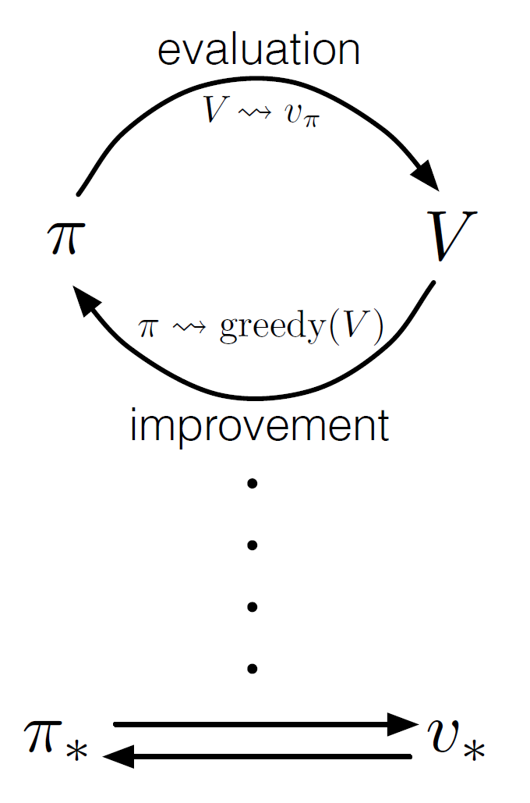
Common Ideas
GPI
Policy Evaluation: Estimate the value function by updates based on backing up values along actual or possible state trajectories.
Generalized policy iteration (GPI): maintain an approx. value function and an approx. policy. Each is used to update the other. Converges due to the policy improvement theorem.
Differences: How to perform policy evaluation.

Slide 20
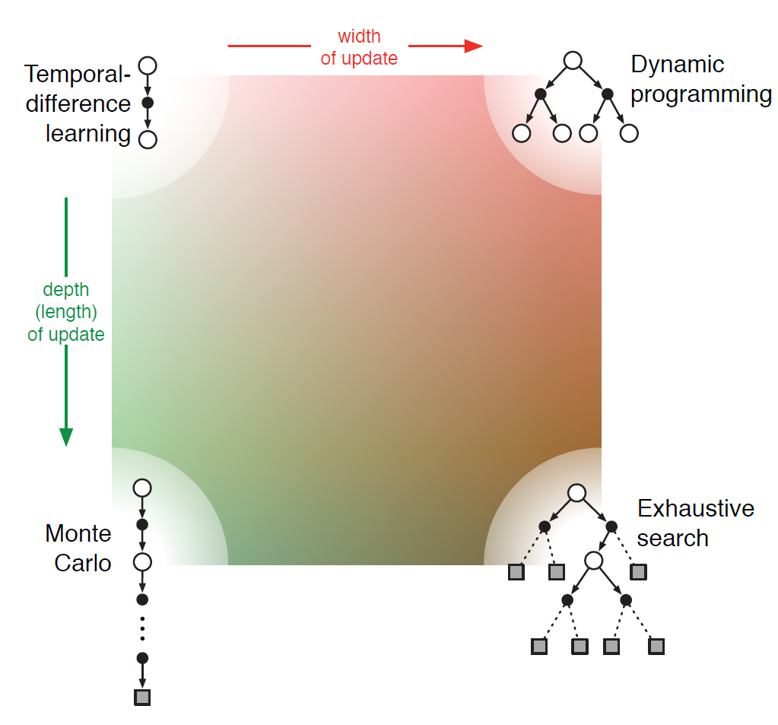
Policy Evaluation: Update Depth vs. Update Width
Depth
One-step methods
one-step Sarsa Q-Learning
+ Expected Sarsa
Bias increases
Bias decreases the closer we get to the optimal value function.
n-step Sarsa
n-step methods
Heuristic Search
Variance decreases with sample size.
Rollout Algorithms
Each method is located somewhere in this continuum.
Full-return methods
Variance increases
Width: Sampled trajectory
Consider all actions (use expectation or max)

Slide 21
On-Policy vs. Off-Policy
On-Policy: Evaluate or learn a policy that is used to sample data.
Off-Policy: Evaluate or learn a target policy different from the behavior policy.
Off-Policy is useful because:
Learn optimal policies while using exploring behavior.
Reuse of data is possible: offline, and batch RL on existing training data leads to better sample efficiency.
Off-Policy learning is harder because:
Requires distributional correction: E.g., importance sampling which is not able to use all data when the behavioral policy is very different from the target policy.
May suffer from high variance caused by importance sampling.
Instability with non-linear function approximation: This is a major issue for deep RL

Slide 22
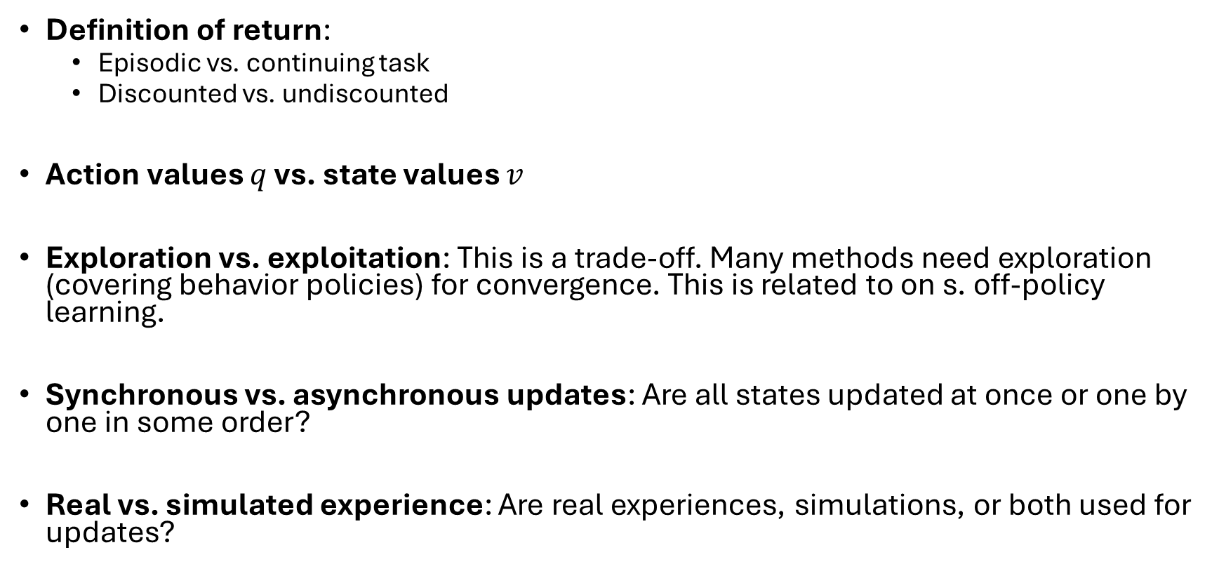
Other Dimensions
Definition of return:
Episodic vs. continuing task
Discounted vs. undiscounted
Action values $q$ vs. state values $v$
Exploration vs. exploitation: This is a trade-off. Many methods need exploration (covering behavior policies) for convergence. This is related to on s. off-policy learning.
Synchronous vs. asynchronous updates: Are all states updated at once or one by one in some order?
Real vs. simulated experience: Are real experiences, simulations, or both used for updates?

Slide 23
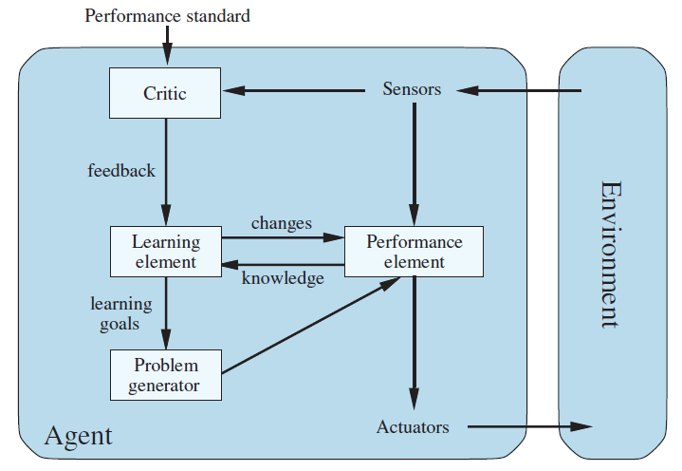
Relationship With Reflex Agents
Tabular methods create a policy that defines the action for each state.
We can implement this policy by a set of rules, one for each state.
The agent is learning because it improves the policy over time.
For episodic tasks, tabular RL implements a learning reflex agent.
For continuous tasks, where the rewards express utility, we get a learning utility-based agent.
Cases:
Fully observable case:
DP uses the MDP for planning to create the optimal simple reflex agent.
Model-free RL learns a simple reflex agent.
Partially observable case: The agent constantly updates its agent state to approximate the environment state. The agent stores the agent state and uses it to decide on actions. It learns a model-based reflex agent.
Model-free RL as A Learning Agent
Expected return
E.g., TD error
policy
Update value func.
Exploring behavior
Source: Artificial Intelligence: A Modern Approach, Chapter 2

Slide 24
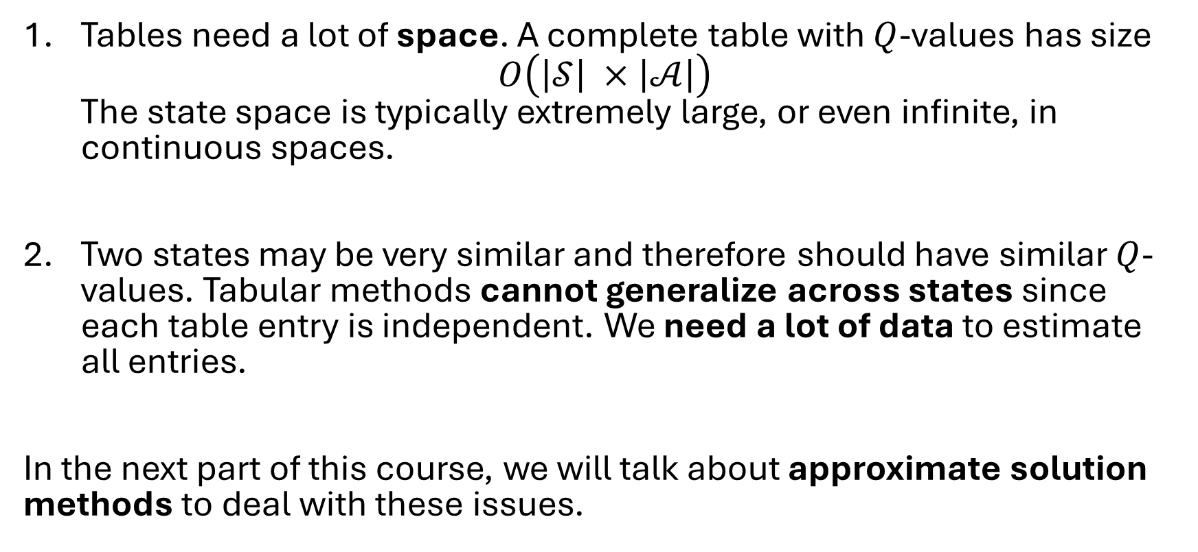
Issues with Tabular Methods
Tables need a lot of space. A complete table with $Q$-values has size $O\left(\left|𝒮\right| ×\left|𝒜\right|\right)$ The state space is typically extremely large, or even infinite, in continuous spaces.
Two states may be very similar and therefore should have similar $Q$-values. Tabular methods cannot generalize across states since each table entry is independent. We need a lot of data to estimate all entries.
In the next part of this course, we will talk about approximate solution methods to deal with these issues.

