Slide 1



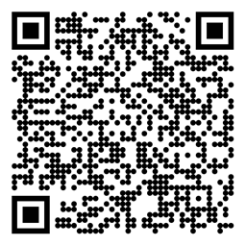

Reinforcement Learning
Temporal-Difference Learning
Sutton/Barto* Chapter 6
Michael Hahsler, SMU
With figures from Sutton/Barto*
*Sutton and Barto, Reinforcement Learning: An Introduction, 2nd edition, MIT Press, Cambridge, MA, 2018

Slide 2
Topics of this Course
Introduction to reinforcement learning
Markov decision processes
Part I: Tabular Methods
  Dynamic programming
  Monte Carlo methods
  Temporal-difference learning
  Multi-step bootstrapping
  Planning and learning with tabular methods
Part II: Approximate Solution Methods
  Prediction and Control using Approximation
  Eligibility Traces
  Policy Gradient Methods
Part III: Modern RL Methods
  Deep Reinforcement Learning
  Current Applications

Slide 3
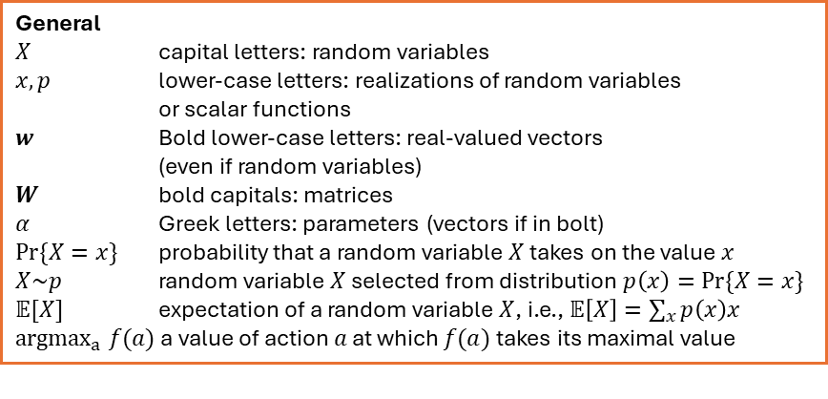
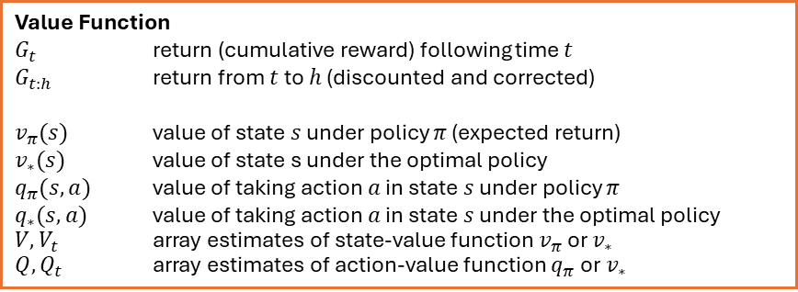
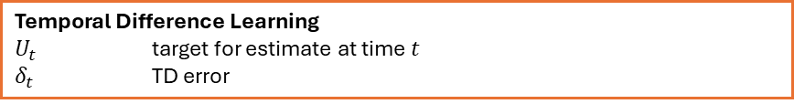
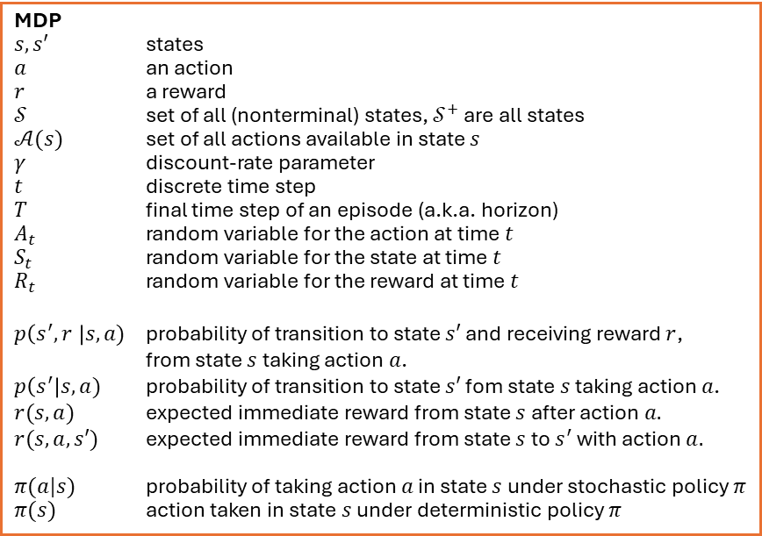
Summary of Notation
General
$X$ capital letters: random variables
$x, p$ lower-case letters: realizations of random variables
or scalar functions
$w$ Bold lower-case letters: real-valued vectors
(even if random variables)
$W$ bold capitals: matrices
$α$ Greek letters: parameters (vectors if in bolt)
$Pr⁡\{X=x\}$ probability that a random variable $X$ takes on the value $x$
$X\sim p$ random variable $X$ selected from distribution $p\left(x\right)=Pr⁡\{X=x\}$
$𝔼[X]$ expectation of a random variable $X$, i.e., $𝔼\left[X\right]=\sum_{x}{p\left(x\right)x}$
${argmax}_{a} f(a)$ a value of action $a$ at which $f(a)$ takes its maximal value
MDP
$s, s′$ states
$a$ an action
$r$ a reward
$𝒮$ set of all (nonterminal) states, $𝒮^{+}$ are all states
$𝒜(s)$ set of all actions available in state $s$
$γ$ discount-rate parameter
$t$ discrete time step
$T$ final time step of an episode (a.k.a. horizon)
$A_{t}$ random variable for the action at time $t$
$S_{t}$ random variable for the state at time $t$
$R_{t}$ random variable for the reward at time $t$
$p\left(s^{′},r \right|s, a)$ probability of transition to state $s′$ and receiving reward $r$,
from state $s$ taking action $a$.
$p\left(s^{′}\right|s, a)$ probability of transition to state $s′$ fom state $s$ taking action $a$.
$r(s,a)$ expected immediate reward from state $s$ after action $a.$
$r(s,a,s′)$ expected immediate reward from state $s$ to $s^{′}$ with action $a.$
$π(a|s)$ probability of taking action $a$ in state $s$ under stochastic policy $π$
$π(s)$ action taken in state $s$ under deterministic policy $π$
Value Function
$G_{t}$ return (cumulative reward) following time $t$
$G_{t:h}$ return from $t$ to $h$ (discounted and corrected)
$v_{π}(s)$ value of state $s$ under policy $π$ (expected return)
$v_{∗}(s)$ value of state s under the optimal policy
$q_{π}(s,a)$ value of taking action $a$ in state $s$ under policy $π$
$q_{∗}(s,a)$ value of taking action $a$ in state $s$ under the optimal policy
$V, V_{t}$ array estimates of state-value function $v_{π}$or $v_{∗}$
$Q,Q_{t}$ array estimates of action-value function $q_{π}$or $v_{∗}$
Temporal Difference Learning
$U_{t}$ target for estimate at time$t$
$δ_{t}$ TD error

Slide 4
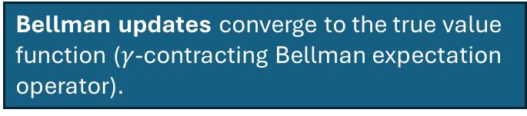
Recap: MDPs, DP and MC
Reward hypothesis: “All goals and purposes of an agent can be represented as the maximization of the expected cumulative reward.”
Finite MDPs: Bellman Expectation Equations convert expected return maximization into an easier value function consistency problem.
Dynamic Programming (DP): Policy evaluation solves the Bellman Expectation Equations by updating the value function iteratively.
Generalized Policy Iteration (GPI): Iterates between policy evaluation and greedy policy improvement to find the optimal policy.
Monte Carlo Methods (MC): Uses sample-averaging for policy evaluation in GPI (update after complete sample episode).
Bellman updates converge to the true value function ($γ$-contracting Bellman expectation operator).
Policy Improvement Theorem: Greedy action choice leads to policy improvement and convergence.
Greedy in the Limit with Infinite Exploration (GLIE): Guarantees convergence to the optimal deterministic policy.
Temporal-Differencing provides another mechanism for policy evaluation.

Slide 5
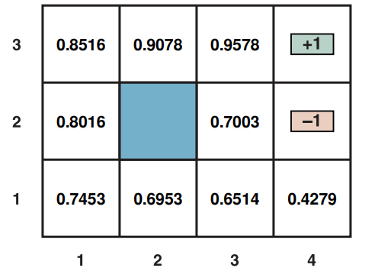

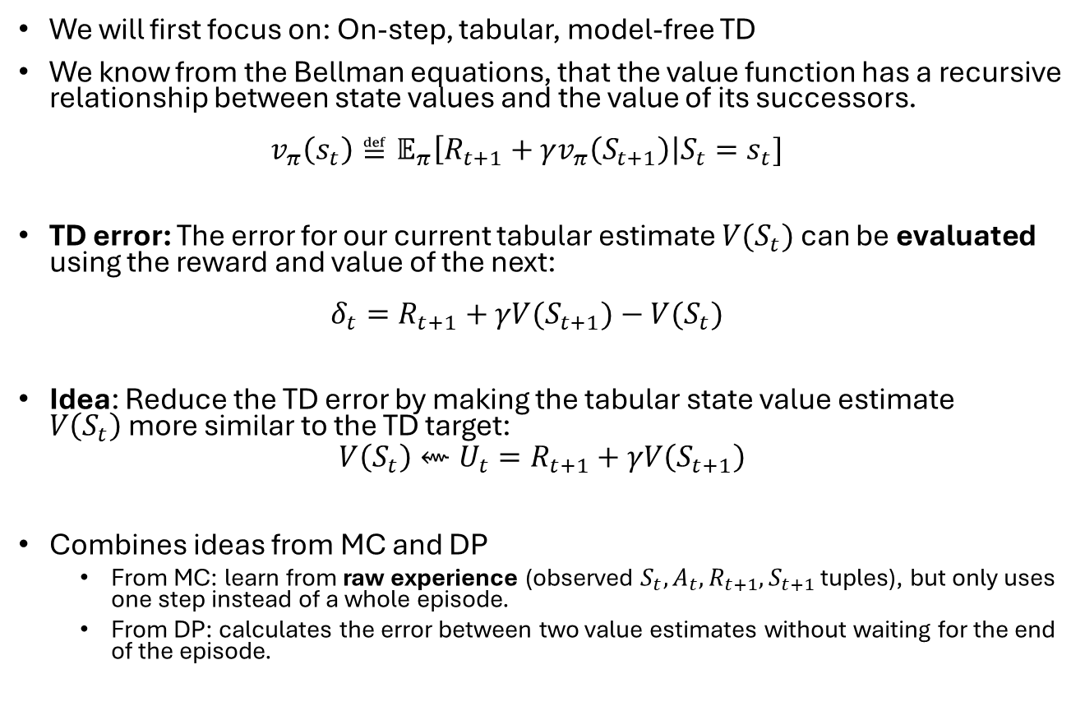




Temporal-Difference (TD) Learning
$$γ=1;r=−0.04$$
We will first focus on: On-step, tabular, model-free TD
We know from the Bellman equations, that the value function has a recursive relationship between state values and the value of its successors.
$v_{π}\left(s_{t}\right)≝𝔼_{π}\left[R_{t+1}+γv_{π}\left(S_{t+1}\right)\right|S_{t}=s_{t}]$
TD error: The error for our current tabular estimate $V(S_{t})$ can be evaluated using the reward and value of the next:
$δ_{t}=R_{t+1}+γV(S_{t+1})−V(S_{t})$
Idea: Reduce the TD error by making the tabular state value estimate $V\left(S_{t}\right)$more similar to the TD target:
$$V\left(S_{t}\right)⇜U_{t}=R_{t+1}+γV\left(S_{t+1}\right)$$
Combines ideas from MC and DP
  From MC: learn from raw experience (observed $S_{t},A_{t},R_{t+1},S_{t+1}$ tuples), but only uses one step instead of a whole episode.
  From DP: calculates the error between two value estimates without waiting for the end of the episode.
$$R_{t+1}$$
$$V\left(s_{t+1}\right)$$
$$V\left(s_{t}\right)$$
+ stochastic transition model
We call this the target $U_{t}$
Note: The TD error is only a sample from the error distribution because we use an observed step and ignore the expectation!
A truly online process that can update after each action

Slide 6
TD Prediction
Estimate the value function for a policy by minimizing the TD error.

Slide 7

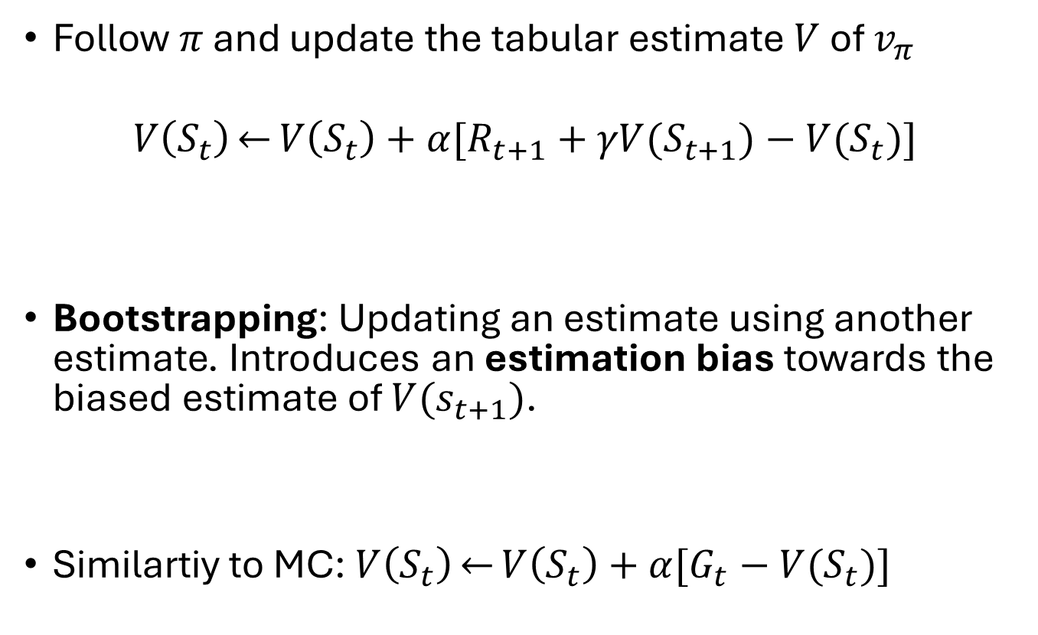
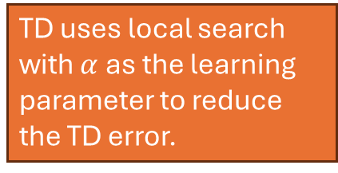
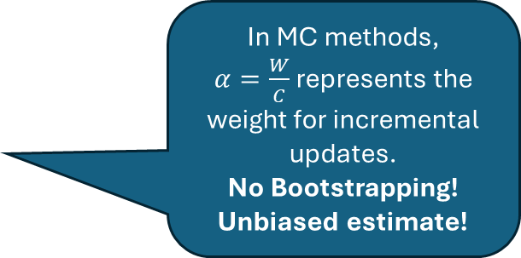
TD Prediction
Follow $π$ and update the tabular estimate $V$ of $v_{π}$
$$V\left(S_{t}\right)\overset{←}{}V\left(S_{t}\right)+α[R_{t+1}+γV(S_{t+1})−V(S_{t})]$$
Bootstrapping: Updating an estimate using another estimate. Introduces an estimation bias towards the biased estimate of $V(s_{t+1})$.
Similartiy to MC: $V\left(S_{t}\right)\overset{←}{}V\left(S_{t}\right)+α[G_{t}−V(S_{t})]$
One-step TD Error
TD uses local search with $α$ as the learning parameter to reduce the TD error.
Uses reward + estimate for next state = target $U_{t}$
In MC methods,
$α=\frac{W}{C}$represents the weight for incremental updates.
No Bootstrapping! Unbiased estimate!
MC Error over complete episode

Slide 8
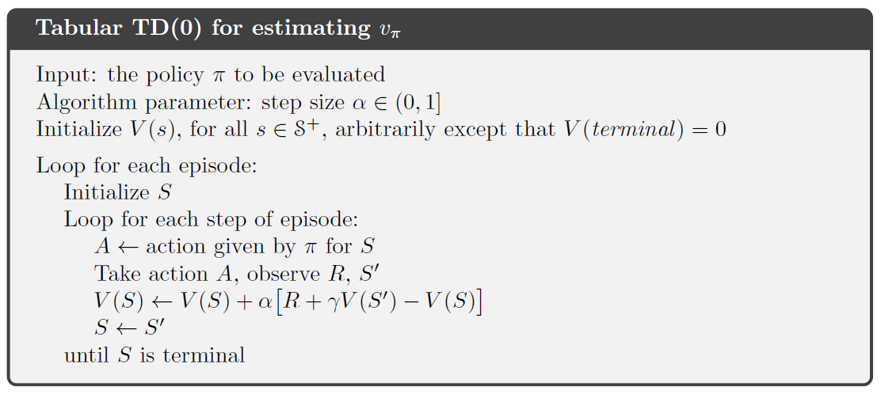
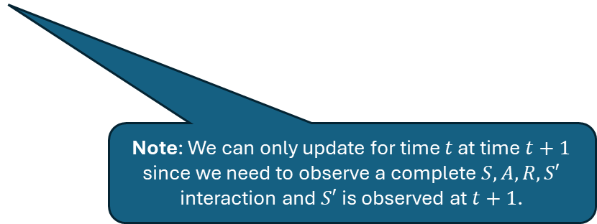
Alg. Tabular TD(0)
We will later learn what 0 means
Note: We can only update for time $t$ at time $t+1$ since we need to observe a complete $S,A,R,S′$ interaction and $S′$ is observed at $t+1$.

Slide 9
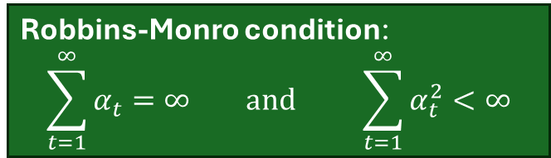
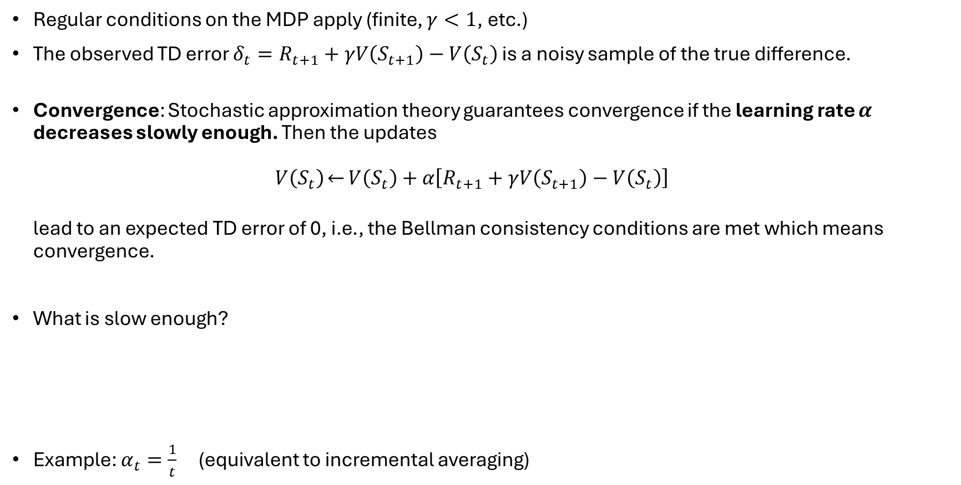
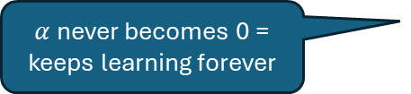
Convergence of TD Methods
Regular conditions on the MDP apply (finite, $γ<1$, etc.)
The observed TD error $δ_{t}=R_{t+1}+γV\left(S_{t+1}\right)−V\left(S_{t}\right)$ is a noisy sample of the true difference.
Convergence: Stochastic approximation theory guarantees convergence if the learning rate $α$ decreases slowly enough. Then the updates
$V\left(S_{t}\right)\overset{←}{}V\left(S_{t}\right)+α\left[R_{t+1}+γV\left(S_{t+1}\right)−V\left(S_{t}\right)\right]$
lead to an expected TD error of 0, i.e., the Bellman consistency conditions are met which means convergence.
What is slow enough?
Example: $α_{t}=\frac{1}{t}$ (equivalent to incremental averaging)
Robbins-Monro condition:
$$\sum_{t=1}^{∞}{α_{t}}=∞ \text{and} \sum_{t=1}^{∞}{α_{t}^{2}}<∞$$
step sizes shrink fast enough so that the random noise in the measurements eventually averages out.
$α$never becomes 0 = keeps learning forever

Slide 10
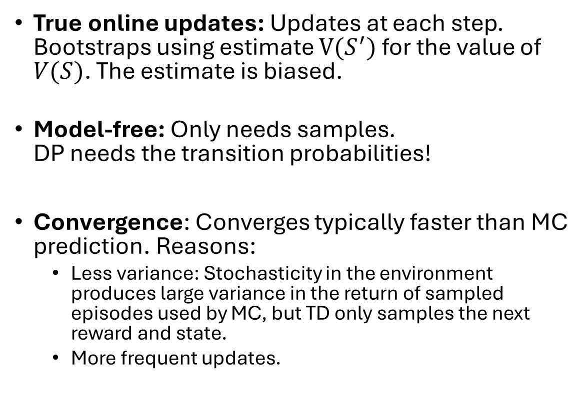
Advantages of TD Prediction Methods
True online updates: Updates at each step. Bootstraps using estimate $V(S^{′})$ for the value of $V(S)$. The estimate is biased.
Model-free: Only needs samples.
DP needs the transition probabilities!
Convergence: Converges typically faster than MC prediction. Reasons:
  Less variance: Stochasticity in the environment produces large variance in the return of sampled episodes used by MC, but TD only samples the next reward and state.
  More frequent updates.
DP plans using the model
MC waits for the end of the episode for an unbiased estimate.
Same as MC
DP needs the model

Slide 11
On-Policy TD Control:
Sarsa
Find a good policy online while you follow the policy.

Slide 12
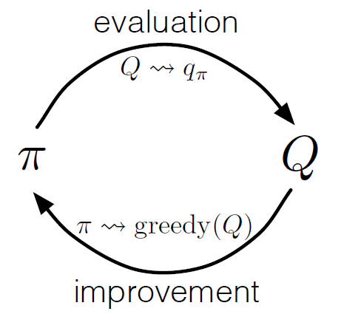
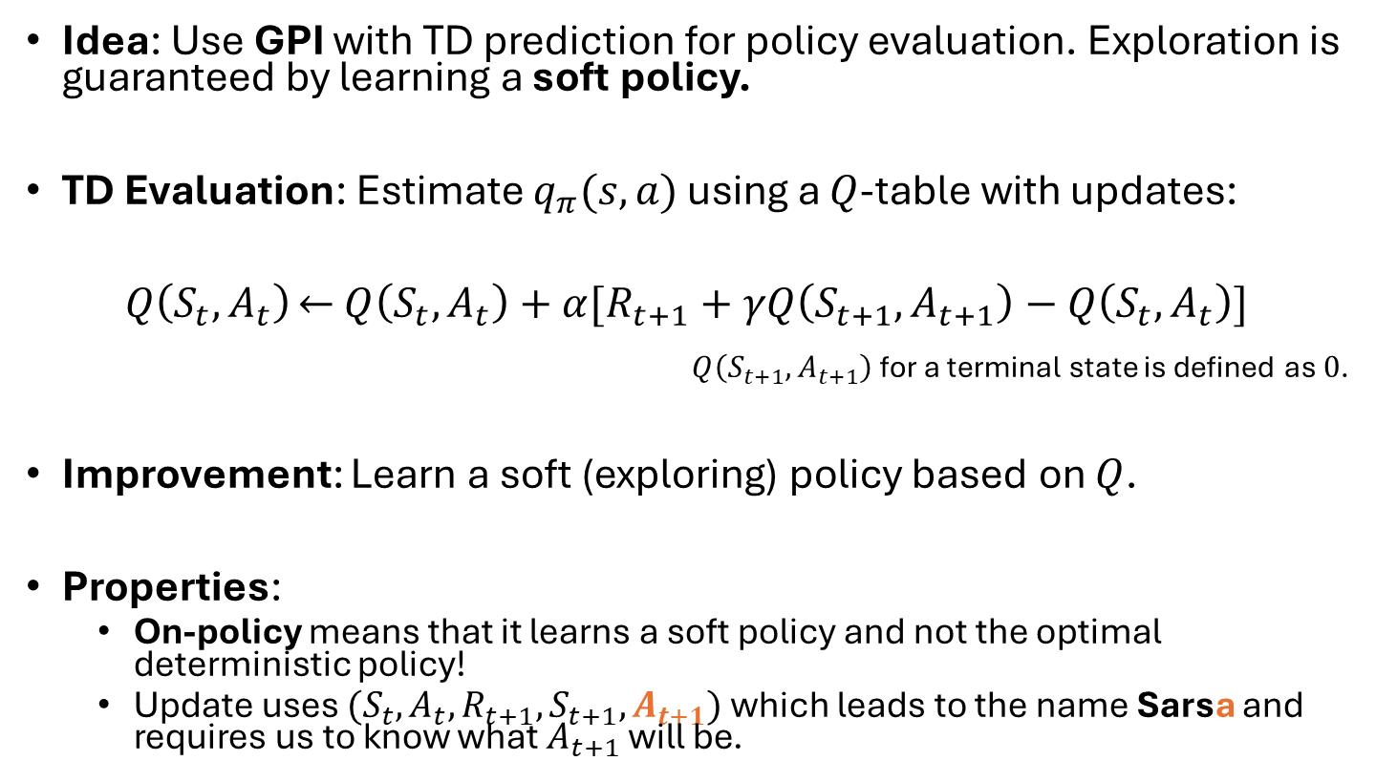

Sarsa
TD prediction
GPI
Idea: Use GPI with TD prediction for policy evaluation. Exploration is guaranteed by learning a soft policy.
TD Evaluation: Estimate $q_{π}(s,a)$ using a $Q$-table with updates:
$Q\left(S_{t},A_{t}\right)\overset{←}{}$ $Q\left(S_{t},A_{t}\right)+α[R_{t+1}+γQ\left(S_{t+1},A_{t+1}\right)−Q\left(S_{t},A_{t}\right)]$
$Q\left(S_{t+1},A_{t+1}\right)$ for a terminal state is defined as $0$.
Improvement: Learn a soft (exploring) policy based on $Q$.
Properties:
  On-policy means that it learns a soft policy and not the optimal deterministic policy!
  Update uses $(S_{t},A_{t},R_{t+1},S_{t+1}, A_{t+1})$ which leads to the name Sarsa and requires us to know what $A_{t+1}$ will be.
$$π⇝ ϵ\text{−}\text{greedy}(Q)$$

Slide 13
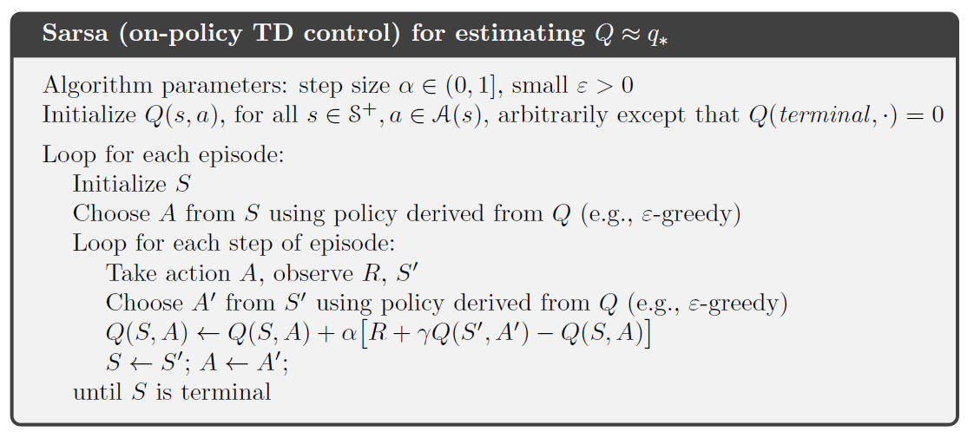


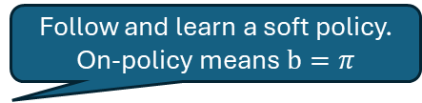
Alg. Sarsa: On-Policy TD Control
The learned and followed policy is expressed as a Q-function.
Follow and learn a soft policy. On-policy means $b=π$
We need $A^{′}$
Update the Q-function with the observed next action.
+ extract $π$ from $Q$

Slide 14
Off-policy TD Control:
Q-Learning
Learn a deterministic target policy while following an exploring behavior policy.

Slide 15
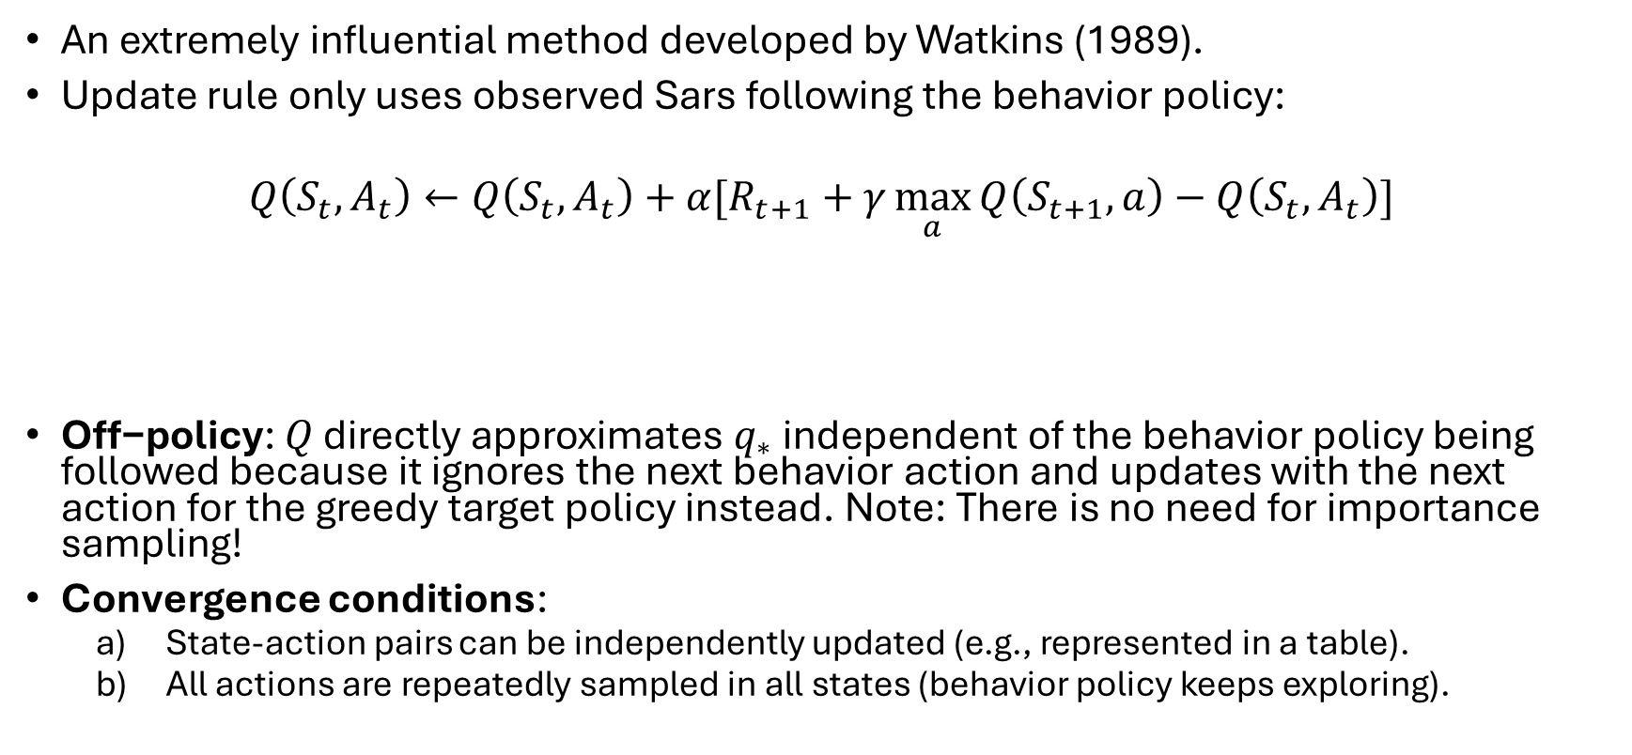
Q-Learning
An extremely influential method developed by Watkins (1989).
Update rule only uses observed Sars following the behavior policy:
$$Q\left(S_{t},A_{t}\right)←Q\left(S_{t},A_{t}\right)+α[R_{t+1}+γ\max_{a}{Q\left(S_{t+1},a\right)}−Q\left(S_{t},A_{t}\right)]$$
$\text{Off−policy}\text{: }Q$ directly approximates $q_{∗}$ independent of the behavior policy being followed because it ignores the next behavior action and updates with the next action for the greedy target policy instead. Note: There is no need for importance sampling!
Convergence conditions:
  State-action pairs can be independently updated (e.g., represented in a table).
  All actions are repeatedly sampled in all states (behavior policy keeps exploring).
The next action has not yet been observed. Updates with the greedy/optimal action for the target policy!

Slide 16
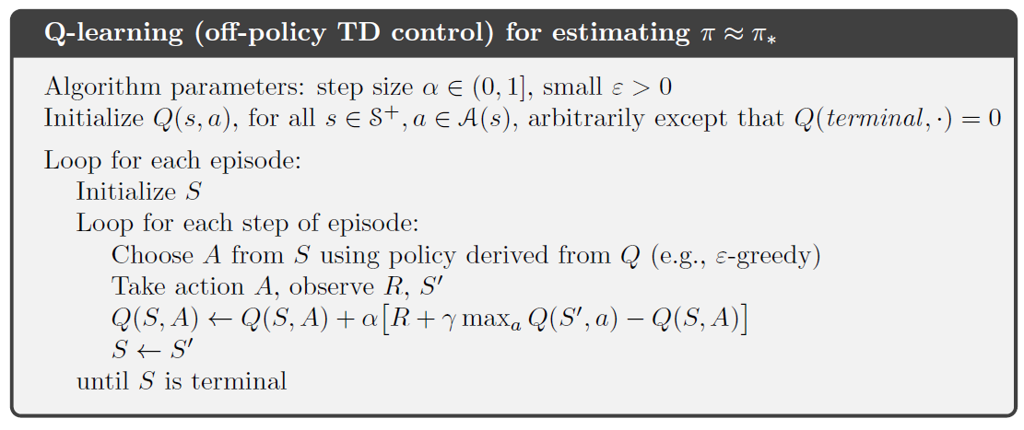

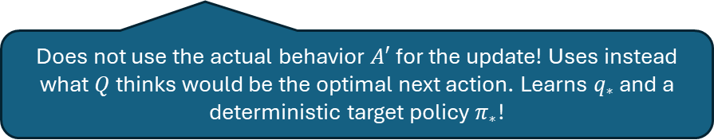
Alg. Q-Learning
Exploring behavior policy
Does not use the actual behavior $A′$ for the update! Uses instead what $Q$ thinks would be the optimal next action. Learns $q_{∗}$ and a deterministic target policy $π_{∗}$!
+ extract $π$ from $Q$

Slide 17
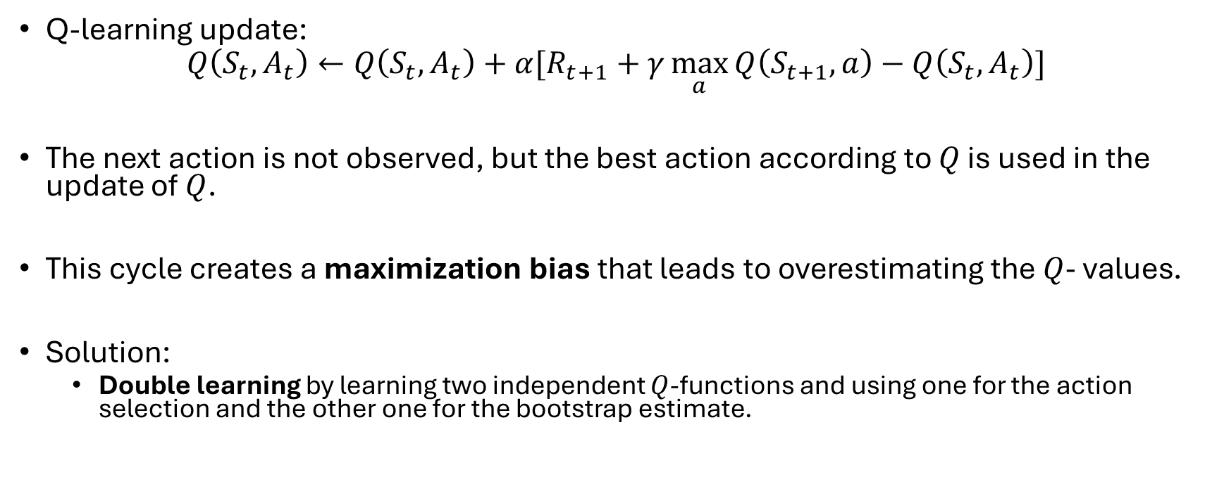
Q-Learning’s Maximization Bias
Q-learning update:
$$Q\left(S_{t},A_{t}\right)←Q\left(S_{t},A_{t}\right)+α[R_{t+1}+γ\max_{a}{Q\left(S_{t+1},a\right)}−Q\left(S_{t},A_{t}\right)]$$
The next action is not observed, but the best action according to $Q$ is used in the update of $Q$.
This cycle creates a maximization bias that leads to overestimating the $Q$- values.
Solution:
  Double learning by learning two independent $Q$-functions and using one for the action selection and the other one for the bootstrap estimate.

Slide 18
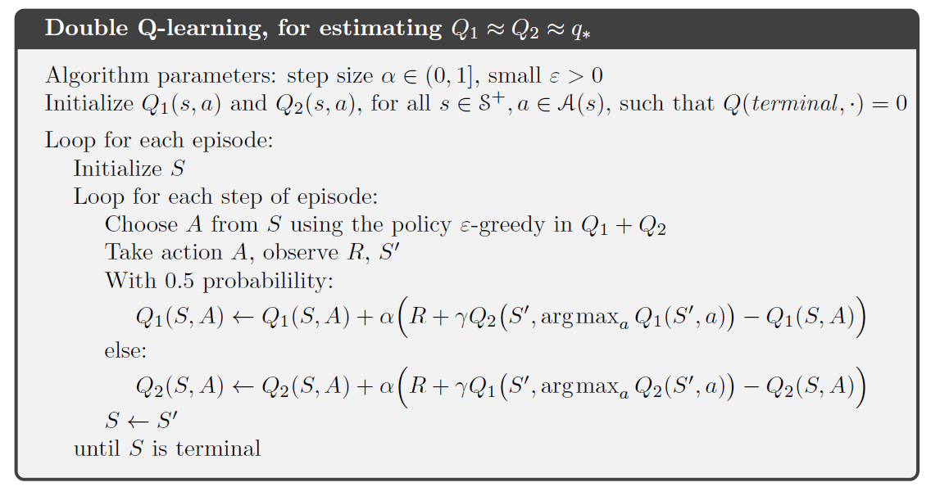
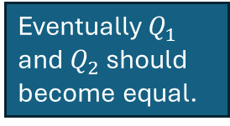
Double Q-Learning
Learns two independent $Q$-functions. One is used for action selection and the other one for the bootstrap estimate.
Eventually $Q_{1}$ and $Q_{2}$ should become equal.
Bootstrap estimate
Action selection
Note: Many TD methods have a similar bias, and double learning extensions for these algorithms also exist.

Slide 19
On-policy TD Control:
Expected Sarsa
Reduce action sample variation for Sarsa.

Slide 20
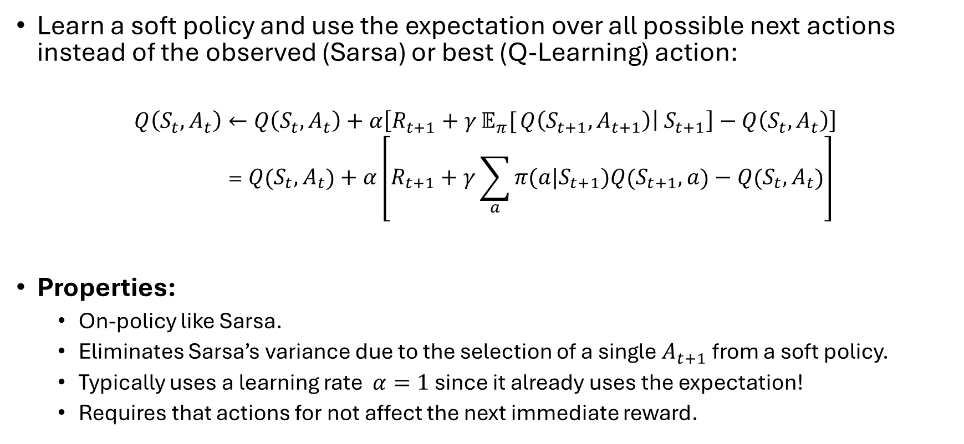
Expected Sarsa
Learn a soft policy and use the expectation over all possible next actions instead of the observed (Sarsa) or best (Q-Learning) action:
$$Q\left(S_{t},A_{t}\right)←Q\left(S_{t},A_{t}\right)+α\left[R_{t+1}+γ𝔼_{π}[{Q\left(S_{t+1},A_{t+1}\right)\left| S_{t+1}\right]}−Q\left(S_{t},A_{t}\right)\right] \\ =Q\left(S_{t},A_{t}\right)+α\left[R_{t+1}+γ\sum_{a}{π(a|S_{t+1})Q\left(S_{t+1},a\right)}−Q\left(S_{t},A_{t}\right)\right]$$
Properties:
  On-policy like Sarsa.
  Eliminates Sarsa’s variance due to the selection of a single $A_{t+1}$ from a soft policy.
  Typically uses a learning rate $α=1$ since it already uses the expectation!
  Requires that actions for not affect the next immediate reward.

Slide 21
Comparison
Sarsa vs. Q-Learning vs. Expected Sarsa

Slide 22

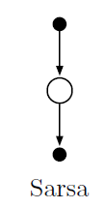
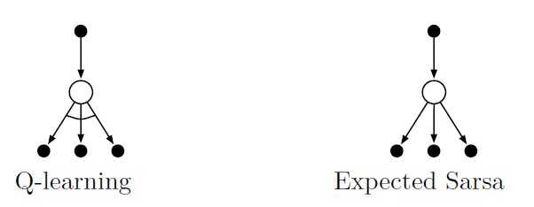












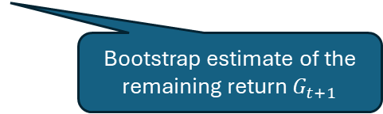

Comparison: 1-step Backup Diagrams
1-step
$$Q(S_{t},A_{t})$$
$$Q(S_{t+1},A_{t+1})$$
Update to reduce the TD error
Bootstrap estimate of the remaining return $G_{t+1}$
Target:
$$U=R_{t+1}+γQ(S_{t+1},A_{t+1})$$
$$U=R_{t+1}+γ\max_{a}{Q(S_{t+1},a)}$$
$$U=R_{t+1}+γ𝔼_{π}[Q(S_{t+1},A_{t+1})|S_{t+1}]$$
$$Q(S_{t},A_{t})$$
$$A_{t}$$
$$R_{t+1}$$
$$S_{t+1}$$
$$𝔼_{π}$$
$\text{max}$ for target policy
$$Q(S_{t+1},A_{t+1})$$
$$A_{t+1}$$
On-policy: Updates with a next action following the learned policy.
Off-policy: Updates with the best next action for the target policy.
On-policy: Updates with the expectation over the action for the learned policy.

Slide 23
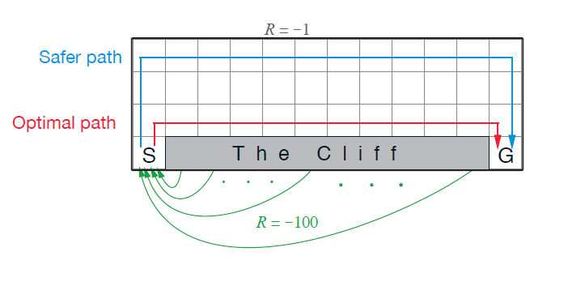
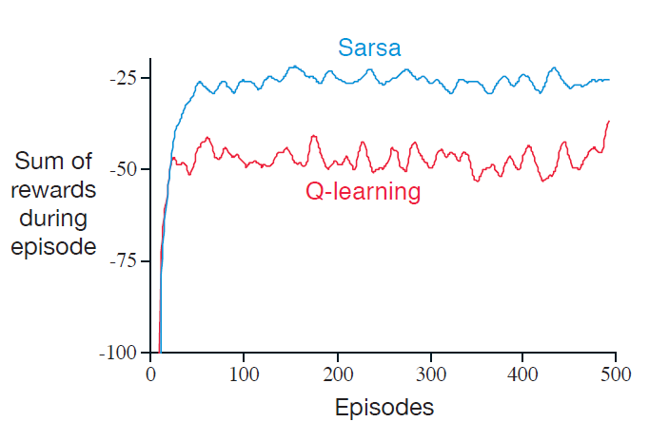
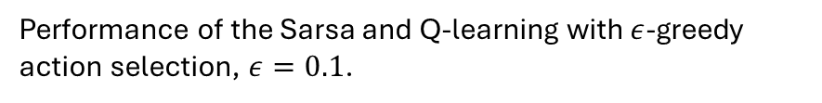
Sarsa vs. Q-Learning
Cliff Walking: Consider the grid world shown to the right.
This is a standard, undiscounted, episodic task with start and goal states.
Actions cause movement up, down, right, and left.
Reward is −1 on all transitions except those into the region marked “The Cliff.” Stepping into this region incurs a reward of −100 and sends the agent instantly back to the start.
Why does Sarsa pick the longer path while Q-Learning finds the optimal path?
Performance of the Sarsa and Q-learning with $ε$-greedy action selection, $ε=0.1$.
Why does the optimal path perform worse?

Slide 24
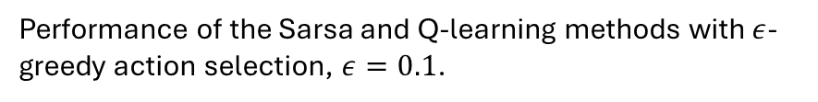
Sarsa vs. Q-Learning
Cliff Walking: Consider the grid world shown to the right.
This is a standard, undiscounted, episodic task with start and goal states.
Actions cause movement up, down, right, and left.
Reward is −1 on all transitions except those into the region marked “The Cliff.” Stepping into this region incurs a reward of −100 and sends the agent instantly back to the start.
Sarsa is on-policy and learns a soft policy. Walking along the cliff would be dangerous! Q-Learning learns the optimal deterministic policy.
Performance of the Sarsa and Q-learning methods with $ε$-greedy action selection, $ε=0.1$.
Q-learning learns the optimal policy, but uses a soft behavior policy to explore. Walking along the cliff with a soft policy is dangerous.
Once we only follow the learned deterministic policy, the sum of rewards will be optimal.
Initial behavior
All Q-values are 0
Produces long episodes following a random walk.
This is pure exploration.

Slide 25
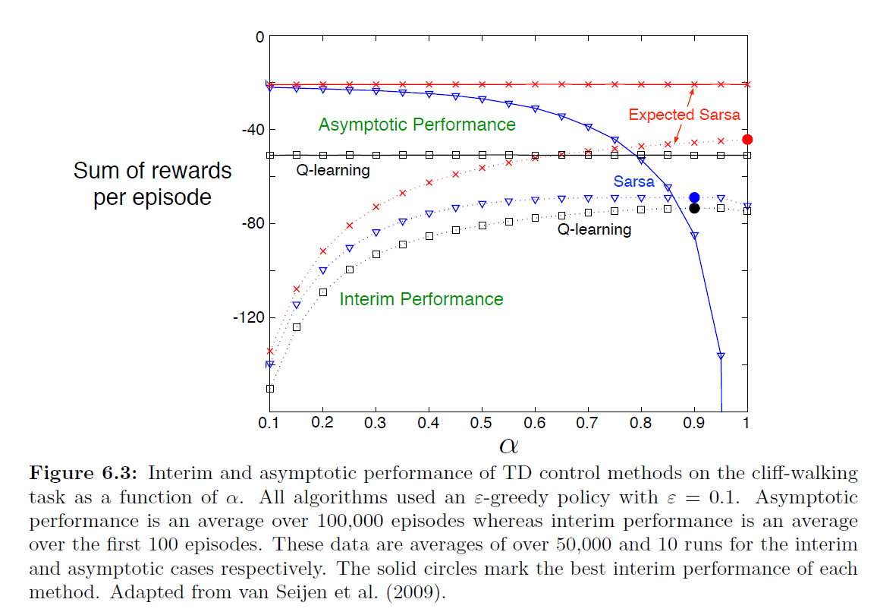
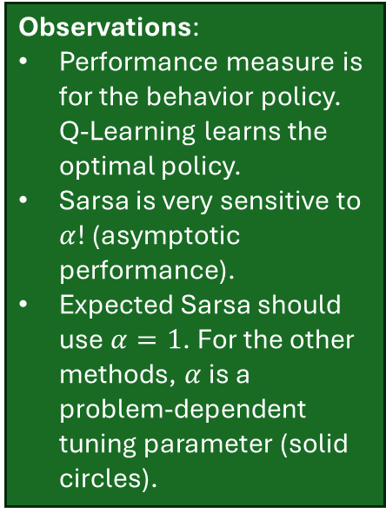
Experimental Comparison
Observations:
Performance measure is for the behavior policy. Q-Learning learns the optimal policy.
Sarsa is very sensitive to $α$! (asymptotic performance).
Expected Sarsa should use $α=1$. For the other methods, $α$ is a problem-dependent tuning parameter (solid circles).

Slide 26
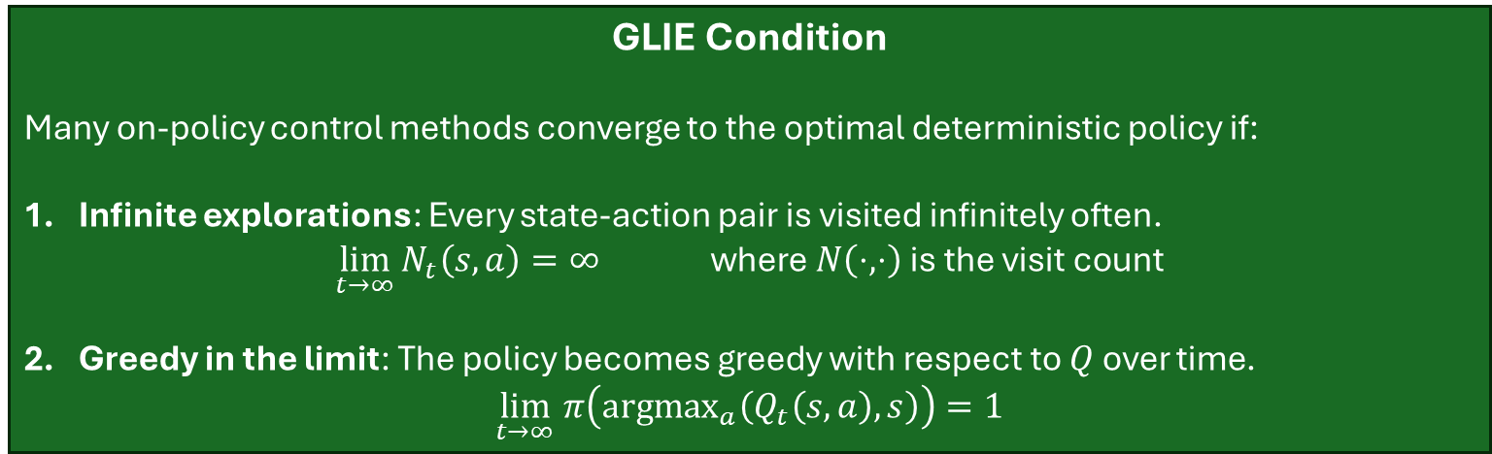
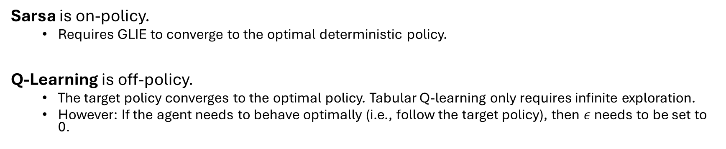

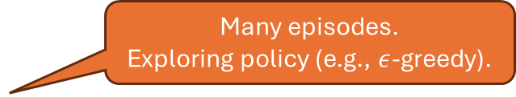
Convergence: GLIE for Sarsa and Q-Learning
GLIE Condition
Many on-policy control methods converge to the optimal deterministic policy if:
Infinite explorations: Every state-action pair is visited infinitely often.
$\lim_{t→∞}{N_{t}\left(s,a\right)=∞} \text{where} N\left(⋅,⋅\right) \text{is the visit count}$
Greedy in the limit: The policy becomes greedy with respect to $Q$ over time.
$\lim_{t→∞} π\left(\text{argma}{\text{x}}_{a}\left(Q_{t}\left(s,a\right),s\right)\right)=1$
Many episodes.
Exploring policy (e.g., $ε$-greedy).
Reduce $ε$ slowly.
Sarsa is on-policy.
  Requires GLIE to converge to the optimal deterministic policy.
Q-Learning is off-policy.
  The target policy converges to the optimal policy. Tabular Q-learning only requires infinite exploration.
  However: If the agent needs to behave optimally (i.e., follow the target policy), then $ε$ needs to be set to 0.

Slide 27
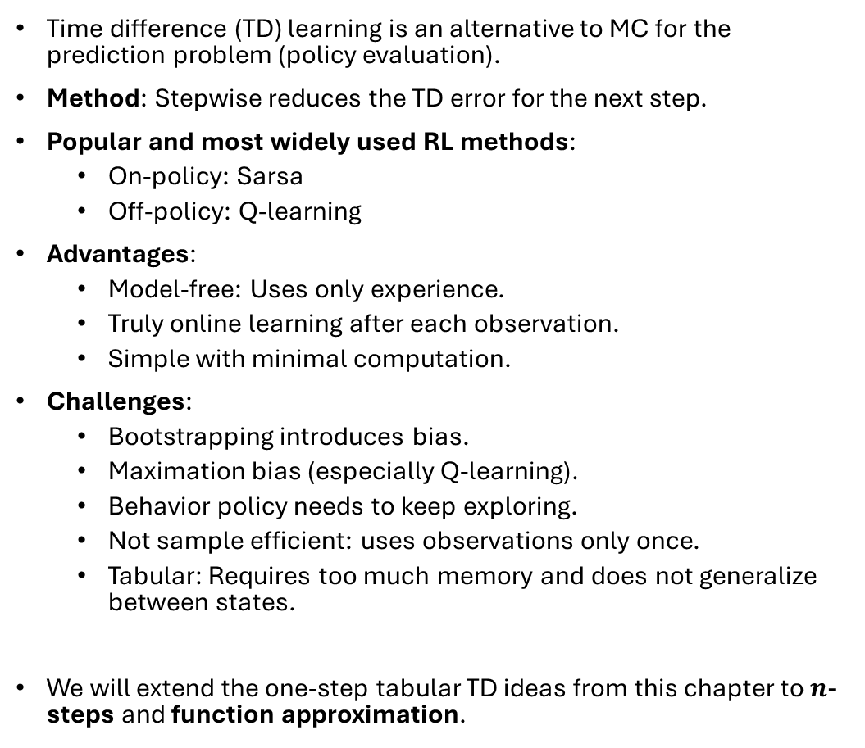
What You Should Know
Time difference (TD) learning is an alternative to MC for the prediction problem (policy evaluation).
Method: Stepwise reduces the TD error for the next step.
Popular and most widely used RL methods:
  On-policy: Sarsa
  Off-policy: Q-learning
Advantages:
  Model-free: Uses only experience.
  Truly online learning after each observation.
  Simple with minimal computation.
Challenges:
  Bootstrapping introduces bias.
  Maximation bias (especially Q-learning).
  Behavior policy needs to keep exploring.
  Not sample efficient: uses observations only once.
  Tabular: Requires too much memory and does not generalize between states.
We will extend the one-step tabular TD ideas from this chapter to $n$-steps and function approximation.

