Slide 1





Reinforcement Learning Policy Gradient Methods Sutton/Barto* Chapter 13
Michael Hahsler, SMU
With figures from Sutton/Barto*
*Sutton and Barto, Reinforcement Learning: An Introduction, 2nd edition, MIT Press, Cambridge, MA, 2018

Slide 2
Topics of this Course
Introduction to reinforcement learning
Markov decision processes
Part I: Tabular Methods
Dynamic programming
Monte Carlo methods
Temporal-difference learning
Multi-step bootstrapping
Planning and learning with tabular methods
Part II: Approximate Solution Methods
Prediction and Control using Approximation
Eligibility Traces
Policy Gradient Methods
Part III: Modern RL Methods
Deep Reinforcement Learning
Current Applications

Slide 3
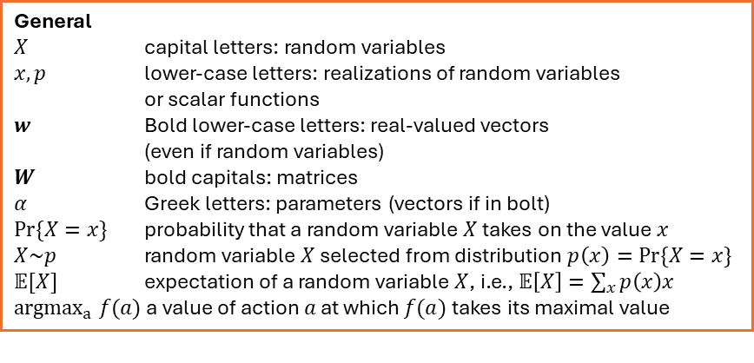
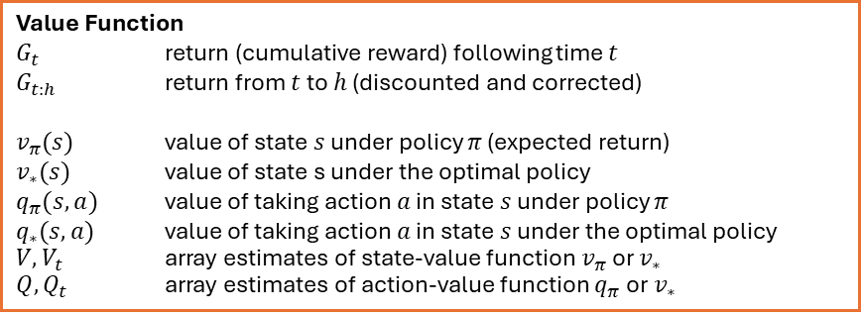
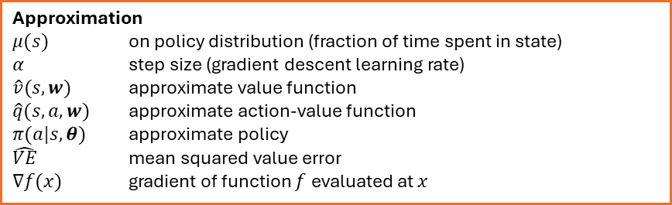
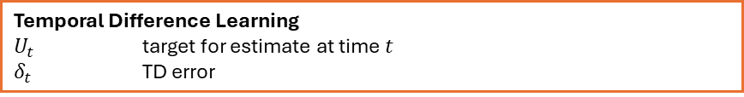
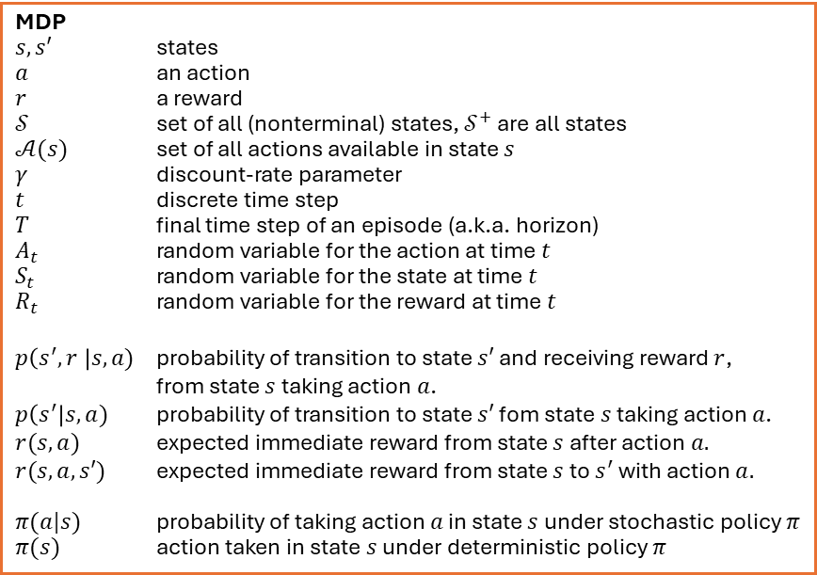
Summary of Notation
General
$X$ capital letters: random variables $x, p$ lower-case letters: realizations of random variables or scalar functions
$w$ Bold lower-case letters: real-valued vectors (even if random variables)
$W$ bold capitals: matrices
$α$ Greek letters: parameters (vectors if in bolt)
$Pr⁡\{X=x\}$ probability that a random variable $X$ takes on the value $x$
$X\sim p$ random variable $X$ selected from distribution $p\left(x\right)=Pr⁡\{X=x\}$
$𝔼[X]$ expectation of a random variable $X$, i.e., $𝔼\left[X\right]=\sum_{x}{p\left(x\right)x}$
${argmax}_{a} f(a)$ a value of action $a$ at which $f(a)$ takes its maximal value
MDP
$s, s′$ states
$a$ an action
$r$ a reward
$𝒮$ set of all (nonterminal) states, $𝒮^{+}$ are all states
$𝒜(s)$ set of all actions available in state $s$
$γ$ discount-rate parameter
$t$ discrete time step
$T$ final time step of an episode (a.k.a. horizon)
$A_{t}$ random variable for the action at time $t$
$S_{t}$ random variable for the state at time $t$
$R_{t}$ random variable for the reward at time $t$
$p\left(s^{′},r \right|s, a)$ probability of transition to state $s′$ and receiving reward $r$, from state $s$ taking action $a$.
$p\left(s^{′}\right|s, a)$ probability of transition to state $s′$ fom state $s$ taking action $a$.
$r(s,a)$ expected immediate reward from state $s$ after action $a.$
$r(s,a,s′)$ expected immediate reward from state $s$ to $s^{′}$ with action $a.$
$π(a|s)$ probability of taking action $a$ in state $s$ under stochastic policy $π$
$π(s)$ action taken in state $s$ under deterministic policy $π$
Value Function
$G_{t}$ return (cumulative reward) following time $t$
$G_{t:h}$ return from $t$ to $h$ (discounted and corrected)
$v_{π}(s)$ value of state $s$ under policy $π$ (expected return)
$v_{∗}(s)$ value of state s under the optimal policy
$q_{π}(s,a)$ value of taking action $a$ in state $s$ under policy $π$
$q_{∗}(s,a)$ value of taking action $a$ in state $s$ under the optimal policy
$V, V_{t}$ array estimates of state-value function $v_{π}$or $v_{∗}$
$Q,Q_{t}$ array estimates of action-value function $q_{π}$or $v_{∗}$
Approximation
$μ(s)$ on policy distribution (fraction of time spent in state)
$α$ step size (gradient descent learning rate)
$\hat{v}(s, w)$ approximate value function $\hat{q}(s, a, w)$ approximate action-value function $π(a|s,θ)$ approximate policy
$\hat{VE}$ mean squared value error
$∇f(x)$ gradient of function $f$ evaluated at $x$
Temporal Difference Learning
$U_{t}$ target for estimate at time$t$
$δ_{t}$ TD error

Slide 4
Parametrized Policies
Learn policies directly

Slide 5
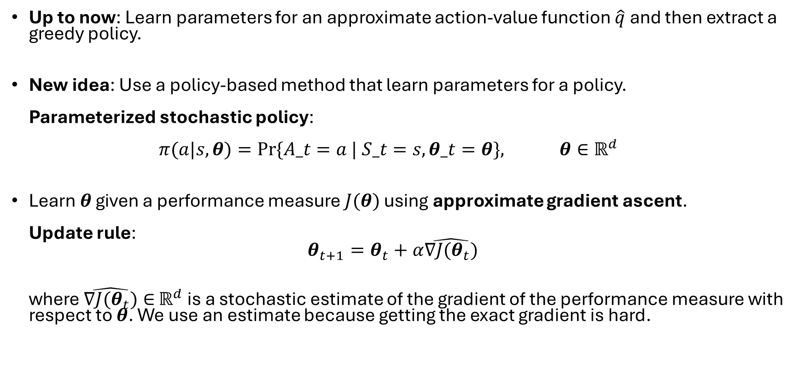
Learn a Parameterized Policy
Up to now: Learn parameters for an approximate action-value function $\hat{q}$ and then extract a greedy policy.
New idea: Use a policy-based method that learn parameters for a policy. Parameterized stochastic policy: $π(a|s,θ)=Pr⁡\{A_t=a | S_t=s, θ_t=θ\}, θ∈ℝ^{d}$
Learn $θ$ given a performance measure $J(θ)$ using approximate gradient ascent. Update rule: $θ_{t+1}=θ_{t}+α\hat{∇J(θ_{t})}$ where $\hat{∇J(θ_{t})}∈$ $ℝ^{d}$ is a stochastic estimate of the gradient of the performance measure with respect to $θ$. We use an estimate because getting the exact gradient is hard.

Slide 6
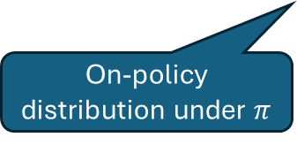
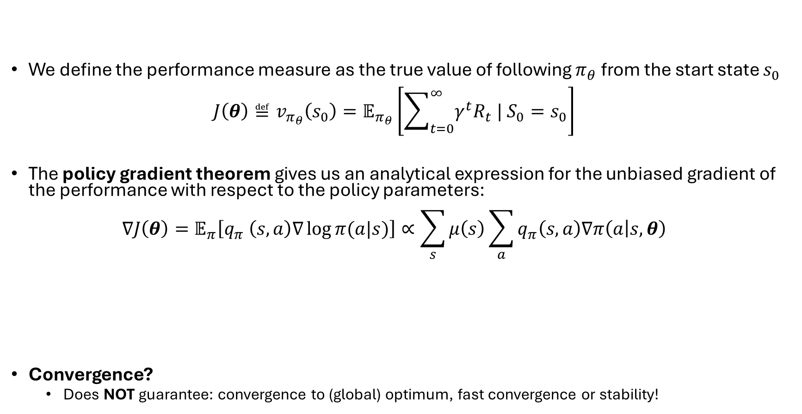
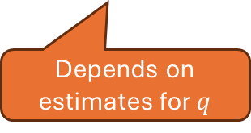
Policy Gradient Theorem
We define the performance measure as the true value of following $π_{θ}$ from the start state $s_{0}$ $J\left(θ\right)≝v_{π_{θ}}\left(s_{0}\right)=𝔼_{π_{θ}}\left[\sum_{t=0}^{∞}{γ^{t}R_{t} | S_{0}=s_{0}}\right]$
The policy gradient theorem gives us an analytical expression for the unbiased gradient of the performance with respect to the policy parameters: $∇J\left(θ\right)=𝔼_{π}\left[q_{π} \left(s,a\right)∇\log{π(a|s)}\right]∝\sum_{s}{μ\left(s\right)\sum_{a}{q_{π}\left(s,a\right)∇π\left(a | s,θ\right)}}$
Convergence?
Does NOT guarantee: convergence to (global) optimum, fast convergence or stability!
On-policy distribution under $π$
Depends on estimates for $q$
Gradient of the policy approximation function.

Slide 7
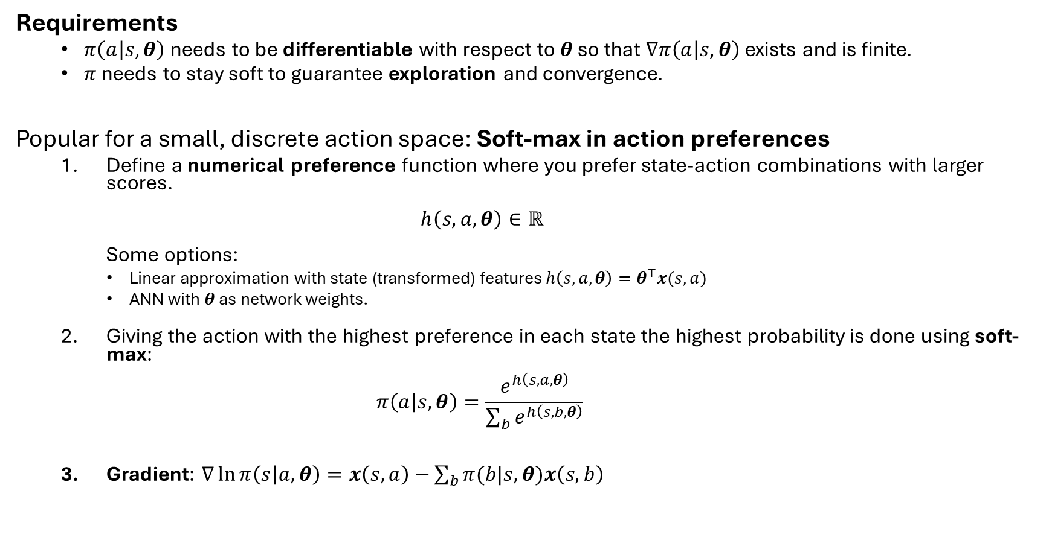
Parametrized Policy Example
Requirements
$π\left(a | s,θ\right)$ needs to be differentiable with respect to $θ$ so that $∇π\left(a | s,θ\right)$ exists and is finite.
$π$ needs to stay soft to guarantee exploration and convergence.
Popular for a small, discrete action space: Soft-max in action preferences
Define a numerical preference function where you prefer state-action combinations with larger scores. $h\left(s,a,θ\right)∈ℝ$ Some options:
Linear approximation with state (transformed) features $h\left(s,a,θ\right)=θ^{⊤}x(s,a)$
ANN with $θ$ as network weights.
Giving the action with the highest preference in each state the highest probability is done using soft-max: $π\left(a | s,θ\right)=\frac{e^{h\left(s,a,θ\right)}}{\sum_{b}{e^{h\left(s,b,θ\right)}}}$
Gradient: $∇\ln{π\left(s | a, θ\right)=x\left(s,a\right)−}\sum_{b}{π(b|s, θ)x\left(s,b\right)}$
Note: Soft-max converts a set of scores into a probability distribution.

Slide 8
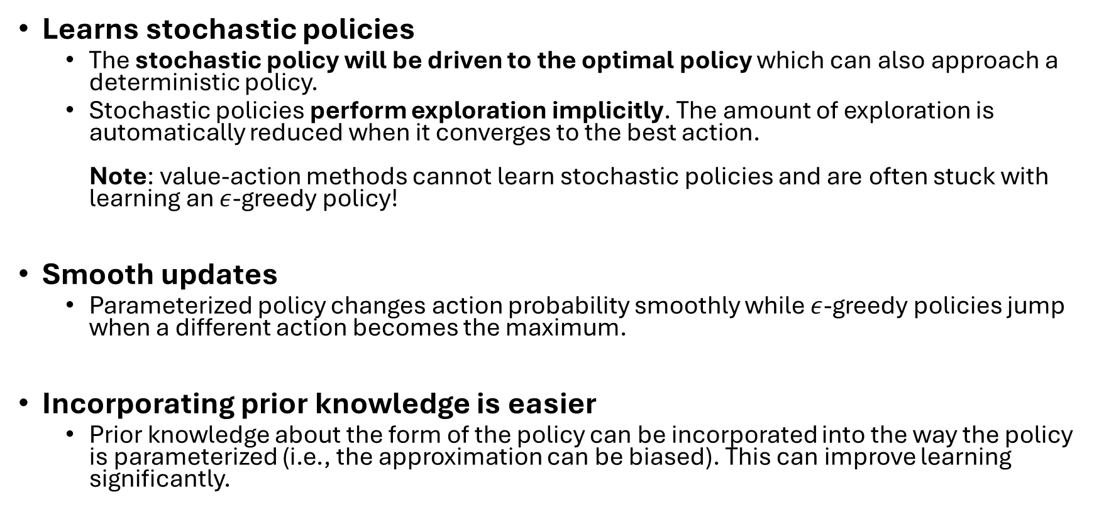
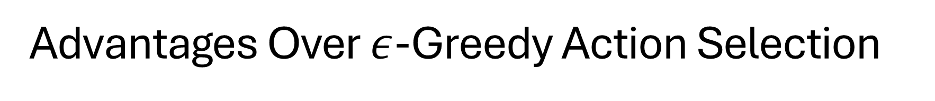
Advantages Over $ε$-Greedy Action Selection
Learns stochastic policies
The stochastic policy will be driven to the optimal policy which can also approach a deterministic policy.
Stochastic policies perform exploration implicitly. The amount of exploration is automatically reduced when it converges to the best action. Note: value-action methods cannot learn stochastic policies and are often stuck with learning an $ε$-greedy policy!
Smooth updates
Parameterized policy changes action probability smoothly while $ε$-greedy policies jump when a different action becomes the maximum.
Incorporating prior knowledge is easier
Prior knowledge about the form of the policy can be incorporated into the way the policy is parameterized (i.e., the approximation can be biased). This can improve learning significantly.

Slide 9
REINFORCE
Monte Carlo Policy Gradient Control

Slide 10
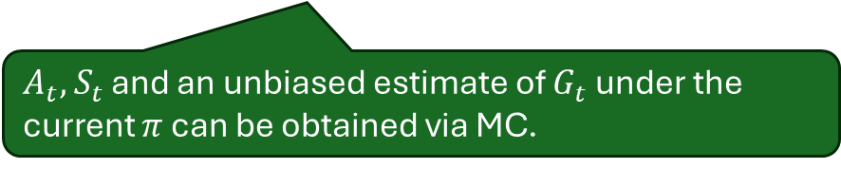


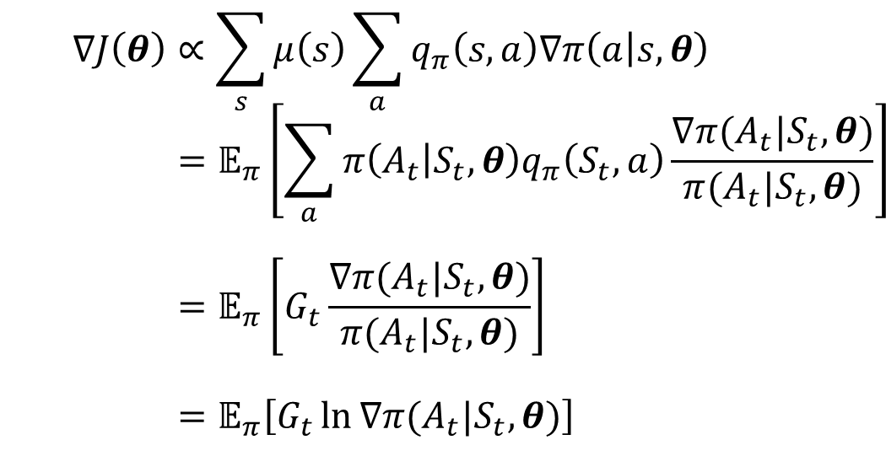
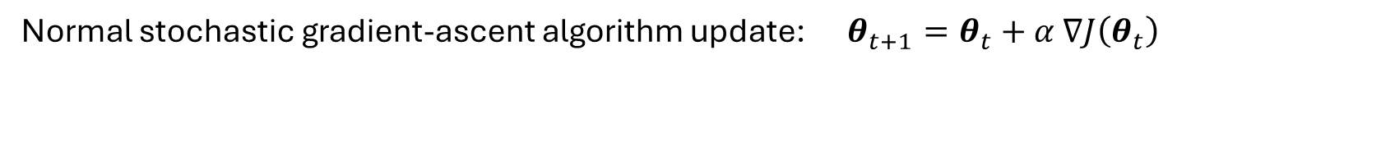


REINFORCE Update
Normal stochastic gradient-ascent algorithm update: $θ_{t+1}=θ_{t}+α$ $∇J\left(θ_{t}\right)$
Policy Gradient Theorem
$$∇J\left(θ\right)∝\sum_{s}{μ\left(s\right)\sum_{a}{q_{π}\left(s,a\right)∇π\left(a | s,θ\right)}} \\ =𝔼_{π}\left[\sum_{a}{π\left(A_{t} | S_{t},θ\right)q_{π}\left(S_{t},a\right)\frac{∇π(A_{t}|S_{t},θ)}{π(A_{t}|S_{t},θ)}}\right] \\ =𝔼_{π}\left[G_{t}\frac{∇π(A_{t}|S_{t},θ)}{π(A_{t}|S_{t},θ)}\right] \\ =𝔼_{π}\left[G_{t}\ln{∇π(A_{t}|S_{t},θ)}\right]$$
(replace $s$ by the sampled $S_{t}\sim μ$)
(replace $a$ by the sampled $A_{t}\sim π$)
(because $𝔼_{π}\left[G_{t}|S_{t},A_{t}\right]=q_{π}(S_{t},A_{t})$)
(because $∇\ln{x=\frac{∇x}{x}}$)
$A_{t},$ $S_{t}$ and an unbiased estimate of $G_{t}$ under the current $π$ can be obtained via MC.
Convergence to a local optimum:
linear approximation
step size reduction

Slide 11
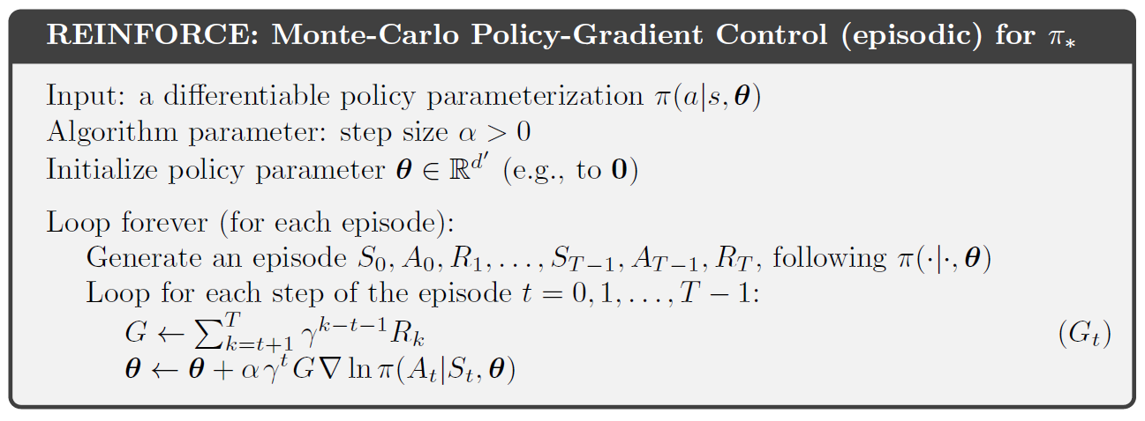
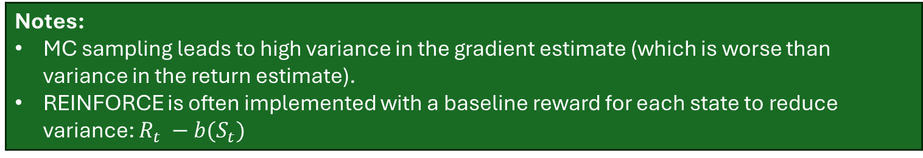
REINFORCE Algorithm
Notes:
MC sampling leads to high variance in the gradient estimate (which is worse than variance in the return estimate).
REINFORCE is often implemented with a baseline reward for each state to reduce variance: $R_{t} −b(S_{t})$

Slide 12
Actor-Critic Methods
Combining an
actor (a parameterized policy) with a
critic (using a parameterized value functions)

Slide 13
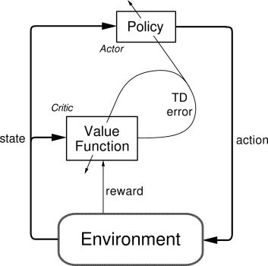
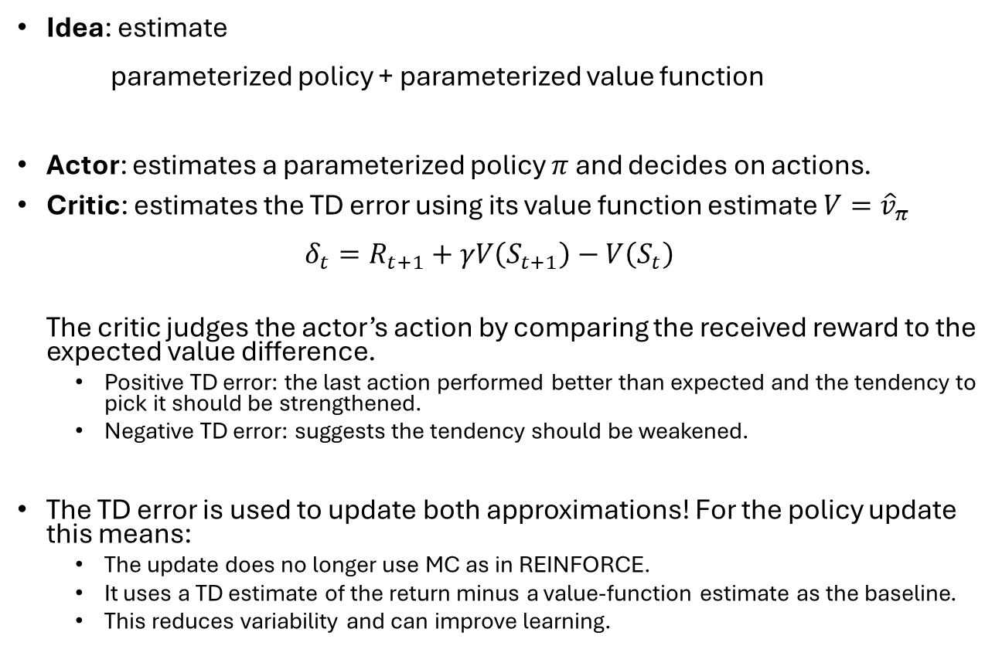
Actor-Critic Methods
Idea: estimate parameterized policy + parameterized value function
Actor: estimates a parameterized policy $π$ and decides on actions.
Critic: estimates the TD error using its value function estimate $V={\hat{v}}_{π}$ $δ_{t}=R_{t+1}+γV\left(S_{t+1}\right)−V\left(S_{t}\right)$ The critic judges the actor’s action by comparing the received reward to the expected value difference.
Positive TD error: the last action performed better than expected and the tendency to pick it should be strengthened.
Negative TD error: suggests the tendency should be weakened.
The TD error is used to update both approximations! For the policy update this means:
The update does no longer use MC as in REINFORCE.
It uses a TD estimate of the return minus a value-function estimate as the baseline.
This reduces variability and can improve learning.
Can be seen as a learned baseline for the policy update!

Slide 14
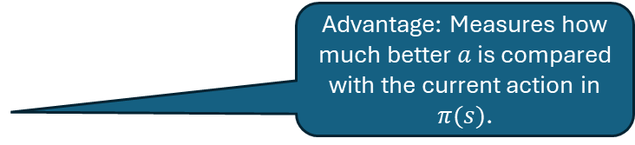
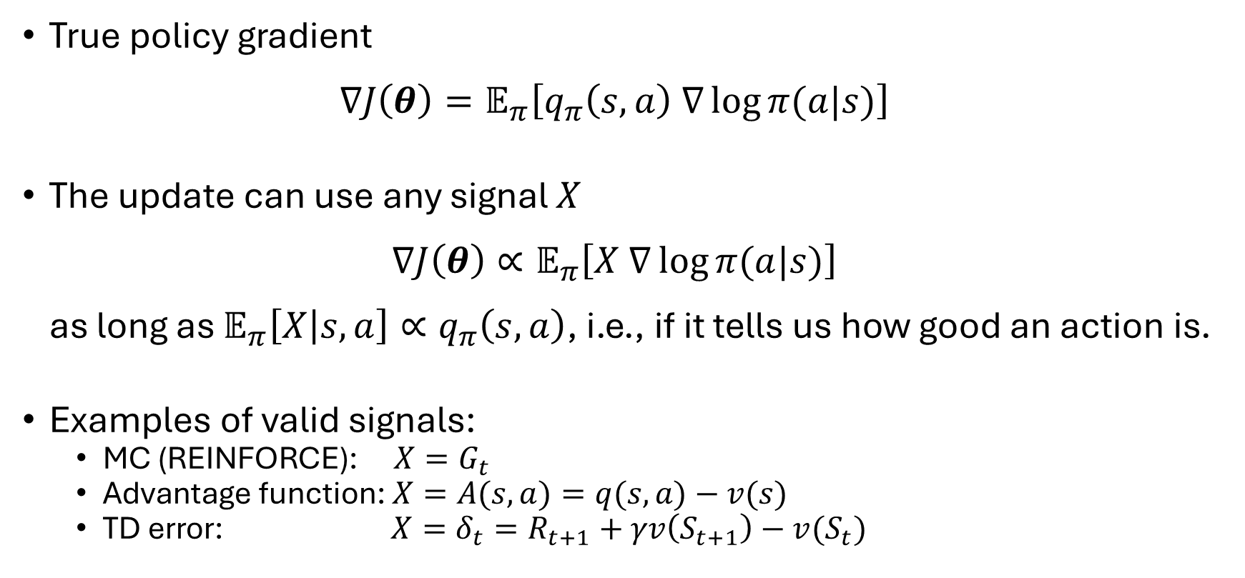
The Policy Gradient Update Signal
True policy gradient $∇J\left(θ\right)=𝔼_{π}\left[q_{π}\left(s,a\right) ∇\log{π(a|s)}\right]$
The update can use any signal $X$ $∇J\left(θ\right)∝𝔼_{π}\left[X ∇\log{π(a|s)}\right]$ as long as $𝔼_{π}\left[X | s,a\right]∝q_{π}\left(s,a\right)$, i.e., if it tells us how good an action is.
Examples of valid signals:
MC (REINFORCE): $X=G_{t}$
Advantage function: $X=A(s,a)=q(s,a)−v(s)$
TD error: $X=δ_{t}=R_{t+1}+γv\left(S_{t+1}\right)−v(S_{t})$
Advantage: Measures how much better $a$ is compared with the current action in $π(s)$.

Slide 15
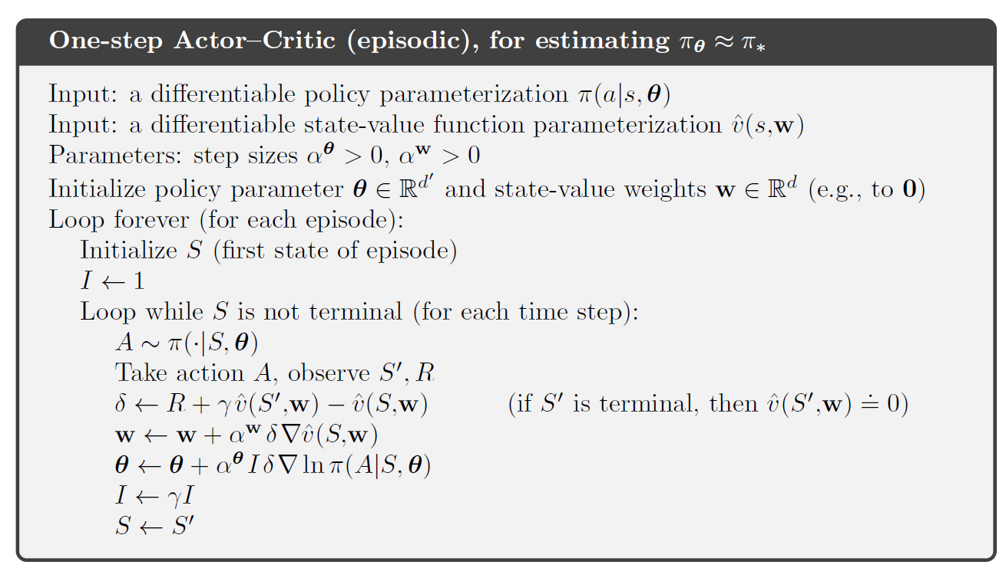
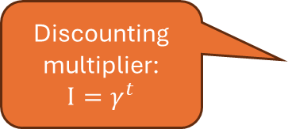

One-Step Actor-Critic Algorithm
actor
critic
Discounting multiplier: $$I=γ^{t}$$
TD error: using $\hat{v}$ estimates.
Policy approximation is soft, so it explores!
Update the critic (value function) = $TD(0)$
Update the actor (policy) using the TD error signal.

Slide 16
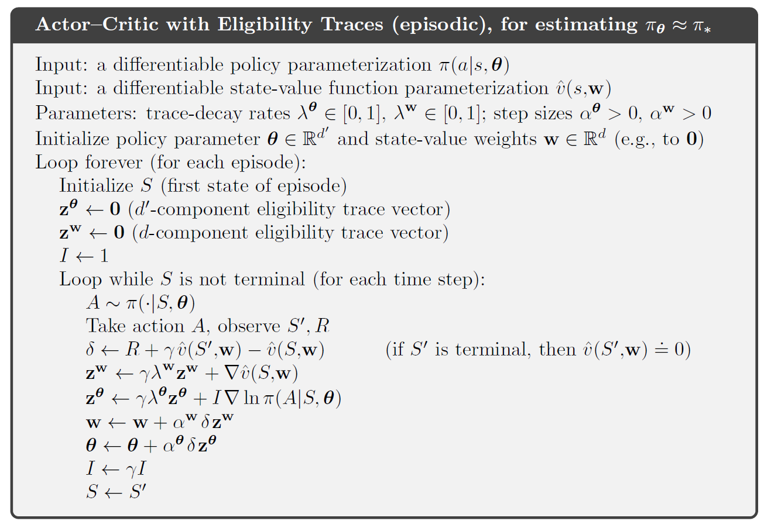
Actor-Critic Methods with Eligibility Traces
Replace the gradients with traces

Slide 17
Off-Policy Learning with Policy Gradient Methods
We have only talked about on-policy methods. This is fine since the parameterized policy can approximate the optimal deterministic policy.
Issue: We cannot use data collected from a different policy!
Off-policy Actor-Critic methods exist and are typically based on neural networks:
Deep Deterministic Policy Gradient (DDPG)
Twin Delayed DDPG (TD3)
Soft Actor Critic (SAC)

Slide 18
Continuous Actions
Parameterized policies can represent continuous actions!

Slide 19
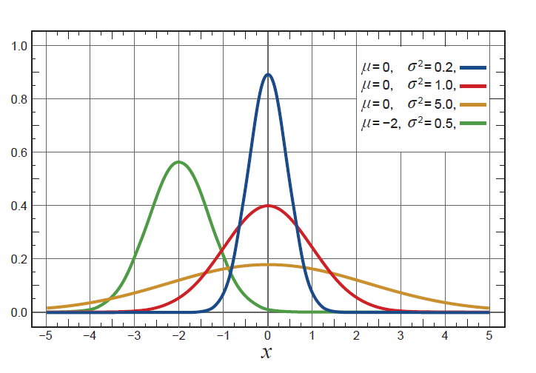
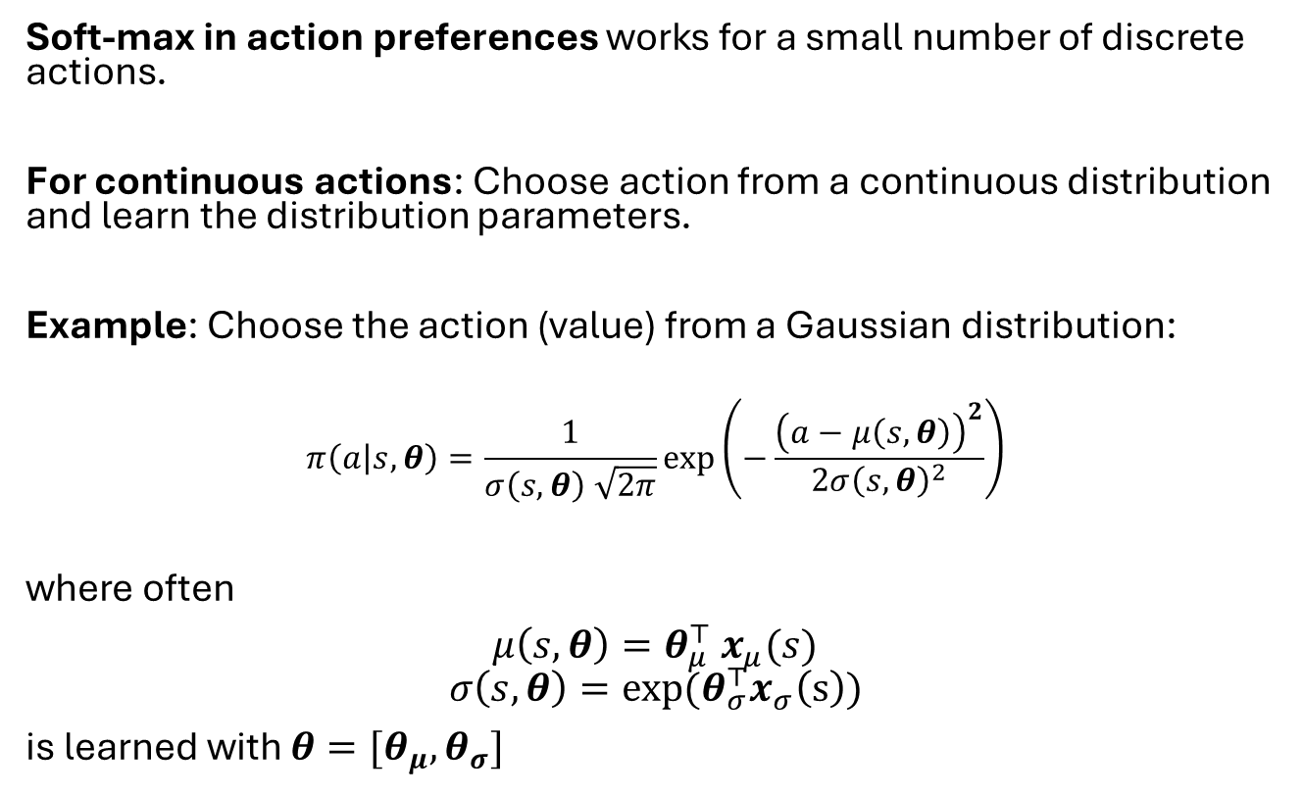
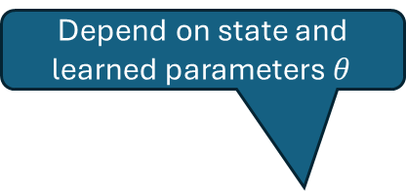

Policy Parameterization for Continuous Actions
Soft-max in action preferences works for a small number of discrete actions.
For continuous actions: Choose action from a continuous distribution and learn the distribution parameters.
Example: Choose the action (value) from a Gaussian distribution:
$$π\left(a | s,θ\right)=\frac{1}{σ\left(s,θ\right) \sqrt{2π}}\exp\left(−\frac{{\left(a−μ\left(s,θ\right)\right)}^{2}}{2σ{\left(s,θ\right)}^{2}}\right)$$
where often
$μ\left(s,θ\right)=θ_{μ}^{⊤} x_{μ}(s)$
$$σ\left(s,θ\right)=exp⁡(θ_{σ}^{⊤}x_{σ}\left(s\right))$$
is learned with $θ=[θ_{μ},θ_{σ}]$
Depend on state and learned parameters $θ$
Probability density
Linear in state features.
Action value $a$

Slide 20
What do you need to know?
Learning a parameterized policy has many advantages:
Learn probabilities for taking an action (stochastic policies).
The policy starts typically soft and automatically explores and later can approximate the optimal discrete policy.
Can handle continuous action spaces.
Policy gradient theorem provides strong performance bounds.
Important methods:
Soft-max in action preferences is a very popular choice for parameterized policies with a small set of discrete actions.
REINFORCE: Use MC to learn the policy parameters.
Actor-Critic Methods: Estimate policy and value function parameters together using TD. Reduces REINFORCE’s variance and leads to more stable and faster learning.
Note: Policy gradient methods (REINFORCE, actor-critic methods) have a different set of strengths and weaknesses compared to action-value methods, and the best choice depends on the problem.

