Slide 1
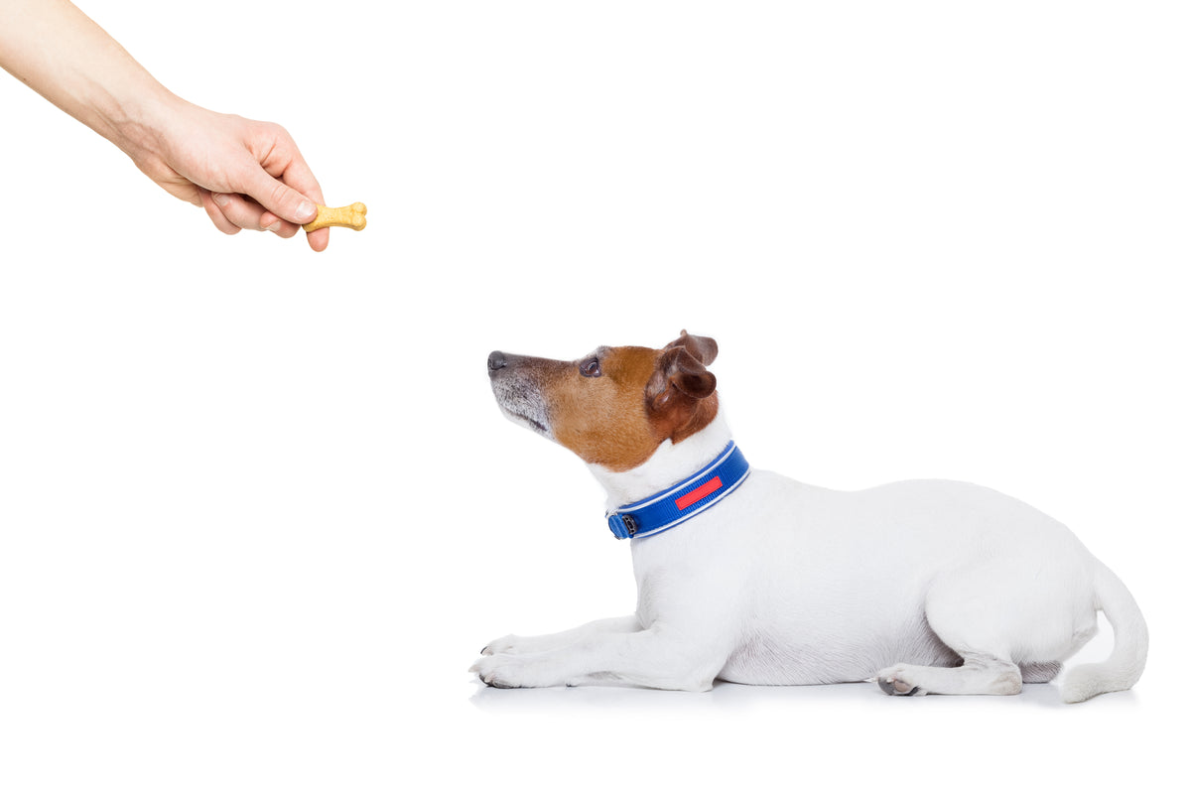


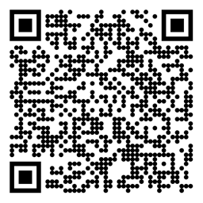

Reinforcement Learning Dynamic Programming Sutton/Barto* Chapter 4
Michael Hahsler, SMU
With figures from Sutton/Barto*
*Sutton and Barto, Reinforcement Learning: An Introduction, 2nd edition, MIT Press, Cambridge, MA, 2018

Slide 2
Topics of this Course
Introduction to reinforcement learning
Markov decision processes
Part I: Tabular Methods
Dynamic programming
Monte Carlo methods
Temporal-difference learning
Multi-step bootstrapping
Planning and learning with tabular methods
Part II: Approximate Solution Methods
Prediction and Control using Approximation
Eligibility Traces
Policy Gradient Methods
Part III: Modern RL Methods
Deep Reinforcement Learning
Current Applications

Slide 3
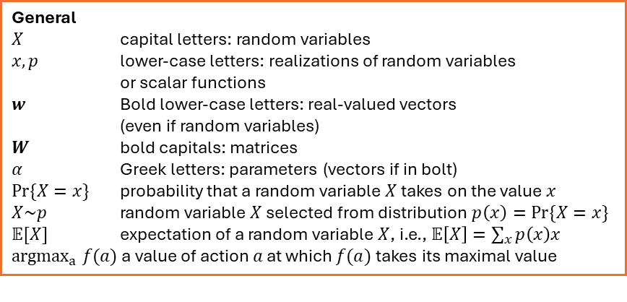
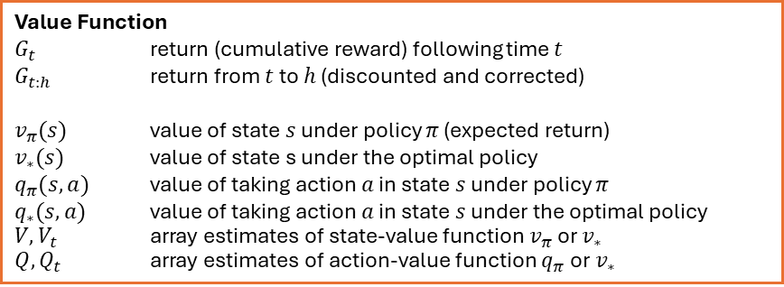
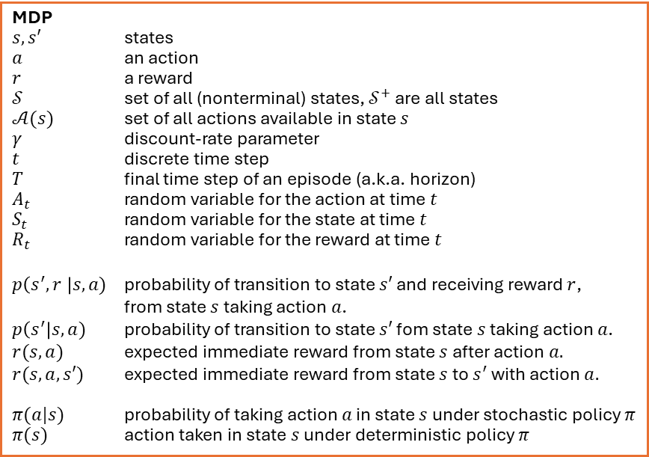
Summary of Notation
General
$X$ capital letters: random variables $x, p$ lower-case letters: realizations of random variables or scalar functions
$w$ Bold lower-case letters: real-valued vectors (even if random variables)
$W$ bold capitals: matrices
$α$ Greek letters: parameters (vectors if in bolt)
$Pr⁡\{X=x\}$ probability that a random variable $X$ takes on the value $x$
$X\sim p$ random variable $X$ selected from distribution $p\left(x\right)=Pr⁡\{X=x\}$
$𝔼[X]$ expectation of a random variable $X$, i.e., $𝔼\left[X\right]=\sum_{x}{p\left(x\right)x}$
${argmax}_{a} f(a)$ a value of action $a$ at which $f(a)$ takes its maximal value
MDP
$s, s′$ states
$a$ an action
$r$ a reward
$𝒮$ set of all (nonterminal) states, $𝒮^{+}$ are all states
$𝒜(s)$ set of all actions available in state $s$
$γ$ discount-rate parameter
$t$ discrete time step
$T$ final time step of an episode (a.k.a. horizon)
$A_{t}$ random variable for the action at time $t$
$S_{t}$ random variable for the state at time $t$
$R_{t}$ random variable for the reward at time $t$
$p\left(s^{′},r \right|s, a)$ probability of transition to state $s′$ and receiving reward $r$, from state $s$ taking action $a$.
$p\left(s^{′}\right|s, a)$ probability of transition to state $s′$ fom state $s$ taking action $a$.
$r(s,a)$ expected immediate reward from state $s$ after action $a.$
$r(s,a,s′)$ expected immediate reward from state $s$ to $s^{′}$ with action $a.$
$π(a|s)$ probability of taking action $a$ in state $s$ under stochastic policy $π$
$π(s)$ action taken in state $s$ under deterministic policy $π$
Value Function
$G_{t}$ return (cumulative reward) following time $t$
$G_{t:h}$ return from $t$ to $h$ (discounted and corrected)
$v_{π}(s)$ value of state $s$ under policy $π$ (expected return)
$v_{∗}(s)$ value of state s under the optimal policy
$q_{π}(s,a)$ value of taking action $a$ in state $s$ under policy $π$
$q_{∗}(s,a)$ value of taking action $a$ in state $s$ under the optimal policy
$V, V_{t}$ array estimates of state-value function $v_{π}$or $v_{∗}$
$Q,Q_{t}$ array estimates of action-value function $q_{π}$or $v_{∗}$

Slide 4

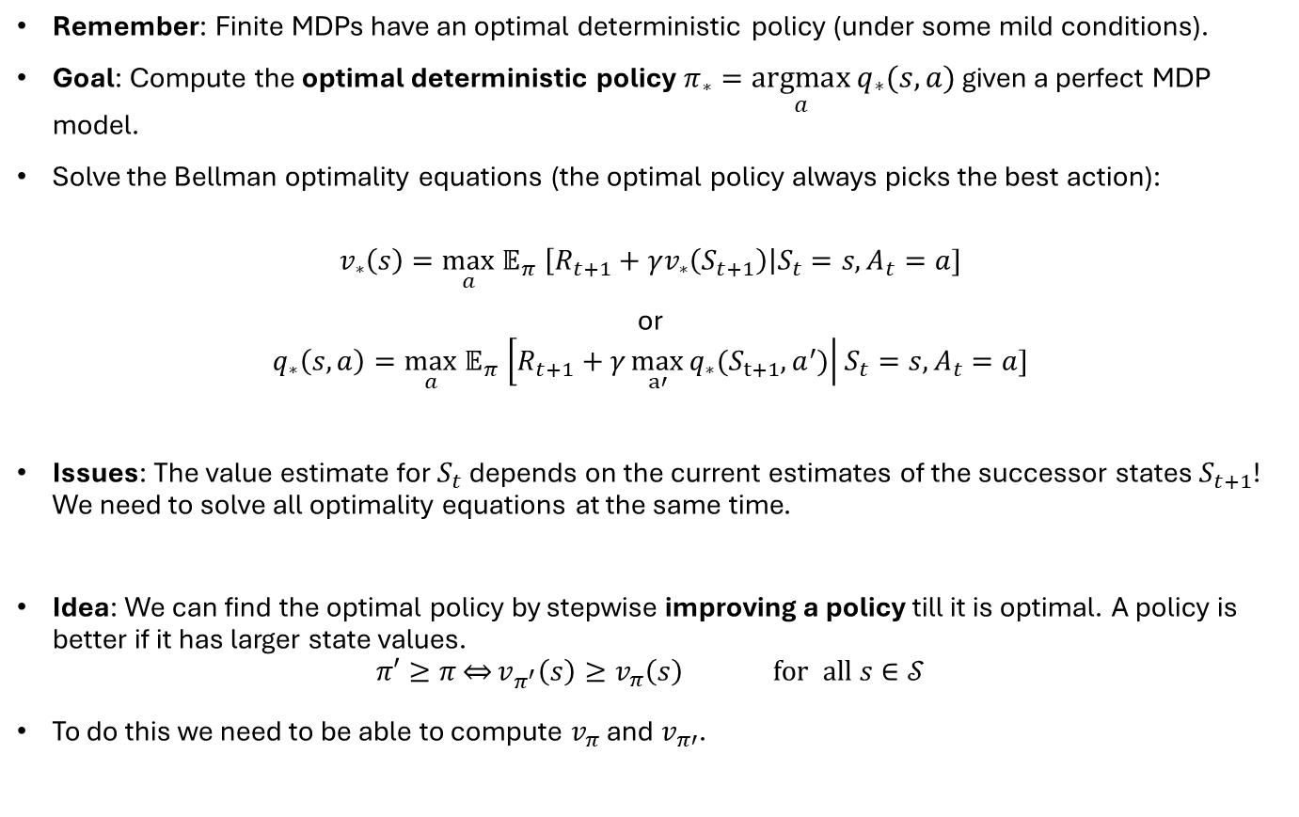
Goal
Remember: Finite MDPs have an optimal deterministic policy (under some mild conditions).
Goal: Compute the optimal deterministic policy $π_{∗}=\underset{a}{argmax}{q_{∗}(s,a)}$ given a perfect MDP model.
Solve the Bellman optimality equations (the optimal policy always picks the best action):
$$v_{∗}\left(s\right){=\max_{a} 𝔼}_{π}\left[R_{t+1}+γv_{∗}\left(S_{t+1}\right)\right|S_{t}=s,A_{t}=a]$$
or
$$q_{∗}\left(s,a\right){=\max_{a} 𝔼}_{π}\left[R_{t+1}+γ\max_{a′}{q_{∗}(S_{t+1},a^{′})}\right|S_{t}=s, A_{t}=a]$$
Issues: The value estimate for $S_{t}$ depends on the current estimates of the successor states $S_{t+1}$! We need to solve all optimality equations at the same time.
Idea: We can find the optimal policy by stepwise improving a policy till it is optimal. A policy is better if it has larger state values.
$$π′≥π\overset{⇔}{}v_{π^{′}}\left(s\right)≥v_{π}\left(s\right) \text{for} \text{all} s∈𝒮$$
To do this we need to be able to compute $v_{π}$ and $v_{π′}$.
Control Problem: Find the optimal policy
$$=v_{∗}(S_{t+1})$$
Prediction Problem: Estimate the value function for a policy.

Slide 5
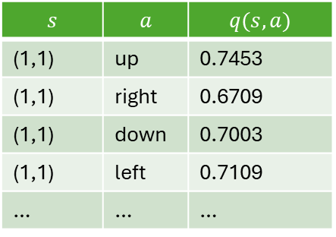
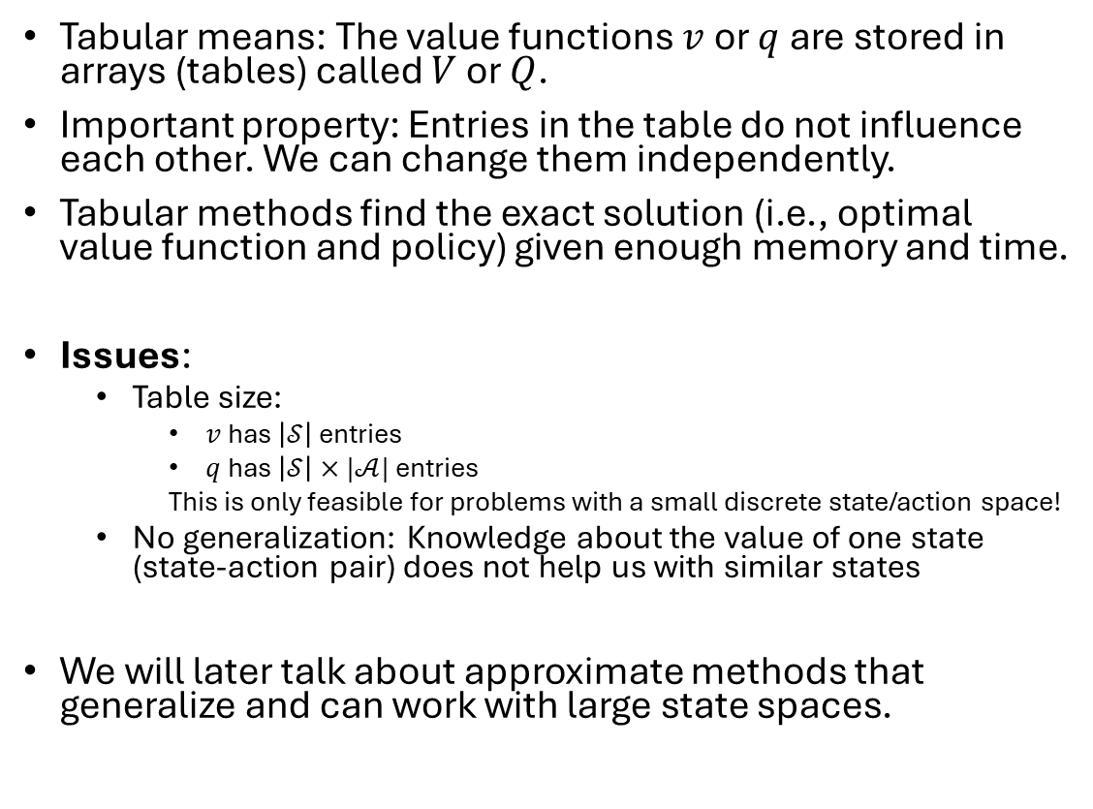
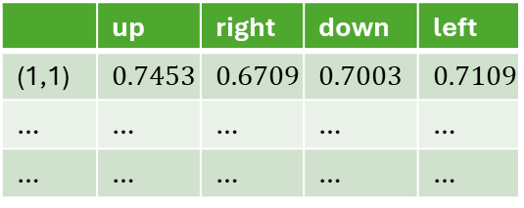
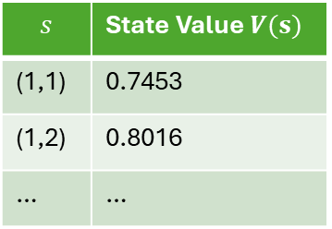
Tabular Methods
Value Function
$$s$$ | State Value $V(s)$
(1,1) | 0.7453
(1,2) | 0.8016
… | …
Tabular means: The value functions $v$ or $q$ are stored in arrays (tables) called $V$ or $Q$.
Important property: Entries in the table do not influence each other. We can change them independently.
Tabular methods find the exact solution (i.e., optimal value function and policy) given enough memory and time.
Issues:
Table size:
$v$ has $\left|𝒮\right|$ entries
$q$ has $\left|𝒮\right|×|𝒜|$ entries
This is only feasible for problems with a small discrete state/action space!
No generalization: Knowledge about the value of one state (state-action pair) does not help us with similar states
We will later talk about approximate methods that generalize and can work with large state spaces.
Q-Table
$$s$$ | $$a$$ | $$q(s,a)$$
(1,1) | up | 0.7453
(1,1) | right | 0.6709
(1,1) | down | 0.7003
(1,1) | left | 0.7109
… | … | …
or
 | up | right | down | left
(1,1) | $$\text{0.7453}$$ | $$\text{0.6709}$$ | $$\text{0.7003}$$ | $$\text{0.7109}$$
… | … | … | … | …
… | … | … | … | …

Slide 6
Prediction vs. Control
In this class, we will always talk about two tasks:
Prediction to evaluate a policy: Estimate the value function for a given policy. We can use this to compare two policies.
Control: Control the agent’s behavior to find the optimal policy. This requires being able to evaluate policies.

Slide 7
Prediction: Policy Evaluation
What is the value function for a given policy?

Slide 8
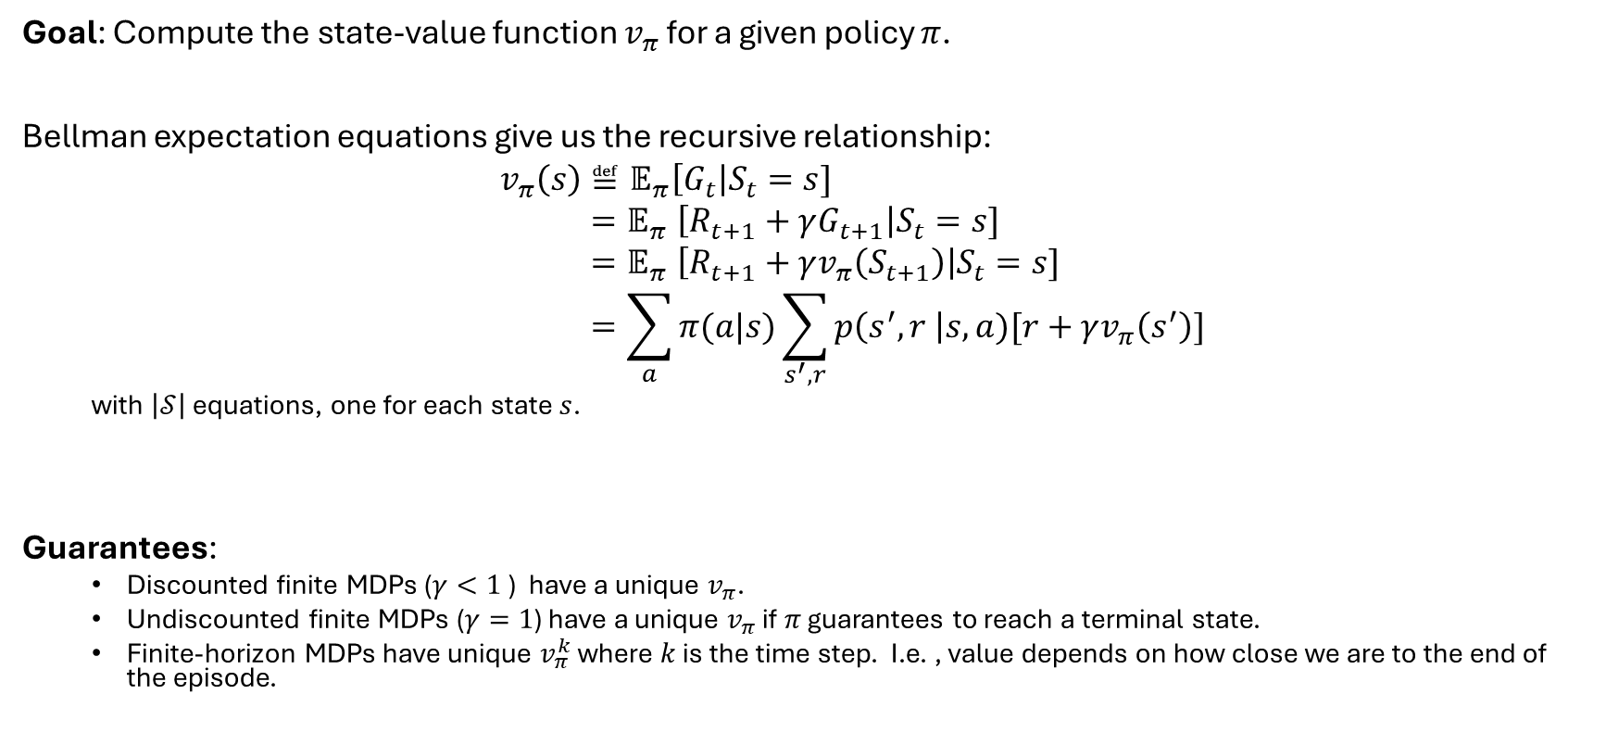
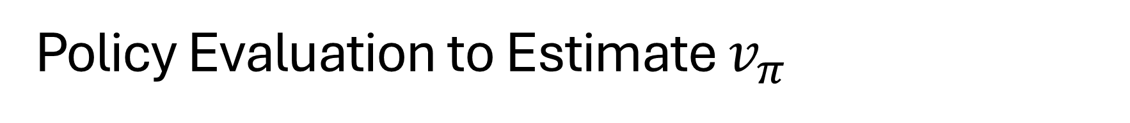
Policy Evaluation to Estimate $v_{π}$
Goal: Compute the state-value function $v_{π}$ for a given policy $π$.
Bellman expectation equations give us the recursive relationship:
$$v_{π}\left(s\right)≝𝔼_{π}\left[G_{t}\right|S_{t}=s] \\ {=𝔼}_{π}\left[R_{t+1}+γG_{t+1}\right|S_{t}=s] \\ {=𝔼}_{π}\left[R_{t+1}+γv_{π}\left(S_{t+1}\right)\right|S_{t}=s] \\ =\sum_{a}{π(a|s)}\sum_{s^{′},r}{p\left(s^{′},r \right|s,a)[r+γv_{π}\left(s^{′}\right)]}$$
with $\left|𝒮\right|$ equations, one for each state $s$.
Guarantees:
Discounted finite MDPs ($γ<1$) have a unique $v_{π}$.
Undiscounted finite MDPs ($γ=1$) have a unique $v_{π}$ if $π$ guarantees to reach a terminal state.
Finite-horizon MDPs have unique $v_{π}^{k}$ where $k$ is the time step. I.e. , value depends on how close we are to the end of the episode.

Slide 9
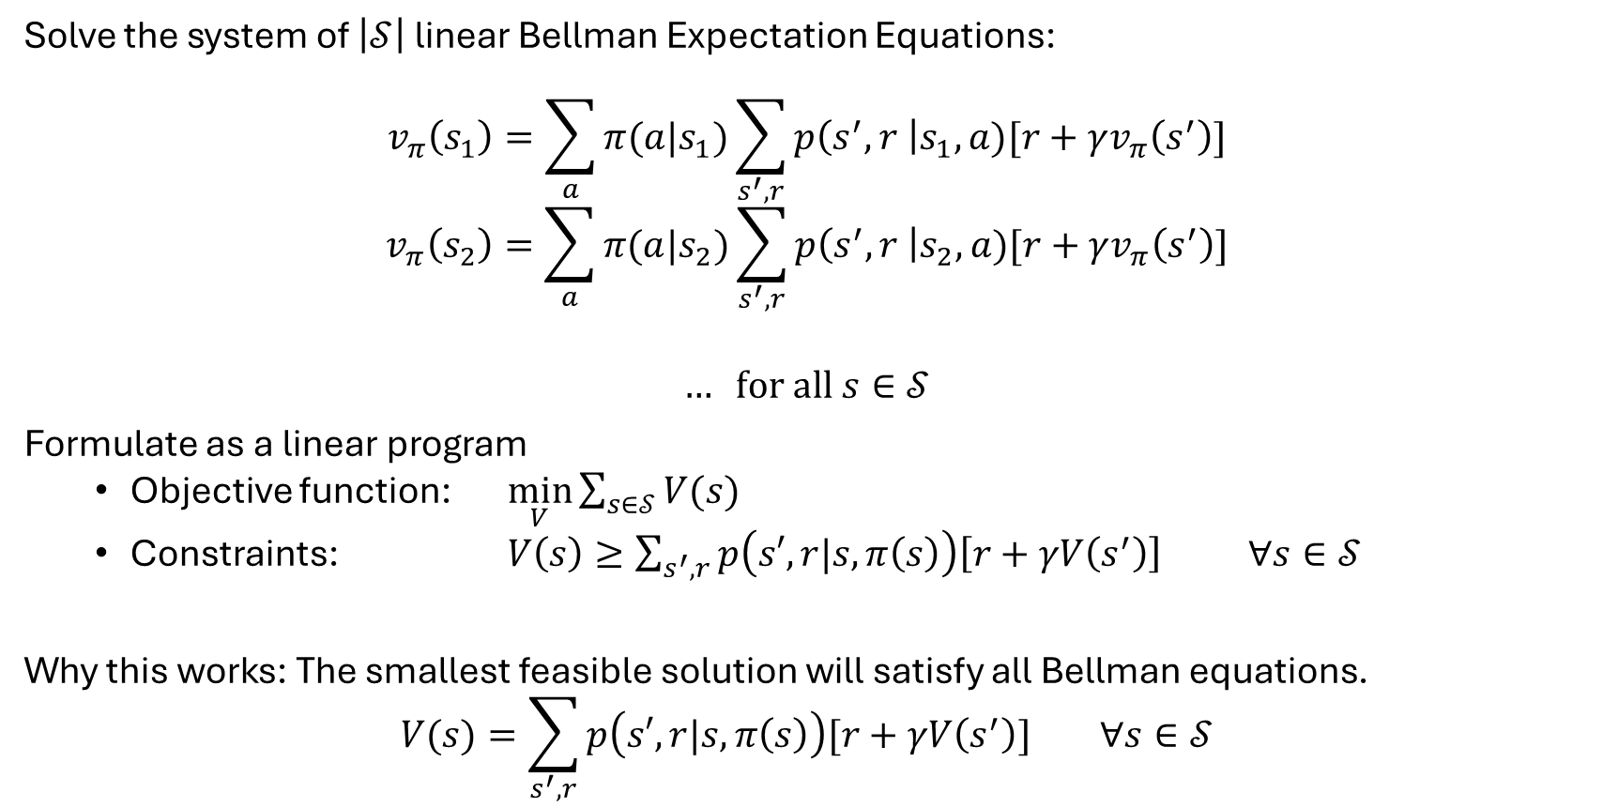
Solution Option 1: Linear Program
Solve the system of $\left|𝒮\right|$ linear Bellman Expectation Equations:
$$v_{π}\left(s_{1}\right)=\sum_{a}{π(a|s_{1})}\sum_{s^{′},r}{p\left(s^{′},r \right|s_{1},a)[r+γv_{π}\left(s^{′}\right)]}$$
$$v_{π}\left(s_{2}\right)=\sum_{a}{π(a|s_{2})}\sum_{s^{′},r}{p\left(s^{′},r \right|s_{2},a)[r+γv_{π}\left(s^{′}\right)]}$$
$$… \text{for} \text{all} s∈𝒮$$
Formulate as a linear program
Objective function: $\min_{V}{\sum_{s∈𝒮}{V(s)}}$
Constraints: $V\left(s\right)≥\sum_{s^{′},r}{p\left(s′,r|s,π\left(s\right)\right)\left[r+γV\left(s^{′}\right)\right] ∀s∈𝒮}$
Why this works: The smallest feasible solution will satisfy all Bellman equations.
$$V(s)=\sum_{s^{′},r}{p\left(s′,r|s,π\left(s\right)\right)[r+γV\left(s^{′}\right)] ∀s∈𝒮}$$

Slide 10
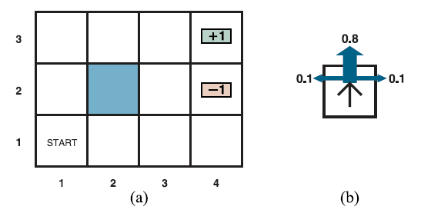
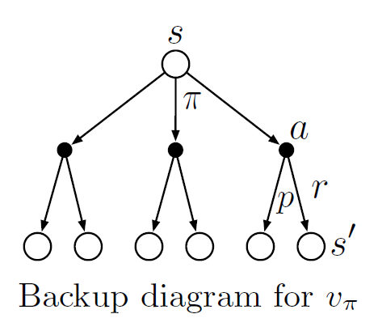
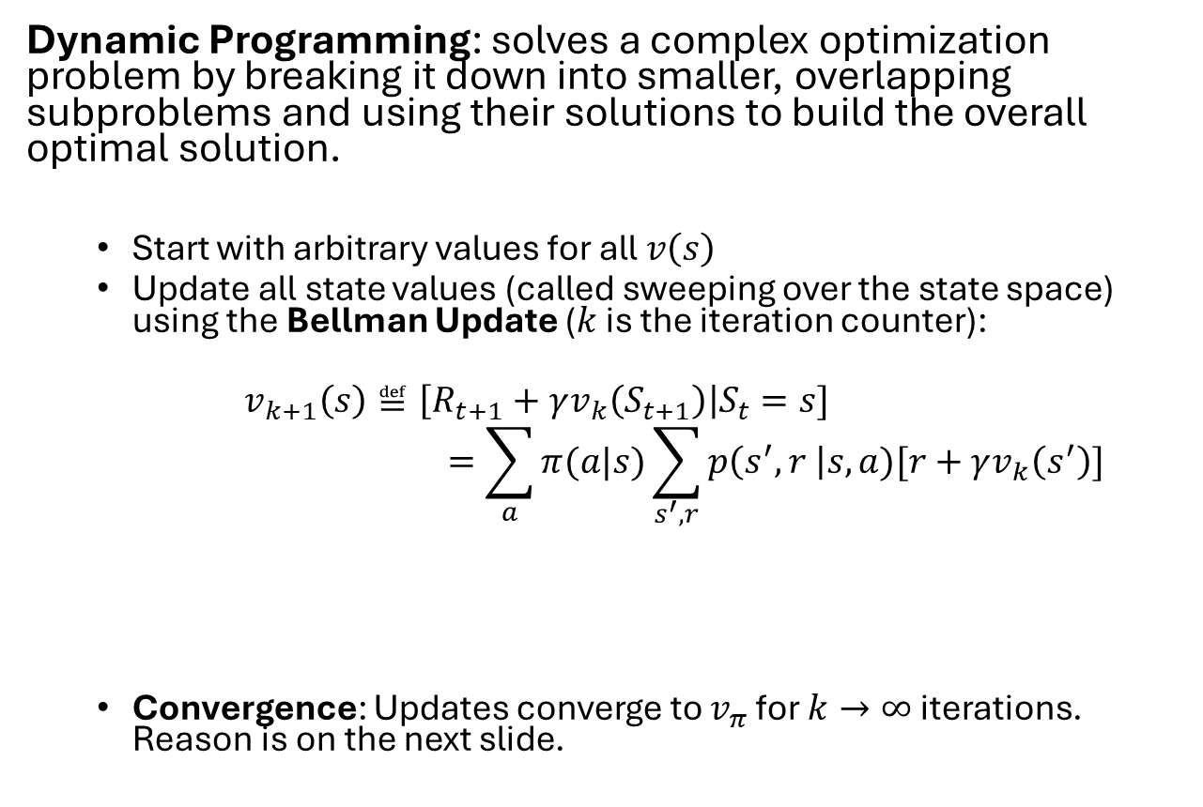



Solution Option 2: Iterative Policy Evaluation
Dynamic Programming: solves a complex optimization problem by breaking it down into smaller, overlapping subproblems and using their solutions to build the overall optimal solution.
Start with arbitrary values for all $v\left(s\right)$
Update all state values (called sweeping over the state space) using the Bellman Update ($k$ is the iteration counter):
$$v_{k+1}\left(s\right)≝\left[R_{t+1}+γv_{k}\left(S_{t+1}\right)\right|S_{t}=s] \\ =\sum_{a}{π(a|s)}\sum_{s^{′},r}{p\left(s^{′},r \right|s,a)[r+γv_{k}\left(s^{′}\right)]}$$
Convergence: Updates converge to $v_{π}$ for $k→∞$ iterations. Reason is on the next slide.
Sweep the state space
Backup diagram
In DP called “expected update.” Uses the expectation over all possible actions and next states.
Bellman updates
$$v_{0}$$
$$v_{1}$$
$$v_{π}$$
Distance means difference

Slide 11
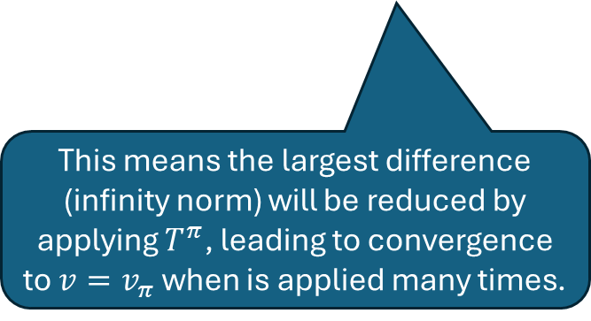
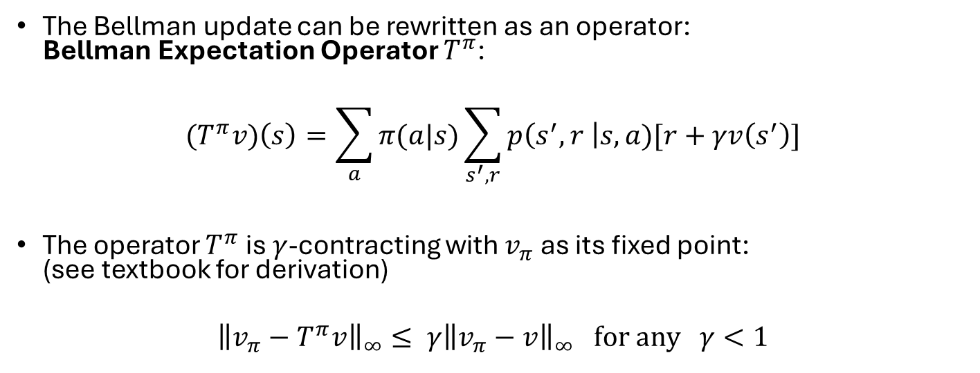
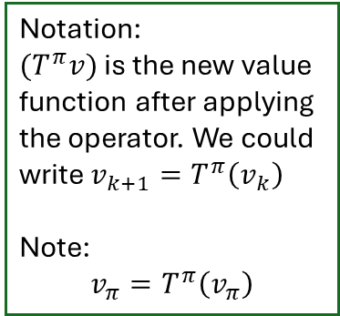
Convergence of Iterative Policy Evaluation
Notation:
${(T}^{π}v)$ is the new value function after applying the operator. We could write $v_{k+1}=T^{π}\left(v_{k}\right)$
Note:
$$v_{π}=T^{π}\left(v_{π}\right)$$
The Bellman update can be rewritten as an operator: Bellman Expectation Operator $T^{π}$:
$${(T}^{π}v)\left(s\right)=\sum_{a}{π(a|s)}\sum_{s^{′},r}{p\left(s^{′},r \right|s,a)[r+γv\left(s^{′}\right)]}$$
The operator $T^{π}$ is $γ$-contracting with $v_{π}$ as its fixed point: (see textbook for derivation)
$${\left\|v_{π}−T^{π}v\right\|}_{∞}≤ {γ\left\|v_{π}−v\right\|}_{∞} \text{for} \text{any} γ<1$$
Bellman updates
$$v_{0}$$
$$v_{1}$$
$$v_{π}$$
Distance means difference
This means the largest difference (infinity norm) will be reduced by applying $T^{π}$, leading to convergence to $v=v_{π}$ when is applied many times.
Convergence is guaranteed if the discount factor is strictly smaller than 1!

Slide 12
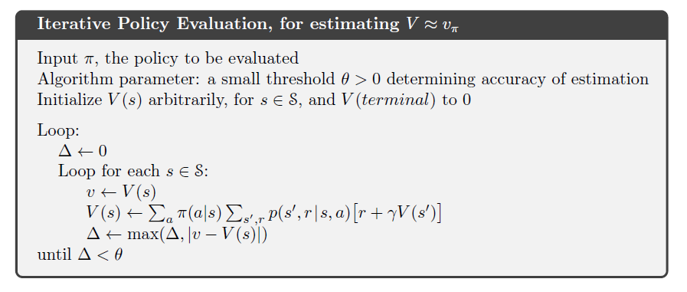
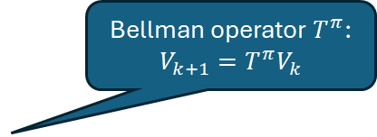
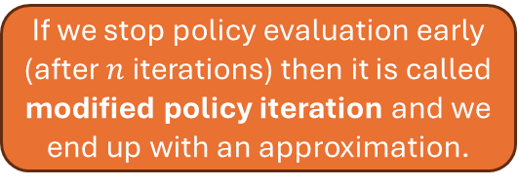
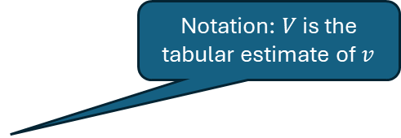
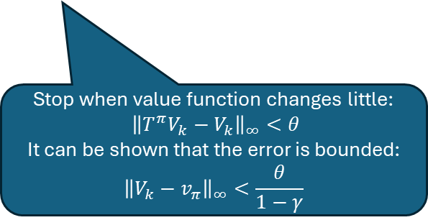
Alg. Iterative Policy Evaluation
Notation: $V$ is the tabular estimate of $v$
Bellman operator $T^{π}$: $$V_{k+1}=T^{π}V_{k}$$
Stop when value function changes little: $${\left\|T^{π}V_{k}−V_{k}\right\|}_{∞}<θ$$
It can be shown that the error is bounded:
$${\left\|V_{k}−v_{π}\right\|}_{∞}<\frac{θ}{1−γ}$$
If we stop policy evaluation early (after $n$ iterations) then it is called modified policy iteration and we end up with an approximation.

Slide 13
Control: Policy Iteration
Find the optimal policy based on the environment model.

Slide 14
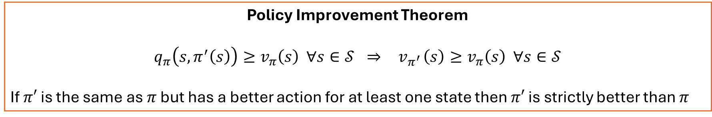
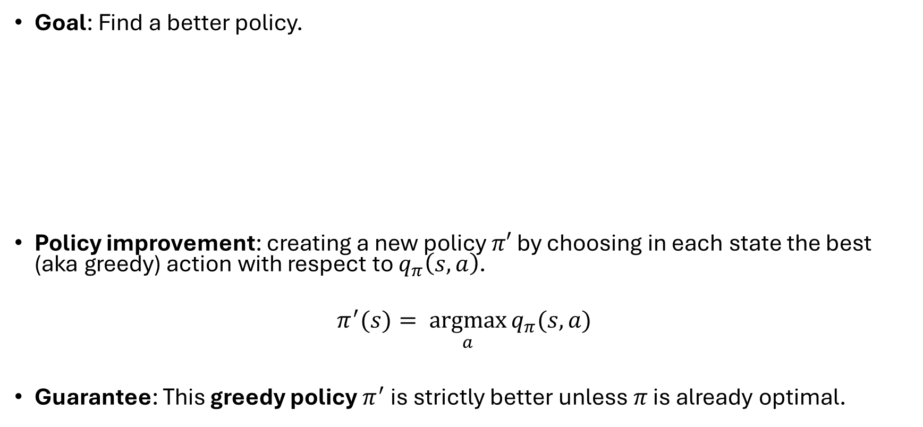
Policy Improvement and the Greedy Policy
Goal: Find a better policy.
Policy improvement: creating a new policy $π′$ by choosing in each state the best (aka greedy) action with respect to $q_{π}\left(s,a\right)$.
$$π^{′}(s)= \underset{a}{argmax}{q_{π}(s,a)}$$
Guarantee: This greedy policy $π^{′}$ is strictly better unless $π$ is already optimal.
Policy Improvement Theorem
$$q_{π}\left(s, π^{′}\left(s\right)\right)≥v_{π}\left(s\right) ∀s∈𝒮 ⇒{ v}_{π^{′}}\left(s\right)≥v_{π}\left(s\right) ∀s∈𝒮$$
If $π′$ is the same as $π$ but has a better action for at least one state then $π′$ is strictly better than $π$

Slide 15
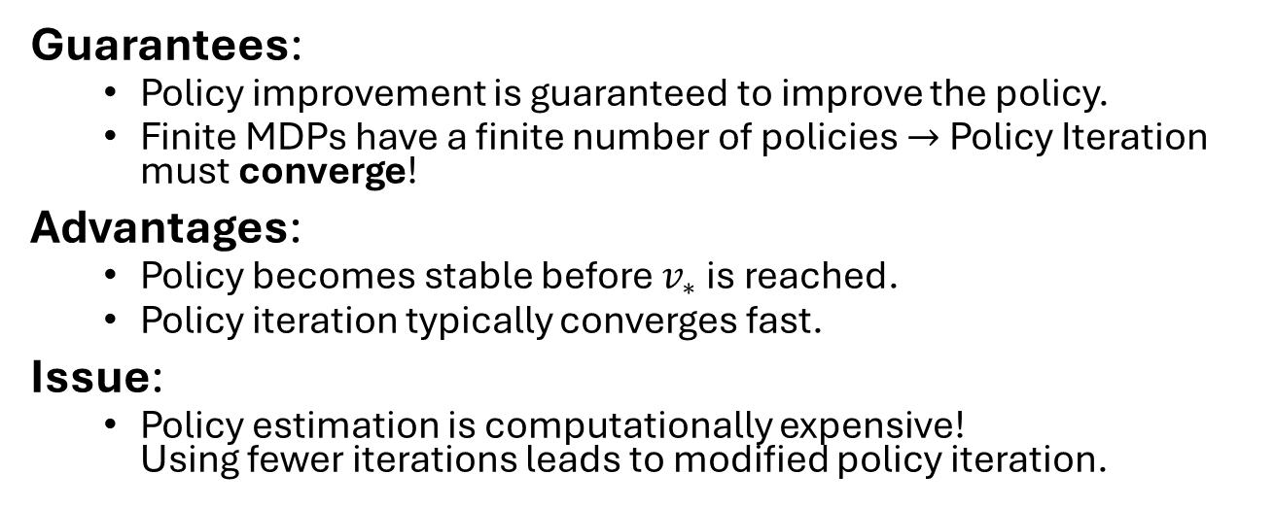
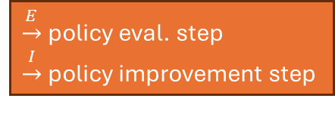

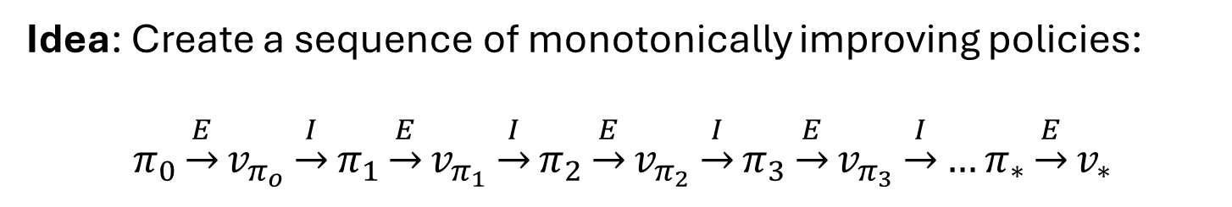



Policy Iteration
Idea: Create a sequence of monotonically improving policies:
$$π_{0}\underset{→}{E}v_{π_{o}}\underset{→}{I}π_{1}\underset{→}{E}v_{π_{1}}\underset{→}{I}π_{2}\underset{→}{E}v_{π_{2}}\underset{→}{I}π_{3}\underset{→}{E}v_{π_{3}}\underset{→}{I}…π_{∗}\underset{→}{E}v_{∗}$$
$\underset{→}{E}$ policy eval. step
$\underset{→}{I}$ policy improvement step
Guarantees:
Policy improvement is guaranteed to improve the policy.
Finite MDPs have a finite number of policies $→$ Policy Iteration must converge!
Advantages:
Policy becomes stable before $v_{∗}$ is reached.
Policy iteration typically converges fast.
Issue:
Policy estimation is computationally expensive! Using fewer iterations leads to modified policy iteration.
$$v_{ π_{0}}$$
$$v_{∗}$$
P. improvement
Policy evaluation
$$π_{∗}$$
$$π_{0}$$

Slide 16
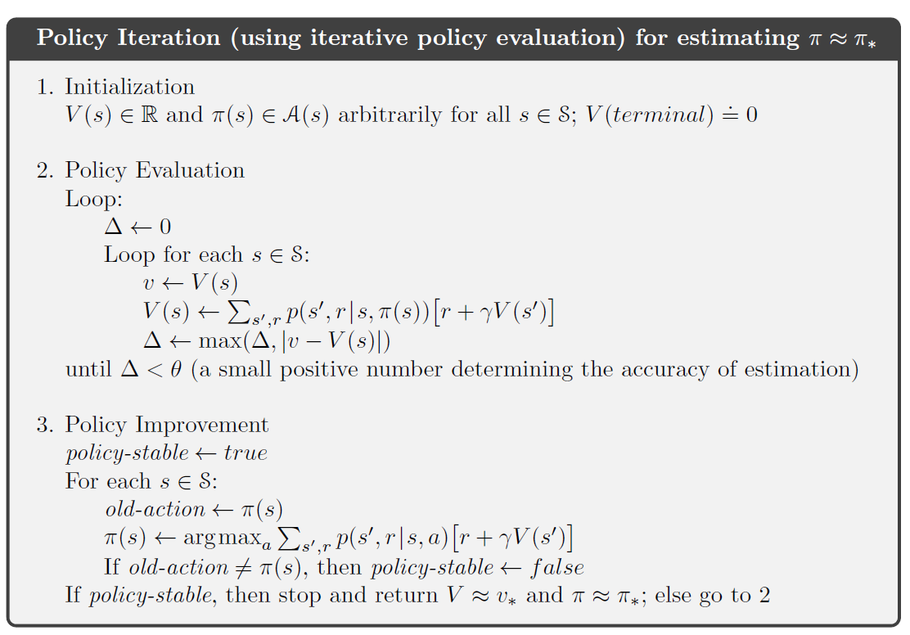
Alg. Policy Iteration
Just policy evaluation from before. We can also stop this loop early (modified policy iteration).
Picks the greedy action with the highest Q-value to improve the policy.

Slide 17
Control: Value Iteration
Find the optimal value function based on the environment model.

Slide 18

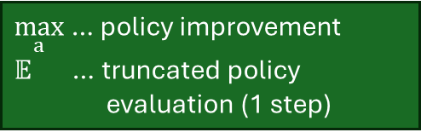
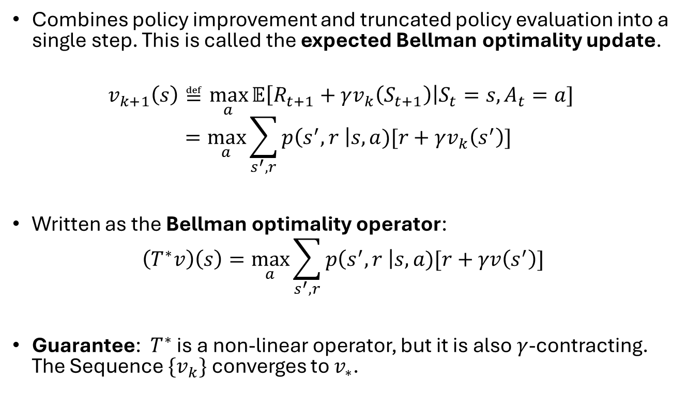
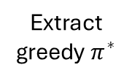


Value Iteration
Combines policy improvement and truncated policy evaluation into a single step. This is called the expected Bellman optimality update.
$$v_{k+1}\left(s\right)≝\max_{a}{𝔼\left[R_{t+1}+γv_{k}\left(S_{t+1}\right)\right|S_{t}=s,A_{t}=a] } \\ =\max_{a}\sum_{s^{′},r}{p\left(s^{′},r \right|s,a)[r+γv_{k}\left(s^{′}\right)]}$$
Written as the Bellman optimality operator:
$$\left(T^{∗}v\right)\left(s\right)=\max_{a}\sum_{s^{′},r}{p\left(s^{′},r \right|s,a)[r+γv\left(s^{′}\right)]}$$
Guarantee: $T^{∗}$ is a non-linear operator, but it is also $γ$-contracting. The Sequence $\{v_{k}\}$ converges to $v_{∗}$.
$\max_{a}$ … policy improvement
$𝔼$ … truncated policy evaluation (1 step)
Bellman updates
$$v_{0}$$
$$v_{1}$$
$$v_{∗}$$
Extract greedy $π^{∗}$

Slide 19
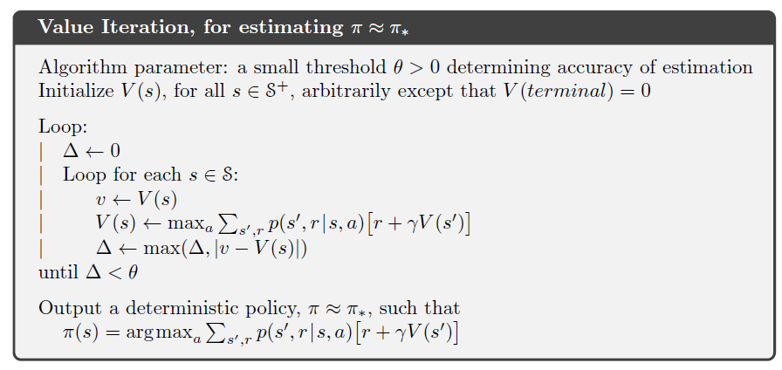
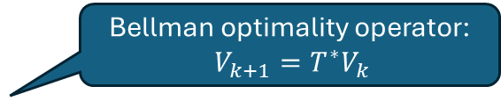
Alg. Value Iteration
Combine improvement and modified evaluation (1 iteration only) into a single update.
Bellman optimality operator: $V_{k+1}=T^{∗}V_{k}$
Stopping criterion from policy evaluation
Extract the greedy policy.

Slide 20
Code…

Slide 21
GPI: Generalized Policy Iteration
Generalizing value and policy iteration into a single framework.

Slide 22
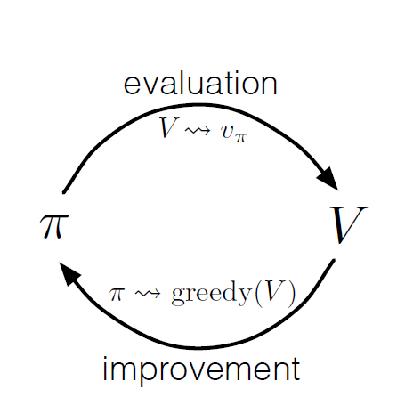
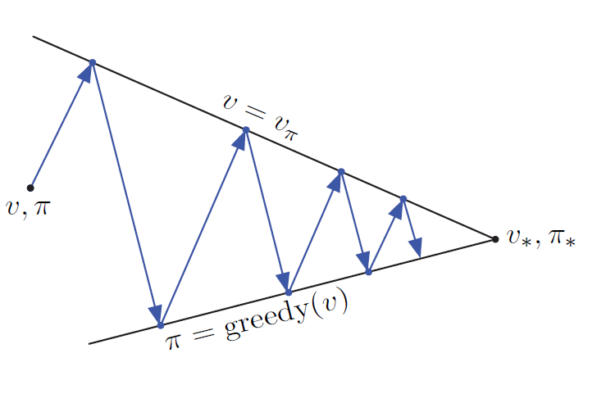
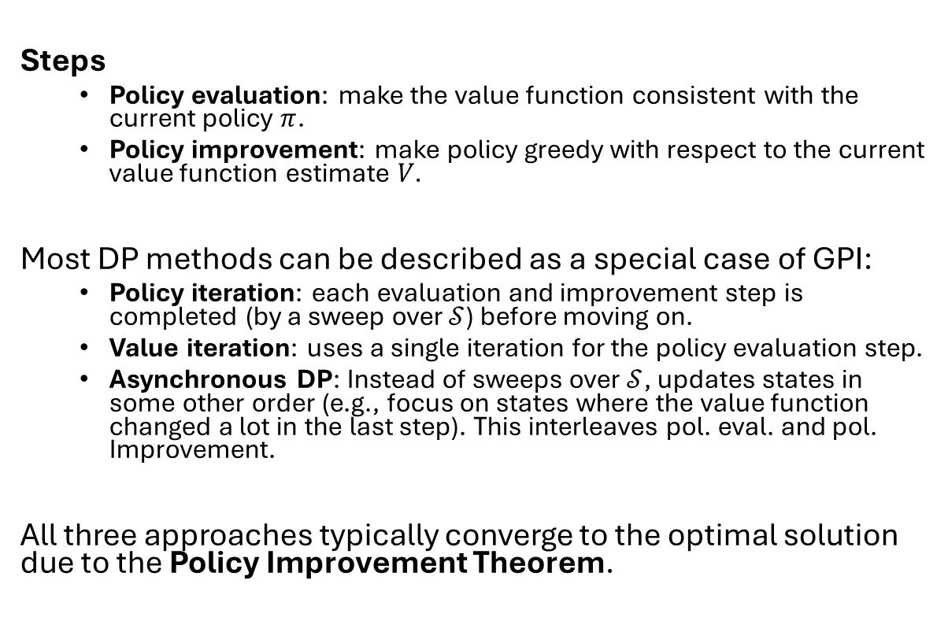
GPI: Generalized Policy Iteration
Steps
Policy evaluation: make the value function consistent with the current policy $π$.
Policy improvement: make policy greedy with respect to the current value function estimate $V.$
Most DP methods can be described as a special case of GPI:
Policy iteration: each evaluation and improvement step is completed (by a sweep over $𝒮$) before moving on.
Value iteration: uses a single iteration for the policy evaluation step.
Asynchronous DP: Instead of sweeps over $𝒮$, updates states in some other order (e.g., focus on states where the value function changed a lot in the last step). This interleaves pol. eval. and pol. Improvement.
All three approaches typically converge to the optimal solution due to the Policy Improvement Theorem.

Slide 23
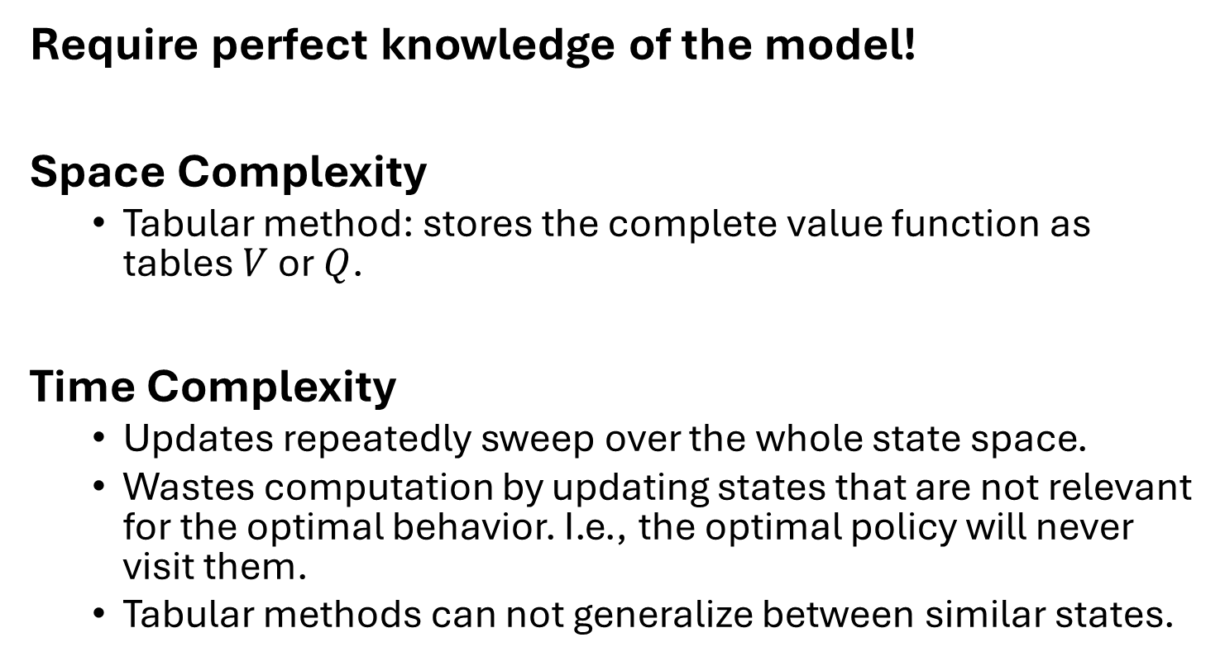
Issues with DP Methods
Require perfect knowledge of the model!
Space Complexity
Tabular method: stores the complete value function as tables $V$ or $Q$.
Time Complexity
Updates repeatedly sweep over the whole state space.
Wastes computation by updating states that are not relevant for the optimal behavior. I.e., the optimal policy will never visit them.
Tabular methods can not generalize between similar states.
Asynchronous DP can help

Slide 24
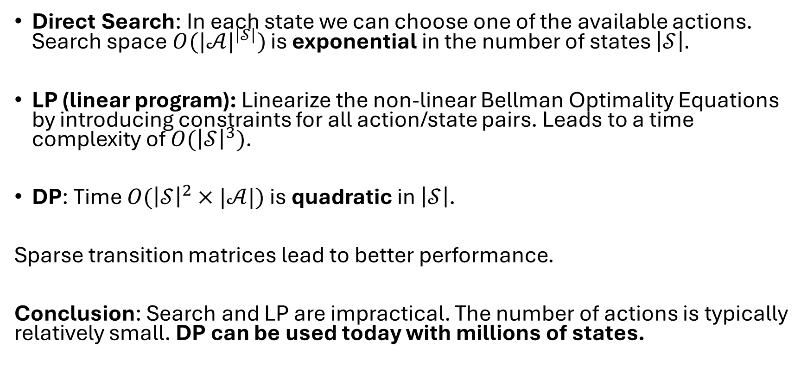
Efficiency
Direct Search: In each state we can choose one of the available actions. Search space $O({|𝒜|}^{\left|𝒮\right|})$ is exponential in the number of states $\left|𝒮\right|.$
LP (linear program): Linearize the non-linear Bellman Optimality Equations by introducing constraints for all action/state pairs. Leads to a time complexity of $O({\left|𝒮\right|}^{3})$.
DP: Time $O({\left|𝒮\right|}^{2}×|𝒜|)$ is quadratic in $\left|𝒮\right|$.
Sparse transition matrices lead to better performance.
Conclusion: Search and LP are impractical. The number of actions is typically relatively small. DP can be used today with millions of states.

Slide 25
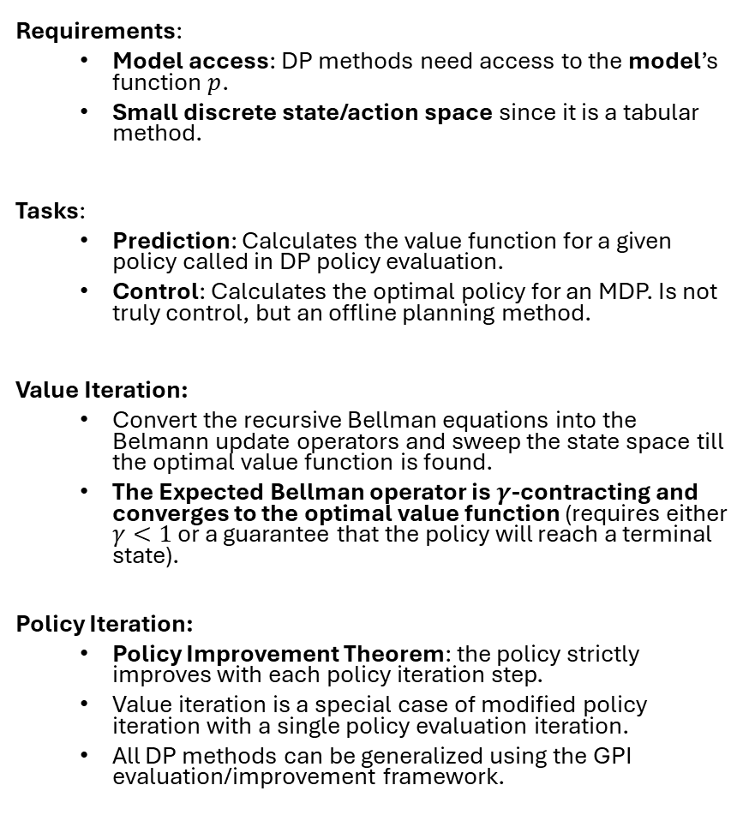
What You Need to Know
Requirements:
Model access: DP methods need access to the model’s function $p$.
Small discrete state/action space since it is a tabular method.
Tasks:
Prediction: Calculates the value function for a given policy called in DP policy evaluation.
Control: Calculates the optimal policy for an MDP. Is not truly control, but an offline planning method.
Value Iteration:
Convert the recursive Bellman equations into the Belmann update operators and sweep the state space till the optimal value function is found.
The Expected Bellman operator is $γ$-contracting and converges to the optimal value function (requires either $γ<1$ or a guarantee that the policy will reach a terminal state).
Policy Iteration:
Policy Improvement Theorem: the policy strictly improves with each policy iteration step.
Value iteration is a special case of modified policy iteration with a single policy evaluation iteration.
All DP methods can be generalized using the GPI evaluation/improvement framework.

