Slide 1
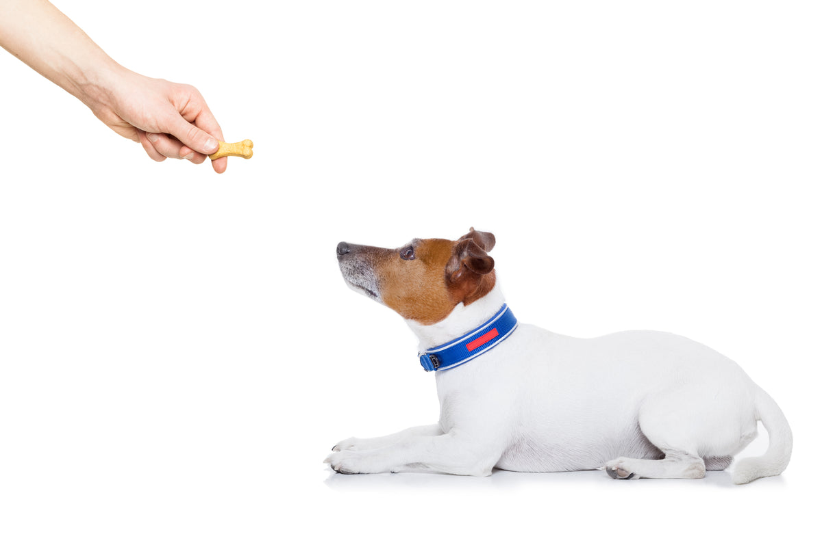


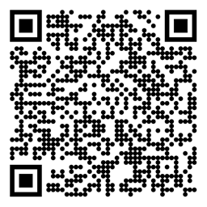

Reinforcement Learning Prediction and Control with Approximation Sutton/Barto* Chapter 9-11
Michael Hahsler, SMU
With figures from Sutton/Barto*
*Sutton and Barto, Reinforcement Learning: An Introduction, 2nd edition, MIT Press, Cambridge, MA, 2018

Slide 2
Topics of this Course
Introduction to reinforcement learning
Markov decision processes
Part I: Tabular Methods
Dynamic programming
Monte Carlo methods
Temporal-difference learning
Multi-step bootstrapping
Planning and learning with tabular methods
Part II: Approximate Solution Methods
Prediction and Control using Approximation
Eligibility Traces
Policy Gradient Methods
Part III: Modern RL Methods
Deep Reinforcement Learning
Current Applications

Slide 3
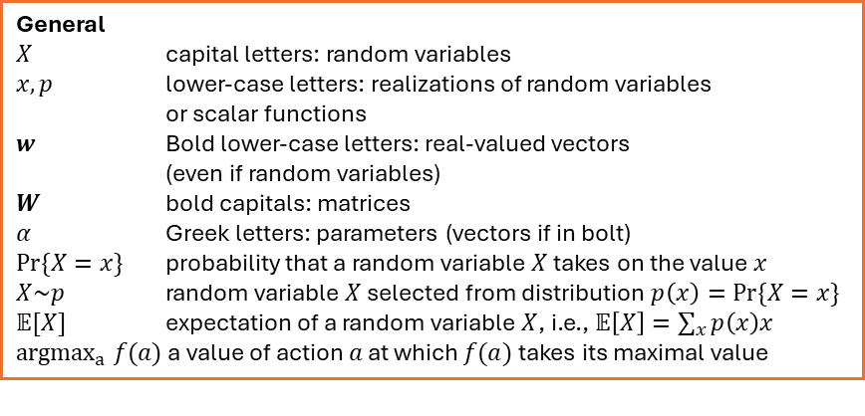
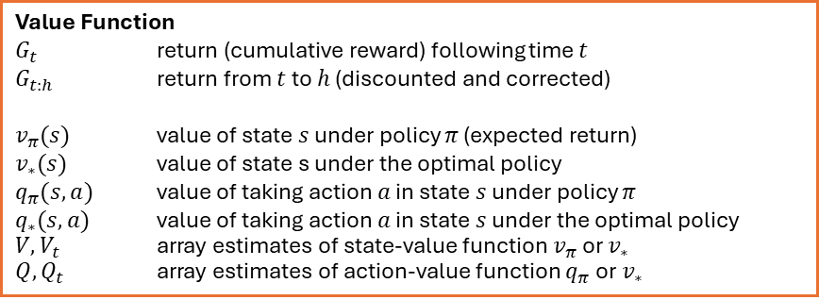
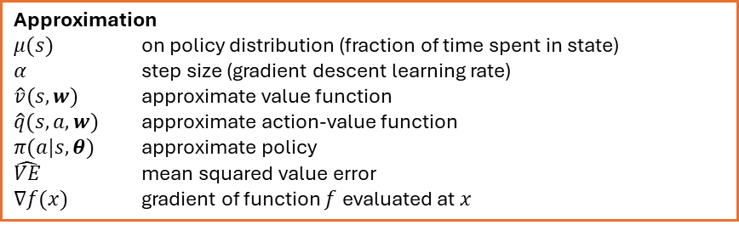
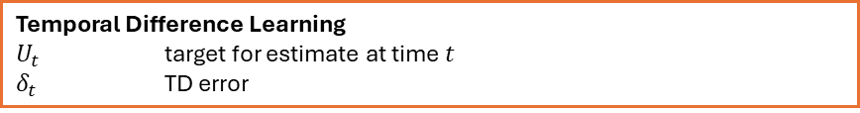
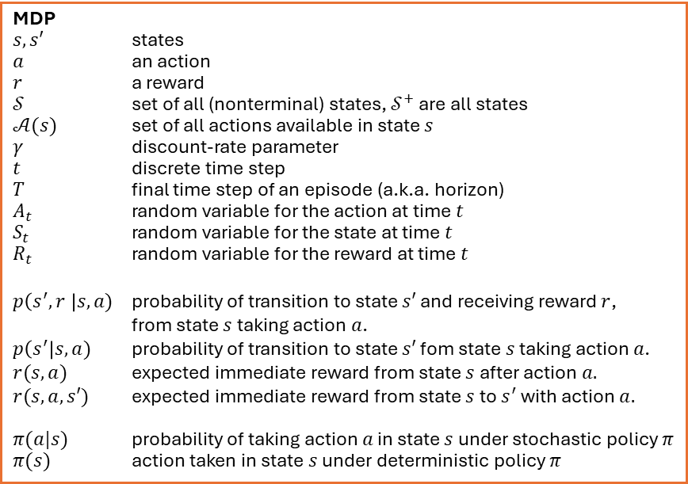
Summary of Notation
General
$X$ capital letters: random variables $x, p$ lower-case letters: realizations of random variables or scalar functions
$w$ Bold lower-case letters: real-valued vectors (even if random variables)
$W$ bold capitals: matrices
$α$ Greek letters: parameters (vectors if in bolt)
$Pr⁡\{X=x\}$ probability that a random variable $X$ takes on the value $x$
$X\sim p$ random variable $X$ selected from distribution $p\left(x\right)=Pr⁡\{X=x\}$
$𝔼[X]$ expectation of a random variable $X$, i.e., $𝔼\left[X\right]=\sum_{x}{p\left(x\right)x}$
${argmax}_{a} f(a)$ a value of action $a$ at which $f(a)$ takes its maximal value
MDP
$s, s′$ states
$a$ an action
$r$ a reward
$𝒮$ set of all (nonterminal) states, $𝒮^{+}$ are all states
$𝒜(s)$ set of all actions available in state $s$
$γ$ discount-rate parameter
$t$ discrete time step
$T$ final time step of an episode (a.k.a. horizon)
$A_{t}$ random variable for the action at time $t$
$S_{t}$ random variable for the state at time $t$
$R_{t}$ random variable for the reward at time $t$
$p\left(s^{′},r \right|s, a)$ probability of transition to state $s′$ and receiving reward $r$, from state $s$ taking action $a$.
$p\left(s^{′}\right|s, a)$ probability of transition to state $s′$ fom state $s$ taking action $a$.
$r(s,a)$ expected immediate reward from state $s$ after action $a.$
$r(s,a,s′)$ expected immediate reward from state $s$ to $s^{′}$ with action $a.$
$π(a|s)$ probability of taking action $a$ in state $s$ under stochastic policy $π$
$π(s)$ action taken in state $s$ under deterministic policy $π$
Value Function
$G_{t}$ return (cumulative reward) following time $t$
$G_{t:h}$ return from $t$ to $h$ (discounted and corrected)
$v_{π}(s)$ value of state $s$ under policy $π$ (expected return)
$v_{∗}(s)$ value of state s under the optimal policy
$q_{π}(s,a)$ value of taking action $a$ in state $s$ under policy $π$
$q_{∗}(s,a)$ value of taking action $a$ in state $s$ under the optimal policy
$V, V_{t}$ array estimates of state-value function $v_{π}$or $v_{∗}$
$Q,Q_{t}$ array estimates of action-value function $q_{π}$or $v_{∗}$
Approximation
$μ(s)$ on policy distribution (fraction of time spent in state)
$α$ step size (gradient descent learning rate)
$\hat{v}(s, w)$ approximate value function $\hat{q}(s, a, w)$ approximate action-value function $π(a|s,θ)$ approximate policy
$\hat{VE}$ mean squared value error
$∇f(x)$ gradient of function $f$ evaluated at $x$
Temporal Difference Learning
$U_{t}$ target for estimate at time$t$
$δ_{t}$ TD error

Slide 4
Approximate Solution Methods
Motivation and Definition

Slide 5
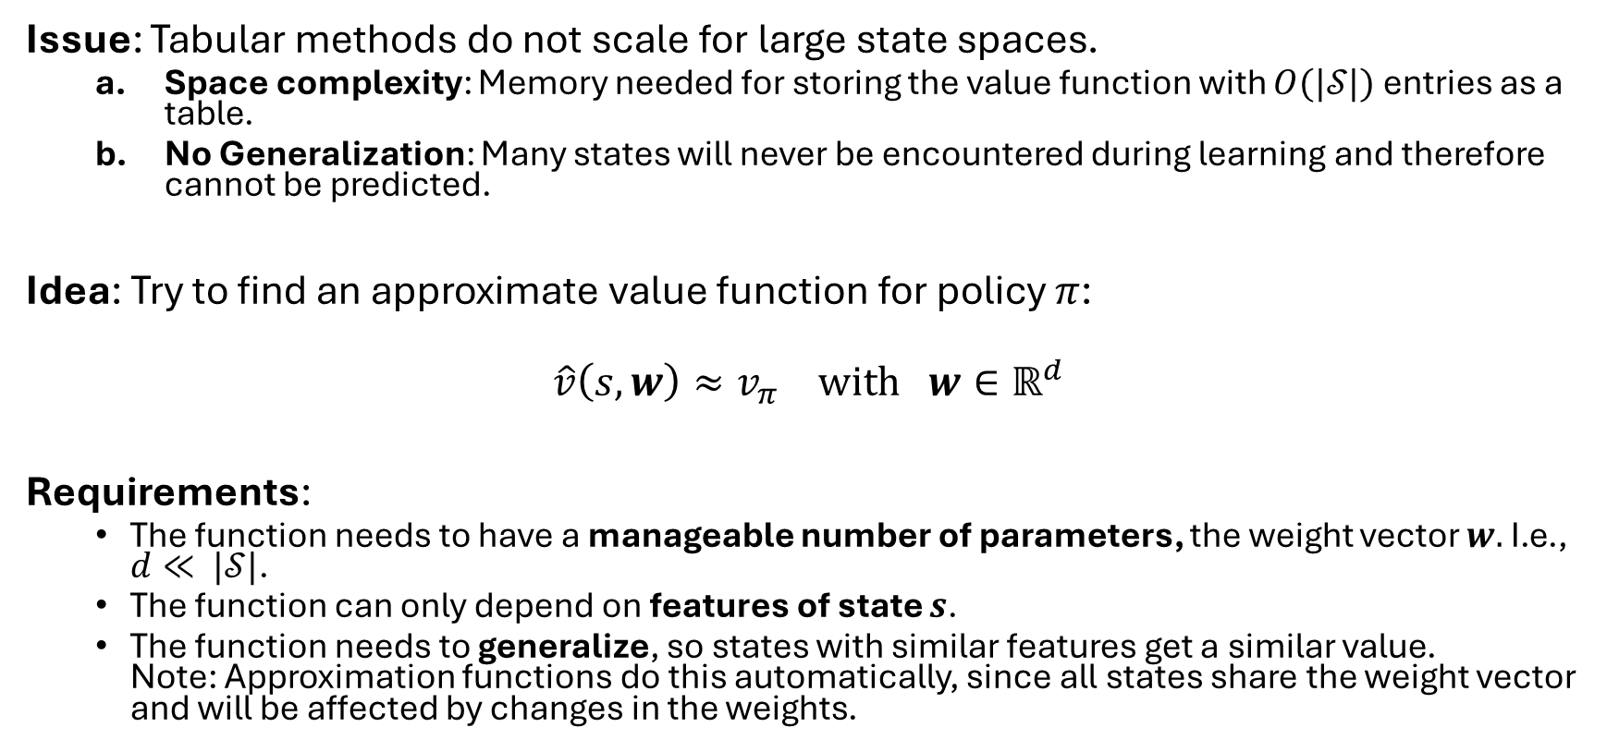
Motivation
Issue: Tabular methods do not scale for large state spaces.
Space complexity: Memory needed for storing the value function with $O(|𝒮|)$ entries as a table.
No Generalization: Many states will never be encountered during learning and therefore cannot be predicted.
Idea: Try to find an approximate value function for policy $π$:
$$\hat{v}\left(s,w\right)≈v_{π} \text{with} w∈ℝ^{d}$$
Requirements:
The function needs to have a manageable number of parameters, the weight vector $w.$I.e., $d≪ |𝒮|$.
The function can only depend on features of state $s$.
The function needs to generalize, so states with similar features get a similar value. Note: Approximation functions do this automatically, since all states share the weight vector and will be affected by changes in the weights.

Slide 6
Goals of Generalization in RL
In ML: Can we make predictions for new data? “Generalization in machine learning is a model's ability to accurately predict outcomes or perform tasks on new, unseen data, having learned patterns only from a training dataset.”
In RL we consider different forms of generalization:
How fast does the algorithm learn? Does it perform well in an environment after limited data is gathered? (= sample efficiency)
Can the algorithm adapt to changes in the environment? Does it generalize for new, but related environment? (~ transfer learning)

Slide 7
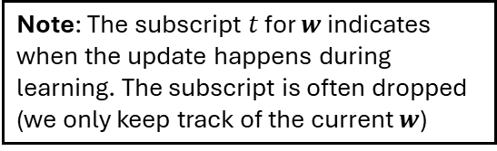
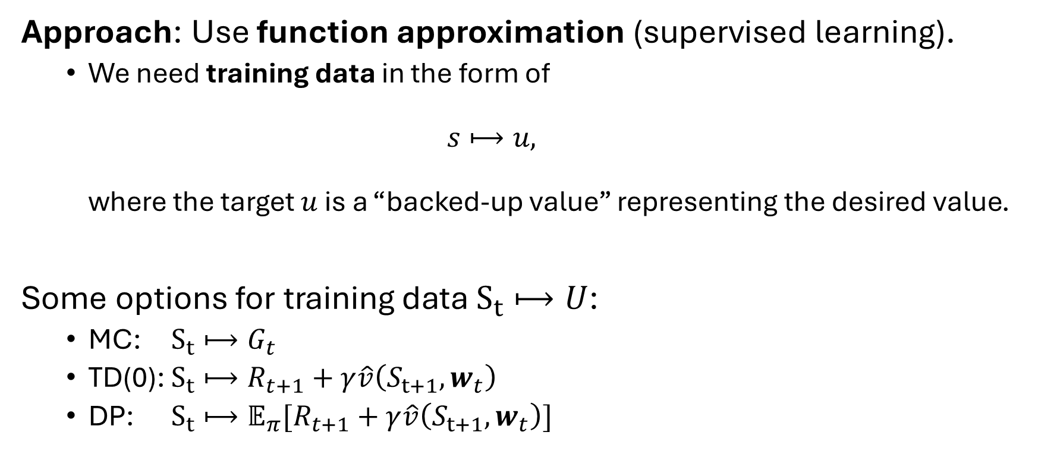
Prediction: Value Function Approximation
Approach: Use function approximation (supervised learning).
We need training data in the form of $s⟼u,$ where the target $u$ is a “backed-up value” representing the desired value.
Some options for training data $S_{t}⟼U$:
MC: $S_{t}⟼G_{t}$
TD(0): $S_{t}⟼R_{t+1}+γ\hat{v}\left(S_{t+1},w_{t}\right)$
DP: $S_{t}⟼𝔼_{π}[R_{t+1}+γ\hat{v}\left(S_{t+1},w_{t}\right)]$
Note: The subscript $t$ for $w$ indicates when the update happens during learning. The subscript is often dropped (we only keep track of the current $w$)

Slide 8
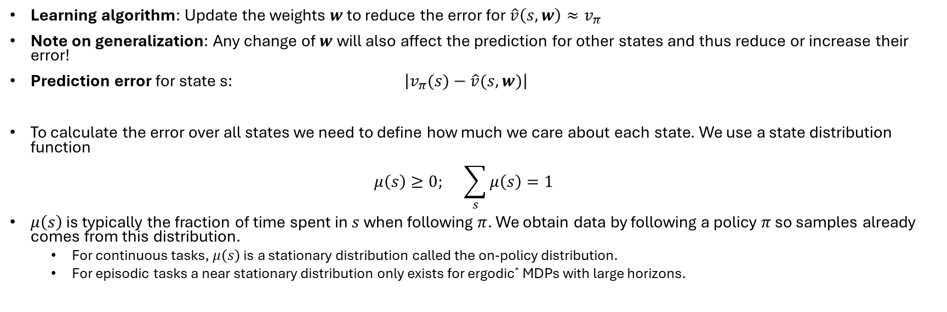
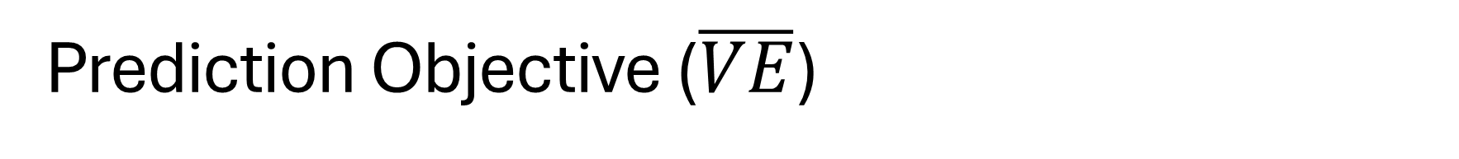

Prediction Objective ($\overline{VE}$)
Learning algorithm: Update the weights $w$ to reduce the error for $\hat{v}\left(s,w\right)≈v_{π}$
Note on generalization: Any change of $w$will also affect the prediction for other states and thus reduce or increase their error!
Prediction error for state s: $\left|v_{π}(s)−\hat{v}(s,w)\right|$
To calculate the error over all states we need to define how much we care about each state. We use a state distribution function $μ\left(s\right)≥0; \sum_{s}{μ\left(s\right)}=1$
$μ\left(s\right)$ is typically the fraction of time spent in $s$ when following $π$. We obtain data by following a policy $π$ so samples already comes from this distribution.
For continuous tasks, $μ\left(s\right)$ is a stationary distribution called the on-policy distribution.
For episodic tasks a near stationary distribution only exists for ergodic* MDPs with large horizons.
See Code
Definition: Mean square value error $$\overline{VE}≝\sum_{s∈𝒮 }{μ\left(s\right){\left[v_{π}−\hat{v}\left(s,w\right)\right]}^{2}}$$
Remember: Squared errors useful mathematical and statistical properties that make learning and optimization easier and more effective.
*Ergodic: The Markov process when following $π$ is irreducible (all states are reachable) and aperiodic (does not get stuck).

Slide 9
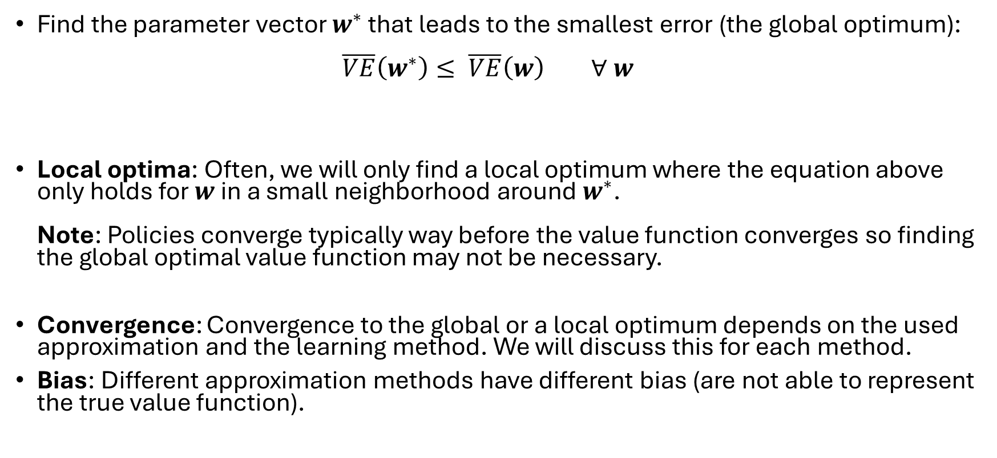
Learning Goal
Find the parameter vector $w^{∗}$ that leads to the smallest error (the global optimum): $\overline{VE}\left(w^{∗}\right)≤ \overline{VE}\left(w\right) ∀ w$
Local optima: Often, we will only find a local optimum where the equation above only holds for $w$in a small neighborhood around $w^{∗}$. Note: Policies converge typically way before the value function converges so finding the global optimal value function may not be necessary.
Convergence: Convergence to the global or a local optimum depends on the used approximation and the learning method. We will discuss this for each method.
Bias: Different approximation methods have different bias (are not able to represent the true value function).

Slide 10
Gradient Methods for Prediction

Slide 11
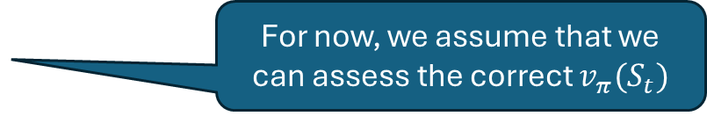
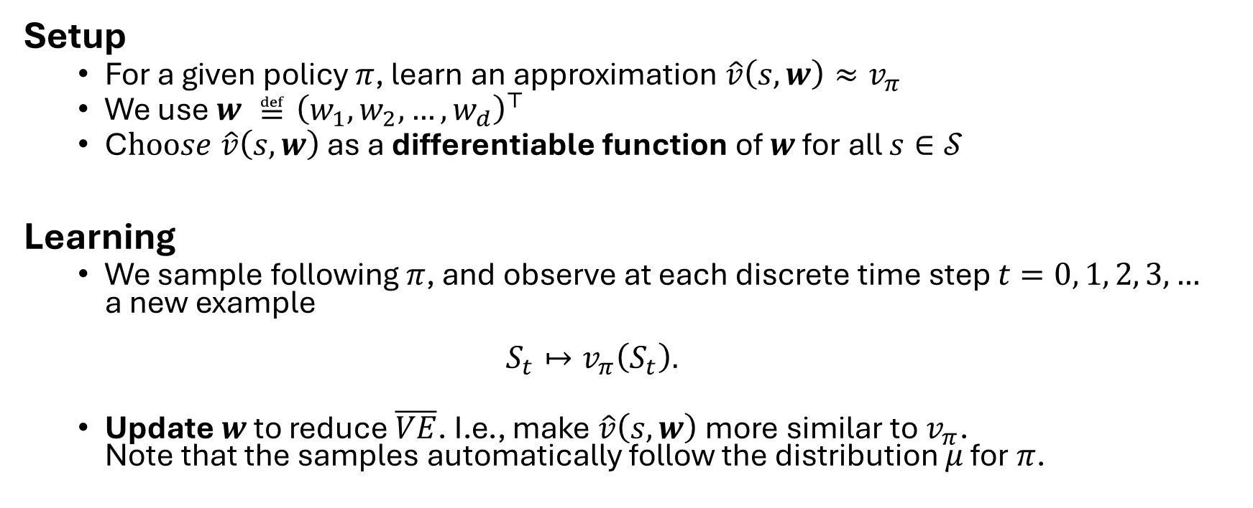
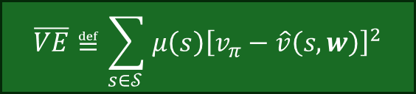
Gradient Learning Method
Setup
For a given policy $π$, learn an approximation $\hat{v}\left(s,w\right)≈v_{π}$
We use $w ≝{\left(w_{1},w_{2},…,w_{d}\right)}^{⊤}$
C$hoose \hat{v}\left(s,w\right)$ as a differentiable function of $w$ for all $s∈𝒮$
Learning
We sample following $π$, and observe at each discrete time step $t=0, 1, 2, 3, …$ a new example $S_{t}↦v_{π}\left(S_{t}\right).$
Update $w$ to reduce $\overline{VE}$. I.e., make $\hat{v}\left(s,w\right)$ more similar to $v_{π}$. Note that the samples automatically follow the distribution $μ$ for $π$.
For now, we assume that we can assess the correct $v_{π}(S_{t})$
$$\overline{VE}≝\sum_{s∈𝒮 }{μ\left(s\right){\left[v_{π}−\hat{v}\left(s,w\right)\right]}^{2}}$$

Slide 12
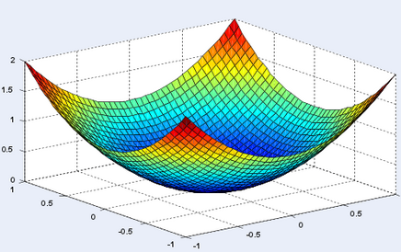

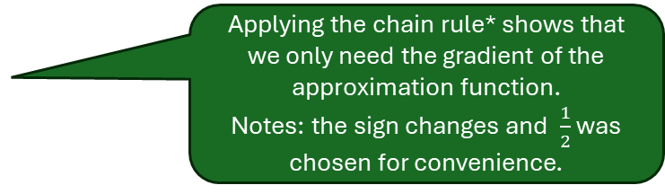




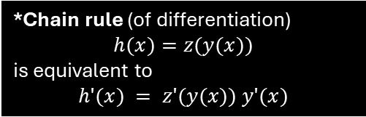
SGD: Stochastic-Gradient Descend
Minimize $\overline{VE}≝\sum_{s∈𝒮 }{μ\left(s\right){\left[v_{π}−\hat{v}\left(s,w\right)\right]}^{2}}$ by moving $w$ in the direction $∇\overline{VE}$.
Definition of the gradient: $∇f\left(w\right)={\left(\frac{∂f\left(w\right)}{∂w_{1}},\frac{∂f\left(w\right)}{∂w_{2}},…,\frac{∂f\left(w\right)}{∂w_{d}}\right)}^{⊤}$
Update for one observation: $S_{t}$ $↦v_{π}\left(S_{t}\right)$
$$w_{t+1}=w_{t}−\frac{1}{2}α ∇{\left[v_{π}\left(S_{t}\right)−\hat{v}\left(S_{t},w_{t}\right)\right]}^{2}$$ $= w_{t}+α\left[v_{π}\left(S_{t}\right)−\hat{v}\left(S_{t},w_{t}\right)\right]$ $∇\hat{v}\left(S_{t},w_{t}\right)$
Important property of SGD: Only depends on the gradient of the loss function. Does not need the gradient of the unknown value function!
Stochastic: because update is on a single (randomly chosen) example for $S_{t}$. This is why there is no sum in the update.
Step size $α$: Since we update towards a sampled value and updates of $w$ for one state will change the value for other states as well, we use many small updates (small value of $α).$
$$f$$
$$∇f\left(w\right)$$
$$w_{1}$$
$$w_{2}$$
Applying the chain rule* shows that we only need the gradient of the approximation function. Notes: the sign changes and $\frac{1}{2}$ was chosen for convenience.
*Chain rule (of differentiation)
$$h(x)=z(y(x))$$
is equivalent to
$$h′(x) = z′(y(x)) y′(x)$$

Slide 13
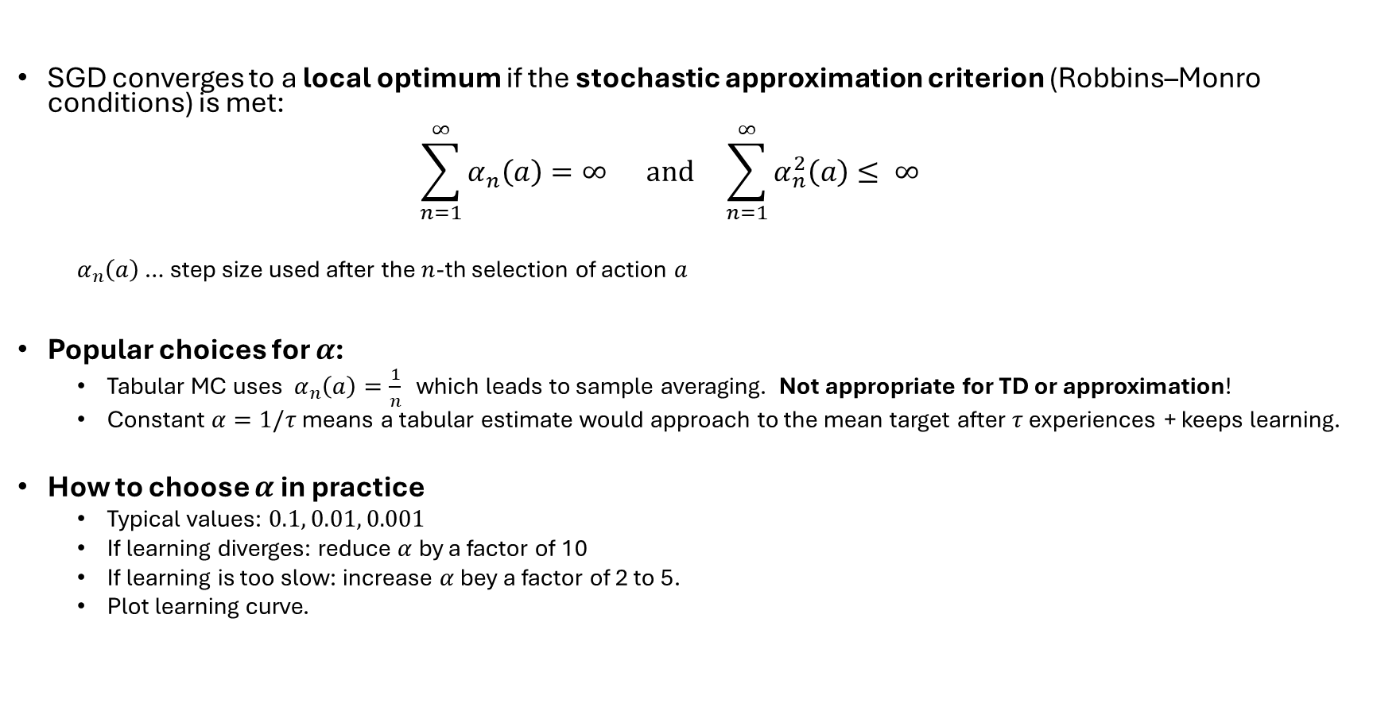
Step Size for SGD
SGD converges to a local optimum if the stochastic approximation criterion (Robbins–Monro conditions) is met: $\sum_{n=1}^{∞}{α_{n}\left(a\right)=∞ \text{and} }\sum_{n=1}^{∞}{α_{n}^{2}\left(a\right)≤ ∞ }$
$α_{n}\left(a\right)$ … step size used after the $n$-th selection of action $a$
Popular choices for $α$:
Tabular MC uses ${ α}_{n}\left(a\right)=\frac{1}{n}$ which leads to sample averaging. Not appropriate for TD or approximation!
Constant $α=1/τ$ means a tabular estimate would approach to the mean target after $τ$ experiences + keeps learning.
How to choose $α$ in practice
Typical values: $0.1, 0.01, 0.001$
If learning diverges: reduce $α$ by a factor of 10
If learning is too slow: increase $α$ bey a factor of 2 to 5.
Plot learning curve.
A constant does not satisfy the stochastic approx. criterion.

Slide 14
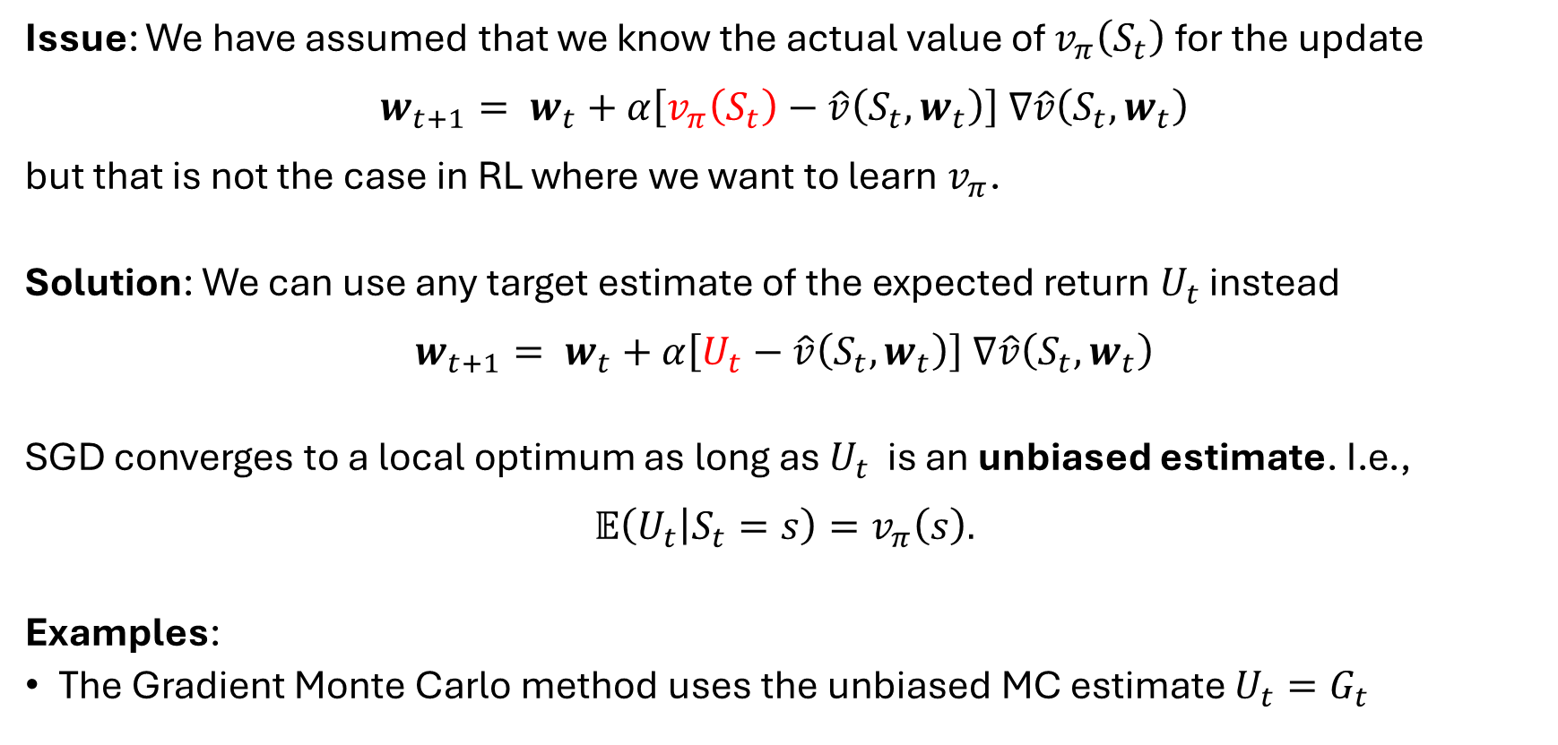
Using a Target Estimate for SGD
Issue: We have assumed that we know the actual value of $v_{π}\left(S_{t}\right)$ for the update $$w_{t+1}= w_{t}+α\left[v_{π}\left(S_{t}\right)−\hat{v}\left(S_{t},w_{t}\right)\right] ∇\hat{v}\left(S_{t},w_{t}\right)$$ but that is not the case in RL where we want to learn $v_{π}$.
Solution: We can use any target estimate of the expected return $U_{t}$ instead $$w_{t+1}= w_{t}+α\left[U_{t}−\hat{v}\left(S_{t},w_{t}\right)\right] ∇\hat{v}\left(S_{t},w_{t}\right)$$
SGD converges to a local optimum as long as $U_{t}$ is an unbiased estimate. I.e., $$𝔼\left(U_{t} | S_{t}=s\right)=v_{π}\left(s\right).$$
Examples:
The Gradient Monte Carlo method uses the unbiased MC estimate $U_{t}=G_{t}$

Slide 15
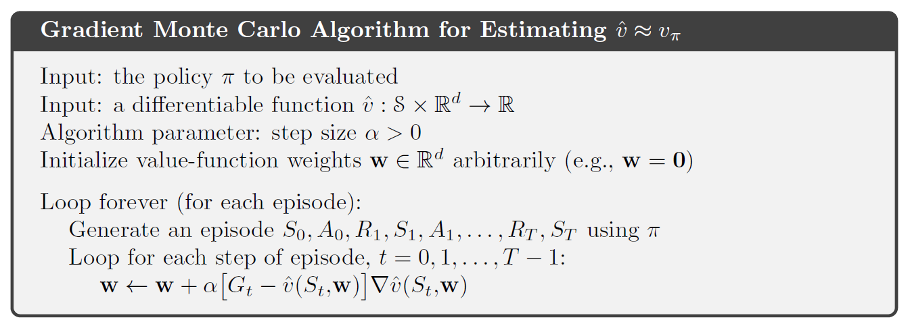

Gradient Monte Carlo Algorithm
Remember from MC: $$G_{t}=\sum_{k=0}^{T}{γ^{k}R_{t+k+1}}$$

Slide 16
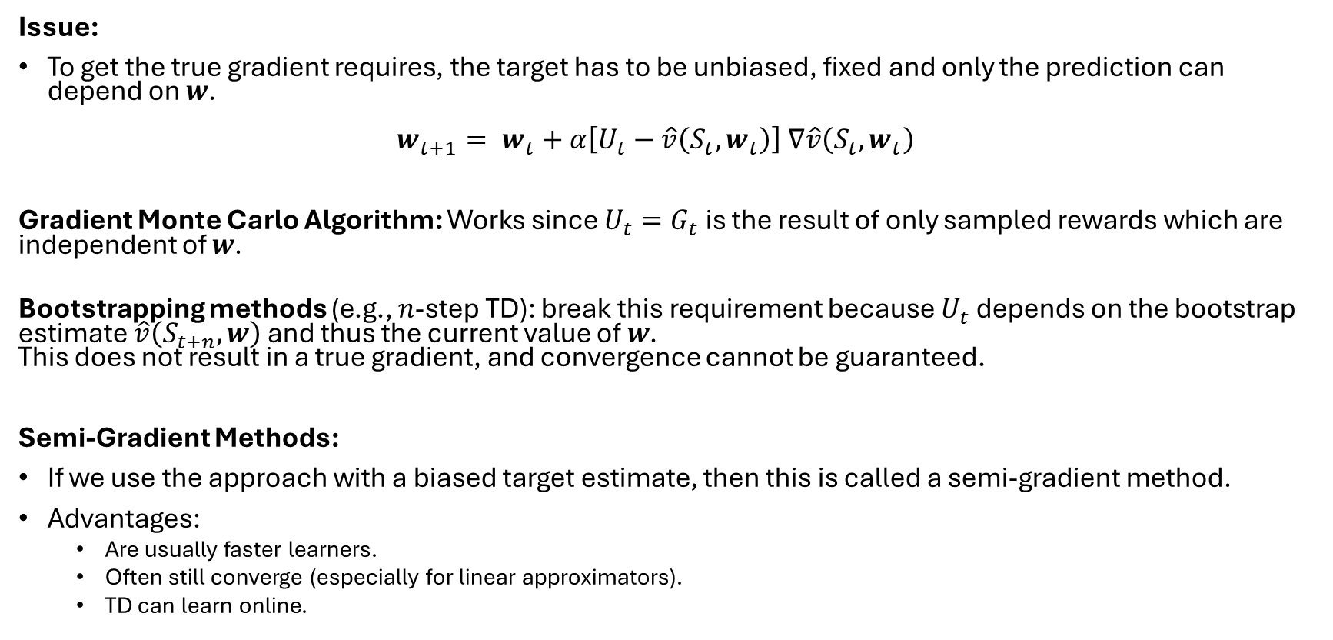
Bootstrapping and Semi-Gradient Methods
Issue:
To get the true gradient requires, the target has to be unbiased, fixed and only the prediction can depend on $w$. $w_{t+1}= w_{t}+α\left[U_{t}−\hat{v}\left(S_{t},w_{t}\right)\right] ∇\hat{v}\left(S_{t},w_{t}\right)$
Gradient Monte Carlo Algorithm: Works since $U_{t}=G_{t}$ is the result of only sampled rewards which are independent of $w$.
Bootstrapping methods (e.g., $n$-step TD): break this requirement because $U_{t}$ depends on the bootstrap estimate $\hat{v}\left(S_{t+n},w\right)$ and thus the current value of $w$. This does not result in a true gradient, and convergence cannot be guaranteed.
Semi-Gradient Methods:
If we use the approach with a biased target estimate, then this is called a semi-gradient method.
Advantages:
Are usually faster learners.
Often still converge (especially for linear approximators).
TD can learn online.

Slide 17
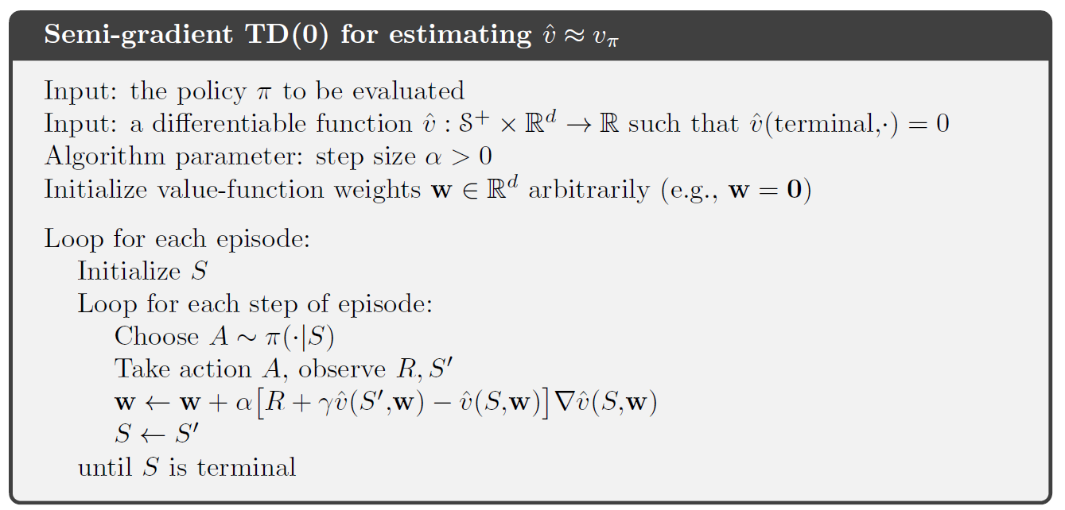
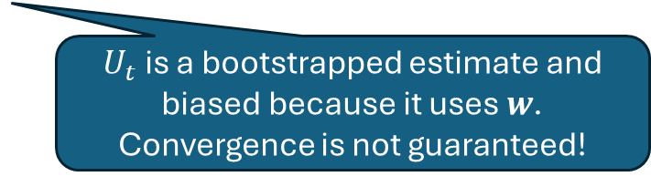
Semi-gradient TD(0)
$U_{t}$ is a bootstrapped estimate and biased because it uses $w$. Convergence is not guaranteed!

Slide 18

Linear Approximation Methods
The approximation function $\hat{v}\left(s,w\right)$

Slide 19
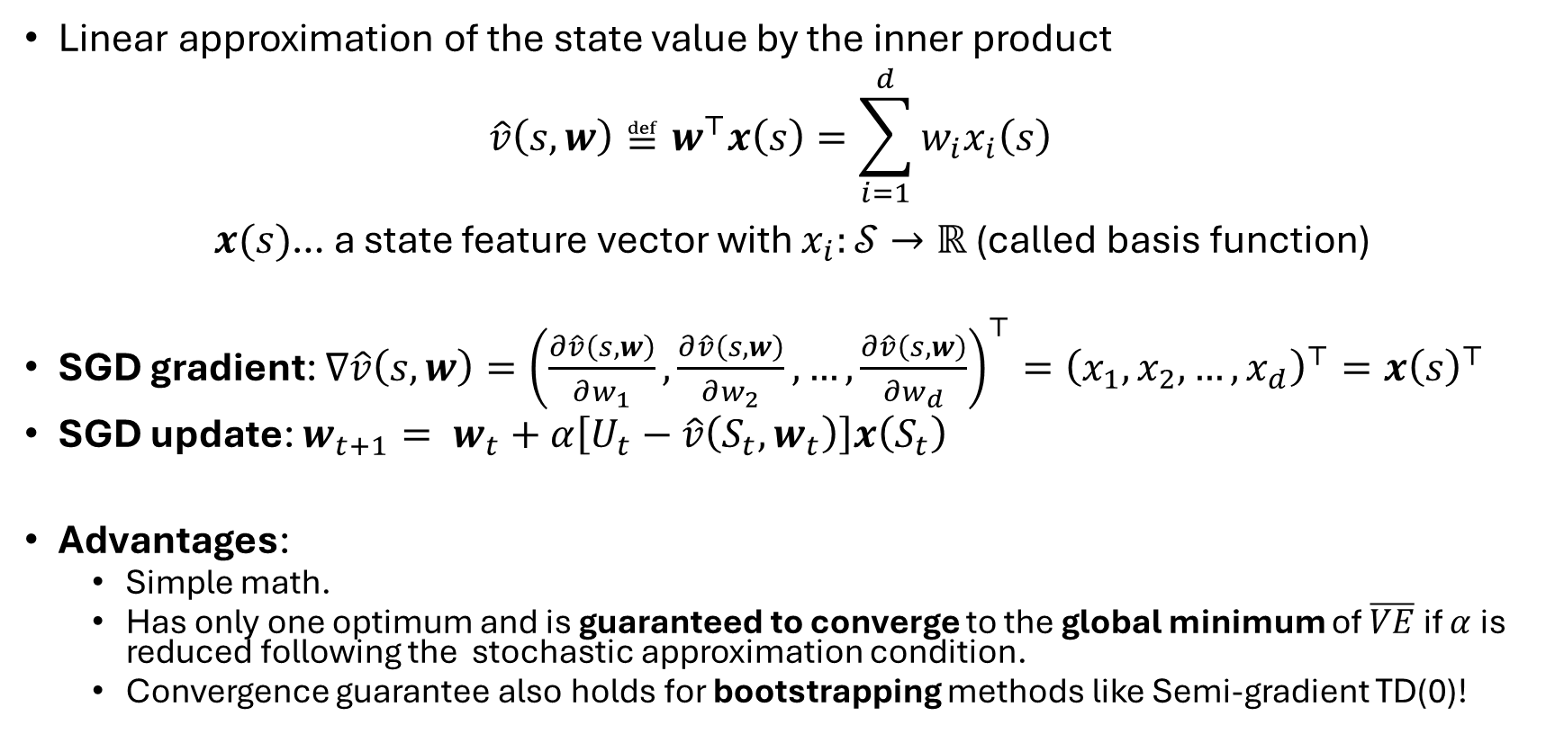
Linear Methods
Linear approximation of the state value by the inner product $\hat{v}\left(s,w\right)≝w^{⊤}x\left(s\right)=\sum_{i=1}^{d}{w_{i}x_{i}\left(s\right)}$ $x(s)$… a state feature vector with $x_{i}:𝒮→ℝ$ (called basis function)
SGD gradient: $∇\hat{v}\left(s,w\right)={\left(\frac{∂\hat{v}\left(s,w\right)}{∂w_{1}},\frac{∂\hat{v}\left(s,w\right)}{∂w_{2}},…,\frac{∂\hat{v}\left(s,w\right)}{∂w_{d}}\right)}^{⊤}={\left(x_{1}, x_{2},…,x_{d}\right)}^{⊤}=x{\left(s\right)}^{⊤}$
SGD update: $w_{t+1}= w_{t}+α\left[U_{t}−\hat{v}\left(S_{t},w_{t}\right)\right]x\left(S_{t}\right)$
Advantages:
Simple math.
Has only one optimum and is guaranteed to converge to the global minimum of $\overline{VE}$if $α$ is reduced following the stochastic approximation condition.
Convergence guarantee also holds for bootstrapping methods like Semi-gradient TD(0)!
These are extremely strong guarantees!

Slide 20
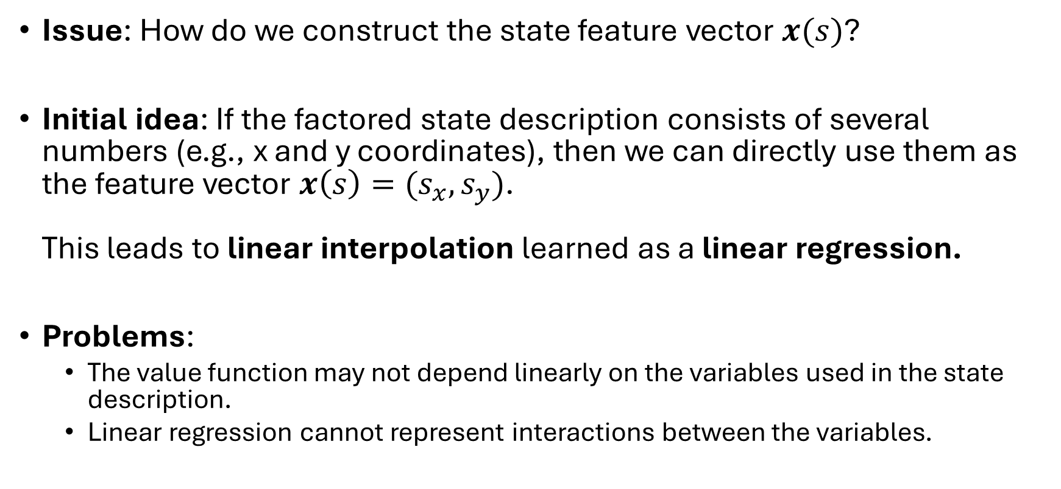
Feature Vector
Issue: How do we construct the state feature vector $x(s)$?
Initial idea: If the factored state description consists of several numbers (e.g., x and y coordinates), then we can directly use them as the feature vector $x\left(s\right)=(s_{x}, s_{y})$. This leads to linear interpolation learned as a linear regression.
Problems:
The value function may not depend linearly on the variables used in the state description.
Linear regression cannot represent interactions between the variables.

Slide 21
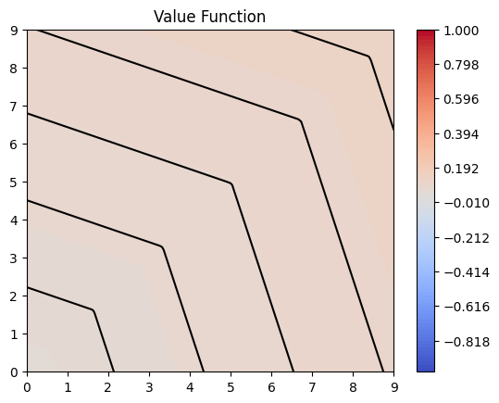
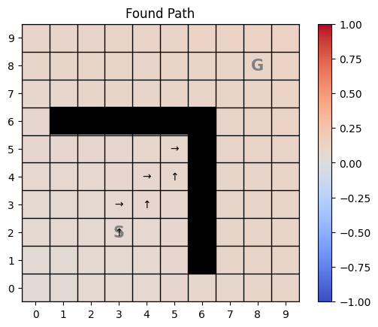
Example: L-Maze with Linear Features
Semi-gradient Sarsa (see Control later) with linear features cannot solve the L-Maze

Slide 22
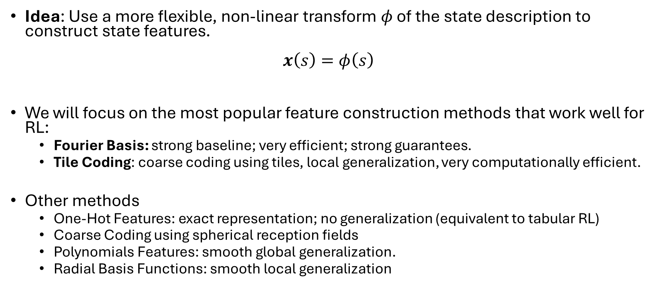
Feature Construction
Idea: Use a more flexible, non-linear transform $φ$ of the state description to construct state features. $x\left(s\right)=φ\left(s\right)$
We will focus on the most popular feature construction methods that work well for RL:
Fourier Basis: strong baseline; very efficient; strong guarantees.
Tile Coding: coarse coding using tiles, local generalization, very computationally efficient.
Other methods
One-Hot Features: exact representation; no generalization (equivalent to tabular RL)
Coarse Coding using spherical reception fields
Polynomials Features: smooth global generalization.
Radial Basis Functions: smooth local generalization

Slide 23
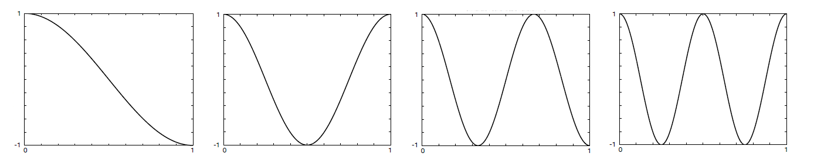




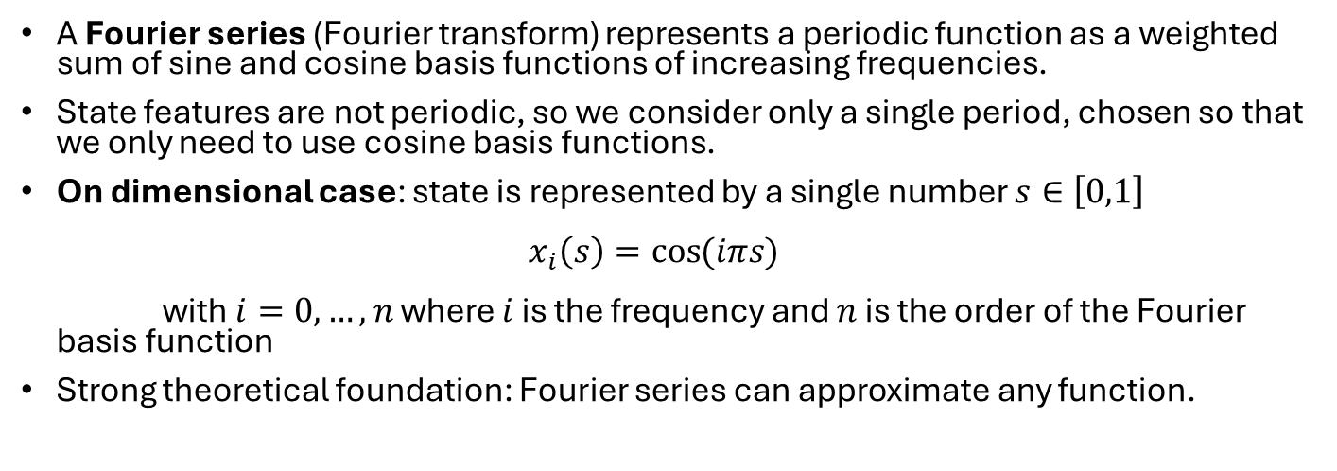




Fourier Basis
A Fourier series (Fourier transform) represents a periodic function as a weighted sum of sine and cosine basis functions of increasing frequencies.
State features are not periodic, so we consider only a single period, chosen so that we only need to use cosine basis functions.
On dimensional case: state is represented by a single number $s∈\left[0,1\right]$ $x_{i}\left(s\right)=\cos{(iπs)}$ with$i=0,…,n$ where $i$ is the frequency and $n$ is the order of the Fourier basis function
Strong theoretical foundation: Fourier series can approximate any function.
Example: Fourier Transform
$π$ is 180° in radians
Source: Wikipedia
Example: Order-4 Fourier cosine basis creates 4 features plus the intercept for $i=0$for linear approximation.
$$i=1$$
$$i=2$$
$$i=3$$
$$i=4$$
$$x_{1}\left(s\right)$$
$$s$$
$$x\left(.2\right)=(1, .9,.65, .35,. 1)$$

Slide 24
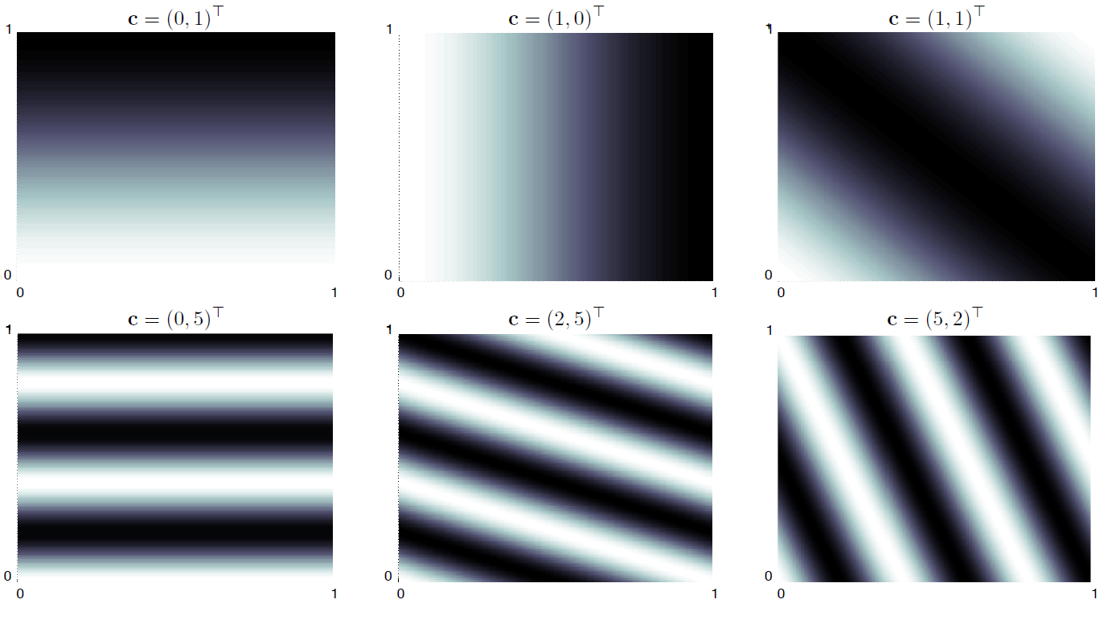
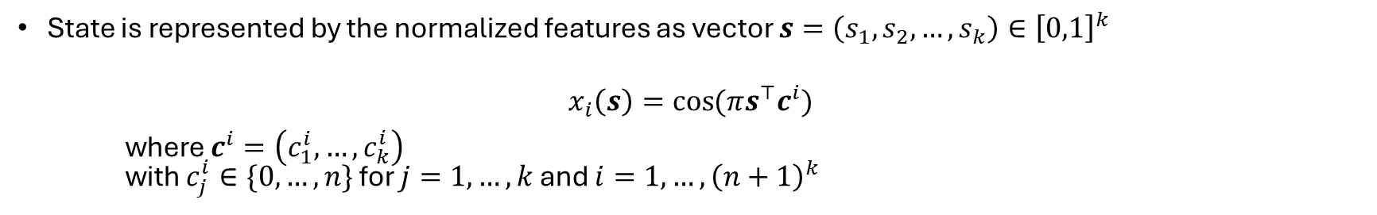
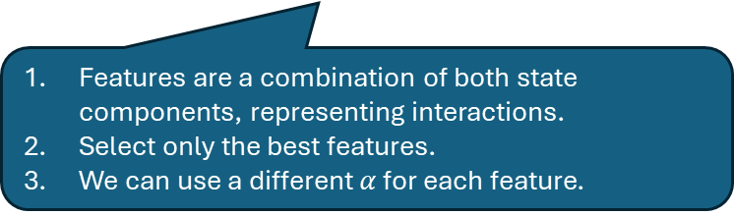
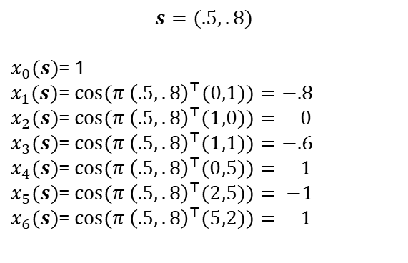
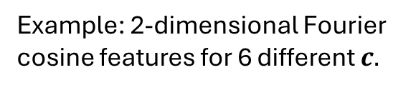
Multi-dimensional Fourier Basis
State is represented by the normalized features as vector $s=\left(s_{1},s_{2},…,s_{k}\right)∈{\left[0,1\right]}^{k}$
$$x_{i}\left(s\right)=\cos{(πs^{⊤}c^{i})}$$
where $c^{i}=\left(c_{1}^{i},…,c_{k}^{i}\right)$ with $c_{j}^{i}∈\{0,…,n\}$ for $j=1,…,k$ and $i=1,…,{\left(n+1\right)}^{k}$
>0 is the frequency
0 means it is constant in that dimension
Example: 2-dimensional Fourier cosine features for 6 different $c.$
.8
$$s=(.5,.8)$$
$x_{0}(s)$= 1
$x_{1}(s)$= $\cos{(π{ \left(.5,.8\right)}^{⊤}(0,1))}=−.8$
$x_{2}(s)$= $\cos{(π{ \left(.5,.8\right)}^{⊤}(1,0))}= 0$
$x_{3}(s)$= $\cos{(π{ \left(.5,.8\right)}^{⊤}(1,1))}=−.6$
$x_{4}(s)$= $\cos{(π{ \left(.5,.8\right)}^{⊤}(0,5))}= 1$
$x_{5}(s)$= $\cos{(π{ \left(.5,.8\right)}^{⊤}(2,5))}= −1$ $x_{6}(s)$= $\cos{(π{ \left(.5,.8\right)}^{⊤}(5,2))}= 1$
.5
Features are a combination of both state components, representing interactions.
Select only the best features.
We can use a different $α$ for each feature.

Slide 25
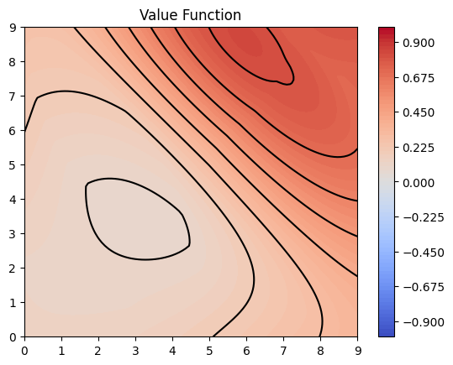
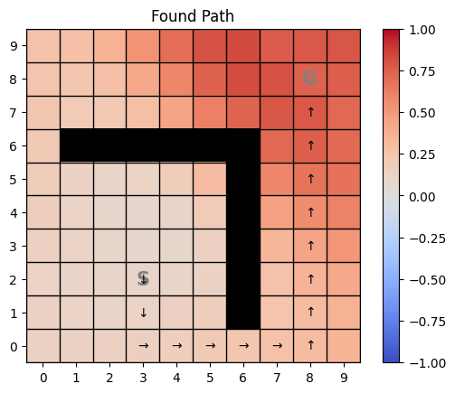
Example: L-Maze with Order-2 Fourier Features
Semi-gradient Sarsa with order-2 Fourier Features can solve the L-Maze

Slide 26
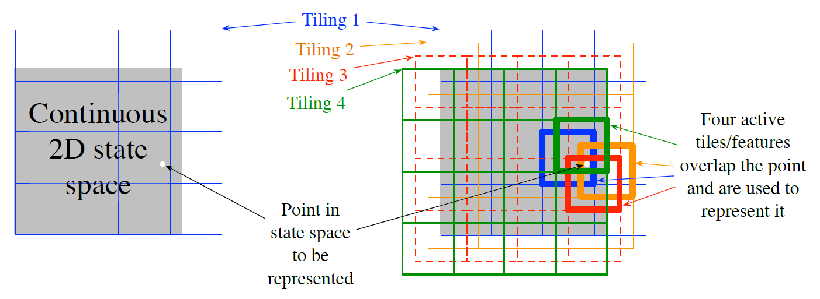
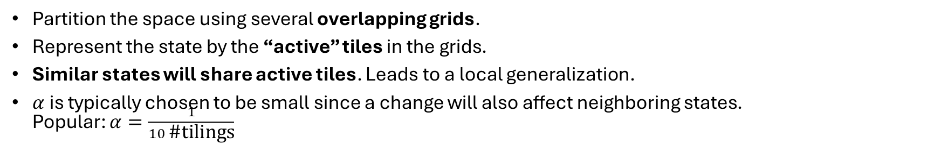

Tile Coding
Partition the space using several overlapping grids.
Represent the state by the “active” tiles in the grids.
Similar states will share active tiles. Leads to a local generalization.
$α$ is typically chosen to be small since a change will also affect neighboring states. Popular: $α=\frac{1}{10 \text{\#}\text{tilings}}$
Example:
State has two components.
4 $4×4$ overlapping tilings give 64 squares.
State features: 60 0s and only the four active tiles have a 1
0
0
0
0
0
0
0
0
0
0
1
0
0
0
0
0
Issue: High-dimensional state spaces lead to too long sparse feature vectors. Idea: Use index hash tables with limited capacity to focus on more frequently encountered states.

Slide 27
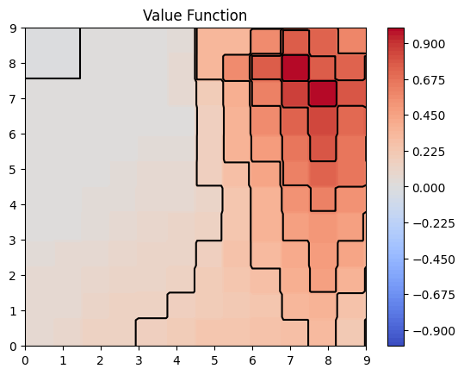
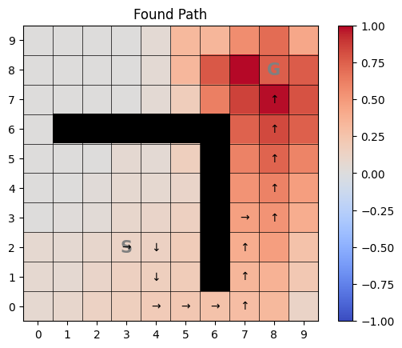
Example: L-Maze with Tile Coding
Semi-gradient Sarsa with Tile Coding (4 tilings, 4 tiles per dimension) can solve the L-Maze
Example tiles

Slide 28
Partially Observable Environments
Observations may be incomplete or noisy.
Standard model: POMDP with belief states
A key feature is that it learns hidden states depending on the history of actions and observations.
Impractical due to the size of the belief state space.
Practical approach: RL
Build a compressed representation with features from current observations and the observation history
Use a (non) linear approximator on those features
Learn a value function or policy from the compressed representation.
Example: Maze solver where the x and y coordinates are noisy. Using the change in coordinates for the last few steps helps.

Slide 29
Non-Linear Function Approximation
Artificial Neural Networks

Slide 30




Approximation with ANNs
$$S$$
Uses simple networks with a single hidden layer or deep architectures to approximate the value function.
Methods:
Recurrent networks
Convolution networks
Transformers
Regularization, dropout, weight sharing
Deep residual learning…
Networks are trained like linear models using SGD. For deep networks this uses backpropagation.
ANNs are non-linear universal approximators so they can learn any value function.
Issues due to nonlinearity:
Instability
Convergence is not guaranteed.
More in Deep Reinforcement Learning (DRL).
$$A$$
$$s$$
$$Q(s, a)$$
Q-network

Slide 31
On-Policy Control with Approximation
Semi-Gradient Sarsa

Slide 32
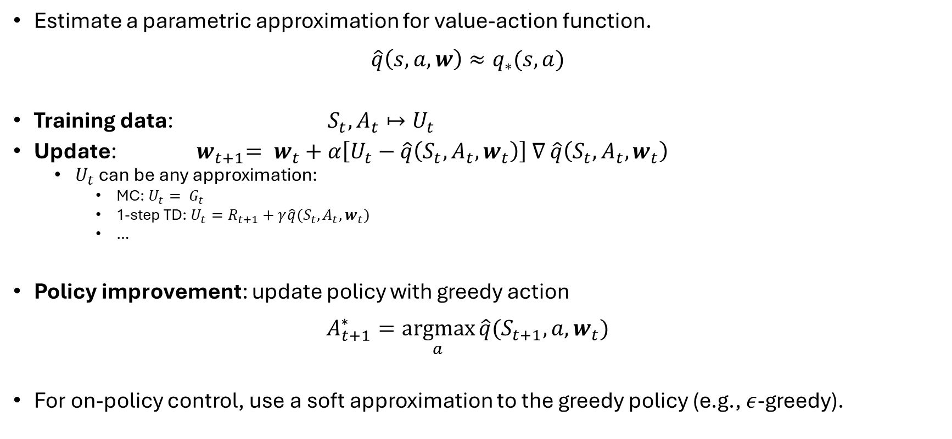
Control Problem
Estimate a parametric approximation for value-action function. $\hat{q}\left(s,a,w\right)≈q_{∗}(s,a)$
Training data: ${ S}_{t},A_{t}↦U_{t}$
Update: ${ w}_{t+1}= w_{t}+α\left[U_{t}−\hat{q}\left(S_{t},A_{t}, w_{t}\right)\right]$ $∇$ $\hat{q}\left(S_{t},A_{t},w_{t}\right)$
$U_{t}$ can be any approximation:
MC: $U_{t}= G_{t}$
1-step TD: $U_{t}=R_{t+1}+γ\hat{q}(S_{t}, A_{t},w_{t})$
…
Policy improvement: update policy with greedy action $A_{t+1}^{∗}=\underset{a}{argmax}{\hat{q}(S_{t+1},a, w_{t})}$
For on-policy control, use a soft approximation to the greedy policy (e.g., $ε$-greedy).
We need state-action features!

Slide 33
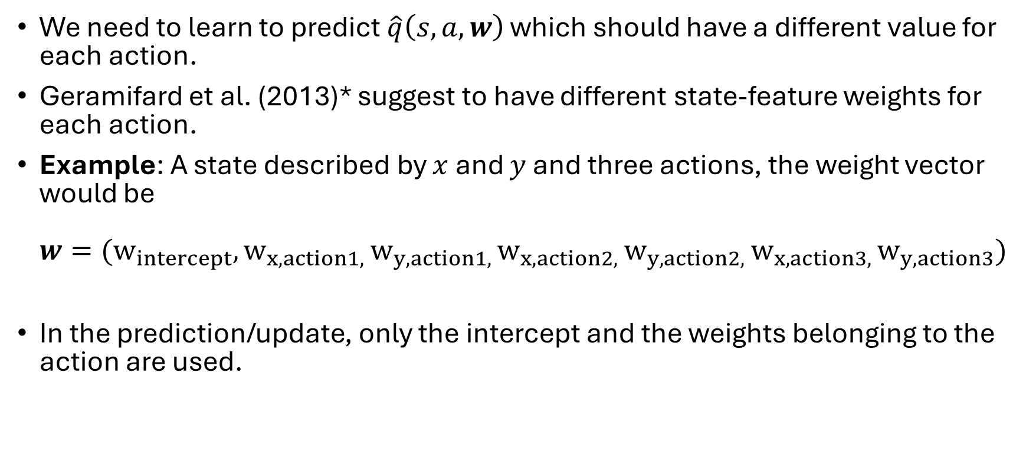
State-Action Features
We need to learn to predict $\hat{q}\left(s,a,w\right)$ which should have a different value for each action.
Geramifard et al. (2013)* suggest to have different state-feature weights for each action.
Example: A state described by $x$ and $y$ and three actions, the weight vector would be $w=(w_{intercept}, w_{x,action1, }w_{y,action1, }w_{x,action2, }w_{y,action2, }w_{x,action3, }w_{y,action3})$
In the prediction/update, only the intercept and the weights belonging to the action are used.
*Alborz Geramifard, Stefanie Tellex, and Thomas J. Walsh. A Tutorial on Linear Function Approximators for Dynamic Programming and Reinforcement Learning, Foundations and Trends in Machine Learning, Vol. 6, No. 4 (2013) 375–454

Slide 34
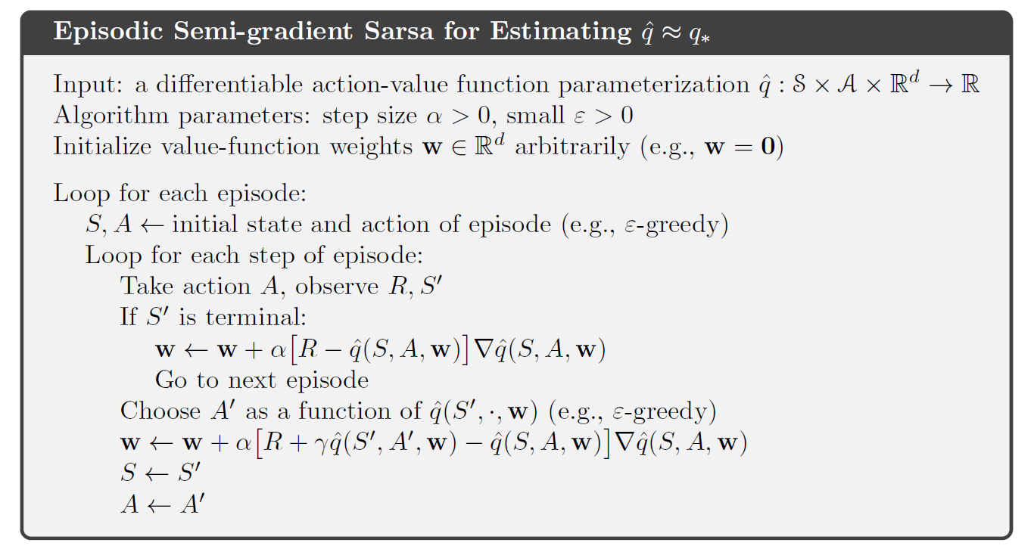
Episodic Semi-gradient Sarsa

Slide 35
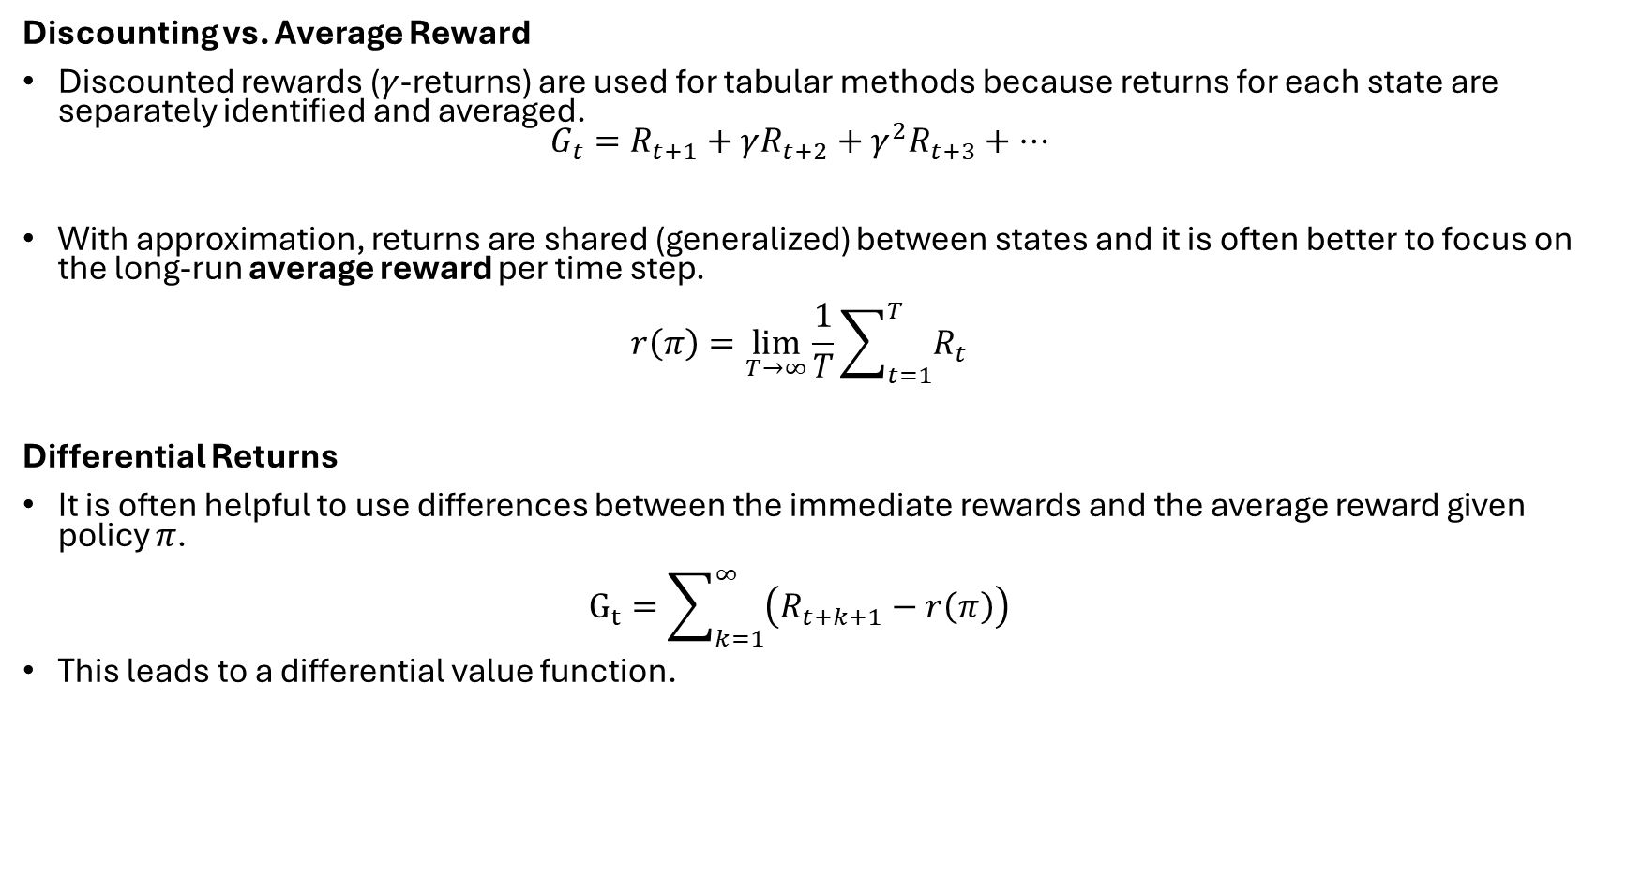
Considerations for Continuing Tasks
Discounting vs. Average Reward
Discounted rewards ($γ$-returns) are used for tabular methods because returns for each state are separately identified and averaged. $G_{t}=R_{t+1}+γR_{t+2}+γ^{2}R_{t+3}+…$
With approximation, returns are shared (generalized) between states and it is often better to focus on the long-run average reward per time step. $r\left(π\right)=\lim_{T→∞}{\frac{1}{T}\sum_{t=1}^{T}{R_{t}}}$
Differential Returns
It is often helpful to use differences between the immediate rewards and the average reward given policy $π$. $G_{t}=\sum_{k=1}^{∞}{\left(R_{t+k+1}−r\left(π\right)\right)}$
This leads to a differential value function.

Slide 36

What You should Know
Approximate the value function using parametrized functions: $\hat{v}\left(s,w\right)$ or $\hat{q}\left(s,a,w\right)$
For linear approximation, we need to create features that take non-linearities and the interaction of state components into account. Popular are:
Fourier basis features
Tile coding
Use SGD or semi-gradient descent to learn $w$ from samples by minimizing $\overline{VE}$. The samples already follow the on-policy distribution $μ\left(s\right).$
Issue: Convergence
Biased target estimates?
Linear vs. non-linear approximation.
choice of $α.$

