Slide 1



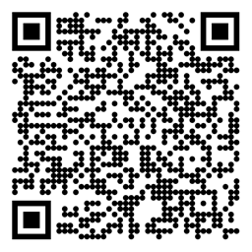

Reinforcement Learning Deep Reinforcement Learning Based on An Introduction to Deep Reinforcement Learning** + Sutton/Barto* Sections 9.7 and 15.7
Michael Hahsler, SMU
*Sutton and Barto, Reinforcement Learning: An Introduction, 2nd edition, MIT Press, Cambridge, MA, 2018
**Vincent François-Lavet, Peter Henderson, Riashat Islam, Marc G. Bellemare and Joelle Pineau (2018), “An Introduction to Deep Reinforcement Learning”, Foundations and Trends in Machine Learning: Vol. 11, No. 3-4. DOI: 10.1561/2200000071.

Slide 2
Topics of this Course
Introduction to reinforcement learning
Markov decision processes
Part I: Tabular Methods
Dynamic programming
Monte Carlo methods
Temporal-difference learning
Multi-step bootstrapping
Planning and learning with tabular methods
Part II: Approximate Solution Methods
Prediction and Control using Approximation
Eligibility Traces
Policy Gradient Methods
Part III: Looking Deeper
Deep Reinforcement Learning
Partial Observability
Reward Engineering
Current Applications

Slide 3
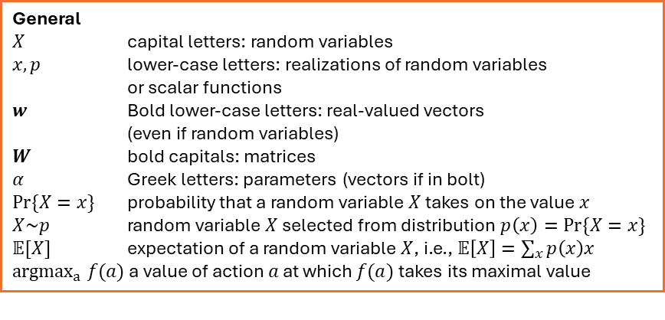
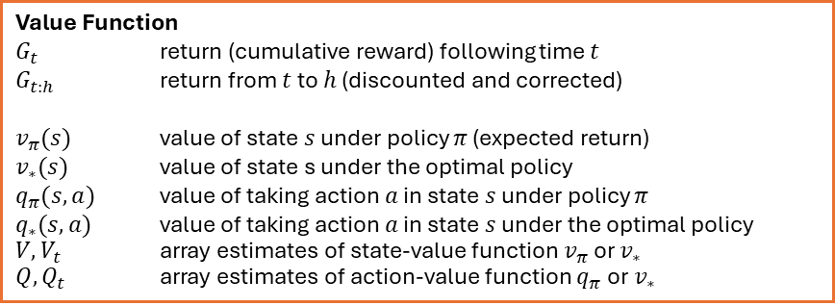
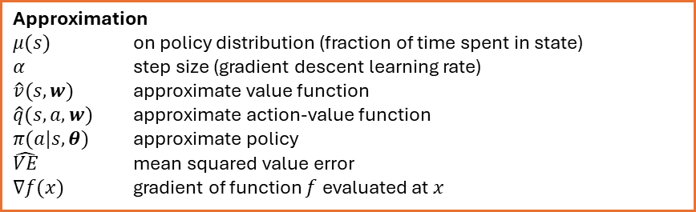
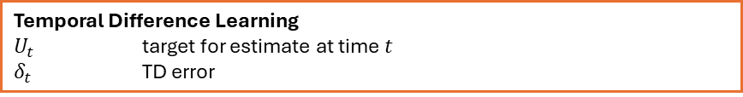
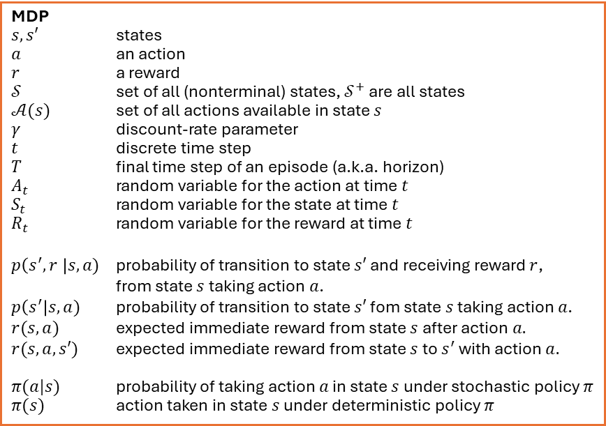
Summary of Notation*
General
$X$ capital letters: random variables $x, p$ lower-case letters: realizations of random variables or scalar functions
$w$ Bold lower-case letters: real-valued vectors (even if random variables)
$W$ bold capitals: matrices
$α$ Greek letters: parameters (vectors if in bolt)
$Pr⁡\{X=x\}$ probability that a random variable $X$ takes on the value $x$
$X\sim p$ random variable $X$ selected from distribution $p\left(x\right)=Pr⁡\{X=x\}$
$𝔼[X]$ expectation of a random variable $X$, i.e., $𝔼\left[X\right]=\sum_{x}{p\left(x\right)x}$
${argmax}_{a} f(a)$ a value of action $a$ at which $f(a)$ takes its maximal value
MDP
$s, s′$ states
$a$ an action
$r$ a reward
$𝒮$ set of all (nonterminal) states, $𝒮^{+}$ are all states
$𝒜(s)$ set of all actions available in state $s$
$γ$ discount-rate parameter
$t$ discrete time step
$T$ final time step of an episode (a.k.a. horizon)
$A_{t}$ random variable for the action at time $t$
$S_{t}$ random variable for the state at time $t$
$R_{t}$ random variable for the reward at time $t$
$p\left(s^{′},r \right|s, a)$ probability of transition to state $s′$ and receiving reward $r$, from state $s$ taking action $a$.
$p\left(s^{′}\right|s, a)$ probability of transition to state $s′$ fom state $s$ taking action $a$.
$r(s,a)$ expected immediate reward from state $s$ after action $a.$
$r(s,a,s′)$ expected immediate reward from state $s$ to $s^{′}$ with action $a.$
$π(a|s)$ probability of taking action $a$ in state $s$ under stochastic policy $π$
$π(s)$ action taken in state $s$ under deterministic policy $π$
Value Function
$G_{t}$ return (cumulative reward) following time $t$
$G_{t:h}$ return from $t$ to $h$ (discounted and corrected)
$v_{π}(s)$ value of state $s$ under policy $π$ (expected return)
$v_{∗}(s)$ value of state s under the optimal policy
$q_{π}(s,a)$ value of taking action $a$ in state $s$ under policy $π$
$q_{∗}(s,a)$ value of taking action $a$ in state $s$ under the optimal policy
$V, V_{t}$ array estimates of state-value function $v_{π}$or $v_{∗}$
$Q,Q_{t}$ array estimates of action-value function $q_{π}$or $v_{∗}$
Approximation
$μ(s)$ on policy distribution (fraction of time spent in state)
$α$ step size (gradient descent learning rate)
$\hat{v}(s, w)$ approximate value function $\hat{q}(s, a, w)$ approximate action-value function $π(a|s,θ)$ approximate policy
$\hat{VE}$ mean squared value error
$∇f(x)$ gradient of function $f$ evaluated at $x$
Temporal Difference Learning
$U_{t}$ target for estimate at time$t$
$δ_{t}$ TD error
*Some authors use a slightly different notation.

Slide 4
From Tabular RL to Deep RL
Tabular Methods
Table
Q-learning, Sarsa
With sufficient exploration, appropriate learning rates.
Table size for big state/action spaces.
Linear Functions Approximation
Linear combination of basis functions
Stochastic Gradient Descent (SGD) used in Sarsa
Can converge to a good approximation of the optimal value function or policy.
Performance depends on choice of basis functions.
Deep RL (DRL)
Deep ANN
Stochastic Gradient Descent (SGD) used in DQN and Actor-Critic methods.
Non-linearity makes convergence challenging.
Converges to local optima
Instability
Hyperparameter sensitivity
Representation (value function or policy)
Methods
Convergence
+ more powerful approximation for high-dimensional and continuous state and action spaces
+ scales to large state/action spaces
+ generalizes over states
Limitations

Slide 5
Disclaimer: Convergence
So far, we have had strong convergence guarantees:
Tabular RL has the contraction mapping guarantee (Bellman Operator): guaranteed convergence to the optimal value function (a fixed point). The policy improvement theorem shows that the policy improves in every step.
TD/Q-learning converges with sufficient exploration and diminishing learning rates.
Linear approximation: Mean squared value error creates a convex optimization problem. On-policy learning converges to the global optimum. But off-Policy convergence is not guaranteed: Off-policy + bootstrapping + function approximation = deadly triad
Non-linear approximation (DRL) breaks most guarantees in RL!
Loss of contraction mapping due to a non-linear projection. A fixed point may not exist or be reachable.
Monotonic policy improvement is lost: Policy can get worse.
Stochastic approximation guarantees break: Targets depend on parameters (bootstrapping), and gradients are biased.

Slide 6
Value-based DRL Methods
Use ANNs to represent a parameterized value function that is updated via gradient descent.

Slide 7
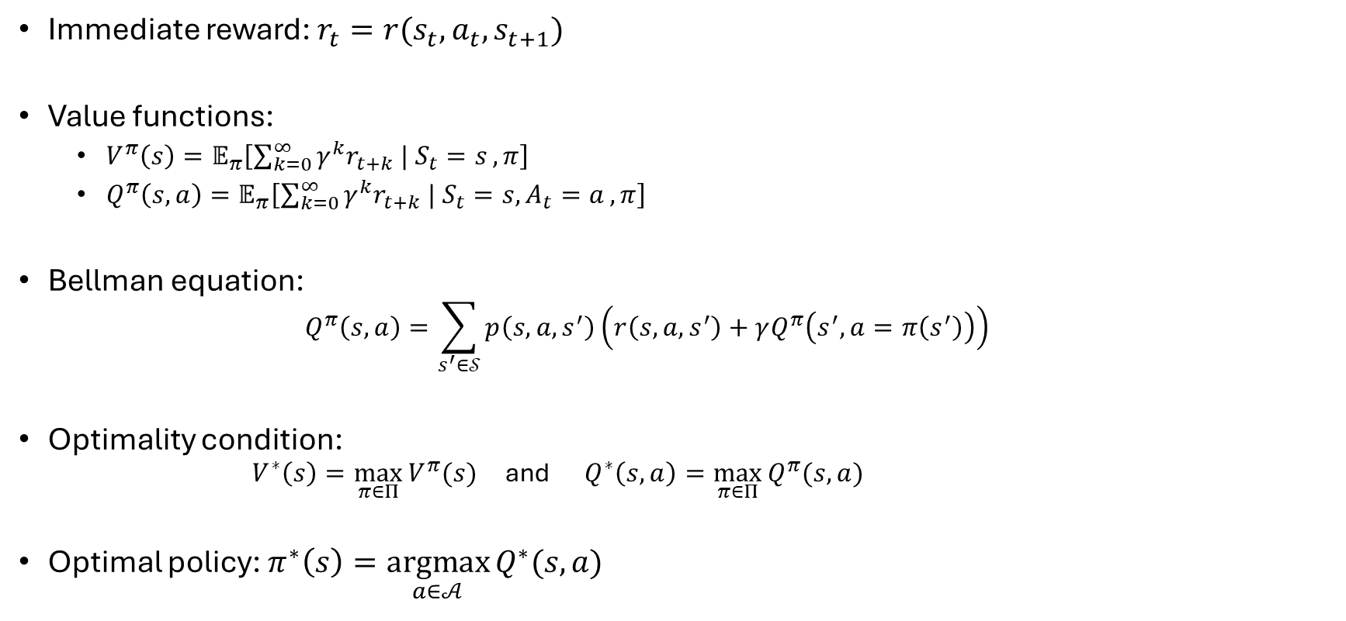
Remember: Value Functions
Immediate reward: $r_{t}=r(s_{t},a_{t}, s_{t+1})$
Value functions:
$V^{π}\left(s\right)=𝔼_{π}\left[\sum_{k=0}^{∞}{γ^{k}r_{t+k} | S_{t}=s},π\right]$
$Q^{π}\left(s,a\right)=𝔼_{π}\left[\sum_{k=0}^{∞}{γ^{k}r_{t+k} | S_{t}=s, A_{t}=a},π\right]$
Bellman equation:
$$Q^{π}\left(s,a\right)=\sum_{s^{′}∈𝒮}{p\left(s,a,s^{′}\right)\left(r\left(s,a,s^{′}\right)+γQ^{π}\left(s^{′},a=π\left(s^{′}\right)\right)\right)}$$
Optimality condition:
$V^{∗}\left(s\right)=\max_{π∈Π}{V^{π}(s)}$ and $Q^{∗}\left(s,a\right)=\max_{π∈Π}{Q^{π}(s,a)}$
Optimal policy: $π^{∗}\left(s\right)=\underset{a∈𝒜}{argmax}{Q^{∗}(s,a)}$
The expectation reflects all uncertainty:
Stochastic policy
Stochastic transitions
Stochastic reward model

Slide 8
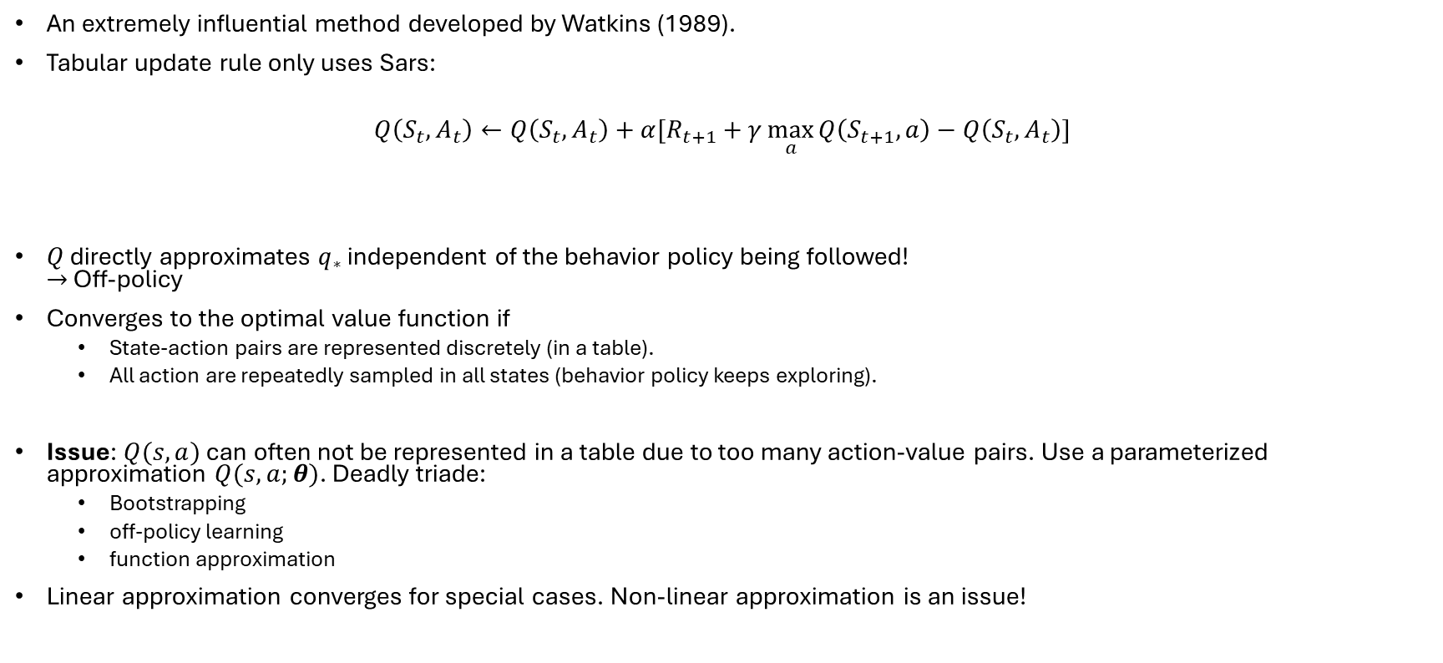
Remember: Tabular Q-Learning
An extremely influential method developed by Watkins (1989).
Tabular update rule only uses Sars:
$$Q\left(S_{t},A_{t}\right)←Q\left(S_{t},A_{t}\right)+α[R_{t+1}+γ\max_{a}{Q\left(S_{t+1},a\right)}−Q\left(S_{t},A_{t}\right)]$$
$Q$ directly approximates $q_{∗}$ independent of the behavior policy being followed! $→$ Off-policy
Converges to the optimal value function if
State-action pairs are represented discretely (in a table).
All action are repeatedly sampled in all states (behavior policy keeps exploring).
Issue: $Q(s,a)$ can often not be represented in a table due to too many action-value pairs. Use a parameterized approximation $Q(s,a;θ)$. Deadly triade:
Bootstrapping
off-policy learning
function approximation
Linear approximation converges for special cases. Non-linear approximation is an issue!
target
prediction
TD-error

Slide 9
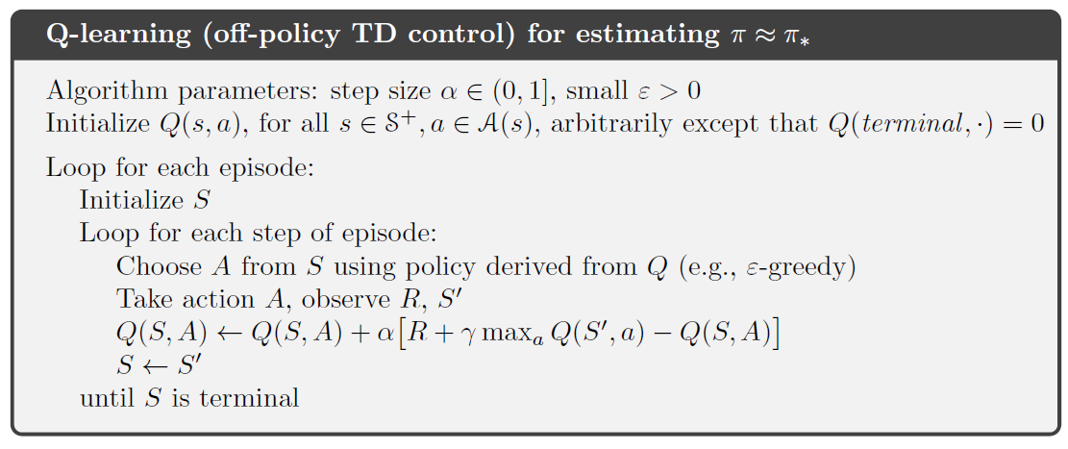
Alg. Tabular Q-Learning

Slide 10
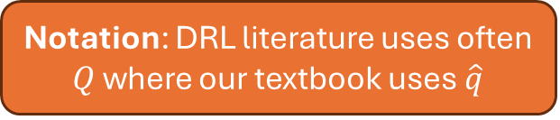
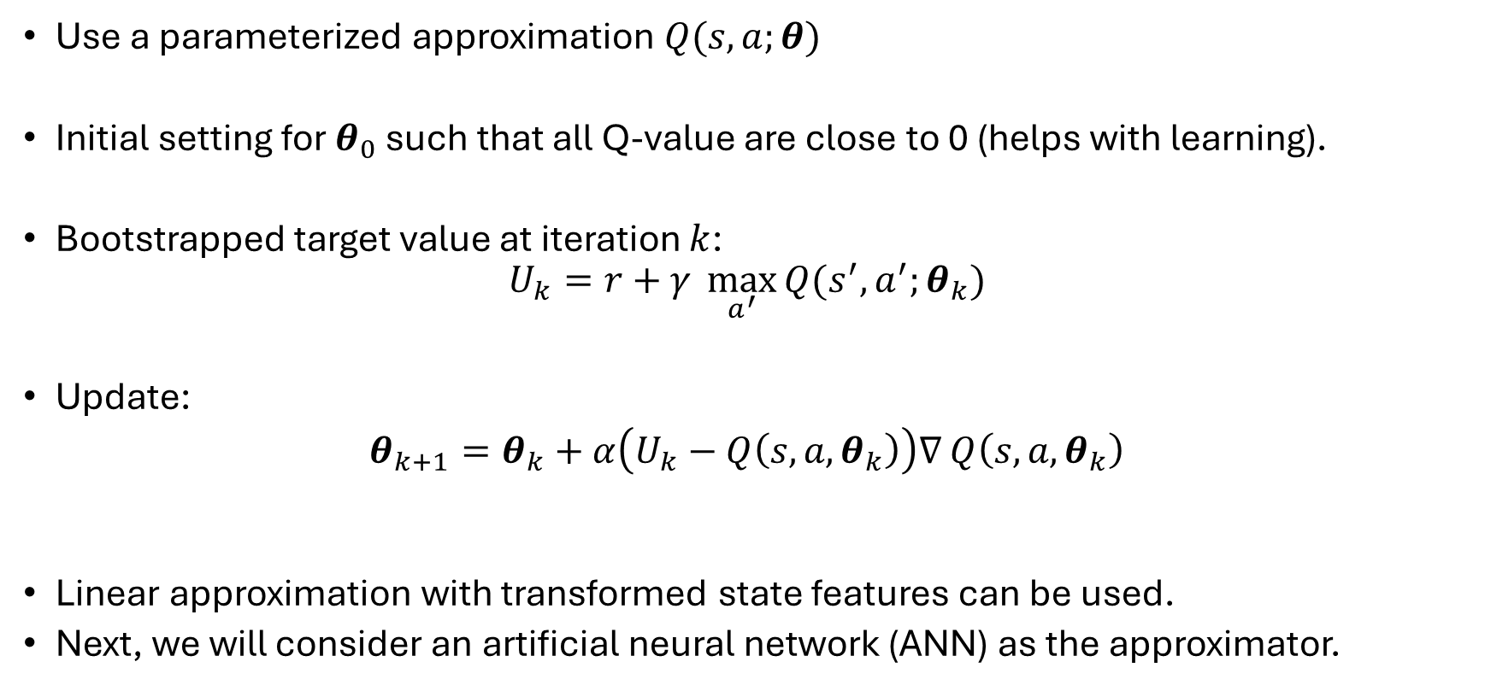
Fitted Q-Learning
Notation: DRL literature uses often $Q$ where our textbook uses $\hat{q}$
Use a parameterized approximation $Q(s,a;θ)$
Initial setting for $θ_{0}$ such that all Q-value are close to 0 (helps with learning).
Bootstrapped target value at iteration $k$:
$$U_{k}=r+γ \max_{a^{′}}{Q(s^{′},a^{′};θ_{k})}$$
Update:
$θ_{k+1}=θ_{k}+α\left(U_{k}−Q\left(s,a,θ_{k}\right)\right)∇$ $Q\left(s,a,θ_{k}\right)$
Linear approximation with transformed state features can be used.
Next, we will consider an artificial neural network (ANN) as the approximator.
Q-learning assumes the best action will be taken

Slide 11
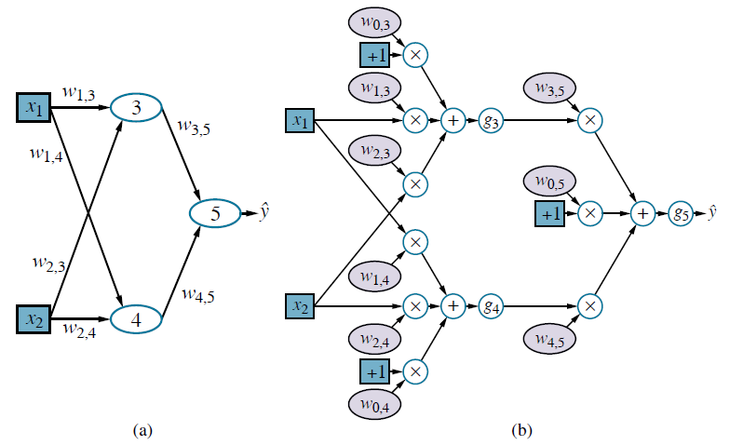
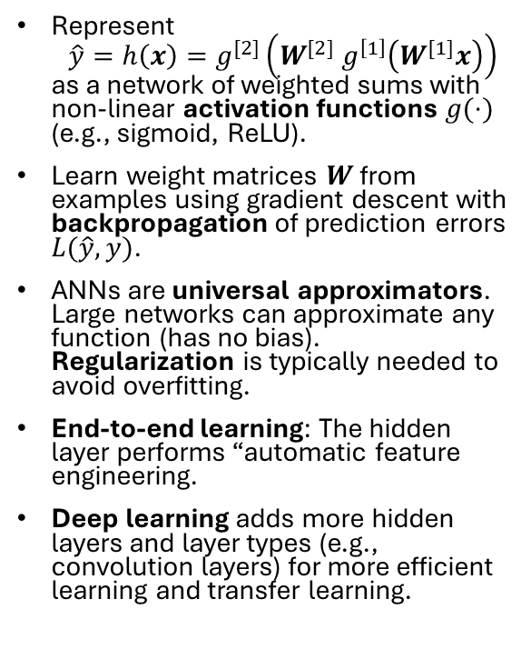
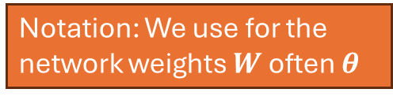
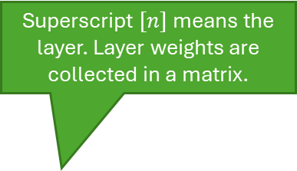
Reminder: Artificial Neural Networks
Superscript $[n]$means the layer. Layer weights are collected in a matrix.
Network Topology
Computational graph
Used activation functions:
Value function: linear
Policy: Softmax
Represent $\hat{y}=h\left(x\right)=g^{[2]}\left(W^{[2]} g^{\left[1\right]}\left(W^{[1]}x\right)\right)$ as a network of weighted sums with non-linear activation functions $g(⋅)$ (e.g., sigmoid, ReLU).
Learn weight matrices $W$ from examples using gradient descent with backpropagation of prediction errors $L(\hat{y}, y)$.
ANNs are universal approximators. Large networks can approximate any function (has no bias). Regularization is typically needed to avoid overfitting.
End-to-end learning: The hidden layer performs “automatic feature engineering.
Deep learning adds more hidden layers and layer types (e.g., convolution layers) for more efficient learning and transfer learning.
Hidden Layer
Notation: We use for the network weights $W$ often $θ$
Neuron
Non-linear activation function: often ReLU
Bias term

Slide 12

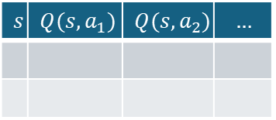

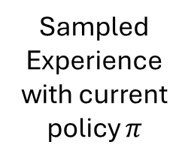
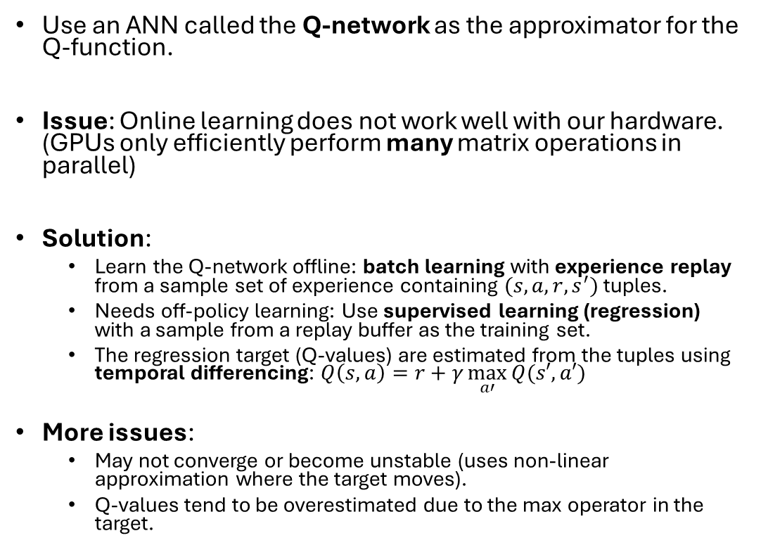

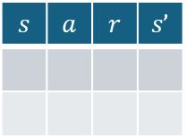


Neural fitted Q-learning (NFQ; Riedmiller, 2005)
Sampled Experience with current policy $π$
Use an ANN called the Q-network as the approximator for the Q-function.
Issue: Online learning does not work well with our hardware. (GPUs only efficiently perform many matrix operations in parallel)
Solution:
Learn the Q-network offline: batch learning with experience replay from a sample set of experience containing $(s,a,r,s^{′})$ tuples.
Needs off-policy learning: Use supervised learning (regression) with a sample from a replay buffer as the training set.
The regression target (Q-values) are estimated from the tuples using temporal differencing: $Q\left(s,a\right)=r+γ\max_{a′}{Q(s′,a′)}$
More issues:
May not converge or become unstable (uses non-linear approximation where the target moves).
Q-values tend to be overestimated due to the max operator in the target.
$$s$$ | $$a$$ | $$r$$ | $$s’$$
Estimate Q-values
$$s$$ | $$Q(s,a_{1})$$ | $$Q(s,a_{2})$$ | $$…$$
Training data
Update network
$$S$$
$$A$$
$$s$$
$$θ_{k}^{}$$
$$Q(s, a)$$
Linear activation
Q-network

Slide 13


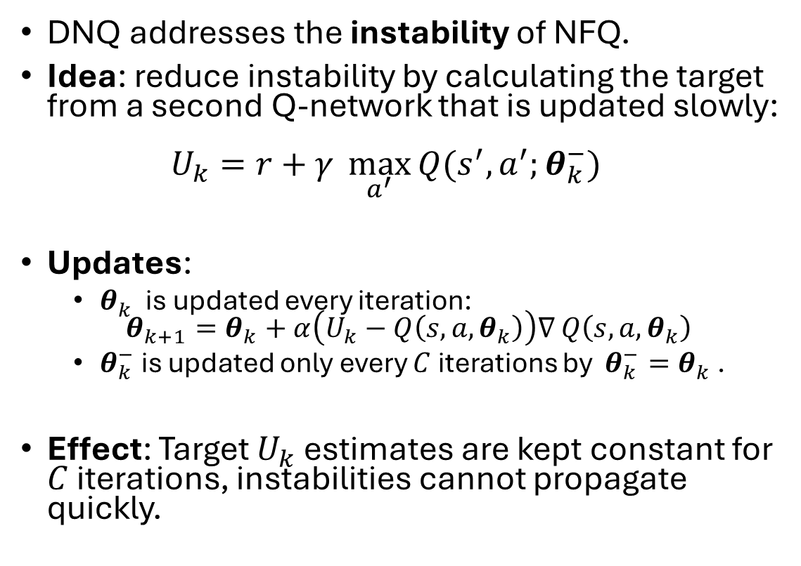


Deep Q-Network (DQN; Minh et al, 2015)
Prediction Q-network (fast updates)
DNQ addresses the instability of NFQ.
Idea: reduce instability by calculating the target from a second Q-network that is updated slowly: $U_{k}=r+γ \max_{a^{′}}{Q(s^{′},a^{′};θ_{k}^{−})}$
Updates:
$θ_{k}^{}$is updated every iteration: $θ_{k+1}=θ_{k}+α\left(U_{k}−Q\left(s,a,θ_{k}\right)\right)∇$ $Q\left(s,a,θ_{k}\right)$
$θ_{k}^{−}$ is updated only every $C$ iterations by ${θ_{k}^{−}=θ}_{k}^{}$.
Effect: Target $U_{k}$ estimates are kept constant for $C$ iterations, instabilities cannot propagate quickly.
$$S$$
$$A$$
$$s$$
$$θ_{k}^{}$$
$$Q(s, a;θ_{k}^{})$$
$$S$$
$$A$$
$$s$$
$$θ_{k}^{−}$$
$$Q(s^{′}, a^{′};θ_{k}^{−})$$
Target Q-network (slow updates)

Slide 14
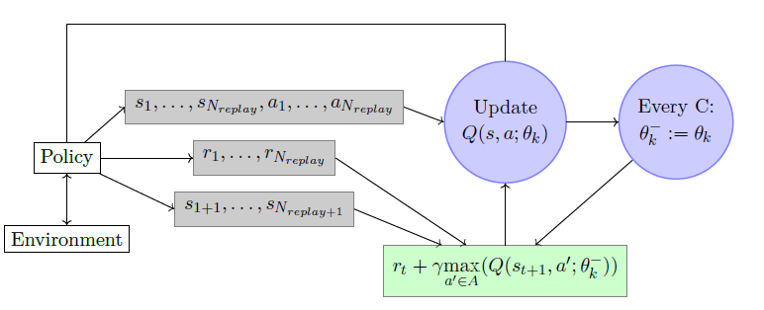
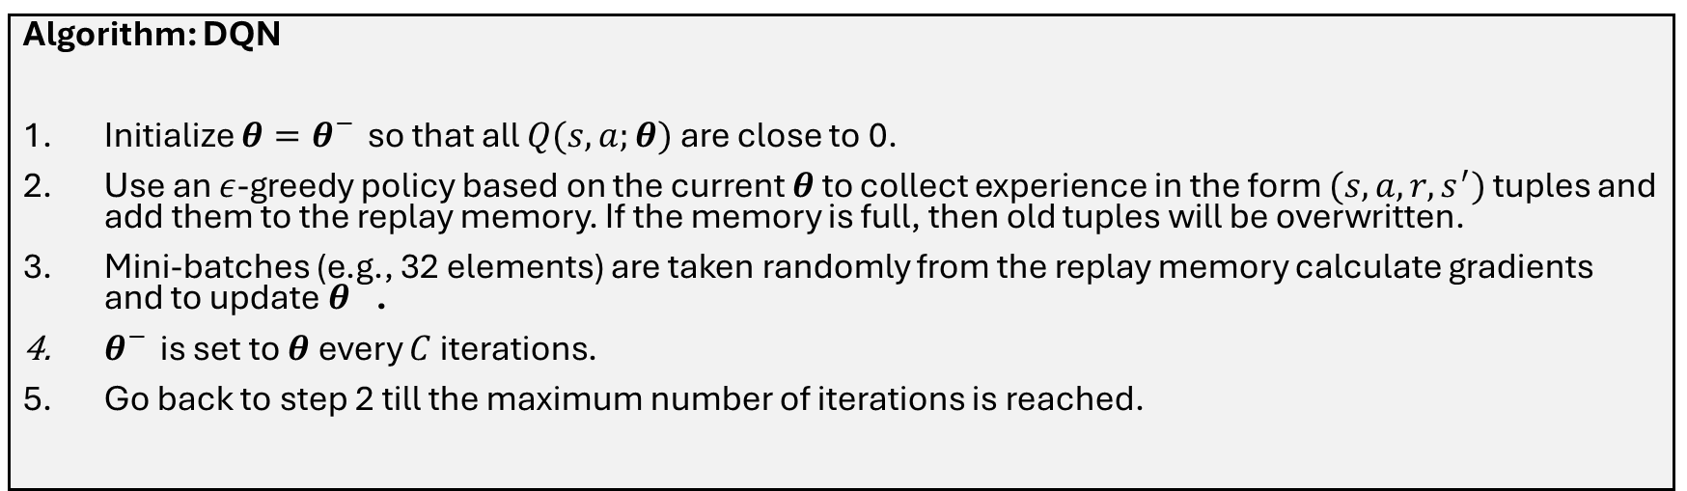
DQN is Not a Truly Online Algorithm
Prediction
Replay memory
Target
Algorithm: DQN
Initialize $θ=θ_{}^{−}$ so that all $Q(s,a;θ)$ are close to 0.
Use an $ε$-greedy policy based on the current $θ$ to collect experience in the form $(s,a,r,s^{′})$ tuples and add them to the replay memory. If the memory is full, then old tuples will be overwritten.
Mini-batches (e.g., 32 elements) are taken randomly from the replay memory calculate gradients and to update $θ_{}$.
$θ_{}^{−}$ is set to $θ$every $C$ iterations.
Go back to step 2 till the maximum number of iterations is reached.

Slide 15
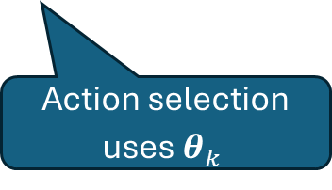
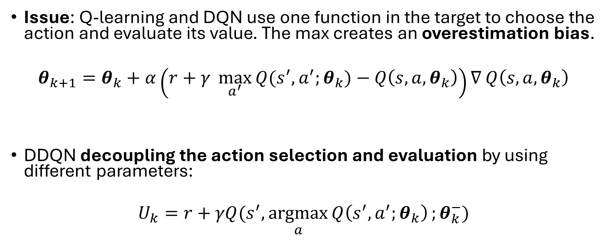
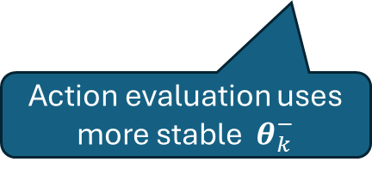
Double DQN (DDQN; Van Hasselt, 2016)
Issue: Q-learning and DQN use one function in the target to choose the action and evaluate its value. The max creates an overestimation bias.
$θ_{k+1}=θ_{k}+α\left(r+γ \max_{a^{′}}{Q(s^{′},a^{′};θ_{k})}−Q\left(s,a,θ_{k}\right)\right)∇$ $Q\left(s,a,θ_{k}\right)$
DDQN decoupling the action selection and evaluation by using different parameters:
$$U_{k}=r+γQ(s^{′},\underset{a}{argmax}{Q\left(s^{′},a^{′};θ_{k}\right)};θ_{k}^{−})$$
target
prediction
TD-error
Action evaluation uses more stable $θ_{k}^{−}$
Action selection uses $θ_{k}^{}$

Slide 16
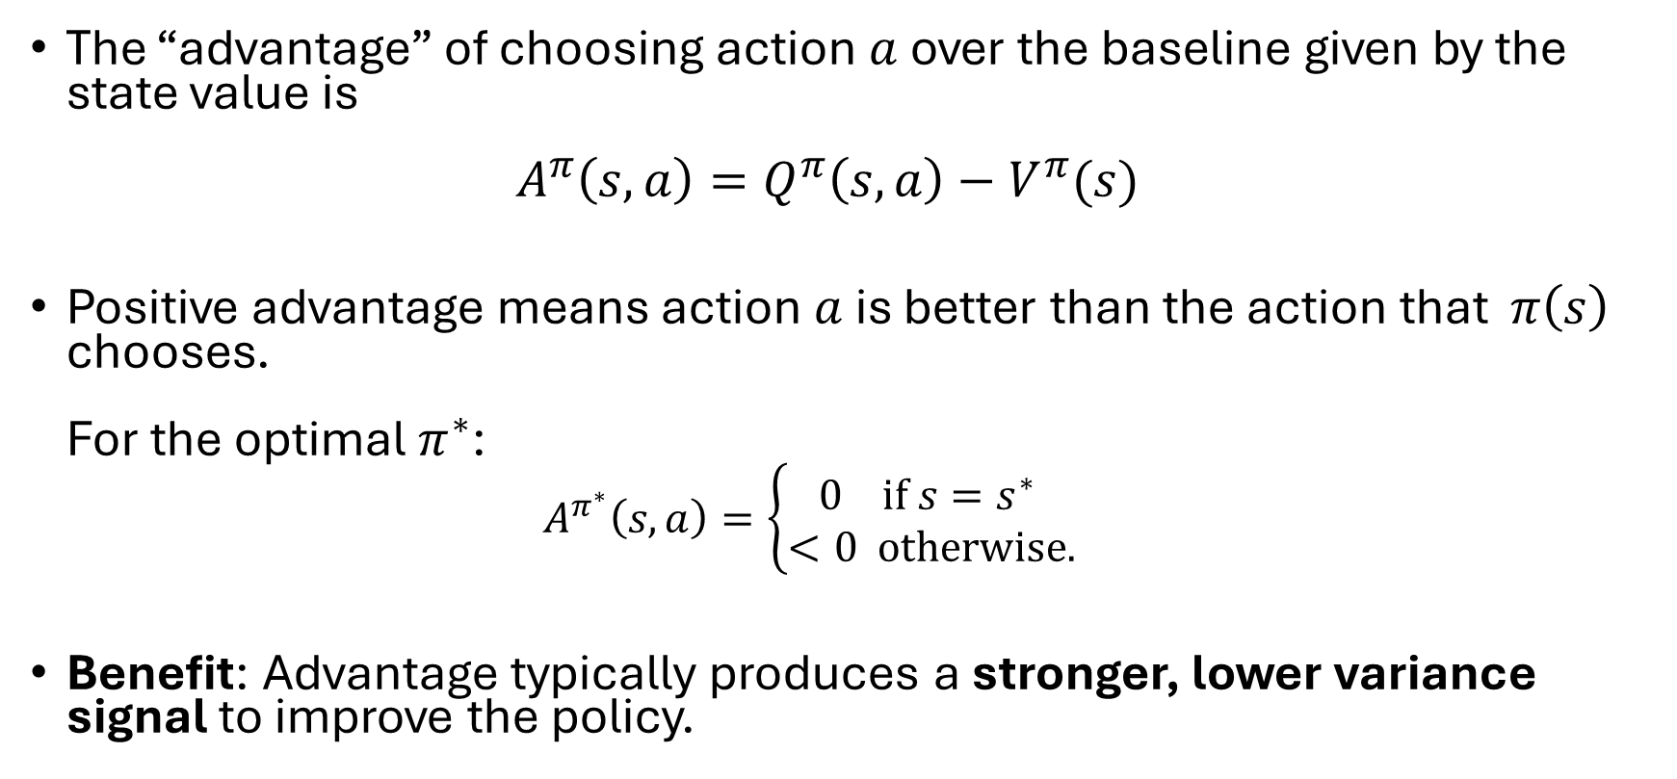
Advantage Function
The “advantage” of choosing action $a$ over the baseline given by the state value is $A^{π}\left(s,a\right)=Q^{π}\left(s,a\right)−V^{π}(s)$
Positive advantage means action $a$ is better than the action that $π\left(s\right)$ chooses. For the optimal $π^{∗}$:
$$A^{π^{∗}}\left(s,a\right)=\left\{\begin{aligned}0 \text{if} s=s^{∗} \\ <0 \text{otherwise}.\end{aligned}\right.$$
Benefit: Advantage typically produces a stronger, lower variance signal to improve the policy.

Slide 17
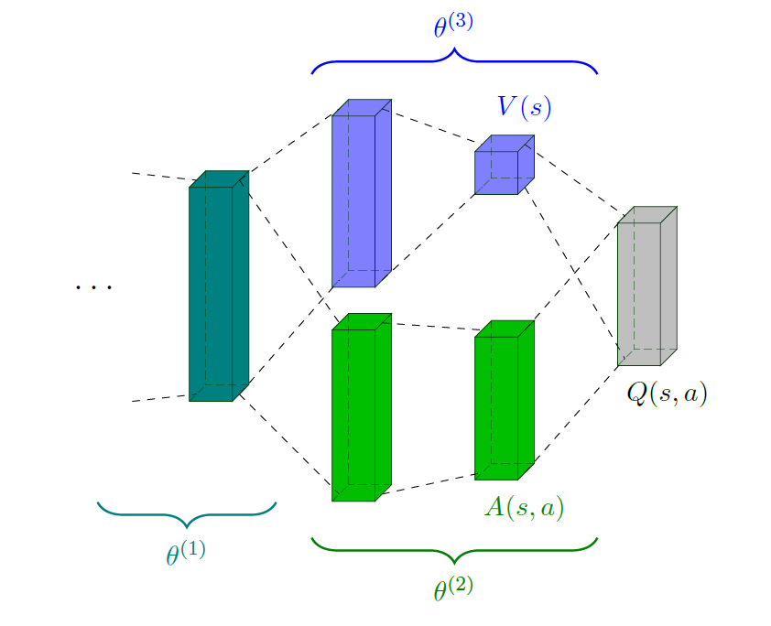
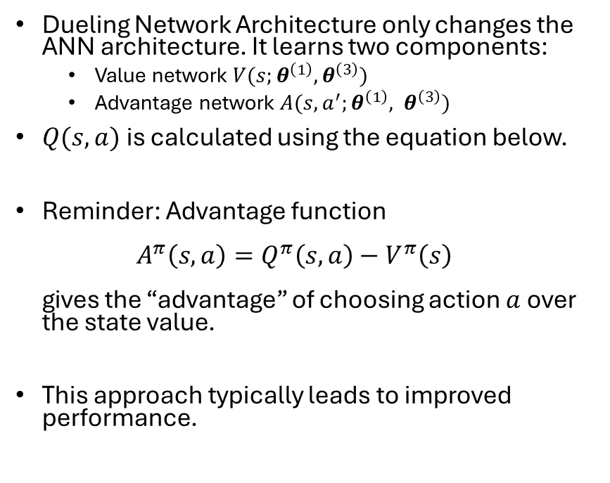

Dueling Network Architecture (Wang, 2015)
shared
Dueling Network Architecture only changes the ANN architecture. It learns two components:
Value network $V(s;θ^{\left(1\right)}, θ^{\left(3\right)})$
Advantage network $A(s, a^{′};θ^{\left(1\right)}, θ^{\left(3\right)})$
$Q(s,a)$ is calculated using the equation below.
Reminder: Advantage function $A^{π}\left(s, a\right)=Q^{π}\left(s,a\right)−V^{π}\left(s\right)$ gives the “advantage” of choosing action $a$ over the state value.
This approach typically leads to improved performance.
shared
$$Q\left(s,a;θ^{\left(1\right)},θ^{\left(2\right)},θ^{\left(3\right)}\right)=V\left(s;θ^{\left(1\right)},θ^{\left(3\right)}\right)+\left(A\left(s,a;θ^{\left(1\right)},θ^{\left(2\right)}\right)−\max_{a^{′}∈𝒜}{A\left(s,a′;θ^{\left(1\right)},θ^{\left(2\right)}\right)}\right)$$
Becomes 0 for $a=a^{∗}$

Slide 18
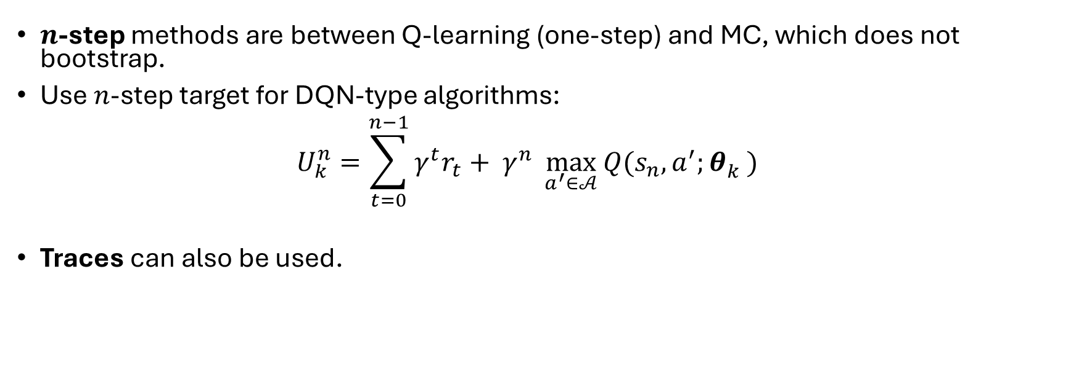
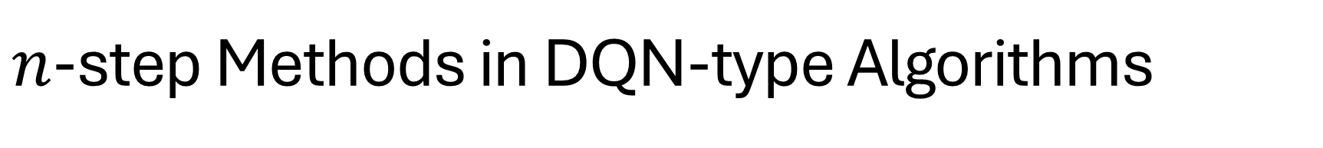
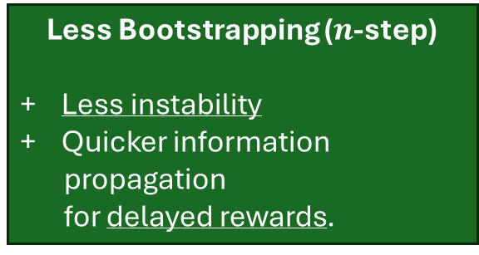
$n$-step Methods in DQN-type Algorithms
Bootstrapping (one-step)
Instability with function approximation (uses its own prediction).
+ Can use off-policy learning.
Less Bootstrapping ($n$-step)
+ Less instability
+ Quicker information propagation for delayed rewards.
MC (no bootstrapping)
+ Stable
- Only on-policy learning leads to sample inefficiency (cannot use replay memory).
$n$-step methods are between Q-learning (one-step) and MC, which does not bootstrap.
Use $n$-step target for DQN-type algorithms: $U_{k}^{n}=\sum_{t=0}^{n−1}{γ^{t}r_{t}}+ γ^{n} \max_{a^{′}∈𝒜}{Q(s_{n},a^{′};θ_{k}^{})}$
Traces can also be used.

Slide 19
Policy Gradient DRL Methods
Use ANNs to represent and learn a parameterized policy.

Slide 20
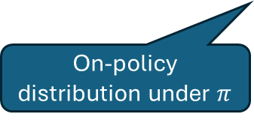
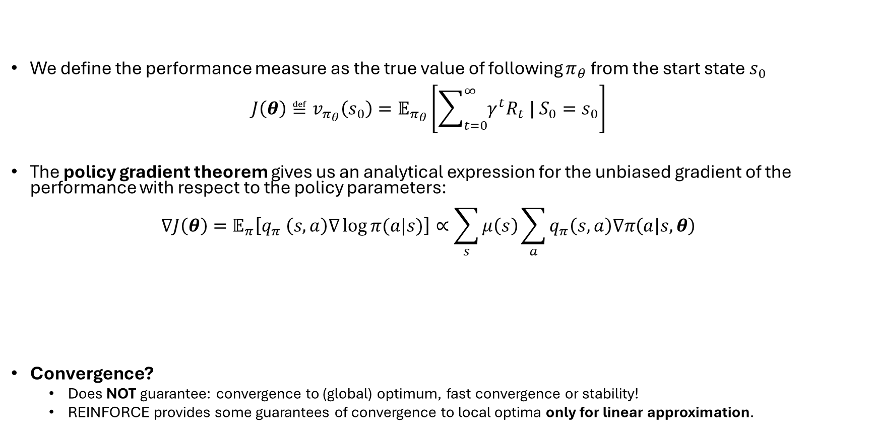
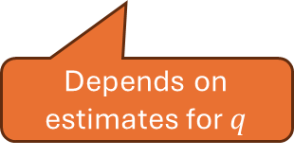
Remember: Policy Gradient Theorem
We define the performance measure as the true value of following $π_{θ}$ from the start state $s_{0}$ $J\left(θ\right)≝v_{π_{θ}}\left(s_{0}\right)=𝔼_{π_{θ}}\left[\sum_{t=0}^{∞}{γ^{t}R_{t} | S_{0}=s_{0}}\right]$
The policy gradient theorem gives us an analytical expression for the unbiased gradient of the performance with respect to the policy parameters: $∇J\left(θ\right)=𝔼_{π}\left[q_{π} \left(s,a\right)∇\log{π(a|s)}\right]∝\sum_{s}{μ\left(s\right)\sum_{a}{q_{π}\left(s,a\right)∇π\left(a | s,θ\right)}}$
Convergence?
Does NOT guarantee: convergence to (global) optimum, fast convergence or stability!
REINFORCE provides some guarantees of convergence to local optima only for linear approximation.
On-policy distribution under $π$
Depends on estimates for $q$
Gradient of the policy approximation function.

Slide 21
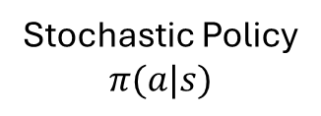
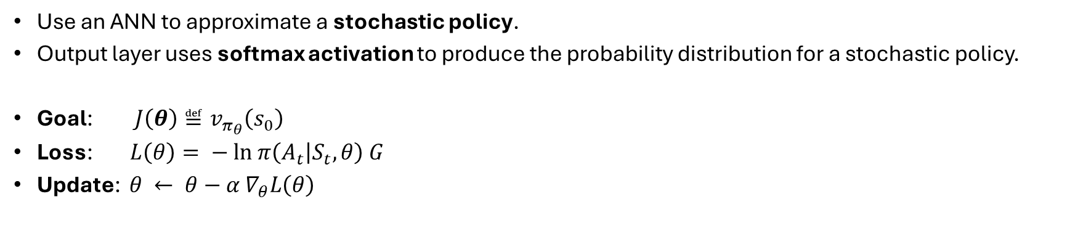

Policy Network
$$S$$
$$A$$
$$s$$
$$θ$$
Stochastic Policy
$$π(a|s)$$
Softmax activation
Use an ANN to approximate a stochastic policy.
Output layer uses softmax activation to produce the probability distribution for a stochastic policy.
Goal: $J\left(θ\right)≝v_{π_{θ}}\left(s_{0}\right)$
Loss: $L\left(θ\right)= − ln π\left(A_{t} | S_{t}, θ\right) G$
Update: $θ ← θ−α ∇_{θ}L\left(θ\right)$
Means that the highest probability action leads to the largest return. Can be reformulated as a loss.

Slide 22
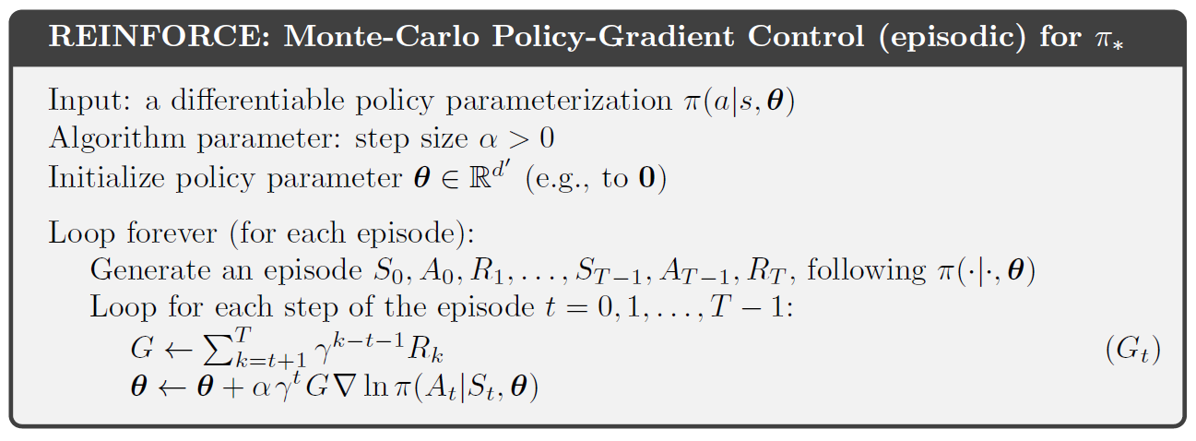
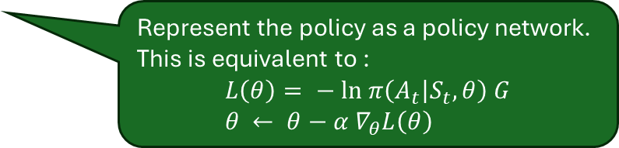
REINFORCE With Policy Network
Represent the policy as a policy network. This is equivalent to :
$$L\left(θ\right)= − ln π\left(A_{t} | S_{t}, θ\right) G \\ θ ← θ−α ∇_{θ}L\left(θ\right)$$
Note: MC leads to instability!

Slide 23
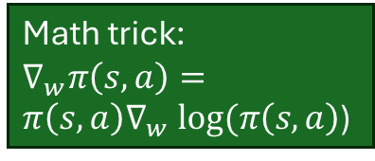
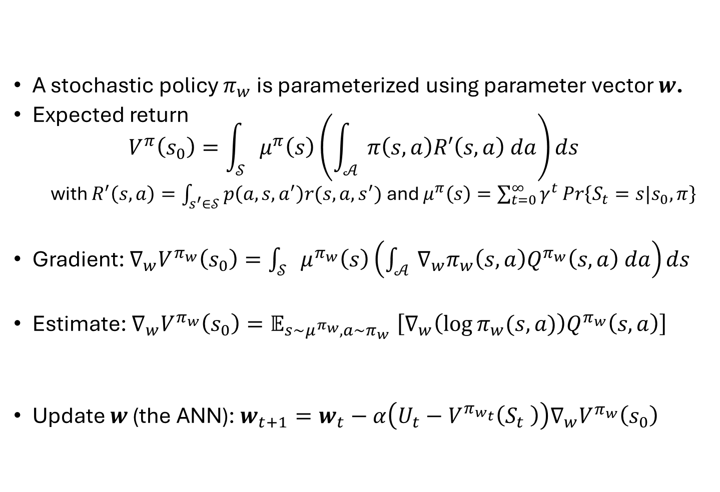
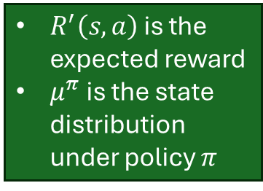
Stochastic Policy Gradient
Integrals work for cont. state and action spaces. Replace with sums for discrete spaces.
A stochastic policy $π_{w}$ is parameterized using parameter vector $w$.
Expected return $V^{π}\left(s_{0}\right)=\int_{𝒮}{μ^{π}\left(s\right)}\left(\int_{𝒜}{π\left(s,a\right)R′\left(s,a\right) da}\right)ds$
with $R^{′}\left(s,a\right)=\int_{s^{′}∈𝒮}{p\left(a,s,a^{′}\right)r(s,a,s^{′})}$ and $μ^{π}\left(s\right)=\sum_{t=0}^{∞}{γ^{t}\operatorname{Pr}\left\{S_{t}=s|s_{0},π\right\}}$
Gradient: $∇_{w}V^{π_{w}}\left(s_{0}\right)=\int_{𝒮}{μ^{π_{w}}\left(s\right)}\left(\int_{𝒜}{∇_{w}π_{w}\left(s,a\right)Q^{π_{w}}\left(s,a\right) da}\right)ds$
Estimate: $∇_{w}V^{π_{w}}\left(s_{0}\right){=𝔼}_{s\sim μ^{π_{w}},a\sim π_{w}}\left[∇_{w}\left(\log{π_{w}(s,a)}\right)Q^{π_{w}}\left(s,a\right)\right]$
Update $w$ (the ANN): $w_{t+1}=w_{t}−α\left(U_{t}−V^{π_{w_{t}}}\left(S_{t} \right)\right)∇_{w}V^{π_{w}}\left(s_{0}\right)$
$R^{′}\left(s,a\right)$ is the expected reward
$μ^{π}$ is the state distribution under policy $π$
Math trick: $∇_{w}π\left(s,a\right)=π\left(s,a\right)∇_{w} log⁡(π\left(s,a\right)$)
Can be estimated with MC roll outs or TD
Needed: Value function estimate
Needed: Policy gradient

Slide 24
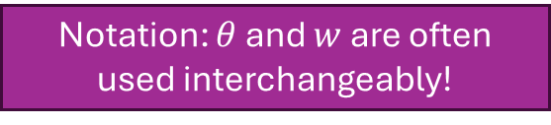
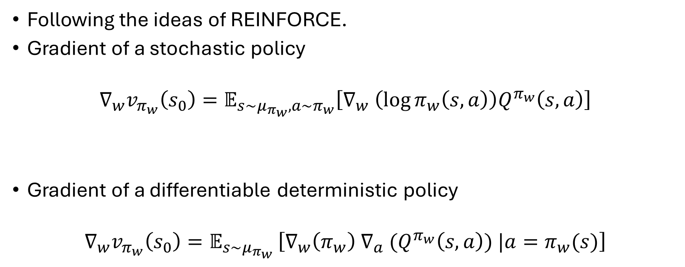
Policy Gradient
Notation: $θ$ and $w$ are often used interchangeably!
Following the ideas of REINFORCE.
Gradient of a stochastic policy
$$∇_{w}v_{π_{w}}\left(s_{0}\right)=𝔼_{s\sim μ_{π_{w}},a\sim π_{w}}\left[∇_{w} \left(\log{π_{w}\left(s,a\right)}\right)Q^{π_{w}}\left(s,a\right)\right]$$
Gradient of a differentiable deterministic policy
$$∇_{w}v_{π_{w}}\left(s_{0}\right)=𝔼_{s\sim μ_{π_{w}} }\left[{∇_{w}\left(π_{w}\right) ∇}_{a} (Q^{π_{w}}\left(s,a\right)) |a=π_{w}(s)\right]$$
Needs a value function estimate
Sample state from the on-policy distribution and action from the policy
Also requires this gradient!

Slide 25
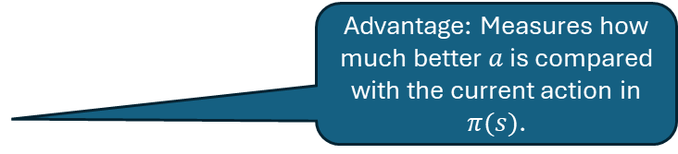
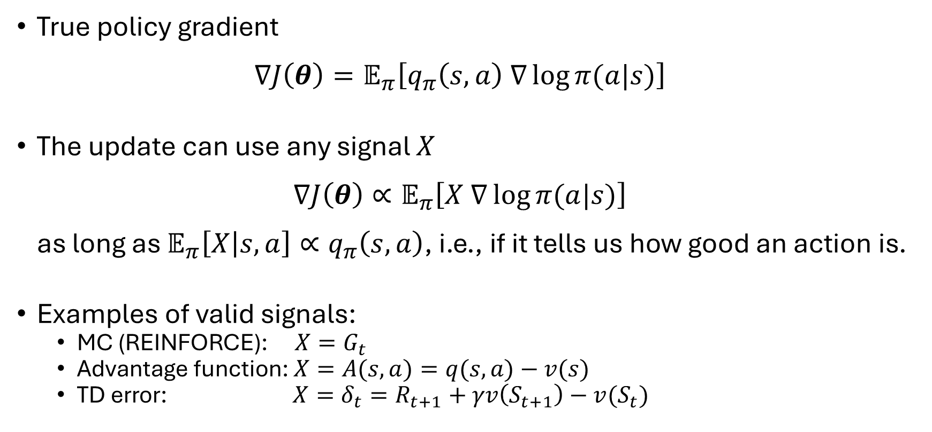
Remember: The Policy Gradient Update Signal
True policy gradient $∇J\left(θ\right)=𝔼_{π}\left[q_{π}\left(s,a\right) ∇\log{π(a|s)}\right]$
The update can use any signal $X$ $∇J\left(θ\right)∝𝔼_{π}\left[X ∇\log{π(a|s)}\right]$ as long as $𝔼_{π}\left[X | s,a\right]∝q_{π}\left(s,a\right)$, i.e., if it tells us how good an action is.
Examples of valid signals:
MC (REINFORCE): $X=G_{t}$
Advantage function: $X=A(s,a)=q(s,a)−v(s)$
TD error: $X=δ_{t}=R_{t+1}+γv\left(S_{t+1}\right)−v(S_{t})$
Advantage: Measures how much better $a$ is compared with the current action in $π(s)$.

Slide 26
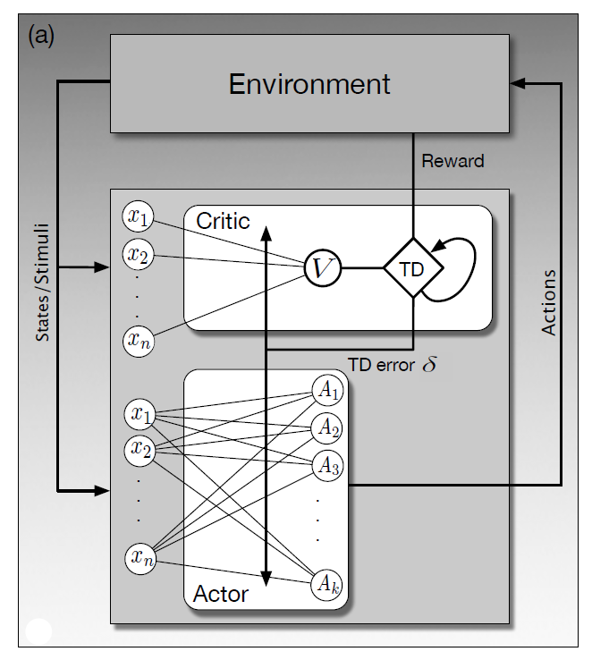
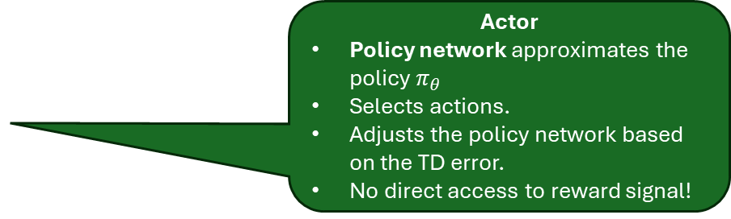
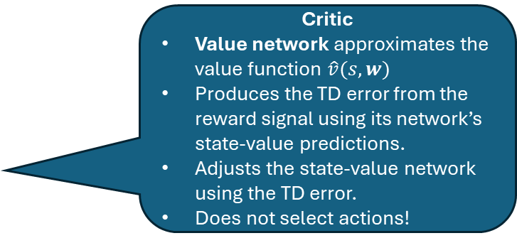


Neural Actor-Critic Method
Use a value network and a policy network for on-policy control.
Critic
Value network approximates the value function $\hat{v}(s,w)$
Produces the TD error from the reward signal using its network’s state-value predictions.
Adjusts the state-value network using the TD error.
Does not select actions!
$$w$$
Hidden layers
$$θ$$
Actor
Policy network approximates the policy $π_{θ}$
Selects actions.
Adjusts the policy network based on the TD error.
No direct access to reward signal!
Observations:
Section 15.7 in Sutton and Barto (2018)

Slide 27
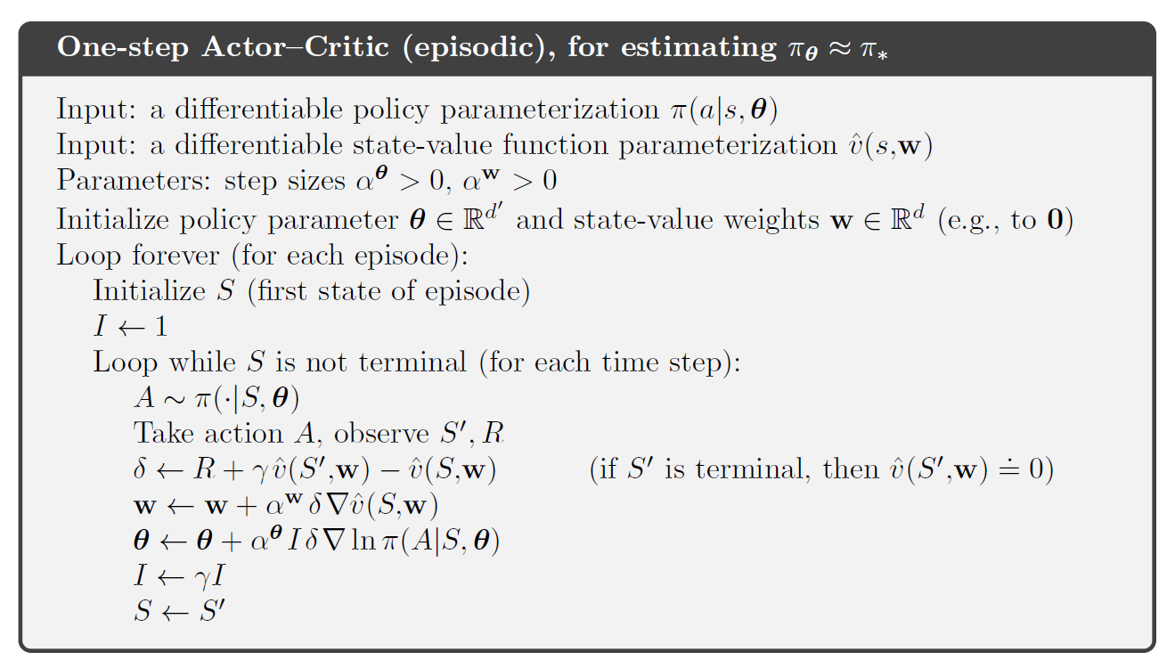


Neural Actor-Critic Method: One-Step Algorithm
actor
critic
Takes care of discounting $γ^{t}$
TD error: uses $\hat{v}$ estimates
Policy approximation is soft, so it explores!
Update the critic (value function) = $TD(0)$
Update the actor (policy) using the TD error signal
Replace these with a value network and a policy network.

Slide 28
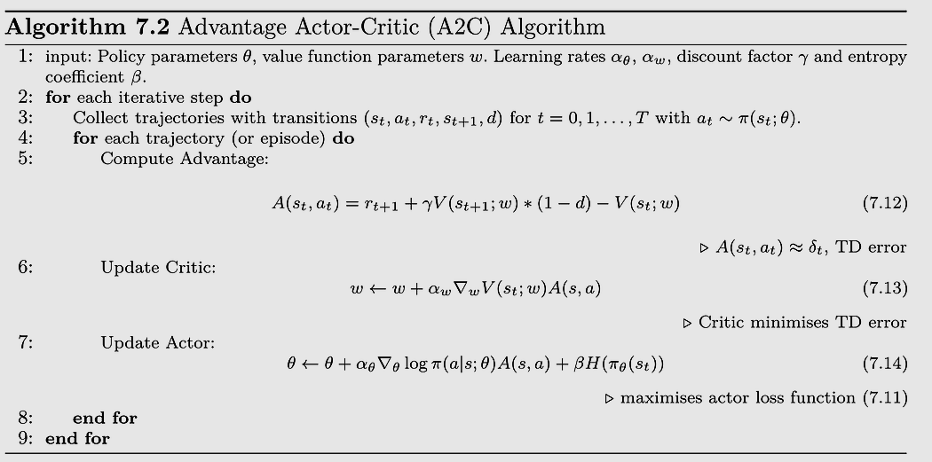



Advantage Actor Critic: A2C
A popular synchronous version of Asynchronous Advantage Actor Critic (A3C).
Note: $d$ is a done indicator for the episode end
Advantage provides a better, lower variance signal by focusing on relative action quality.
Could use multi-step bootstrapping for more stability and faster reward propagation.
This is the 1-step estimate of $Q(s_{t},a_{t})$
$$𝔼[δ_{t}​∣s,a]=A(s,a)$$
Optional
Entropy regularization: encourages the policy to stay uncertain/spread out and explore. (Not all implementations do this)
Source: https://medium.com/@kswagat1979/advantage-actor-critic-a2c-models-ab188ddfcb72

Slide 29
















Natural Policy Gradients (NPG)
Notation: $θ$ and $w$ are often used interchangeably!
$$w_{2}$$
Regular policy gradient methods
Update policy parameters $w$ in the direction of the steepest ascent of the performance measure $J\left(w\right)≝v_{π_{w}}\left(s_{0}\right)$
The update changes the parameters $∆w ∝∇_{w}J(w)$. The step size $α$ restricts moves in the parameter space to some ${\left\|∆w\right\|}_{2}$.
Issue: The same amount of change in the parameter space $w$can have very different effects on the change of the stochastic policy $π_{w}$ (the probability distribution over actions). This can cause instability.
Idea: Natural policy gradients take the geometry of the policy (a probability manifold) into account.
Measure of the difference between two policies’ action probability distributions: Kullback-Leibler (KL) divergence $D_{KL}(π_{w}|\left|π_{w+∆w}\right)$
Constraint $∆w$ by a maximum allowable policy change using${ D}_{KL}(π_{w}|\left|π_{w+∆w}\right)≤δ$.
Local approximation: The Fisher information criterion can be used to the steepness of the gradient for changes in policy distribution. $α$ is now controls how much the policy changes: $∆w ∝{F_{w}^{−1} ∇}_{w}J\left(w\right)$
Problem: Calculating the Fisher information matrix ($F_{w}$) is too expensive for deep learning models. We need an approximation for the approximation! This idea inspired several state-of-the-art methods:
Trust Region Optimization (TRPO)
Proximal Policy optimization (PPO)
$w$ +
$${\left\|∆w\right\|}_{2}$$
$$w_{1}$$
Prob.
Prob.
$$a_{1}$$
$$a_{1}$$
$$a_{2}$$
$$a_{2}$$
$$a_{3}$$
$$a_{3}$$
$$π_{w}$$
$$π_{w+∆w}$$
$$D_{KL}(π_{w}||π_{w+∆w})$$
$$w_{2}$$
$w$ +
$$D_{KL}(π_{w}|\left|π_{w+∆w}\right)≤δ$$
$$w_{1}$$

Slide 30

Trust Region Policy Optimization (TRPO; Schulman et al, 2015)
Notation: $θ$ and $w$ are often used interchangeably!
An actor critic method using a simplification of the natural policy gradient.
Surrogate objective. Instead of directly maximizing the value function, it uses the probability ratio of choosing an action before and after the update weighed by the advantage.
It prefers updates that increases the probability of picking high-advantage actions.
$$\max_{∆w}{𝔼_{π_{w}}\left[\frac{π_{w+∆w}(s,a)}{π_{w}(s,a)}A^{π_{w}}(s,a)\right]}$$
Under a constrain that explicitly bound of the policy change per update step.
$$𝔼 \left[D_{KL}\left(π_{w}\left(s,⋅\right)||π_{w+∆w}(s,⋅)\right)\right]≤δ$$
$δ$ is a tune-able hyperparameter specifying the size of the safe “trust region.” This prevents destructive large changes in the policy.

Slide 31

Proximal Policy Optimization (PPO; Schulman et al, 2017)
Notation: $θ$ and $w$ are often used interchangeably!
A popular and more practical variant of TRPO.
Also uses the probability ratio of choosing an action weighted by the advantage.
Replaces the expensive KL-divergence constraint with a clipped surrogate objective function that keeps the policy changes within a probability ratio of $[1−ε,1+ε$]
$$\max_{∆w}{𝔼_{π_{w}}\left[\min_{}\left(\frac{π_{w+∆w}(s,a)}{π_{w}(s,a)}A^{π_{w}}\left(s,a\right), {\text{clip}}_{1±ε}\left(\frac{π_{w+∆w}(s,a)}{π_{w}(s,a)}\right)A^{π_{w}}\left(s,a\right)\right)\right]}$$
$ε$ is a tunable hyperparameter.
Typically achieves much of the stability of NPG methods like TRPO without the computational cost of calculating the KL divergence or the Fisher information matrix.

Slide 32

PPO Algorithm
Advantage is more stable
Actor
Clipping approximates the expensive natural-gradient computation.
Critic

Slide 33


Soft Actor-Critic (SAC)
Soft Actor-Critic (SAC) is a popular method that is off-policy and for continuous action space.
SAC uses a large set of enhancements that can also be used in other algorithms:
Maximum entropy objective: Adds policy entropy regularization to encourage exploration: $J\left(θ\right)=𝔼\left[\sum_{t}{r\left(S_{t},A_{t}\right)+αℋ\left(π_{θ}(⋅|S_{t})\right)}\right]$ The temperature $α$ to balance exploration and exploitation is automatically tunes.
Reparameterization trick for actor policy: Instead of using $a\sim π_{θ}(a|s)$, it samples from $a=f_{θ}\left(ε,s\right), ε=𝒩\left(0,1\right)$ where $a$ is a continuous action and $f_{θ}$ is a learned ANN. This Gaussian actor is a popular choice since it has a closed-form solution for the entropy used in the objective and allows for backpropagation through actions.
Replay buffer: Improve sample efficiency and updates can be done in batches on GPUs. Possible since it is off-policy.
Twin Q-networks: The critic learns two Q-networks and used $min⁡(Q_{1}(s,a),Q_{2}(s,a))$ to reduce the maximization bias.
Slow update of target network: $θ_{\text{target}}←τθ+(1−τ)θ_{\text{target}}$
$ℋ$is the policy’s entropy measuring how spread out the policy probability distribution is.
Idea from double Q-learning.
Instead of copying the network every C timesteps.

Slide 34
Comparison of Popular DRL Methods
Method | Type | On/Off Policy | Action Space | Key Idea | Strengths | Weaknesses
DQN | Value-based | Off-policy | Discrete | Learn Q(s,a) with neural net | Simple, foundational | Unstable, overestimation bias
Double DQN | Value-based | Off-policy | Discrete | Reduces Q overestimation | More stable than DQN | Still limited to discrete
Dueling DQN | Value-based | Off-policy | Discrete | Separates value & advantage | Better learning efficiency | More complex
REINFORCE | Policy gradient | On-policy | Both | Monte Carlo policy gradient | Conceptually simple | High variance
TRPO | Policy gradient / Actor-critic | On-policy | Both | Constrained updates (KL bound) | Stable updates | Complex, slow
PPO ⭐ | Actor-critic | On-policy | Both | Clipped objective for stability | Easy, robust, widely used | Less sample efficient
A2C | Actor-critic | On-policy | Both | Advantage-based updates | Simpler than PPO | Less stable
A3C | Actor-critic | On-policy | Both | Parallel workers | Faster training | Harder to implement
DDPG | Actor-critic | Off-policy | Continuous | Deterministic policy + Q-learning | Works for continuous control | Unstable, sensitive
TD3 ⭐ | Actor-critic | Off-policy | Continuous | Twin critics + delayed updates | More stable than DDPG | Still sensitive
SAC ⭐ | Actor-critic | Off-policy | Continuous | Max entropy RL + twin critics | Very stable, sample efficient | More computation
⭐= most popular

Slide 35

Method Used in DRL
Policy Gradients (REINFORCE and all actor-critic methods)
Natural Policy Gradients (TRPO, PPO)
Actor–Critic Framework (A2C, PPO, SAC, TD3, DDPG)
Stochastic policies (PPO, SAC)
Advantage estimation to reduce variance (PPO, A2C, TRPO)
Target Networks to stabilize training (DQN, DDPG, TD3, SAC)
Experience Replay for off-policy methods to improve sample efficiency and use hardware efficiently (DQN, DDPG, TD3, SAC)
Entropy Regularization to prevent premature convergence of policy (SAC and sometimes in PPO)
New approaches use model learning to learn environment dynamics ($p$) (Dreamer, MuZero)

Slide 36
What you Should Know
DRL uses neural networks for non-linear value function or policy approximation, resulting in:
more powerful for high-dimensional and continuous state and action spaces, and
does not need explicit state feature engineering.
However, most convergence guarantees are gone (for semi-gradient methods, for linear approximation, etc).
Instability from the “Deadly Triad” (e.g., in DQN)
Function approximation
Bootstrapping (moving targets using current estimates)
Off-policy learning (learning from data generated by a different policy)
Lead to
Non-linear approximation means that small errors can get amplified through bootstrapping
The network chases a moving target.
Training can diverge or oscillate wildly.
Many tricks are needed
Experience replay → decorrelate data, improve sample efficiency, requires off-policy learning
DQN uses slower-moving target networks → reduce instability due to moving targets
Double DQN → decouple next action selection and q-value estimation to reduce overestimation bias
Advantage normalization → reduce variance
Natural policy gradients → improve stability

