Slide 1
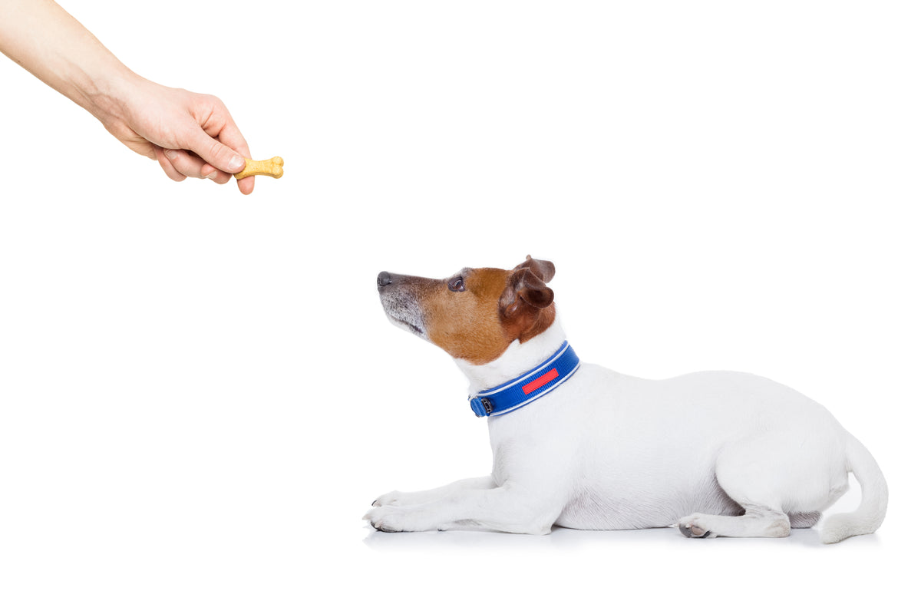


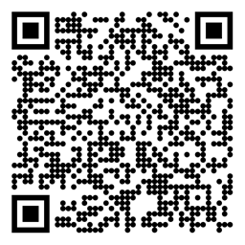

Reinforcement Learning Partial Observability Sutton/Barto* Chapter 17.3 AIMA** Chapters 14 and 15
Michael Hahsler, SMU
*Sutton and Barto, Reinforcement Learning: An Introduction, 2nd edition, MIT Press, Cambridge, MA, 2018
**Russell and Norvig, Artificial Intelligence: A Modern Approach, 4th edition, Pearson, 2021

Slide 2
Topics of this Course
Introduction to reinforcement learning
Markov decision processes
Part I: Tabular Methods
Dynamic programming
Monte Carlo methods
Temporal-difference learning
Multi-step bootstrapping
Planning and learning with tabular methods
Part II: Approximate Solution Methods
Prediction and Control using Approximation
Eligibility Traces
Policy Gradient Methods
Part III: Looking Deeper
Deep Reinforcement Learning
Partial Observability
Reward Engineering
Current Applications

Slide 3
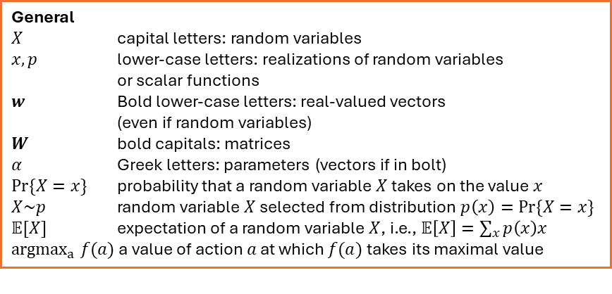
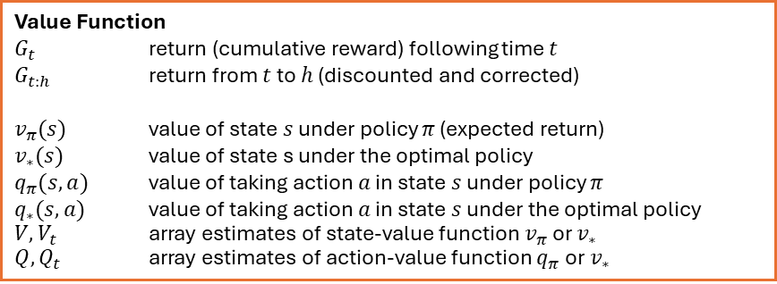
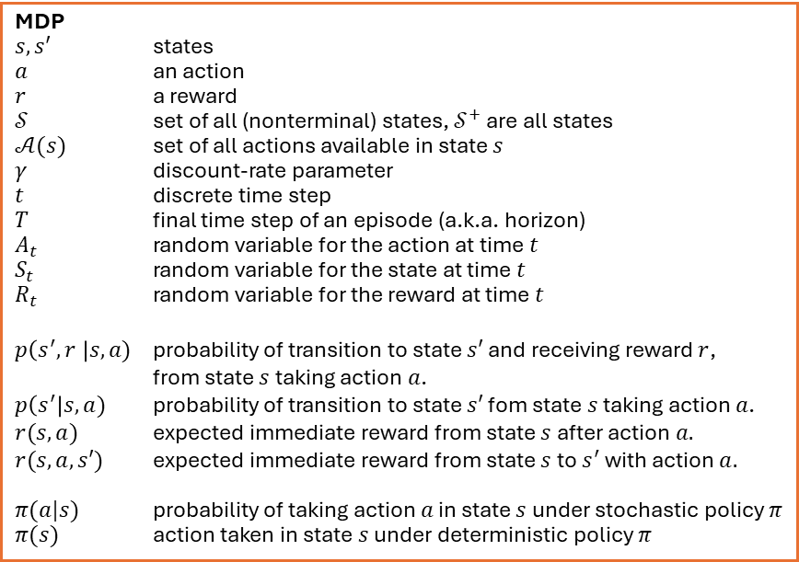
Summary of Notation
General
$X$ capital letters: random variables $x, p$ lower-case letters: realizations of random variables or scalar functions
$w$ Bold lower-case letters: real-valued vectors (even if random variables)
$W$ bold capitals: matrices
$α$ Greek letters: parameters (vectors if in bolt)
$Pr⁡\{X=x\}$ probability that a random variable $X$ takes on the value $x$
$X\sim p$ random variable $X$ selected from distribution $p\left(x\right)=Pr⁡\{X=x\}$
$𝔼[X]$ expectation of a random variable $X$, i.e., $𝔼\left[X\right]=\sum_{x}{p\left(x\right)x}$
${argmax}_{a} f(a)$ a value of action $a$ at which $f(a)$ takes its maximal value
MDP
$s, s′$ states
$a$ an action
$r$ a reward
$𝒮$ set of all (nonterminal) states, $𝒮^{+}$ are all states
$𝒜(s)$ set of all actions available in state $s$
$γ$ discount-rate parameter
$t$ discrete time step
$T$ final time step of an episode (a.k.a. horizon)
$A_{t}$ random variable for the action at time $t$
$S_{t}$ random variable for the state at time $t$
$R_{t}$ random variable for the reward at time $t$
$p\left(s^{′},r \right|s, a)$ probability of transition to state $s′$ and receiving reward $r$, from state $s$ taking action $a$.
$p\left(s^{′}\right|s, a)$ probability of transition to state $s′$ fom state $s$ taking action $a$.
$r(s,a)$ expected immediate reward from state $s$ after action $a.$
$r(s,a,s′)$ expected immediate reward from state $s$ to $s^{′}$ with action $a.$
$π(a|s)$ probability of taking action $a$ in state $s$ under stochastic policy $π$
$π(s)$ action taken in state $s$ under deterministic policy $π$
Value Function
$G_{t}$ return (cumulative reward) following time $t$
$G_{t:h}$ return from $t$ to $h$ (discounted and corrected)
$v_{π}(s)$ value of state $s$ under policy $π$ (expected return)
$v_{∗}(s)$ value of state s under the optimal policy
$q_{π}(s,a)$ value of taking action $a$ in state $s$ under policy $π$
$q_{∗}(s,a)$ value of taking action $a$ in state $s$ under the optimal policy
$V, V_{t}$ array estimates of state-value function $v_{π}$or $v_{∗}$
$Q,Q_{t}$ array estimates of action-value function $q_{π}$or $v_{∗}$

Slide 4

Foundation
Probabilistic reasoning over time
AIMA Chapter 15
iStock Credit: bernie_photo

Slide 5
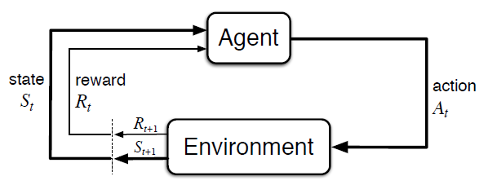
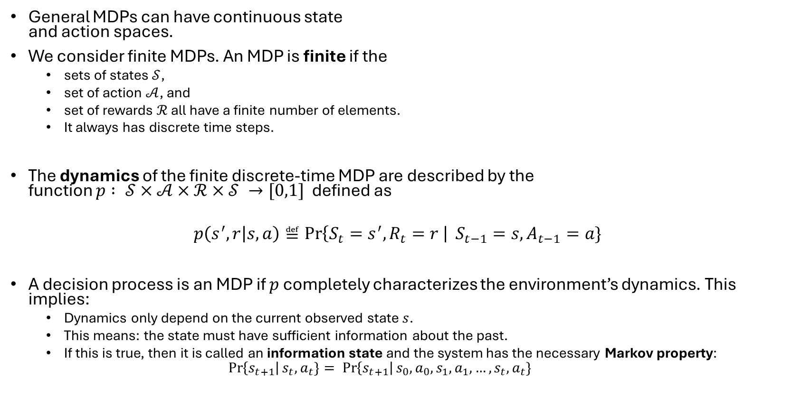
Fully Observable RL
General MDPs can have continuous state and action spaces.
We consider finite MDPs. An MDP is finite if the
sets of states $𝒮$,
set of action $𝒜$, and
set of rewards $ℛ$ all have a finite number of elements.
It always has discrete time steps.
The dynamics of the finite discrete-time MDP are described by the function $p : 𝒮×𝒜×ℛ×𝒮 →[0,1]$defined as
$$p\left(s^{′},r | s,a\right)≝\operatorname{Pr}\left\{S_{t}=s^{′}, R_{t}=r \right| S_{t−1}=s, A_{t−1}=a\}$$
A decision process is an MDP if $p$ completely characterizes the environment’s dynamics. This implies:
Dynamics only depend on the current observed state $s$.
This means: the state must have sufficient information about the past.
If this is true, then it is called an information state and the system has the necessary Markov property:
$$\operatorname{Pr}\left\{s_{t+1}\right|s_{t}, a_{t}\}= \operatorname{Pr}\left\{s_{t+1}\right|s_{0}, a_{0},s_{1}, a_{1}, …,s_{t}, a_{t}\}$$
MDP

Slide 6

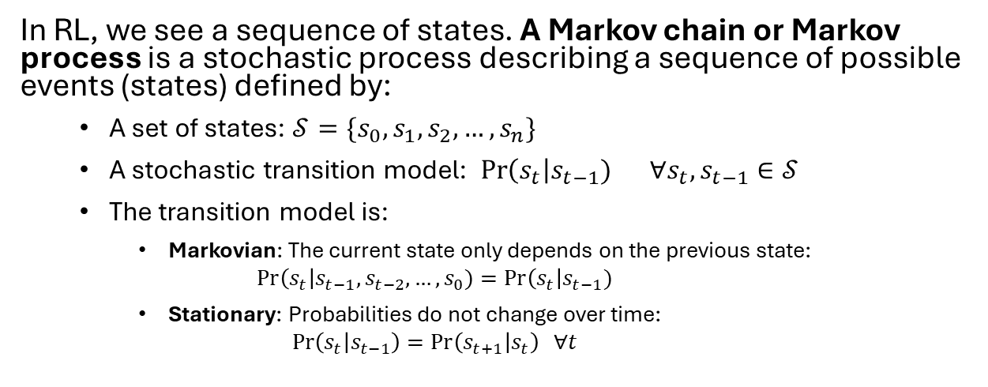
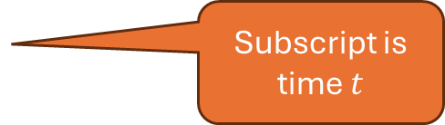






Markov Process
In RL, we see a sequence of states. A Markov chain or Markov process is a stochastic process describing a sequence of possible events (states) defined by:
A set of states: $𝒮=\{s_{0}, s_{1},s_{2}, …,s_{n}\}$
A stochastic transition model: Pr$\left(s_{t}\right|s_{t−1}) ∀s_{t},s_{t−1}∈𝒮$
The transition model is:
Markovian: The current state only depends on the previous state: $Pr\left(s_{t}\right|s_{t−1}, s_{t−2},…,s_{0})=Pr\left(s_{t}\right|s_{t−1})$
Stationary: Probabilities do not change over time: $\operatorname{Pr}\left(s_{t} | s_{t−1}\right)=\operatorname{Pr}\left(s_{t+1} | s_{t}\right) ∀t$
Markov model as a graph
$$s_{1}$$
$$s_{0}$$
$$s_{2}$$
$$s_{3}$$
Episode is a trajectory: Markov process “unrolled” over time: $s_{0},s_{1},s_{2},…$
Subscript is the state ID
$$s_{0}$$
$$s_{1}$$
$$s_{2}$$
…
Subscript is time $t$
Note: This is called a discrete-time, stationary, 1st –order Markov process with finite state space.

Slide 7



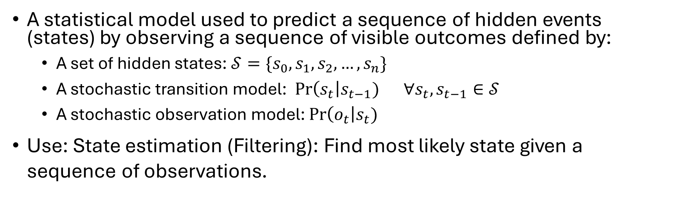



Hidden Markov Model (HMM)
A statistical model used to predict a sequence of hidden events (states) by observing a sequence of visible outcomes defined by:
A set of hidden states: $𝒮=\{s_{0}, s_{1},s_{2}, …,s_{n}\}$
A stochastic transition model: Pr$\left(s_{t}\right|s_{t−1}) ∀s_{t},s_{t−1}∈𝒮$
A stochastic observation model: Pr$\left(o_{t}\right|s_{t})$
Use: State estimation (Filtering): Find most likely state given a sequence of observations.
HMM
$$o_{1}$$
$$o_{2}$$
$$o_{3}$$
$$s_{1}$$
$$s_{2}$$
$$s_{3}$$
…

Slide 8



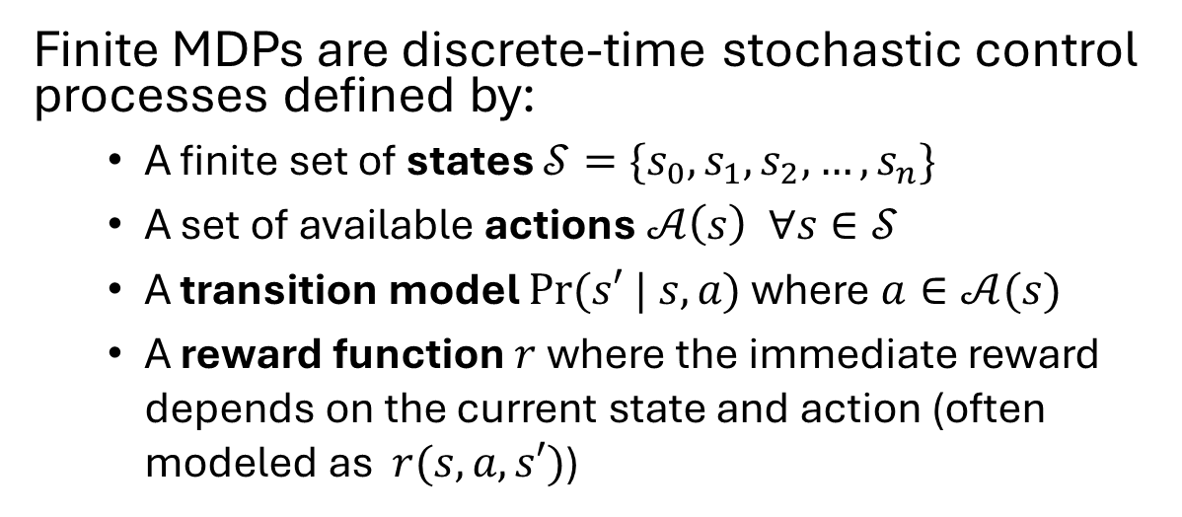


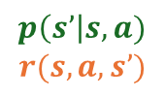












Markov Decision Process (MDP)
Finite MDPs are discrete-time stochastic control processes defined by:
A finite set of states $𝒮=\{s_{0}, s_{1},s_{2}, …,s_{n}\}$
A set of available actions $𝒜\left(s\right) ∀s∈𝒮$
A transition model $Pr(s′ | s, a)$ where $a∈𝒜(s)$
A reward function $r$ where the immediate reward depends on the current state and action (often modeled as $r(s,a,s′)$)
Example MDP as a Graph
1
$$a_{1}$$
.5
10
$$s_{0}$$
$$s_{1}$$
$$a_{2}$$
-5
10
$$a_{2}$$
.5
1
$$a_{1}$$
100
$$p\left(s’\right|s,a)$$
$$r(s,a,s’)$$
$$s_{2}$$
$$a_{1},a_{2}$$
0
Trajectory as a Markov decision process “unrolled” over time:
$$s_{0}, a_{0},r_{1},s_{1},a_{1},r_{2},s_{2},a_{2},r_{3},…$$
$$a_{o}$$
$$a_{1}$$
$$a_{2}$$
MDP
$$s_{0}$$
$$s_{1}$$
$$s_{2}$$
…
Arrow show dependencies
$$r_{1}$$
$$r_{2}$$
$$r_{3}$$

Slide 9



























Partially Observable MDP (POMDP)
Add hidden states and observations to an MDP
$$a_{o}$$
$$a_{1}$$
$$a_{2}$$
+
HMM
$$o_{1}$$
$$o_{2}$$
$$o_{3}$$
$$s_{0}$$
$$s_{1}$$
$$s_{2}$$
…
$$s_{1}$$
$$s_{2}$$
$$s_{3}$$
…
MDP
$$r_{1}$$
$$r_{2}$$
$$r_{3}$$
Note: Actions depend on all observations seen so far! POMDPs can be solved model-based using belief states.
=
$$o_{0}$$
$$a_{o}$$
$$o_{1}$$
$$a_{1}$$
$$o_{2}$$
$$a_{2}$$
$$s_{0}$$
$$s_{1}$$
$$s_{2}$$
…
$$r_{1}$$
$$r_{2}$$
$$r_{3}$$

Slide 10

Partially Observable RL
iStock Credit: RomoloTavani

Slide 11
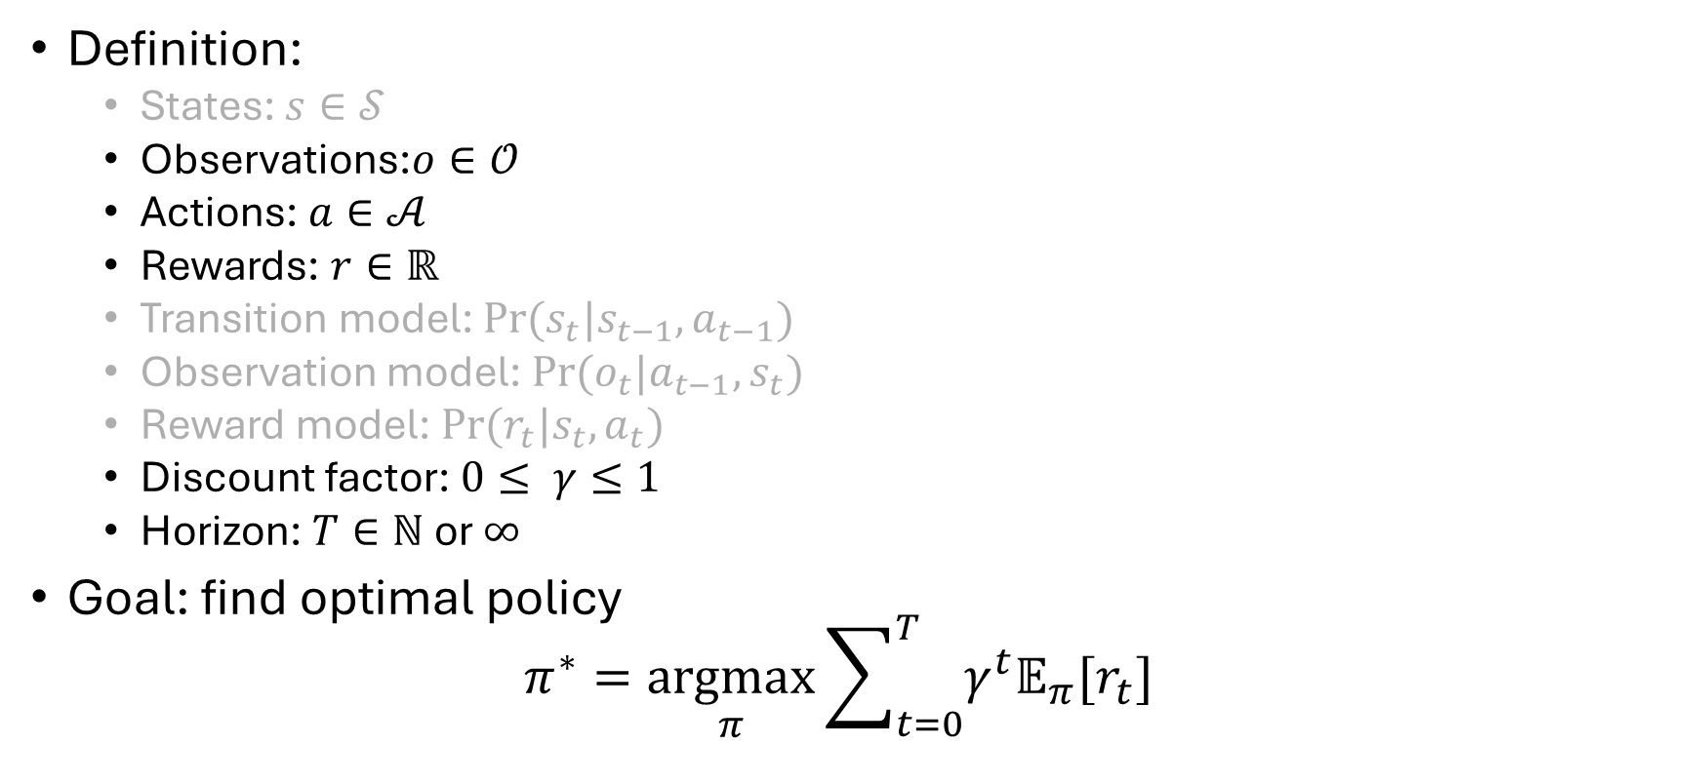

RL with Partial Observability
Unobservable
Definition:
States: $s∈𝒮$
Observations:$o∈𝒪$
Actions: $a∈𝒜$
Rewards: $r∈ℝ$
Transition model: $Pr⁡(s_{t}|s_{t−1},a_{t−1})$
Observation model: $Pr⁡(o_{t}|a_{t−1},s_{t})$
Reward model: $Pr⁡(r_{t}|s_{t},a_{t})$
Discount factor: $0≤ γ≤1$
Horizon: $T∈ℕ$ or $∞$
Goal: find optimal policy $π^{∗}=\underset{π}{argmax}{\sum_{t=0}^{T}{γ^{t}𝔼_{π}[r_{t}]}}$
x
observation $$O_{t}$$
MDP
Unknown model

Slide 12
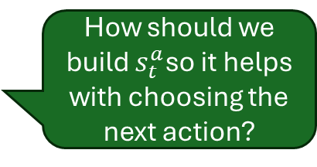
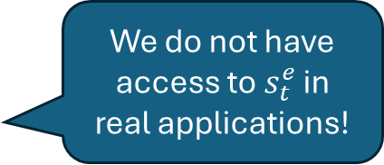
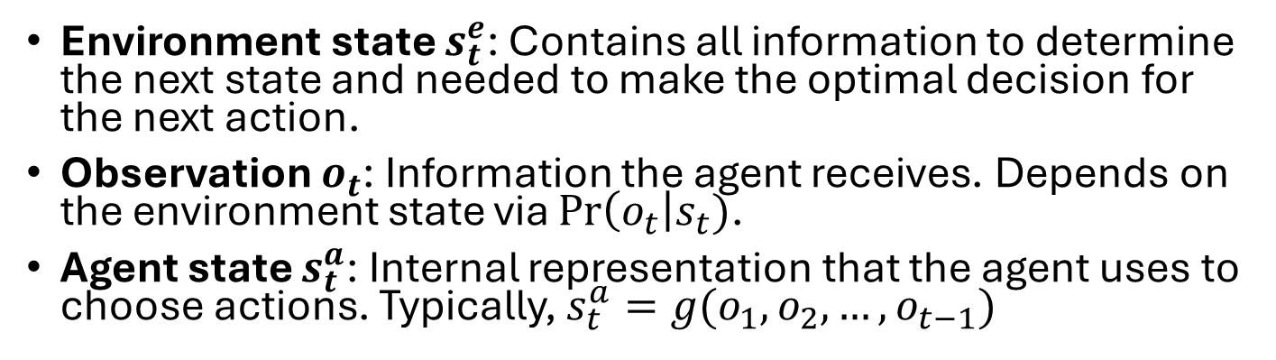




States and Observations
Agent state $S_{t}^{a}$
Policy $π(a|s^{a})$
x
MDP
Observation $$O_{t}$$
Environment state $S_{t}^{e}$
We do not have access to $s_{t}^{e}$ in real applications!
Environment state $s_{t}^{e}$: Contains all information to determine the next state and needed to make the optimal decision for the next action.
Observation $o_{t}$: Information the agent receives. Depends on the environment state via Pr$\left(o_{t}\right|s_{t})$.
Agent state $s_{t}^{a}$: Internal representation that the agent uses to choose actions. Typically, $s_{t}^{a}=g(o_{1},o_{2},…,o_{t−1})$
How should we build $s_{t}^{a}$so it helps with choosing the next action?

Slide 13





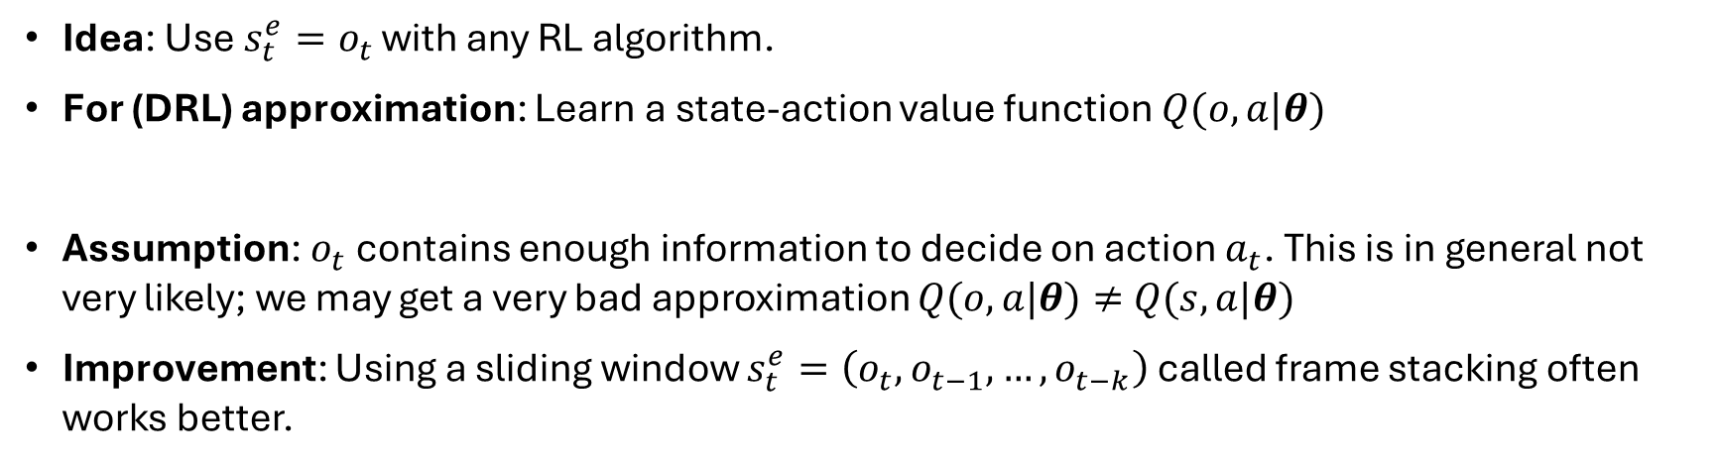







Simple Heuristic: Observation as State
$$o_{0}$$
$$a_{o}$$
$$o_{1}$$
$$a_{1}$$
$$o_{2}$$
$$a_{2}$$
$$s_{0}$$
$$s_{1}$$
$$s_{2}$$
…
$$r_{1}$$
$$r_{2}$$
$$r_{3}$$
Idea: Use $s_{t}^{e}=o_{t}$ with any RL algorithm.
For (DRL) approximation: Learn a state-action value function $Q(o,a|θ)$
Assumption: $o_{t}$ contains enough information to decide on action $a_{t}$. This is in general not very likely; we may get a very bad approximation $Q(o,a|θ)≠$ $Q(s,a|θ)$
Improvement: Using a sliding window $s_{t}^{e}=\left(o_{t}, o_{t−1},…,o_{t−k}\right)$ called frame stacking often works better.

Slide 14




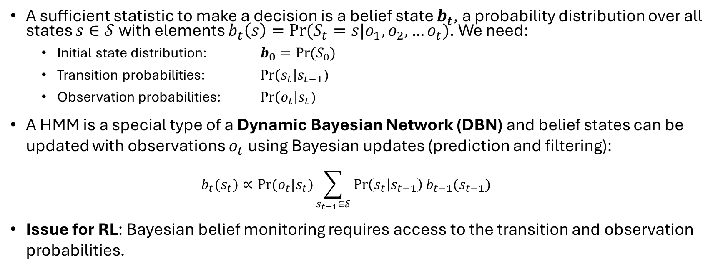






Optimal Belief Monitoring
HMM
$$b_{0}$$
$$b_{1}$$
$$b_{2}$$
$$b_{3}$$
$$o_{1}$$
$$o_{2}$$
$$o_{3}$$
$$s_{1}$$
$$s_{2}$$
$$s_{3}$$
…
A sufficient statistic to make a decision is a belief state $b_{t}$, a probability distribution over all states $s∈𝒮$ with elements $b_{t}\left(s\right)=Pr⁡(S_{t}=s|o_{1},o_{2},…o_{t})$. We need:
Initial state distribution: $b_{0}=Pr⁡(S_{0})$
Transition probabilities: Pr$\left(s_{t}\right|s_{t−1})$
Observation probabilities: Pr$\left(o_{t}\right|s_{t})$
A HMM is a special type of a Dynamic Bayesian Network (DBN) and belief states can be updated with observations $o_{t}$ using Bayesian updates (prediction and filtering):
$$b_{t}(s_{t})∝Pr⁡(o_{t}|s_{t})\sum_{s_{t−1}∈𝒮}{\operatorname{Pr}\left(s_{t} | s_{t−1}\right)b_{t−1}(s_{t−1})}$$
Issue for RL: Bayesian belief monitoring requires access to the transition and observation probabilities.

Slide 15








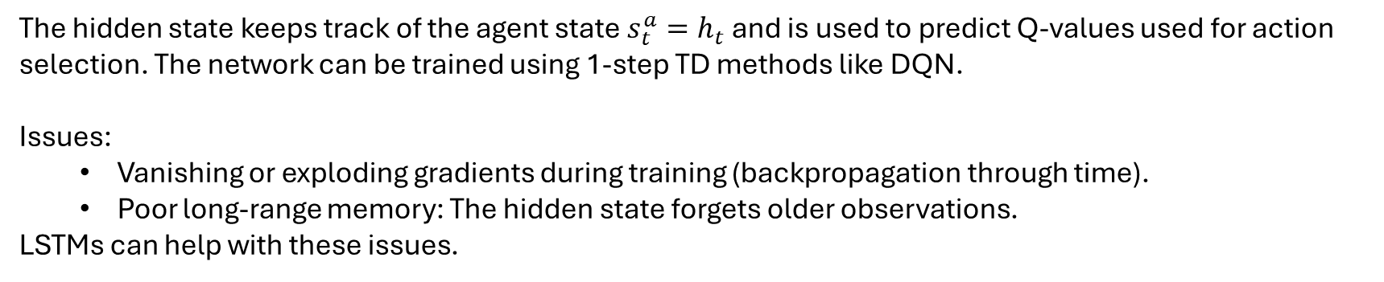







Deep Belief Monitoring with RNNs
Recurrent Neural Networks (RNNs)
$$q_{t}=f(Vh_{t})$$
RNN
$$q_{t}$$
$$q_{1}$$
$$q_{2}$$
$$q_{3}$$
Unroll
$$h_{t}$$
$$h_{0}$$
$$h_{1}$$
$$h_{2}$$
$$h_{3}$$
…
$$h_{t}=g\left(Uh_{t−1}+Wo_{t}\right)$$
$$o_{1}$$
$$o_{2}$$
$$o_{3}$$
$$o_{t}$$
The hidden state keeps track of the agent state $s_{t}^{a}=h_{t}$ and is used to predict Q-values used for action selection. The network can be trained using 1-step TD methods like DQN.
Issues:
Vanishing or exploding gradients during training (backpropagation through time).
Poor long-range memory: The hidden state forgets older observations.
LSTMs can help with these issues.

Slide 16
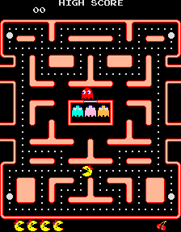
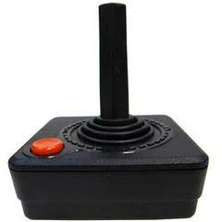
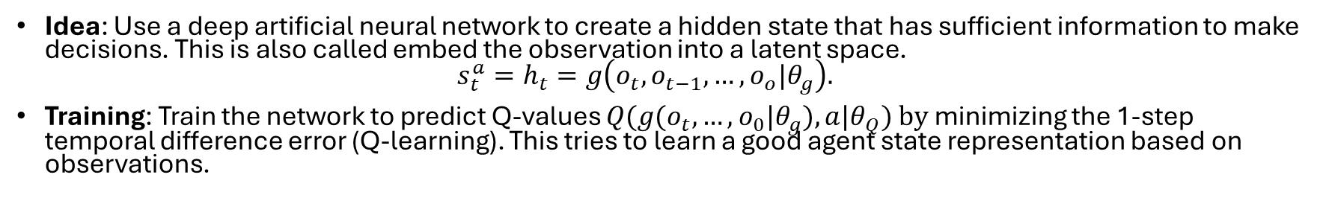

Example
Idea: Use a deep artificial neural network to create a hidden state that has sufficient information to make decisions. This is also called embed the observation into a latent space. $s_{t}^{a}=h_{t}=g\left(o_{t}, o_{t−1},…,o_{o}|θ_{g}\right).$
Training: Train the network to predict Q-values $Q(g(o_{t},…,o_{0}|θ_{g}),a|θ_{Q}) by$minimizing the 1-step temporal difference error (Q-learning). This tries to learn a good agent state representation based on observations.
Hidden State $h$
Deep Network
Convolution,
RNN, etc.
Fully connected layer
observation
Q-values
action
The direction of the moving ghosts is not observable!
Train using TD-error as loss

Slide 17
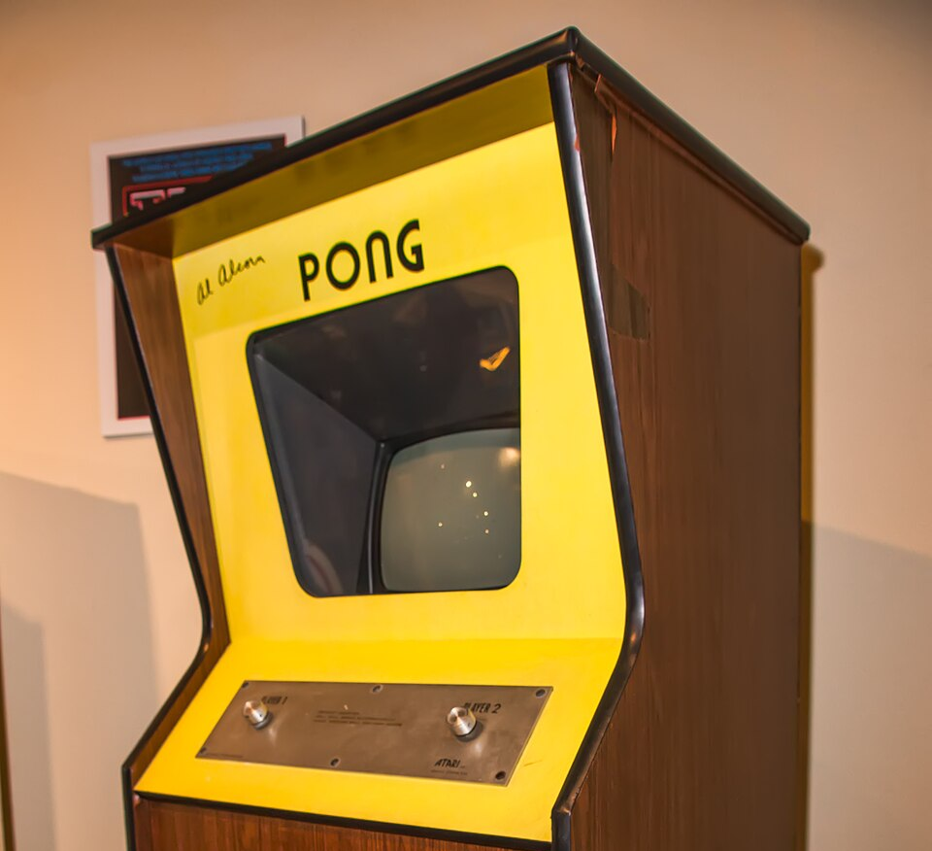
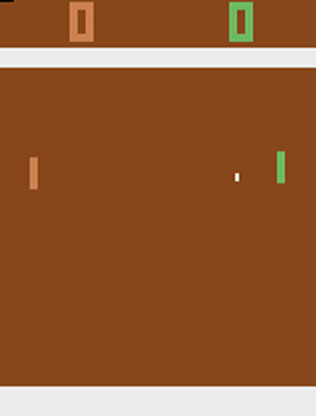
Case Study: Atari Pong
Atari Inc., 1972
Pong simulates table tennis. The players use paddles to hit a ball back and forth. Points are earned when the opponent fails to return the ball. The goal is for each player to reach eleven points before the opponent.

Slide 18
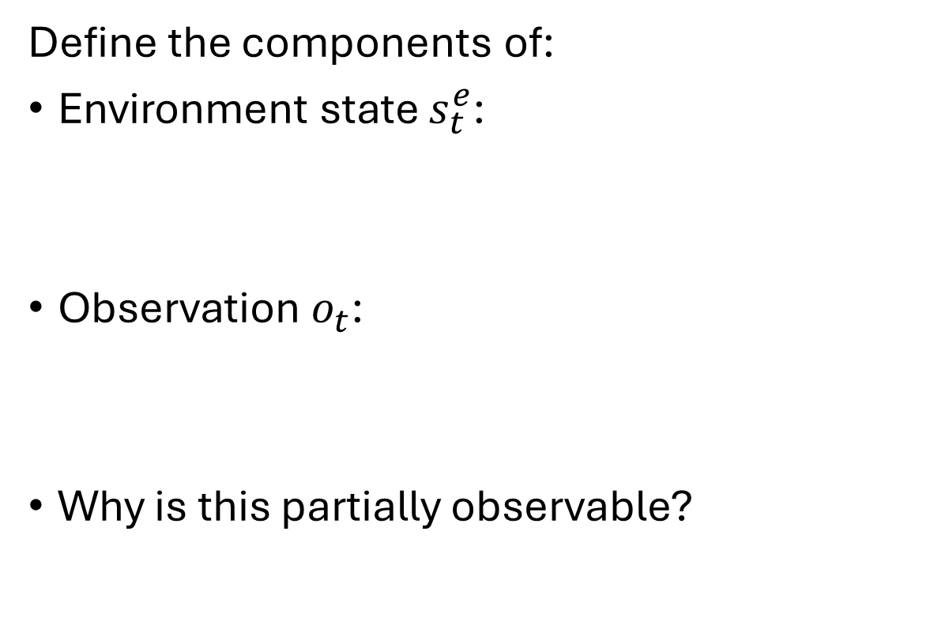
States and Observations
Define the components of:
Environment state $s_{t}^{e}$:
Observation $o_{t}$:
Why is this partially observable?
Actions: move paddle up or down.
Reward: +1 when the opponent cannot return the ball.

Slide 19

Single Observation as State
Learn an approximate $Q(o_{t},a|θ)$ using a TD method.
How well do you think this will work?
Feature from current frame

Slide 20
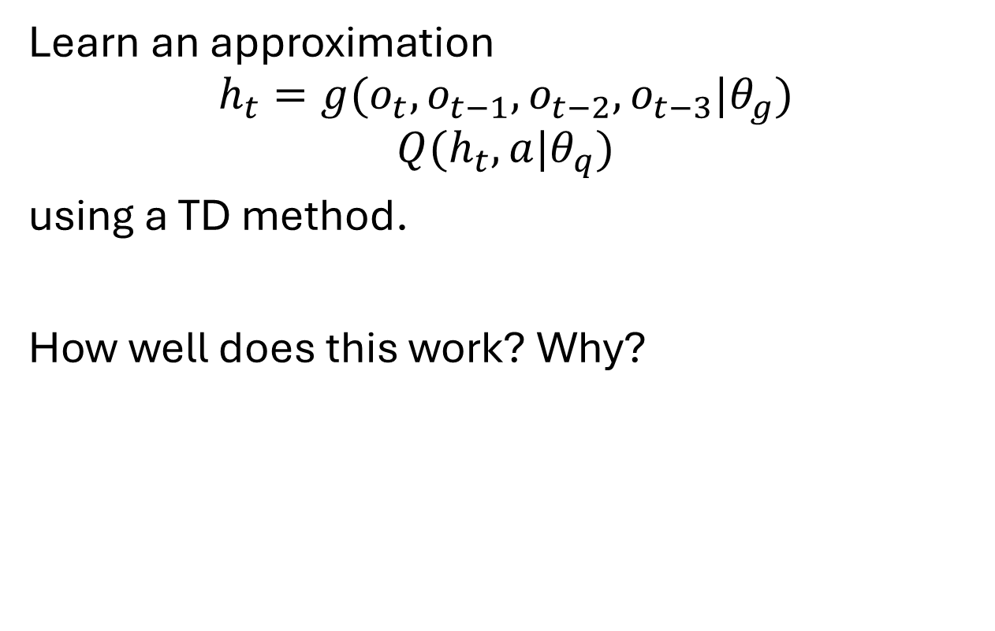
Frame Stacking
Learn an approximation
$$h_{t}=g(o_{t}, o_{t−1}, o_{t−2},o_{t−3}|θ_{g})$$
$$Q(h_{t}, a|θ_{q})$$
using a TD method.
How well does this work? Why?
Feature from four frames

Slide 21
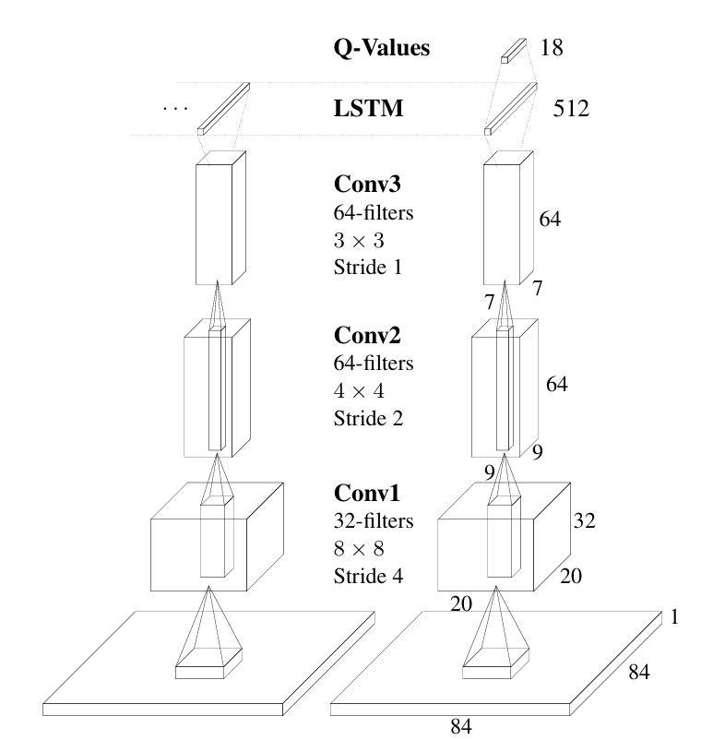
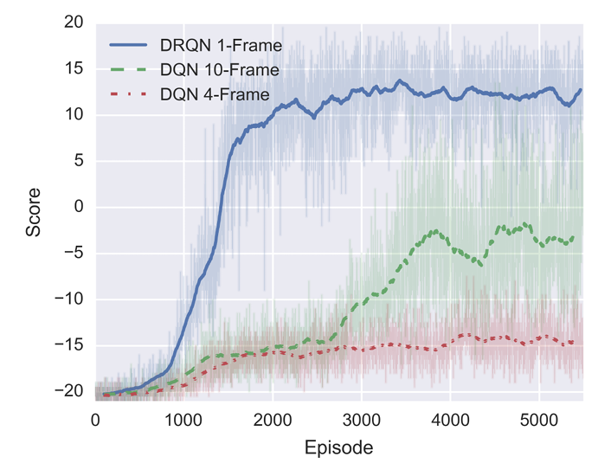





Deep Recurrent Q-Learning
Architecture $$Q(g(o_{t},…,o_{0}|θ_{g}),a| θ_{Q})$$
Paper: Matthew Hausknecht and Peter Stone, Deep Recurrent Q-Learning for Partially Observable MDPs, 2015 AAAI Fall Symposium.
Approach: Deep belief monitoring using
convolution to process the screen image (observation model)
RNN (LSTM) to update the agent state (transition model)
A fully connected layer to predict Q-values
Results: Works better than frame stacking on some Atari games.
$$h_{t−1}$$
$$h_{t}$$
…
$$o_{t−1}$$
$$o_{t}$$

Slide 22
What You Should Know
How observations are related to the environment state and the agent state.
The relationship between Markov Chains, MDPs, HMMs, and POMDPs.
Why using (stacked) observations instead of states sometimes works.
Belief states and belief monitoring. How deep neural networks can be used to learn belief states.

