Slide 1



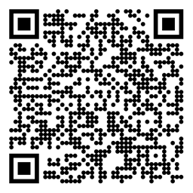

Reinforcement Learning Course Intro
Michael Hahsler, SMU

Slide 2
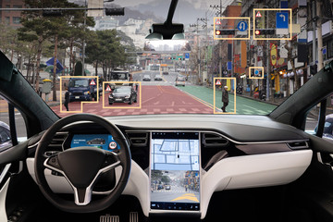
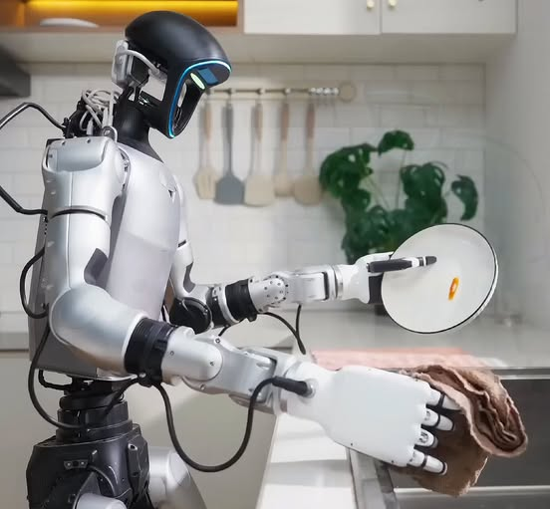
Course Goal
How Do We Build Intelligent Systems?
Options:
Explicitly program behavior: Rule-based agent, planning
Learn behavior from labeled data offline: Supervised learning
Learn behavior using feedback from interacting with the environment (online): Reinforcement Learning

Slide 3
Course Learning Outcomes
CLO 1: Explain foundational concepts of reinforcement learning
CLO 2: Formulate sequential decision-making problems as Markov Decision Processes (MDPs)
CLO 3: Apply dynamic programming and Monte Carlo methods to solve reinforcement learning problems
CLO 4: Implement and evaluate Temporal-Difference (TD) learning algorithms
CLO 5: Utilize function approximation methods for large or continuous state spaces
CLO 6: Implement reinforcement learning agents with policy gradients
CLO 7: Critically evaluate current research and applications of deep reinforcement learning

Slide 4
Learning Method
Lecture + Problem Sets: We will discuss algorithms appropriate for different tasks and types of environments. Problem sets will improve the understanding.
Projects: You will implement algorithms to solve several tasks and conduct experiments to investigate how well the algorithms work and how they scale with problem size.
Research: paper and presentation (graduate students only)
Exams: Checks knowledge of AI concepts and the ability to apply them.
Evaluation: is based on problem sets, projects, and exams. + research paper for graduate students

Slide 5
Course Mechanics
Office hours:
My office hours can be found on my home page.
Weekly TA office hours will be done using Zoom. The time and the link will be on Canvas soon.
Communication: Use Canvas messages and leave comments for assignments.
Assignment Grading: The TA will grade assignments and problem sets. Please contact the TA (e.g., during office hours or by leaving a comment) to discuss your assignment and grade.
Final Grade: The calculated grade on Canvas serves as a rough guide. I will assign your final grade at the end of the semester.

Slide 6
Tools and Support
Canvas: For material, assignments, and communication.
Course GitHub page: https://mhahsler.github.io/Introduction_to_Reinforcement_Learning/
Howtos
Slides
Code Examples
AI-Use Guideline:
Self-study outside of the classroom is allowed because Generative AI can enhance learning by providing multiple ways to engage with the content and skills developed in this class.
Help with coding for assignments. Most algorithms in this course are quite simple, and you should try to implement them first by yourself. Use AI to provide glue code and for debugging. Be careful. AI chatbots are often inaccurate and sometimes produce incorrect answers. You are responsible for checking the accuracy before using the code.
You are not allowed to use AI tools to write your assignment report.
Specific AI-use guidelines may be part of the assignment description.

Slide 7
Recommended Readings
Richard S. Sutton, Andrew G. Barto, Reinforcement Learning: An Introduction, 2nd edition, MIT Press, Cambridge, MA, 2018.
Vincent François-Lavet, Peter Henderson, Riashat Islam, Marc G. Bellemare and Joelle Pineau, An Introduction to Deep Reinforcement Learning, Foundations and Trends in Machine Learning, 11:3-4, pp 219-354, 2018.

Slide 8
To Be Successful You Need…
Proficiency in Python programming.
Familiarity with artificial intelligence fundamentals, including intelligent agents and search.
Knowledge of machine learning (e.g., supervised learning, deep learning, model evaluation).
Knowledge of math and probability theory (probability, expectation)

