Slide 1
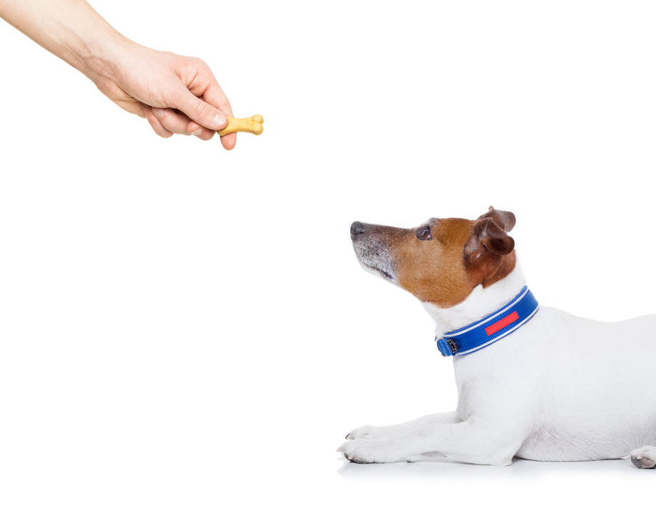

Reinforcement Learning Temporal Difference Learning Sutton/Barto* Chapter 6
Michael Hahsler, SMU
With figures from Sutton/Barto*
*Sutton and Barto, Reinforcement Learning: An Introduction, 2nd edition, MIT Press, Cambridge, MA, 2018

Slide 2
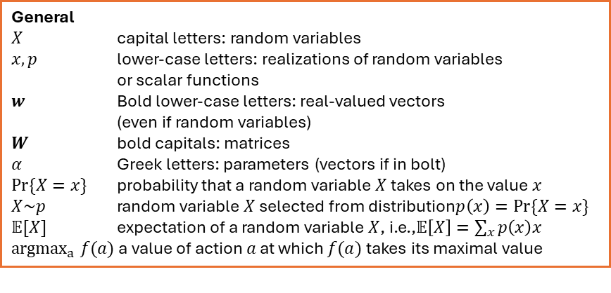
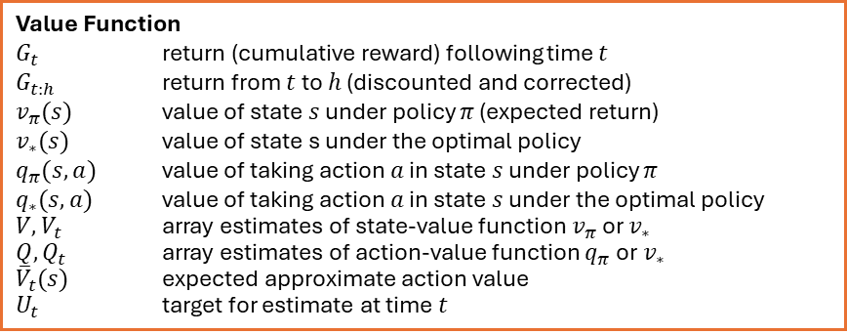
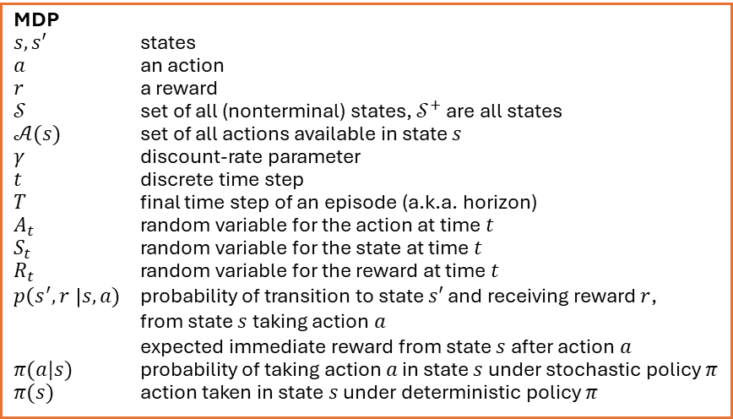
Summary of Notation
General
$X$ capital letters: random variables $x, p$ lower-case letters: realizations of random variables or scalar functions
$w$ Bold lower-case letters: real-valued vectors (even if random variables)
$W$ bold capitals: matrices
$α$ Greek letters: parameters (vectors if in bolt)
$Pr⁡\{X=x\}$ probability that a random variable $X$ takes on the value $x$
$X\sim p$ random variable $X$ selected from distribution$p\left(x\right)=Pr⁡\{X=x\}$
$𝔼[X]$ expectation of a random variable $X$, i.e.,$𝔼\left[X\right]=\sum_{x}{p\left(x\right)x}$
${argmax}_{a} f(a)$ a value of action $a$ at which $f(a)$ takes its maximal value
Value Function
$G_{t}$ return (cumulative reward) following time $t$
$G_{t:h}$ return from $t$ to $h$ (discounted and corrected)
$v_{π}(s)$ value of state $s$ under policy $π$ (expected return)
$v_{∗}(s)$ value of state s under the optimal policy
$q_{π}(s,a)$ value of taking action $a$ in state $s$ under policy $π$
$q_{∗}(s,a)$ value of taking action $a$ in state $s$ under the optimal policy
$V, V_{t}$ array estimates of state-value function $v_{π}$or $v_{∗}$
$Q,Q_{t}$ array estimates of action-value function $q_{π}$or $v_{∗}$
${\overline{V}}_{t}(s)$ expected approximate action value
$U_{t}$ target for estimate at time$t$
MDP
$s, s′$ states
$a$ an action
$r$ a reward
$𝒮$ set of all (nonterminal) states, $𝒮^{+}$ are all states
$𝒜(s)$ set of all actions available in state $s$
$γ$ discount-rate parameter
$t$ discrete time step
$T$ final time step of an episode (a.k.a. horizon)
$A_{t}$ random variable for the action at time $t$
$S_{t}$ random variable for the state at time $t$
$R_{t}$ random variable for the reward at time $t$
$p\left(s^{′},r \right|s, a)$ probability of transition to state $s′$ and receiving reward $r$, from state $s$ taking action $a$
expected immediate reward from state $s$ after action $a$
$π(a|s)$ probability of taking action $a$ in state $s$ under stochastic policy $π$
$π(s)$ action taken in state $s$ under deterministic policy $π$

Slide 3
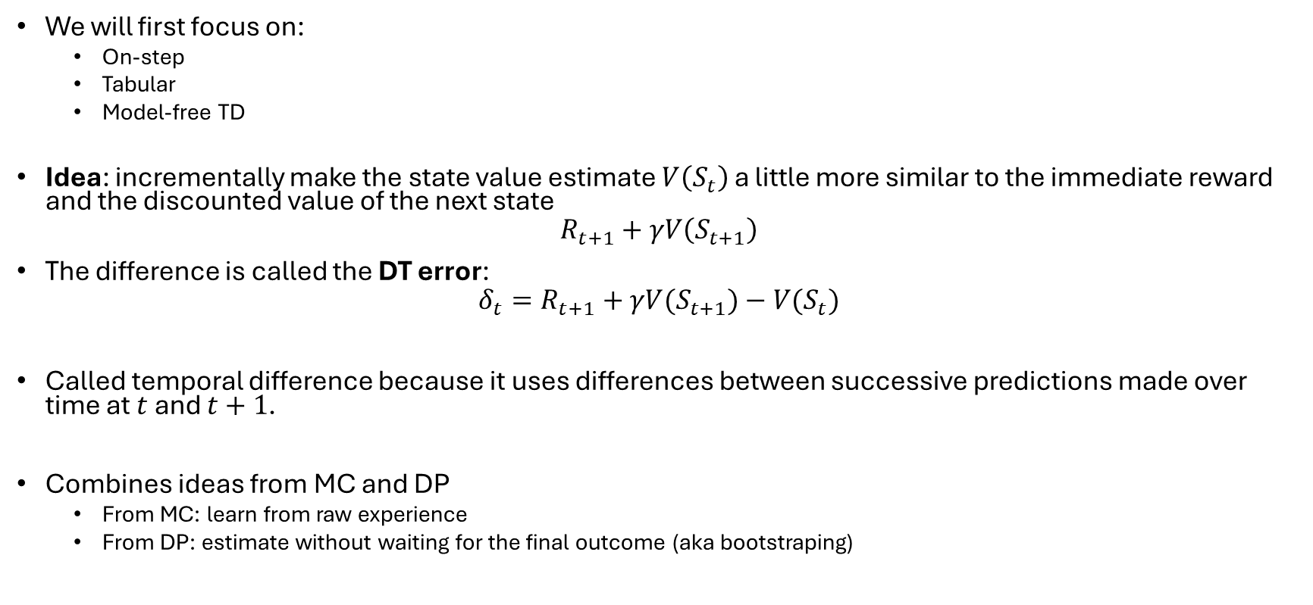
Temporal Difference (TD)
We will first focus on:
On-step
Tabular
Model-free TD
Idea: incrementally make the state value estimate $V\left(S_{t}\right)$a little more similar to the immediate reward and the discounted value of the next state
$$R_{t+1}+γV\left(S_{t+1}\right)$$
The difference is called the DT error:
$$δ_{t}=R_{t+1}+γV(S_{t+1})−V(S_{t})$$
Called temporal difference because it uses differences between successive predictions made over time at $t$ and $t+1$.
Combines ideas from MC and DP
From MC: learn from raw experience
From DP: estimate without waiting for the final outcome (aka bootstraping)

Slide 4
TD Prediction

Slide 5

TD Prediction
Follow $π$ and update estimate $V$ of $v_{π}$
MC: $V\left(S_{t}\right)\overset{←}{}V\left(S_{t}\right)+α[G_{t}−V(S_{t})]$
TD: $V\left(S_{t}\right)\overset{←}{}V\left(S_{t}\right)+α[R_{t+1}+γV(S_{t+1})−V(S_{t})]$
MC Error
TD Error
Uses reward + estimate for next state = target
Without waiting for the end of the sequence. Similar to bootstrapping in DP

Slide 6
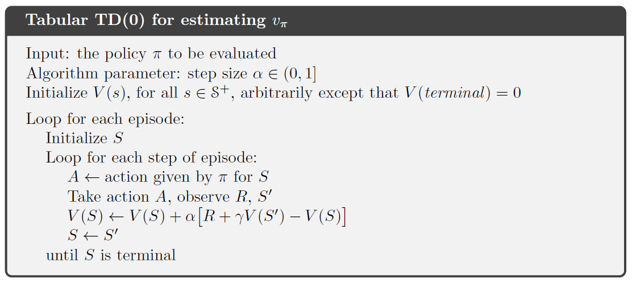
Alg. Tabular TD(0)
Note: We can only update for time $t$ at time $t+1$ since we need $S′$ and the reward $R_{t+1}$!

Slide 7
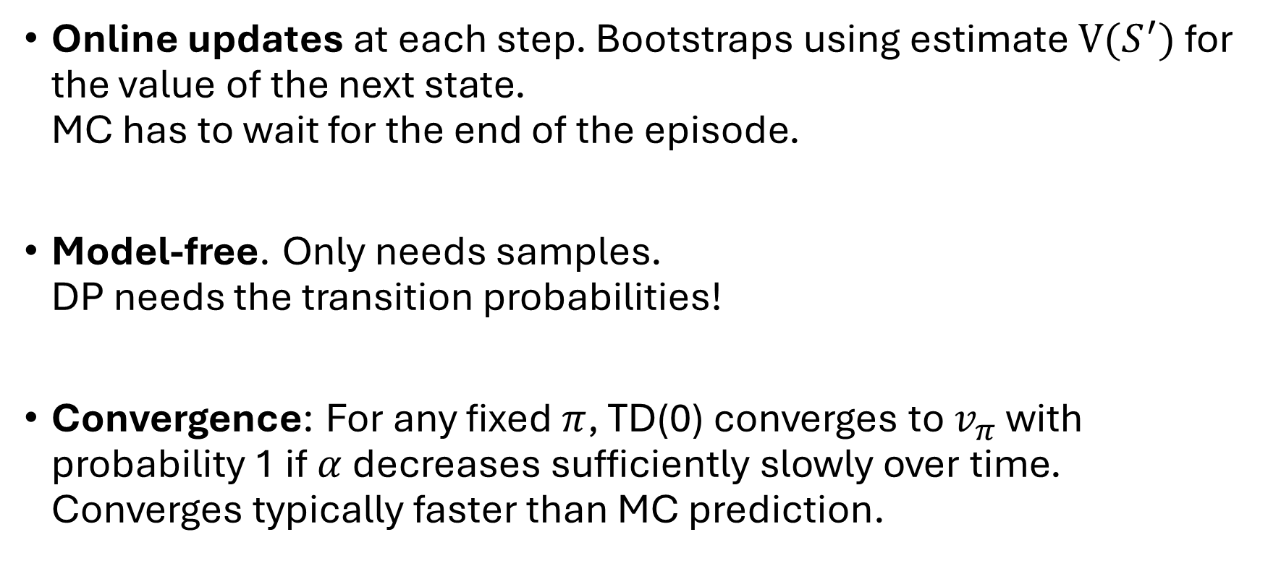
Advantages of TD Prediction Methods
Online updates at each step. Bootstraps using estimate $V(S^{′})$ for the value of the next state. MC has to wait for the end of the episode.
Model-free. Only needs samples. DP needs the transition probabilities!
Convergence: For any fixed $π$, TD(0) converges to $v_{π}$ with probability 1 if $α$ decreases sufficiently slowly over time. Converges typically faster than MC prediction.

Slide 8
Sarsa: On-policy TD Control

Slide 9
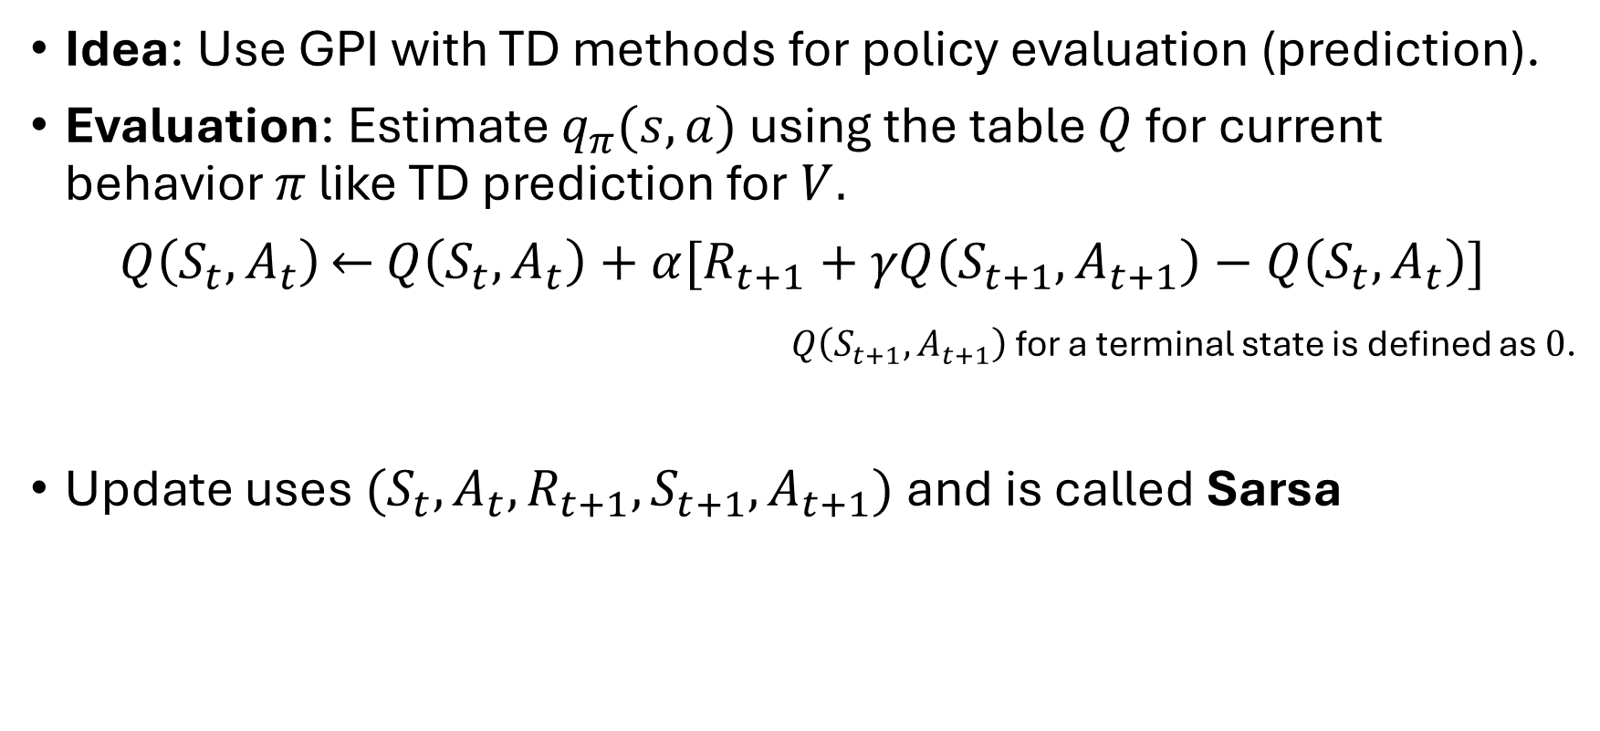
Sarsa
Idea: Use GPI with TD methods for policy evaluation (prediction).
Evaluation: Estimate $q_{π}(s,a)$ using the table $Q$ for current behavior $π$ like TD prediction for $V.$
$Q\left(S_{t},A_{t}\right)\overset{←}{}$ $Q\left(S_{t},A_{t}\right)+α[R_{t+1}+γQ\left(S_{t+1},A_{t+1}\right)−Q\left(S_{t},A_{t}\right)]$
$Q\left(S_{t+1},A_{t+1}\right)$ for a terminal state is defined as $0$.
Update uses $(S_{t},A_{t},R_{t+1},S_{t+1}, A_{t+1})$ and is called Sarsa

Slide 10
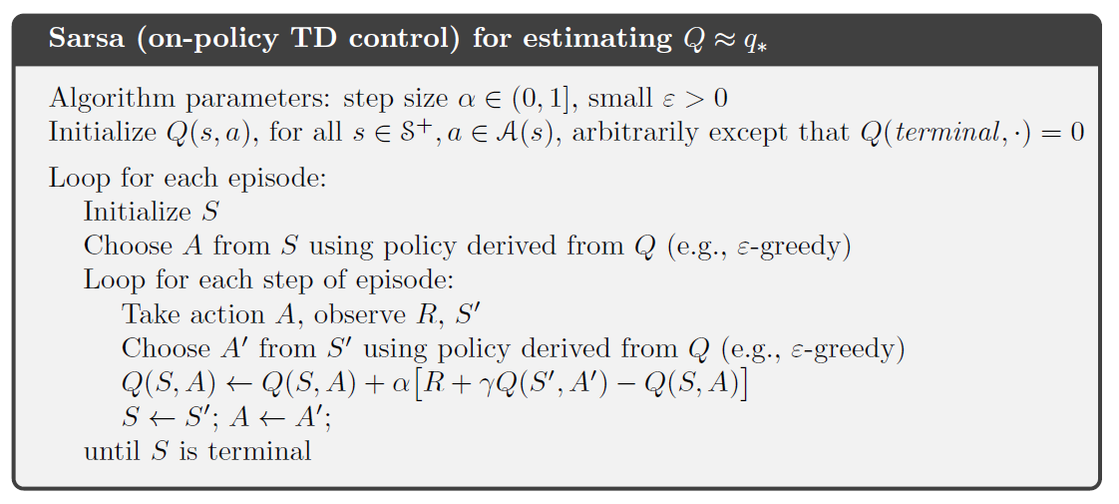
Alg. Sarsa

Slide 11
Q-learning: Off-policy TD Control

Slide 12
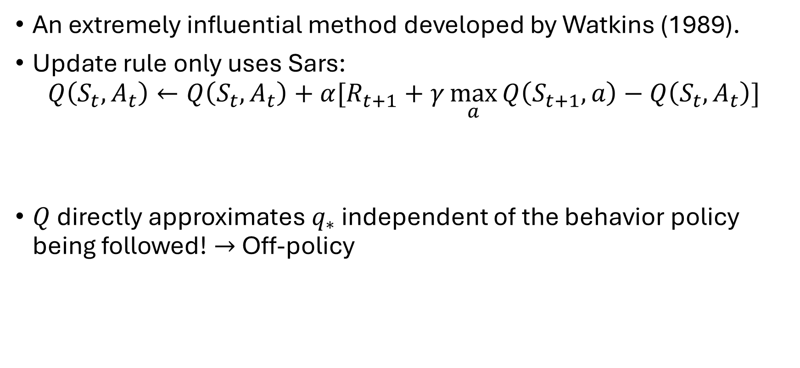
Q-learning
An extremely influential method developed by Watkins (1989).
Update rule only uses Sars:
$$Q\left(S_{t},A_{t}\right)←Q\left(S_{t},A_{t}\right)+α[R_{t+1}+γ\max_{a}{Q\left(S_{t+1},a\right)}−Q\left(S_{t},A_{t}\right)]$$
$Q$ directly approximates $q_{∗}$ independent of the behavior policy being followed! $→$ Off-policy
The next action is not observed, but greedily chosen!

Slide 13
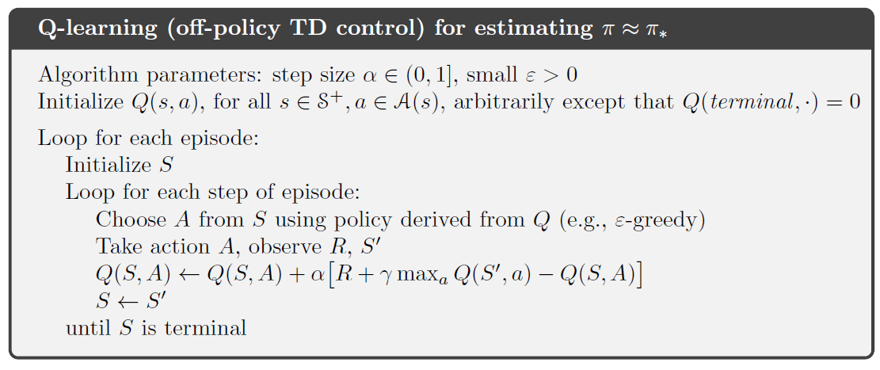
Alg. Q-Learning

Slide 14
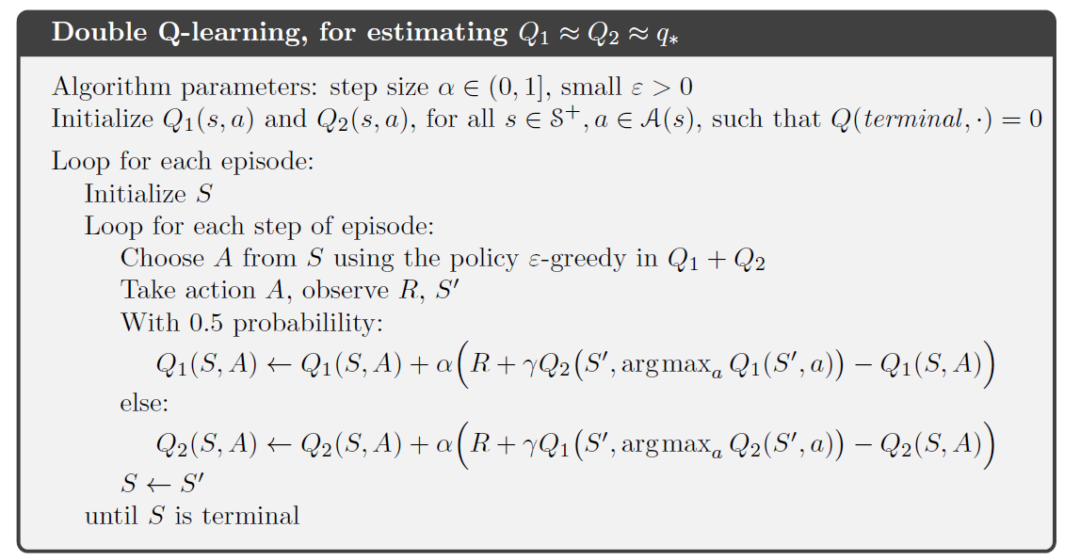
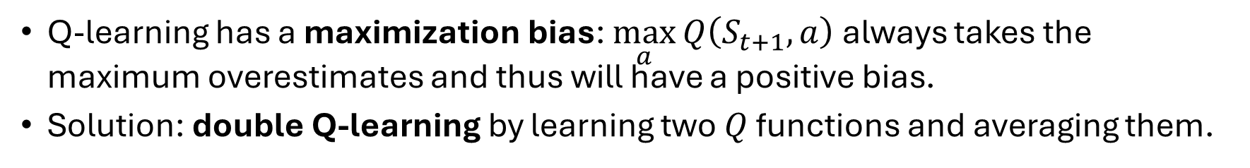
Q-Learning’s Maximization Bias
Q-learning has a maximization bias: $\max_{a}{Q\left(S_{t+1},a\right)}$ always takes the maximum overestimates and thus will have a positive bias.
Solution: double Q-learning by learning two $Q$ functions and averaging them.

Slide 15
Expected Sarsa

Slide 16
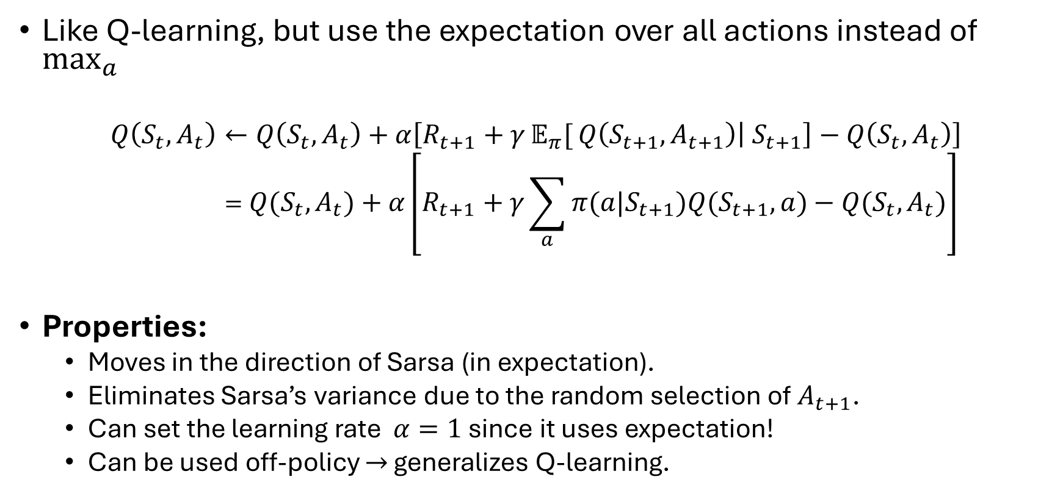
Expected Sarsa
Like Q-learning, but use the expectation over all actions instead of $\max_{a}{}$
$$Q\left(S_{t},A_{t}\right)←Q\left(S_{t},A_{t}\right)+α\left[R_{t+1}+γ𝔼_{π}[{Q\left(S_{t+1},A_{t+1}\right)\left| S_{t+1}\right]}−Q\left(S_{t},A_{t}\right)\right] \\ =Q\left(S_{t},A_{t}\right)+α\left[R_{t+1}+γ\sum_{a}{π(a|S_{t+1})Q\left(S_{t+1},a\right)}−Q\left(S_{t},A_{t}\right)\right]$$
Properties:
Moves in the direction of Sarsa (in expectation).
Eliminates Sarsa’s variance due to the random selection of $A_{t+1}$.
Can set the learning rate $α=1$ since it uses expectation!
Can be used off-policy $→$ generalizes Q-learning.

Slide 17
Comaprison

Slide 18

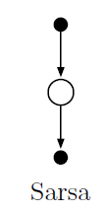
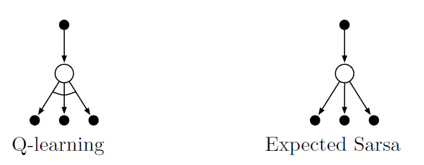










Comparison: 1-step Backup Diagrams
1-step
$$V(S_{t})$$
$$V(S_{t+1})$$
update
Used to bootstrap the remaining return $G_{t+1}$
$$S_{t}$$
$$A_{t}$$
$$R_{t+1}$$
$$S_{t+1}$$
$$\text{max}$$
$$𝔼$$
$$A_{t+1}$$

Slide 19
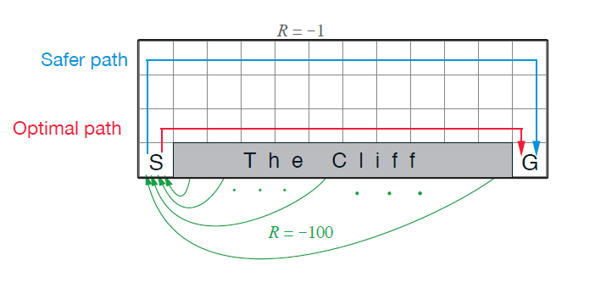
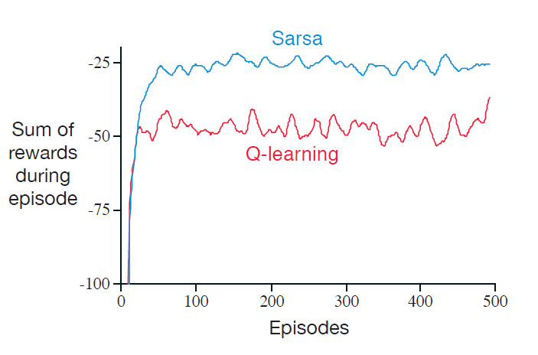
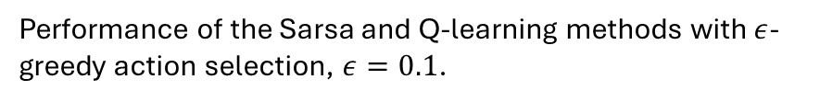
Sarsa vs. Q-Learning
Cliff Walking: Consider the gridworld shown to the right.
This is a standard undiscounted, episodic task, with start and goal states.
Actions causing movement up, down, right, and left.
Reward is −1 on all transitions except those into the region marked “The Cliff.” Stepping into this region incurs a reward of −100 and sends the sends the agent instantly back to the start.
Performance of the Sarsa and Q-learning methods with $ε$-greedy action selection, $ε=0.1$.
Why does the optimal path perform worse?

Slide 20
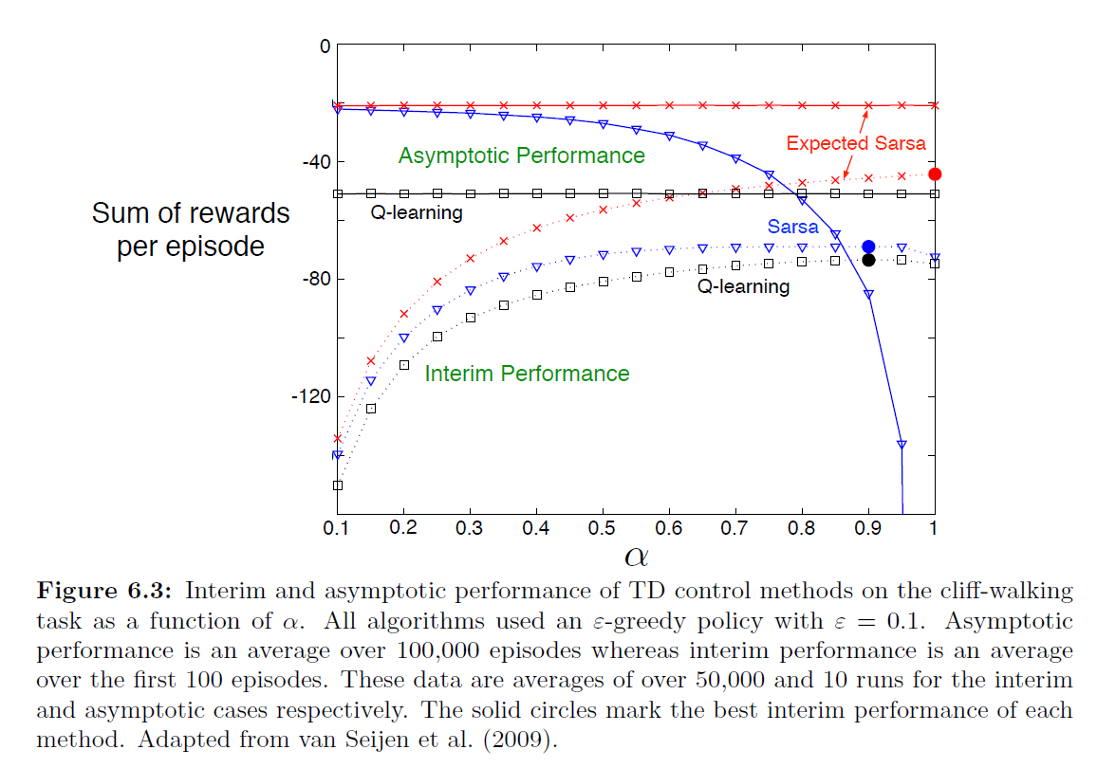
Comparison

Slide 21
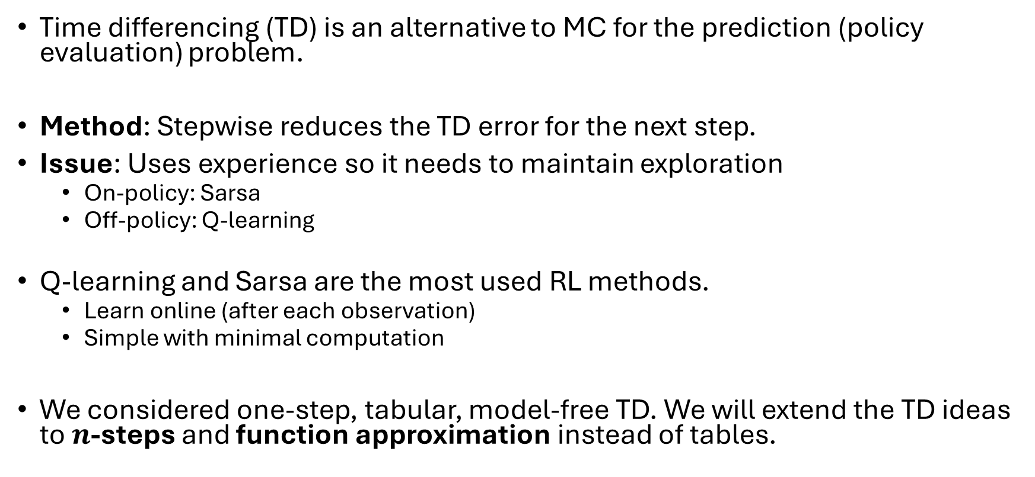
Summary
Time differencing (TD) is an alternative to MC for the prediction (policy evaluation) problem.
Method: Stepwise reduces the TD error for the next step.
Issue: Uses experience so it needs to maintain exploration
On-policy: Sarsa
Off-policy: Q-learning
Q-learning and Sarsa are the most used RL methods.
Learn online (after each observation)
Simple with minimal computation
We considered one-step, tabular, model-free TD. We will extend the TD ideas to $n$-steps and function approximation instead of tables.

