Slide 1



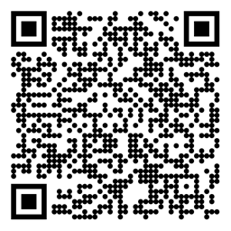

Reinforcement Learning Eligibility Traces Sutton/Barto* Chapter 12
Michael Hahsler, SMU
With figures from Sutton/Barto*
*Sutton and Barto, Reinforcement Learning: An Introduction, 2nd edition, MIT Press, Cambridge, MA, 2018

Slide 2
Topics of this Course
Introduction to reinforcement learning
Markov decision processes
Part I: Tabular Methods
Dynamic programming
Monte Carlo methods
Temporal-difference learning
Multi-step bootstrapping
Planning and learning with tabular methods
Part II: Approximate Solution Methods
Prediction and Control using Approximation
Eligibility Traces
Policy Gradient Methods
Part III: Modern RL Methods
Deep Reinforcement Learning
Current Applications

Slide 3
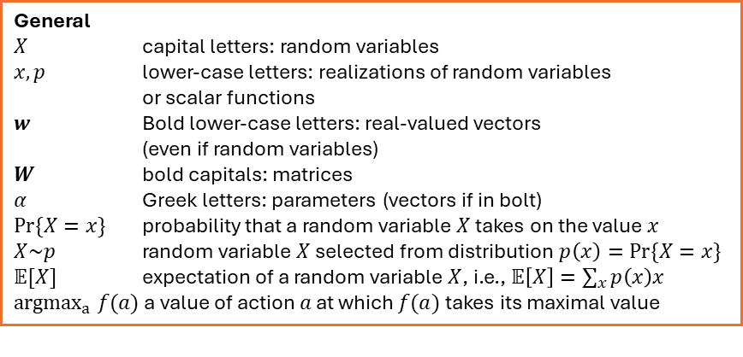
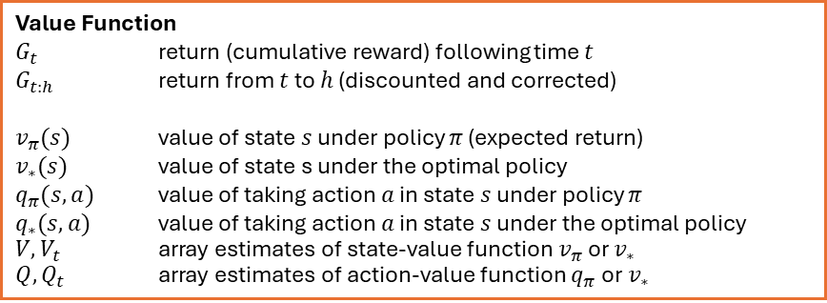
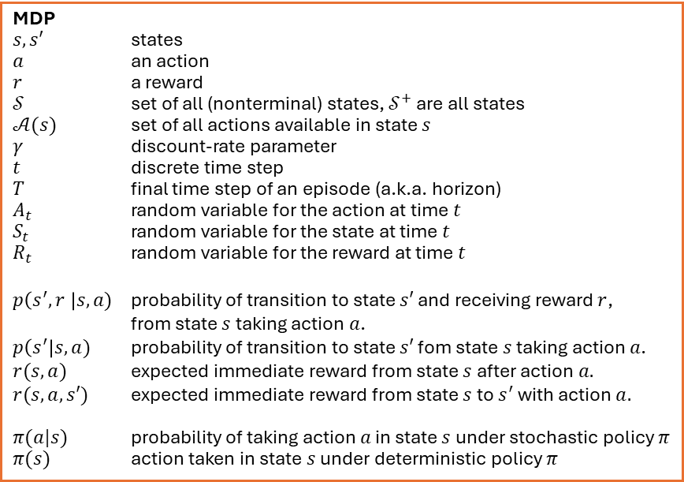
Summary of Notation
General
$X$ capital letters: random variables $x, p$ lower-case letters: realizations of random variables or scalar functions
$w$ Bold lower-case letters: real-valued vectors (even if random variables)
$W$ bold capitals: matrices
$α$ Greek letters: parameters (vectors if in bolt)
$Pr⁡\{X=x\}$ probability that a random variable $X$ takes on the value $x$
$X\sim p$ random variable $X$ selected from distribution $p\left(x\right)=Pr⁡\{X=x\}$
$𝔼[X]$ expectation of a random variable $X$, i.e., $𝔼\left[X\right]=\sum_{x}{p\left(x\right)x}$
${argmax}_{a} f(a)$ a value of action $a$ at which $f(a)$ takes its maximal value
MDP
$s, s′$ states
$a$ an action
$r$ a reward
$𝒮$ set of all (nonterminal) states, $𝒮^{+}$ are all states
$𝒜(s)$ set of all actions available in state $s$
$γ$ discount-rate parameter
$t$ discrete time step
$T$ final time step of an episode (a.k.a. horizon)
$A_{t}$ random variable for the action at time $t$
$S_{t}$ random variable for the state at time $t$
$R_{t}$ random variable for the reward at time $t$
$p\left(s^{′},r \right|s, a)$ probability of transition to state $s′$ and receiving reward $r$, from state $s$ taking action $a$.
$p\left(s^{′}\right|s, a)$ probability of transition to state $s′$ fom state $s$ taking action $a$.
$r(s,a)$ expected immediate reward from state $s$ after action $a.$
$r(s,a,s′)$ expected immediate reward from state $s$ to $s^{′}$ with action $a.$
$π(a|s)$ probability of taking action $a$ in state $s$ under stochastic policy $π$
$π(s)$ action taken in state $s$ under deterministic policy $π$
Value Function
$G_{t}$ return (cumulative reward) following time $t$
$G_{t:h}$ return from $t$ to $h$ (discounted and corrected)
$v_{π}(s)$ value of state $s$ under policy $π$ (expected return)
$v_{∗}(s)$ value of state s under the optimal policy
$q_{π}(s,a)$ value of taking action $a$ in state $s$ under policy $π$
$q_{∗}(s,a)$ value of taking action $a$ in state $s$ under the optimal policy
$V, V_{t}$ array estimates of state-value function $v_{π}$or $v_{∗}$
$Q,Q_{t}$ array estimates of action-value function $q_{π}$or $v_{∗}$

Slide 4
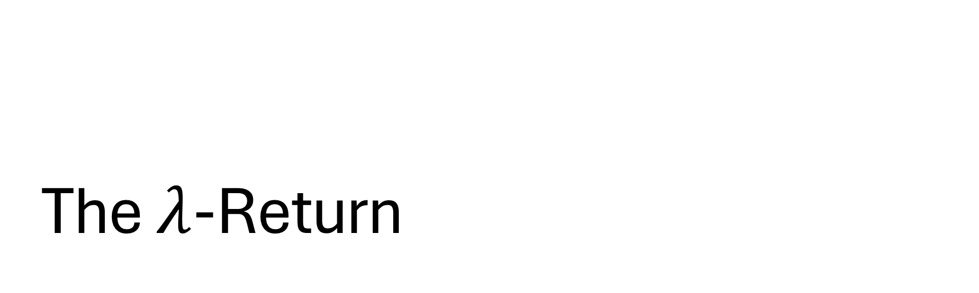
The $λ$-Return
Performing updates with compound return targets

Slide 5
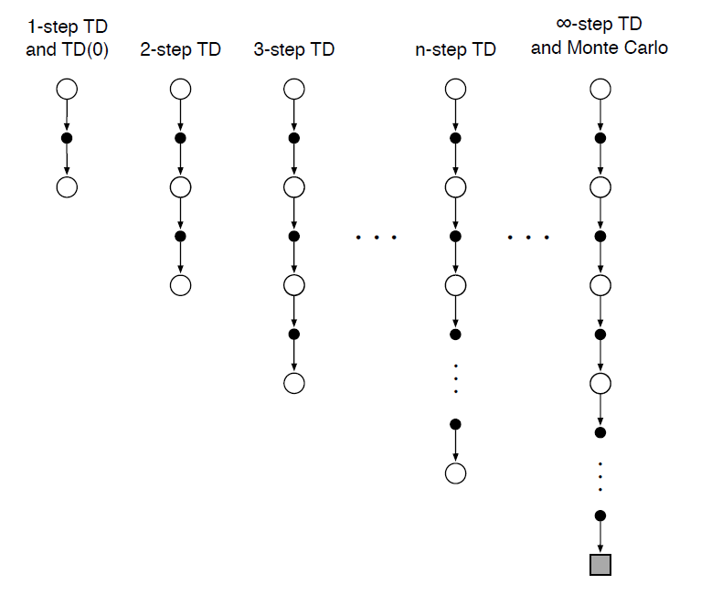
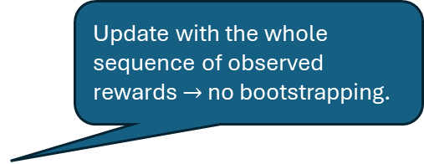

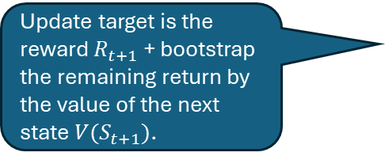
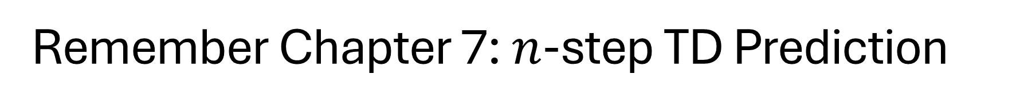


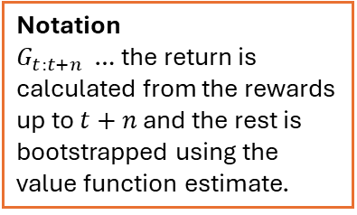

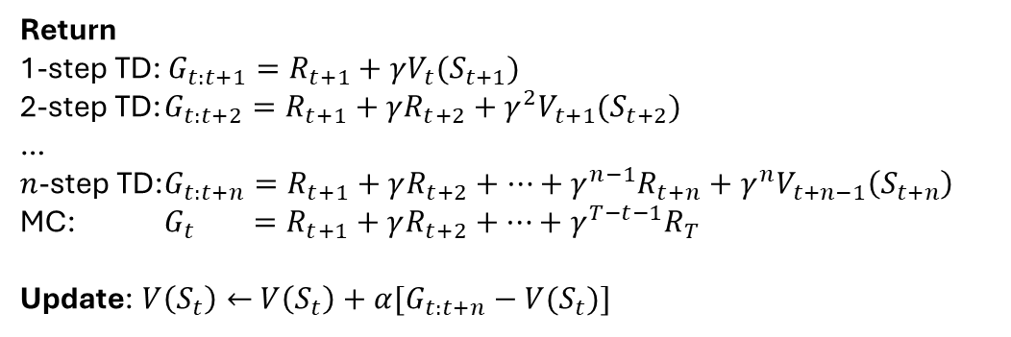
Remember Chapter 7: $n$-step TD Prediction
$$V(S_{t})$$
Update target is the reward $R_{t+1}$ + bootstrap the remaining return by the value of the next state $V(S_{t+1})$.
$$R_{t+1}$$
$$V(S_{t+1})$$
Update with the whole sequence of observed rewards $→$ no bootstrapping.
Return
1-step TD: $G_{t:t+1}=R_{t+1}+γV_{t}(S_{t+1})$
2-step TD: $G_{t:t+2}=R_{t+1}+γ{R_{t+2}+γ^{2}V}_{t+1}(S_{t+2})$
…
$n$-step TD: $G_{t:t+n}=R_{t+1}+γ{R_{t+2}+…+γ^{n−1}R_{t+n}+γ^{n}V}_{t+n−1}\left(S_{t+n}\right)$
MC: $G_{t} =R_{t+1}+γR_{t+2}+…+γ^{T−t−1}R_{T}$
Update: $V\left(S_{t}\right)←$ $V\left(S_{t}\right)+α[G_{t:t+n}−V(S_{t})]$
Notation
$G_{t:t+n}$ … the return is calculated from the rewards up to $t+n$ and the rest is bootstrapped using the value function estimate.
The update target $G_{t:t+n}$ is only available with a $n$-steps delay!

Slide 6
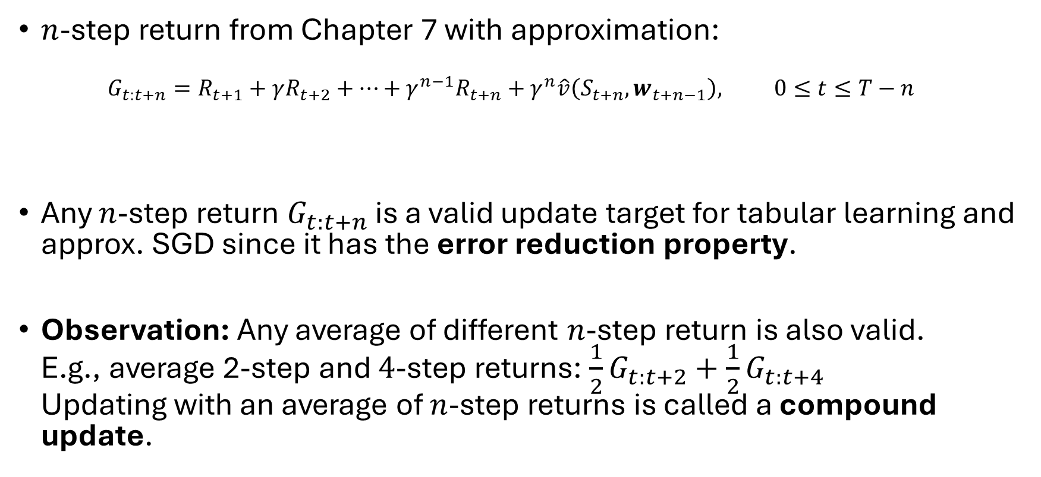

Valid $n$-step Update Targets and Compound Updates
Episode termination
$n$-step return from Chapter 7 with approximation: $G_{t:t+n}=R_{t+1}+γR_{t+2}+…+γ^{n−1}R_{t+n}+γ^{n}\hat{v}\left(S_{t+n}, w_{t+n−1}\right), 0≤t≤T−n$
Any $n$-step return $G_{t:t+n}$ is a valid update target for tabular learning and approx. SGD since it has the error reduction property.
Observation: Any average of different $n$-step return is also valid. E.g., average 2-step and $4$-step returns: $\frac{1}{2}G_{t:t+2}+\frac{1}{2}G_{t:t+4}$ Updating with an average of $n$-step returns is called a compound update.
$n$ next rewards
approx. value

Slide 7
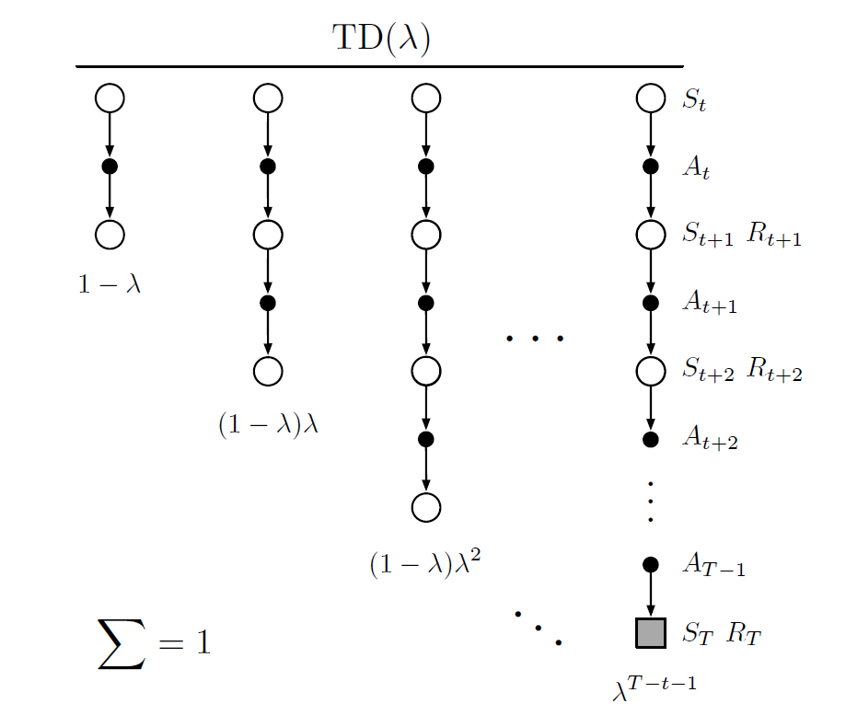
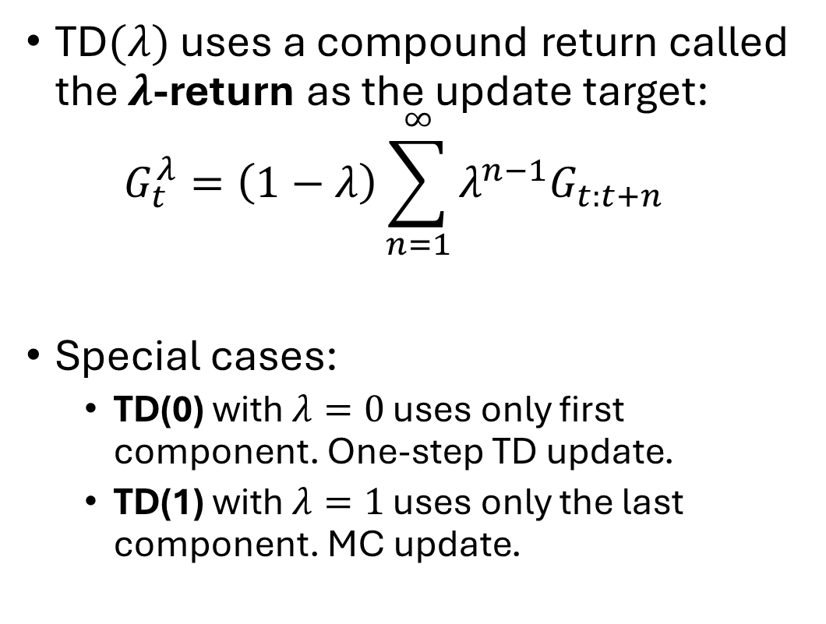
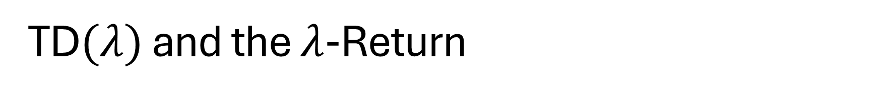


TD$(λ)$ and the $λ$-Return
Backup diagram Weighting of the components of the $λ$-return
TD$(λ)$ uses a compound return called the $λ$-return as the update target: $G_{t}^{λ}=\left(1−λ\right)\sum_{n=1}^{∞}{λ^{n−1}G_{t:t+n}}$
Special cases:
TD(0) with $λ=0$ uses only first component. One-step TD update.
TD(1) with $λ=1$ uses only the last component. MC update.
One-step TD update
MC update
Weight fades with $λ$ with each step

Slide 8
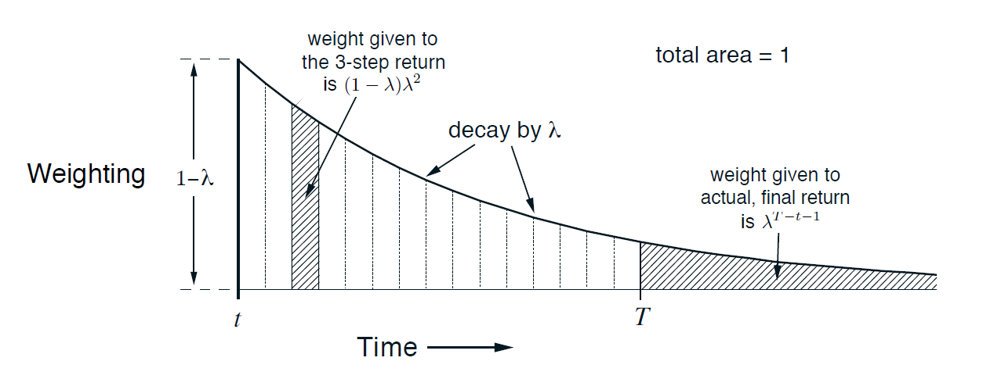
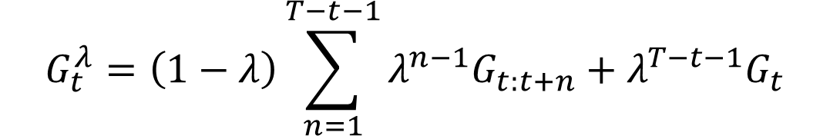

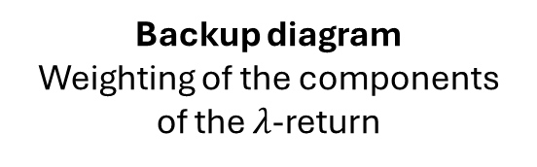
Exponential Weighting Scheme
Backup diagram Weighting of the components of the $λ$-return
$$G_{t}^{λ}=\left(1−λ\right)\sum_{n=1}^{T−t−1}{λ^{n−1}G_{t:t+n}}+λ^{T−t−1}G_{t}$$
MC return
$n$-step return

Slide 9
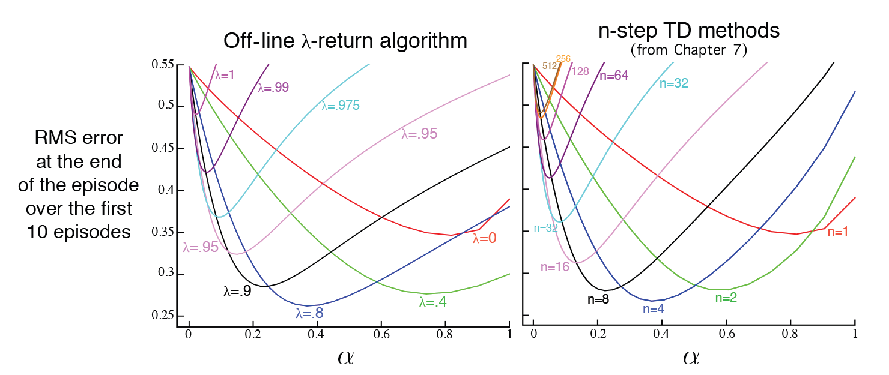
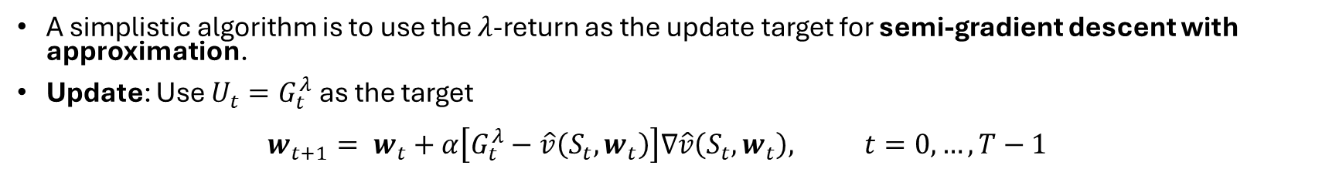

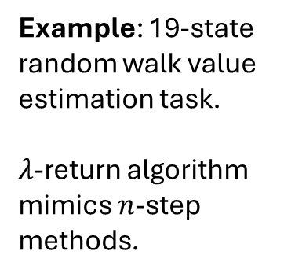
The Off-Line $λ$-Return Algorithm
A simplistic algorithm is to use the $λ$-return as the update target for semi-gradient descent with approximation.
Update: Use $U_{t}=G_{t}^{λ}$as the target $w_{t+1}= w_{t}+α\left[G_{t}^{λ}−\hat{v}\left(S_{t},w_{t}\right)\right]∇\hat{v}\left(S_{t},w_{t}\right), t=0,…,T−1$
Example: 19-state random walk value estimation task. $λ$-return algorithm mimics $n$-step methods.
1
start
All other reward is 0

Slide 10
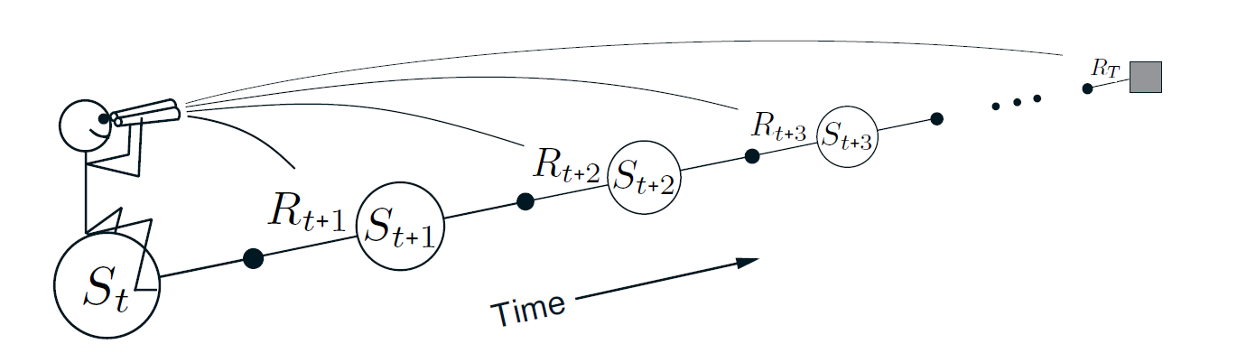

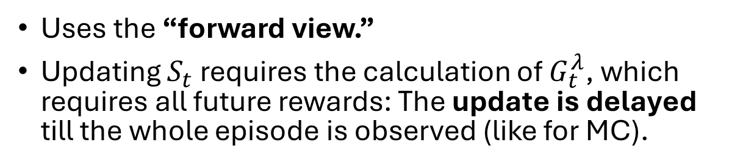


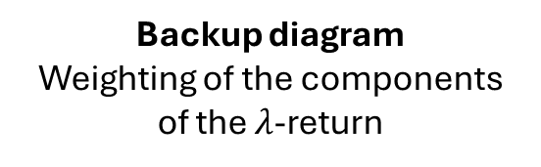
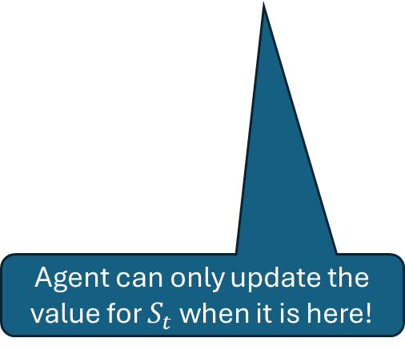
The Forward View Issue with the Off-Line $λ$-Return Algorithm
Backup diagram Weighting of the components of the $λ$-return
Uses the “forward view.”
Updating $S_{t}$ requires the calculation of $G_{t}^{λ}$, which requires all future rewards: The update is delayed till the whole episode is observed (like for MC).
update
$$w_{t+1}$$
$$w_{t}$$
Agent can only update the value for $S_{t}$ when it is here!

Slide 11
The Backward View
Using eligibility traces

Slide 12
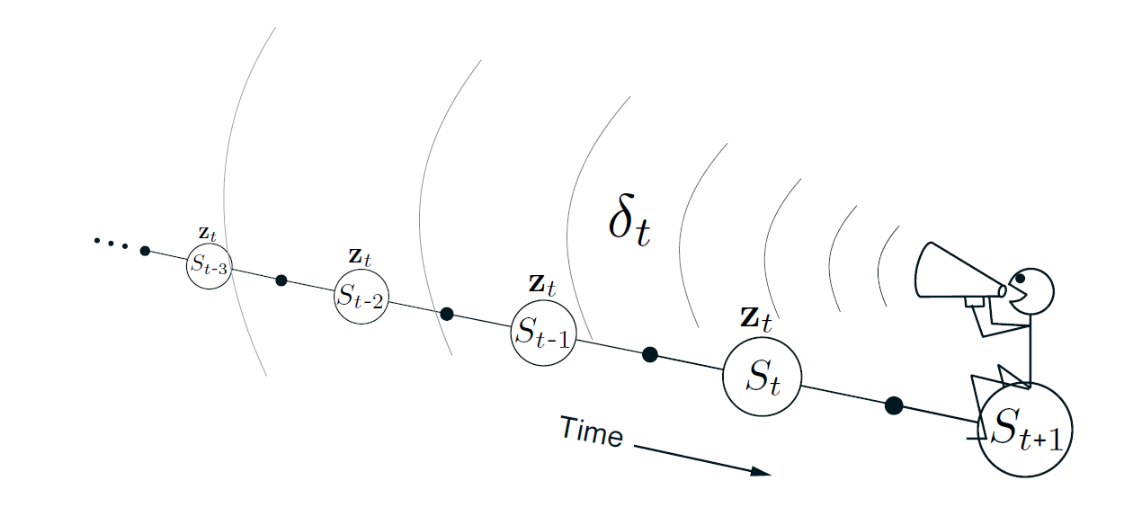
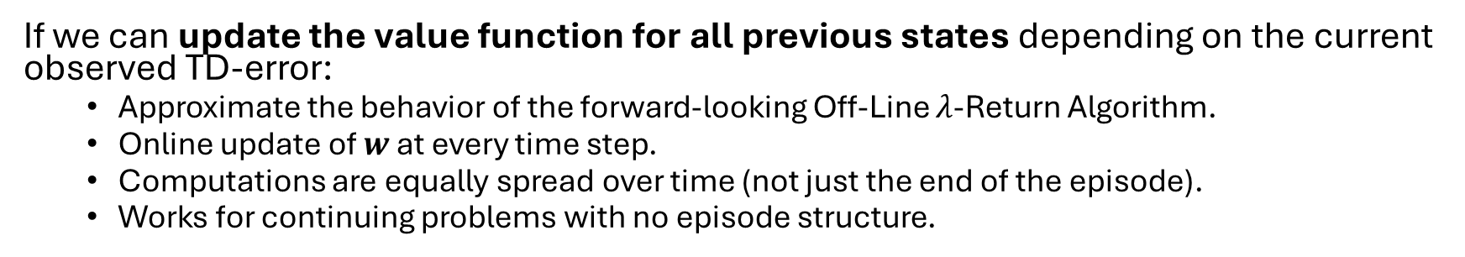
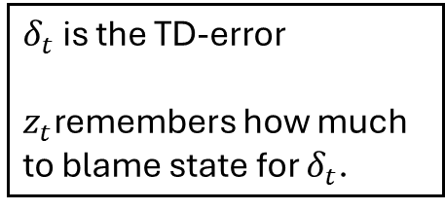


The Backward View
$δ_{t}$ is the TD-error
$z_{t}$remembers how much to blame state for $δ_{t}$.
$$w_{t}$$
update
$$w_{t+1}$$
If we can update the value function for all previous states depending on the current observed TD-error:
Approximate the behavior of the forward-looking Off-Line 𝜆-Return Algorithm.
Online update of $w$ at every time step.
Computations are equally spread over time (not just the end of the episode).
Works for continuing problems with no episode structure.

Slide 13
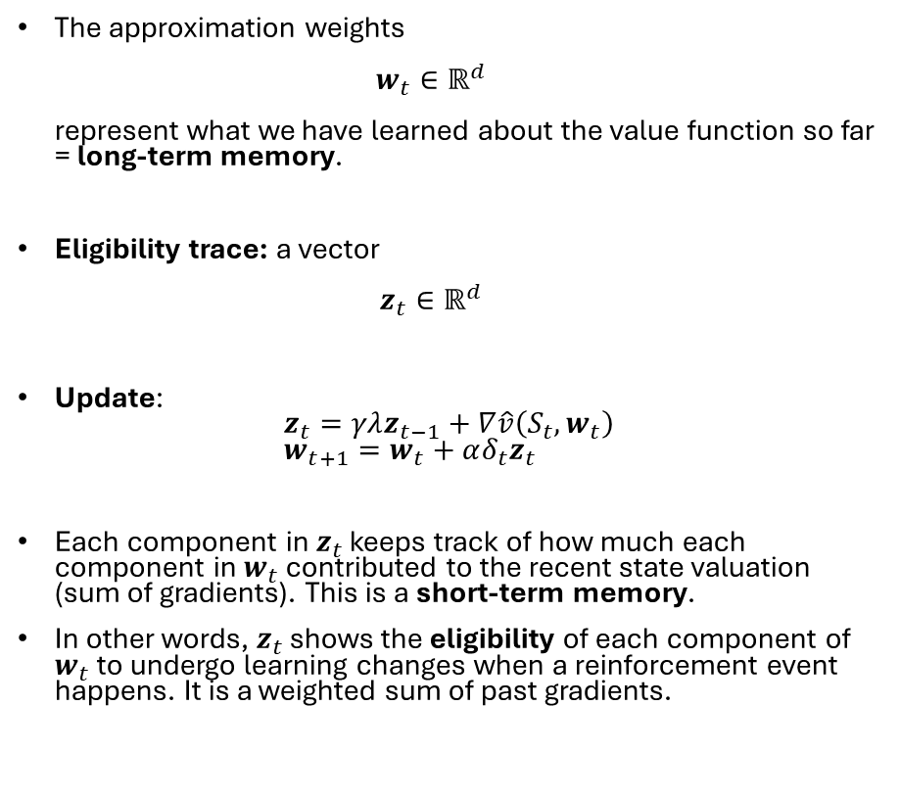
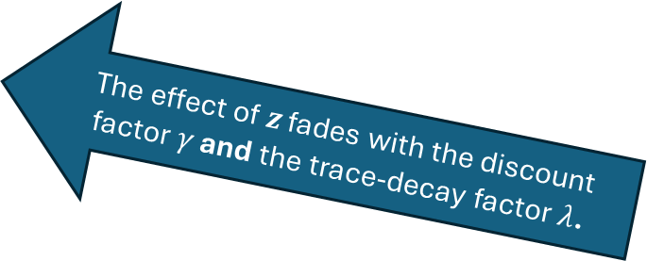


Eligibility Traces
The approximation weights $w_{t}∈ℝ^{d}$ represent what we have learned about the value function so far = long-term memory.
Eligibility trace: a vector $z_{t}∈ℝ^{d}$
Update: $z_{t}=γλz_{t−1}+∇\hat{v}\left(S_{t},w_{t}\right)$ $w_{t+1}=w_{t}+αδ_{t}z_{t}$
Each component in $z_{t}$ keeps track of how much each component in $w_{t}$ contributed to the recent state valuation (sum of gradients). This is a short-term memory.
In other words, $z_{t}$ shows the eligibility of each component of $w_{t}$ to undergo learning changes when a reinforcement event happens. It is a weighted sum of past gradients.
$$w_{t}$$
The effect of $z$ fades with the discount factor $γ$ and the trace-decay factor $λ$.
update
$$w_{t+1}$$

Slide 14
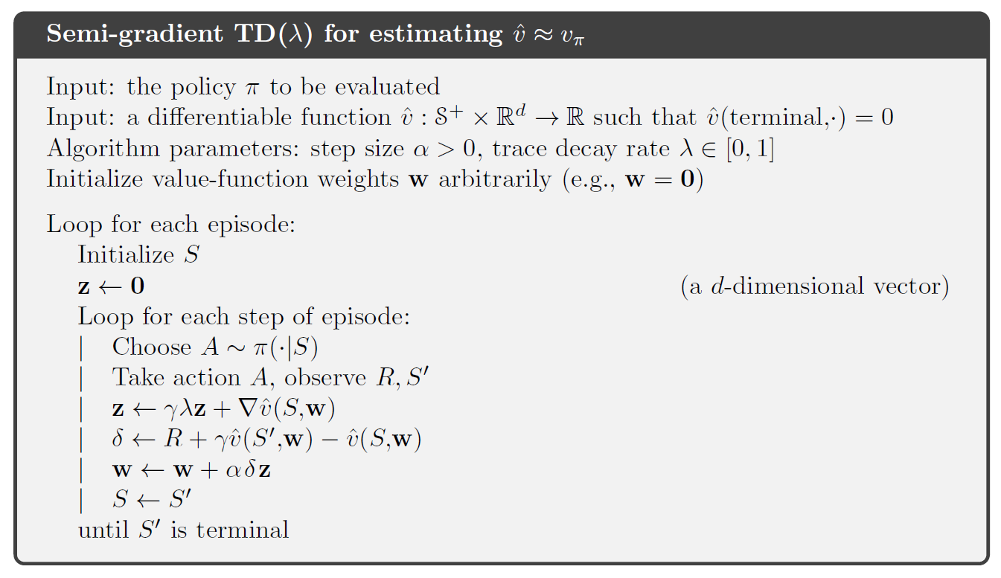
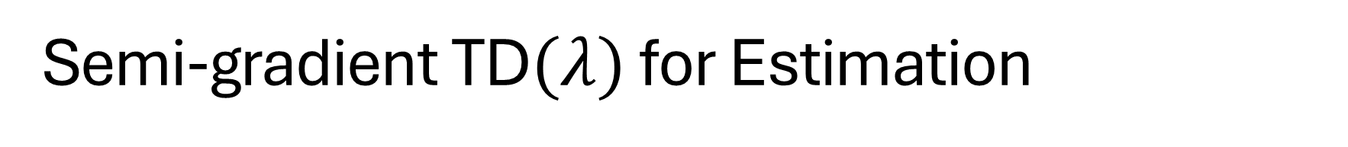
Semi-gradient TD$(λ)$ for Estimation

Slide 15
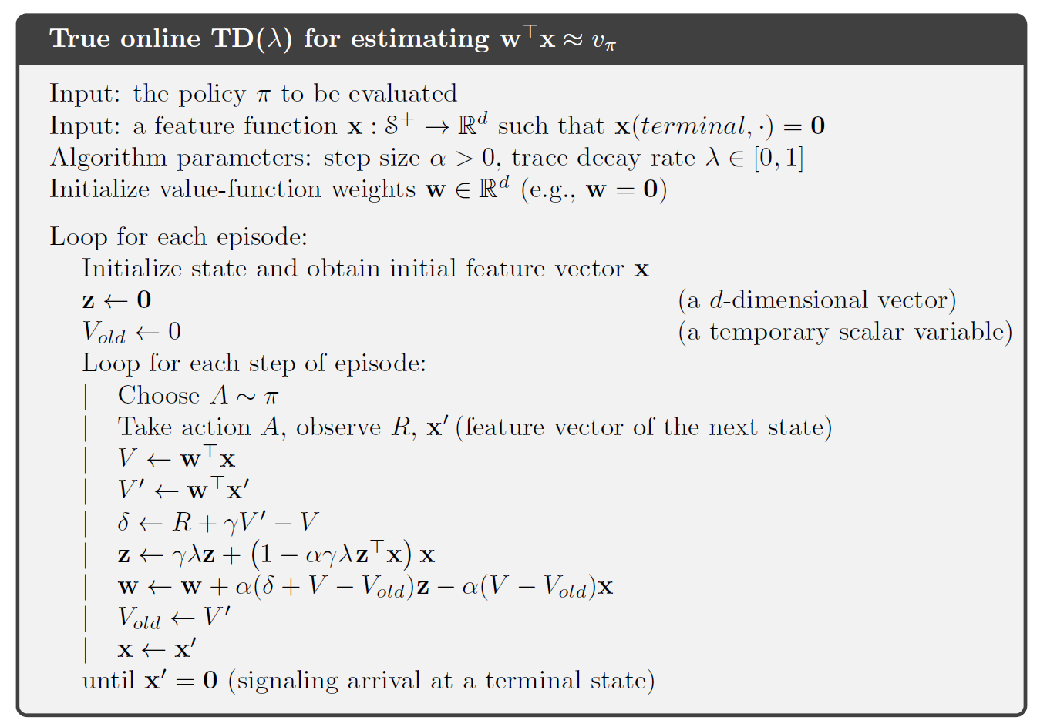

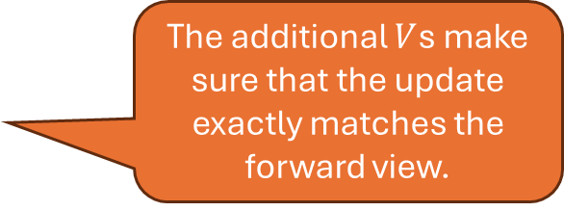
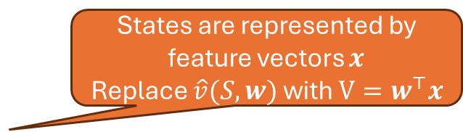
True Online TD$(λ)$ for Estimation
States are represented by feature vectors $x$
Replace $\hat{v}(S, w)$ with $V=w^{⊤}x$
The additional $V$s make sure that the update exactly matches the forward view.

Slide 16

Control with Eligibility Traces
Sarsa$(λ)$

Slide 17
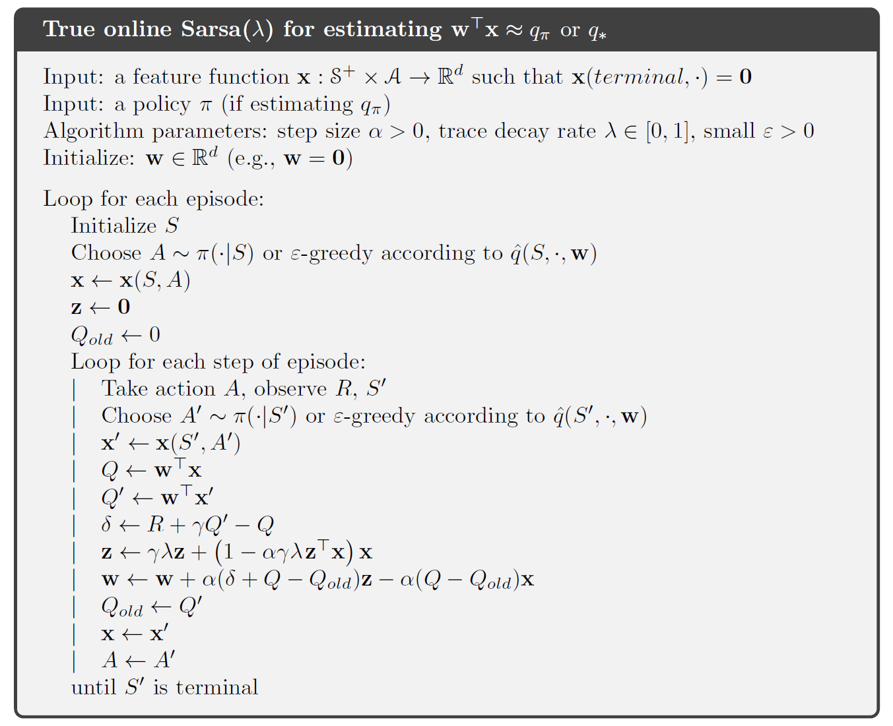
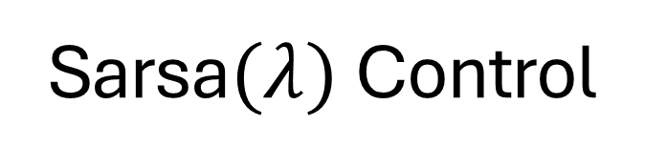
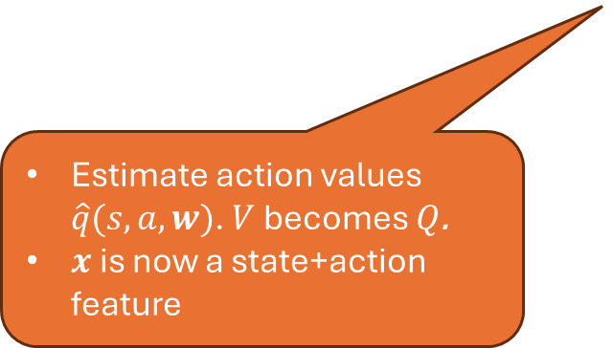
Sarsa$(λ)$ Control
On-policy learning! Needs to keep exploring
Estimate action values $\hat{q}(s,a,w)$. $V$ becomes $Q$.
$x$ is now a state+action feature

Slide 18
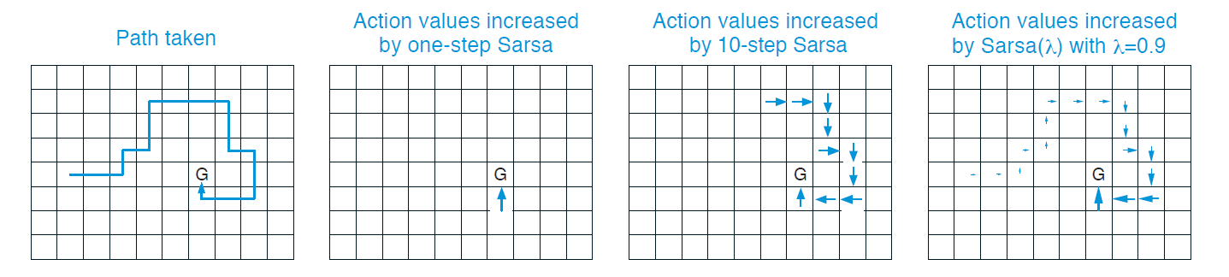
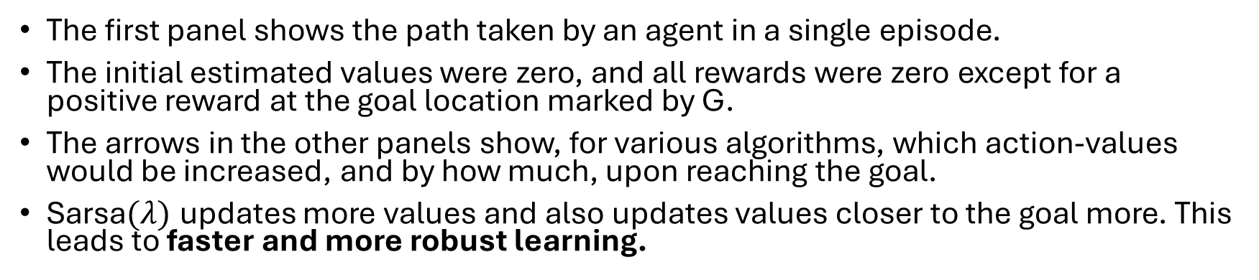
Example: Traces in a Gridworld
The first panel shows the path taken by an agent in a single episode.
The initial estimated values were zero, and all rewards were zero except for a positive reward at the goal location marked by G.
The arrows in the other panels show, for various algorithms, which action-values would be increased, and by how much, upon reaching the goal.
Sarsa$(λ)$ updates more values and also updates values closer to the goal more. This leads to faster and more robust learning.

Slide 19
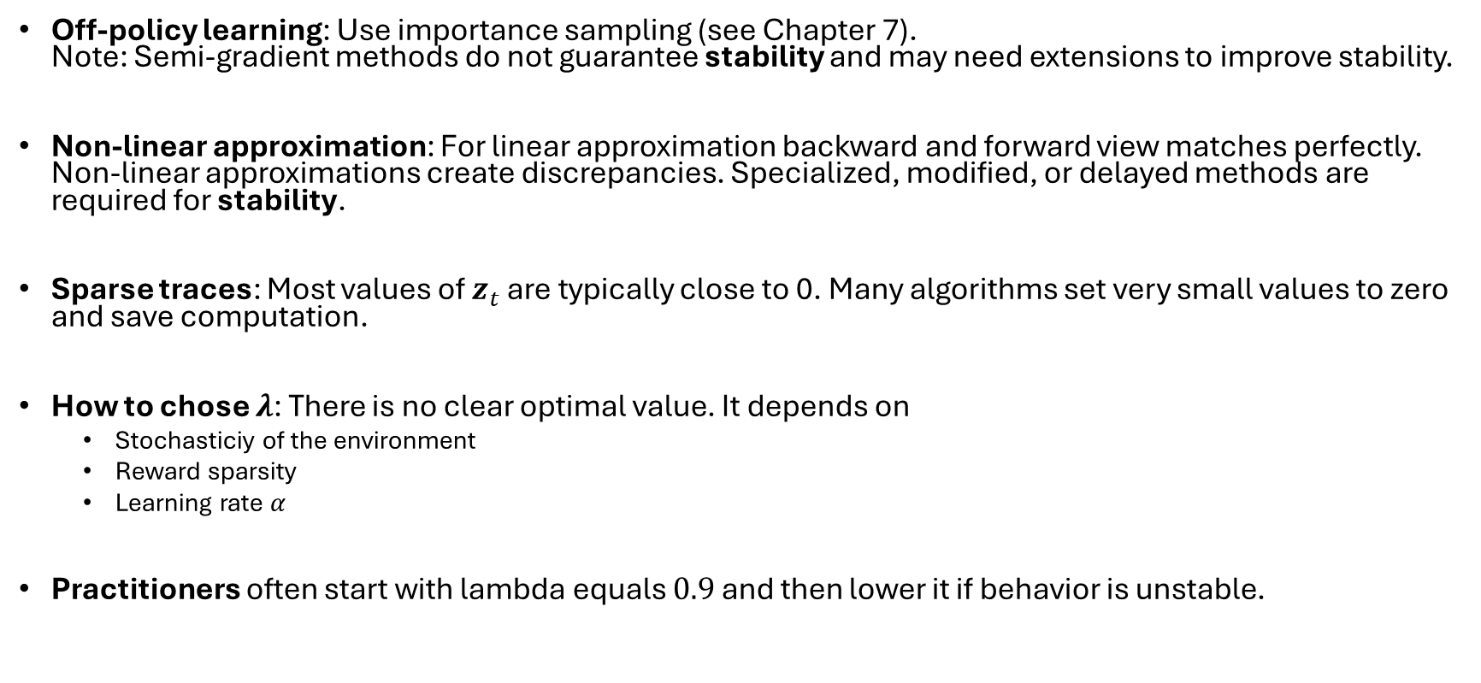
Implementation Issues
Off-policy learning: Use importance sampling (see Chapter 7). Note: Semi-gradient methods do not guarantee stability and may need extensions to improve stability.
Non-linear approximation: For linear approximation backward and forward view matches perfectly. Non-linear approximations create discrepancies. Specialized, modified, or delayed methods are required for stability.
Sparse traces: Most values of $z_{t}$ are typically close to 0. Many algorithms set very small values to zero and save computation.
How to chose $λ$: There is no clear optimal value. It depends on
Stochasticiy of the environment
Reward sparsity
Learning rate $α$
Practitioners often start with lambda equals $0.9$ and then lower it if behavior is unstable.

Slide 20
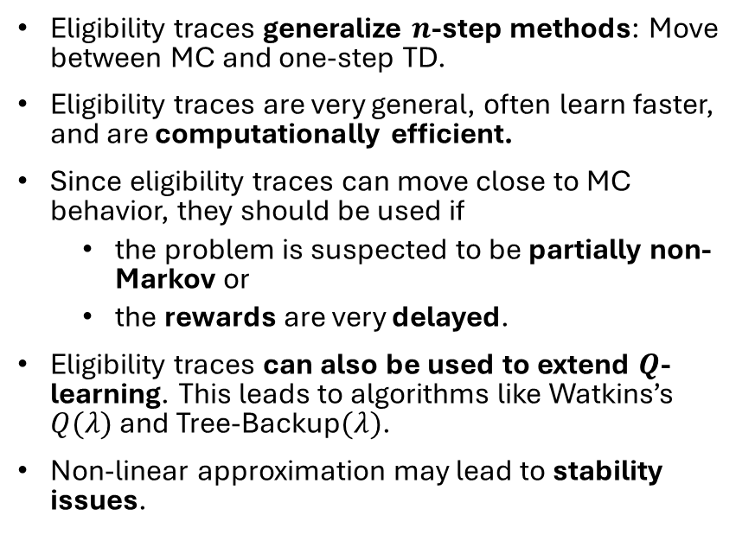
What You Should Know
Eligibility traces generalize $n$-step methods: Move between MC and one-step TD.
Eligibility traces are very general, often learn faster, and are computationally efficient.
Since eligibility traces can move close to MC behavior, they should be used if
the problem is suspected to be partially non-Markov or
the rewards are very delayed.
Eligibility traces can also be used to extend $Q$-learning. This leads to algorithms like Watkins’s $Q(λ)$ and Tree-Backup$(λ)$.
Non-linear approximation may lead to stability issues.

