Slide 1
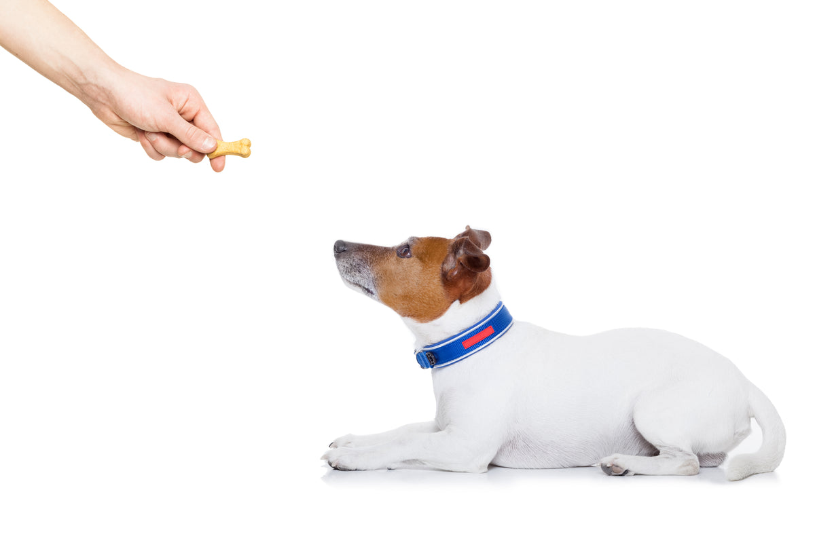

Reinforcement Learning Introduction Textbook Chapter 1
Michael Hahsler, SMU
Based on slides by Oliver Wallscheid (Paderborn University) and material by David Silver (University College London)

Slide 2
Topics of this course
Introduction to reinforcement learning
Markov decision processes
Dynamic programming
Monte Carlo methods
Temporal-difference learning
Multi-step bootstrapping
Planning and learning with tabular methods
Function approximation with supervised learning
On-policy prediction with function approximation
Value-based control with function approximation
Stochastic policy gradient methods
Deterministic policy gradient methods

Slide 3
Recommended textbooks
Reinforcement learning: an introduction,
R. Sutton and G. Barto
MIT Press, 2nd edition, 2020
Available here
Reinforcement learning (lecture script)
D. Silver
Entire slide set available here
YouTube lecture series (click here)

Slide 4
Table of contents
What is RL?
RL basics
Reward
States
Actions and policies
A small example
RL and planning

Slide 5
What is RL?

Slide 6
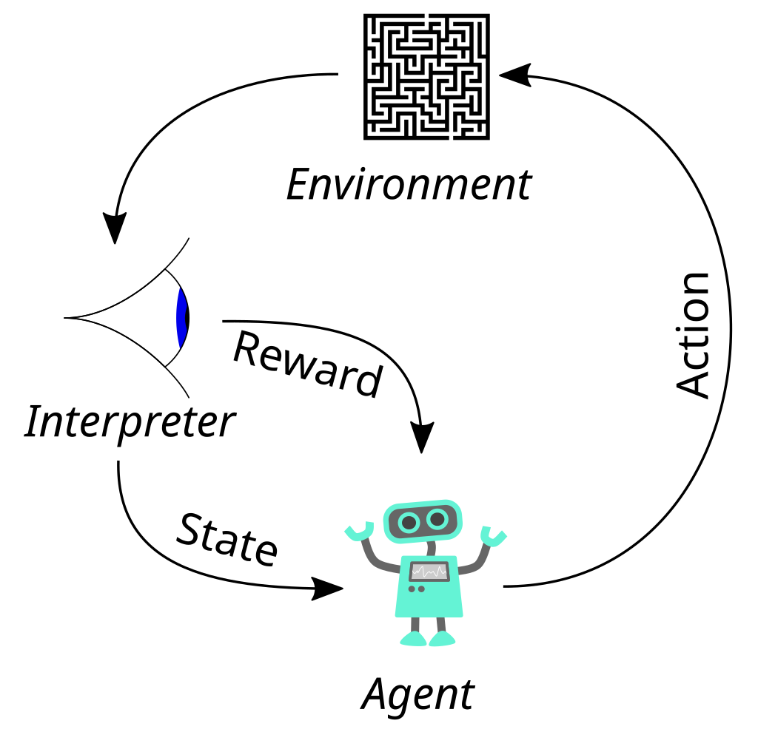



The basic reinforcement learning structure
$$a_{t}$$
Goal: Map a situation to an action to maximize the reward
Key characteristics:
Uncertainty about the environment leads to a need for sensing.
No supervisor: discover actions by trying them (data-driven)
Sequential decision making: Agent actions affect subsequent data. Agent maximizes over future (delayed) rewards which need to be estimated!
Action discovery and maximization lead to a tradeoff: exploit vs. explore
$$r_{t}$$
$$s_{t}$$
The basic RL operation principle (derivative of www.wikipedia.org, CC0 1.0)

Slide 7
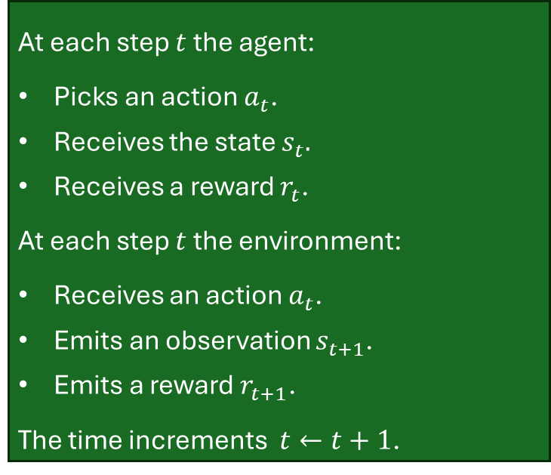



Agent and environment
At each step $t$ the agent:
Picks an action $a_{t}$.
Receives the state $s_{t}.$
Receives a reward $r_{t}$.
At each step $t$ the environment:
Receives an action $a_{t}$.
Emits an observation $s_{t+1}$.
Emits a reward $r_{t+1}$.
The time increments $t←t+1$.
$$a_{t}$$
$$r_{t}$$
$$s_{t}$$
Remark on time: A one step time delay is assumed between executing the action and receiving the observation as well as reward.

Slide 8
Some basic definitions from the literature
What is reinforcement?
“Reinforcement refers to consequences that increase the likelihood of an organism’s future behavior, typically in the presence of a particular antecedent stimulus.[...] Reinforcers serve to increase behaviors whereas punishers serve to decrease behaviors; thus, positive reinforcers are stimuli that the subject will work to attain, and negative reinforcers are stimuli that the subject will work to be rid of or to end.”, source: wikipedia.org (obtained 2025-03-19)
What is learning?
“Acquiring knowledge and skills and having them readily available from memory so you can make sense of future problems and opportunities.”, source: Make It Stick: The Science of Successful Learning, Brown et al., Harvard Press, 2014

Slide 9






RL and machine learning
RL is a 3rd type of machine learning
Unsupervised Learning
Process and interpret data based only
on the input
Clustering
Dimension Reduction
Supervised Learning
Develop models to map input and output data
Regression
Machine Learning
Classification
Reinforcement Learning
Learn optimal control actions to maximize long-term reward
Single-Agent
Multi-Agent

Slide 10
Context around machine learning
Deep Learning (DL)
A class of ML which uses large, layered models (e.g., vast artifical neural networks) to
progressively extract more information from the data.
Machine Learning (ML)
A subset of AI involved with the creation of algorithms which can modify itself without human intervention to produce desired output by feeding itself through structured data.
Artifical Intelligence (AI)
Any device that perceives its environment and takes actions that maximize its chance of successfully achieving its goals. AI is often used to describe machines that mimic "cognitive" functions that humans associate with the human mind.
Figure 1.3: The broader scope around machine learning

Slide 11







Many faces of reinforcement learning
Computer Science
Engineering
Machine Learning
Neuroscience
Optimal Control
Reward System
Reinforcement Learning
Operations Classical/Operant Research Conditioning
Bounded Rationality
Mathematics
Psychology
Economics
RL and its neighboring domains
(source: D. Silver, “Reinforcement learning”, 2015. CC BY-NC 4.0)

Slide 12
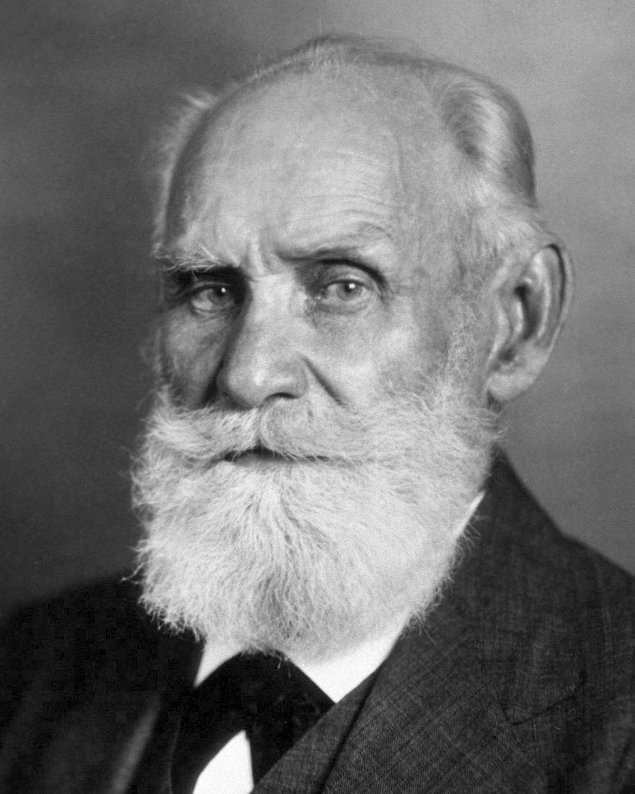
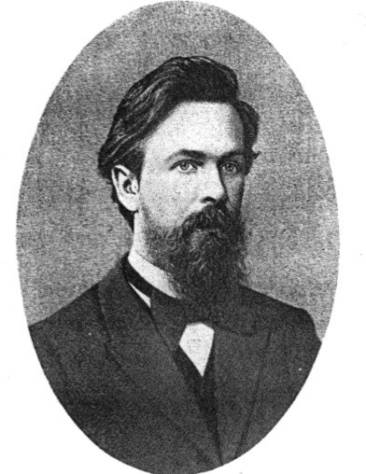
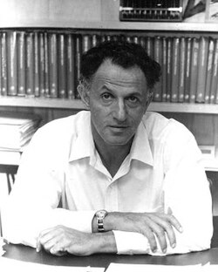
Methodical origins
Classical conditioning
Stochastic process formalism
Optimal sequential decision making
Ivan Pavlov (1849-1936)
Russian physiologist and Nobel laureate who discovered classical conditioning through his experiments with dogs.
Andrei Markov (1856-1922)
Russian mathematician developed the groundwork for Markov chains to model dynamical systems.
Richard E. Bellman (1920-1984)
American applied mathematician, who introduced dynamic programming and the Bellman equation.
Source of : Wikipedia

Slide 13
History of reinforcement learning
Huge field with many interconnections to different fields. One could give a lecture only on the historic development. Hence, interested readers are referred to:
Chapter 1.7 of Barto/Sutton, Reinforcement learning: an introduction, 2nd edition, MIT Press, 2018
30 minutes talk of A. Barto: https://www.youtube.com/watch?v=ul6B2oFPNDM
Survey papers on historic as well as more recent developments:
Kaelbling et al., Reinforcement learning: A survey, in Journal of Artificial Intelligence Research, vol. 4, pp. 237 - 285, 1996
Arulkumaran et al., Deep reinforcement learning: a brief survey, in IEEE Signal Processing Magazine, vol. 34, no. 6, pp. 26-38, 2017
Botvinick et al., Reinforcement learning, fast and slow, in Trends in Cognitive Sciences, vol. 23, iss. 5, pp. 408-422, 2019

Slide 14
Contemporary application examples
Controlling electric drive systems
Swinging-up and balance a cart-pole / an inverted pendulum
Flipping pancakes with a roboter arm
Drifting with a RC-car
Driving an autonomous car
Playing Atari Breakout
Play strategy board game Go at super-human performance
Nuclear fusion reactor plasma control
Training chat bots (like chatGPT)
...

Slide 15
RL basics
Reward

Slide 16
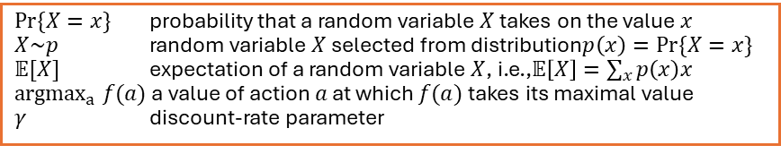
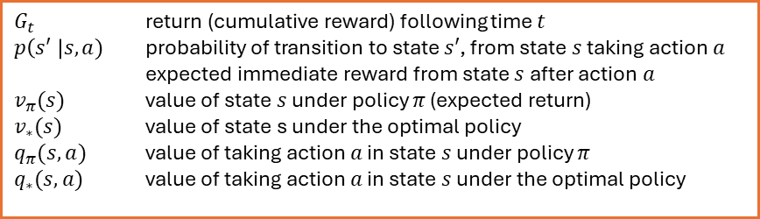
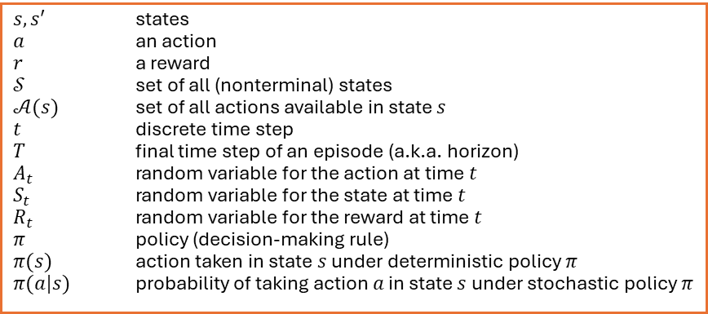
Notation
Capital letters random variables Lower case letters realizations of random variables and for scalar functions
Bold lower-case letters real-valued vectors (even if random variables)
Bold capitals matrices
$G_{t}$ return (cumulative reward) following time $t$
$p\left(s′ \right|s, a)$ probability of transition to state $s′$, from state $s$ taking action $a$
expected immediate reward from state $s$ after action $a$
$v_{π}(s)$ value of state $s$ under policy $π$ (expected return)
$v_{∗}(s)$ value of state s under the optimal policy
$q_{π}(s,a)$ value of taking action $a$ in state $s$ under policy $π$
$q_{∗}(s,a)$ value of taking action $a$ in state $s$ under the optimal policy
$Pr⁡\{X=x\}$ probability that a random variable $X$ takes on the value $x$
$X\sim p$ random variable $X$ selected from distribution$p\left(x\right)=Pr⁡\{X=x\}$
$𝔼[X]$ expectation of a random variable $X$, i.e.,$𝔼\left[X\right]=\sum_{x}{p\left(x\right)x}$
${argmax}_{a} f(a)$ a value of action $a$ at which $f(a)$ takes its maximal value
$γ$ discount-rate parameter
$s, s′$ states
$a$ an action
$r$ a reward
$𝒮$ set of all (nonterminal) states
$𝒜(s)$ set of all actions available in state $s$
$t$ discrete time step
$T$ final time step of an episode (a.k.a. horizon)
$A_{t}$ random variable for the action at time $t$
$S_{t}$ random variable for the state at time $t$
$R_{t}$ random variable for the reward at time $t$
$π$ policy (decision-making rule)
$π(s)$ action taken in state $s$ under deterministic policy $π$
$π(a|s)$ probability of taking action $a$ in state $s$ under stochastic policy $π$

Slide 17

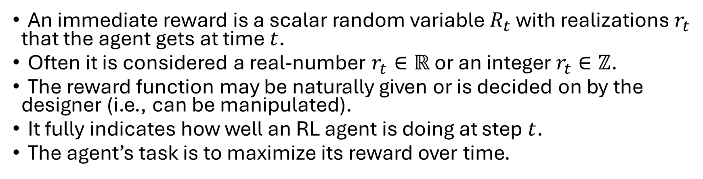
Reward
An immediate reward is a scalar random variable $R_{t}$ with realizations $r_{t}$ that the agent gets at time $t$.
Often it is considered a real-number $r_{t}∈ℝ$ or an integer $r_{t}∈ℤ$.
The reward function may be naturally given or is decided on by the designer (i.e., can be manipulated).
It fully indicates how well an RL agent is doing at step $t$.
The agent’s task is to maximize its reward over time.
Reward hypothesis: All goals can be described by the maximization of the expected cumulative reward:
$$\max{𝔼\left[\sum_{t=0}^{∞}{R_{t}}\right]}$$

Slide 18
Reward examples
Flipping a pancake:
Pos. reward: catching the 180◦ rotated pancake
Neg. reward: dropping the pancake on the floor
Stock trading:
Trading portfolio monetary value
Playing Atari games:
Highscore value at the end of a game episode
Driving an autonomous car:
Pos. reward: getting save from A to B without crashing
Neg. reward: hitting another car, pedestrian, bicycle,...
Classical control task (e.g., electric drive, inverted pendulum,...):
Pos. reward: following a given reference trajectory precisely
Neg. reward: violating system constraints and/or large control error

Slide 19
Reward characteristics
Rewards are highly depending on the given problem:
Actions may have short and/or long-term consequences.
The reward for a certain action may be delayed.
Examples: Stock trading, strategic board games,...
Rewards can be positive and negative values.
Certain situations (e.g., car hits wall) might lead to a negative reward (= a cost).
Exogenous impacts might introduce stochastic reward components.
Example: A wind gust pushes an autonomous helicopter into a tree.
Remarks on reward
The RL agent’s learning process is heavily linked with the reward distribution over time. Designing expedient rewards functions is therefore crucially important for successfully applying RL. And often there is no predefined way on how to design the “best reward function”.

Slide 20
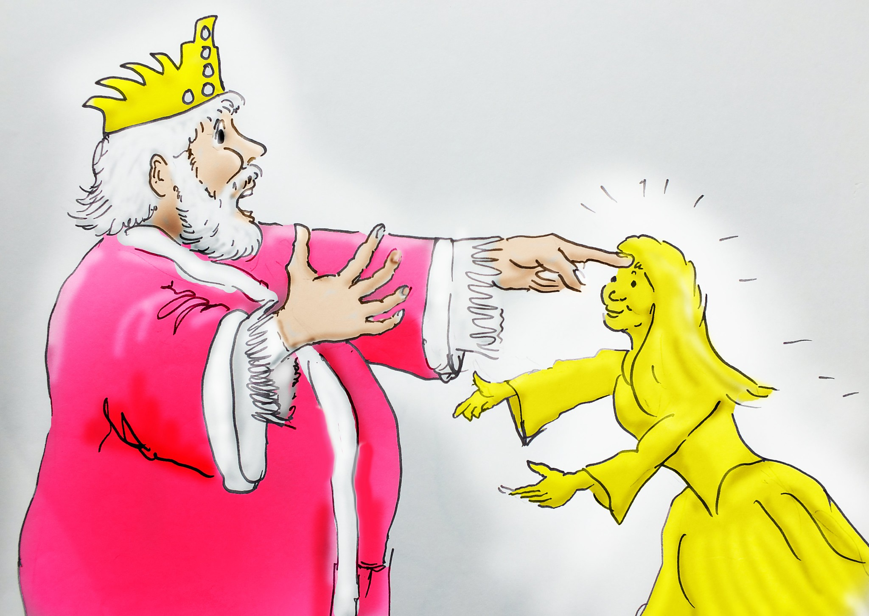
Issues with the reward function
“Be careful what you wish for - you might get it” (pro-verb)
“...it grants what you ask for, not what you should have asked for or what you intend.” (Norbert Wiener, American mathematician)
Midas and daughter (good as gold) (source: www.flickr.com, by Robin Hutton CC BY-NC-ND 2.0)

Slide 21
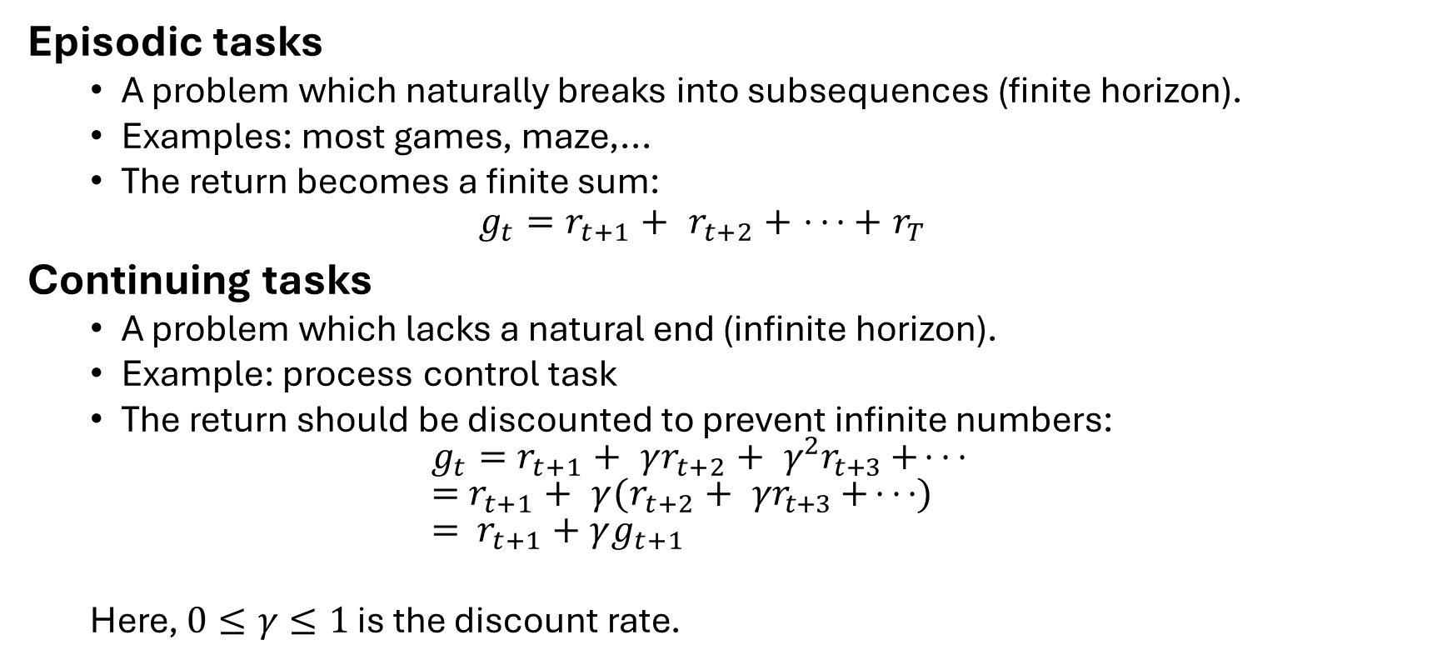
Task-dependent return definitions
Episodic tasks
A problem which naturally breaks into subsequences (finite horizon).
Examples: most games, maze,...
The return becomes a finite sum:
$$g_{t}=r_{t+1}+r_{t+2}+⋅ ⋅ ⋅+r_{T}$$
Continuing tasks
A problem which lacks a natural end (infinite horizon).
Example: process control task
The return should be discounted to prevent infinite numbers: $g_{t}=r_{t+1}+{γr}_{t+2}+γ^{2}r_{t+3}+ ⋅ ⋅ ⋅$ $=r_{t+1}+{γ(r}_{t+2}+γr_{t+3}+ ⋅ ⋅ ⋅)$ $= r_{t+1}+γg_{t+1}$
Here, $0≤γ≤1$ is the discount rate.

Slide 22
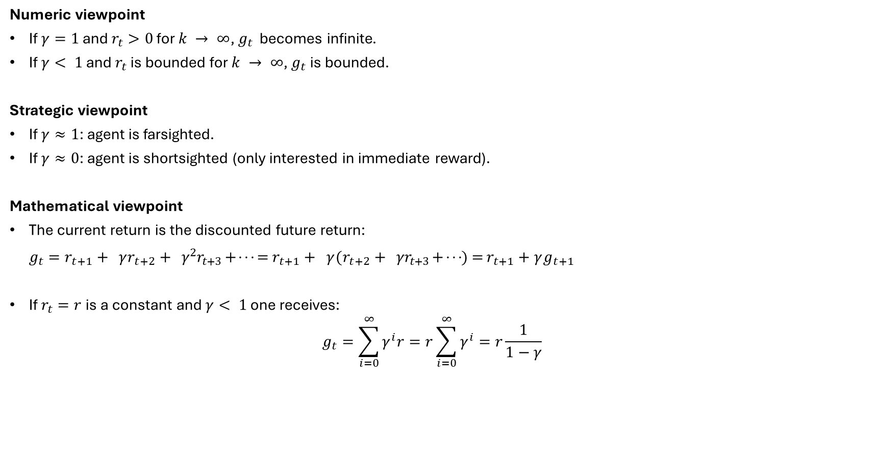
Discounted rewards
$$g_{t}=r_{t+1}+{γr}_{t+2}+γ^{2}r_{t+3}+ ⋅ ⋅ ⋅$$
Numeric viewpoint
If $γ=1$ and $r_{t}>0$ for $k → ∞$, $g_{t}$ becomes infinite.
If $γ< 1$ and $r_{t}$ is bounded for $k → ∞$, $g_{t}$ is bounded.
Strategic viewpoint
If $γ≈1$: agent is farsighted.
If $γ≈0$: agent is shortsighted (only interested in immediate reward).
Mathematical viewpoint
The current return is the discounted future return: $g_{t}=r_{t+1}+{γr}_{t+2}+γ^{2}r_{t+3}+ ⋅ ⋅ ⋅ =r_{t+1}+{γ(r}_{t+2}+γr_{t+3}+ ⋅ ⋅ ⋅)=$ $r_{t+1}+γg_{t+1}$
If $r_{t}=r$is a constant and $γ< 1$ one receives: $g_{t}=\sum_{i=0}^{∞}{γ^{i}r}=r\sum_{i=0}^{∞}{γ^{i}}=r\frac{1}{1−γ}$

Slide 23
RL basics
States

Slide 24
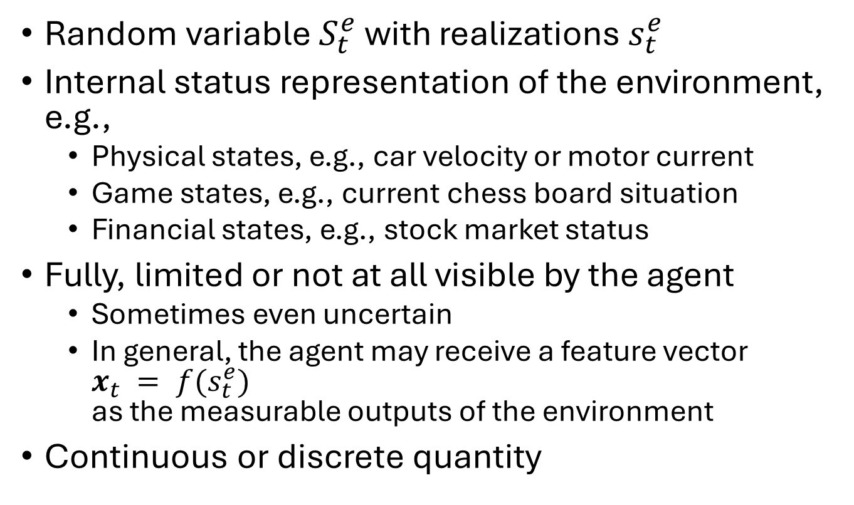
State: Environment state
Random variable $S_{t}^{e}$ with realizations $s_{t}^{e}$
Internal status representation of the environment, e.g.,
Physical states, e.g., car velocity or motor current
Game states, e.g., current chess board situation
Financial states, e.g., stock market status
Fully, limited or not at all visible by the agent
Sometimes even uncertain
In general, the agent may receive a feature vector $x_{t} = f(s_{t}^{e})$ as the measurable outputs of the environment
Continuous or discrete quantity
Notation
Bold symbols are non-scalar multidimensional quantities, e.g., vectors and matrices.
Capitalized symbols denote random variables and lower-case symbols their realizations.

Slide 25
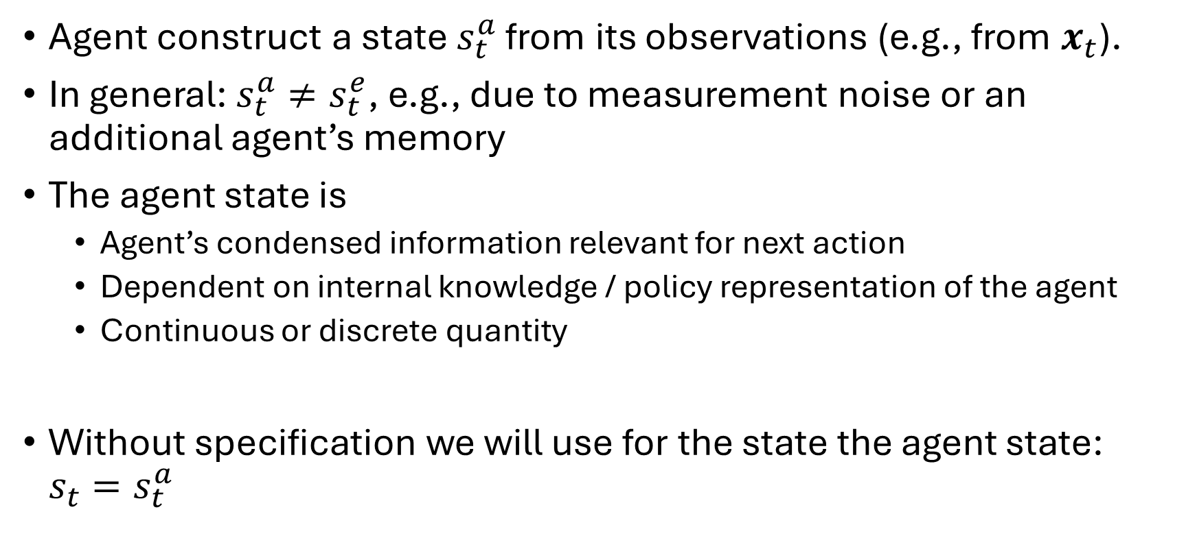
State: Agent state
Agent construct a state $s_{t}^{a}$ from its observations (e.g., from $x_{t}$).
In general: $s_{t}^{a}≠s_{t}^{e}$, e.g., due to measurement noise or an additional agent’s memory
The agent state is
Agent’s condensed information relevant for next action
Dependent on internal knowledge / policy representation of the agent
Continuous or discrete quantity
Without specification we will use for the state the agent state: ${s_{t}=s}_{t}^{a}$

Slide 26

History and information state
Definition: The history is the past sequence of all observations, actions and rewards
$$H_{t}=\left\{s_{0}, r_{0},a_{0},…, a_{t−1}, s_{t−1},r_{t}\right\}$$ up to the time step $t$.
If the current state $s_{t}$ contains all useful information from the history, it is called an information or Markov state (history is fully condensed in $s_{t}$)
Definition: A state $s_{t}$ is called an information state if and only if $$Pr\left[s_{t+1} | s_{t}\right]=Pr\left[s_{t+1}\right|s_{0},s_{1},…,s_{t}]$$

Slide 27
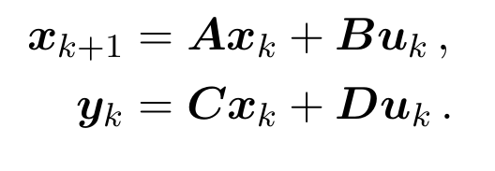
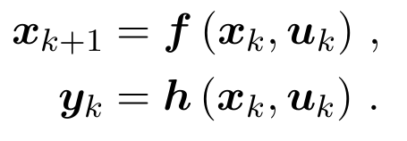
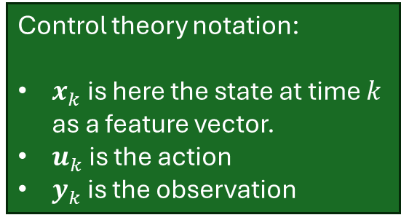
Model examples with Markov states
Linear time-invariant (LTI) state-space model
Nonlinear time-invariant state-space model:
Control theory notation:
$x_{k}$ is here the state at time $k$ as a feature vector.
$u_{k}$ is the action
$y_{k}$ is the observation

Slide 28
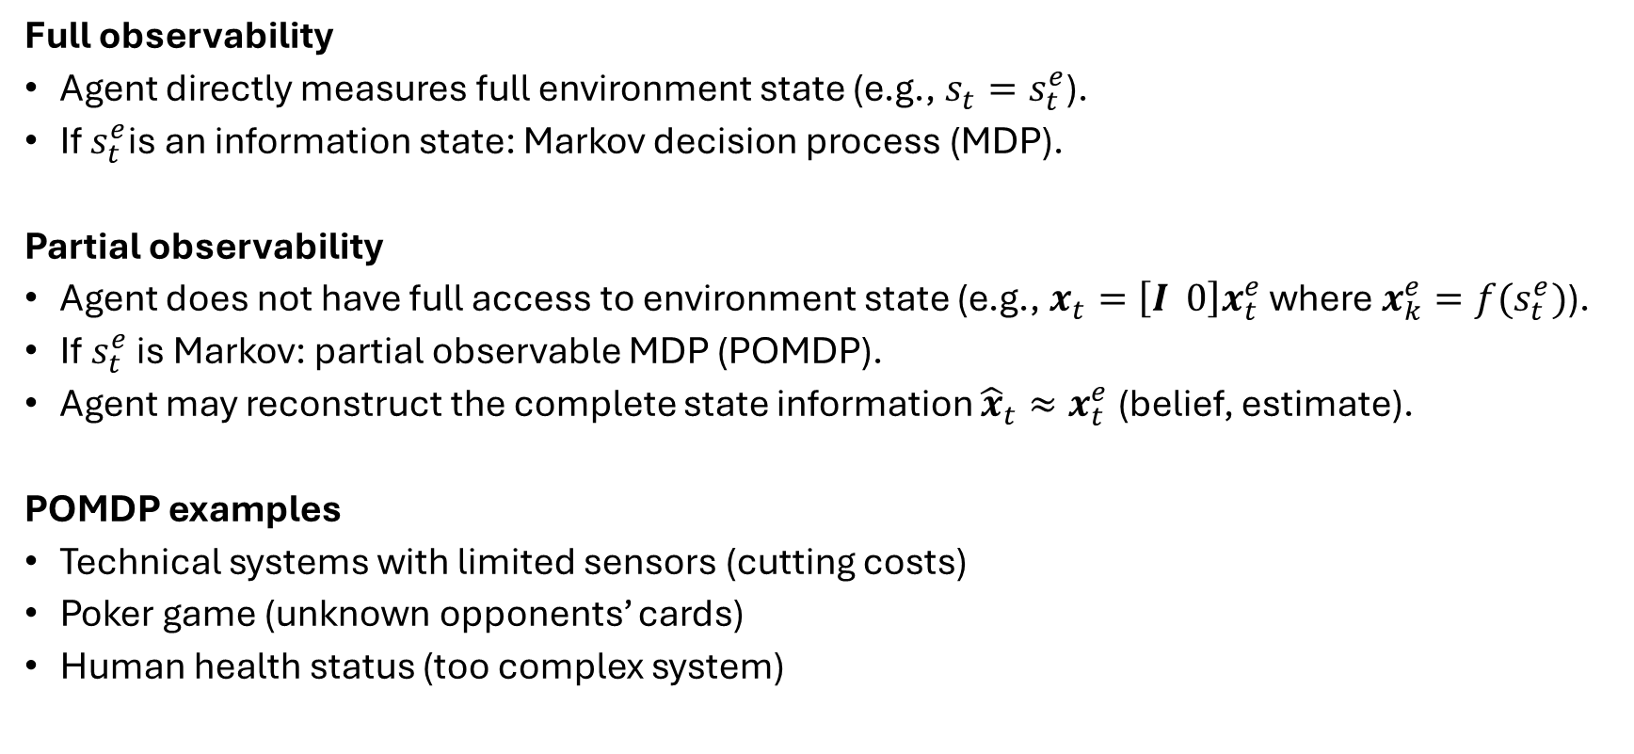
Degree of observability
Full observability
Agent directly measures full environment state (e.g., $s_{t}=s_{t}^{e}$).
If $s_{t}^{e}$is an information state: Markov decision process (MDP).
Partial observability
Agent does not have full access to environment state (e.g., $x_{t}=\left[I 0\right]x_{t}^{e}$ where $x_{k}^{e}=f(s_{t}^{e})$).
If$s_{t}^{e}$ is Markov: partial observable MDP (POMDP).
Agent may reconstruct the complete state information ${\hat{x}}_{t}≈x_{t}^{e}$ (belief, estimate).
POMDP examples
Technical systems with limited sensors (cutting costs)
Poker game (unknown opponents’ cards)
Human health status (too complex system)

Slide 29
RL basics
Actions and policies

Slide 30
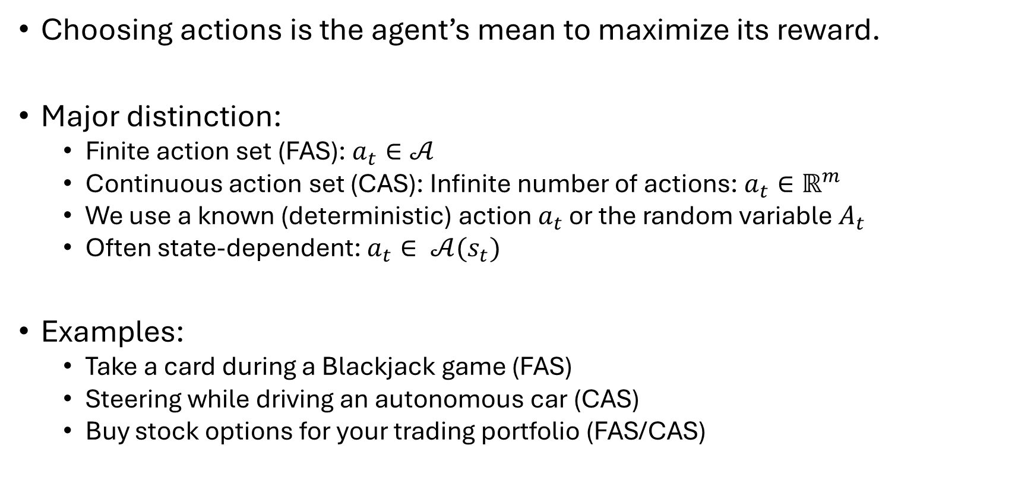
Action
Choosing actions is the agent’s mean to maximize its reward.
Major distinction:
Finite action set (FAS): $a_{t}∈𝒜$
Continuous action set (CAS): Infinite number of actions: $a_{t}∈ℝ^{m}$
We use a known (deterministic) action $a_{t}$ or the random variable $A_{t}$
Often state-dependent: $a_{t}∈ 𝒜(s_{t})$
Examples:
Take a card during a Blackjack game (FAS)
Steering while driving an autonomous car (CAS)
Buy stock options for your trading portfolio (FAS/CAS)

Slide 31
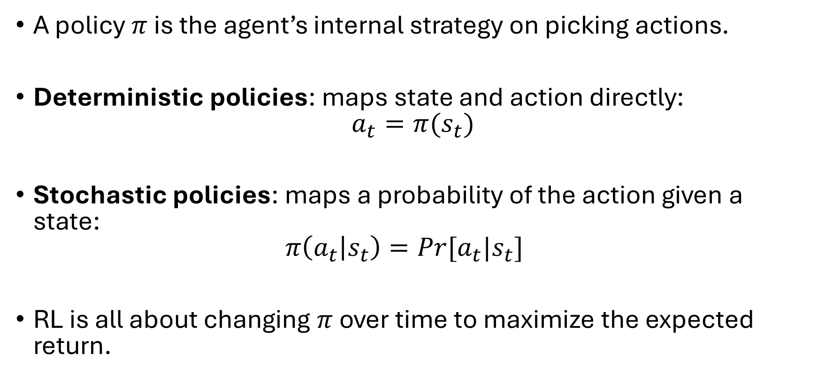
Policy
A policy $π$ is the agent’s internal strategy on picking actions.
Deterministic policies: maps state and action directly: $a_{t}=π(s_{t})$
Stochastic policies: maps a probability of the action given a state: $π\left(a_{t} | s_{t}\right)=Pr[a_{t}|s_{t}]$
RL is all about changing $π$ over time to maximize the expected return.

Slide 32
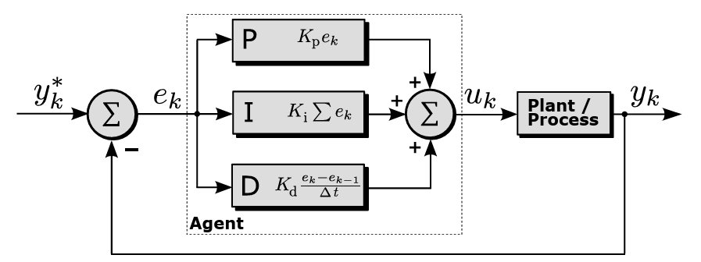
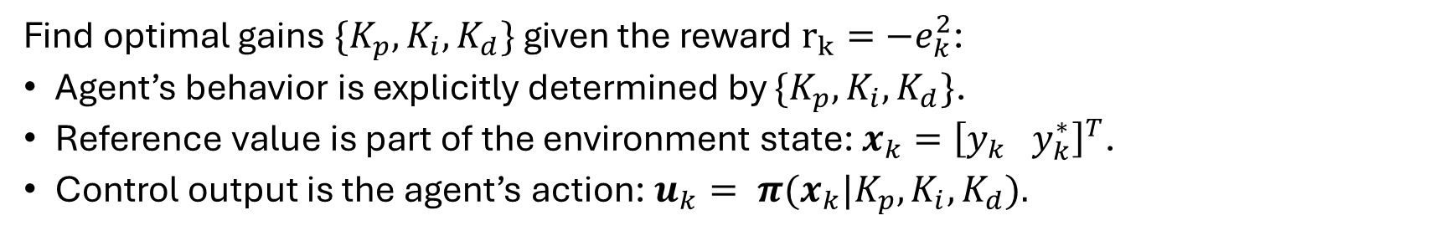
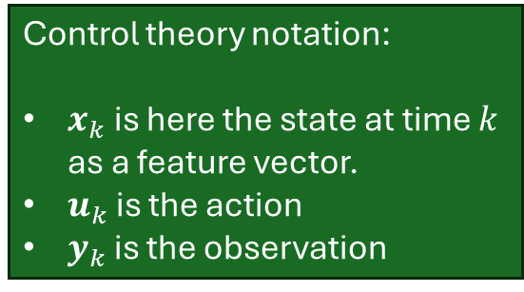
Deterministic policy example
Control theory notation:
$x_{k}$ is here the state at time $k$ as a feature vector.
$u_{k}$ is the action
$y_{k}$ is the observation
Find optimal gains $\{K_{p},K_{i},K_{d}\}$ given the reward $r_{k}=−e_{k}^{2}$:
Agent’s behavior is explicitly determined by $\{K_{p},K_{i},K_{d}\}$.
Reference value is part of the environment state: $x_{k}={\left[y_{k} y_{k}^{∗}\right]}^{T}$.
Control output is the agent’s action: $u_{k}= π(x_{k}|K_{p},K_{i},K_{d}).$
Classical PID control loop with scalar quantities (derivative of www.wikipedia.org, by Arturo Urquizo CC BY-SA 3.0)

Slide 33
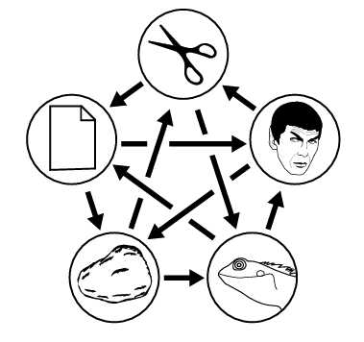
Stochastic policy
Two-player game of extended rock-paper-scissors:
A deterministic policy can be easily exploited by the opponent.
A uniform random policy would be instead unpredictable (assuming an ideal random number generator).
Figure: Rock paper scissors lizard Spock game mechanics (source: www.wikipedia.org, by Diriector Doc CC BY-SA 4.0)

Slide 34
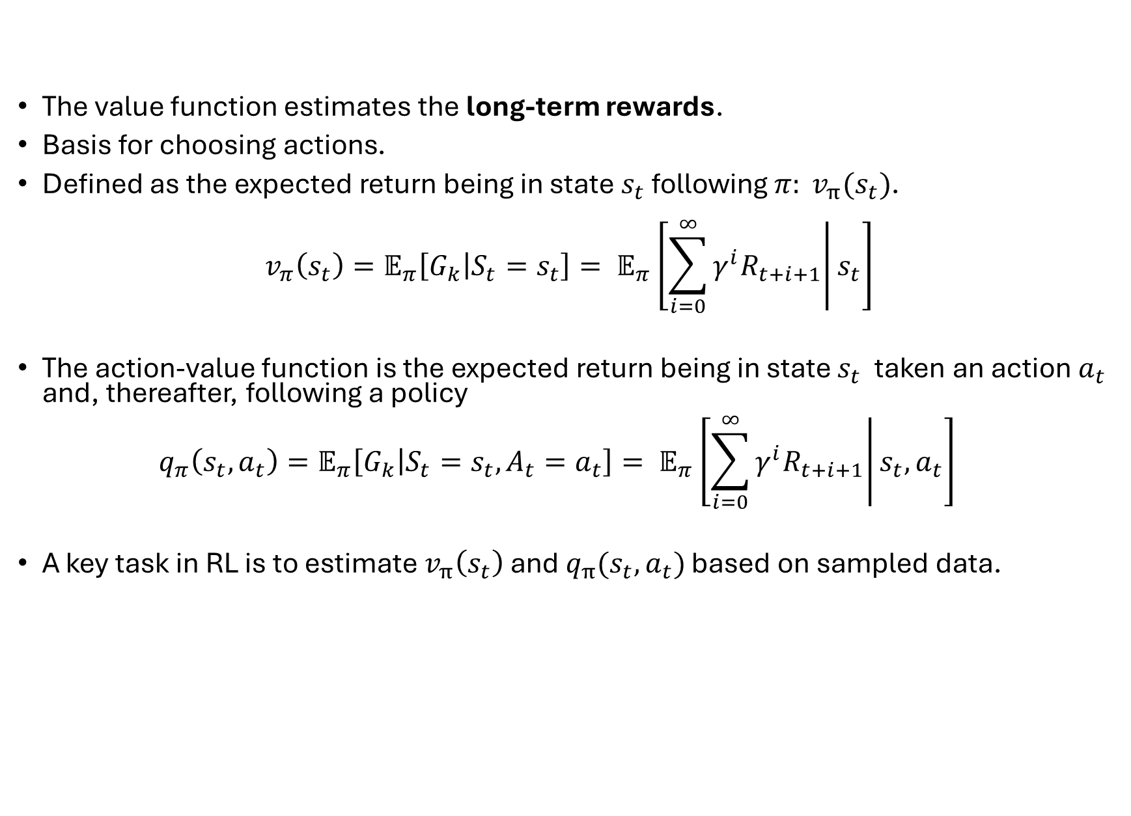
Value Function
The value function estimates the long-term rewards.
Basis for choosing actions.
Defined as the expected return being in state $s_{t}$ following $π: v_{π}(s_{t})$.
$$v_{π}\left(s_{t}\right)=𝔼_{π}\left[G_{k} | S_{t}=s_{t}\right]= 𝔼_{π}\left[\left.\sum_{i=0}^{∞}{γ^{i}R_{t+i+1}}\right|s_{t}\right]$$
The action-value function is the expected return being in state $s_{t}$ taken an action $a_{t}$ and, thereafter, following a policy $q_{π}\left(s_{t},a_{t}\right)=𝔼_{π}\left[G_{k} | S_{t}=s_{t}, A_{t}=a_{t}\right]= 𝔼_{π}\left[\left.\sum_{i=0}^{∞}{γ^{i}R_{t+i+1}}\right|s_{t},a_{t}\right]$
A key task in RL is to estimate $v_{π}\left(s_{t}\right)$ and $q_{π}(s_{t},a_{t})$ based on sampled data.

Slide 35

Exploration and exploitation
In RL the environment is initially unknown.
The agent needs to learn to act optimal. That is to use the reward signal to alter its behavior policy.
Exploration: find out more about the environment.
Exploitation: maximize current reward using limited information.
Trade-off problem: what’s the best split between both strategies?
Something new
The usual stuff
Figure: The exploration-exploitation dilemma

Slide 36
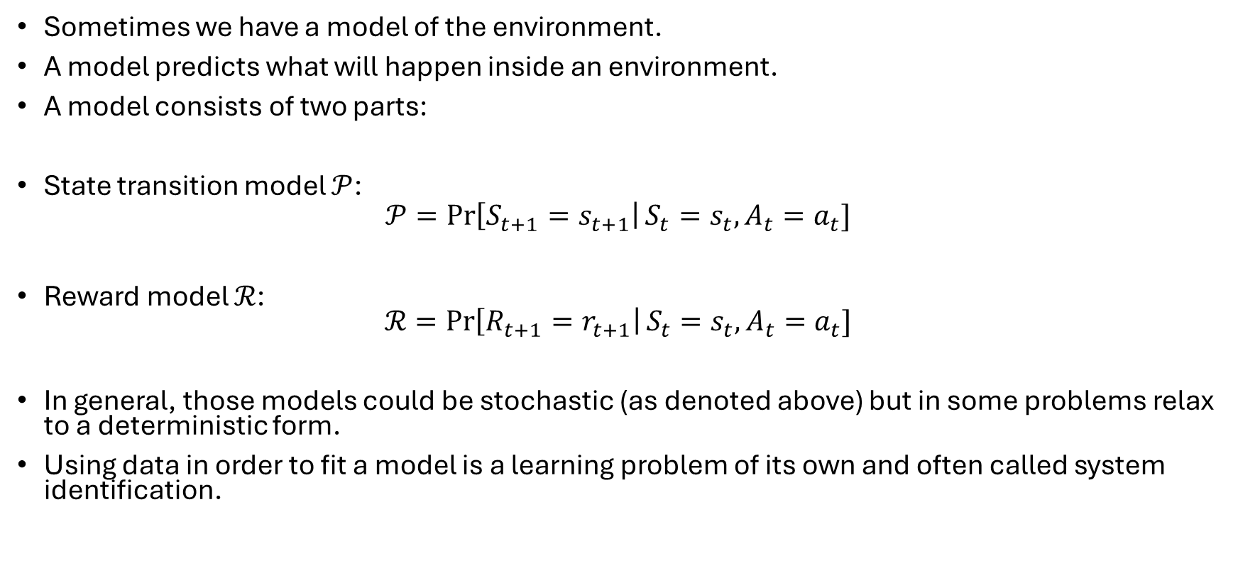
Model
Sometimes we have a model of the environment.
A model predicts what will happen inside an environment.
A model consists of two parts:
State transition model $𝒫$:
$$𝒫=\operatorname{Pr}\left[S_{t+1}=s_{t+1}\right|S_{t}=s_{t}, A_{t}=a_{t}]$$
Reward model $ℛ$: $ℛ=\operatorname{Pr}\left[R_{t+1}=r_{t+1}\right|S_{t}=s_{t}, A_{t}=a_{t}]$
In general, those models could be stochastic (as denoted above) but in some problems relax to a deterministic form.
Using data in order to fit a model is a learning problem of its own and often called system identification.

Slide 37
A small example

Slide 38

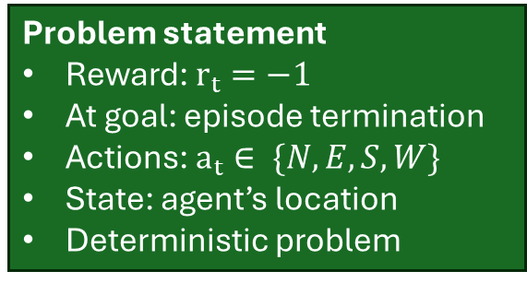
Maze example
Problem statement
Reward: $r_{t}=−1$
At goal: episode termination
Actions: $a_{t}∈ \{N,E,S,W\}$
State: agent’s location
Deterministic problem
Start
Goal
Maze setup (source: D. Silver, “Reinforcement learning”, 2015. CC BY-NC 4.0)

Slide 39

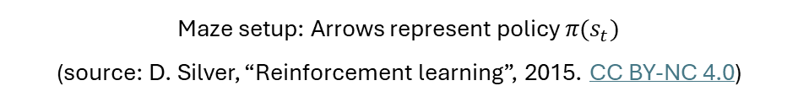
Maze example: RL-solution by policy
Key characteristics
For any state there is a direct action command.
The policy is explicitly available.
Start
Goal
Maze setup: Arrows represent policy $π(s_{t})$ (source: D. Silver, “Reinforcement learning”, 2015. CC BY-NC 4.0)

Slide 40


Maze example: RL-solution by value function
-14 -13 -12 -11 -10 -9
Key characteristics
The agent evaluates neighboring maze positions by their value. Goal
The policy is only implicitly available.
Start
-16 -15
-12
-8
-16 -17
-6
-7
-18 -19
-5
-24
-20
-4
-3
-23 -22 -21 -22
-2
-1
Goal
Numbers represent value $v_{π}(s_{t})$ (source: D. Silver, “Reinforcement learning”, 2015. CC BY-NC 4.0)

Slide 41


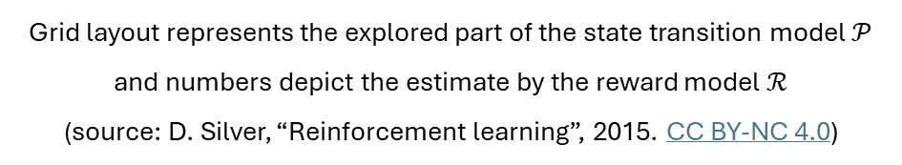
Maze example: RL-solution by model evaluation
-1
-1
-1
-1
-1
-1
Key characteristics
Agent uses internal model of the environment.
The model is only an estimate (inaccurate, incomplete).
The agent interacts with the model before taking the next action (e.g., by numerical optimizers).
Start
-1
-2
-1
-1
-4
-1
-3
-1
-1
-1
-1
-1
Goal
Grid layout represents the explored part of the state transition model $𝒫$ and numbers depict the estimate by the reward model $ℛ$ (source: D. Silver, “Reinforcement learning”, 2015. CC BY-NC 4.0)

Slide 42
RL and planning

Slide 43




RL agent taxonomy
Model-Free
Value Function
Actor Critic
Policy
Value-Based
Policy-Based
Model-Based
Model
Main categories of reinforcement learning algorithms (source: D. Silver, “Reinforcement learning”, 2015. CC BY-NC 4.0)

Slide 44
RL vs. planning
Two fundamental solutions to sequential decision making:
Reinforcement learning:
The environment is initially unknown.
The agents interacts with the environment.
The policy is improved based on environment feedback (reward).
Planning:
An a priori environment model exists.
The agents interacts with its own model.
The policy is improved based on the model feedback (’virtual reward’).
Remark on learning and planning
Above the two extreme cases are confronted:
RL = learning based on data obtained from interacting with the system.
Planning = iterating on a model without improving it based on data.
Can one of these extreme cases lead alone to an efficient and optimal solution?

Slide 45

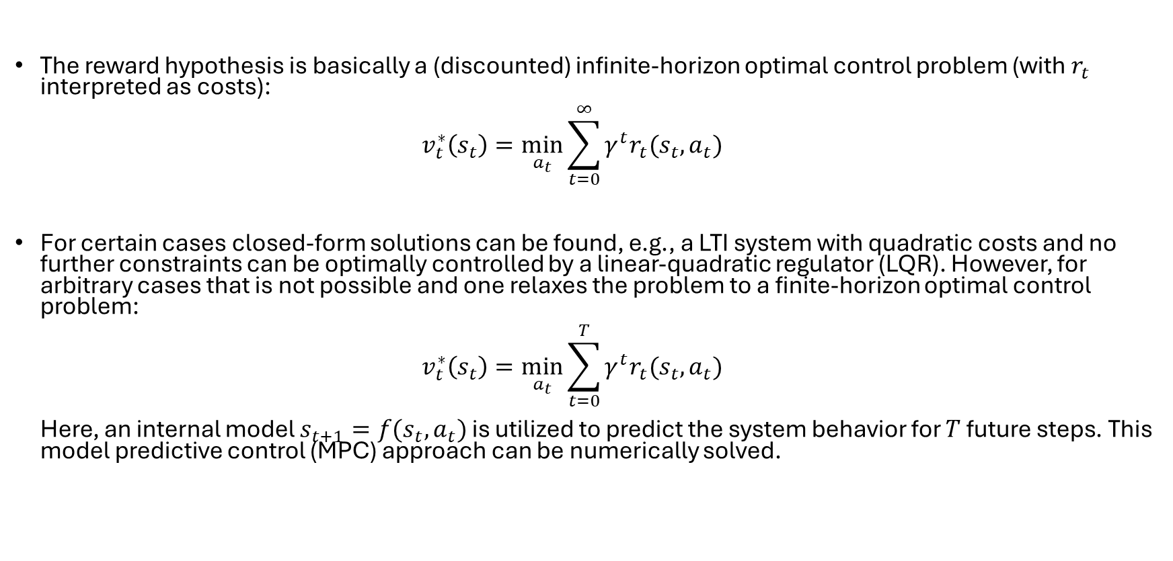
Problem reconsideration
Reward hypothesis: All goals can be described by the maximization of the expected cumulative reward:
$$\max{𝔼\left[\sum_{t=0}^{∞}{R_{t}}\right]}$$
The reward hypothesis is basically a (discounted) infinite-horizon optimal control problem (with $r_{t}$ interpreted as costs): $v_{t}^{∗}\left(s_{t}\right)=\min_{a_{t}}{\sum_{t=0}^{∞}{γ^{t}r_{t}({s_{t},a}_{t})}}$
For certain cases closed-form solutions can be found, e.g., a LTI system with quadratic costs and no further constraints can be optimally controlled by a linear-quadratic regulator (LQR). However, for arbitrary cases that is not possible and one relaxes the problem to a finite-horizon optimal control problem: $v_{t}^{∗}\left(s_{t}\right)=\min_{a_{t}}{\sum_{t=0}^{T}{γ^{t}r_{t}({s_{t},a}_{t})}}$ Here, an internal model $s_{t+1}=f(s_{t},a_{t})$ is utilized to predict the system behavior for $T$ future steps. This model predictive control (MPC) approach can be numerically solved.

Slide 46
MPC vs. RL
Hence, MPC and RL are two sides of the same coin. Both share the same general goal (sequential optimal decision making), but follow their own philosophy:
Property | MPC | RL
Objective | Min. cost | Max. reward
Model of the environment | required | Can be unknown
Integration of existing knowledge | Easy | hard
Constraint handling | inherent | Only indirect
Adaptive to environment changes | Typically not | inherent
Online complexity | Depends | depends
Stability theory | Mature | immature
Key differences on MPC vs. RL (inspired from D. Görges, Relations between Model Predictive Control and Reinforcement Learning, IFAC PapersOnine 50-1, pp. 4920-4928, 2017)

Slide 47
Summary: what you should know
Understanding the role of RL in machine learning and optimal sequential decision making.
Become acquainted with the basic RL interaction loop (agent, environment, interpreter).
Finding your way around the basic RL vocabulary.
Internalize the significance of proper reward formulations (design parameter).
Differentiate solution ideas on how to retrieve an optimal agent behavior (policy).
Delimit RL towards model predictive control as a sequential decision-making alternative.

