Slide 1
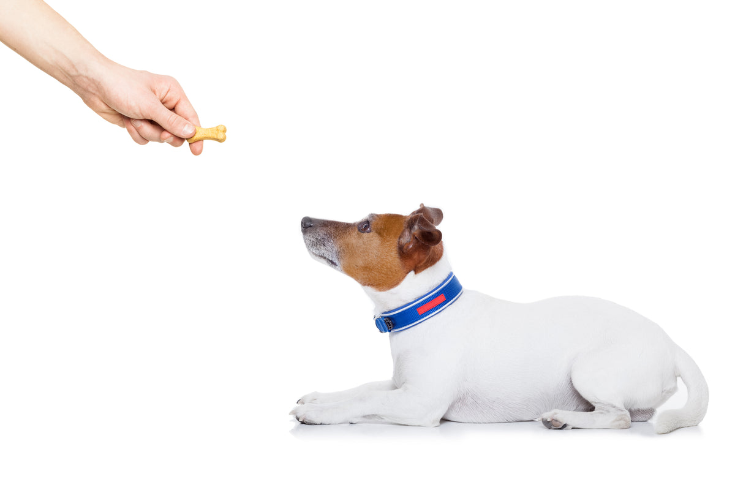

Reinforcement Learning Markov Decision Processes (MDP) Sutton/Barto* Chapter 3
Michael Hahsler, SMU
With figures from Sutton/Barto*
*Sutton and Barto, Reinforcement Learning: An Introduction, 2nd edition, MIT Press, Cambridge, MA, 2018

Slide 2
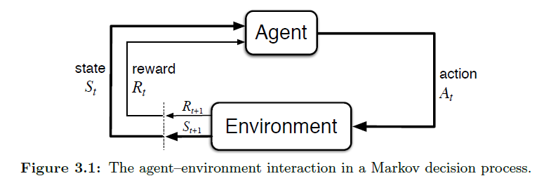
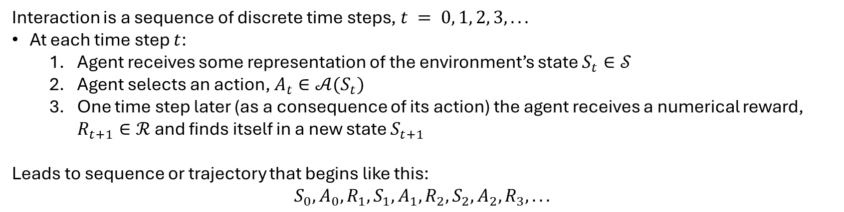
The Agent–Environment Interface
MDPs are meant to be a straightforward framing of the problem of learning from interaction to achieve a goal.
Actions influence the future rewards by leading to different states.
Interaction is a sequence of discrete time steps, $t = 0, 1, 2, 3, . . .$
At each time step $t$:
Agent receives some representation of the environment’s state $S_{t}∈𝒮$
Agent selects an action, $A_{t}∈𝒜(S_{t})$
One time step later (as a consequence of its action) the agent receives a numerical reward, $R_{t+1}∈ℛ$and finds itself in a new state $S_{t+1}$
Leads to sequence or trajectory that begins like this:
$$S_{0},A_{0},R_{1}, S_{1},A_{1},R_{2}, S_{2},A_{2},R_{3}, . . .$$

Slide 3
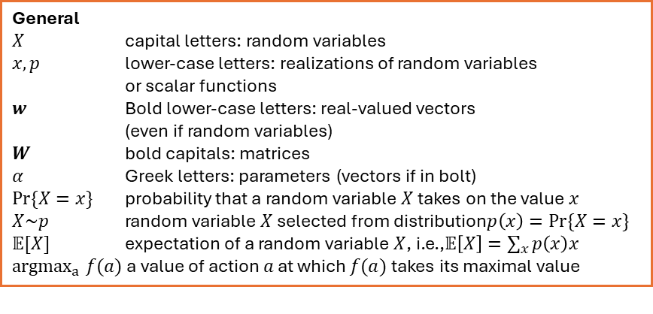
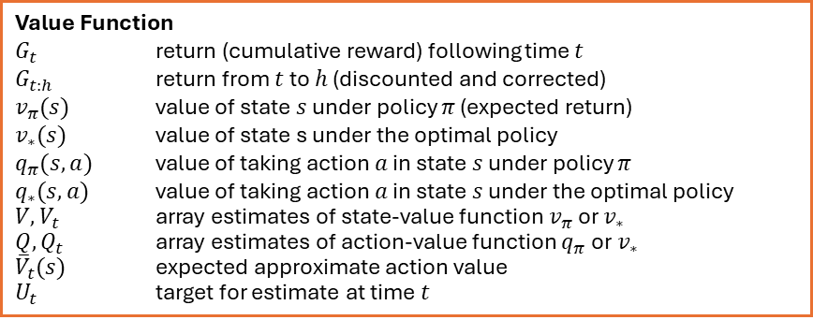
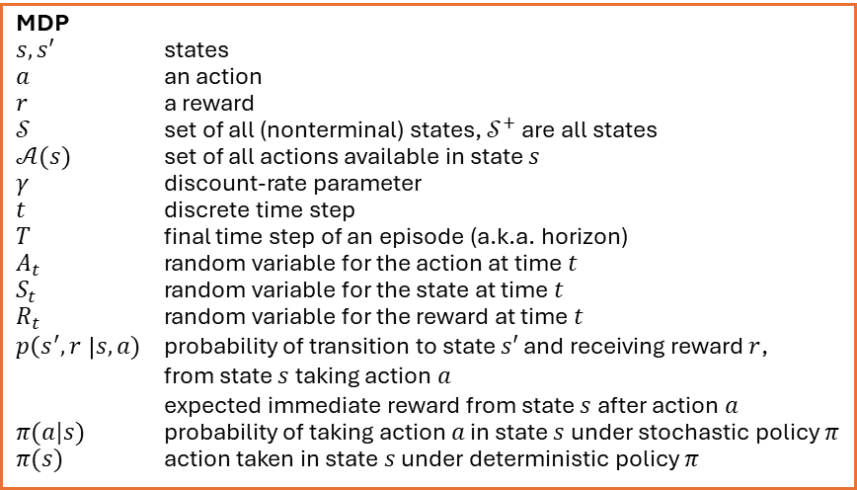
Summary of Notation
General
$X$ capital letters: random variables $x, p$ lower-case letters: realizations of random variables or scalar functions
$w$ Bold lower-case letters: real-valued vectors (even if random variables)
$W$ bold capitals: matrices
$α$ Greek letters: parameters (vectors if in bolt)
$Pr⁡\{X=x\}$ probability that a random variable $X$ takes on the value $x$
$X\sim p$ random variable $X$ selected from distribution$p\left(x\right)=Pr⁡\{X=x\}$
$𝔼[X]$ expectation of a random variable $X$, i.e.,$𝔼\left[X\right]=\sum_{x}{p\left(x\right)x}$
${argmax}_{a} f(a)$ a value of action $a$ at which $f(a)$ takes its maximal value
Value Function
$G_{t}$ return (cumulative reward) following time $t$
$G_{t:h}$ return from $t$ to $h$ (discounted and corrected)
$v_{π}(s)$ value of state $s$ under policy $π$ (expected return)
$v_{∗}(s)$ value of state s under the optimal policy
$q_{π}(s,a)$ value of taking action $a$ in state $s$ under policy $π$
$q_{∗}(s,a)$ value of taking action $a$ in state $s$ under the optimal policy
$V, V_{t}$ array estimates of state-value function $v_{π}$or $v_{∗}$
$Q,Q_{t}$ array estimates of action-value function $q_{π}$or $v_{∗}$
${\overline{V}}_{t}(s)$ expected approximate action value
$U_{t}$ target for estimate at time$t$
MDP
$s, s′$ states
$a$ an action
$r$ a reward
$𝒮$ set of all (nonterminal) states, $𝒮^{+}$ are all states
$𝒜(s)$ set of all actions available in state $s$
$γ$ discount-rate parameter
$t$ discrete time step
$T$ final time step of an episode (a.k.a. horizon)
$A_{t}$ random variable for the action at time $t$
$S_{t}$ random variable for the state at time $t$
$R_{t}$ random variable for the reward at time $t$
$p\left(s^{′},r \right|s, a)$ probability of transition to state $s′$ and receiving reward $r$, from state $s$ taking action $a$
expected immediate reward from state $s$ after action $a$
$π(a|s)$ probability of taking action $a$ in state $s$ under stochastic policy $π$
$π(s)$ action taken in state $s$ under deterministic policy $π$

Slide 4
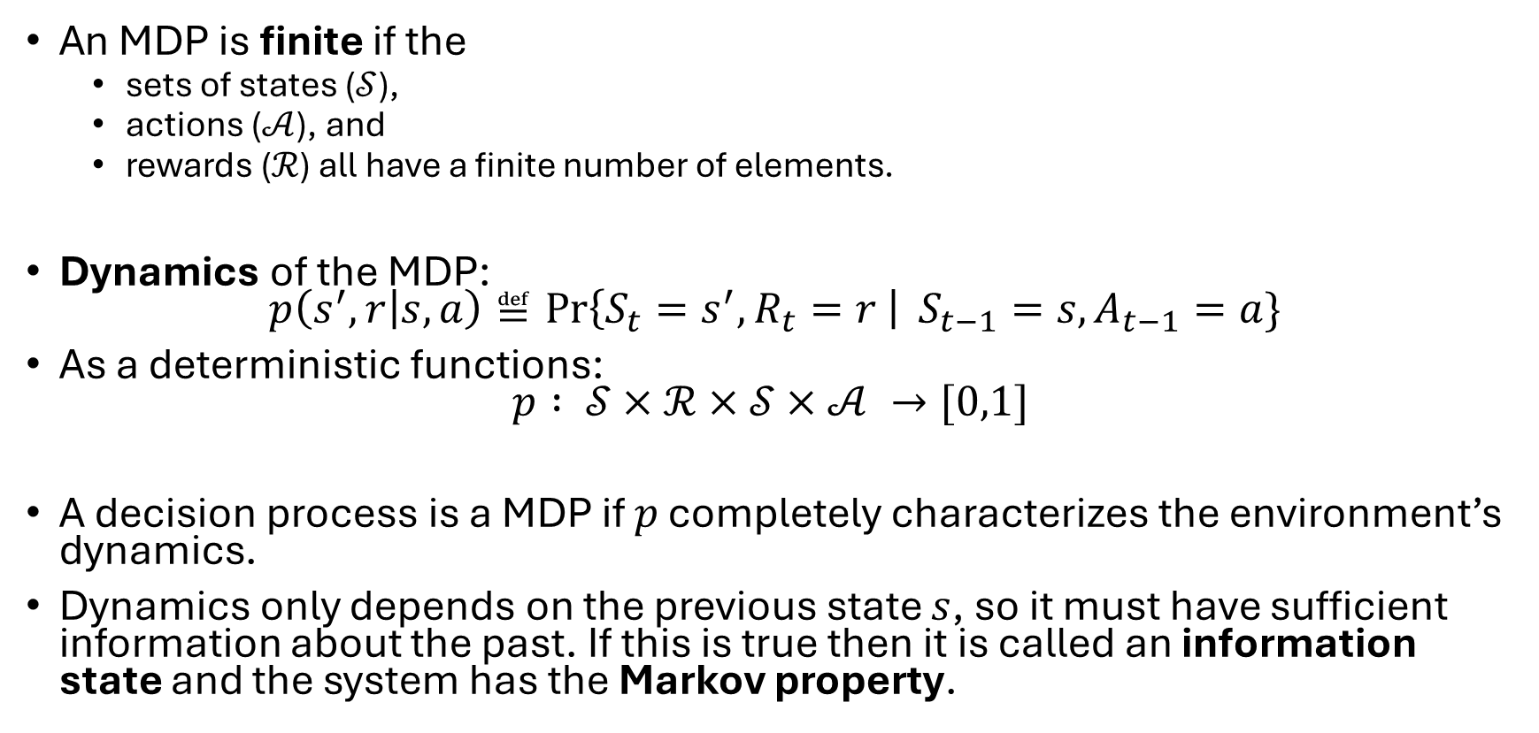
Finite MDP
An MDP is finite if the
sets of states ($𝒮$),
actions ($𝒜$), and
rewards ($ℛ$) all have a finite number of elements.
Dynamics of the MDP: $p\left(s^{′},r | s,a\right)≝\operatorname{Pr}\left\{S_{t}=s^{′}, R_{t}=r \right| S_{t−1}=s, A_{t−1}=a\}$
As a deterministic functions: $p : 𝒮×ℛ×𝒮×𝒜 →[0,1]$
A decision process is a MDP if $p$ completely characterizes the environment’s dynamics.
Dynamics only depends on the previous state $s$, so it must have sufficient information about the past. If this is true then it is called an information state and the system has the Markov property.

Slide 5
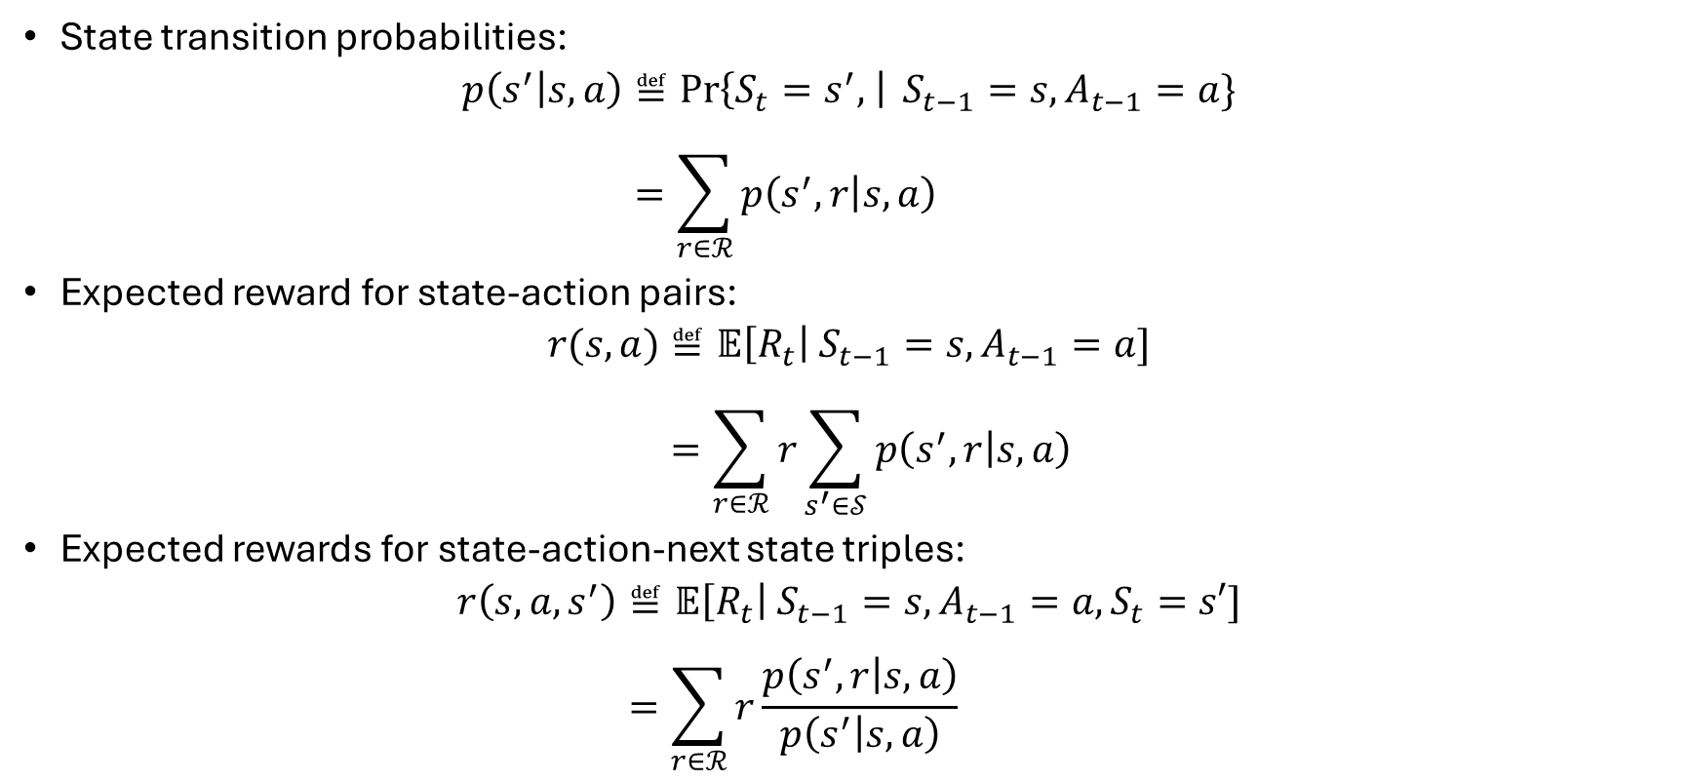
Transition and Reward Functions
State transition probabilities:
$$p\left(s^{′} | s,a\right)≝\operatorname{Pr}\left\{S_{t}=s^{′}, \right| S_{t−1}=s, A_{t−1}=a\} \\ =\sum_{r∈ℛ}{p\left(s^{′},r | s,a\right)}$$
Expected reward for state-action pairs:
$$r(s,a)≝𝔼\left[R_{t}\right| S_{t−1}=s, A_{t−1}=a] \\ =\sum_{r∈ℛ}{r\sum_{s^{′}∈𝒮}{p\left(s^{′},r | s,a\right)}}$$
Expected rewards for state-action-next state triples:
$$r\left(s,a,s^{′}\right)≝𝔼\left[R_{t}\right| S_{t−1}=s, A_{t−1}=a,S_{t}=s′] \\ =\sum_{r∈ℛ}{r\frac{p\left(s^{′},r | s,a\right)}{p\left(s^{′} | s,a\right)}}$$

Slide 6
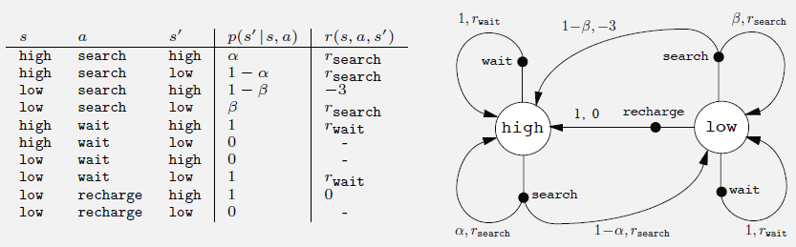

Add an Example!!!!!!!!!!!!

Slide 7
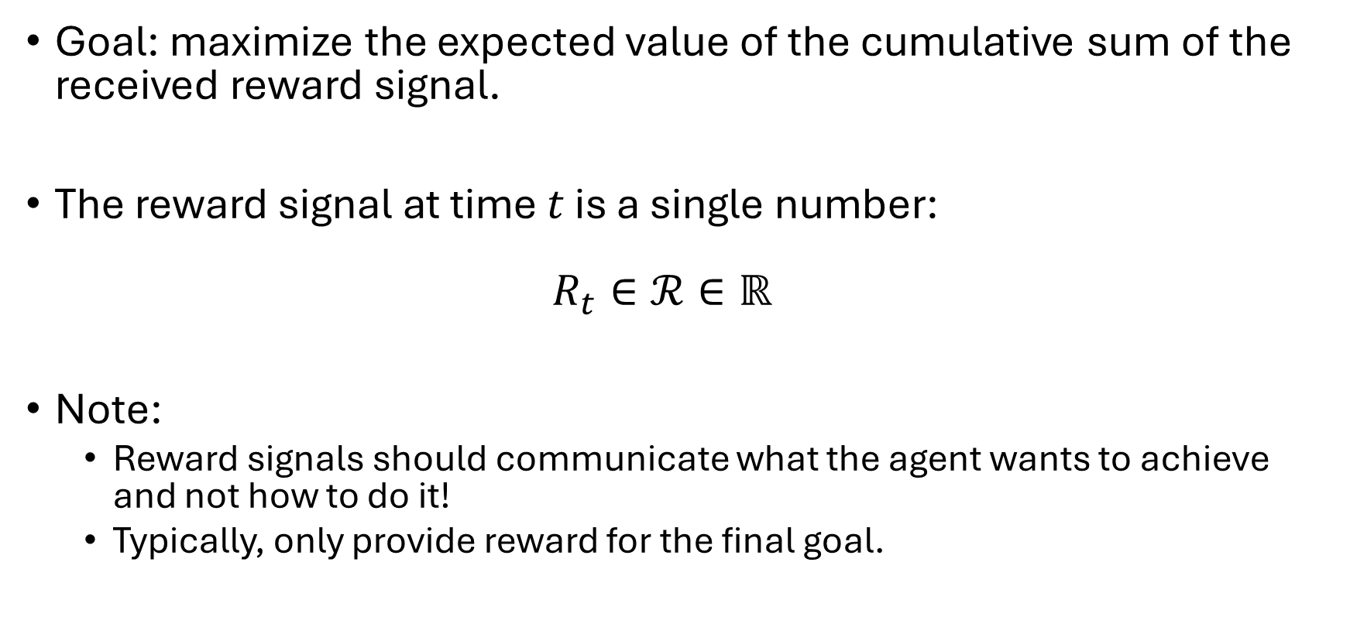
Goals and Rewards
Goal: maximize the expected value of the cumulative sum of the received reward signal.
The reward signal at time $t$ is a single number: $R_{t}∈ℛ∈ℝ$
Note:
Reward signals should communicate what the agent wants to achieve and not how to do it!
Typically, only provide reward for the final goal.

Slide 8
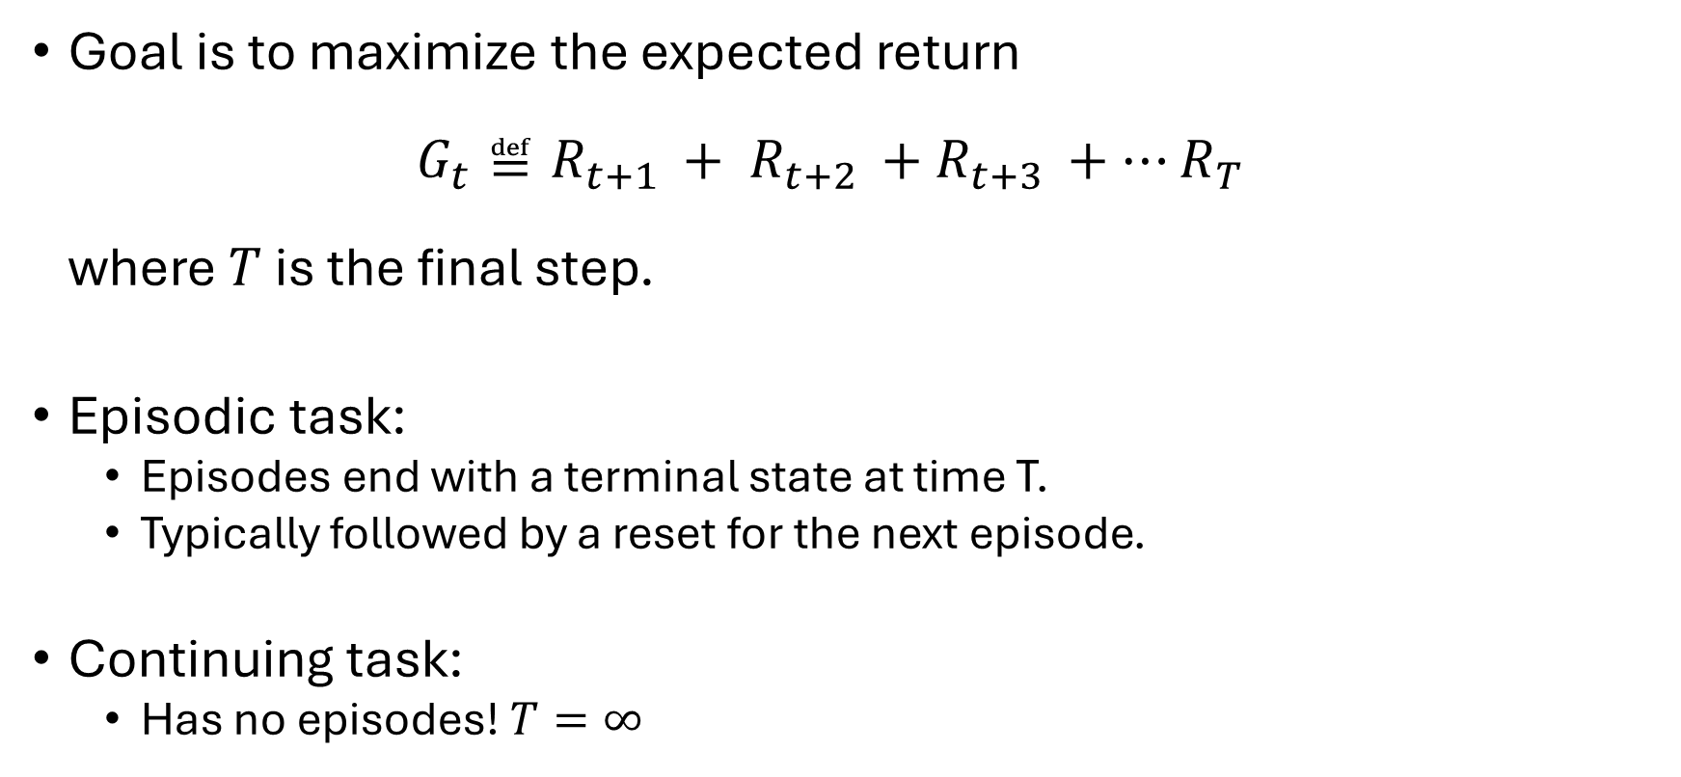
Return and Episodes
Goal is to maximize the expected return $G_{t}≝R_{t+1 }+ R_{t+2 }+R_{t+3 }+…R_{T}$ where $T$ is the final step.
Episodic task:
Episodes end with a terminal state at time T.
Typically followed by a reset for the next episode.
Continuing task:
Has no episodes! $T=∞$

Slide 9
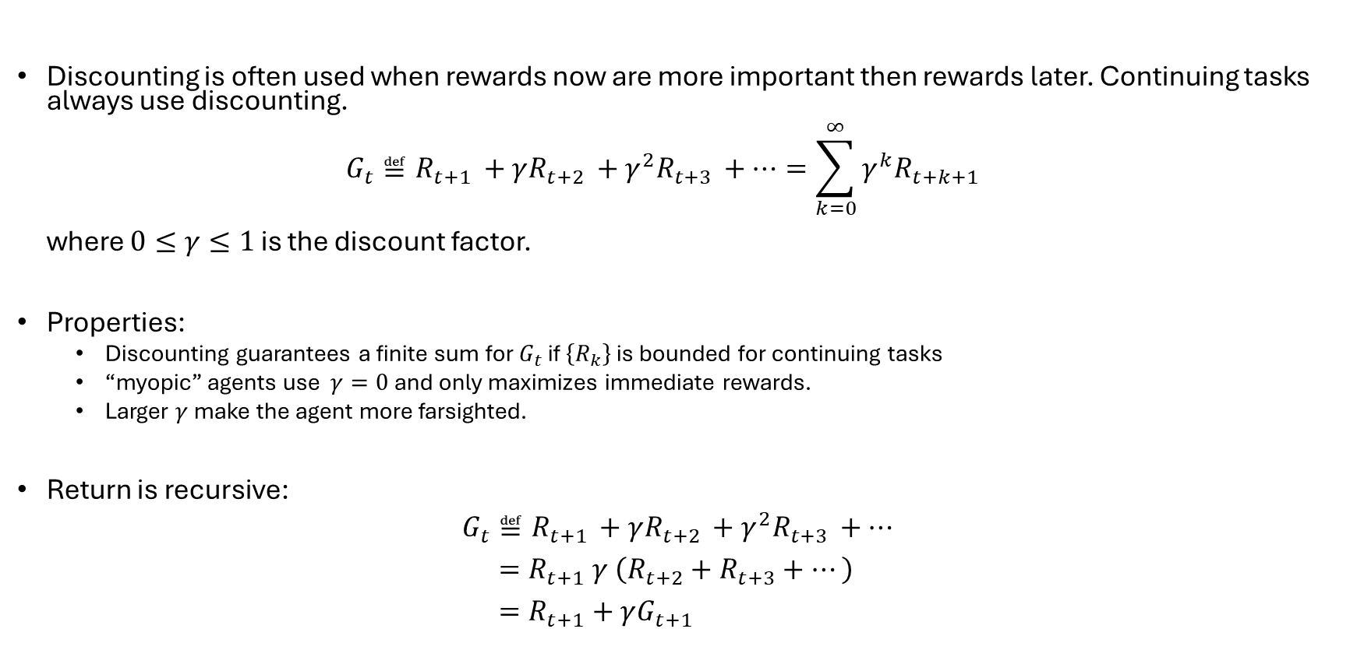
Reward Discounting
Discounting is often used when rewards now are more important then rewards later. Continuing tasks always use discounting. $G_{t}≝R_{t+1 }+γR_{t+2 }+{γ^{2}R}_{t+3 }+…=\sum_{k=0}^{∞}{γ^{k}R_{t+k+1}}$ where $0≤γ≤1$ is the discount factor.
Properties:
Discounting guarantees a finite sum for $G_{t}$ if $\left\{R_{k}\right\}$ is bounded for continuing tasks
“myopic” agents use $γ=0$ and only maximizes immediate rewards.
Larger $γ$ make the agent more farsighted.
Return is recursive:
$$G_{t}≝R_{t+1 }+γR_{t+2 }+{γ^{2}R}_{t+3 }+… \\ =R_{t+1} γ \left(R_{t+2}+R_{t+3}+…\right) \\ =R_{t+1}+γG_{t+1}$$

Slide 10
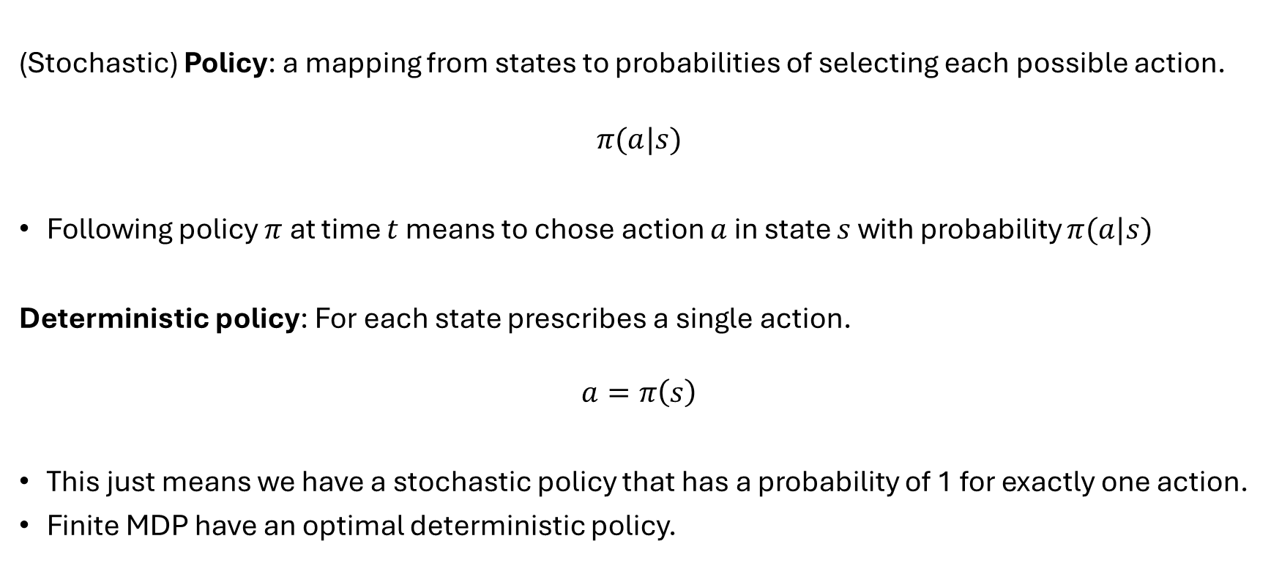
Policy
(Stochastic) Policy: a mapping from states to probabilities of selecting each possible action.
$$π(a|s)$$
Following policy $π$ at time $t$ means to chose action $a$ in state $s$ with probability $π(a|s)$
Deterministic policy: For each state prescribes a single action.
$$a=π\left(s\right)$$
This just means we have a stochastic policy that has a probability of 1 for exactly one action.
Finite MDP have an optimal deterministic policy.

Slide 11
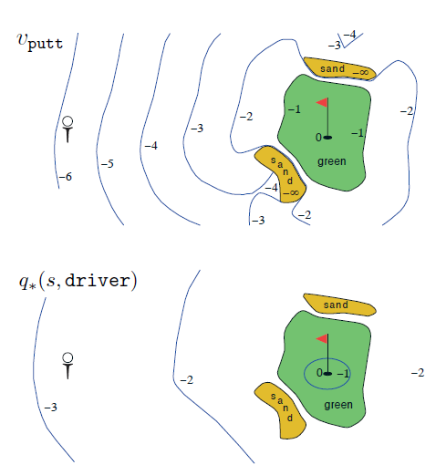
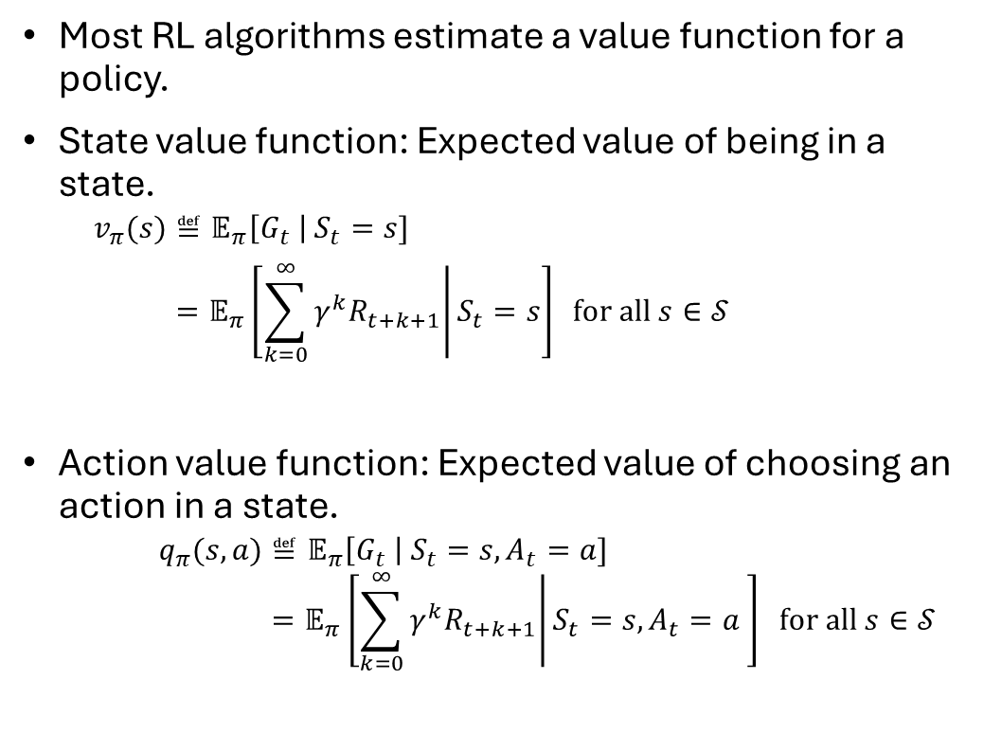


Value Functions
Each stroke: $r=−1$
Most RL algorithms estimate a value function for a policy.
State value function: Expected value of being in a state.
$$v_{π}(s)≝𝔼_{π}\left[G_{t} \right| S_{t}=s] \\ =𝔼_{π}\left[\left.\sum_{k=0}^{∞}{γ^{k}R_{t+k+1}}\right|S_{t}=s\right] \text{for} \text{all} s∈𝒮$$
Action value function: Expected value of choosing an action in a state.
$$q_{π}(s,a)≝𝔼_{π}\left[G_{t} \right| S_{t}=s,A_{t}=a] \\ =𝔼_{π}\left[\left.\sum_{k=0}^{∞}{γ^{k}R_{t+k+1}}\right|S_{t}=s,A_{t}=a \right] \text{for} \text{all} s∈𝒮$$
$$v_{π}(s)$$
State-value function for policy $π$ that always uses the putter.
Optimal action-value function for using the driver.
$𝔼_{π}$ … Expectation under policy $π$ = follow the policy

Slide 12
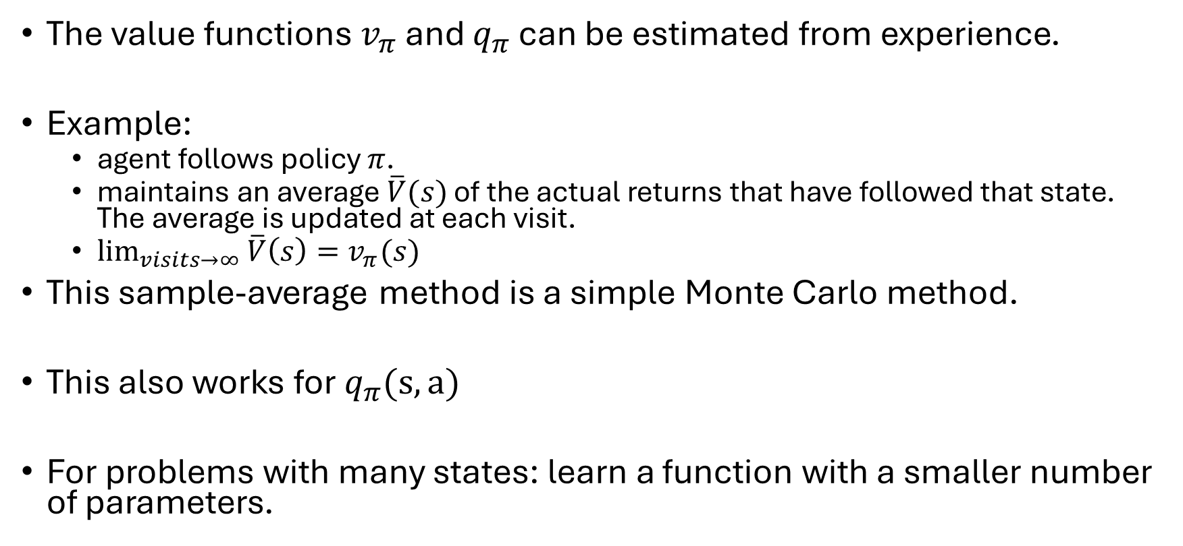
Value Function Estimation and Monte Carlo Methods
The value functions $v_{π}$ and $q_{π}$ can be estimated from experience.
Example:
agent follows policy $π$.
maintains an average $\overline{V}(s)$ of the actual returns that have followed that state. The average is updated at each visit.
$\lim_{visits→∞}{\overline{V}\left(s\right)=v_{π}(s)}$
This sample-average method is a simple Monte Carlo method.
This also works for $q_{π}(s,a)$
For problems with many states: learn a function with a smaller number of parameters.

Slide 13
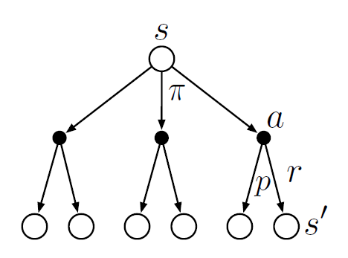
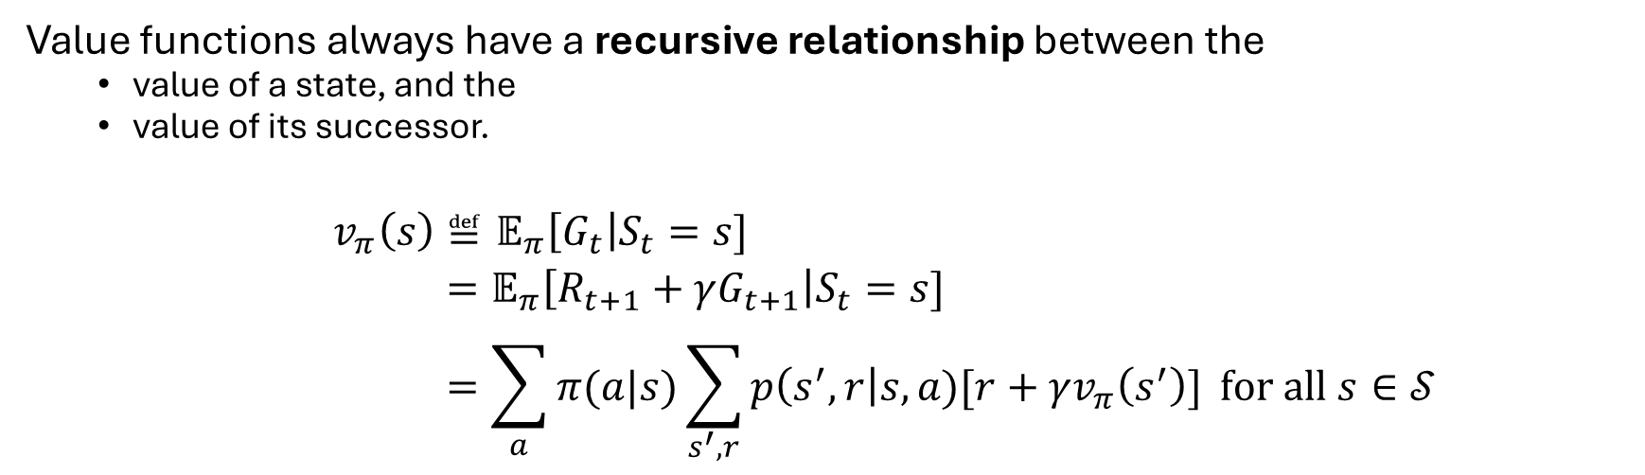
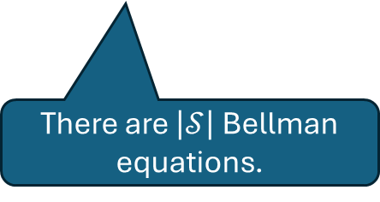
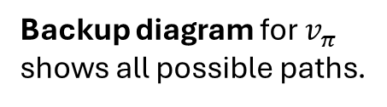
Bellman Equation
Value functions always have a recursive relationship between the
value of a state, and the
value of its successor.
$$v_{π}\left(s\right)≝𝔼_{π}\left[G_{t}\right|S_{t}=s] \\ =𝔼_{π}\left[R_{t+1}+γG_{t+1}\right|S_{t}=s] \\ =\sum_{a}{π(a|s)}\sum_{s^{′},r}{p\left(s^{′},r\right|s,a)[r+γv_{π}\left(s^{′}\right)]} \text{for} \text{all} s∈𝒮$$
Value of a state = reward + value of successor
Expectation
There are $\left|𝒮\right|$ Bellman equations.
Backup diagram for $v_{π}$ shows all possible paths.
Backup
Bellman equation averages over all

Slide 14
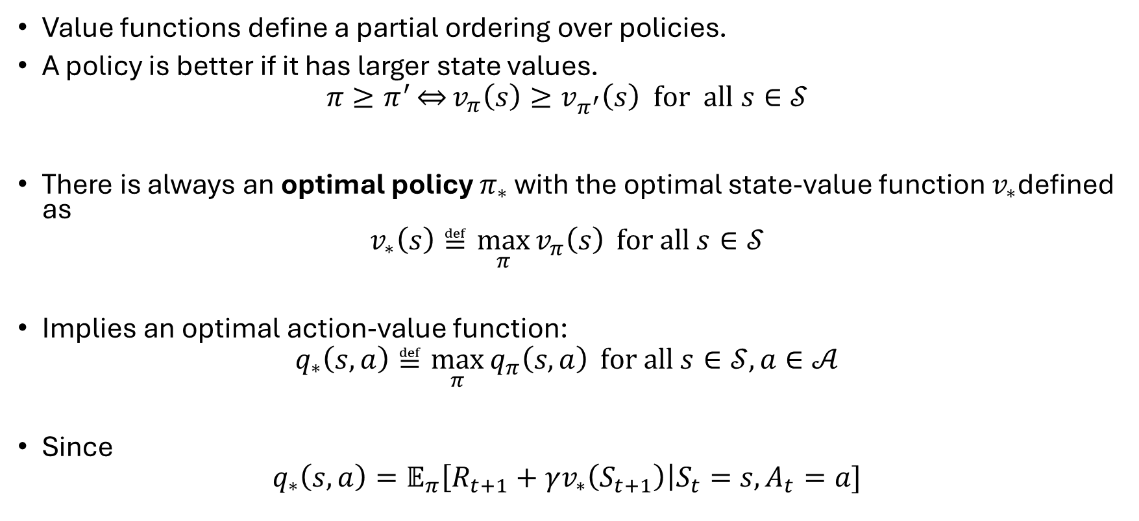
Optimal Policies and Value Functions
Value functions define a partial ordering over policies.
A policy is better if it has larger state values.
$$π≥π^{′}\overset{⇔}{}v_{π}\left(s\right)≥v_{π^{′}}\left(s\right) \text{for} \text{all} s∈𝒮$$
There is always an optimal policy $π_{∗}$ with the optimal state-value function $v_{∗}$defined as
$$v_{∗}\left(s\right)≝\max_{π}{v_{π}\left(s\right)} \text{for} \text{all} s∈𝒮$$
Implies an optimal action-value function:
$$q_{∗}\left(s,a\right)≝\max_{π}{q_{π}\left(s,a\right)} \text{for} \text{all} s∈𝒮,a∈𝒜$$
Since
$$q_{∗}\left(s,a\right)=𝔼_{π}\left[R_{t+1}+γv_{∗}\left(S_{t+1}\right)\right|S_{t}=s, A_{t}=a]$$

Slide 15
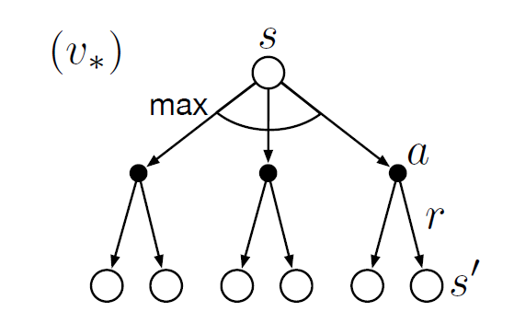
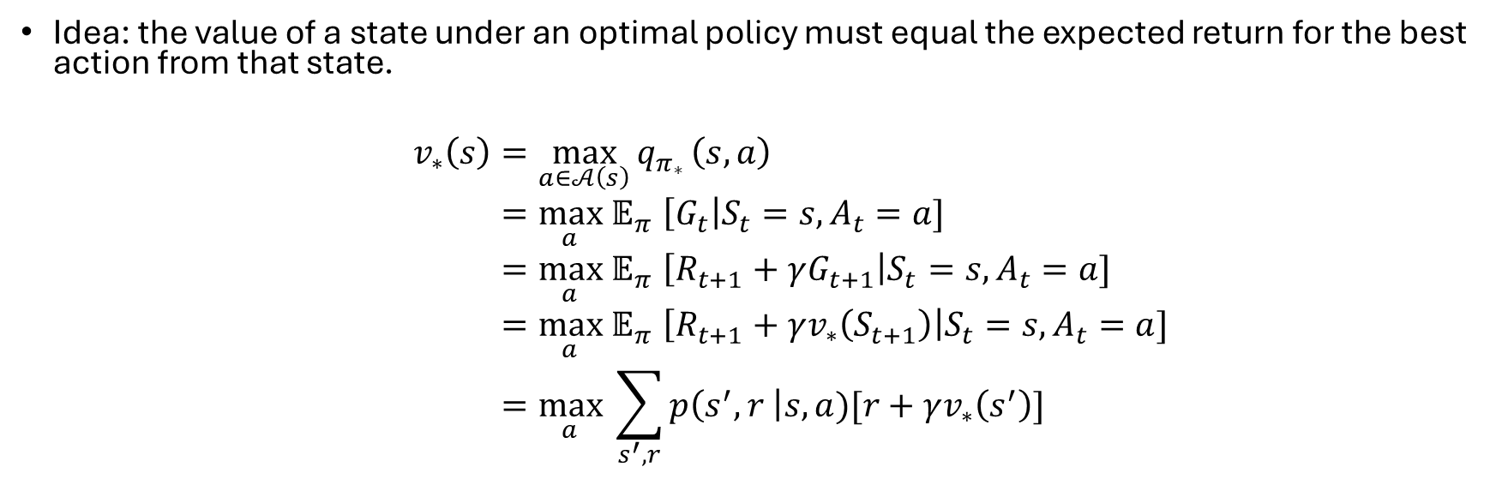
Bellman Optimality Equation
Idea: the value of a state under an optimal policy must equal the expected return for the best action from that state.
$$v_{∗}\left(s\right)=\max_{a∈𝒜\left(s\right)}{q_{π_{∗}}}\left(s,a\right) \\ {=\max_{a} 𝔼}_{π}\left[G_{t}\right|S_{t}=s, A_{t}=a] \\ {=\max_{a} 𝔼}_{π}\left[R_{t+1}+γG_{t+1}\right|S_{t}=s, A_{t}=a] \\ {=\max_{a} 𝔼}_{π}\left[R_{t+1}+γv_{∗}\left(S_{t+1}\right)\right|S_{t}=s, A_{t}=a] \\ =\max_{a} \sum_{s^{′},r}{p\left(s^{′},r \right|s,a)[r+γv_{∗}\left(s^{′}\right)]}$$

Slide 16
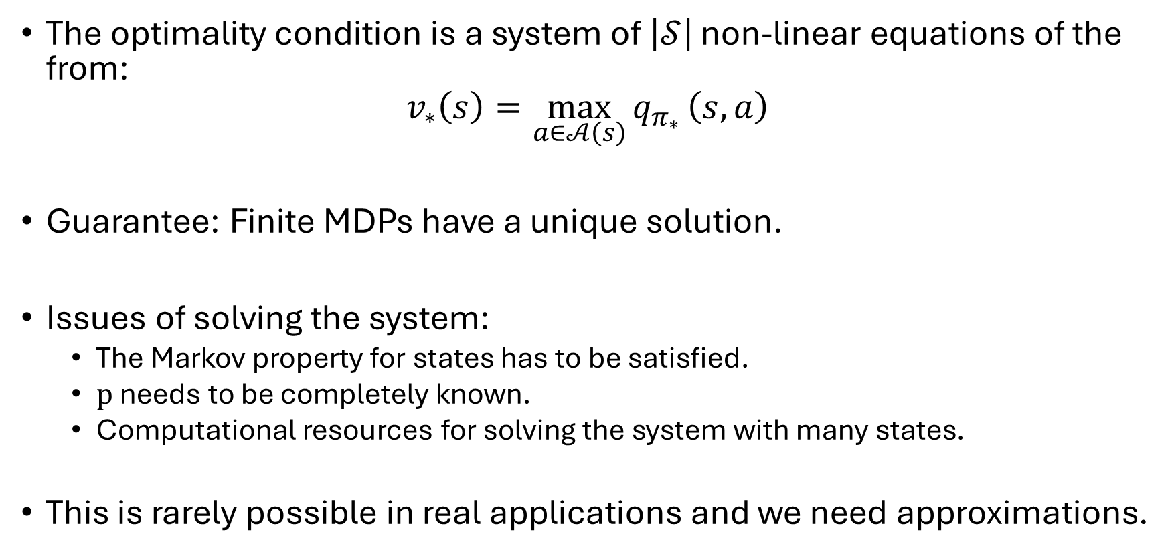
Bellman Optimality
The optimality condition is a system of $\left|𝒮\right|$ non-linear equations of the from:
$$v_{∗}\left(s\right)=\max_{a∈𝒜\left(s\right)}{q_{π_{∗}}}\left(s,a\right)$$
Guarantee: Finite MDPs have a unique solution.
Issues of solving the system:
The Markov property for states has to be satisfied.
$p$ needs to be completely known.
Computational resources for solving the system with many states.
This is rarely possible in real applications and we need approximations.

Slide 17
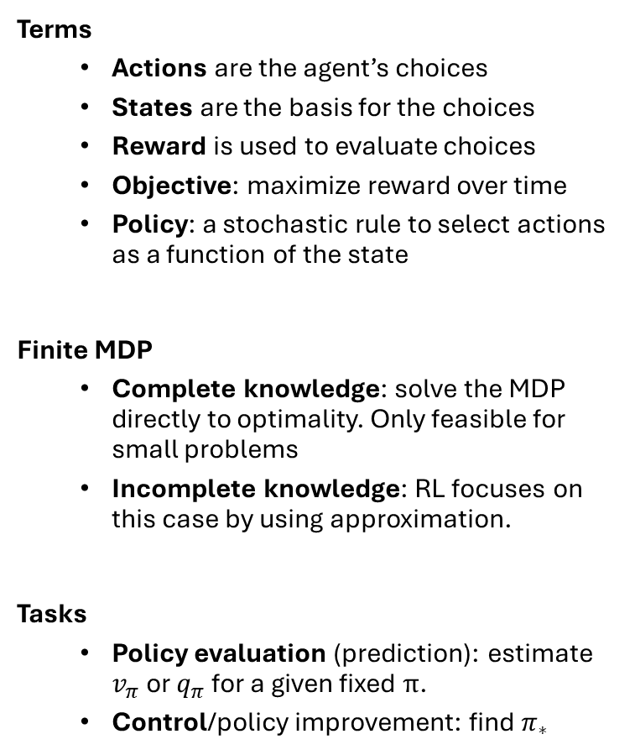
Summary
Terms
Actions are the agent’s choices
States are the basis for the choices
Reward is used to evaluate choices
Objective: maximize reward over time
Policy: a stochastic rule to select actions as a function of the state
Finite MDP
Complete knowledge: solve the MDP directly to optimality. Only feasible for small problems
Incomplete knowledge: RL focuses on this case by using approximation.
Tasks
Policy evaluation (prediction): estimate $v_{π}$ or $q_{π}$ for a given fixed $π$.
Control/policy improvement: find $π_{∗}$

