Slide 1
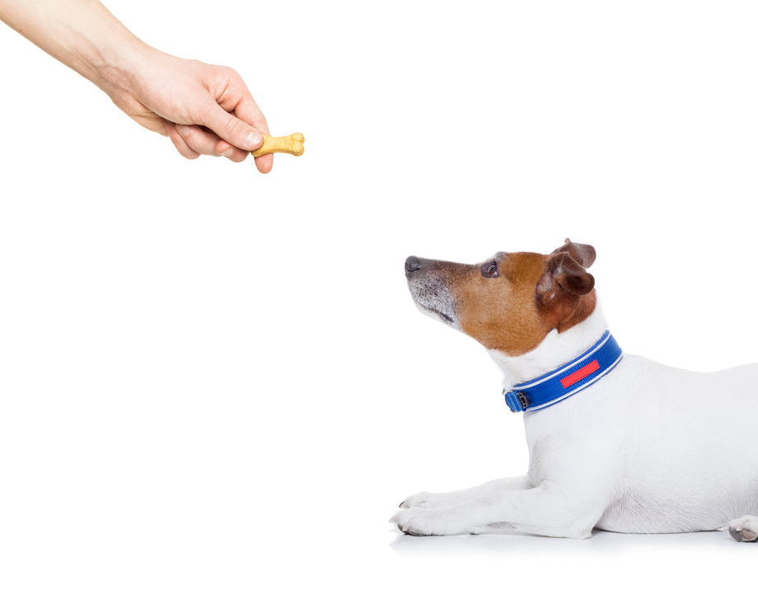

Reinforcement Learning Dynamic Programming Sutton/Barto* Chapter 4
Michael Hahsler, SMU
With figures from Sutton/Barto*
*Sutton and Barto, Reinforcement Learning: An Introduction, 2nd edition, MIT Press, Cambridge, MA, 2018

Slide 2

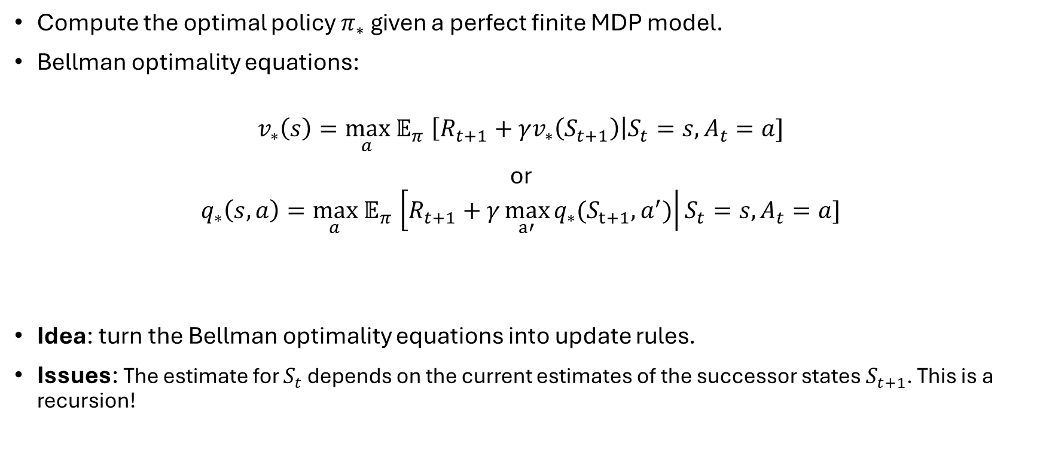
Goal
Compute the optimal policy $π_{∗}$ given a perfect finite MDP model.
Bellman optimality equations:
$$v_{∗}\left(s\right){=\max_{a} 𝔼}_{π}\left[R_{t+1}+γv_{∗}\left(S_{t+1}\right)\right|S_{t}=s, A_{t}=a]$$
or
$$q_{∗}\left(s,a\right){=\max_{a} 𝔼}_{π}\left[R_{t+1}+γ\max_{a′}{q_{∗}(S_{t+1},a^{′})}\right|S_{t}=s, A_{t}=a]$$
Idea: turn the Bellman optimality equations into update rules.
Issues: The estimate for $S_{t}$ depends on the current estimates of the successor states $S_{t+1}$. This is a recursion!
$$=v_{∗}(S_{t+1})$$

Slide 3
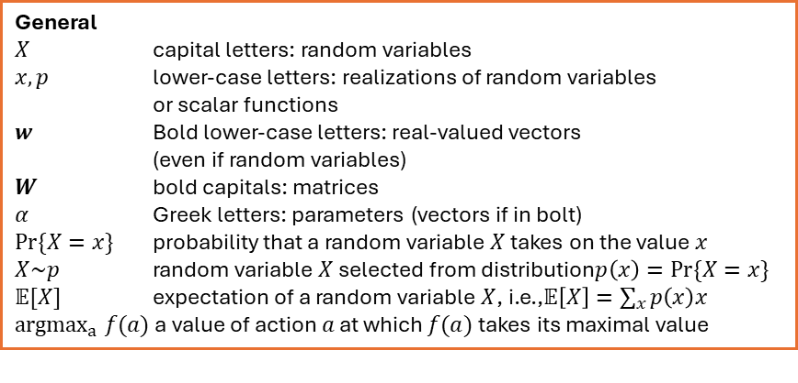
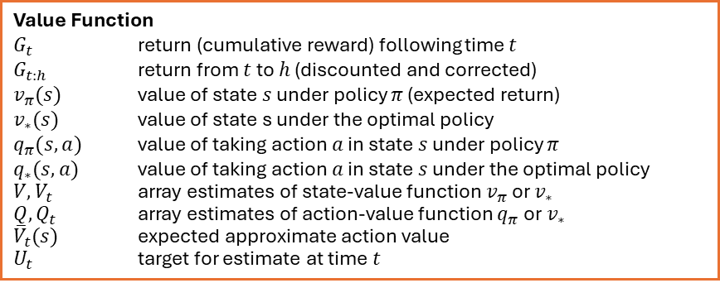
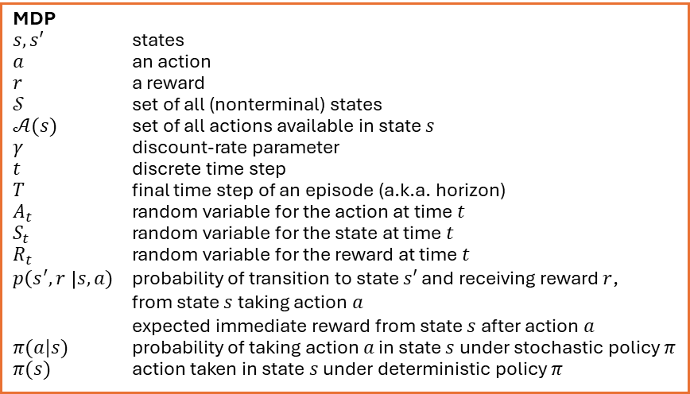
Summary of Notation
General
$X$ capital letters: random variables $x, p$ lower-case letters: realizations of random variables or scalar functions
$w$ Bold lower-case letters: real-valued vectors (even if random variables)
$W$ bold capitals: matrices
$α$ Greek letters: parameters (vectors if in bolt)
$Pr⁡\{X=x\}$ probability that a random variable $X$ takes on the value $x$
$X\sim p$ random variable $X$ selected from distribution$p\left(x\right)=Pr⁡\{X=x\}$
$𝔼[X]$ expectation of a random variable $X$, i.e.,$𝔼\left[X\right]=\sum_{x}{p\left(x\right)x}$
${argmax}_{a} f(a)$ a value of action $a$ at which $f(a)$ takes its maximal value
Value Function
$G_{t}$ return (cumulative reward) following time $t$
$G_{t:h}$ return from $t$ to $h$ (discounted and corrected)
$v_{π}(s)$ value of state $s$ under policy $π$ (expected return)
$v_{∗}(s)$ value of state s under the optimal policy
$q_{π}(s,a)$ value of taking action $a$ in state $s$ under policy $π$
$q_{∗}(s,a)$ value of taking action $a$ in state $s$ under the optimal policy
$V, V_{t}$ array estimates of state-value function $v_{π}$or $v_{∗}$
$Q,Q_{t}$ array estimates of action-value function $q_{π}$or $v_{∗}$
${\overline{V}}_{t}(s)$ expected approximate action value
$U_{t}$ target for estimate at time$t$
MDP
$s, s′$ states
$a$ an action
$r$ a reward
$𝒮$ set of all (nonterminal) states
$𝒜(s)$ set of all actions available in state $s$
$γ$ discount-rate parameter
$t$ discrete time step
$T$ final time step of an episode (a.k.a. horizon)
$A_{t}$ random variable for the action at time $t$
$S_{t}$ random variable for the state at time $t$
$R_{t}$ random variable for the reward at time $t$
$p\left(s^{′},r \right|s, a)$ probability of transition to state $s′$ and receiving reward $r$, from state $s$ taking action $a$
expected immediate reward from state $s$ after action $a$
$π(a|s)$ probability of taking action $a$ in state $s$ under stochastic policy $π$
$π(s)$ action taken in state $s$ under deterministic policy $π$

Slide 4
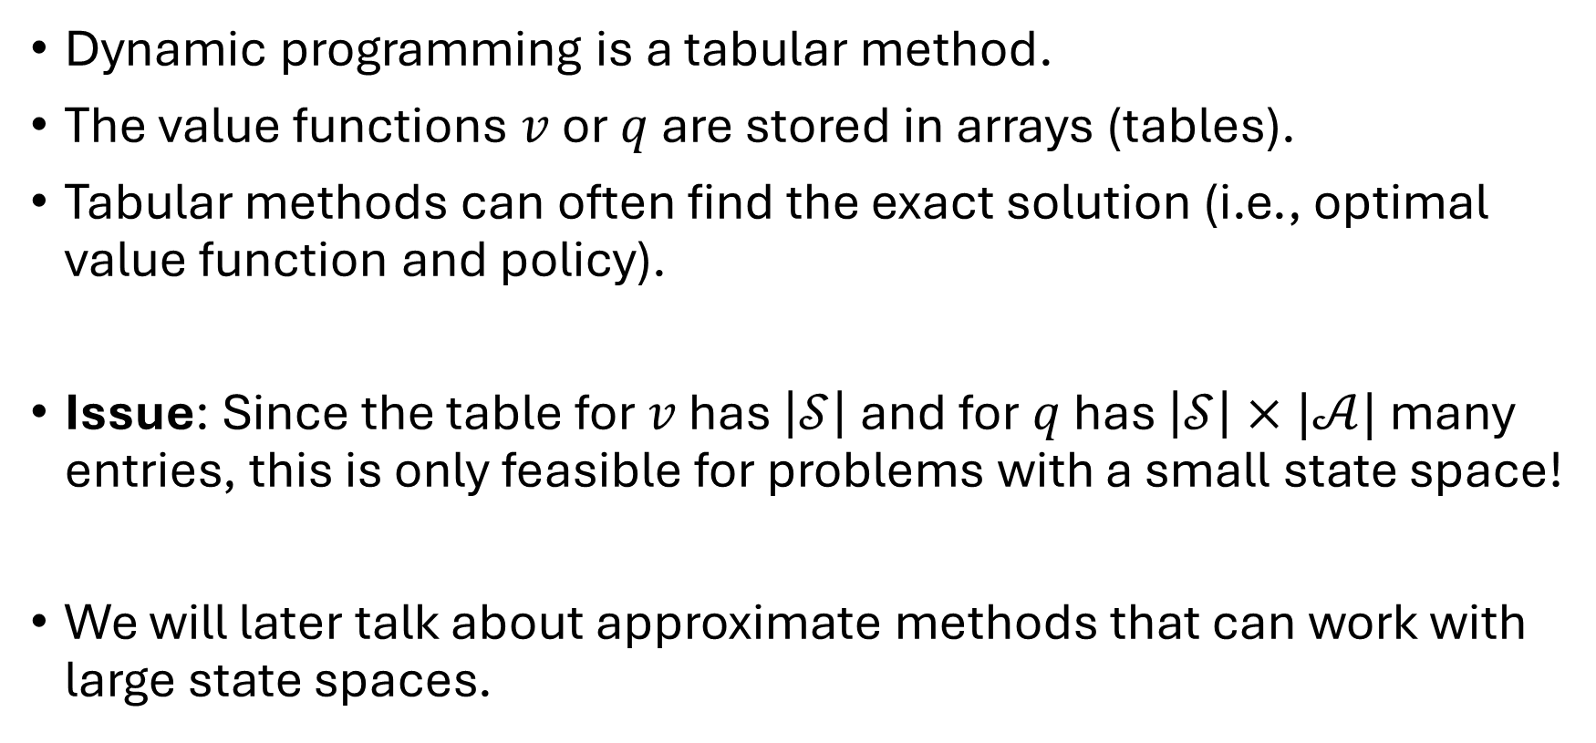
Tabular Methods
Dynamic programming is a tabular method.
The value functions $v$ or $q$ are stored in arrays (tables).
Tabular methods can often find the exact solution (i.e., optimal value function and policy).
Issue: Since the table for $v$ has $\left|𝒮\right|$ and for $q$ has $\left|𝒮\right|×|𝒜|$ many entries, this is only feasible for problems with a small state space!
We will later talk about approximate methods that can work with large state spaces.

Slide 5
Policy Evaluation

Slide 6
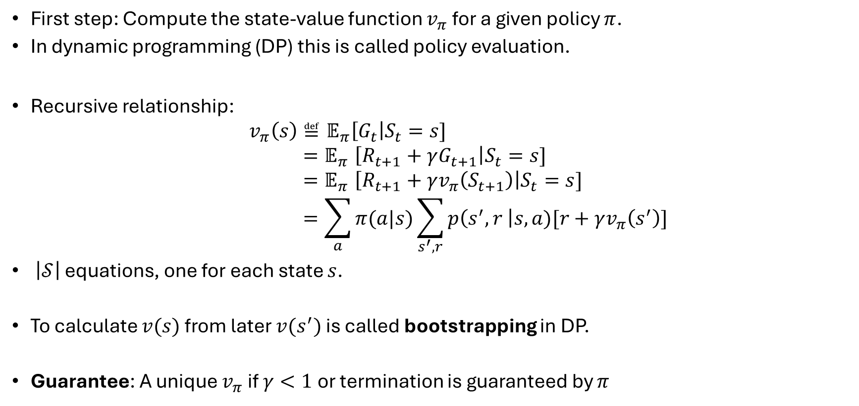
Policy Evaluation (Prediction)
First step: Compute the state-value function $v_{π}$ for a given policy $π$.
In dynamic programming (DP) this is called policy evaluation.
Recursive relationship:
$$v_{π}\left(s\right)≝𝔼_{π}\left[G_{t}\right|S_{t}=s] \\ {=𝔼}_{π}\left[R_{t+1}+γG_{t+1}\right|S_{t}=s] \\ {=𝔼}_{π}\left[R_{t+1}+γv_{π}\left(S_{t+1}\right)\right|S_{t}=s] \\ =\sum_{a}{π(a|s)}\sum_{s^{′},r}{p\left(s^{′},r \right|s,a)[r+γv_{π}\left(s^{′}\right)]}$$
$\left|𝒮\right|$ equations, one for each state $s$.
To calculate $v(s)$ from later $v(s^{′})$ is called bootstrapping in DP.
Guarantee: A unique $v_{π}$ if $γ<1$or termination is guaranteed by $π$

Slide 7
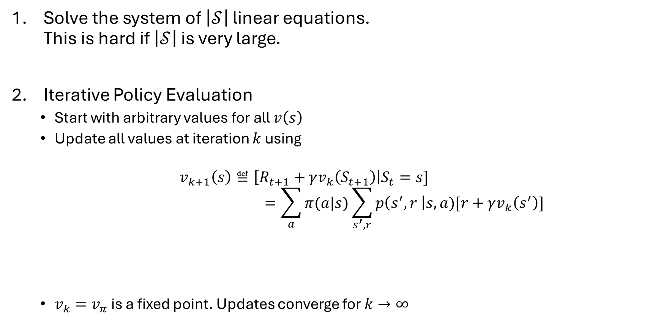
Solution Options
Solve the system of $\left|𝒮\right|$ linear equations. This is hard if $\left|𝒮\right|$ is very large.
Iterative Policy Evaluation
Start with arbitrary values for all $v\left(s\right)$
Update all values at iteration $k$ using
$$v_{k+1}\left(s\right)≝\left[R_{t+1}+γv_{k}\left(S_{t+1}\right)\right|S_{t}=s] \\ =\sum_{a}{π(a|s)}\sum_{s^{′},r}{p\left(s^{′},r \right|s,a)[r+γv_{k}\left(s^{′}\right)]}$$
$v_{k}=v_{π}$ is a fixed point. Updates converge for $k→∞$
In DP called “expected update.” Uses the expectation over all possible next states.

Slide 8
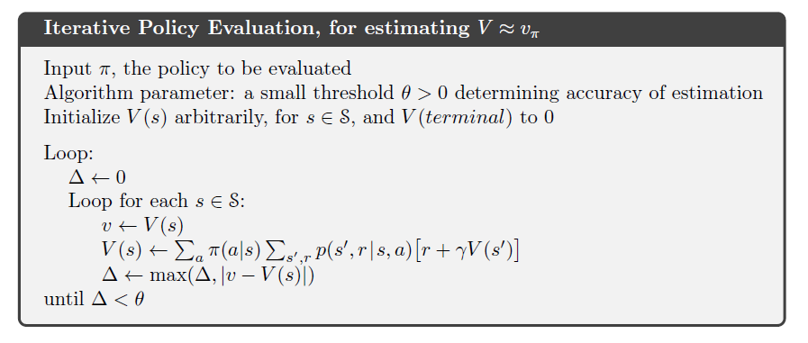
Alg. Iterative Policy Evaluation

Slide 9
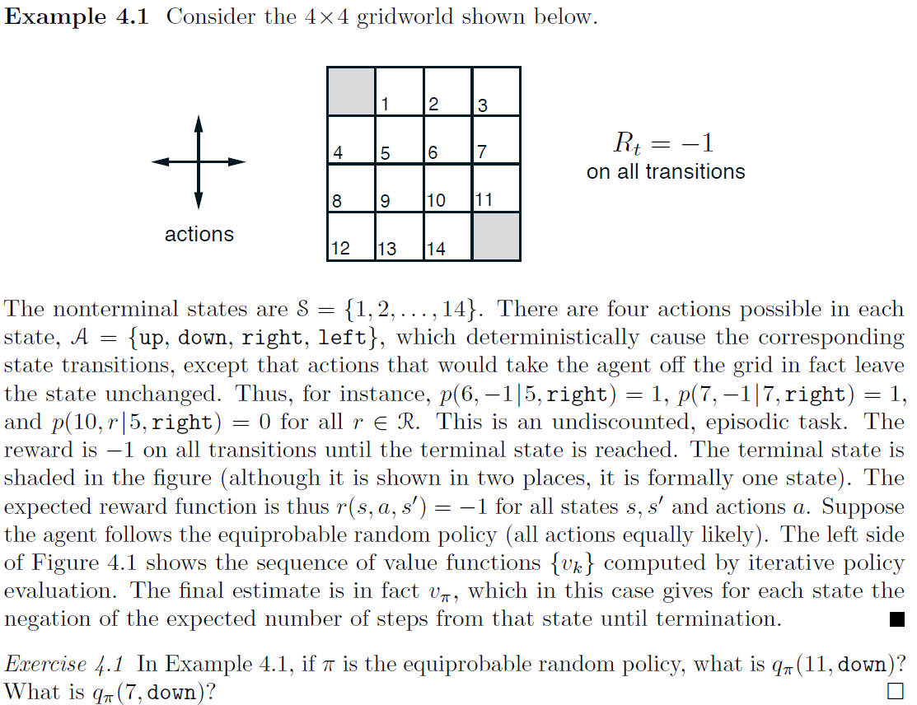
Example
The nonterminal states are S = {1, 2, . . . , 14}. There are four actions possible in each
state, A = {up, down, right, left}, which deterministically cause the corresponding
state transitions, except that actions that would take the agent o↵ the grid in fact leave
the state unchanged. Thus, for instance, p(6,−1|5, right) = 1, p(7,−1|7, right) = 1,
and p(10, r|5, right) = 0 for all r 2 R. This is an undiscounted, episodic task. The
reward is −1 on all transitions until the terminal state is reached. The terminal state is
shaded in the figure (although it is shown in two places, it is formally one state). The
expected reward function is thus r(s, a, s0) = −1 for all states s, s0 and actions a. Suppose
the agent follows the equiprobable random policy (all actions equally likely). The left side
of Figure 4.1 shows the sequence of value functions {vk} computed by iterative policy
evaluation. The final estimate is in fact v⇡, which in this case gives for each state the
negation of the expected number of steps from that state until termination.
Exercise 4.1 In Example 4.1, if ⇡ is the equiprobable random policy, what is q⇡(11, down)?
What is q⇡(7, down)?

Slide 10
Policy Iteration

Slide 11
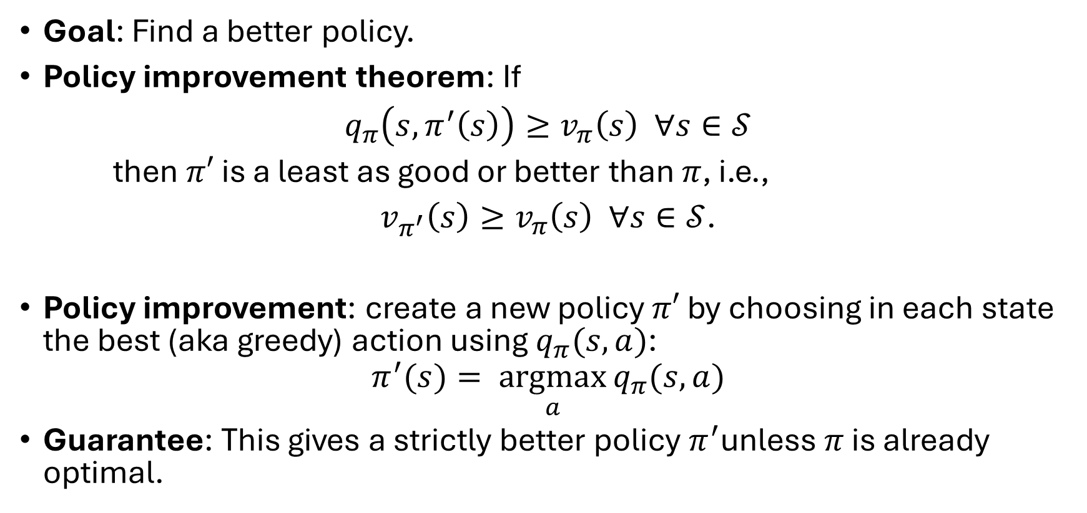
Policy Improvement
Goal: Find a better policy.
Policy improvement theorem: If
$q_{π}\left(s, π^{′}\left(s\right)\right)≥v_{π}\left(s\right) ∀s∈𝒮$
then $π′$ is a least as good or better than $π$, i.e.,
$v_{π^{′}}\left(s\right)≥v_{π}\left(s\right) ∀s∈𝒮$.
Policy improvement: create a new policy $π′$ by choosing in each state the best (aka greedy) action using $q_{π}(s,a)$:
$$π^{′}(s)= \underset{a}{argmax}{q_{π}(s,a)}$$
Guarantee: This gives a strictly better policy $π^{′}$unless $π$ is already optimal.

Slide 12
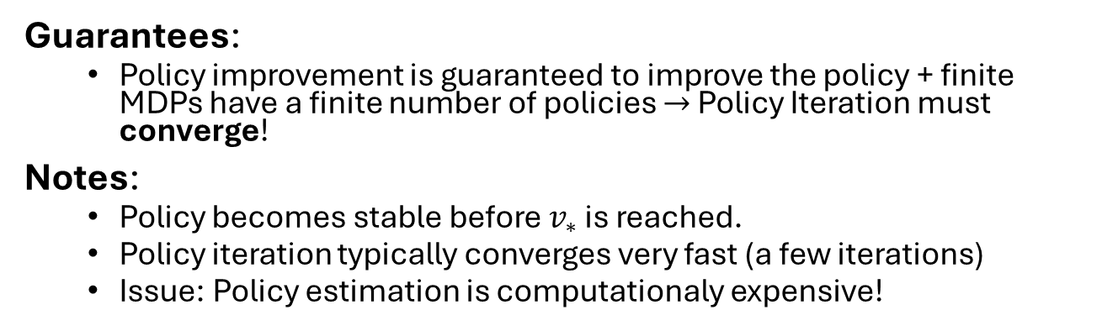
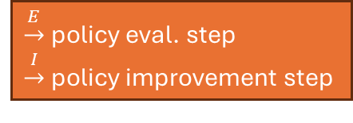

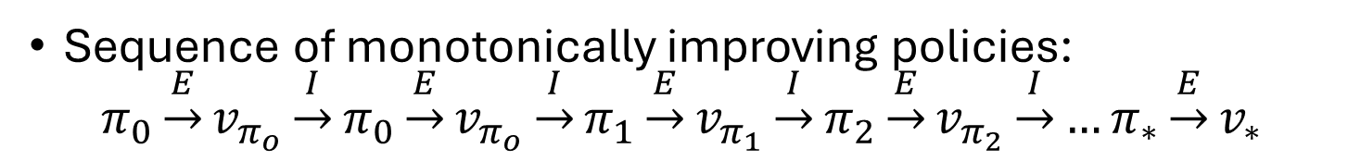



Policy Iteration
Sequence of monotonically improving policies:
$$π_{0}\underset{→}{E}v_{π_{o}}\underset{→}{I}π_{0}\underset{→}{E}v_{π_{o}}\underset{→}{I}π_{1}\underset{→}{E}v_{π_{1}}\underset{→}{I}π_{2}\underset{→}{E}v_{π_{2}}\underset{→}{I}…π_{∗}\underset{→}{E}v_{∗}$$
$\underset{→}{E}$ policy eval. step
$\underset{→}{I}$ policy improvement step
$$v_{ π_{0}}$$
$$v_{∗}$$
P. improvement
Policy evaluation
$$π_{∗}$$
Guarantees:
Policy improvement is guaranteed to improve the policy + finite MDPs have a finite number of policies $→$ Policy Iteration must converge!
Notes:
Policy becomes stable before $v_{∗}$ is reached.
Policy iteration typically converges very fast (a few iterations)
Issue: Policy estimation is computationaly expensive!
$$π_{0}$$

Slide 13
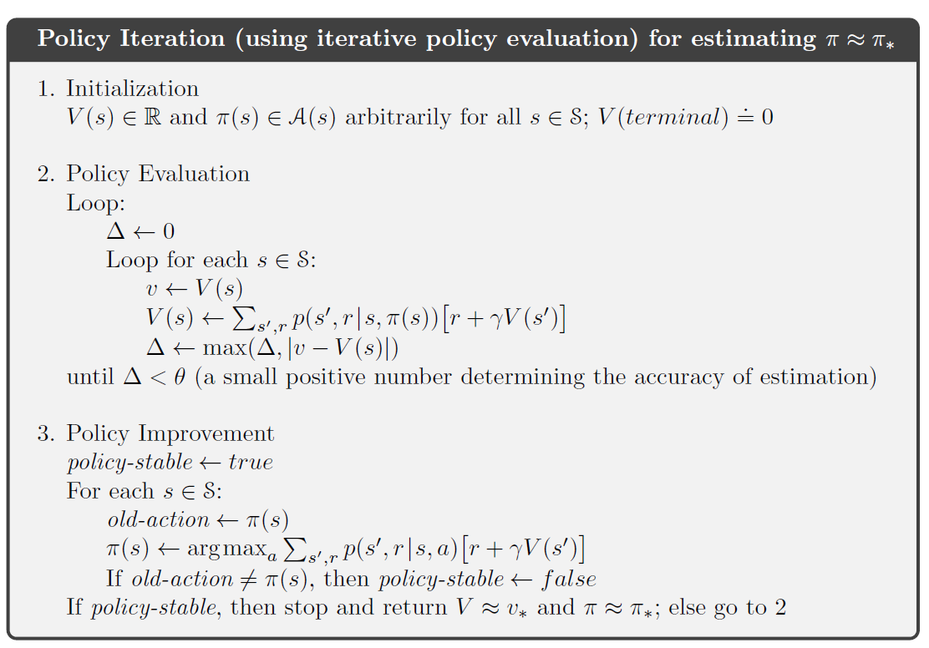
Alg. Policy Iteration

Slide 14
Value Iteration

Slide 15

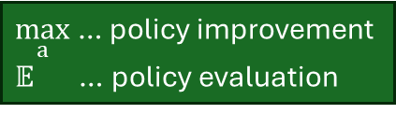
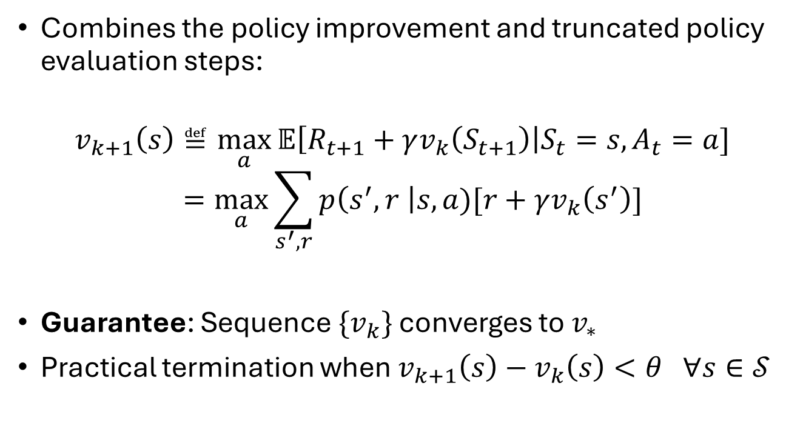
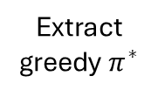


Value Iteration
Combines the policy improvement and truncated policy evaluation steps:
$$v_{k+1}\left(s\right)≝\max_{a}{𝔼\left[R_{t+1}+γv_{k}\left(S_{t+1}\right)\right|S_{t}=s,A_{t}=a] } \\ =\max_{a}\sum_{s^{′},r}{p\left(s^{′},r \right|s,a)[r+γv_{k}\left(s^{′}\right)]}$$
Guarantee: Sequence $\{v_{k}\}$ converges to $v_{∗}$
Practical termination when $v_{k+1}\left(s\right)−v_{k}\left(s\right)<θ ∀s∈𝒮$
$\max_{a}$ … policy improvement
$𝔼$ … policy evaluation
Bellman updates
$$v_{0}$$
$$v_{1}$$
$$v_{∗}$$
Extract greedy $π^{∗}$

Slide 16
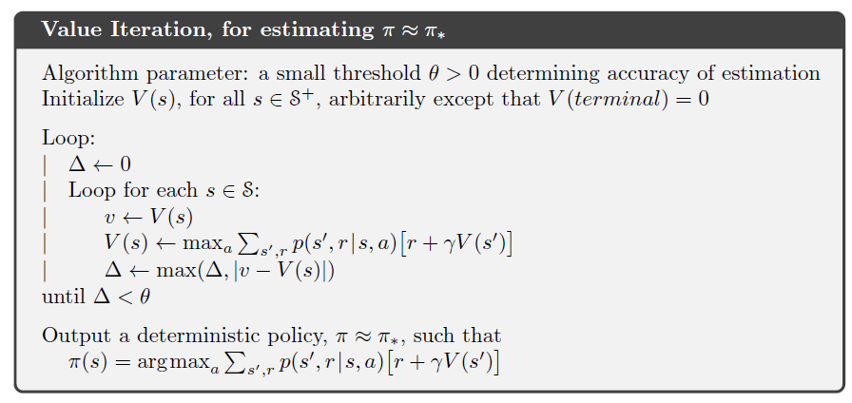
Alg. Value Iteration

Slide 17
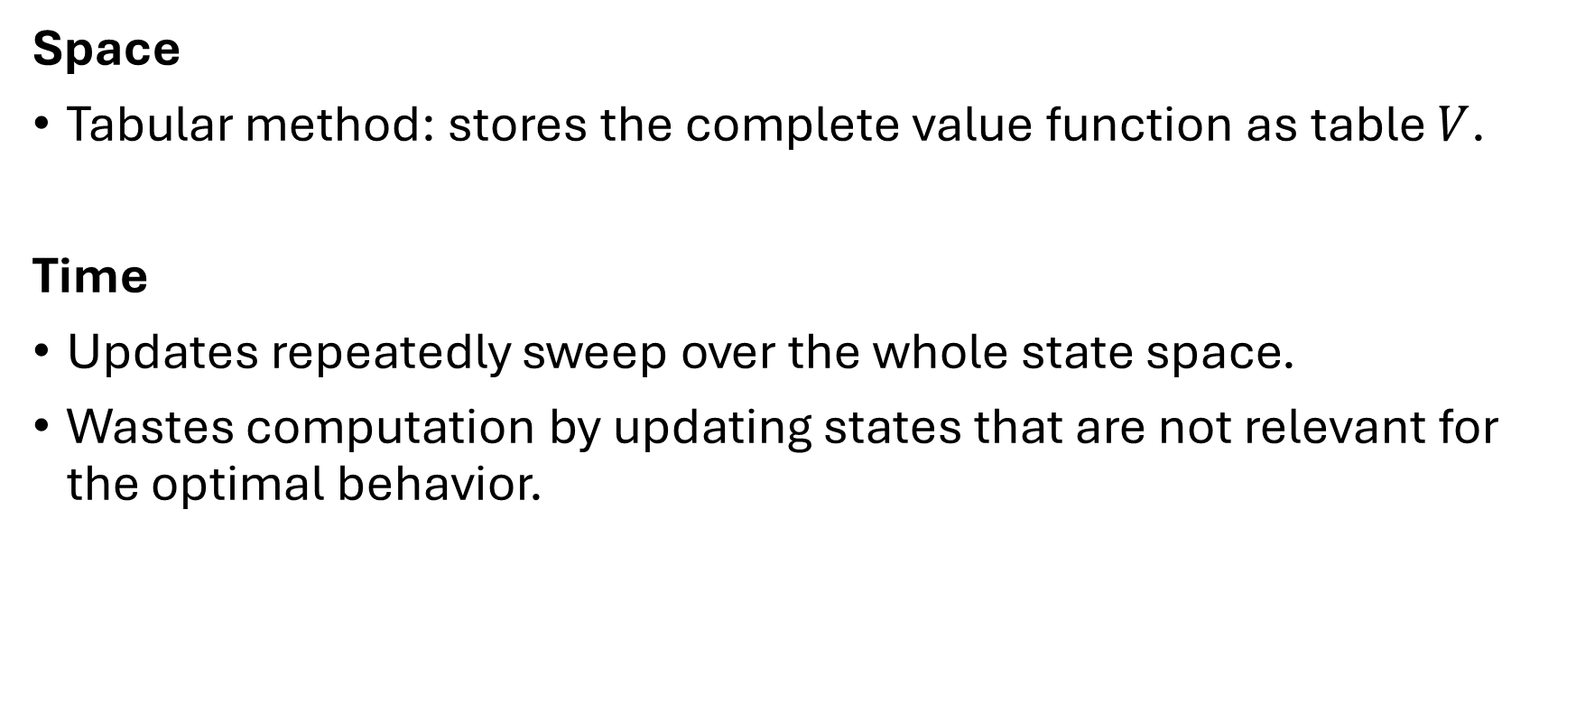
Issues with DP Methods
Space
Tabular method: stores the complete value function as table $V$.
Time
Updates repeatedly sweep over the whole state space.
Wastes computation by updating states that are not relevant for the optimal behavior.

Slide 18
GPI: Generalized Policy Iteration

Slide 19
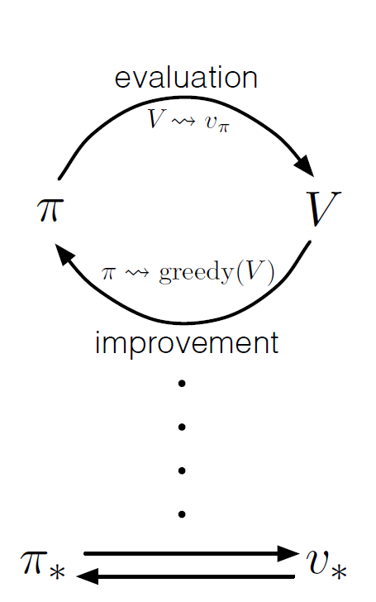
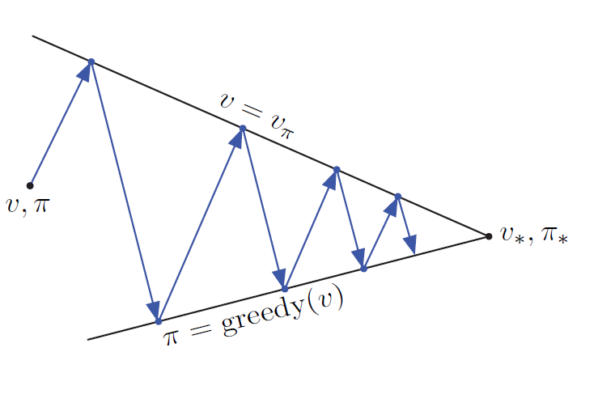
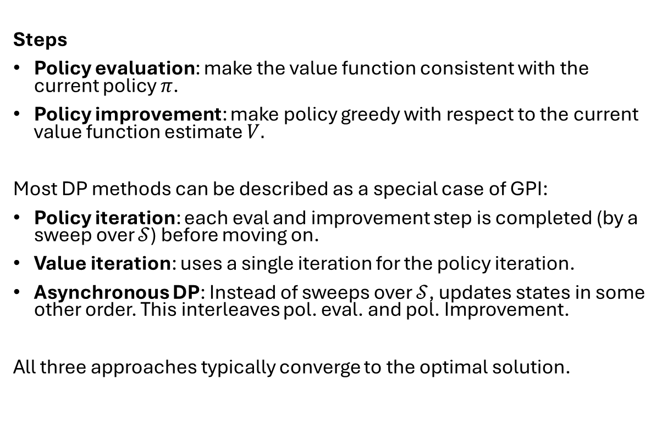
GPI: Generalized Policy Iteration
Steps
Policy evaluation: make the value function consistent with the current policy $π$.
Policy improvement: make policy greedy with respect to the current value function estimate $V.$
Most DP methods can be described as a special case of GPI:
Policy iteration: each eval and improvement step is completed (by a sweep over $𝒮$) before moving on.
Value iteration: uses a single iteration for the policy iteration.
Asynchronous DP: Instead of sweeps over $𝒮$, updates states in some other order. This interleaves pol. eval. and pol. Improvement.
All three approaches typically converge to the optimal solution.

Slide 20
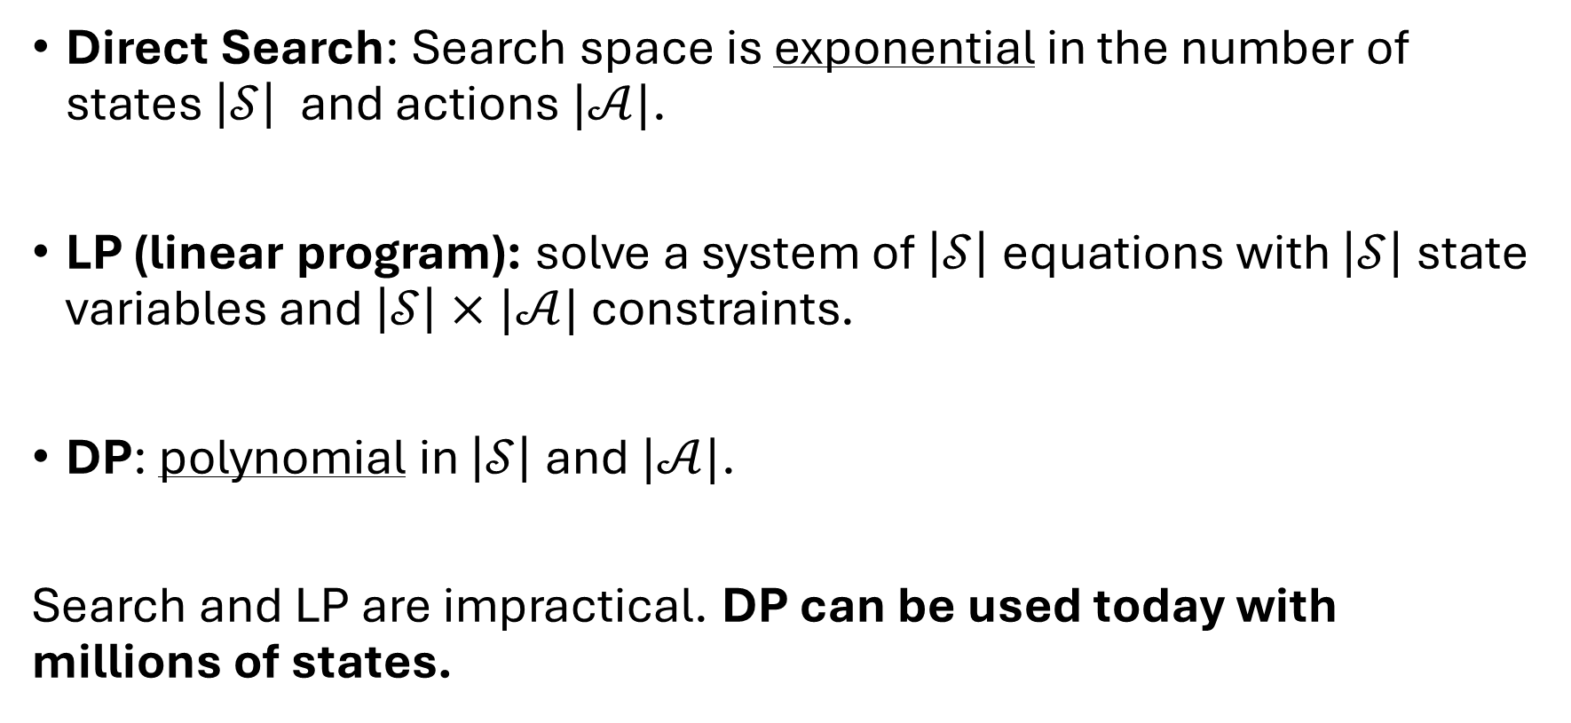
Efficiency
Direct Search: Search space is exponential in the number of states $\left|𝒮\right|$ and actions $|𝒜|$.
LP (linear program): solve a system of $\left|𝒮\right|$ equations with $\left|𝒮\right|$ state variables and $\left|𝒮\right|×|𝒜|$ constraints.
DP: polynomial in $\left|𝒮\right|$ and $|𝒜|$.
Search and LP are impractical. DP can be used today with millions of states.

Slide 21
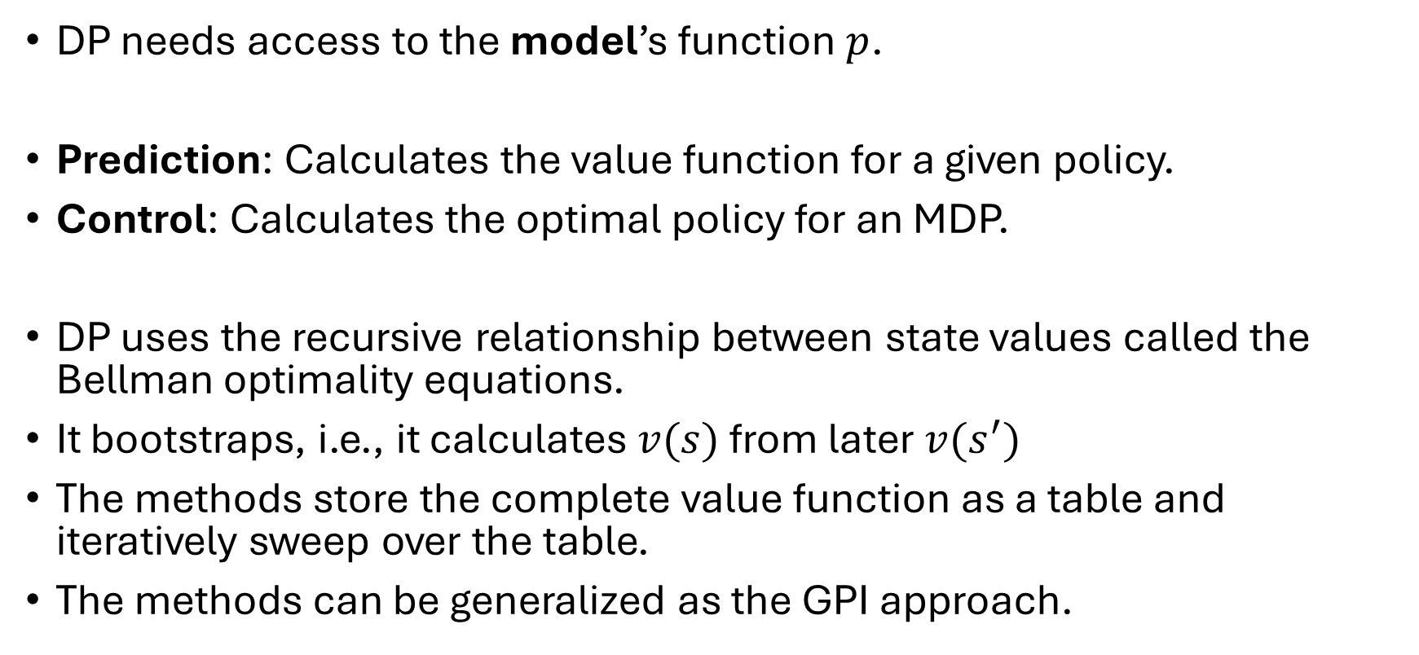
Summary
DP needs access to the model’s function $p$.
Prediction: Calculates the value function for a given policy.
Control: Calculates the optimal policy for an MDP.
DP uses the recursive relationship between state values called the Bellman optimality equations.
It bootstraps, i.e., it calculates $v(s)$ from later $v(s^{′})$
The methods store the complete value function as a table and iteratively sweep over the table.
The methods can be generalized as the GPI approach.

