Slide 1


Reinforcement Learning Monte Carlo Methods Sutton/Barto* Chapter 5
Michael Hahsler, SMU
With figures from Sutton/Barto*
*Sutton and Barto, Reinforcement Learning: An Introduction, 2nd edition, MIT Press, Cambridge, MA, 2018

Slide 2
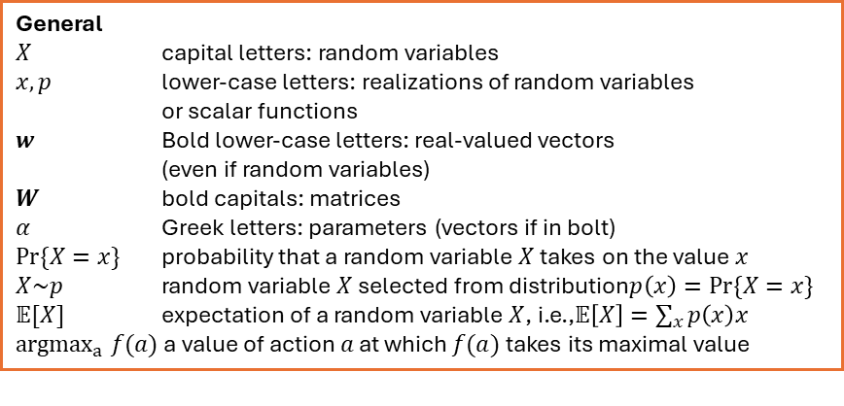
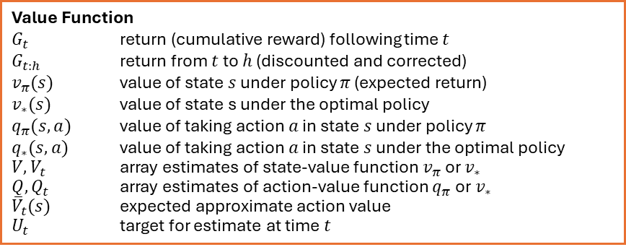
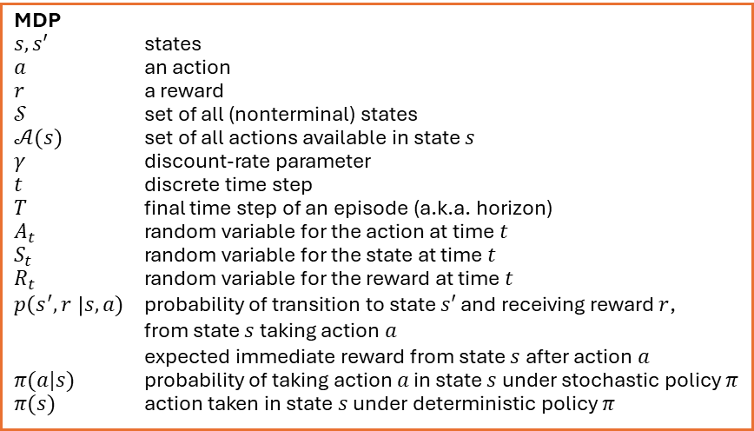
Summary of Notation
General
$X$ capital letters: random variables $x, p$ lower-case letters: realizations of random variables or scalar functions
$w$ Bold lower-case letters: real-valued vectors (even if random variables)
$W$ bold capitals: matrices
$α$ Greek letters: parameters (vectors if in bolt)
$Pr⁡\{X=x\}$ probability that a random variable $X$ takes on the value $x$
$X\sim p$ random variable $X$ selected from distribution$p\left(x\right)=Pr⁡\{X=x\}$
$𝔼[X]$ expectation of a random variable $X$, i.e.,$𝔼\left[X\right]=\sum_{x}{p\left(x\right)x}$
${argmax}_{a} f(a)$ a value of action $a$ at which $f(a)$ takes its maximal value
Value Function
$G_{t}$ return (cumulative reward) following time $t$
$G_{t:h}$ return from $t$ to $h$ (discounted and corrected)
$v_{π}(s)$ value of state $s$ under policy $π$ (expected return)
$v_{∗}(s)$ value of state s under the optimal policy
$q_{π}(s,a)$ value of taking action $a$ in state $s$ under policy $π$
$q_{∗}(s,a)$ value of taking action $a$ in state $s$ under the optimal policy
$V, V_{t}$ array estimates of state-value function $v_{π}$or $v_{∗}$
$Q,Q_{t}$ array estimates of action-value function $q_{π}$or $v_{∗}$
${\overline{V}}_{t}(s)$ expected approximate action value
$U_{t}$ target for estimate at time$t$
MDP
$s, s′$ states
$a$ an action
$r$ a reward
$𝒮$ set of all (nonterminal) states
$𝒜(s)$ set of all actions available in state $s$
$γ$ discount-rate parameter
$t$ discrete time step
$T$ final time step of an episode (a.k.a. horizon)
$A_{t}$ random variable for the action at time $t$
$S_{t}$ random variable for the state at time $t$
$R_{t}$ random variable for the reward at time $t$
$p\left(s^{′},r \right|s, a)$ probability of transition to state $s′$ and receiving reward $r$, from state $s$ taking action $a$
expected immediate reward from state $s$ after action $a$
$π(a|s)$ probability of taking action $a$ in state $s$ under stochastic policy $π$
$π(s)$ action taken in state $s$ under deterministic policy $π$

Slide 3
Idea
No complete knowledge of the environment (the MDP). This is called a “model-free” method.
Use instead “experience” = sample sequences of states, actions, and rewards from actual or simulated interactions with the environment.
Note: It is easier to simulate transitions than to specify the complete MDP for DP.
Monte Carlo (MC) methods: a family of algorithms that rely on repeated random sampling to obtain numerical results.
Applied to value function approximation: average sample returns for each state-action pair obtained from sampled sequences (called episodes or trajectories).
Note: Value estimates or the policy are only updated after a whole episode is sampled. This is not a step-by-step online method!
Monte Carlo method applied to approximating the value of π Source: Wikipedia

Slide 4
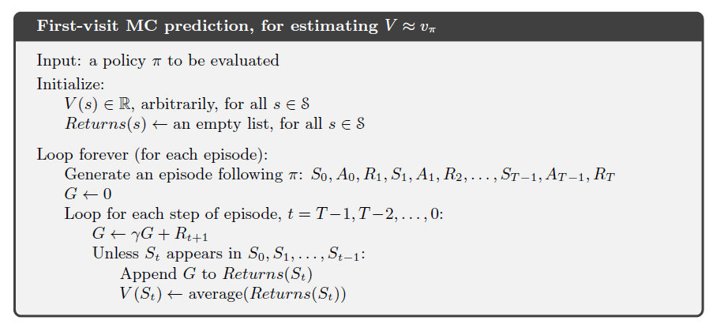

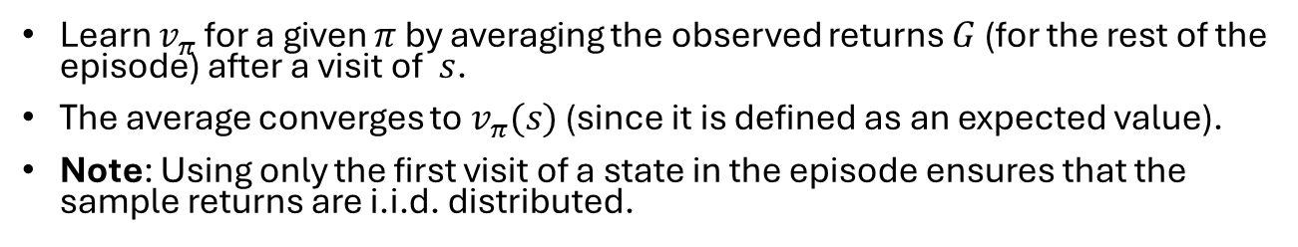

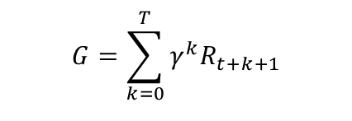

MC Prediction
Episode
Learn $v_{π}$ for a given $π$ by averaging the observed returns $G$ (for the rest of the episode) after a visit of $s$.
The average converges to $v_{π}(s)$ (since it is defined as an expected value).
Note: Using only the first visit of a state in the episode ensures that the sample returns are i.i.d. distributed.
$$s_{0}$$
$$s$$
$$s_{T}$$
$$G=\sum_{k=0}^{T}{γ^{k}R_{t+k+1}}$$
update
Update in reverse order!
Uses only the first visit.

Slide 5
Monte Carlo Control

Slide 6
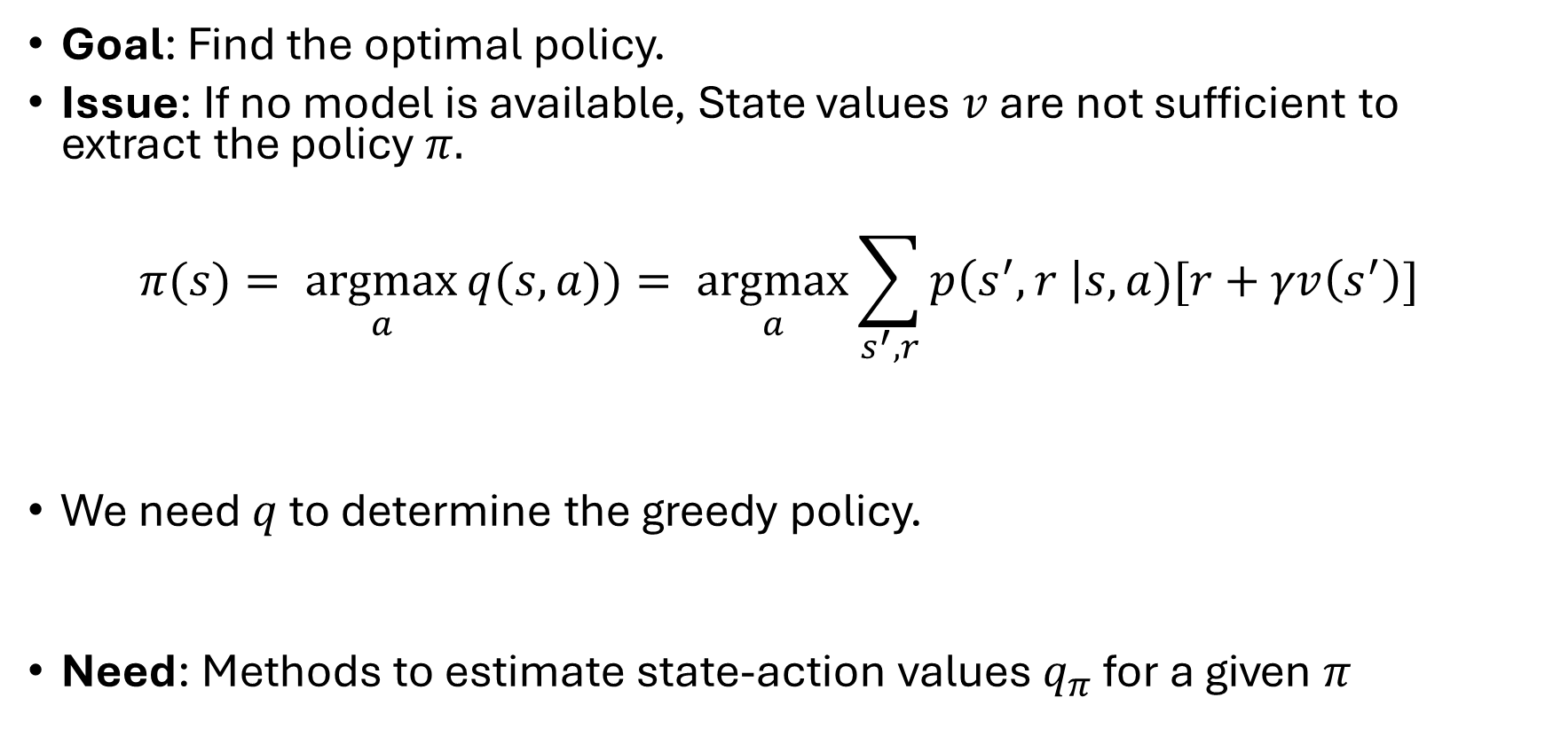
MC Control
Goal: Find the optimal policy.
Issue: If no model is available, State values $v$ are not sufficient to extract the policy $π.$
$$π(s)= \underset{a}{argmax}{q(s,a)})= \underset{a}{argmax}{\sum_{s^{′},r}{p\left(s^{′},r \right|s,a)[r+γv\left(s^{′}\right)]}}$$
We need $q$ to determine the greedy policy.
Need: Methods to estimate state-action values $q_{π}$ for a given $π$
This is called a one-step look-ahead which requires $p$

Slide 7
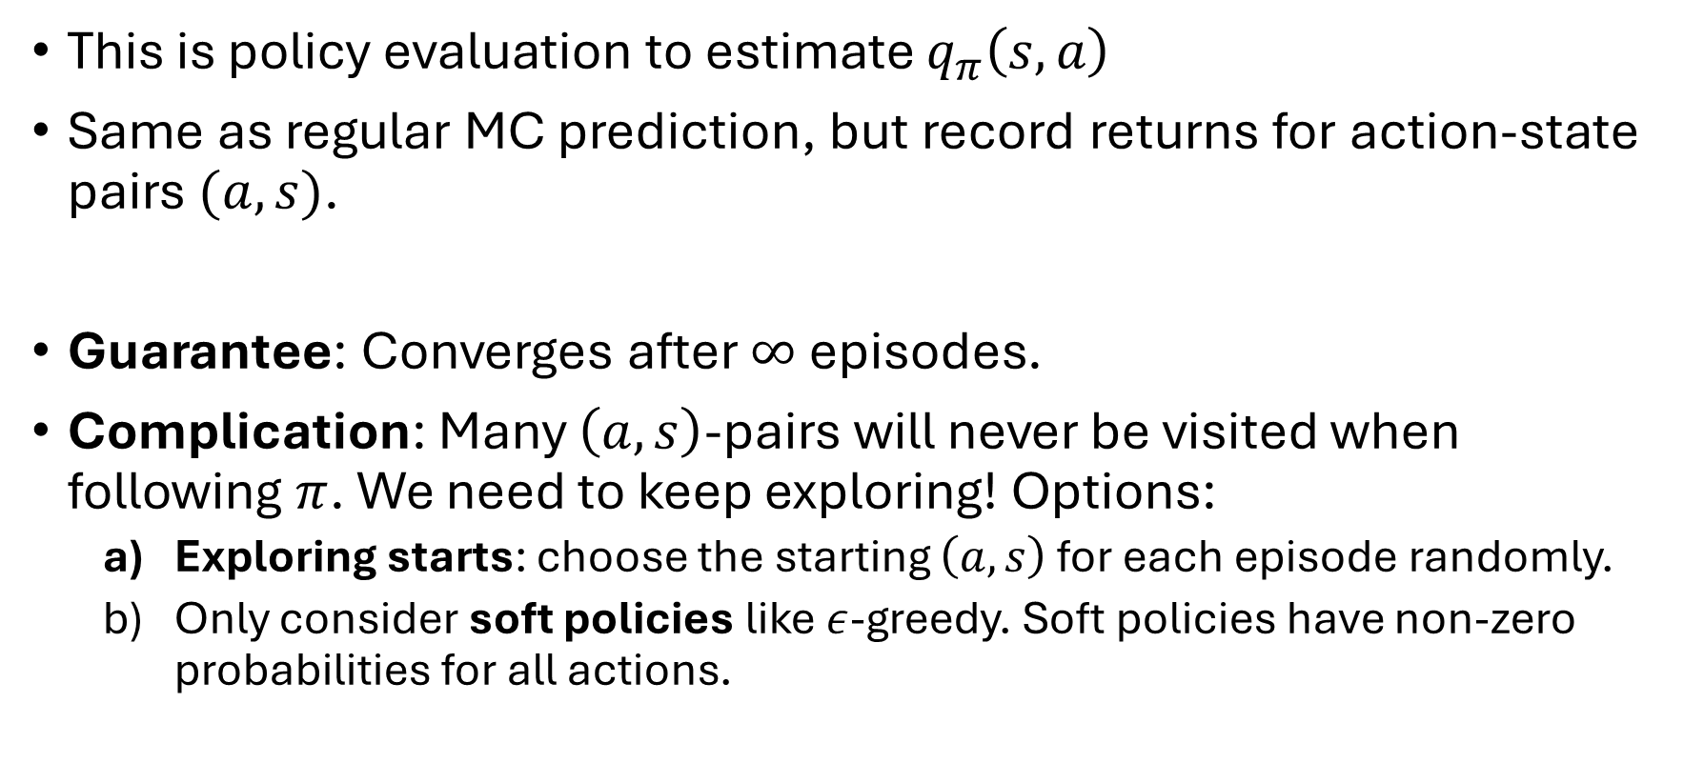
MC Estimate of Action Values
This is policy evaluation to estimate $q_{π}\left(s,a\right)$
Same as regular MC prediction, but record returns for action-state pairs $(a,s)$.
Guarantee: Converges after $∞$ episodes.
Complication: Many $\left(a,s\right)$-pairs will never be visited when following $π$. We need to keep exploring! Options:
Exploring starts: choose the starting $\left(a,s\right)$ for each episode randomly.
Only consider soft policies like $ε$-greedy. Soft policies have non-zero probabilities for all actions.

Slide 8
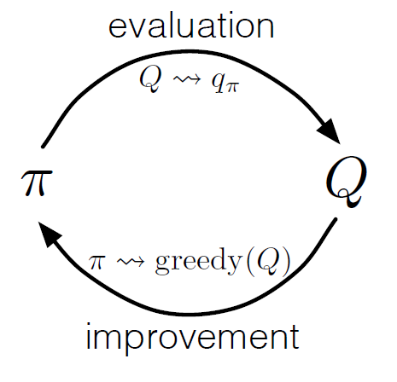
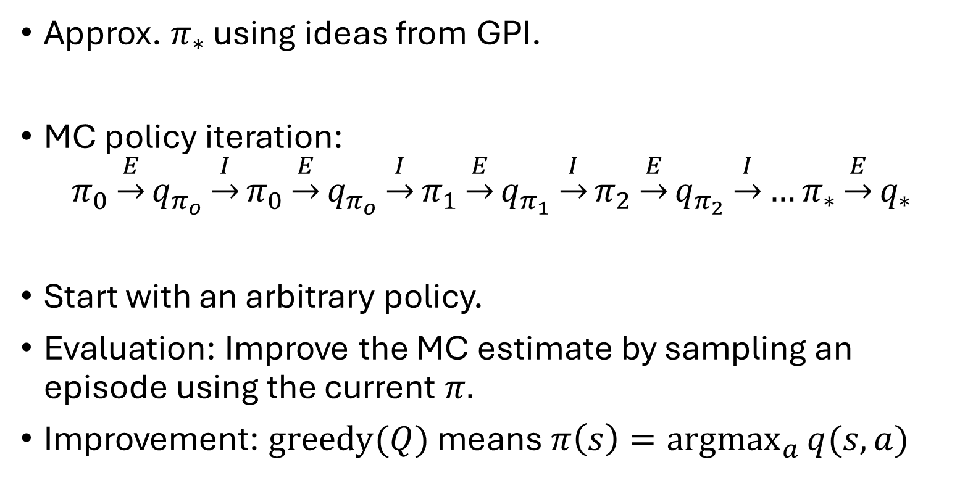
MC Control
Approx. $π_{∗}$ using ideas from GPI.
MC policy iteration:
$$π_{0}\underset{→}{E}q_{π_{o}}\underset{→}{I}π_{0}\underset{→}{E}q_{π_{o}}\underset{→}{I}π_{1}\underset{→}{E}q_{π_{1}}\underset{→}{I}π_{2}\underset{→}{E}q_{π_{2}}\underset{→}{I}…π_{∗}\underset{→}{E}q_{∗}$$
Start with an arbitrary policy.
Evaluation: Improve the MC estimate by sampling an episode using the current $π.$
Improvement: $\text{greedy}(Q)$ means $π\left(s\right)=\underset{a}{argmax}{q(s,a)}$

Slide 9
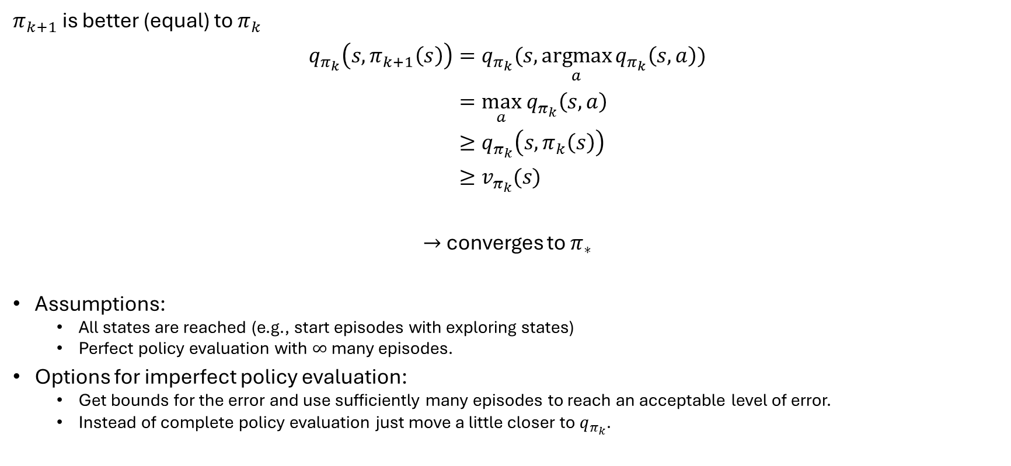
Remember: Policy Improvement Theorem
$π_{k+1}$ is better (equal) to $π_{k}$
$$q_{π_{k}}\left(s, π_{k+1}\left(s\right)\right)=q_{π_{k}}(s, \underset{a}{argmax}{q_{π_{k}}\left(s,a\right)}) \\ =\max_{a} q_{π_{k}}\left(s,a\right) \\ ≥q_{π_{k}}\left(s,π_{k}\left(s\right)\right) \\ ≥v_{π_{k}}(s)$$
$→$ converges to $π_{∗}$
Assumptions:
All states are reached (e.g., start episodes with exploring states)
Perfect policy evaluation with $∞$ many episodes.
Options for imperfect policy evaluation:
Get bounds for the error and use sufficiently many episodes to reach an acceptable level of error.
Instead of complete policy evaluation just move a little closer to $q_{π_{k}}$.

Slide 10
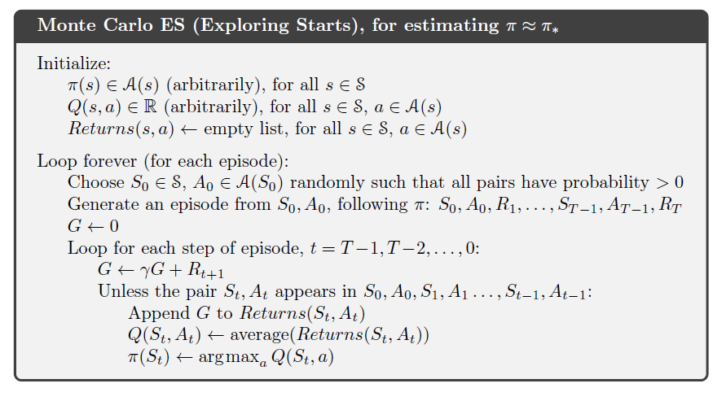
Alg. MC Control with Exploring Starts

Slide 11
MC Control without Exploring Starts
Need: a guarantee that all state-action combinations are tried.
Options:
On-policy control: use a soft policy
Off-policy control: use a behavior policy for sampling that tries all state-action pairs.

Slide 12
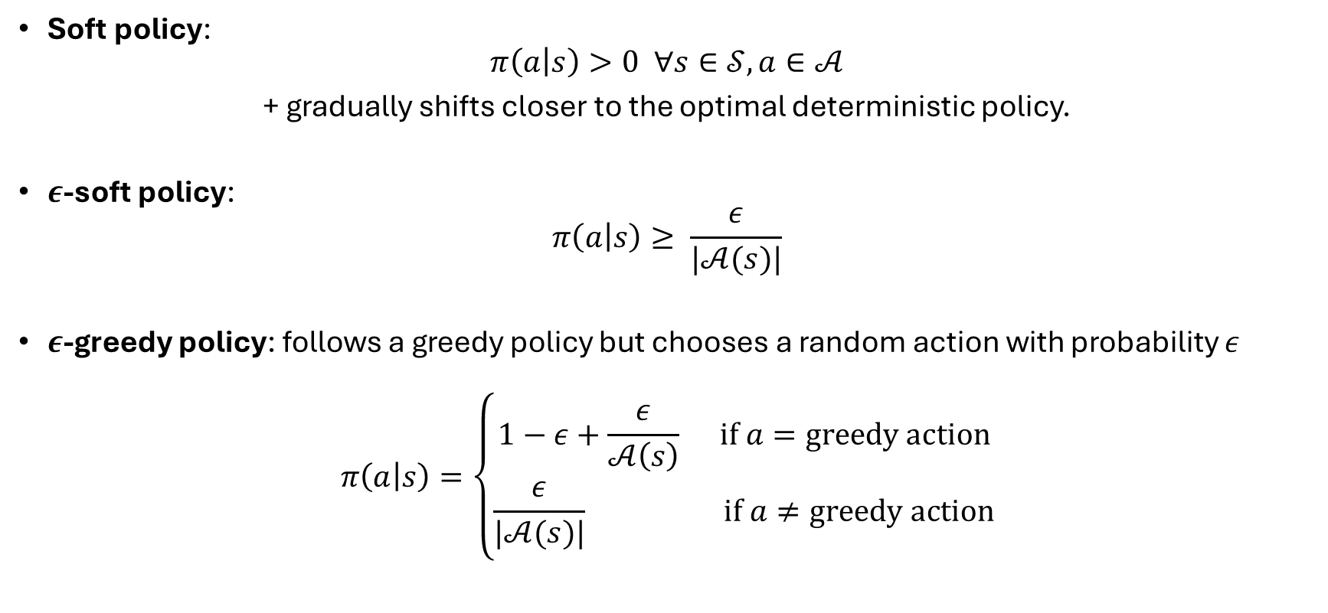
Types of Soft Policies
Soft policy:
$$π\left(a | s\right)>0 ∀s∈𝒮, a∈𝒜$$
+ gradually shifts closer to the optimal deterministic policy.
$ε$-soft policy:
$$π\left(a | s\right)≥ \frac{ε}{|𝒜(s)|}$$
$ε$-greedy policy: follows a greedy policy but chooses a random action with probability $ε$
$$π\left(a | s\right)=\left\{\begin{aligned}1−ε+\frac{ε}{𝒜\left(s\right)} \text{if} a=\text{greedy} \text{action} \\ \frac{ε}{|𝒜(s)|} \text{if} a≠\text{greedy} \text{action}\end{aligned}\right.$$

Slide 13

On-Policy MC
Like Monte Carlo ES except:
Start with an arbitrary $ε$-soft policy.
After each update of $Q$, instead of a greedy deterministic policy, construct a $ε$-greedy policy.

Slide 14
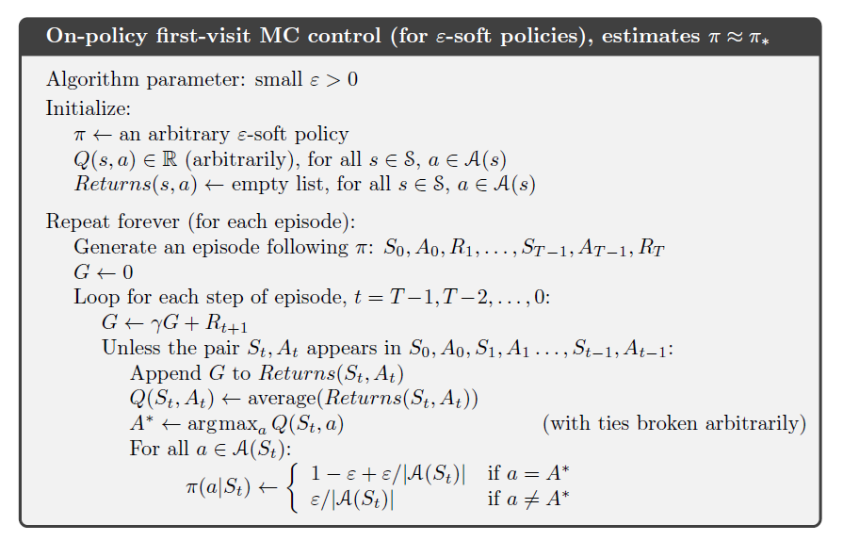
Alg. On-Policy MC Control

Slide 15
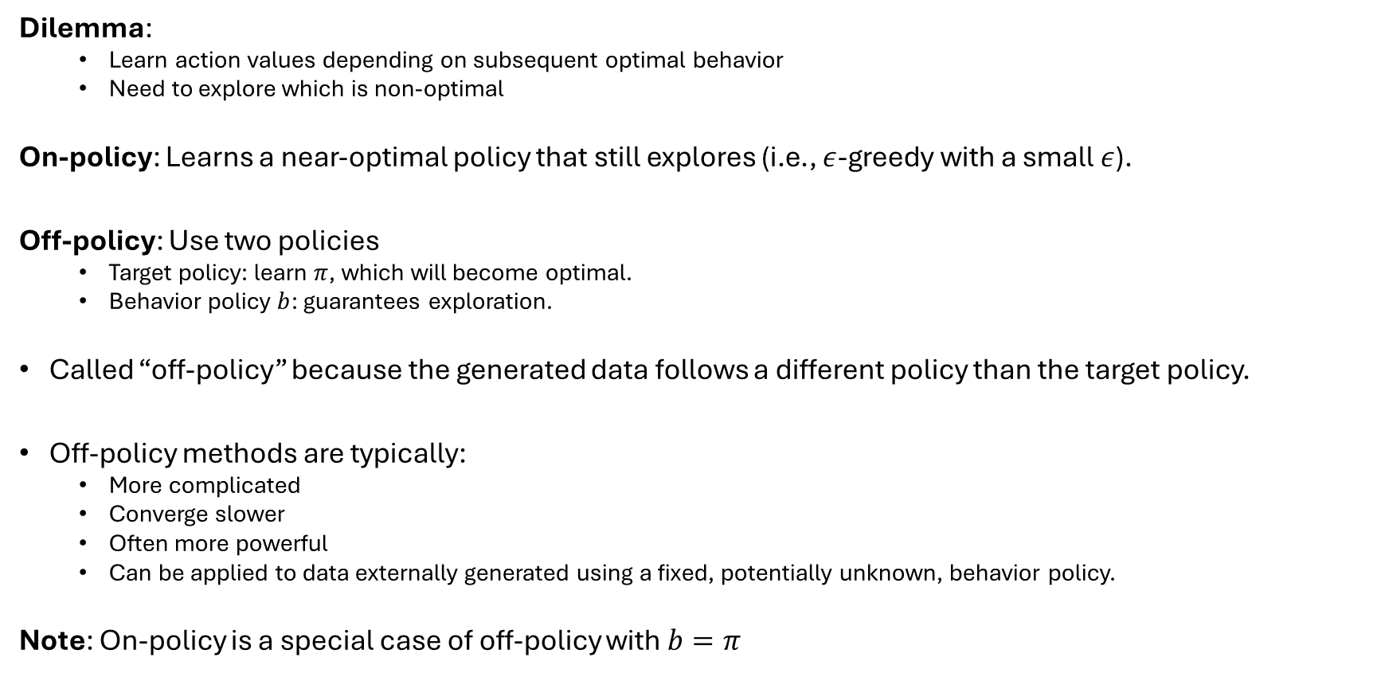
Off-Policy vs. On-Policy
Dilemma:
Learn action values depending on subsequent optimal behavior
Need to explore which is non-optimal
On-policy: Learns a near-optimal policy that still explores (i.e., $ε$-greedy with a small $ε$).
Off-policy: Use two policies
Target policy: learn $π$, which will become optimal.
Behavior policy $b$: guarantees exploration.
Called “off-policy” because the generated data follows a different policy than the target policy.
Off-policy methods are typically:
More complicated
Converge slower
Often more powerful
Can be applied to data externally generated using a fixed, potentially unknown, behavior policy.
Note: On-policy is a special case of off-policy with $b=π$

Slide 16
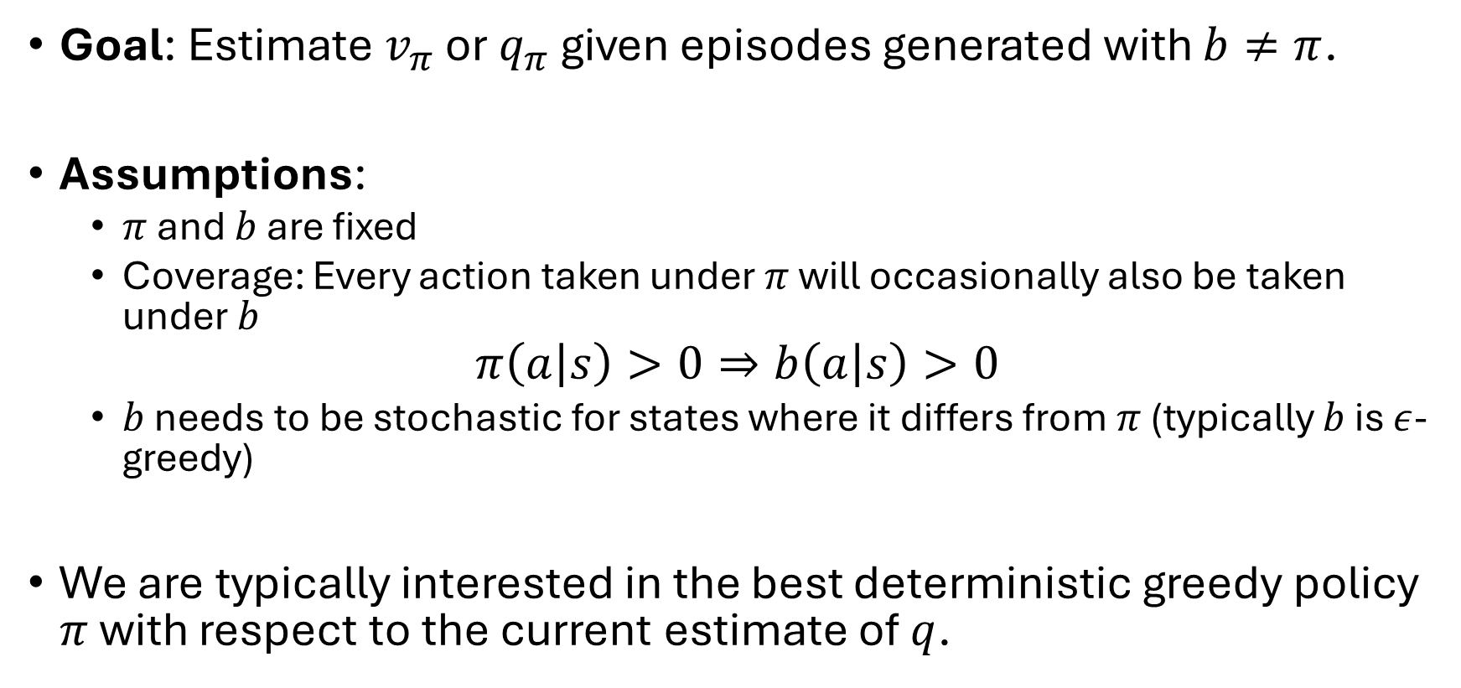
Off-Policy Prediciton
Goal: Estimate $v_{π}$ or $q_{π}$ given episodes generated with $b≠π$.
Assumptions:
$π$ and $b$ are fixed
Coverage: Every action taken under $π$ will occasionally also be taken under $b$
$$π\left(a | s\right)>0⇒b\left(a | s\right)>0$$
$b$ needs to be stochastic for states where it differs from $π$ (typically $b$ is $ε$-greedy)
We are typically interested in the best deterministic greedy policy $π$ with respect to the current estimate of $q$.

Slide 17
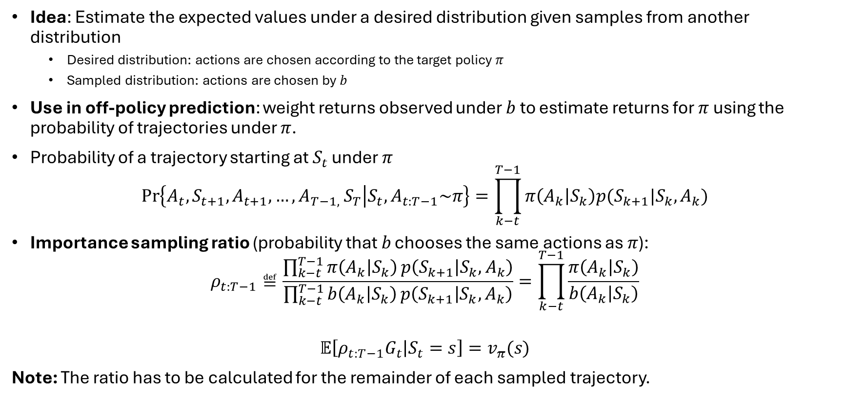
Importance Sampling
Idea: Estimate the expected values under a desired distribution given samples from another distribution
Desired distribution: actions are chosen according to the target policy $π$
Sampled distribution: actions are chosen by $b$
Use in off-policy prediction: weight returns observed under $b$ to estimate returns for $π$ using the probability of trajectories under $π$.
Probability of a trajectory starting at $S_{t}$ under $π$
$$\operatorname{Pr}\left\{A_{t},S_{t+1},A_{t+1},…,{A_{T−1, }S}_{T} | S_{t}, A_{t:T−1}\sim π\right\}=\prod_{k−t}^{T−1}{π\left(A_{k} | S_{k}\right)p(S_{k+1}|S_{k},A_{k})}$$
Importance sampling ratio (probability that 𝑏 chooses the same actions as 𝜋):
$$ρ_{t:T−1}≝\frac{\prod_{k−t}^{T−1}{π\left(A_{k} | S_{k}\right)}p\left(S_{k+1} | S_{k},A_{k}\right)}{\prod_{k−t}^{T−1}{b\left(A_{k} | S_{k}\right)}p\left(S_{k+1} | S_{k},A_{k}\right)}=\prod_{k−t}^{T−1}{\frac{π\left(A_{k} | S_{k}\right)}{b\left(A_{k} | S_{k}\right)}}$$
$$𝔼\left[{ρ_{t:T−1}G}_{t} | S_{t}=s\right]=v_{π}(s)$$
Note: The ratio has to be calculated for the remainder of each sampled trajectory.
Needs unknown transition probabilities!
Luckily, the unknown transition probabilities cancel out!
All we need to do is correct the returns by multiplying them with the ratio.

Slide 18

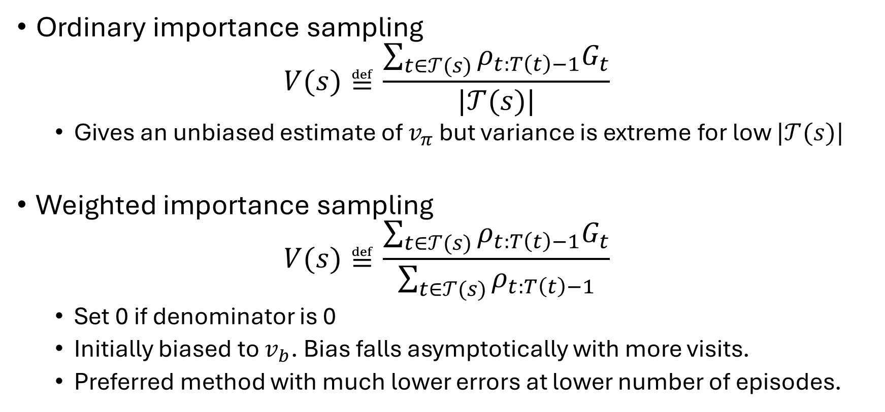
Ordinary vs. Weighted Importance Sampling
Ordinary importance sampling
$$V(s)≝\frac{\sum_{t∈𝒯(s)}{ρ_{t:T\left(t\right)−1}G_{t}}}{|𝒯(s)|}$$
Gives an unbiased estimate of $v_{π}$ but variance is extreme for low $|𝒯(s)|$
Weighted importance sampling
$$V(s)≝\frac{\sum_{t∈𝒯(s)}{ρ_{t:T\left(t\right)−1}G_{t}}}{\sum_{t∈𝒯(s)}{ρ_{t:T\left(t\right)−1}}}$$
Set 0 if denominator is 0
Initially biased to $v_{b}$. Bias falls asymptotically with more visits.
Preferred method with much lower errors at lower number of episodes.
$𝒯\left(s\right)$time steps that s was visited

Slide 19
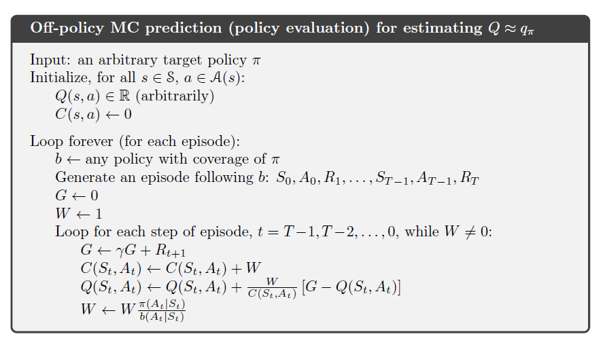


Incremental Implementation using Weighted Importance Sampling
cumulative sum of weights for $(s,a)$
$b$ can change every episode!
Update in Reverse order!
Correct the update

Slide 20
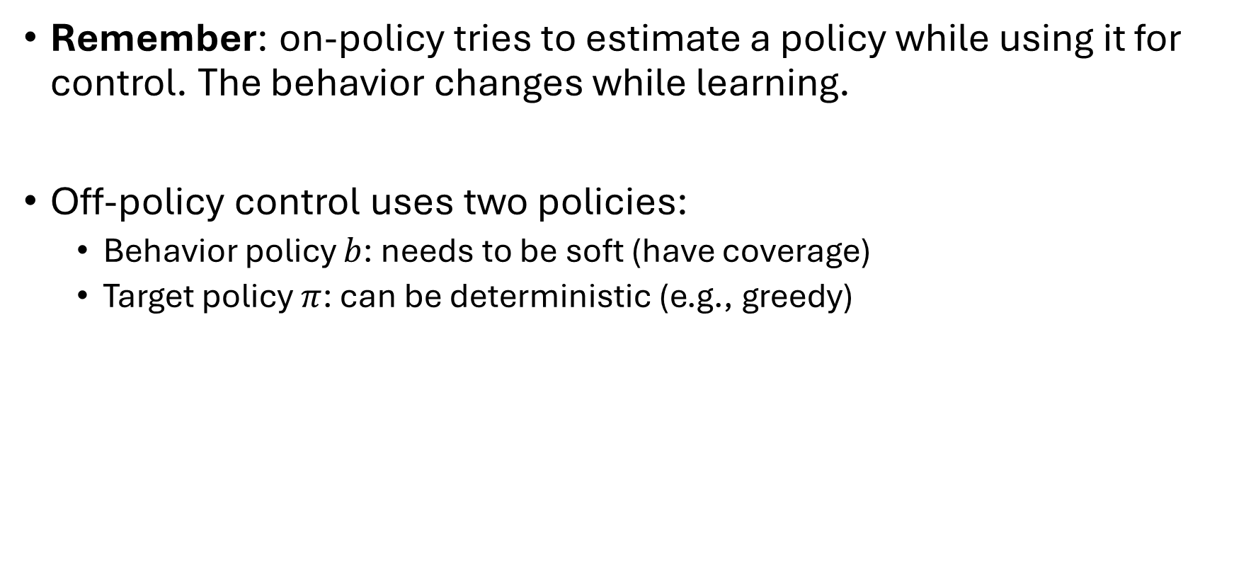
Off-Policy MC Control
Remember: on-policy tries to estimate a policy while using it for control. The behavior changes while learning.
Off-policy control uses two policies:
Behavior policy $b$: needs to be soft (have coverage)
Target policy $π$: can be deterministic (e.g., greedy)

Slide 21
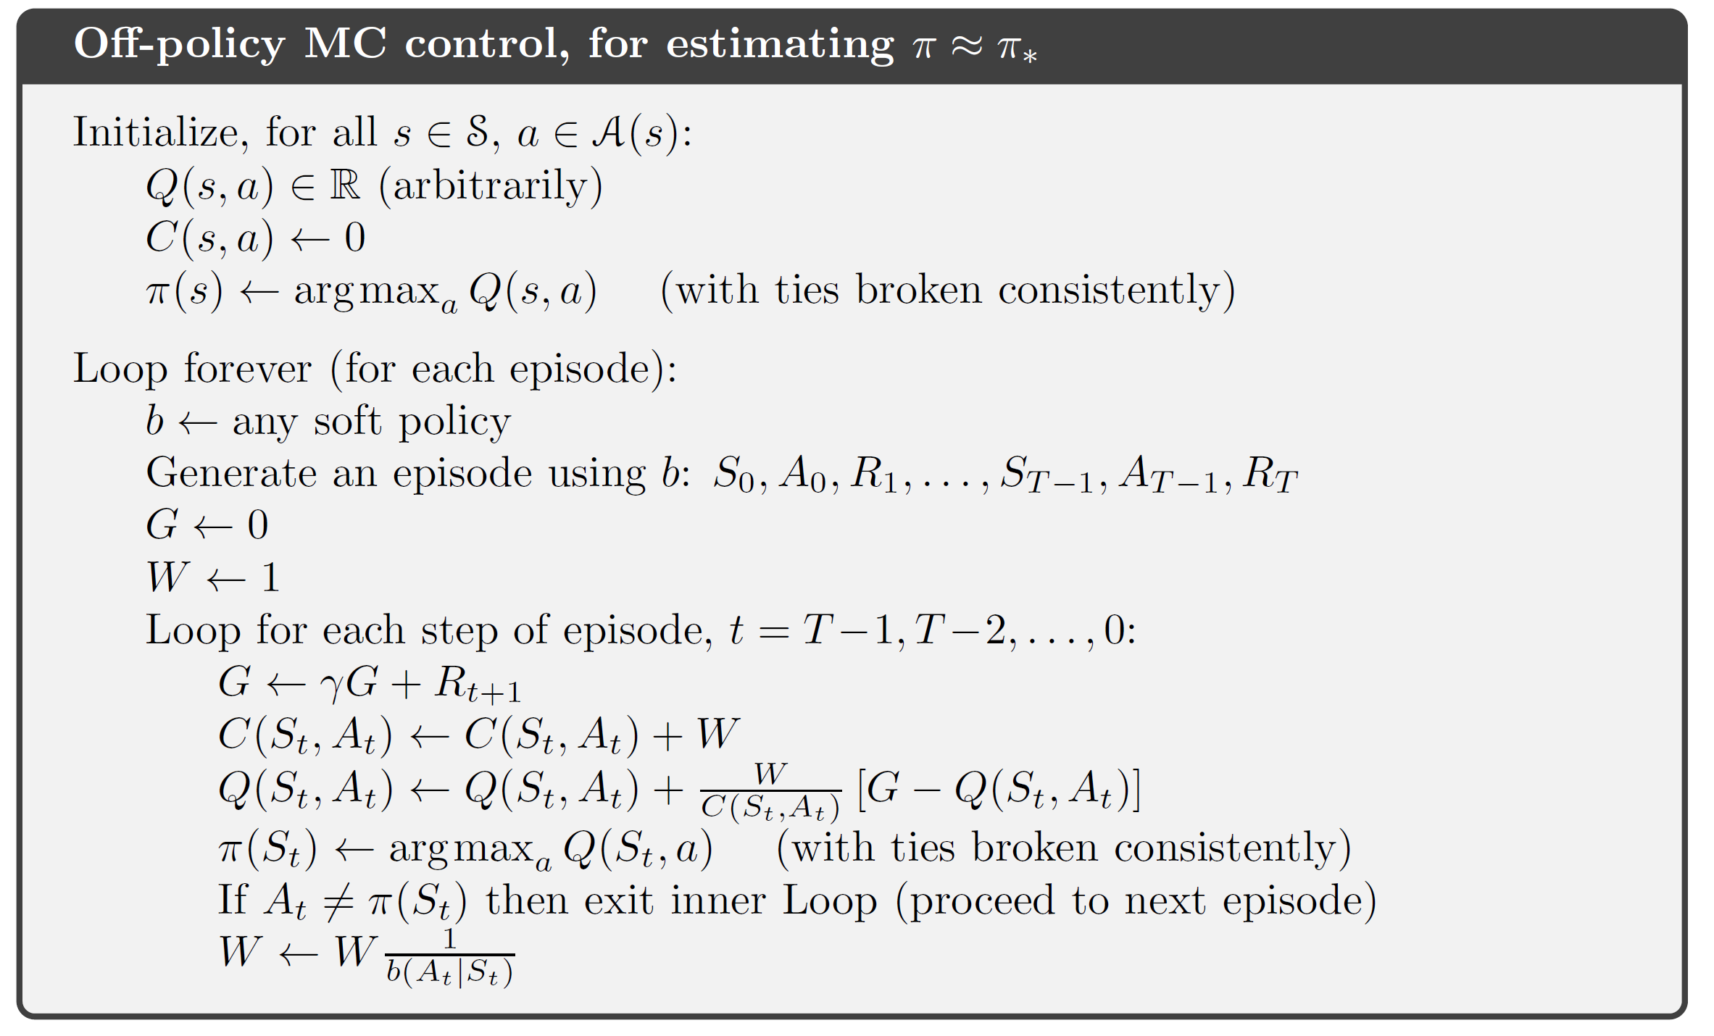
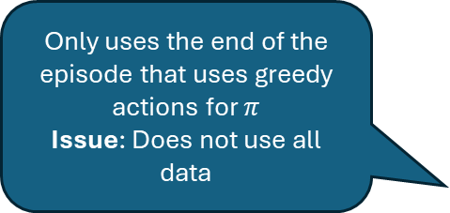
Alg. Off-Policy MC Control
Only uses the end of the episode that uses greedy actions for $π$ Issue: Does not use all data
This is added to prediction

Slide 22
Summary
Advantages of MC methods:
Works with sample episodes
No need for an environment model.
Simulation is often easy.
Can focus on a small subset of states.
May be less harmed by violations of the Markov property because it does not bootstrap (use predicted successor states) but uses observed states.
Policy Evaluation: Averages many returns starting in a state with a specific action.
Control: Interleaves pol. eval. and pol. improvement on an episode-by-episode basis.
Issues:
Maintain sufficient exploration. Needs exploring starts or a behavioral policy with coverage (e.g., a soft policy).

