Slide 1



Reinforcement Learning $n$-step Bootstrapping Sutton/Barto* Chapter 7
Michael Hahsler, SMU
With figures from Sutton/Barto*
*Sutton and Barto, Reinforcement Learning: An Introduction, 2nd edition, MIT Press, Cambridge, MA, 2018

Slide 2
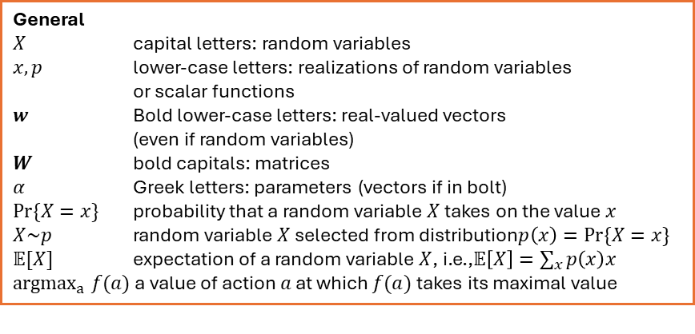
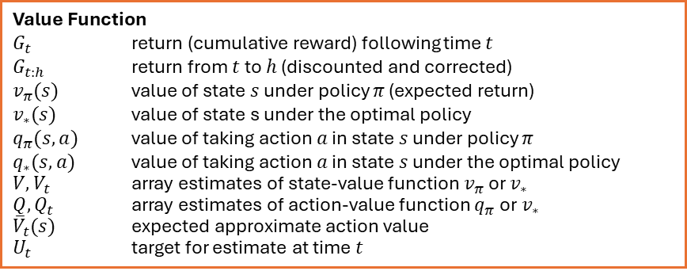
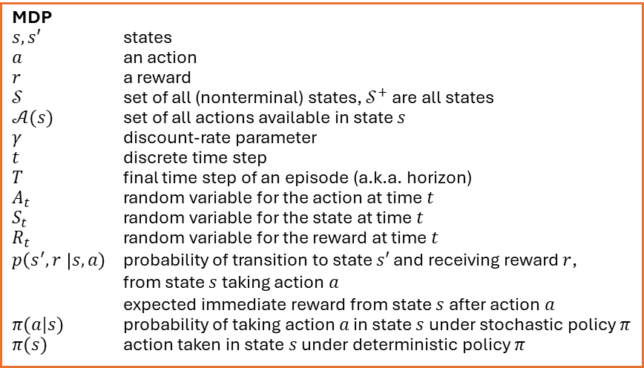
Summary of Notation
General
$X$ capital letters: random variables $x, p$ lower-case letters: realizations of random variables or scalar functions
$w$ Bold lower-case letters: real-valued vectors (even if random variables)
$W$ bold capitals: matrices
$α$ Greek letters: parameters (vectors if in bolt)
$Pr⁡\{X=x\}$ probability that a random variable $X$ takes on the value $x$
$X\sim p$ random variable $X$ selected from distribution$p\left(x\right)=Pr⁡\{X=x\}$
$𝔼[X]$ expectation of a random variable $X$, i.e.,$𝔼\left[X\right]=\sum_{x}{p\left(x\right)x}$
${argmax}_{a} f(a)$ a value of action $a$ at which $f(a)$ takes its maximal value
Value Function
$G_{t}$ return (cumulative reward) following time $t$
$G_{t:h}$ return from $t$ to $h$ (discounted and corrected)
$v_{π}(s)$ value of state $s$ under policy $π$ (expected return)
$v_{∗}(s)$ value of state s under the optimal policy
$q_{π}(s,a)$ value of taking action $a$ in state $s$ under policy $π$
$q_{∗}(s,a)$ value of taking action $a$ in state $s$ under the optimal policy
$V, V_{t}$ array estimates of state-value function $v_{π}$or $v_{∗}$
$Q,Q_{t}$ array estimates of action-value function $q_{π}$or $v_{∗}$
${\overline{V}}_{t}(s)$ expected approximate action value
$U_{t}$ target for estimate at time$t$
MDP
$s, s′$ states
$a$ an action
$r$ a reward
$𝒮$ set of all (nonterminal) states, $𝒮^{+}$ are all states
$𝒜(s)$ set of all actions available in state $s$
$γ$ discount-rate parameter
$t$ discrete time step
$T$ final time step of an episode (a.k.a. horizon)
$A_{t}$ random variable for the action at time $t$
$S_{t}$ random variable for the state at time $t$
$R_{t}$ random variable for the reward at time $t$
$p\left(s^{′},r \right|s, a)$ probability of transition to state $s′$ and receiving reward $r$, from state $s$ taking action $a$
expected immediate reward from state $s$ after action $a$
$π(a|s)$ probability of taking action $a$ in state $s$ under stochastic policy $π$
$π(s)$ action taken in state $s$ under deterministic policy $π$

Slide 3



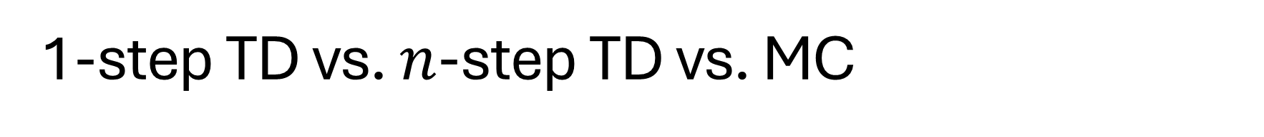
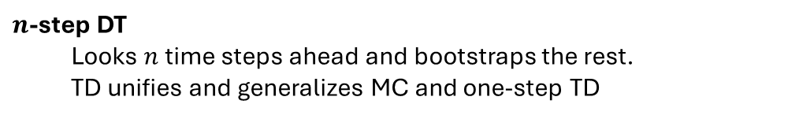

1-step TD vs. $n$-step TD vs. MC
How far do we look in the sampled episode ahead to update the state value?
1-step DT
We have already discussed 1-step TD: Q-Learning, Sarsa
We only observe the next step and its reward. The remaining return is bootstrapped using the estimate of the next state’s value.
1-step
$$V(S_{t})$$
$$V(S_{t+1})$$
update
Used to bootstrap the remaining return $G_{t+1}$
$n$-step DT
Looks $n$ time steps ahead and bootstraps the rest.
TD unifies and generalizes MC and one-step TD
1-step TD
MC
Spectrum

Slide 4
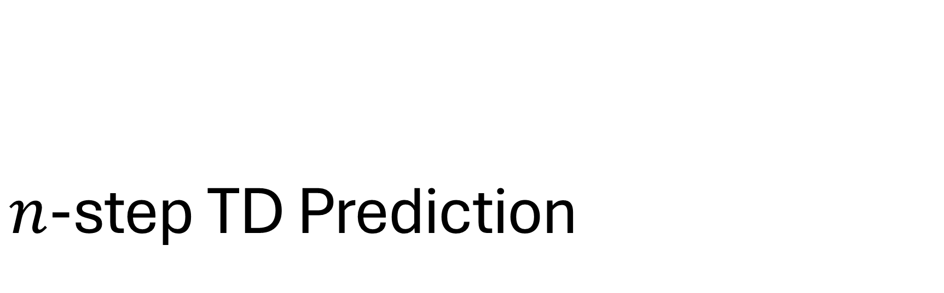
$n$-step TD Prediction
Predict V-values for a given policy.

Slide 5
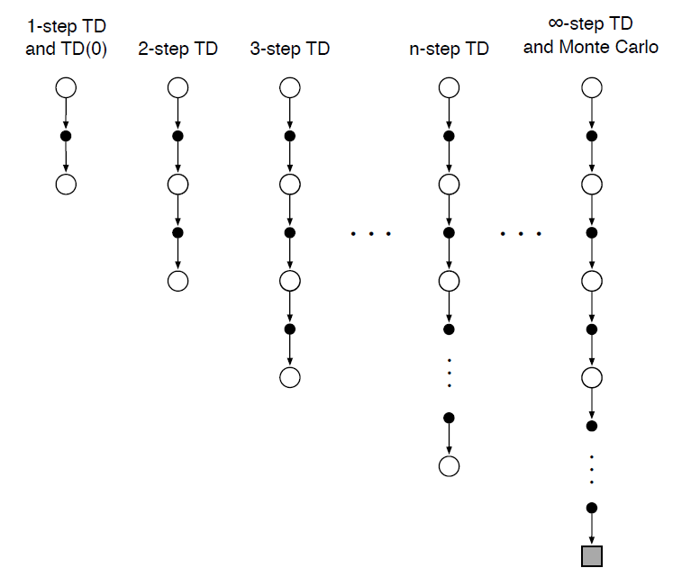
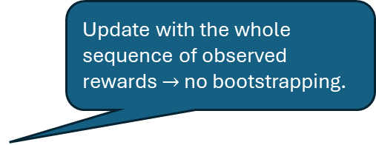

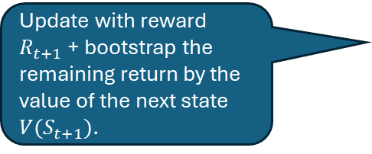
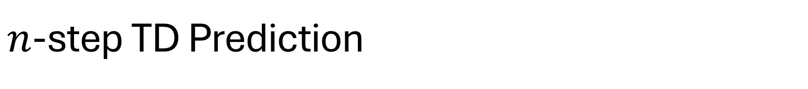


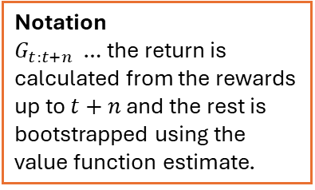

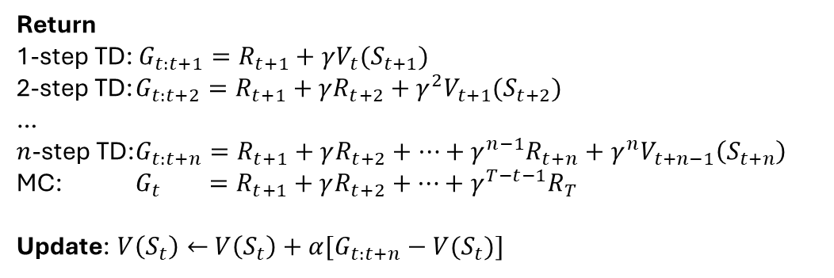
$n$-step TD Prediction
$$V(S_{t})$$
Update with reward $R_{t+1}$ + bootstrap the remaining return by the value of the next state $V(S_{t+1})$.
$$R_{t+1}$$
$$V(S_{t+1})$$
Update with the whole sequence of observed rewards $→$ no bootstrapping.
Return
1-step TD: $G_{t:t+1}=R_{t+1}+γV_{t}(S_{t+1})$
2-step TD: $G_{t:t+2}=R_{t+1}+γ{R_{t+2}+γ^{2}V}_{t+1}(S_{t+2})$
…
$n$-step TD: $G_{t:t+n}=R_{t+1}+γ{R_{t+2}+…+γ^{n−1}R_{t+n}+γ^{n}V}_{t+n−1}\left(S_{t+n}\right)$
MC: $G_{t} =R_{t+1}+γR_{t+2}+…+γ^{T−t−1}R_{T}$
Update: $V\left(S_{t}\right)←$ $V\left(S_{t}\right)+α[G_{t:t+n}−V(S_{t})]$
Notation
$G_{t:t+n}$ … the return is calculated from the rewards up to $t+n$ and the rest is bootstrapped using the value function estimate.
Question: The implementation drops the subscript for V!
The update needs $G_{t:t+n}$ and is $n$ steps delayed!

Slide 6
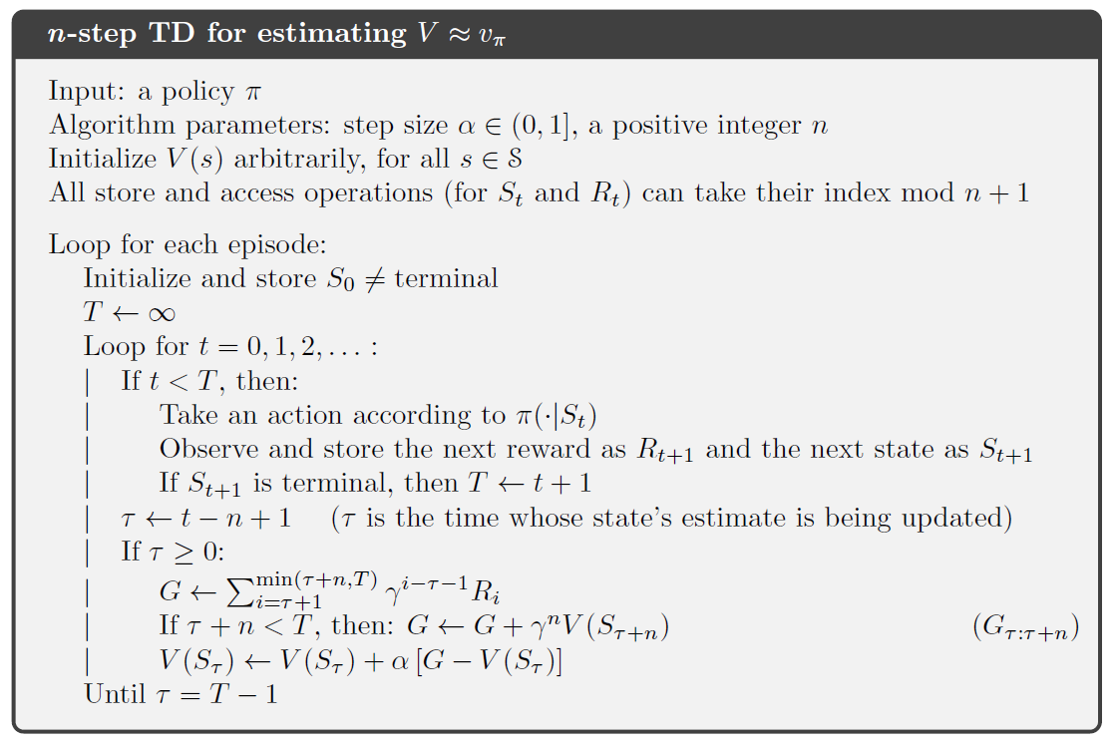
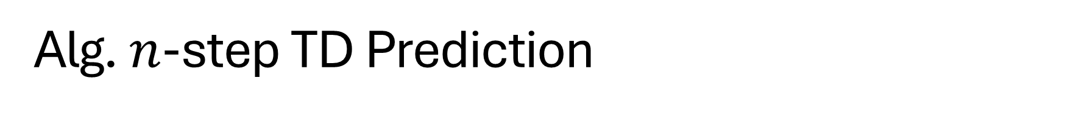

Alg. $n$-step TD Prediction
end of episode is detected below
start only when we can update $t≥ n$
()
Use bootstrapping if the episode is not over
The update

Slide 7
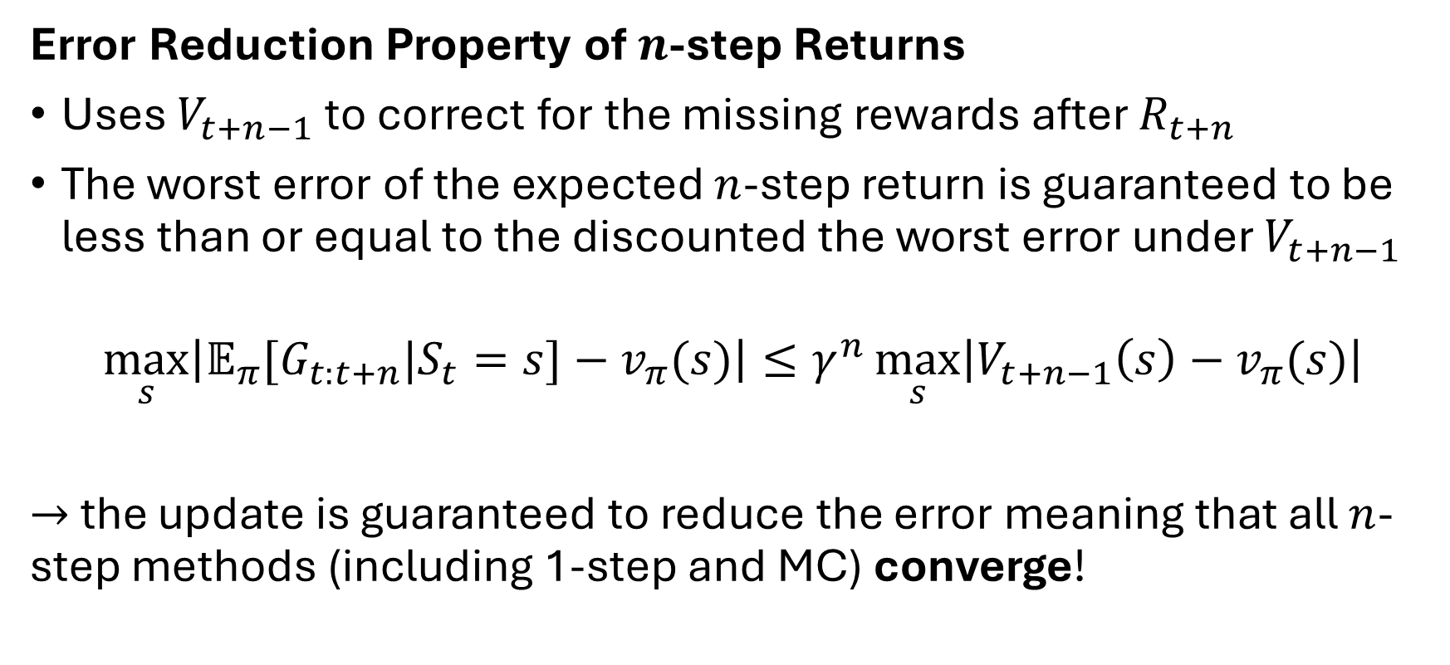
Convergence
Error Reduction Property of $n$-step Returns
Uses $V_{t+n−1}$ to correct for the missing rewards after $R_{t+n}$
The worst error of the expected $n$-step return is guaranteed to be less than or equal to the discounted the worst error under $V_{t+n−1}$
$$\max_{s}\left|𝔼_{π}[G_{t:t+n}|S_{t}=s]−v_{π}(s)\right|≤γ^{n}\max_{s}\left|V_{t+n−1}\left(s\right)−v_{π}(s)\right|$$
$→$ the update is guaranteed to reduce the error meaning that all $n$-step methods (including 1-step and MC) converge!

Slide 8

$n$-step Control (Sarsa)
Learn a policy. This is done by estimating Q-values instead of V-values.

Slide 9
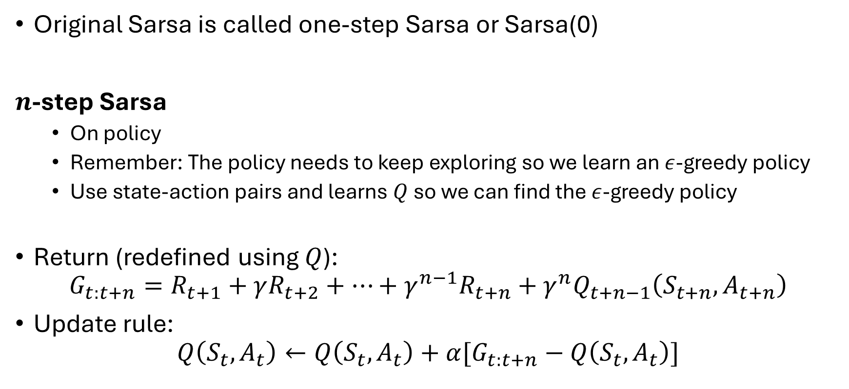
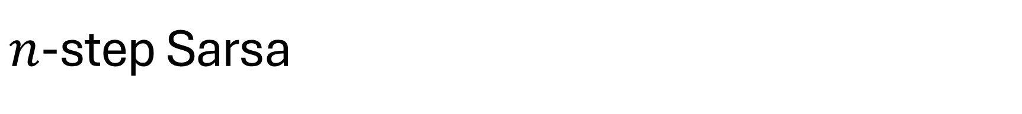
$n$-step Sarsa
Note (0) has nothing to do with the steps!
Original Sarsa is called one-step Sarsa or Sarsa(0)
$n$-step Sarsa
On policy
Remember: The policy needs to keep exploring so we learn an $ε$-greedy policy
Use state-action pairs and learns $Q$ so we can find the $ε$-greedy policy
Return (redefined using $Q$):
$$G_{t:t+n}=R_{t+1}+γ{R_{t+2}+…+γ^{n−1}R_{t+n}+γ^{n}Q}_{t+n−1}\left(S_{t+n},A_{t+n}\right)$$
Update rule:
$$Q\left(S_{t},A_{t}\right)←Q\left(S_{t},A_{t}\right)+α[G_{t:t+n}−Q\left(S_{t},A_{t}\right)]$$

Slide 10
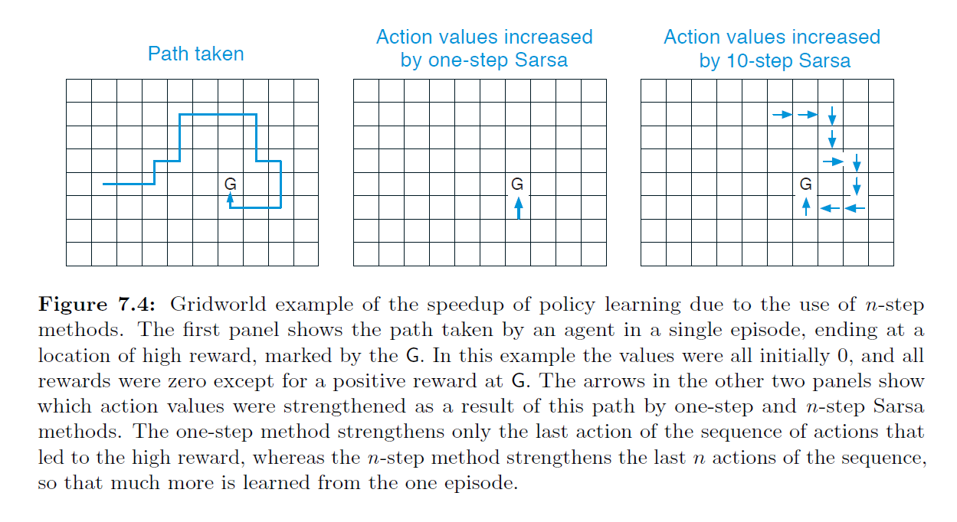
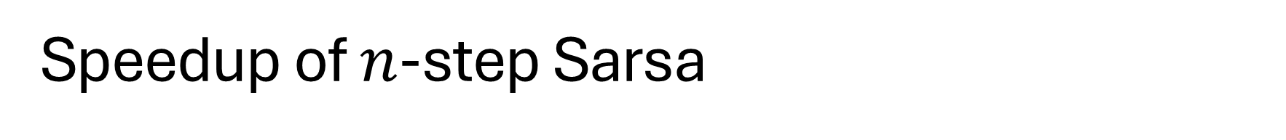

Speedup of $n$-step Sarsa
$Q$-values updated during one episode

Slide 11
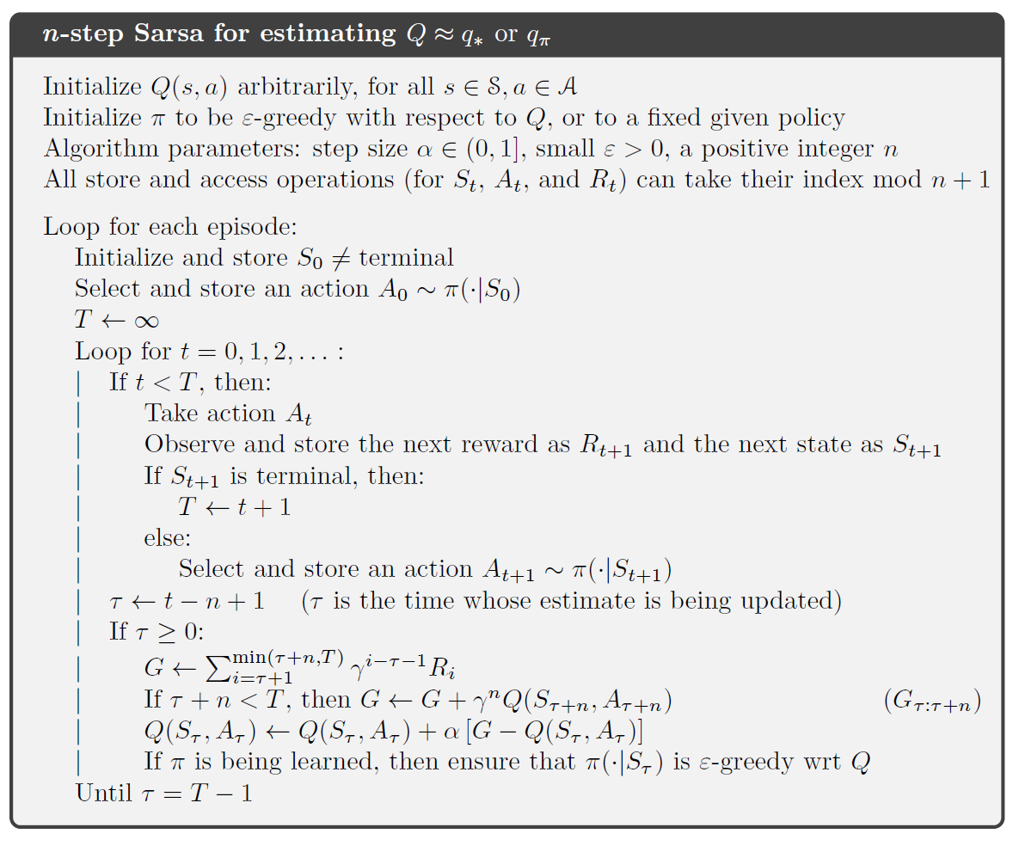
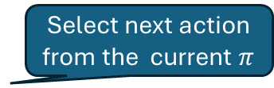
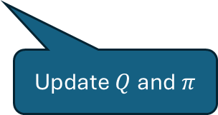


Alg. From DT prediction to $n$-step Sarsa Control
$π$ is given
Select next action from the current $π$
Update $V$
Update $Q$ and $π$

Slide 12
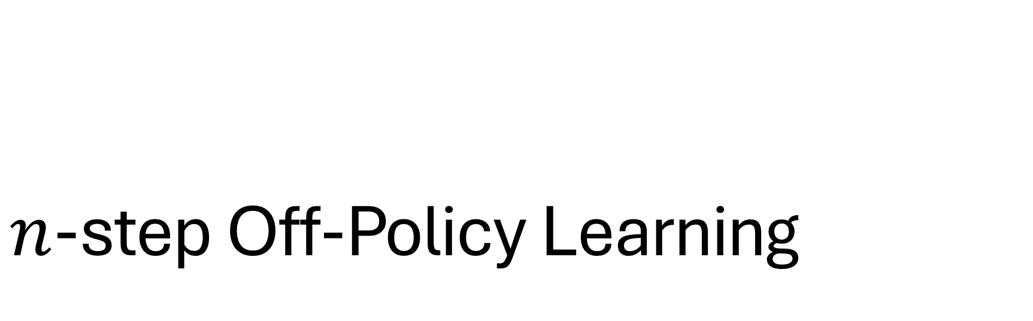
$n$-step Off-Policy Learning

Slide 13
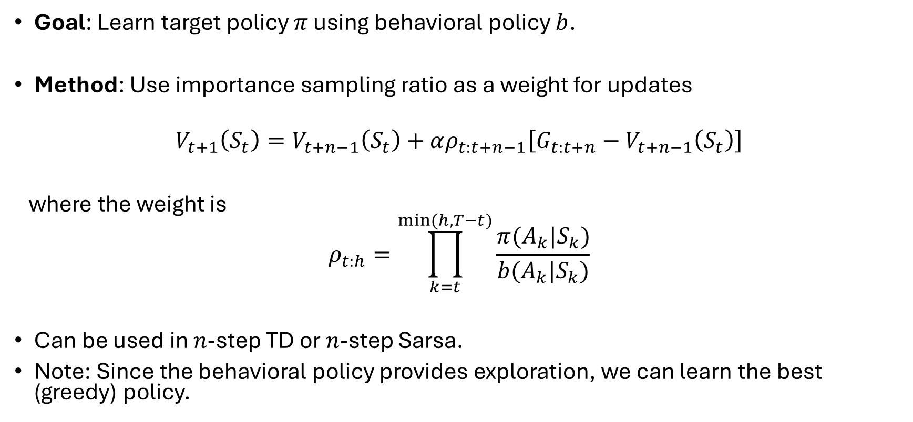
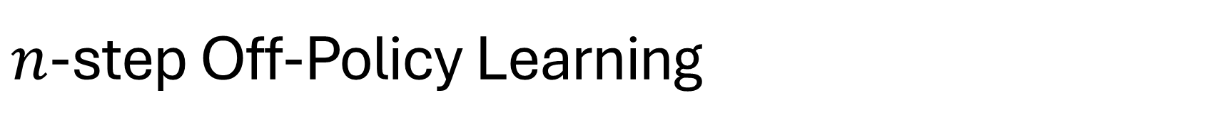
$n$-step Off-Policy Learning
Goal: Learn target policy $π$ using behavioral policy $b$.
Method: Use importance sampling ratio as a weight for updates
$$V_{t+1}\left(S_{t}\right)=V_{t+n−1}\left(S_{t}\right)+αρ_{t:t+n−1}\left[G_{t:t+n}−V_{t+n−1}\left(S_{t}\right)\right]$$
where the weight is
$$ρ_{t:h}=\prod_{k=t}^{min⁡(h,T−t)}{\frac{π(A_{k}|S_{k})}{b(A_{k}|S_{k})}}$$
Can be used in $n$-step TD or $n$-step Sarsa.
Note: Since the behavioral policy provides exploration, we can learn the best (greedy) policy.
Probability that 𝑏 chooses the same actions as 𝜋

Slide 14
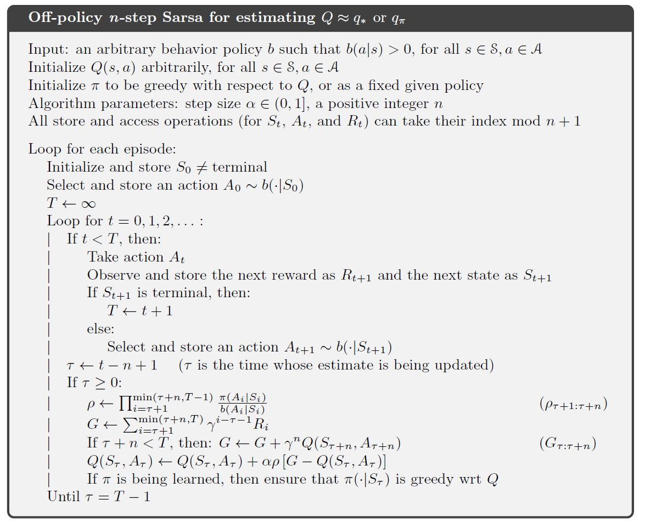
Alg. Comparing On-Policy with Off-Policy
Add behavior policy
Importance sampling ratio
The behavioral policy provides exploration do we can learn a greedy policy!

Slide 15
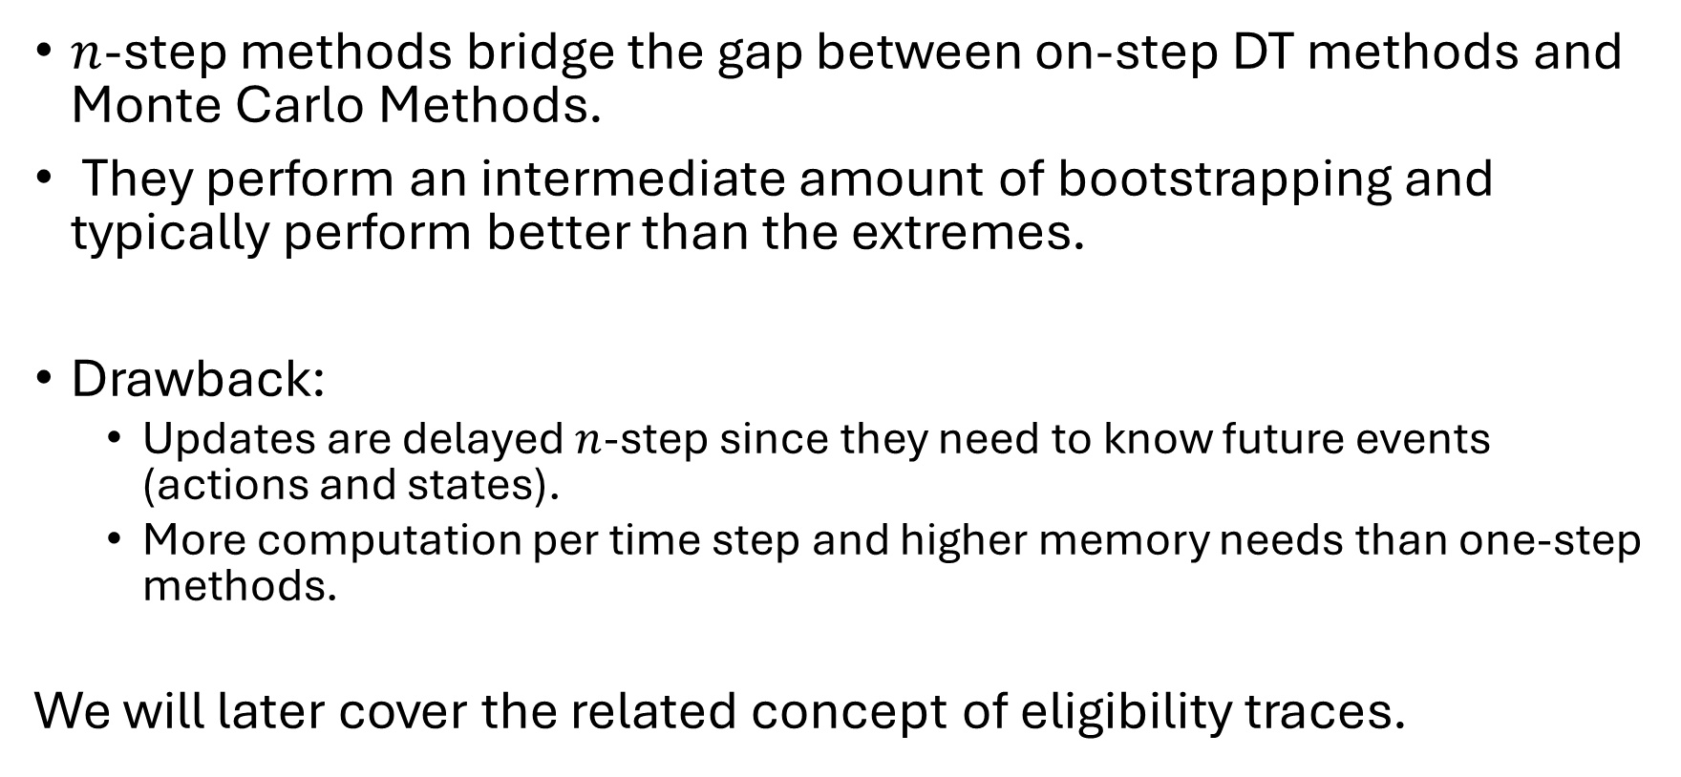
Summary
$n$-step methods bridge the gap between on-step DT methods and Monte Carlo Methods.
They perform an intermediate amount of bootstrapping and typically perform better than the extremes.
Drawback:
Updates are delayed $n$-step since they need to know future events (actions and states).
More computation per time step and higher memory needs than one-step methods.
We will later cover the related concept of eligibility traces.

