Slide 1
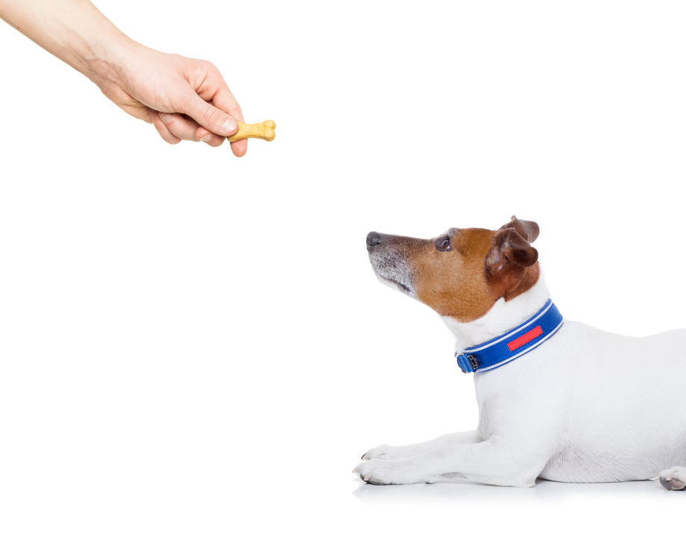

Reinforcement Learning Planning and Learning with Tabular Methods Sutton/Barto* Chapter 8
Michael Hahsler, SMU
With figures from Sutton/Barto*
*Sutton and Barto, Reinforcement Learning: An Introduction, 2nd edition, MIT Press, Cambridge, MA, 2018

Slide 2
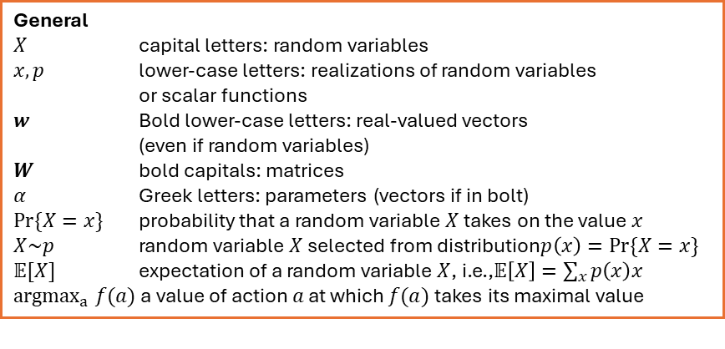
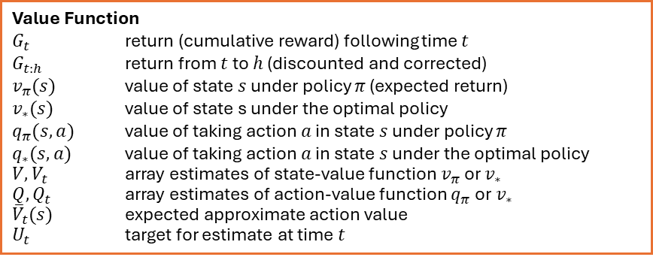
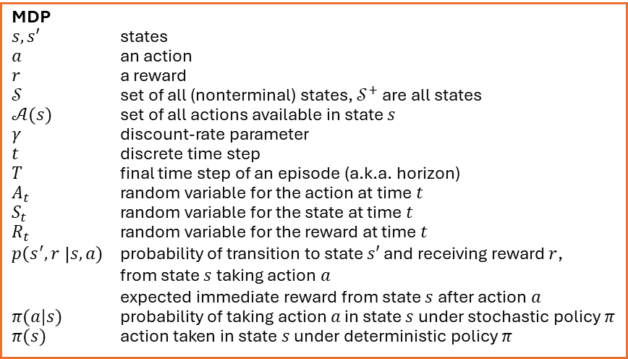
Summary of Notation
General
$X$ capital letters: random variables $x, p$ lower-case letters: realizations of random variables or scalar functions
$w$ Bold lower-case letters: real-valued vectors (even if random variables)
$W$ bold capitals: matrices
$α$ Greek letters: parameters (vectors if in bolt)
$Pr⁡\{X=x\}$ probability that a random variable $X$ takes on the value $x$
$X\sim p$ random variable $X$ selected from distribution$p\left(x\right)=Pr⁡\{X=x\}$
$𝔼[X]$ expectation of a random variable $X$, i.e.,$𝔼\left[X\right]=\sum_{x}{p\left(x\right)x}$
${argmax}_{a} f(a)$ a value of action $a$ at which $f(a)$ takes its maximal value
Value Function
$G_{t}$ return (cumulative reward) following time $t$
$G_{t:h}$ return from $t$ to $h$ (discounted and corrected)
$v_{π}(s)$ value of state $s$ under policy $π$ (expected return)
$v_{∗}(s)$ value of state s under the optimal policy
$q_{π}(s,a)$ value of taking action $a$ in state $s$ under policy $π$
$q_{∗}(s,a)$ value of taking action $a$ in state $s$ under the optimal policy
$V, V_{t}$ array estimates of state-value function $v_{π}$or $v_{∗}$
$Q,Q_{t}$ array estimates of action-value function $q_{π}$or $v_{∗}$
${\overline{V}}_{t}(s)$ expected approximate action value
$U_{t}$ target for estimate at time$t$
MDP
$s, s′$ states
$a$ an action
$r$ a reward
$𝒮$ set of all (nonterminal) states, $𝒮^{+}$ are all states
$𝒜(s)$ set of all actions available in state $s$
$γ$ discount-rate parameter
$t$ discrete time step
$T$ final time step of an episode (a.k.a. horizon)
$A_{t}$ random variable for the action at time $t$
$S_{t}$ random variable for the state at time $t$
$R_{t}$ random variable for the reward at time $t$
$p\left(s^{′},r \right|s, a)$ probability of transition to state $s′$ and receiving reward $r$, from state $s$ taking action $a$
expected immediate reward from state $s$ after action $a$
$π(a|s)$ probability of taking action $a$ in state $s$ under stochastic policy $π$
$π(s)$ action taken in state $s$ under deterministic policy $π$

Slide 3
Planning vs. Learning

Slide 4
Planning vs. Learning
Model-based RL
Model-free RL
Requires knowledge of the MDP model.
Methods: Dynamic Programming, heuristic search
Use the known model to plan
Model is unknown.
Methods: MC, TD
Learn from interactions with the environment (sampling).
All methods:
Compute a value function
Look ahead to future events and compute a backed-up value to update an approximate value function.

Slide 5
Models and Planning
Model of the environment:
Anything the agent can use to predict the outcome of actions (e.g., next state and reward)
Models can be:
Distribution models: produce a distribution of all possible outcomes
Sample models: produce (simulate) one sampled outcome for an action.

Slide 6
General Approach
simulated experience
model
backups
values
policy
Model-based: Simulated experience comes from the model. Can be done offline, which leads to planning.
Model-free: Simulated experience comes from real experience, leads to online learning.

Slide 7
Dyna
Integrating Planning, Acting, and Learning

Slide 8
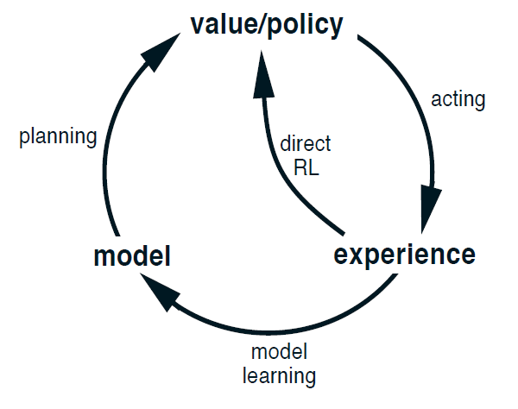
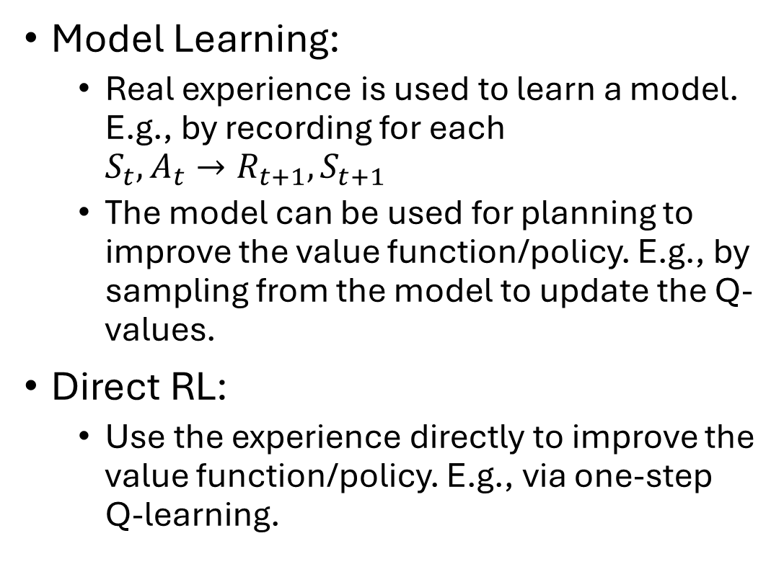
Dyna: Integrating Planning, Acting, and Learning
Model Learning:
Real experience is used to learn a model. E.g., by recording for each $S_{t},A_{t}→R_{t+1}, S_{t+1}$
The model can be used for planning to improve the value function/policy. E.g., by sampling from the model to update the Q-values.
Direct RL:
Use the experience directly to improve the value function/policy. E.g., via one-step Q-learning.

Slide 9
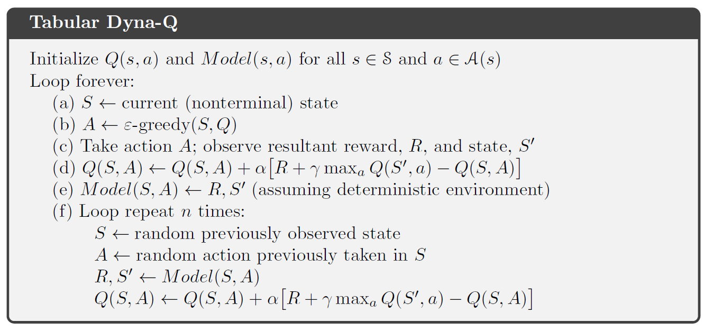
Alg. Tabular Dyna-Q
Direct RL
Model learning and planning

Slide 10
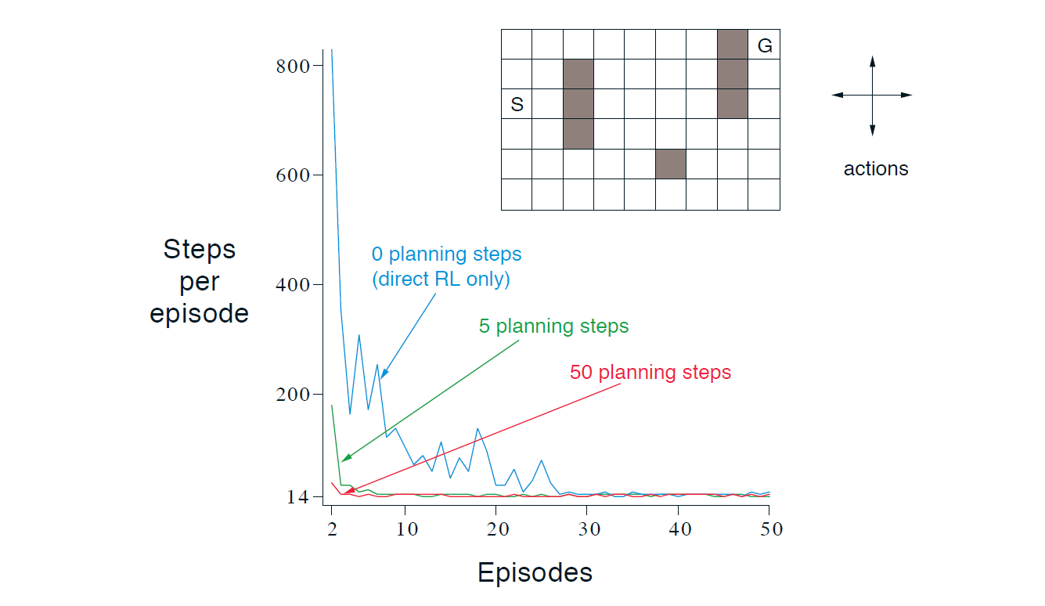
The Effect of Planning
Planning is a problem if the model is wrong:
Based on an insufficient number of samples
Function approximation not great.
Environment changes
Dyna quickly corrects too optimistic predictions since they will be selected for the next real action.
For changing environments:
Keep exploring.
Keep track of long action/state combinations that were not tried.
Planning helps!

Slide 11
Sampling
Base updates on sampled experience

Slide 12
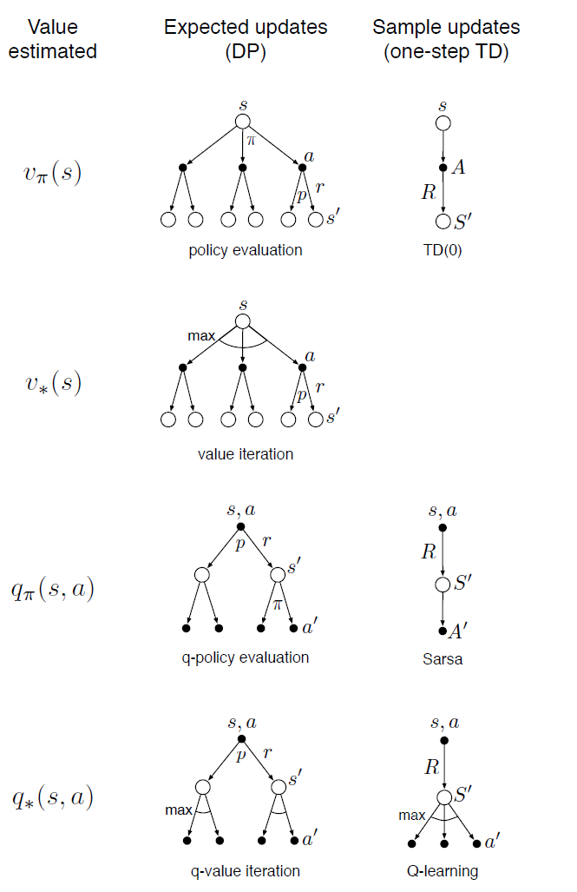
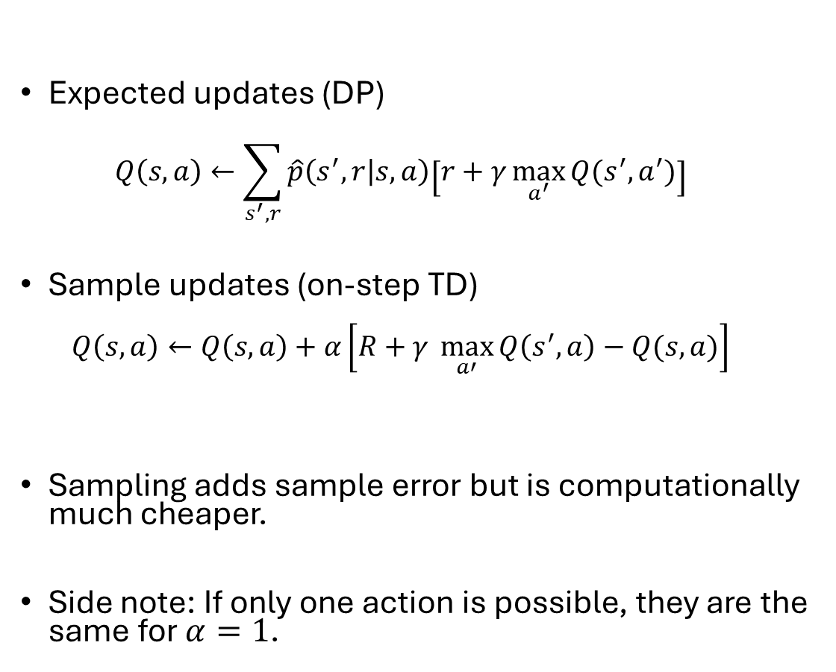
Expected vs. Sample Updates
Expected updates (DP) $Q\left(s,a\right)←\sum_{s^{′},r}{\hat{p}\left(s^{′},r | s,a\right)\left[r+γ\max_{a^{′}}{Q(s^{′},a^{′})}\right]}$
Sample updates (on-step TD) $Q\left(s,a\right)←Q\left(s,a\right)+α\left[R+γ \max_{a′}{Q\left(s^{′},a\right)−Q(s,a)}\right]$
Sampling adds sample error but is computationally much cheaper.
Side note: If only one action is possible, they are the same for $α=1$.

Slide 13
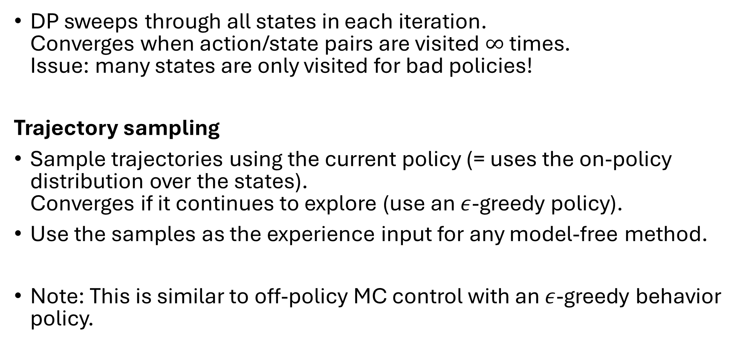
Trajectory Sampling
DP sweeps through all states in each iteration. Converges when action/state pairs are visited $∞$ times. Issue: many states are only visited for bad policies!
Trajectory sampling
Sample trajectories using the current policy (= uses the on-policy distribution over the states). Converges if it continues to explore (use an $ε$-greedy policy).
Use the samples as the experience input for any model-free method.
Note: This is similar to off-policy MC control with an $ε$-greedy behavior policy.

Slide 14
Heuristic Search and Rollout Algorithms
Decision-time planning

Slide 15
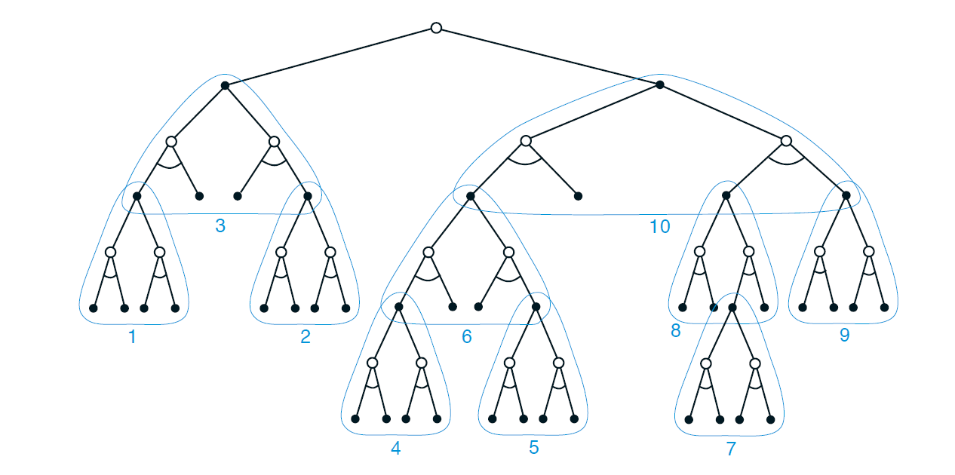
Heuristic Search
4. Pick best action
At decision time:
Consider a large tree of possible continuations (trajectories of a given length) for the current state.
Apply an approx. value function to the states in leaf nodes.
Back values towards the current state (using max).
Choose the best next action for the current state.
3. backup
2. Estimate value

Slide 16
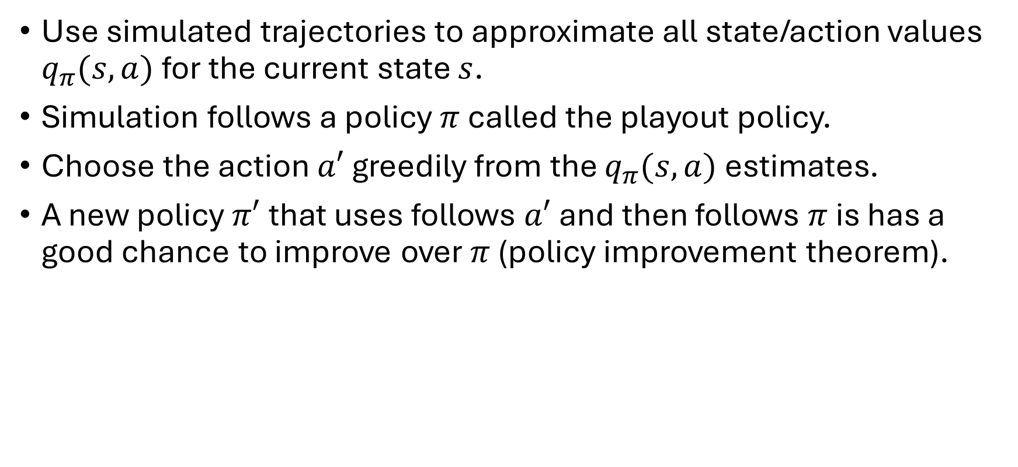
Rollout Algorithms (Monte Carlo Estimates)
Use simulated trajectories to approximate all state/action values $q_{π}(s,a)$ for the current state $s$.
Simulation follows a policy $π$ called the playout policy.
Choose the action $a′$ greedily from the $q_{π}(s,a)$ estimates.
A new policy $π′$that uses follows $a′$ and then follows $π$ is has a good chance to improve over $π$ (policy improvement theorem).

Slide 17
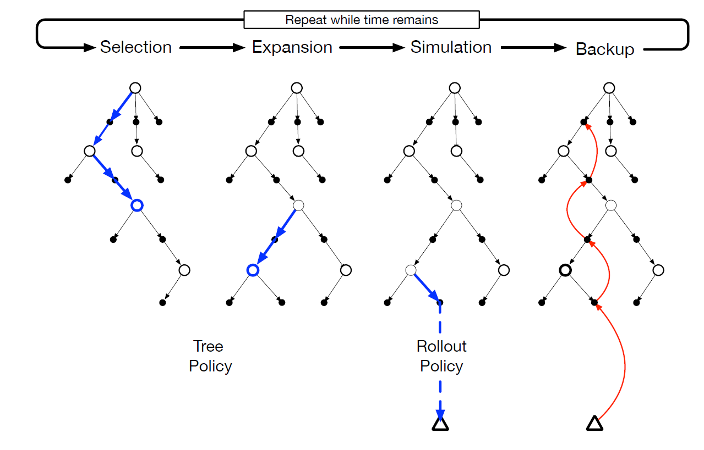
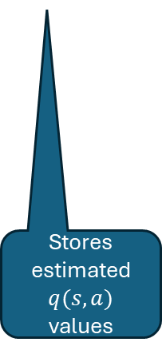
Monte Carlo Tree Search (MCTS)
A rollout algorithm that stores some intermediate estimates in a depth-limited tree structure.
Selection: Pick the currently best leaf node (e.g., greedy, UCB).
Expansion: Add new nodes, but keep the tree small enough.
Simulation: From a selected node, simulate complete episode(s).
Backup: update the tree with the result of the playout.
Advantage: selection steers the simulation towards better trajectories. This avoids trying to approximate the complete value function.
Stores estimated $q(s,a)$ values

Slide 18
Summary

Slide 19
Summary
Planning requires a model of the environment.
Distribution model
Sample model
DP requires a distribution model because it uses expected updates.
RL models like TD can use a sample model to perform sample updates.
Decision-time planning can also use a sample model. E.g., rollout algorithms sample trajectories.
Planning and learning are related: They try to estimate the same value function.

Slide 20
Summary of Part I
Tabular solution methods

Slide 21
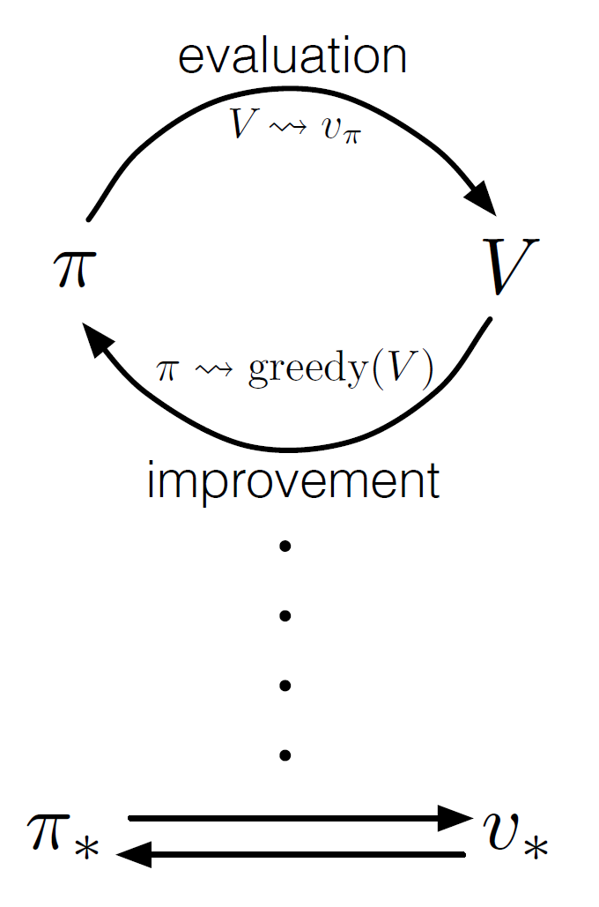
Common Ideas
GPI
Estimate a value function
Back up along actual or possible state trajectories
Generalized policy iteration (GPI): maintain an approx. value function and an approx. policy. Each is used to update the other. Converges due to the policy improvement theorem.

Slide 22
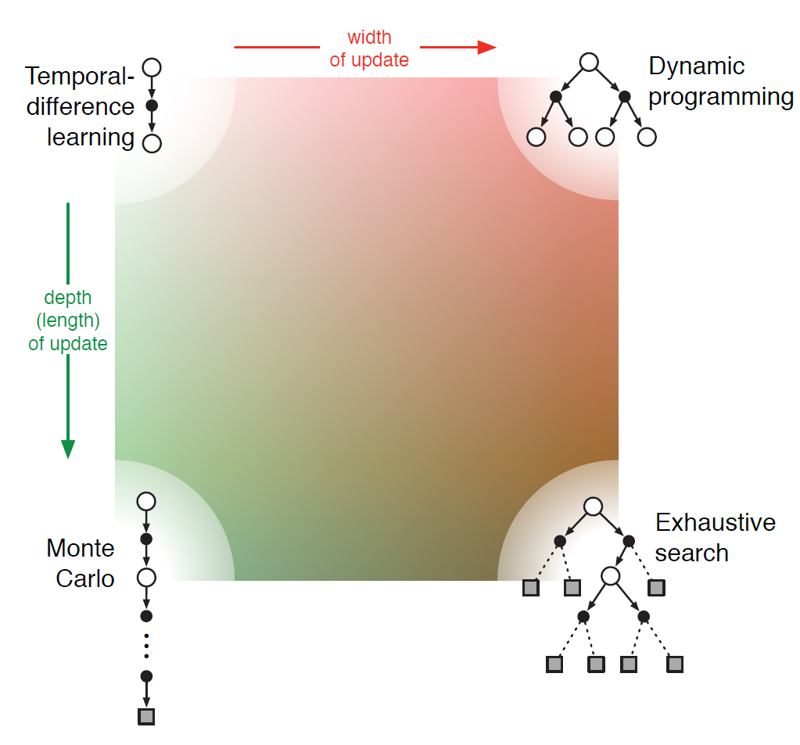
Update Depth vs. Update Width
One-step methods
n-step methods
Full-return methods
Sampled trajectory
Consider all actions

Slide 23
On-Policy vs. Off-Policy
On-Policy: Learn the policy the agent is following
Off-Policy: Learn a target policy that is different from the followed (behavior) policy.

Slide 24
Other Dimensions
Definition of return: episodic vs. continuing task; discounted vs. undiscounted.
Action values vs. state values
Exploration vs Exploitation: How are actions selected to ensure a trade-off between exploration and exploitation? Many methods need exploration to converge.
Synchronous vs. Asynchronous: Are all states updated as once or on-by-one in some order?
Real vs. Simulated: Is real experience or simulations or both used for updates?

Slide 25
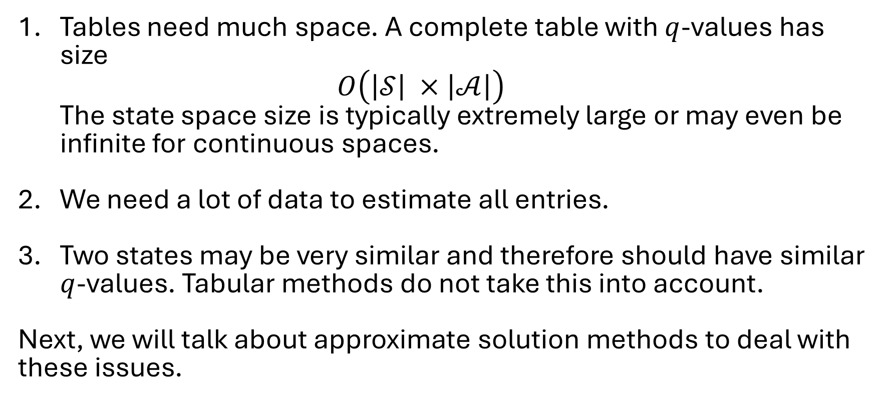
Issues with Tabular Methods
Tables need much space. A complete table with $q$-values has size $O\left(\left|𝒮\right| ×\left|𝒜\right|\right)$ The state space size is typically extremely large or may even be infinite for continuous spaces.
We need a lot of data to estimate all entries.
Two states may be very similar and therefore should have similar $q$-values. Tabular methods do not take this into account.
Next, we will talk about approximate solution methods to deal with these issues.

