Slide 1
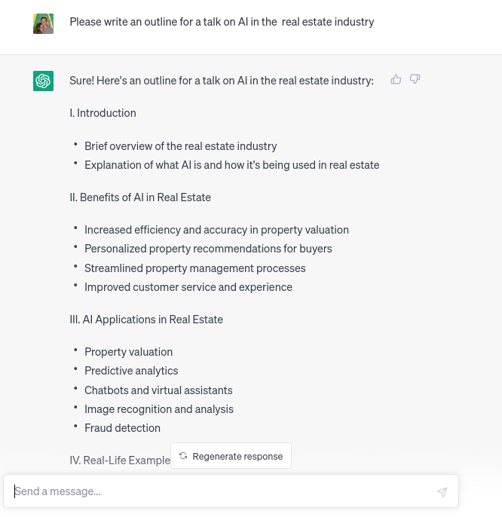

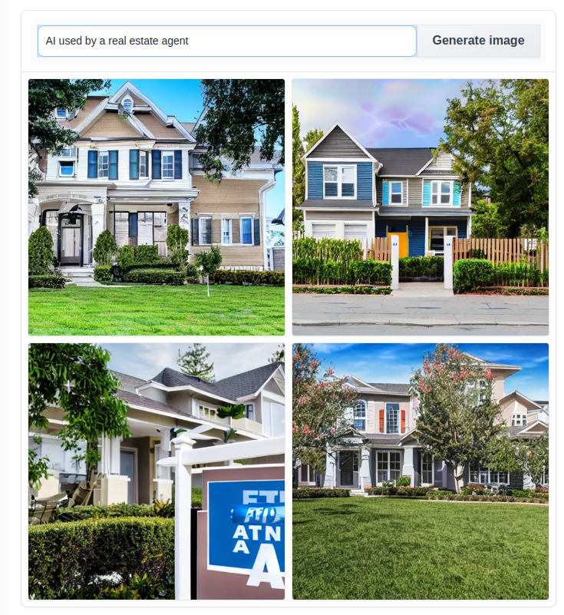
ChatGPT
What is AI?
How did we get here?
Where will it lead us?
CBRE – Texas Multifamily Exclusive Client Forum
April 19, 2023
Michael Hahsler
Clinical Associate Professor of Computer Science
http://michael.hahsler.net
Stable Diffusion

Slide 2
What is AI?
AI Today
History of AI
?
AI Ethics & Safety

Slide 3
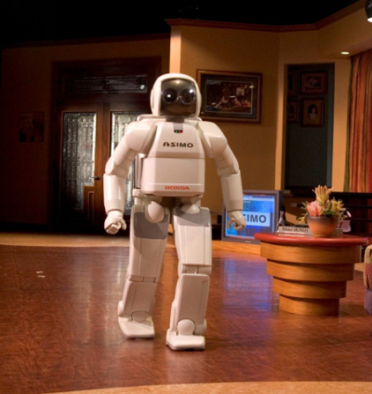
What is AI?
ASIMO (Advanced Step in Innovative Mobility) is a humanoid robot created by Honda in 2000

Slide 4

What is AI?
Goals for a task
User
AI
Result

Slide 5

What is AI?
Goals for a task
User
AI
Result
Rules / Reward model
train
Goals for the AI
Data
select
Developers / owners

Slide 6
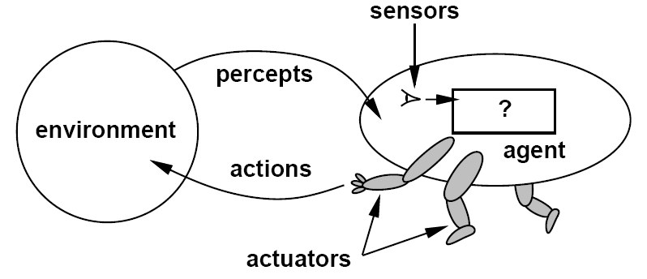
What is AI?
An artificial general intelligence (AGI) is a hypothetical intelligent agent which can understand or learn any intellectual task that human beings or other animals can. [Wikipedia entry on AGI]
Narrow AI focuses on agents to solve a specific subproblem.
Intelligent agents need to
Communicate with the environment
Represent knowledge
Reason and plan to achieve a desired outcome
Learn
Agent interacting with the environment
[Artificial Intelligence: A Modern Approach, Editions 1-3]

Slide 7
Machine Learning vs. Artificial Intelligence
AI
ML
DL
Designing an intelligent agent
Goals for the Agent
Vision
Other Sensors
Motion
NLP
Planning
Goals
Learning from examples instead of being programmed
Supervised learning
Unsupervised l.
RL
Developers
ML
ML
ML
Agent interacting with the environment
[Artificial Intelligence: A Modern Approach, Editions 1-3]

Slide 8
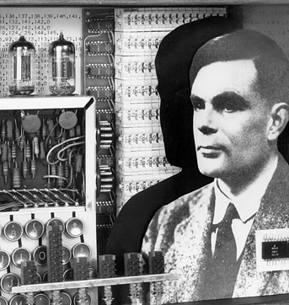
History of AI

Slide 9
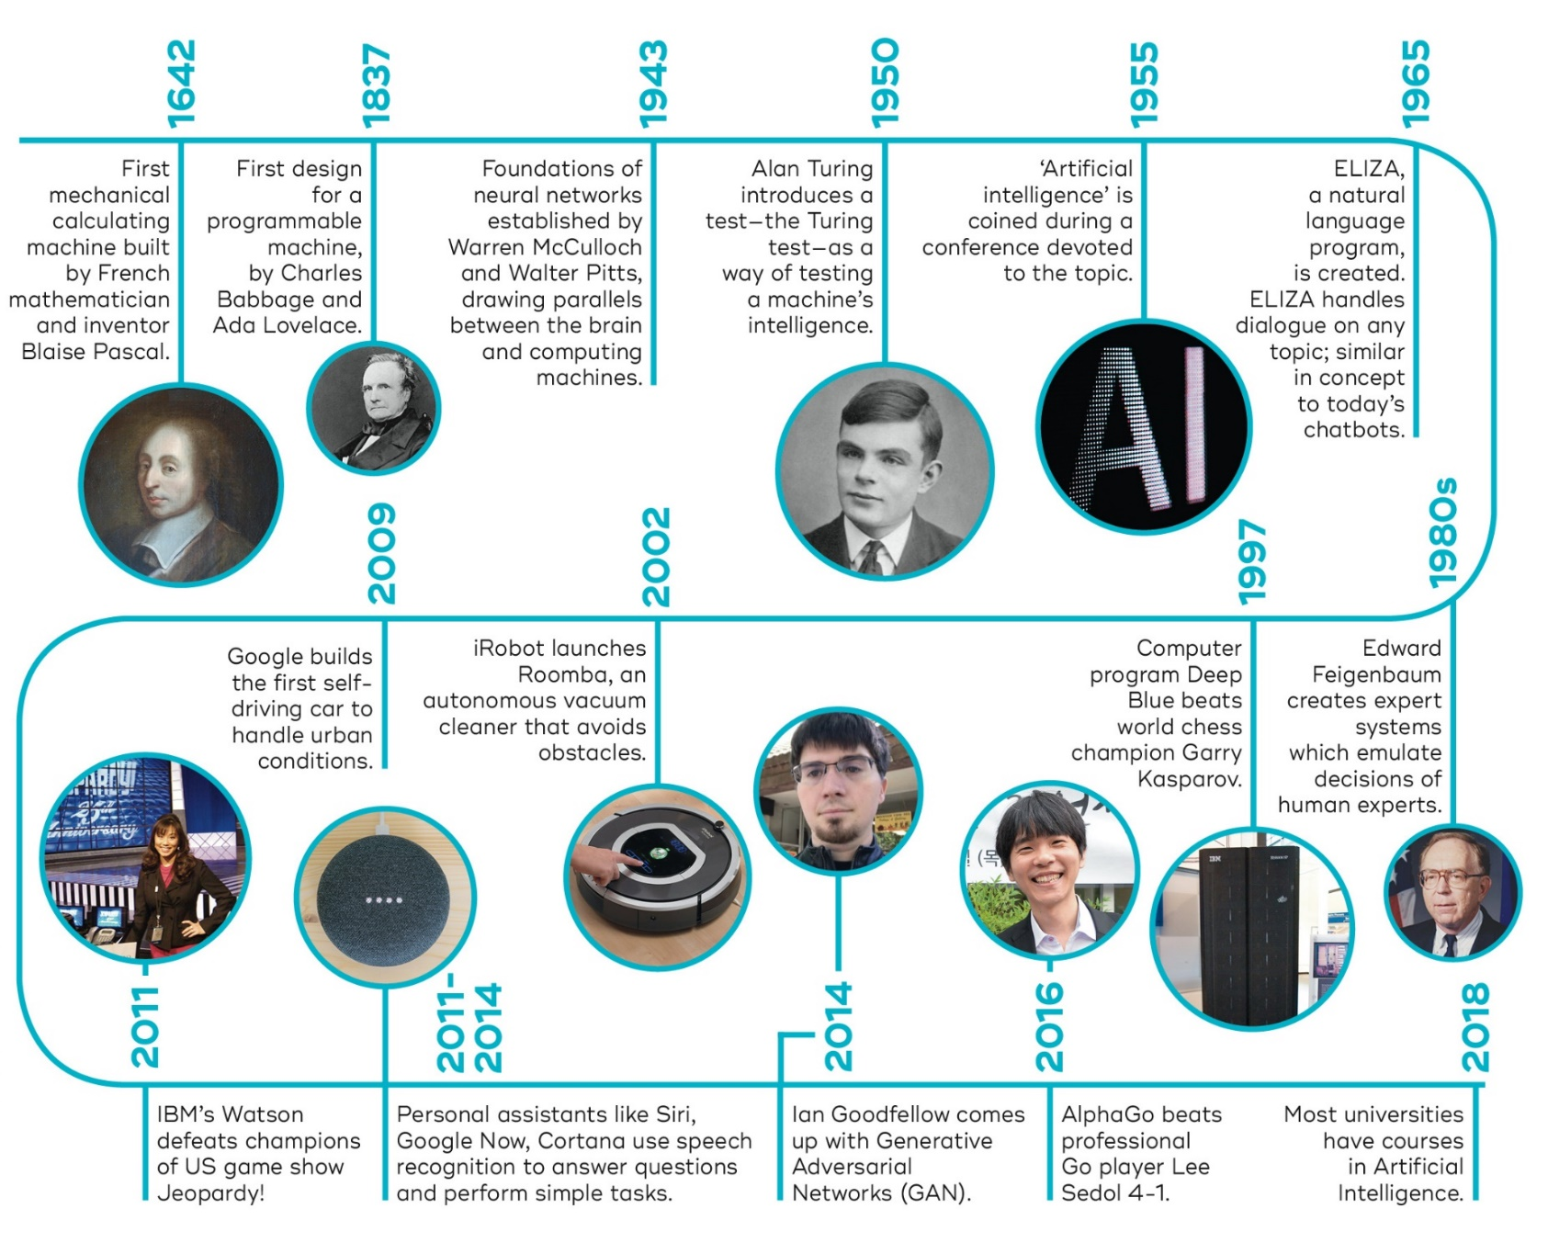




1974-1980
First AI Winter
1987-1993
Second AI Winter
1989
Universal approximation theorem for neural networks.
2010
2015
2017
2022
Transformer architecture and large language models LLMs
Generative AI models:
DALL-E
ChatGPT, Bard
…
Deep Learning Revolution (learning layered artificial neural networks) starts fueled by NVIDIA GPUs. Enables leaps in image processing and speech recognition.
Now Google
Source: https://qbi.uq.edu.au/brain/intelligent-machines/history-artificial-intelligence + additions

Slide 10
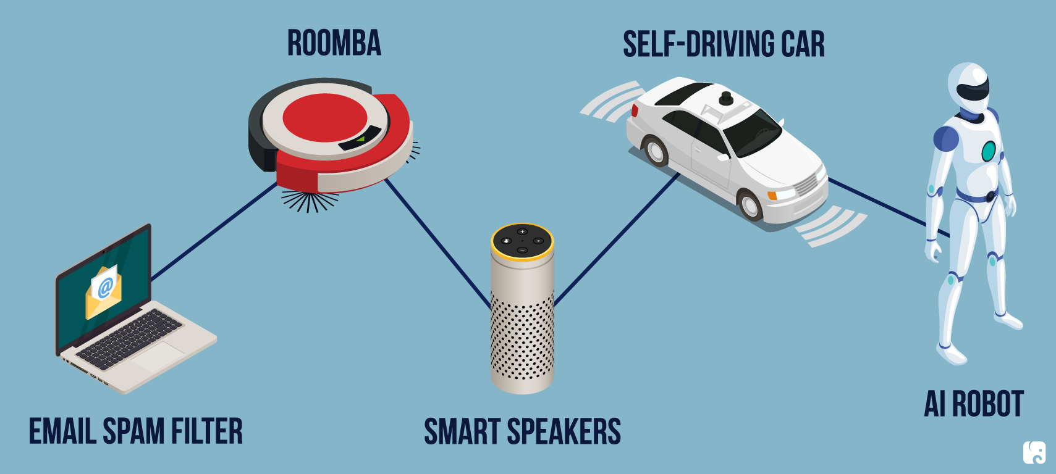
AI Today

Slide 11
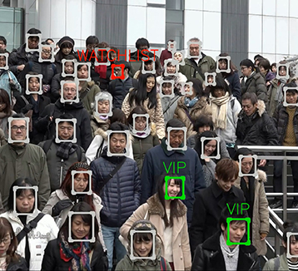
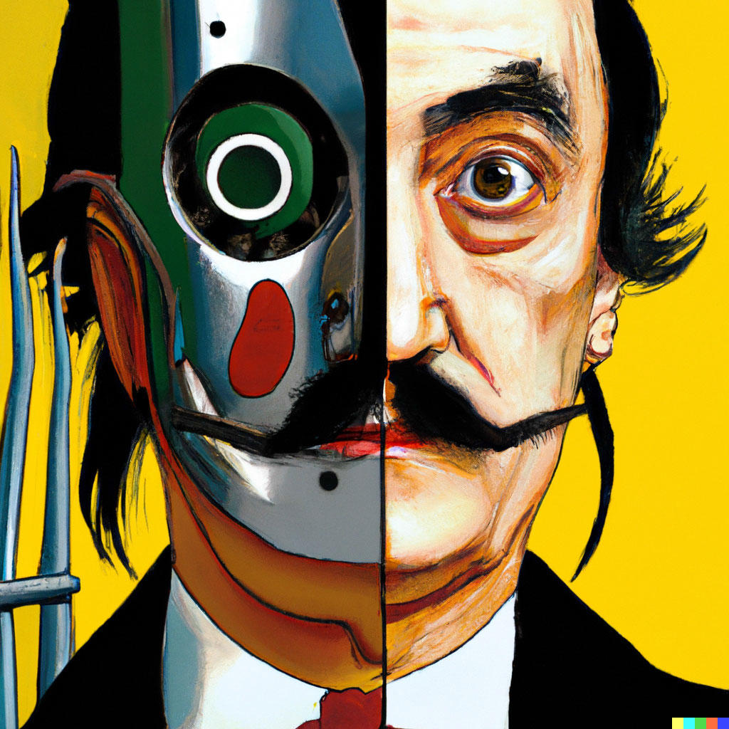


Vision and Image Processing
OCR: read license plates, handwriting recognition (e.g., mail sorting).
Face detection: now standard for smart phone cameras.
Visual search
Vehicle safety systems
Image generation
All these technologies can now operate now at superhuman performance.
DALL-E

Slide 12
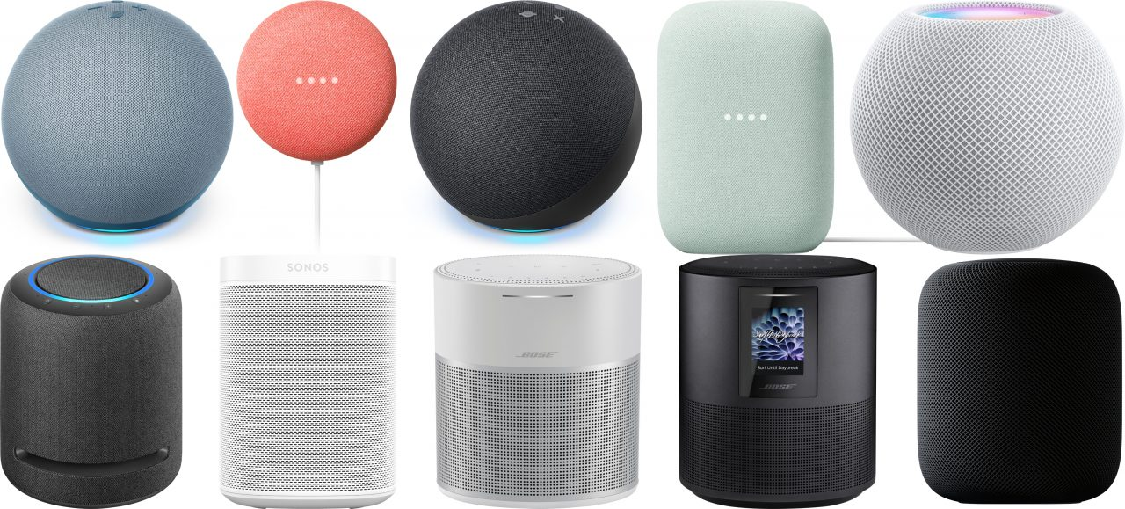
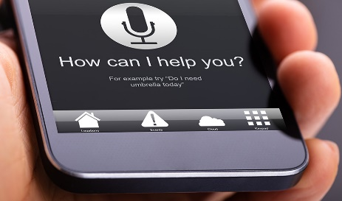
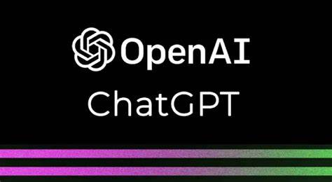
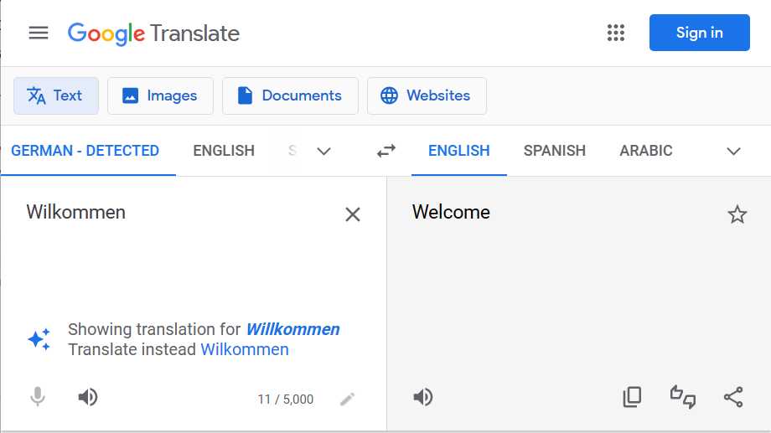
Natural Language Processing
  Text-to-speech
  Speech-to-text to detect voice commands
  Machine translation
  Text generation (Q/A systems, text summarization)
All these technologies can operate now with close to or even superhuman performance.
Humans use language to reason. Does that mean AI that can create good language can reason?

Slide 13

Large Language Models
ChatGPT in a Nutshell
A language model learns how words follow each other from a large training data set.
We give it a prompt: “Please write an outline for a talk on AI in the real estate industry.”
And then continues the prompt one word at a time:
“Sure! Here's an outline for a talk on AI in the real estate industry…”
The model gets fine-tuned by humans to produce “good” responses. E.g., about ¼ page long, stay on topic, etc.
The model learns to produce text that sounds right and “it thinks” the human will like…
Where will this lead?
  We will get natural language assistants for everything.
  We will get personalized summaries.
  Writing documents will become automated.
  For now, it is an assistant and needs someone to check the result is factually correct…
  Artificial content generation will explode. ”Genuine” content may become valued.
  Who pays more will get access to a more powerful model.
  The group that controls the models will gain extreme influence.
Cost of training GPT-4
$100 million+
Source: https://www.wired.com

Slide 14
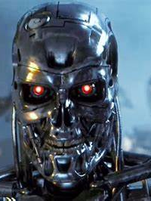
AI Safety
“Prevent accidents, misuse, or other harmful consequences of AI.”
Robustness: Black swan vs. adversarial robustness
Monitoring AI
Goal/reward alignment
Reward hacking
Instrumental Convergence
What about liability?
Goals
User
AI
Action
Rules
train
Goals
select
Data
Developers / owners
Credit: Terminator 3: Rise of the Machines. Warner Bros.

Slide 15
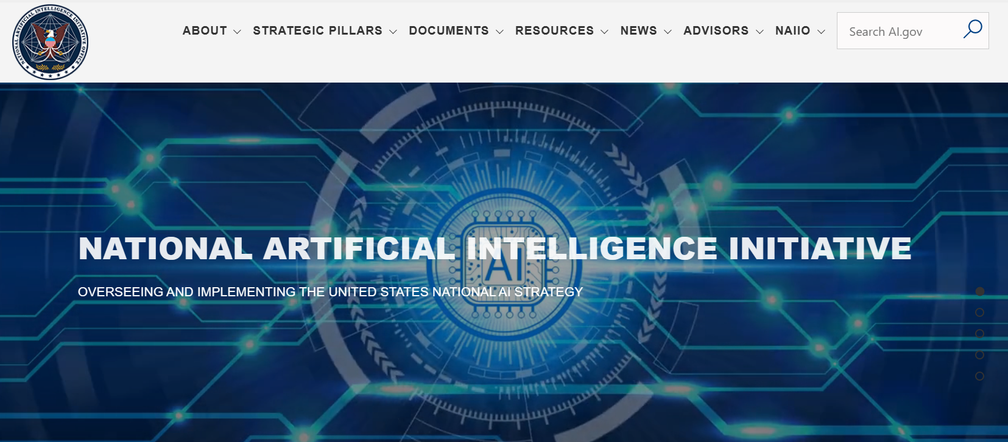
US National AI Initiative Act of 2020
https://www.ai.gov
“The National AI Initiative Act of 2020 became law on January 1, 2021, providing for a coordinated program across the entire Federal government to accelerate AI research and application for the Nation’s economic prosperity and national security. The mission of the National AI Initiative is to ensure continued U.S. leadership in AI research and development, lead the world in the development and use of trustworthy AI in the public and private sectors, and prepare the present and future U.S. workforce for the integration of AI systems across all sectors of the economy and society.”

Slide 16
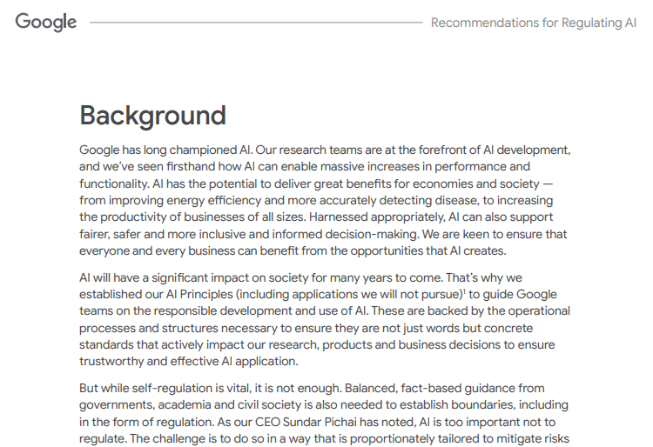
Source: https://ai.google/static/documents/recommendations-for-regulating-ai.pdf, 2021

Slide 17
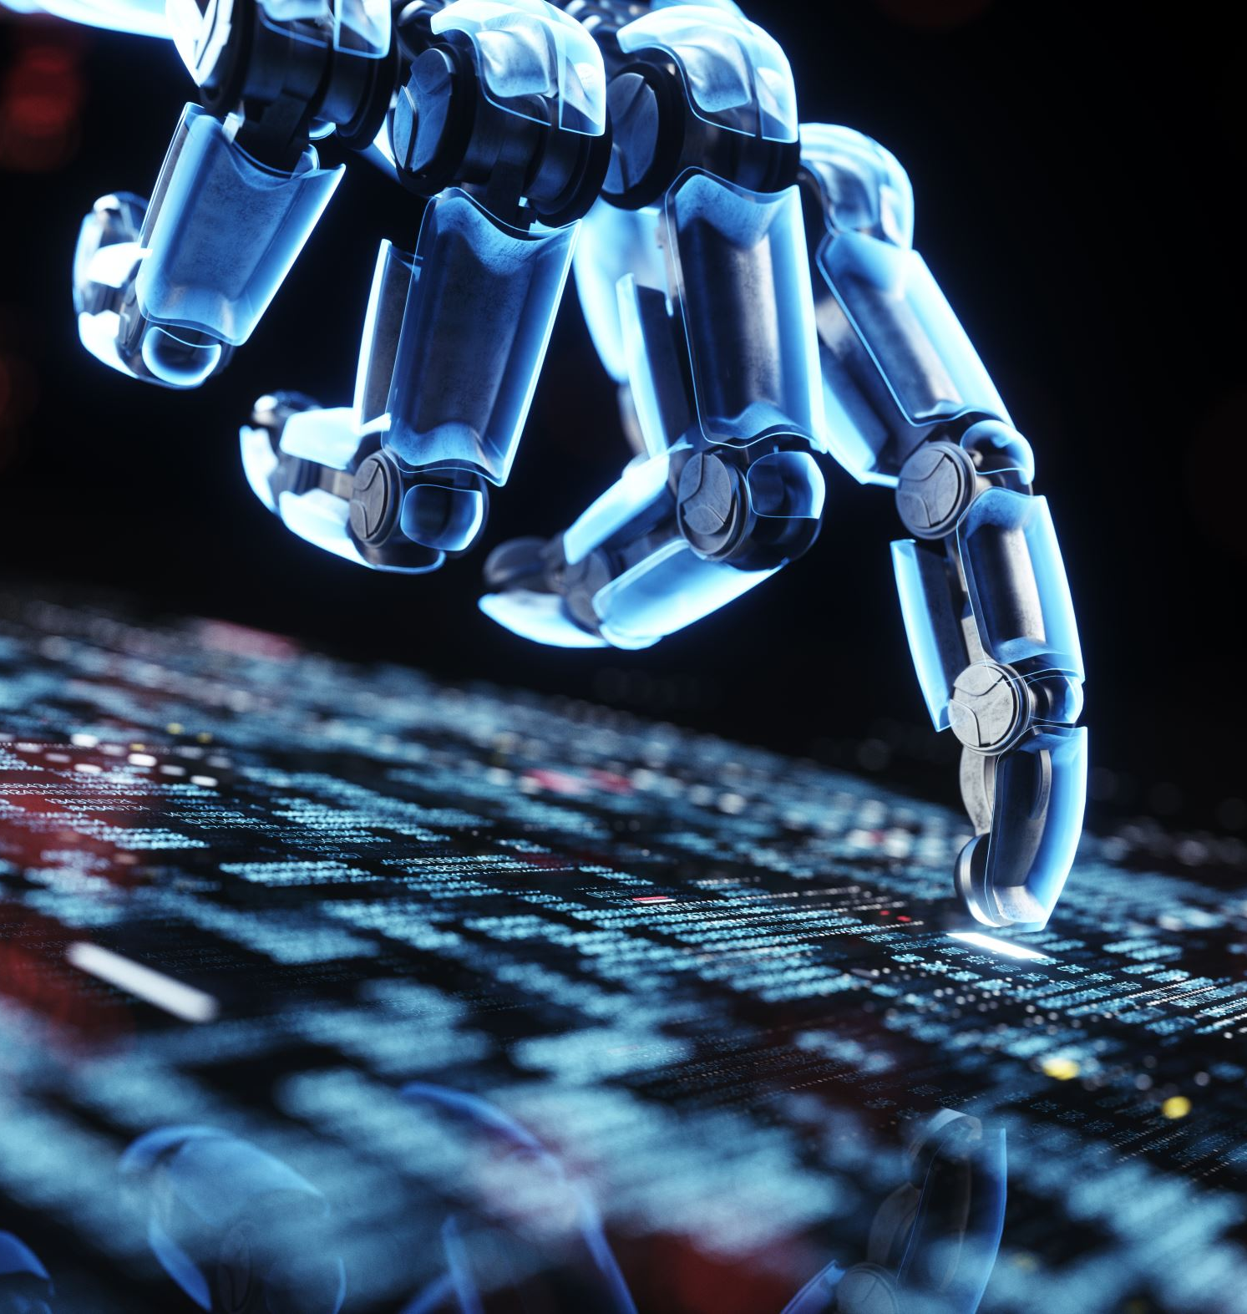
Outlook
AI is a technology that is on the verge of significant leaps…
New technologies always had a profound impacted on the way we live and work.
We can expect unprecedented gains in productivity from better narrow AI.
All technologies have the potential for misuse need to be regulated.

