Slide 1
The Impact of Information Sharing on Organ Transplantation:
A Simulation Model
Zahra Gharibi and Michael Hahsler
Department of Engineering Management, Information, and Systems
INFORMS Annual Meeting 2018
Phoenix, AZ

Slide 2
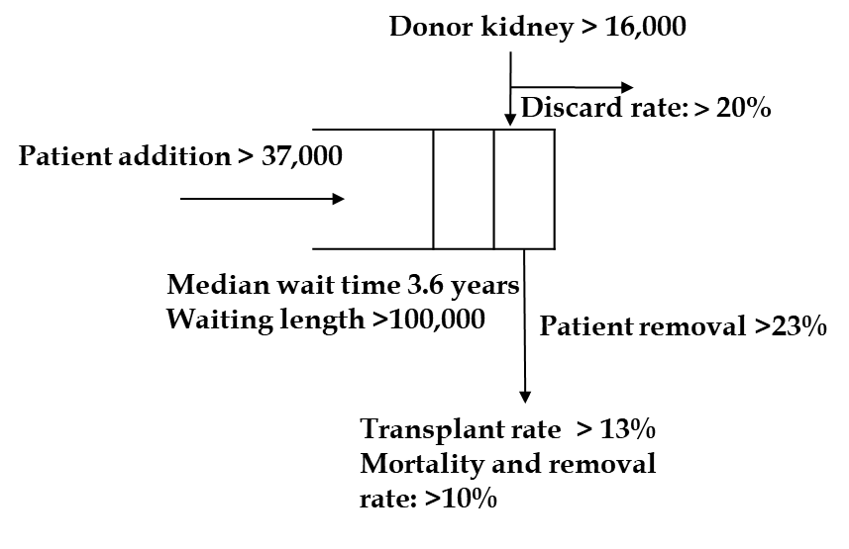
Motivation
Key Question:
Why Is The Kidney Discard Rate
in the US Greater Than 20 Percent?
Donor Kidneys are discarded because of
Medical concerns
Kidney allocation process
  Time to find patient (CIT)
  Early donor kidney rejection
  Conditions of Participation (CoP)
Data sources: United Network for Organ Sharing (UNOS)
Notes:
When comparing the number of donated and discarded kidneys with the number of patients who are added to the waiting list and number of transplantation, it becomes very clear that there is a serious shortage of kidneys. Each year more than 37000 patients are added to the waitlist while only around 16000 kidneys are donated which more than 20 percent of them are discard.
Despites a high demand for kidney transplantation, there is a serious shortage in the number of donated kidneys and more than 20% of the recoverd kidneys are discarded each year.
High discard rates among donated kidneys could have several reasons: the first reason is medical concerns such as biopsy finding which makes it very hard for kidney to be allocated. The second reason is CMS COP that has made transplant centers to be reluctant to accept marginal kidneys. Also CIT which is the time between harvesting and transplanting the organ can play an essential role in kidney functioning after transplantation. Long CIT could be the indication of inefficient kidney allocation process. Also studies show that early kidney rejection suspects patients with regard to the quality of the kidney and increased the kidney’s chance of getting discarded.
Generates a vbad reputation

Slide 3
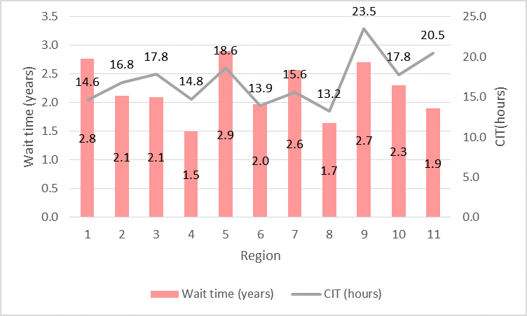
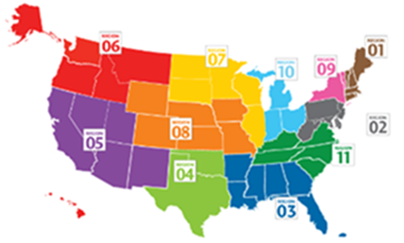
Motivation
Regional Differences in the US
Data sources: United Network for Organ Sharing (UNOS) and Scientific Registry of Transplant Recipients (SRTR)

Slide 4
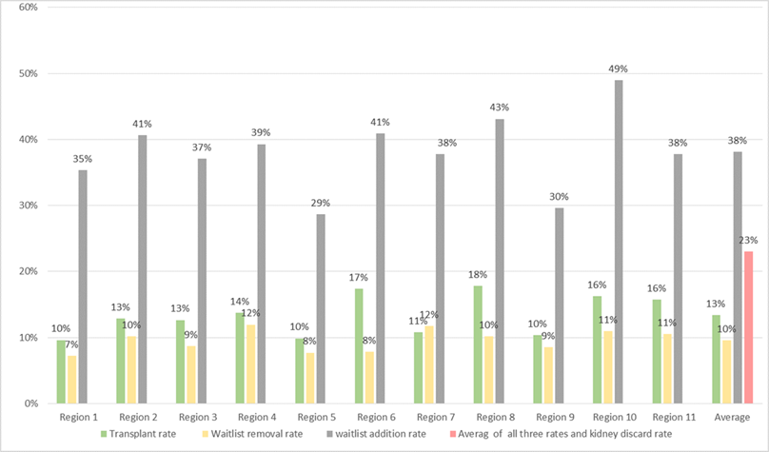
Motivation
Regional Differences in the US
Data sources: United Network for Organ Sharing (UNOS) and Scientific Registry of Transplant Recipients (SRTR) - 2015

Slide 5
Goal
Increase Donor Kidney Utilization
Decision maker (patient & surgeon):
  Reconsidering decision criteria for acceptance/rejection of donor kidney
  Listing decision (Multiple listing)
Social planner (OPTN & CMS):
  Changing kidney allocation system (KAS)
  Changes in Organ Procurement and Transplantation Network (OPTN; currently performed by UNOS) and CMS evaluation metrics
  Using information technology such as Unet to improve efficiency.
Information sharing
Notes:
Both social planner and patient can help to address the high kidney discard rate. social planner have made major changes in kidney assignment rules by introducing kas. Also they have changed the evaluation metrics that are used to evaluate tx centers outcomes. They also encourage tx centers to use technology for transplant and curranty they have unet network that allows transplant center to register candidates on the national waiting list, and submit their medical data. The social planner also document information about donor offers, when they become available and send them to transplant centers. This system allows for faster consideration of organ offers, which may result in using more organs and shorter cit.
And also to increase kidney utilization rate , patients can consider multiple listing option which allows patients to be enlisted in more than one transplant center. And if it is done in a correct way it can significantly reduce patients wait time as well as kidney CIT if it is done in a correct way. Currently Around 4\% of the patients are multiple listed.

Slide 6
Literature Review
  Kidney acceptance decision making
  Ahn and Hornberger (1996), Howard (2002), Alagoz et al. (2004)
  Allocation process and queueing models
  Zenios et al. (2000), Su and Zenios (2004), Su and Zenios (2005), Su and Zenios (2006)
  Simulation
  Ruth et al. (1985)
  Regional variations
  Bertsimas et al. (2013), Koizumi et al. (2015)

Slide 7
Method and Questions
  Simulation optimization model to evaluate the impact of information sharing on organ transplantation.
  Information sharing from OPTN to patient and surgeon.
    What is the optimal kidney acceptance policy depending on region?
    How to find the optimal region selection policy under a set of budget, distance and performance constraints?
  Information sharing from patient/surgeon with OPTN
    How does information sharing improve the efficiency of the kidney allocation system and enhance social welfare utility?
Notes:
I use simulation and integer programing model to find out an optimal region selection policy under budget, distance and performance constraints? And also I show the optimal kidney acceptance decision at any region. and finally I use the simulation model to show the impact of information sharing on improving kidney discard rate and social welfare utility.

Slide 8

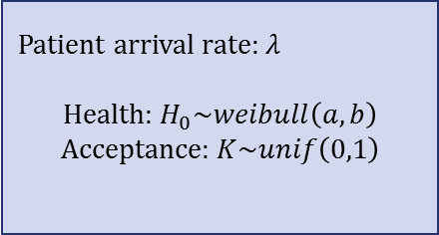
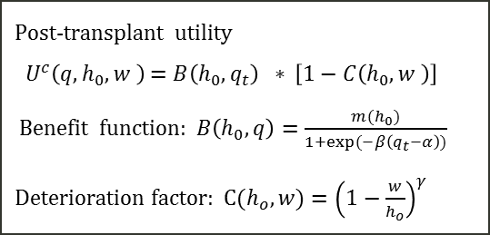
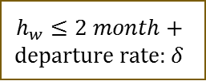
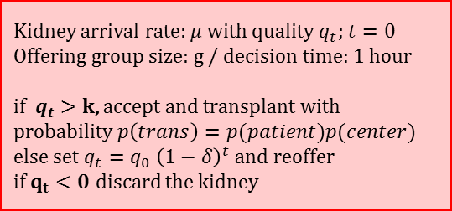
Simulation Model & Assumptions
Patient enrollment and arrival
Regional waiting list
Kidney allocation and acceptance
Patient arrival rate: $λ$
Health: $H_{0}\sim weibull\left(a,b\right)$
Acceptance: $K\sim unif\left(0,1\right)$
Kidney arrival rate: $μ$ with quality $q_{t};$ $t=0$
Offering group size: g / decision time: 1 hour
if $q_{t}>k$, accept and transplant with probability $p\left(trans\right)=p(patient)p(center)$
else set $q_{t}=q_{0} {\left(1−δ\right)}^{t}$and reoffer
if $q_{t}<0$ discard the kidney
g
Patient removal
$$h_{w}≤2 month+$$
departure rate: $δ$
Kidney transplant
Post-transplant utility
${ U}^{c}\left(q,h_{0},w \right)$ $=$ $B\left(h_{0},q_{t}\right)$ $∗$ $\left[1−C\left(h_{0},w \right)\right]$
Benefit function: $B\left(h_{0},q\right)=\frac{m(h_{0})}{1+exp⁡(−β\left(q_{t}−α\right))}$
Deterioration factor: $C(h_{o},w)={\left(1−\frac{w}{h_{o}}\right)}^{γ}$
Notes:
To capture so many real world sittion that happens in leindey allocation process and acceptance decsison.
In the basic allocation system, when a new donor kidney becomes available, its quality $q_0$ is assessed and
the kidney is simultaneously offered to a group of $g$ patients with a given window to decide. OPTN currently uses a group size of five and a time window of one hour.
At the time of offer, the kidney has accumulated CIT $t$ and the quality is reduced to $q_t$.
We model the decision by the patient and surgeon using a threshold strategy governed by
rejecting the offer if $q_t<k$, where $k$ is the set threshold. In case that the kidney meets the quality threshold (i.e, $q_t \ge k$),
the offer will only be accepted with probability $p(\text{trans})$.
This probability represents the fact that the patient or the surgeon may decide against the kidney for reasons
not explained by purely kidney quality. Examples are that the patient is currently not available or that
resources needed for the surgery cannot be provided in time.
If nobody in the group of $g$ patients is able to accept the kidney after the alloted time, then
the kidney is offered to the next group of $g$ patients on the waitlist. Over time,
the kidney deteriorates. We model this deterioration as $q_t = q_0 (1-\delta)^t$, where
$\delta$ is a deterioration factor and $t$ is
the accumulated CIT in hours.
For convenience, we measure time here as multiples of the time allowed for one round of offering.
If the patients have one hour to decide, then $t$ represents accumulated CIT in hours.
When $q_t$ becomes zero, then
the kidney needs to be discarded.
Patients choose their decision threshold $k$. The threshold is influenced by the patient's health $h_0$,
since a patient who has more time left on dialysis will be able to wait for a better quality kidney. We model
this relationship by choosing $k$ for each patient from a random variable
$K \sim \text{Unif(0,1)}$
which
is correlated to the patient's $h_0$ with Spearman's rank correlation coefficient $\rho_{H,K}$.
A patient's post-transplant utility depends on the quality of the transplanted kidney $q_t$, patient's health when she joins the wait list $h_0$, and the remaining time she waits for the transplant since she receives the first offer $w$.
We use
\begin{equation}\label{eq:Uc}
U(q_t, h_0, w) = B(h_0, q_t)\; D(h_0, w),
\end{equation}
where $B(h_0, q_t)$ is the patients utility if she receives a kidney with quality $q_t$ right after she
joins the waitlist without waiting. $D(\cdot)$ represents a cost in the form of degradation factor
due to waiting $w$ for the kidney.
$B(\cdot)$ can be defined in the form of a logistic regression for survival proposed by Cox \citep{survival_models}. %http://data.princeton.edu/wws509/notes/c7.pdf,
which models the conditional odds of dying at any time point given survival up to that point.
\begin{equation}\label{eq:Ub}
B(h_0, q_t) = \frac{m(h_0)}{1 + exp(-\beta(q_t - \alpha))},
\end{equation}
where $m(h_0)$ indicates the transplant outcome for a patient with health level $h_0$ who received a perfect kidney ($q_t = 1$) right after her first offer ($w = 0$).
Natural, $m(h_0)$ is increasing with $h_0$.
The benefit function therefore increases with patient's health $h_0$ and also kidney quality $q_0$, since $\frac{\partial B(h_0, q_t)}{\partial q_t} > 0$.
For patient's health deterioration factor we use
\begin{equation}\label{eq:uc}
D (h_0, w) = \left(1 -\frac{w}{h_0}\right)^\gamma.
\end{equation}
The deterioration factor in Equation~\ref{eq:uc} equals one when the wait time
is zero ($w = 0$). It emphasizes that by accepting the first offer, the patient terminates her health deterioration.
On the other hand, if the patient decides to wait for a very high-quality kidney, she cannot survive longer than $w=h_0$. In that case, equation~\ref{eq:uc} becomes zero. %which LSO means zero utility from receiving a kidney transplant.
In equation \ref{eq:uc}, $\gamma$
controls the rate of deterioration. For $\gamma = 1$ the deterioration is linear,
$\gamma > 1$ results in initially faster deterioration and for $\gamma < 1$
the deterioration is initially slower and then speeds up.

Slide 9
Method and Questions
  Simulation optimization model to evaluate the impact of information sharing on organ transplantation.
  Information sharing from OPTN to patient and surgeon.
    What is the optimal kidney acceptance policy depending on region?
    How to find the optimal region selection policy under a set of budget, distance and performance constraints?
  Information sharing from patient/surgeon with OPTN
    How does information sharing improve the efficiency of the kidney allocation system and enhance social welfare utility?
Notes:
I use simulation and integer programing model to find out an optimal region selection policy under budget, distance and performance constraints? And also I show the optimal kidney acceptance decision at any region. and finally I use the simulation model to show the impact of information sharing on improving kidney discard rate and social welfare utility.

Slide 10
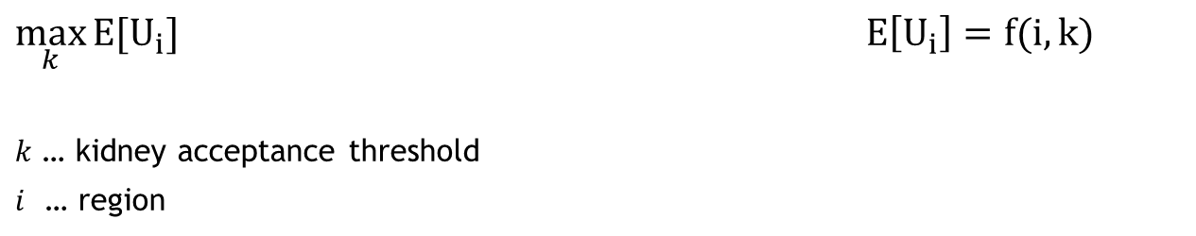
Optimal Kidney Acceptance Threshold
Simulation
$\max_{k}{E[U_{i}]}$ $E\left[U_{i}\right]=f(i,k)$
$k$ … kidney acceptance threshold
$i$ … region
Notes:
To assist the patient to identify a region to transfer to or identifying a set of regions for multiple-listing, we present a simple.
The objective function uses the maximum utility that a given patient can obtain by receiving transplant in different regions.
These utilities can be obtained through the simulation model. The simulation model is run for each region to find the the optimal kidney quality threshold that maximizes the patient's post-transplant utility
I maximize patient's post-transplant expected utility given constraints on distance $D$, budget $C$, and performance $P$. To formulate our multiple-listing problem, we define the binary variable $r_i$ which is equal to one if region $i \in I=\left \{ 1,2,..,11 \right \}$ is selected and 0 otherwise.
#The first constraint makes sure that the solution satisfies the total budget $C$ of individual patient on the evaluation, traveling and loading expenses.
#The second constraint considers the maximum distance $D$ the patient desires to travel.
#The third constraints consider patient's expectation from region's performance $P$ and finally the last constraint restricts the model to select only one region.
We execute the optimization iteratively. At each run, the model finds the region that maximizes patient's expected post-transplant utility under the given constraints represented as the only 1 entry in the decision vector $r$. After each optimization run, we remove the selected region and update the remaining budget as $C=C-\sum_{i \in I}c_ir^*_i$ to find the next region. The model returns no region when it fails to find any region that satisfies the patient's constraints. The generated optimal solution at each run forms a list that provides multiple-listing options to the patient in a descending order of post-transplant expected utility.

Slide 11
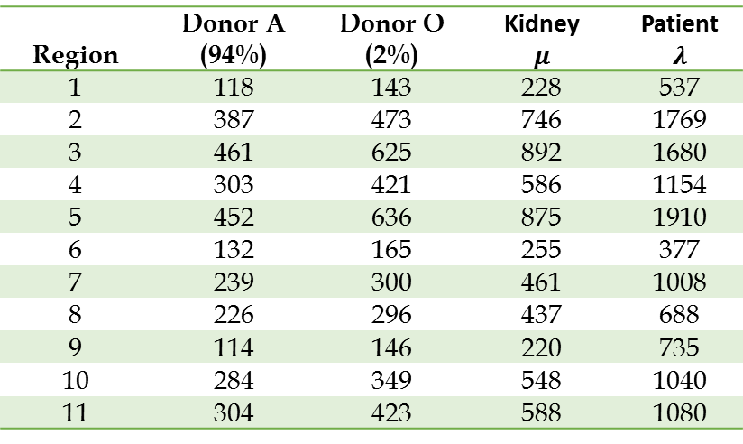
Estimation of Arrival Rates
Recipient with blood type A
Region | Donor A (94%) | Donor O (2%) | Kidney $$μ$$ | Patient $$λ$$
1 | 118 | 143 | 228 | 537
2 | 387 | 473 | 746 | 1769
3 | 461 | 625 | 892 | 1680
4 | 303 | 421 | 586 | 1154
5 | 452 | 636 | 875 | 1910
6 | 132 | 165 | 255 | 377
7 | 239 | 300 | 461 | 1008
8 | 226 | 296 | 437 | 688
9 | 114 | 146 | 220 | 735
10 | 284 | 349 | 548 | 1040
11 | 304 | 423 | 588 | 1080
Data sources: United Network for Organ Sharing (UNOS) and Scientific Registry of Transplant Recipients (SRTR)
Notes:
I usdes UNOS and SRTR data set to estimate model parameters and the numbers are based on year 2015 data for blood type A patients.

Slide 12
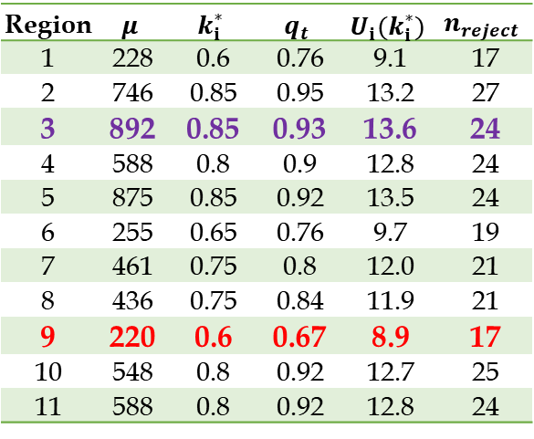

Optimal Kidney Acceptance Threshold by Region
Blood type | $$h_{o}$$ | $$a$$ | $$b$$ | $$θ$$ | $$α$$ | $$β$$ | $$γ$$ | $$t$$ | $$δ$$ | $$g$$ | $$P(trans)$$
$$A$$ | 1(yr) | $$8$$ | $$2$$ | $$5$$ | $$0.4$$ | $$8$$ | 0.5 | $1 (hr$) | $$0.05$$ | $$5$$ | $$0.8$$
Notes:
To find out the objective function coefficient for multi listing problem first, we perform the simulation for a target
patient with blood type A with a remaining one life-year on dialysis $h_0=1$. We fill
the waitlist with randomly generated patients and place the target patient at position $j=100$ in the wait list.
We perform the same simulation 100 times each for the
decision threshold values $k \in \{0, 0.1, 0.2, \cdots, 0.9\}$
and average the results of the 100 runs
In Table~\ref{pu} we report the results
for the best $k$ resulting in the largest average utility
for each region. Note that the reported wait time (in years) is very short, since it only includes
the time from when the patient already reached position $j=100$ in the wait list.
For instance, if the target patient is enrolled in region 6 a threshold of $k=0.65$ is optimal which leads to a utility of 9.6 years, whereas if she is enlisted in region 2 the optimal decision can be as high as 0.85 with a utility of 13.22 years.

Slide 13
Method and Questions
  Simulation optimization model to evaluate the impact of information sharing on organ transplantation.
  Information sharing from OPTN to patient and surgeon.
    What is the optimal kidney acceptance policy depending on region?
    How to find the optimal region selection policy under a set of budget, distance and performance constraints?
  Information sharing from patient/surgeon with OPTN
    How does information sharing improve the efficiency of the kidney allocation system and enhance social welfare utility?
Notes:
I use simulation and integer programing model to find out an optimal region selection policy under budget, distance and performance constraints? And also I show the optimal kidney acceptance decision at any region. and finally I use the simulation model to show the impact of information sharing on improving kidney discard rate and social welfare utility.

Slide 14
Optimal Decision Without Constraints
Blood type | $$h_{o}$$ | $$a$$ | $$b$$ | $$θ$$ | $$α$$ | $$β$$ | $$γ$$ | $$t$$ | $$δ$$ | $$g$$ | $$P(trans)$$
$$A$$ | 1(yr) | $$8$$ | $$2$$ | $$5$$ | $$0.4$$ | $$8$$ | 0.5 | $1 (hr$) | $$0.05$$ | $$5$$ | $$0.8$$
Notes:
To find out the objective function coefficient for multi listing problem first, we perform the simulation for a target
patient with blood type A with a remaining one life-year on dialysis $h_0=1$. We fill
the waitlist with randomly generated patients and place the target patient at position $j=100$ in the wait list.
We perform the same simulation 100 times each for the
decision threshold values $k \in \{0, 0.1, 0.2, \cdots, 0.9\}$
and average the results of the 100 runs
In Table~\ref{pu} we report the results
for the best $k$ resulting in the largest average utility
for each region. Note that the reported wait time (in years) is very short, since it only includes
the time from when the patient already reached position $j=100$ in the wait list.
For instance, if the target patient is enrolled in region 6 a threshold of $k=0.65$ is optimal which leads to a utility of 9.6 years, whereas if she is enlisted in region 2 the optimal decision can be as high as 0.85 with a utility of 13.22 years.

Slide 15
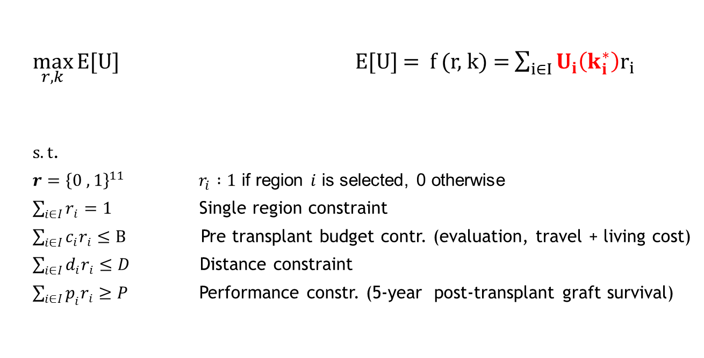
Region Selection
Simulation
$\max_{r,k}{E[U]}$ E[U] = f (r, k) = $\sum_{i∈I}{U_{i}\left(k_{i}^{∗}\right)r_{i}}$
$s.t$.
$r={\left\{0 ,1\right\}}^{11}$ $r_{i} :1$ if region $i$ is selected, 0 otherwise
$\sum_{i∈I}{r_{i}=1}$ Single region constraint
$\sum_{i∈I}{c_{i}r_{i}≤B }$Pre transplant budget contr. (evaluation, travel + living cost)
$\sum_{i∈I}{d_{i}r_{i}≤D}$ Distance constraint
$\sum_{i∈I}{p_{i}r_{i}≥P}$ Performance constr. (5-year post-transplant graft survival)
Notes:
To assist the patient to identify a region to transfer to or identifying a set of regions for multiple-listing, we present a simple.
The objective function uses the maximum utility that a given patient can obtain by receiving transplant in different regions.
These utilities can be obtained through the simulation model. The simulation model is run for each region to find the the optimal kidney quality threshold that maximizes the patient's post-transplant utility
I maximize patient's post-transplant expected utility given constraints on distance $D$, budget $C$, and performance $P$. To formulate our multiple-listing problem, we define the binary variable $r_i$ which is equal to one if region $i \in I=\left \{ 1,2,..,11 \right \}$ is selected and 0 otherwise.
#The first constraint makes sure that the solution satisfies the total budget $C$ of individual patient on the evaluation, traveling and loading expenses.
#The second constraint considers the maximum distance $D$ the patient desires to travel.
#The third constraints consider patient's expectation from region's performance $P$ and finally the last constraint restricts the model to select only one region.
We execute the optimization iteratively. At each run, the model finds the region that maximizes patient's expected post-transplant utility under the given constraints represented as the only 1 entry in the decision vector $r$. After each optimization run, we remove the selected region and update the remaining budget as $C=C-\sum_{i \in I}c_ir^*_i$ to find the next region. The model returns no region when it fails to find any region that satisfies the patient's constraints. The generated optimal solution at each run forms a list that provides multiple-listing options to the patient in a descending order of post-transplant expected utility.

Slide 16
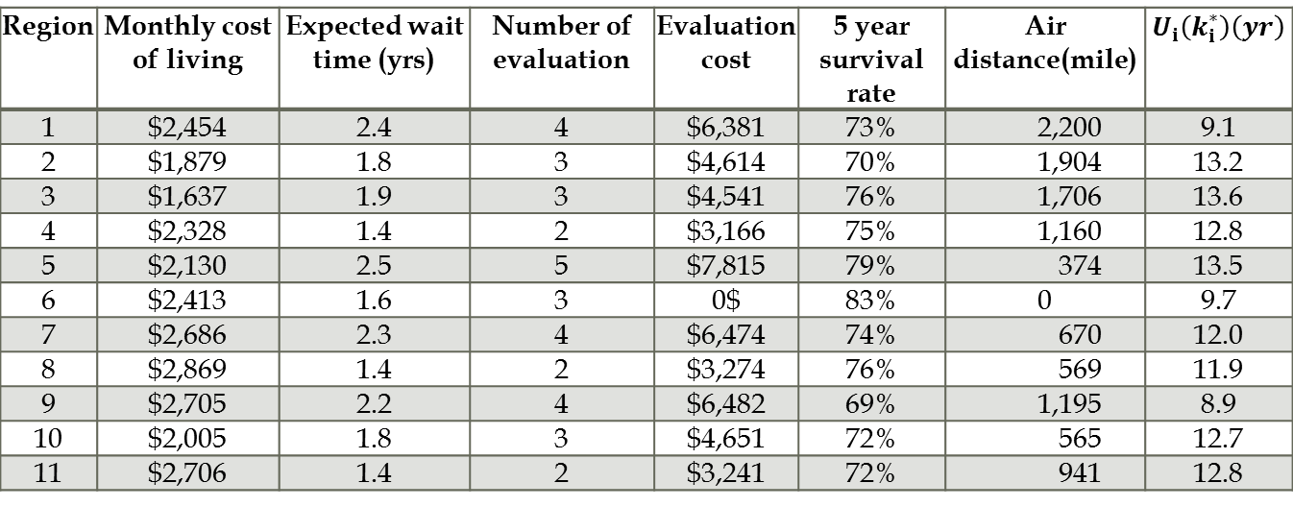
Region Selection
  Patient with blood type A living in Region 6
  Constraints: Budget <$15,000; Performance>75%, Distance <1,500 miles
Region | Monthly cost of living | Expected wait time (yrs) | Number of evaluation | Evaluation cost | 5 year survival rate | Air distance(mile) | $$U_{i}\left(k_{i}^{∗}\right)\left(yr\right)$$
1 | $2,454 | 2.4 | 4 | $6,381 | 73% | 2,200 | 9.1
2 | $1,879 | 1.8 | 3 | $4,614 | 70% | 1,904 | 13.2
3 | $1,637 | 1.9 | 3 | $4,541 | 76% | 1,706 | 13.6
4 | $2,328 | 1.4 | 2 | $3,166 | 75% | 1,160 | 12.8
5 | $2,130 | 2.5 | 5 | $7,815 | 79% | 374 | 13.5
6 | $2,413 | 1.6 | 3 | 0$ | 83% | 0 | 9.7
7 | $2,686 | 2.3 | 4 | $6,474 | 74% | 670 | 12.0
8 | $2,869 | 1.4 | 2 | $3,274 | 76% | 569 | 11.9
9 | $2,705 | 2.2 | 4 | $6,482 | 69% | 1,195 | 8.9
10 | $2,005 | 1.8 | 3 | $4,651 | 72% | 565 | 12.7
11 | $2,706 | 1.4 | 2 | $3,241 | 72% | 941 | 12.8
  Set of feasible regions : {R6, R5, R4, R8}
Notes:
To come up with a set of region to suggest patient for multiple listing

Slide 17
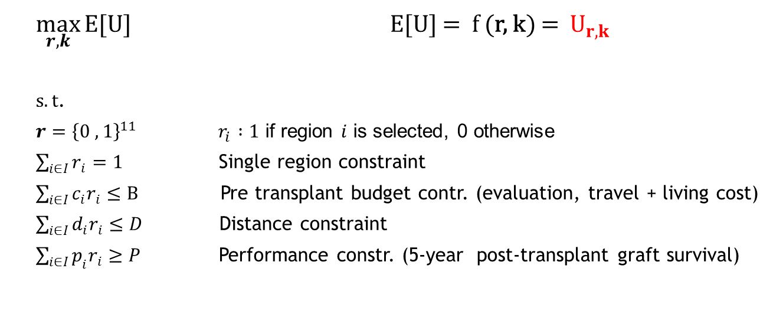
Proposed Approach for Multi-Listing
Simulation
$\max_{r,k}{E[U]}$ E[U] = f (r, k) =$U_{r,k}$
$s.t$.
$r={\left\{0 ,1\right\}}^{11}$ $r_{i} :1$ if region $i$ is selected, 0 otherwise
$\sum_{i∈I}{r_{i}=1}$ Single region constraint
$\sum_{i∈I}{c_{i}r_{i}≤B }$Pre transplant budget contr. (evaluation, travel + living cost)
$\sum_{i∈I}{d_{i}r_{i}≤D}$ Distance constraint
$\sum_{i∈I}{p_{i}r_{i}≥P}$ Performance constr. (5-year post-transplant graft survival)
Notes:
To assist the patient to identify a region to transfer to or identifying a set of regions for multiple-listing, we present a simple.
The objective function uses the maximum utility that a given patient can obtain by receiving transplant in different regions.
These utilities can be obtained through the simulation model. The simulation model is run for each region to find the the optimal kidney quality threshold that maximizes the patient's post-transplant utility
I maximize patient's post-transplant expected utility given constraints on distance $D$, budget $C$, and performance $P$. To formulate our multiple-listing problem, we define the binary variable $r_i$ which is equal to one if region $i \in I=\left \{ 1,2,..,11 \right \}$ is selected and 0 otherwise.
#The first constraint makes sure that the solution satisfies the total budget $C$ of individual patient on the evaluation, traveling and loading expenses.
#The second constraint considers the maximum distance $D$ the patient desires to travel.
#The third constraints consider patient's expectation from region's performance $P$ and finally the last constraint restricts the model to select only one region.
We execute the optimization iteratively. At each run, the model finds the region that maximizes patient's expected post-transplant utility under the given constraints represented as the only 1 entry in the decision vector $r$. After each optimization run, we remove the selected region and update the remaining budget as $C=C-\sum_{i \in I}c_ir^*_i$ to find the next region. The model returns no region when it fails to find any region that satisfies the patient's constraints. The generated optimal solution at each run forms a list that provides multiple-listing options to the patient in a descending order of post-transplant expected utility.

Slide 18
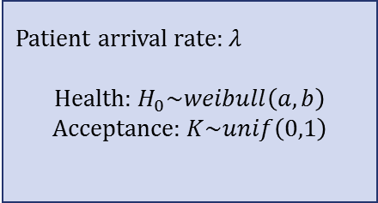


Simulation Model for Multi-Listing
11 regional servers
Patient enrollment and arrival
national waitinglist
Kidney allocation and acceptance
region waiting list
Patient arrival rate: $λ$
Health: $H_{0}\sim weibull\left(a,b\right)$
Acceptance: $K\sim unif\left(0,1\right)$
Kidney arrival rate: $μ$ with quality $q_{t};$ $t=0$
Offering group size: g / decision time: 1 hour
if $q_{t}>k$, accept and transplant with probability $p\left(trans\right)=p(patient)p(center)$
else set $q_{t}=q_{0} {\left(1−δ\right)}^{t}$and reoffer
if $q_{t}<0$ discard the kidney
g
Add region labels
Patient removal
$$h_{w}≤2 month+$$
departure rate: $δ$
Kidney transplant
Post-transplant utility
${ U}^{c}\left(q,h_{0},w \right)$ $=$ $B\left(h_{0},q_{t}\right)$ $∗$ $\left[1−C\left(h_{0},w \right)\right]$
Benefit function: $B\left(h_{0},q\right)=\frac{m(h_{0})}{1+exp⁡(−β\left(q_{t}−α\right))}$
Deterioration factor: $C(h_{o},w)={\left(1−\frac{w}{h_{o}}\right)}^{γ}$
Repeat simulation for all combinations of the feasible regions.
Notes:
To capture so many real world sittion that happens in leindey allocation process and acceptance decsison.
In the basic allocation system, when a new donor kidney becomes available, its quality $q_0$ is assessed and
the kidney is simultaneously offered to a group of $g$ patients with a given window to decide. OPTN currently uses a group size of five and a time window of one hour.
At the time of offer, the kidney has accumulated CIT $t$ and the quality is reduced to $q_t$.
We model the decision by the patient and surgeon using a threshold strategy governed by
rejecting the offer if $q_t<k$, where $k$ is the set threshold. In case that the kidney meets the quality threshold (i.e, $q_t \ge k$),
the offer will only be accepted with probability $p(\text{trans})$.
This probability represents the fact that the patient or the surgeon may decide against the kidney for reasons
not explained by purely kidney quality. Examples are that the patient is currently not available or that
resources needed for the surgery cannot be provided in time.
If nobody in the group of $g$ patients is able to accept the kidney after the alloted time, then
the kidney is offered to the next group of $g$ patients on the waitlist. Over time,
the kidney deteriorates. We model this deterioration as $q_t = q_0 (1-\delta)^t$, where
$\delta$ is a deterioration factor and $t$ is
the accumulated CIT in hours.
For convenience, we measure time here as multiples of the time allowed for one round of offering.
If the patients have one hour to decide, then $t$ represents accumulated CIT in hours.
When $q_t$ becomes zero, then
the kidney needs to be discarded.
Patients choose their decision threshold $k$. The threshold is influenced by the patient's health $h_0$,
since a patient who has more time left on dialysis will be able to wait for a better quality kidney. We model
this relationship by choosing $k$ for each patient from a random variable
$K \sim \text{Unif(0,1)}$
which
is correlated to the patient's $h_0$ with Spearman's rank correlation coefficient $\rho_{H,K}$.
A patient's post-transplant utility depends on the quality of the transplanted kidney $q_t$, patient's health when she joins the wait list $h_0$, and the remaining time she waits for the transplant since she receives the first offer $w$.
We use
\begin{equation}\label{eq:Uc}
U(q_t, h_0, w) = B(h_0, q_t)\; D(h_0, w),
\end{equation}
where $B(h_0, q_t)$ is the patients utility if she receives a kidney with quality $q_t$ right after she
joins the waitlist without waiting. $D(\cdot)$ represents a cost in the form of degradation factor
due to waiting $w$ for the kidney.
$B(\cdot)$ can be defined in the form of a logistic regression for survival proposed by Cox \citep{survival_models}. %http://data.princeton.edu/wws509/notes/c7.pdf,
which models the conditional odds of dying at any time point given survival up to that point.
\begin{equation}\label{eq:Ub}
B(h_0, q_t) = \frac{m(h_0)}{1 + exp(-\beta(q_t - \alpha))},
\end{equation}
where $m(h_0)$ indicates the transplant outcome for a patient with health level $h_0$ who received a perfect kidney ($q_t = 1$) right after her first offer ($w = 0$).
Natural, $m(h_0)$ is increasing with $h_0$.
The benefit function therefore increases with patient's health $h_0$ and also kidney quality $q_0$, since $\frac{\partial B(h_0, q_t)}{\partial q_t} > 0$.
For patient's health deterioration factor we use
\begin{equation}\label{eq:uc}
D (h_0, w) = \left(1 -\frac{w}{h_0}\right)^\gamma.
\end{equation}
The deterioration factor in Equation~\ref{eq:uc} equals one when the wait time
is zero ($w = 0$). It emphasizes that by accepting the first offer, the patient terminates her health deterioration.
On the other hand, if the patient decides to wait for a very high-quality kidney, she cannot survive longer than $w=h_0$. In that case, equation~\ref{eq:uc} becomes zero. %which LSO means zero utility from receiving a kidney transplant.
In equation \ref{eq:uc}, $\gamma$
controls the rate of deterioration. For $\gamma = 1$ the deterioration is linear,
$\gamma > 1$ results in initially faster deterioration and for $\gamma < 1$
the deterioration is initially slower and then speeds up.

Slide 19
Method and Questions
  Simulation optimization model to evaluate the impact of information sharing on organ transplantation.
  Information sharing from OPTN to patient and surgeon.
    What is the optimal kidney acceptance policy depending on region?
    How to find the optimal region selection policy under a set of budget, distance and performance constraints?
  Information sharing from patient/surgeon with OPTN
    How does information sharing improve the efficiency of the kidney allocation system and enhance social welfare utility?
Notes:
I use simulation and integer programing model to find out an optimal region selection policy under budget, distance and performance constraints? And also I show the optimal kidney acceptance decision at any region. and finally I use the simulation model to show the impact of information sharing on improving kidney discard rate and social welfare utility.

Slide 20
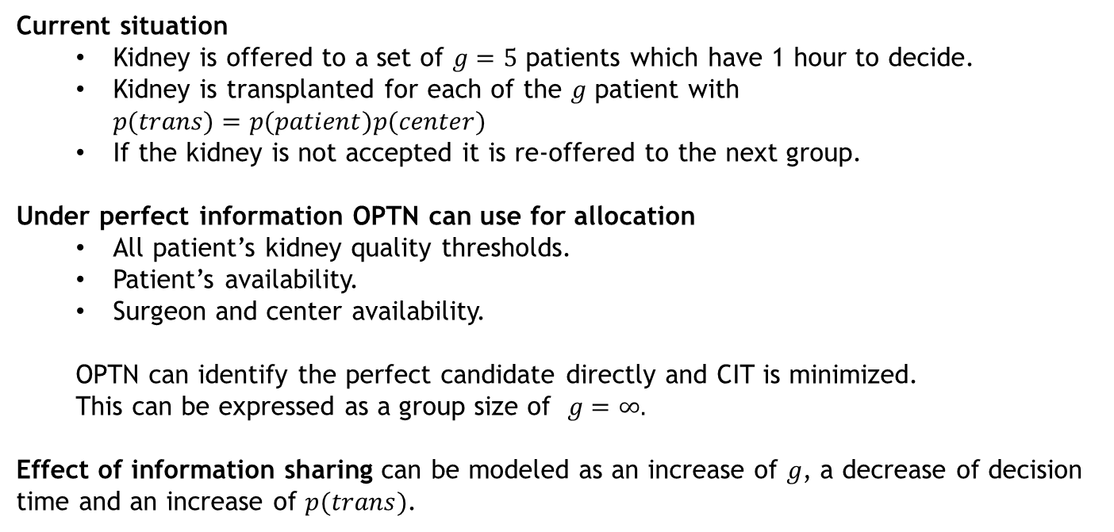
The Effect of Information Sharing on Patient Transplant Outcomes
Current situation
  Kidney is offered to a set of $g=5$ patients which have 1 hour to decide.
  Kidney is transplanted for each of the $g$ patient with $p(trans)=p(patient)p(center)$
  If the kidney is not accepted it is re-offered to the next group.
Under perfect information OPTN can use for allocation
  All patient’s kidney quality thresholds.
  Patient’s availability.
  Surgeon and center availability.
  OPTN can identify the perfect candidate directly and CIT is minimized.
  This can be expressed as a group size of $g=∞.$
Effect of information sharing can be modeled as an increase of $g$, a decrease of decision time and an increase of $p(trans)$.
Notes:
I show the impact of information sharing expressed in the form of group size, which reflects how many patients on the waitlist can effectively be considered per hour. At the baseline group size of five, the average quality of accepted kidney is 0.66 which leads to receiving the average utility of 10.76 years per transplanted patient. The kidney can travel as far as 45 patients on the waitlist and is accepted on average by the 6th patient who waited 3.84 years. Table~\ref{rate} presents kidney utilization and waitlist mortality rate in addition to the transplant rate. The kidney utilization rate increases significantly as the group size of patients expands.
Due to information sharing, kidney can be allocated more efficiently. In
the simulation this is represented by an increase of the offer group
size g, i.e., the number of candidates that can be considered per hour.
More efficient kidney allocation can reduce CIT and as a result has a
positive effect on the utility of accepted kidneys, and also reduces the
discard rate. The simulation results show that an increase in g also
increases the number of performed transplantations and in turn increases
the overall utility for the whole system. We observe a decrease in the
average utility per transplant, however, this does not mean that patient
are now worse off. It merely reflects that we now can also utilize
lower-quality kidneys and average over a larger number of lower-utility
patients who were not able to receive a transplant before.

Slide 21
Simulation Model for Information Sharing
Patient enrollment and arrival
region waiting list
Kidney allocation and acceptance
Patient arrival rate: $λ$
Health: $H_{0}\sim weibull\left(a,b\right)$
Acceptance: $K\sim unif\left(0,1\right)$
Kidney arrival rate: $μ$ with quality $q_{t};$ $t=0$
Offering group size: g / decision time: 1 hour
if $q_{t}>k$, accept and transplant with probability $p\left(trans\right)=p(patient)p(center)$
else set $q_{t}=q_{0} {\left(1−δ\right)}^{t}$and reoffer
if $q_{t}<0$ discard the kidney
Modify group size g or decision time
g
increases
Patient removal
$$h_{w}≤2 month+$$
departure rate: $δ$
Kidney transplant
Post-transplant utility
${ U}^{c}\left(q,h_{0},w \right)$ $=$ $B\left(h_{0},q_{t}\right)$ $∗$ $\left[1−C\left(h_{0},w \right)\right]$
Benefit function: $B\left(h_{0},q\right)=\frac{m(h_{0})}{1+exp⁡(−β\left(q_{t}−α\right))}$
Deterioration factor: $C(h_{o},w)={\left(1−\frac{w}{h_{o}}\right)}^{γ}$
Notes:
In the basic allocation system, when a new donor kidney becomes available, its quality $q_0$ is assessed and
the kidney is simultaneously offered to a group of $g$ patients with a given window to decide. OPTN currently uses a group size of five and a time window of one hour.
At the time of offer, the kidney has accumulated CIT $t$ and the quality is reduced to $q_t$.
We model the decision by the patient and surgeon using a threshold strategy governed by
rejecting the offer if $q_t<k$, where $k$ is the set threshold. In case that the kidney meets the quality threshold (i.e, $q_t \ge k$),
the offer will only be accepted with probability $p(\text{trans})$.
This probability represents the fact that the patient or the surgeon may decide against the kidney for reasons
not explained by purely kidney quality. Examples are that the patient is currently not available or that
resources needed for the surgery cannot be provided in time.
If nobody in the group of $g$ patients is able to accept the kidney after the alloted time, then
the kidney is offered to the next group of $g$ patients on the waitlist. Over time,
the kidney deteriorates. We model this deterioration as $q_t = q_0 (1-\delta)^t$, where
$\delta$ is a deterioration factor and $t$ is
the accumulated CIT in hours.
For convenience, we measure time here as multiples of the time allowed for one round of offering.
If the patients have one hour to decide, then $t$ represents accumulated CIT in hours.
When $q_t$ becomes zero, then
the kidney needs to be discarded.
Patients choose their decision threshold $k$. The threshold is influenced by the patient's health $h_0$,
since a patient who has more time left on dialysis will be able to wait for a better quality kidney. We model
this relationship by choosing $k$ for each patient from a random variable
$K \sim \text{Unif(0,1)}$
which
is correlated to the patient's $h_0$ with Spearman's rank correlation coefficient $\rho_{H,K}$.
A patient's post-transplant utility depends on the quality of the transplanted kidney $q_t$, patient's health when she joins the wait list $h_0$, and the remaining time she waits for the transplant since she receives the first offer $w$.
We use
\begin{equation}\label{eq:Uc}
U(q_t, h_0, w) = B(h_0, q_t)\; D(h_0, w),
\end{equation}
where $B(h_0, q_t)$ is the patients utility if she receives a kidney with quality $q_t$ right after she
joins the waitlist without waiting. $D(\cdot)$ represents a cost in the form of degradation factor
due to waiting $w$ for the kidney.
$B(\cdot)$ can be defined in the form of a logistic regression for survival proposed by Cox \citep{survival_models}. %http://data.princeton.edu/wws509/notes/c7.pdf,
which models the conditional odds of dying at any time point given survival up to that point.
\begin{equation}\label{eq:Ub}
B(h_0, q_t) = \frac{m(h_0)}{1 + exp(-\beta(q_t - \alpha))},
\end{equation}
where $m(h_0)$ indicates the transplant outcome for a patient with health level $h_0$ who received a perfect kidney ($q_t = 1$) right after her first offer ($w = 0$).
Natural, $m(h_0)$ is increasing with $h_0$.
The benefit function therefore increases with patient's health $h_0$ and also kidney quality $q_0$, since $\frac{\partial B(h_0, q_t)}{\partial q_t} > 0$.
For patient's health deterioration factor we use
\begin{equation}\label{eq:uc}
D (h_0, w) = \left(1 -\frac{w}{h_0}\right)^\gamma.
\end{equation}
The deterioration factor in Equation~\ref{eq:uc} equals one when the wait time
is zero ($w = 0$). It emphasizes that by accepting the first offer, the patient terminates her health deterioration.
On the other hand, if the patient decides to wait for a very high-quality kidney, she cannot survive longer than $w=h_0$. In that case, equation~\ref{eq:uc} becomes zero. %which LSO means zero utility from receiving a kidney transplant.
In equation \ref{eq:uc}, $\gamma$
controls the rate of deterioration. For $\gamma = 1$ the deterioration is linear,
$\gamma > 1$ results in initially faster deterioration and for $\gamma < 1$
the deterioration is initially slower and then speeds up.

Slide 22
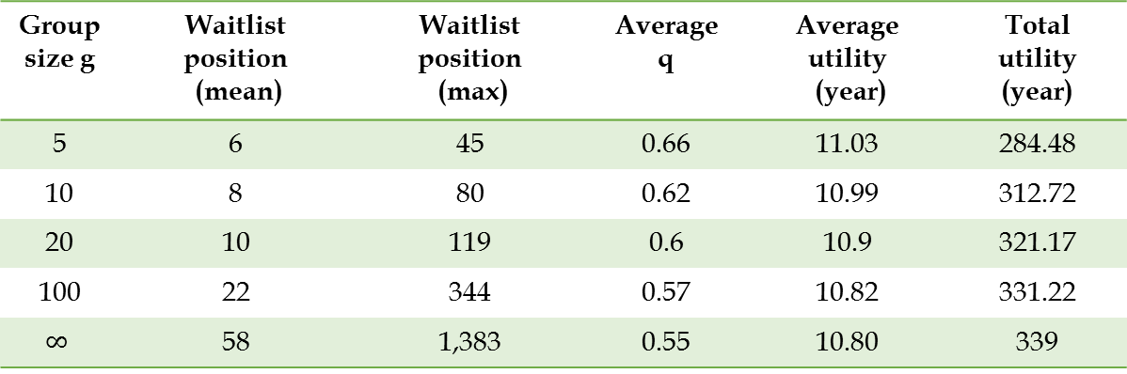
The Effect of Information Sharing on Patient Post Transplant Utility Based on Region 6 Kidneys Supply and Demands
Group size g | Waitlist position (mean) | Waitlist position (max) | Average q | Average utility (year) | Total utility (year)
5 | 6 | 45 | 0.66 | 11.03 | 284.48
10 | 8 | 80 | 0.62 | 10.99 | 312.72
20 | 10 | 119 | 0.6 | 10.9 | 321.17
100 | 22 | 344 | 0.57 | 10.82 | 331.22
$$∞$$ | 58 | 1,383 | 0.55 | 10.80 | 339

Slide 23
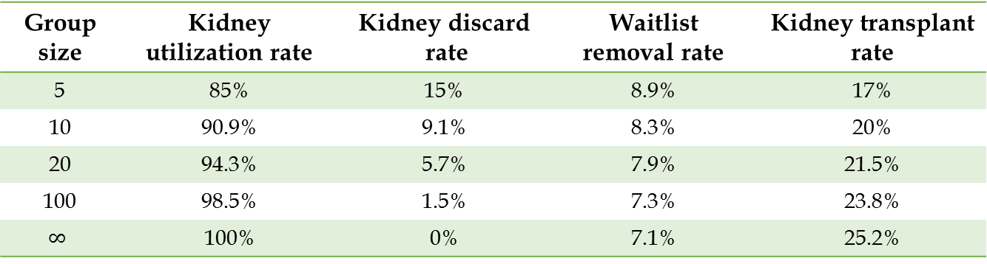
Kidney Utilization, Waitlist Removal, and Kidney Transplant Rates In Region 6
Group size | Kidney utilization rate | Kidney discard rate | Waitlist removal rate | Kidney transplant rate
5 | 85% | 15% | 8.9% | 17%
10 | 90.9% | 9.1% | 8.3% | 20%
20 | 94.3% | 5.7% | 7.9% | 21.5%
100 | 98.5% | 1.5% | 7.3% | 23.8%
$$∞$$ | 100% | 0% | 7.1% | 25.2%
-39%
Notes:
As Figure \ref{fig:imp} demonstrates, the minimum improvement in the kidney transplant rate is 17\% which can be obtained by slightly expanding patient's search group size, and it reaches to 47\% when the use of information is perfect. On the other hand, the waitlist mortality rate decreases by 7\% when the group size is 10, and the reduction can be as high as 21\%.

Slide 24
Concluding Remarks
High organ discard rates are a known problem.
UNOS encourages the development of modern technology such as mobile devices to facilitate organ allocation.
The presented simulation model shows what the impact of different information strategies are.
Challenge: Incentive system for information sharing.

Slide 25
Questions?
Contact Information
Michael Hahsler
mhahsler@lyle.smu.edu

Slide 26
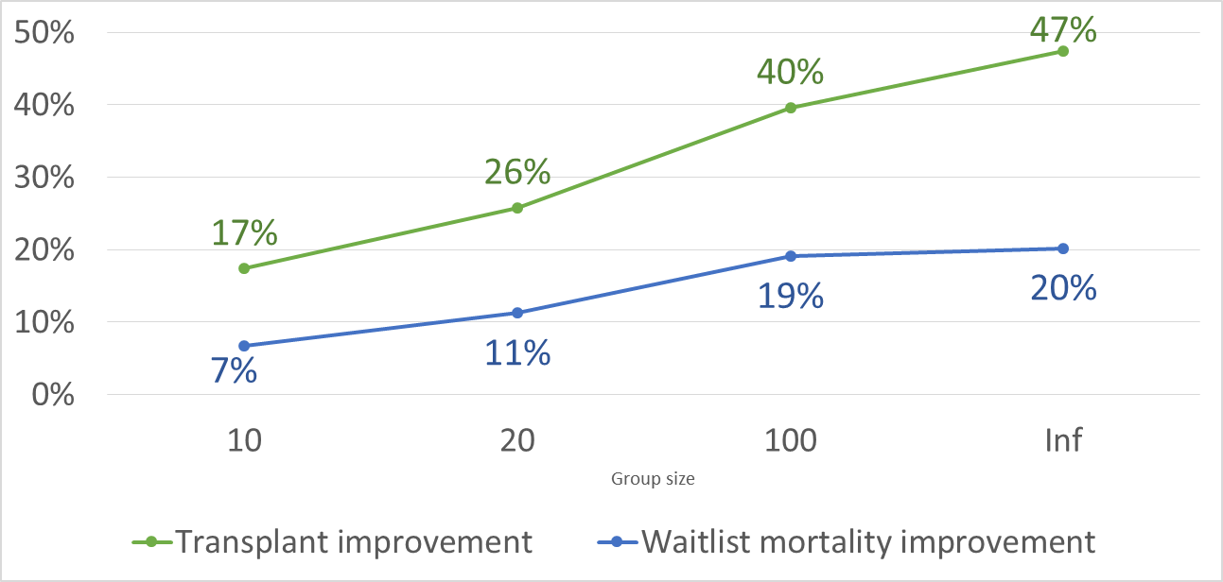
Kidney Transplant and Waitlist Mortality Rates Improvement

Slide 27

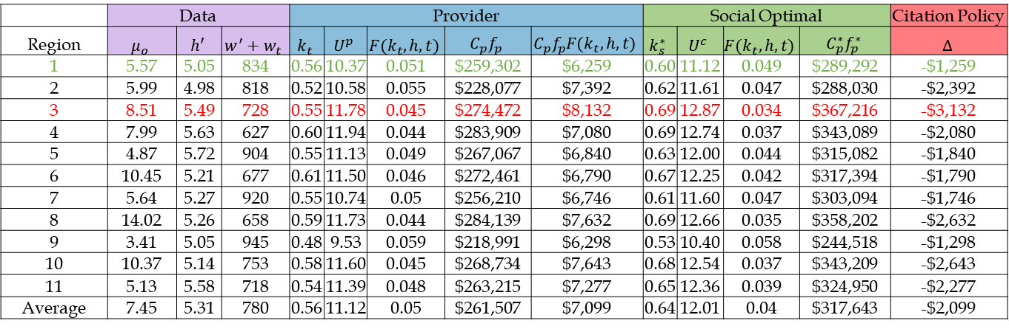
Optimal Citation Policy
 | Data |  |  | Provider |  |  |  |  | Social Optimal |  |  |  | Citation Policy
Region | $$μ_{o}$$ | $$h′$$ | $$w^{′}+w_{t}$$ | $$k_{t}$$ | $$U^{p}$$ | $$F(k_{t},h,t)$$ | $$C_{p}f_{p}$$ | $$C_{p}f_{p}F(k_{t},h,t)$$ | $$k_{s}^{∗}$$ | $$U^{c}$$ | $$F(k_{t},h,t)$$ | $$C_{p}^{∗}f_{p}^{∗}$$ | $$Δ$$
1 | 5.57 | 5.05 | 834 | 0.56 | 10.37 | 0.051 | $259,302 | $6,259 | 0.60 | 11.12 | 0.049 | $289,292 | -$1,259
2 | 5.99 | 4.98 | 818 | 0.52 | 10.58 | 0.055 | $228,077 | $7,392 | 0.62 | 11.61 | 0.047 | $288,030 | -$2,392
3 | 8.51 | 5.49 | 728 | 0.55 | 11.78 | 0.045 | $274,472 | $8,132 | 0.69 | 12.87 | 0.034 | $367,216 | -$3,132
4 | 7.99 | 5.63 | 627 | 0.60 | 11.94 | 0.044 | $283,909 | $7,080 | 0.69 | 12.74 | 0.037 | $343,089 | -$2,080
5 | 4.87 | 5.72 | 904 | 0.55 | 11.13 | 0.049 | $267,067 | $6,840 | 0.63 | 12.00 | 0.044 | $315,082 | -$1,840
6 | 10.45 | 5.21 | 677 | 0.61 | 11.50 | 0.046 | $272,461 | $6,790 | 0.67 | 12.25 | 0.042 | $317,394 | -$1,790
7 | 5.64 | 5.27 | 920 | 0.55 | 10.74 | 0.05 | $256,210 | $6,746 | 0.61 | 11.60 | 0.047 | $303,094 | -$1,746
8 | 14.02 | 5.26 | 658 | 0.59 | 11.73 | 0.044 | $284,139 | $7,632 | 0.69 | 12.66 | 0.035 | $358,202 | -$2,632
9 | 3.41 | 5.05 | 945 | 0.48 | 9.53 | 0.059 | $218,991 | $6,298 | 0.53 | 10.40 | 0.058 | $244,518 | -$1,298
10 | 10.37 | 5.14 | 753 | 0.58 | 11.60 | 0.045 | $268,734 | $7,643 | 0.68 | 12.54 | 0.037 | $343,209 | -$2,643
11 | 5.13 | 5.58 | 718 | 0.54 | 11.39 | 0.048 | $263,215 | $7,277 | 0.65 | 12.36 | 0.039 | $324,950 | -$2,277
Average | 7.45 | 5.31 | 780 | 0.56 | 11.12 | 0.05 | $261,507 | $7,099 | 0.64 | 12.01 | 0.04 | $317,643 | -$2,099

Slide 28
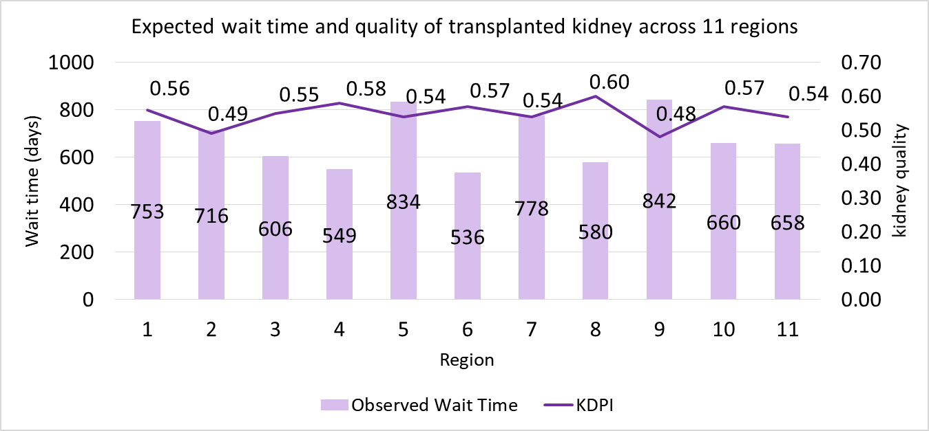

Slide 29
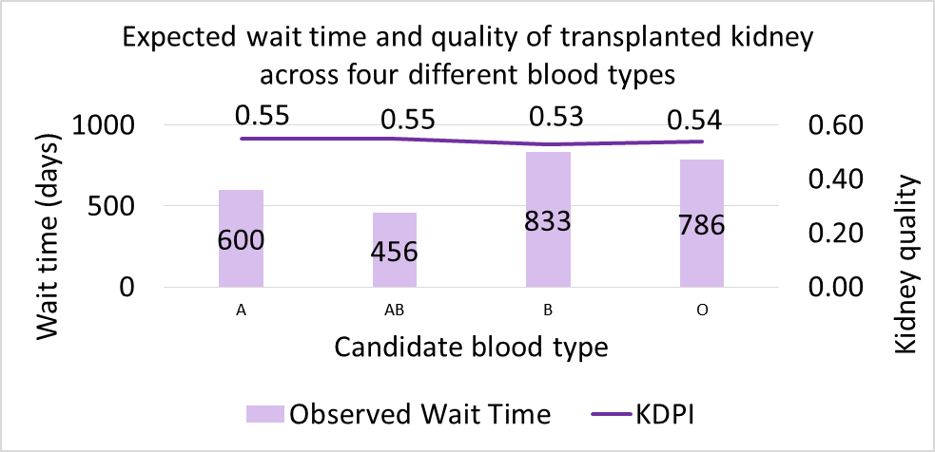

Slide 31
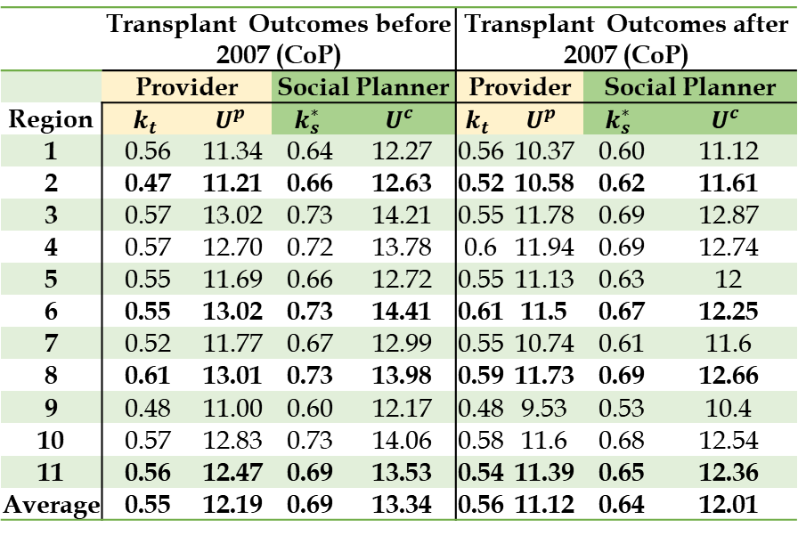

Slide 32
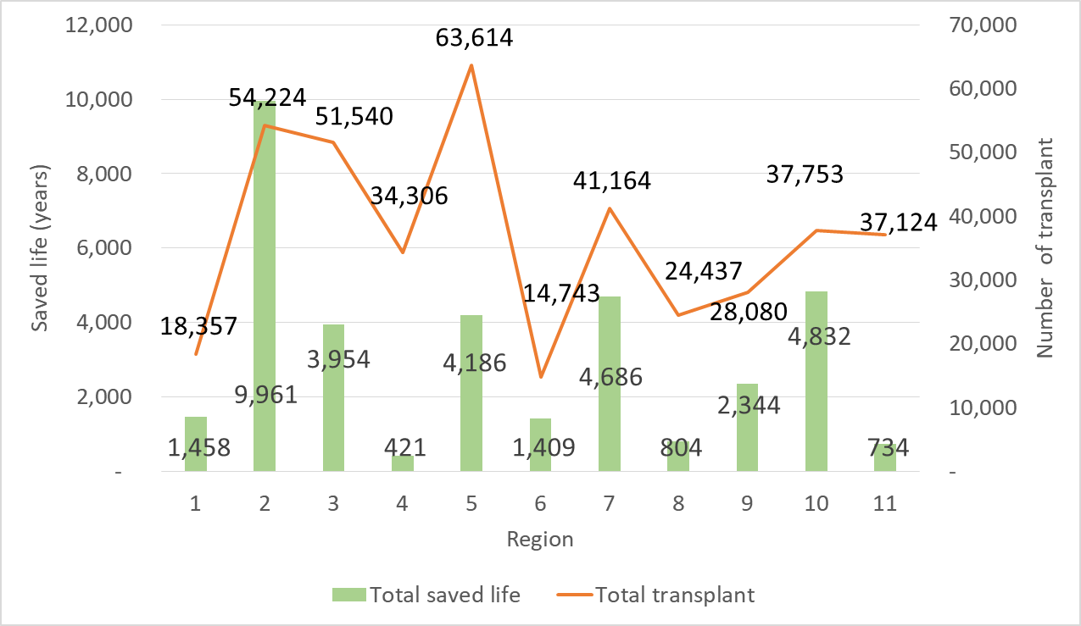

Slide 33
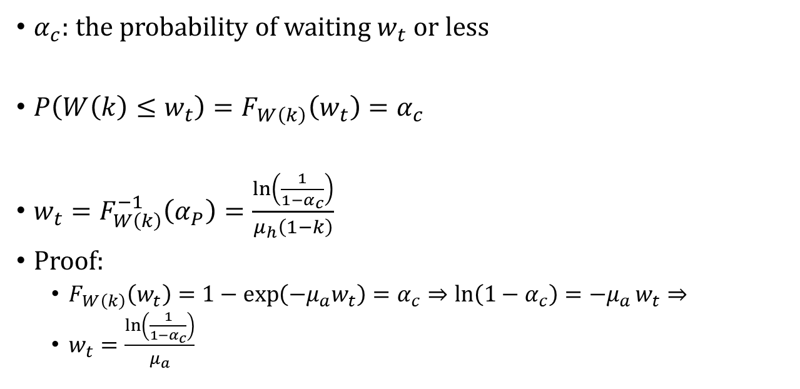
$α_{c}:$ the probability of waiting $w_{t}$ or less
$P\left(W\left(k\right)≤w_{t}\right)=F_{W\left(k\right)}\left(w_{t}\right)=α_{c}$
$w_{t}=F_{W\left(k\right)}^{−1}\left(α_{P}\right)=\frac{\ln\left(\frac{1}{1−α_{c}}\right)}{μ_{h}\left(1−k\right)}$
Proof:
  $F_{W\left(k\right)}\left(w_{t}\right)=1−\exp\left(−μ_{a}w_{t}\right)=α_{c}⇒\ln\left(1−α_{c}\right)=−μ_{a}w_{t}⇒$
  $w_{t}=\frac{\ln\left(\frac{1}{1−α_{c}}\right)}{μ_{a}}$

