Slide 1
Load Balancing
Martin Haiden & Nikolaus Schrack

Slide 2
Need and Goals
Scalability
Availability
Performance
Manageability
Security
Costs
Fusnote fehlt
Notes:
scaling: capcity, to grow with the popularity of the business, old days-> bigger better server, now -> many
availability: if one server fails, the others can manage the traffic. -> keeping the site up (reputation,functionality of the company, e-commerce -> money loss) , to have redundancy.
performance: How fast is my application, again money loss, angry customers
manageability: how difficult operate the system, updates , to maintain and update, finding and understanding problems, health checks
security: since the Load Balancer is front end, easy point to protect from malicious users., security features

Slide 3
Products
Software Load Balancing
Appliances
Switches
Notes:
Software: on different levels of the application, runs on load balancers, algorithms to coordinate traffic, FE: nginx, mod_proxy which is a popular tool
Appliances: all-in-one products, hardware and software, Cisco
Switches: high end switches, Zen Load Balancer
Google -> software components on every level, high end switches in their data centers

Slide 4
OSI-Model

Slide 5
Fundamentals
Low Layer (1-4)
IP- / MAC-Addresses
Making a decition
Distrinute load based on required performance

Slide 6
Layer-7 LB
Content based decition
Applicatin Delivery Controllers
Parsing application data
LB Policy
Heavy processing time

Slide 7
Advanced Concepts
Session Persistance
TCP-SYN Packet
Application Request
URL Switching
Seperating content
Coockie Swithing
SSL Termination

Slide 8
Web-App. Design
Same goals as load balancing
Content
Service
Redundancy
Partitions

Slide 9
Content
Distribute request handler
Shorten querying time
Raise scalebility

Slide 10
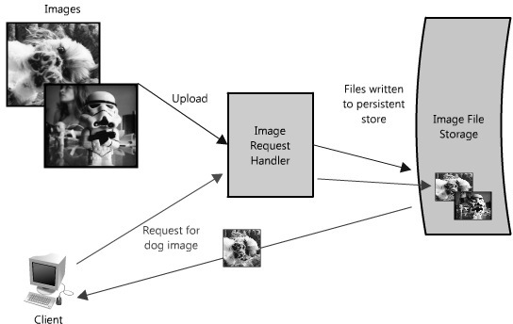
Content

Slide 11
Service
See everey component as own service
Define clear interfaces
Service Oriented Architectures (SOA)
Public-Facing API's

Slide 12
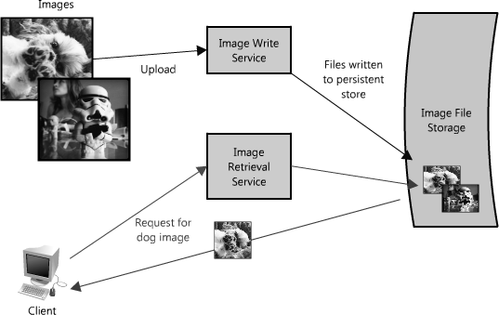
Service

Slide 13
Scheduling Algorithm
Round Robin
Weighed Round Robin
Last Connection
Least Connected Slow Start Time
Weighed Least Connected
Agent Based Adaptive

Slide 14
Caches
Notes:
Caches are faster then a DB query. advantage of idea: „Recently requested data is likely to be requested again.“
But what if we need more servers?

Slide 15
Caches
Notes:
Load Balancer distributes request -> same request different node.
—> would have cache misses
two strategies: Global and Distributed Caches.

Slide 16
Global Caches
Notes:
all servers-> one cache
cache pulls the data
(specialized hardware that make the cache very fast, or a fixed data sheet that is cached. )

Slide 17
Global Cache
Notes:
Server requests the Data

Slide 18
Distributed Cache
Notes:
every node has its own part of the cache. the

Slide 19
Queue
Notes:
writing data, saving some into a database
small systems-> no problem
Client waits for response. he is not working
under load -> performance client
synchronized
(written in several places or indexes)

Slide 20
Queue
Notes:
solution->queue
tasks are in a queu. abstraction between the client’s request and the actual work performed
acknowledgement and asks periodically
protection outages failure -> easy robust queue, retry
Multiple Queue Scheduling !!!!!!!

Slide 21
Mega Proxy Problem
Load Balancing Problem
Proxy Server
Single source IP
Group virtual sources

Slide 22
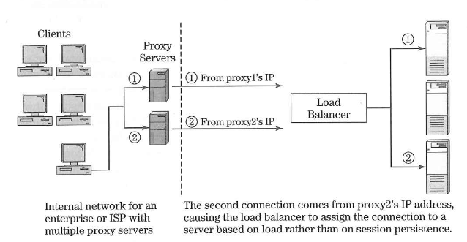
Mega Proxy Problem

Slide 23
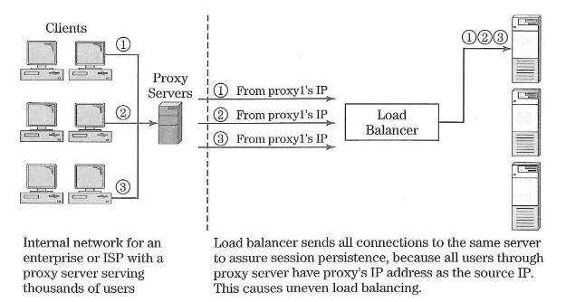
Mega Proxy Problem

