Slide 1
Load Balancing
Martin Haiden & Nikolaus Schrack

Slide 2
Need and Goals
Scalability
Availability
Performance
Manageability
Security
Costs
Fusnote fehlt
Notes:
scaling: capcity, to grow with the popularity of the business, old days-> bigger better server, now -> many
availability: if one server fails, the others can manage the traffic. -> keeping the site up (reputation,functionality of the company, e-commerce -> money loss) , to have redundancy.
performance: How fast is my application, again money loss, angry customers
manageability: how difficult operate the system, updates , to maintain and update, finding and understanding problems, health checks
security: since the Load Balancer is front end, easy point to protect from malicious users., security features

Slide 3
Products
Software Load Balancing
Appliances
Switches
Notes:
Software: on different levels of the application, runs on load balancers, algorithms to coordinate traffic, FE: nginx, mod_proxy which is a popular tool
Appliances: all-in-one products, hardware and software, Cisco
Switches: high end switches, Zen Load Balancer
Google -> software components on every level, high end switches in their data centers

Slide 4
OSI-Model

Slide 5
Scheduling Algorithm
Round Robin
Weighed Round Robin
Last Connection
Least Connected Slow Start Time
Weighed Least Connected
Agent Based Adaptive

Slide 6
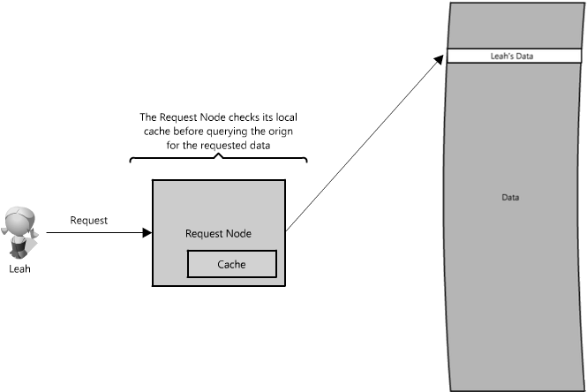
Caches
Notes:
Caches are faster then a DB query. advantage of idea: „Recently requested data is likely to be requested again.“
But what if we need more servers?

Slide 7
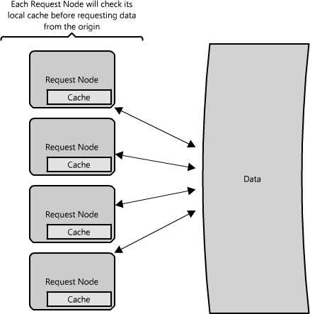
Caches
Notes:
Load Balancer distributes request -> same request different node.
—> would have cache misses
two strategies: Global and Distributed Caches.

Slide 8
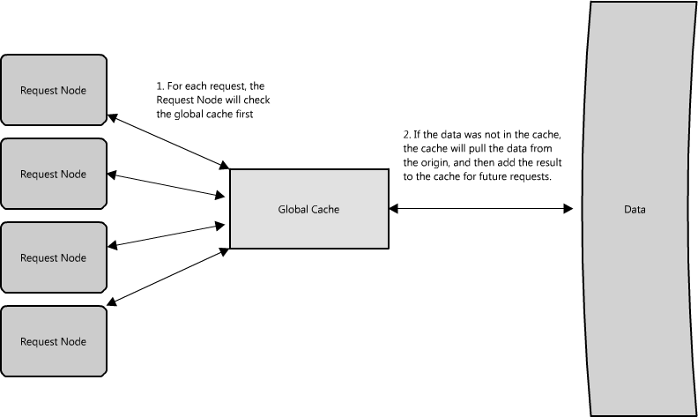
Global Caches
Notes:
all servers-> one cache
cache pulls the data
(specialized hardware that make the cache very fast, or a fixed data sheet that is cached. )

Slide 9
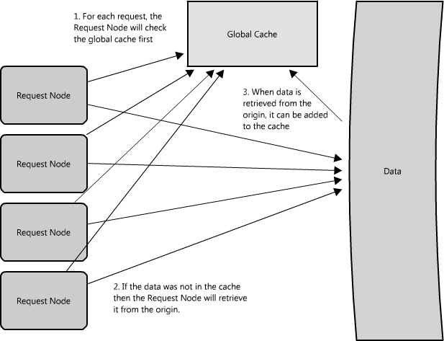
Global Cache
Notes:
Server requests the Data

Slide 10
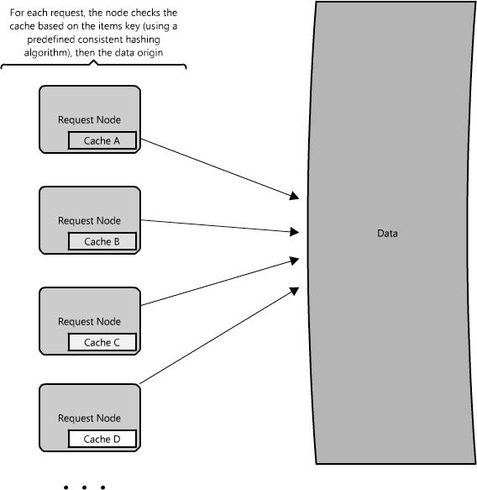
Distributed Cache
Notes:
every node has its own part of the cache. the

Slide 11
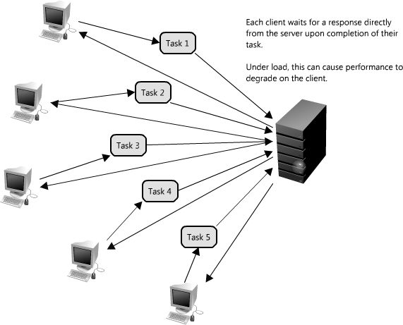
Queue
Notes:
writing data, saving some into a database
small systems-> no problem
Client waits for response. he is not working
under load -> performance client
synchronized
(written in several places or indexes)

Slide 12
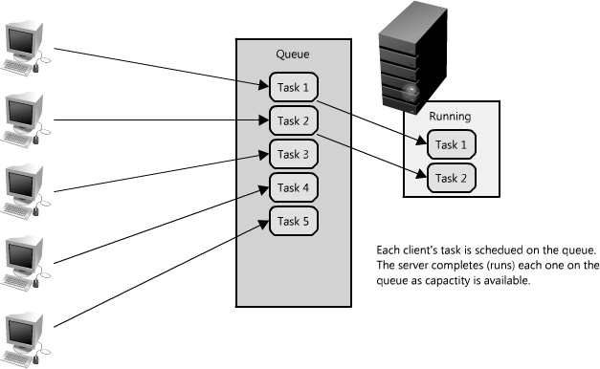
Queue
Notes:
solution->queue
tasks are in a queu. abstraction between the client’s request and the actual work performed
acknowledgement and asks periodically
protection outages failure -> easy robust queue, retry
Multiple Queue Scheduling !!!!!!!

