Slide 1
World Suicide Prevention Day
September 10th 2020
Working Together to Prevent Suicide
Facts and Figures

Slide 2


Over 800,000 people die by suicide annually,
representing 1 person every 40 seconds

Slide 3
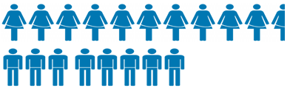
Suicide is the 15th leading cause of death globally, account for 1.4% of all deaths and
The global suicide rate is 11.4 per 100 000 population
15.0/100 000 for males 8.0/100 000 for females

Slide 4

Suicide is the leading cause of death in people aged 15-24 in many European countries
Globally suicide rates among this age group are higher in males than females
Self-harm largely occurs among older adolescents, and globally is the 2nd leading cause of death for older adolescent girls

Slide 5
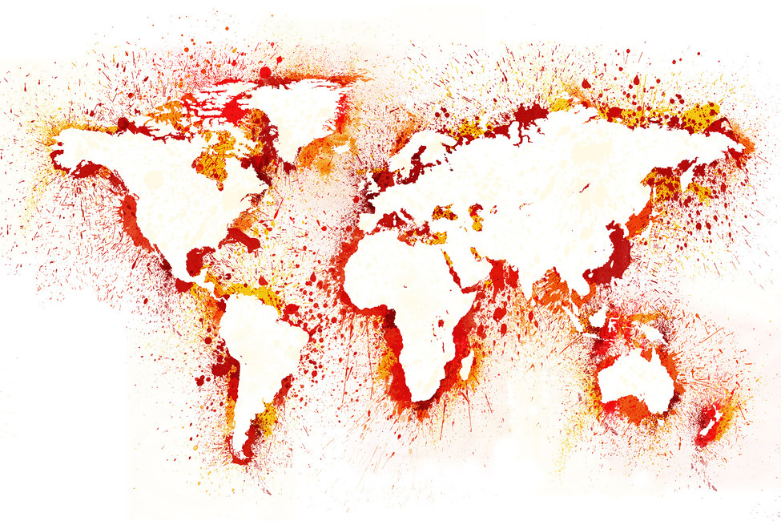
In 2012, 76% of global suicide occurred in low- and middle-income countries 39% of which occurred in the South-East Asia Region

Slide 6

In 25 countries (within WHO member states) suicide is currently still criminalized
In an additional 20 countries suicide attempters may be punished with jail sentences, according to Sharia law

Slide 7

Suicide is the result of a convergence of risk factors including but not limited to genetic, psychological, social and cultural risk factors, sometimes combined with experiences of trauma and loss

Slide 8
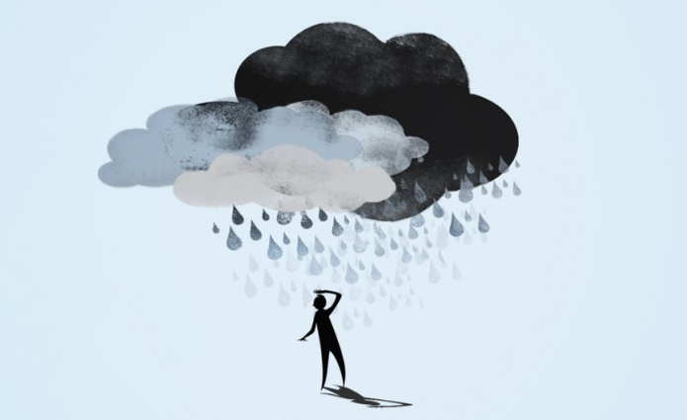
Depression is the most common psychiatric disorder in people who die by suicide
50% of individuals in high income countries who die by suicide have major depressive disorder at their time of death

Slide 9
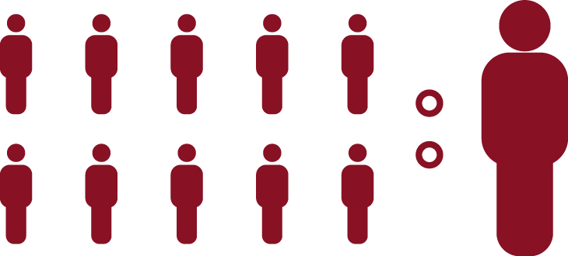
For every 1 suicide 25 people make a suicide attempt

Slide 10

135 people are affected by each suicide death
This equates to 108 million people bereaved by suicide worldwide every year

Slide 11
Relatives and close friends of people who die by suicide are a high-risk group for suicide, due to:
The psychological trauma of a suicide loss
Potential shared familial and environmental risk
Suicide contagion through the process of social modelling, and
The burden of stigma associated with this loss

Slide 12

Suicide prevention strategies aim to prevent suicide among targeted high-risk groups but also at a universal level
Effective suicide prevention strategies need to incorporate public health policy strategies and healthcare strategies, incorporating measure with the strongest evidence of efficacy such as:
Restriction of access to lethal means
Treatment of depression
Ensuring chain of care, and
School-based universal prevention

Slide 13
Suicide prevention programmes face ongoing challenges including:
Insufficient resources
Ineffective coordination
Limited access to surveillance data on suicide and self-harm
Lack of enforced guidelines
Lack of independent and systematic evaluation

Slide 14
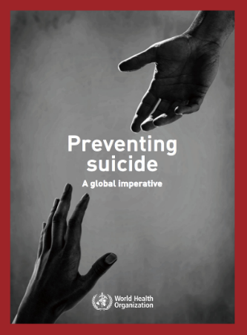

Since the 2014 WHO Global Report Preventing Suicide, progress in suicide prevention is ongoing, particularly in countries where no suicide initiatives were active, such as Guyana, Suriname and Bhutan
Many countries have initiated their 2nd national suicide prevention programme, including: Scotland, England, Ireland and the United States

Slide 15
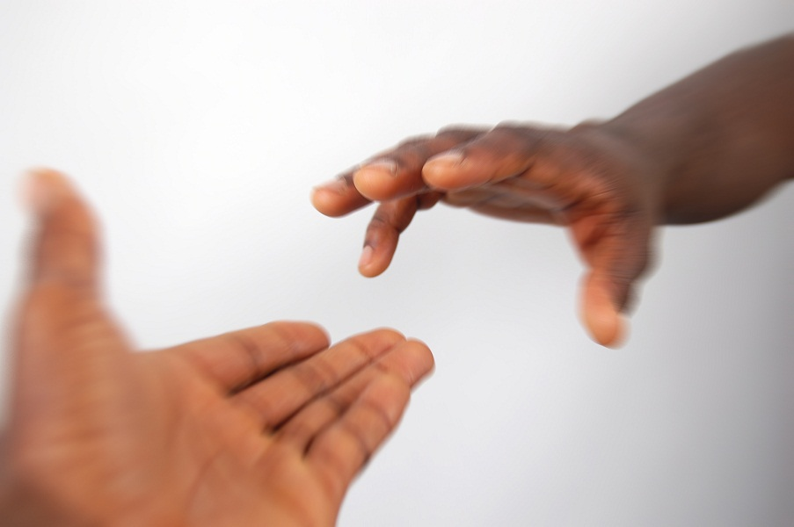
Take a minute, change a life
This World Suicide Prevention Day and everyday take a minute to reach out to someone - a complete stranger, close family member or friend - this can change a life

Slide 16

The importance of community
We are all part of a community, linked to family, friends, work colleagues, neighbours or teams.
Sometimes we become isolated and disconnected from our communities.
We have the responsibility to support and empower those who become vulnerable in our communities.

Slide 17

Reaching out to those in the community
If you are worried about someone in your community reach out and ask them “are you okay?”
By simply checking in with them and offering non-judgemental support you can make a difference.

Slide 18

Empowering our community
Encourage those in distress to tell their own story in their way and at their pace.
By engaging in active listening and reaching out to those who are vulnerable in the community together we can build resilient and strong communities

Slide 19

No one has all of the answers
People are often reluctant to intervene when they are worried for others.
They may not feel knowledgeable enough or may not feel like the right person.
It is important to know that people in distress are often not looking for specific advice, but merely to be listened to with compassion and empathy.

Slide 20
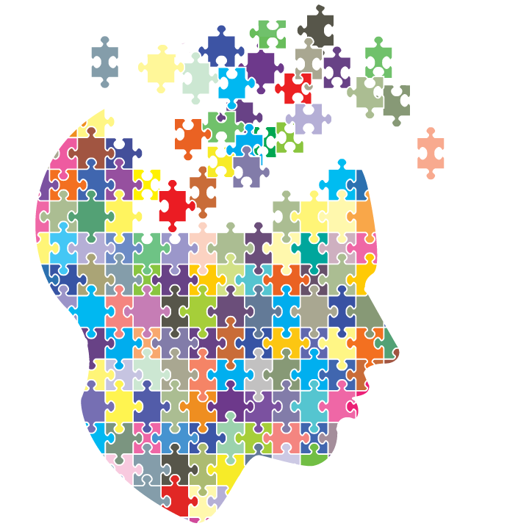
Learn from people who reach out
People with lived experience of suicidal behaviour or suicide bereavement have a lot to teach us.
By listening to these often inspiring individuals we are learning and they may become empowered to seek help.

Slide 21
Visit the WSPD webpage at: https://iasp.info/wspd2020/
Working Together to Prevent Suicide
References:
WHO, 2014; Mishara & Weisstub 2016; Arsenault-Lapierre et al., 2004; Cavanagh et al., 2003; Pitman et al., 2016; Zalsman et al., 2017

