Slide 1

AI Integration in Procurement and Sales
This presentation explores the transformative potential of AI in procurement and sales modules, highlighting key features and benefits for businesses.

Slide 2
AI in Procurement: Revolutionizing Purchasing
Cost Forecasting
Demand Forecasting
Forecast the estimated cost according to the item, project or any other category
AI analyzes historical data to predict future demand, enabling better procurement planning.

Slide 3
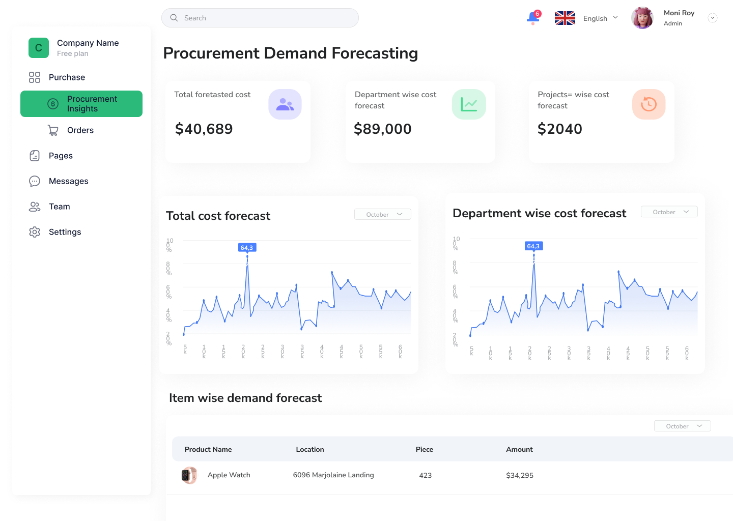

Slide 4
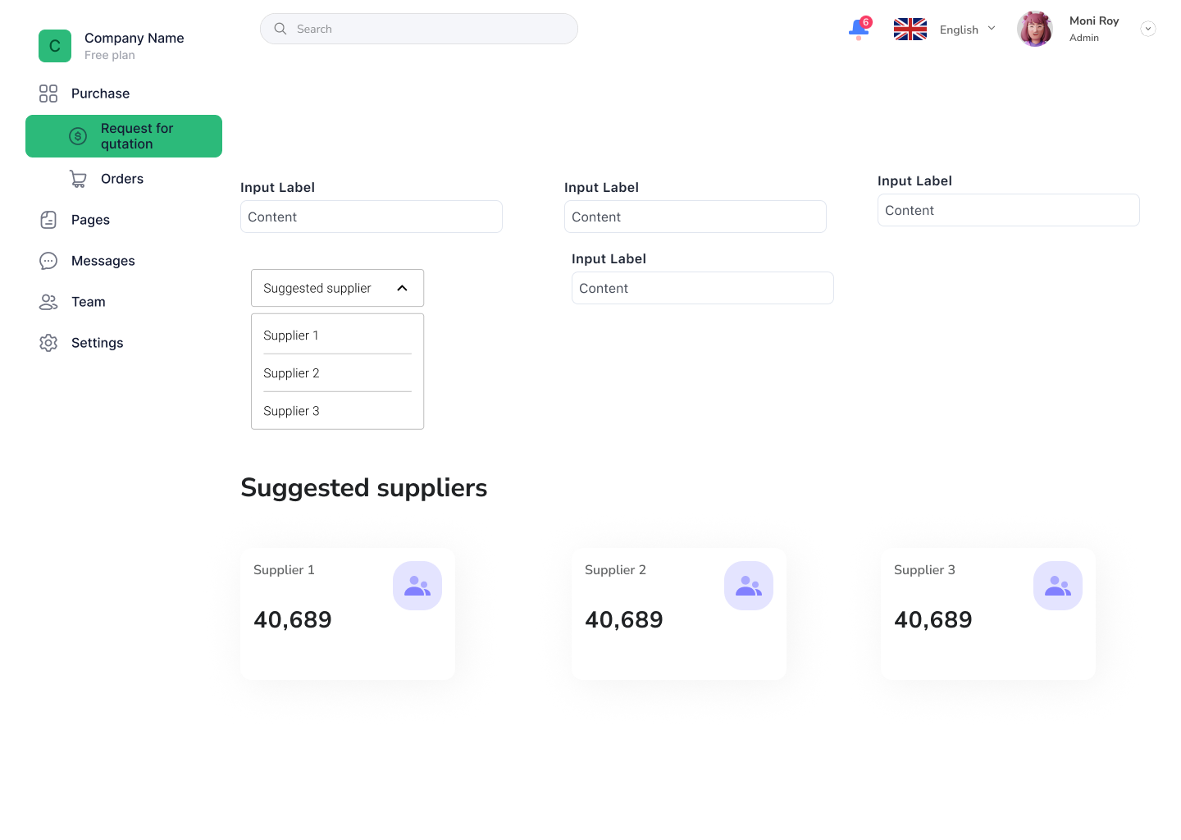
Supplier Selection
AI algorithms evaluate suppliers based on performance, price, quality, and reliability.

Slide 5
AI in Procurement: Mitigating Risks
Estimation of returned item
Risk Assessment
% of returned item in a year according to category could be forecasted
AI identifies risks like supplier failures, delivery delays, or price fluctuation due to natural causes

Slide 6
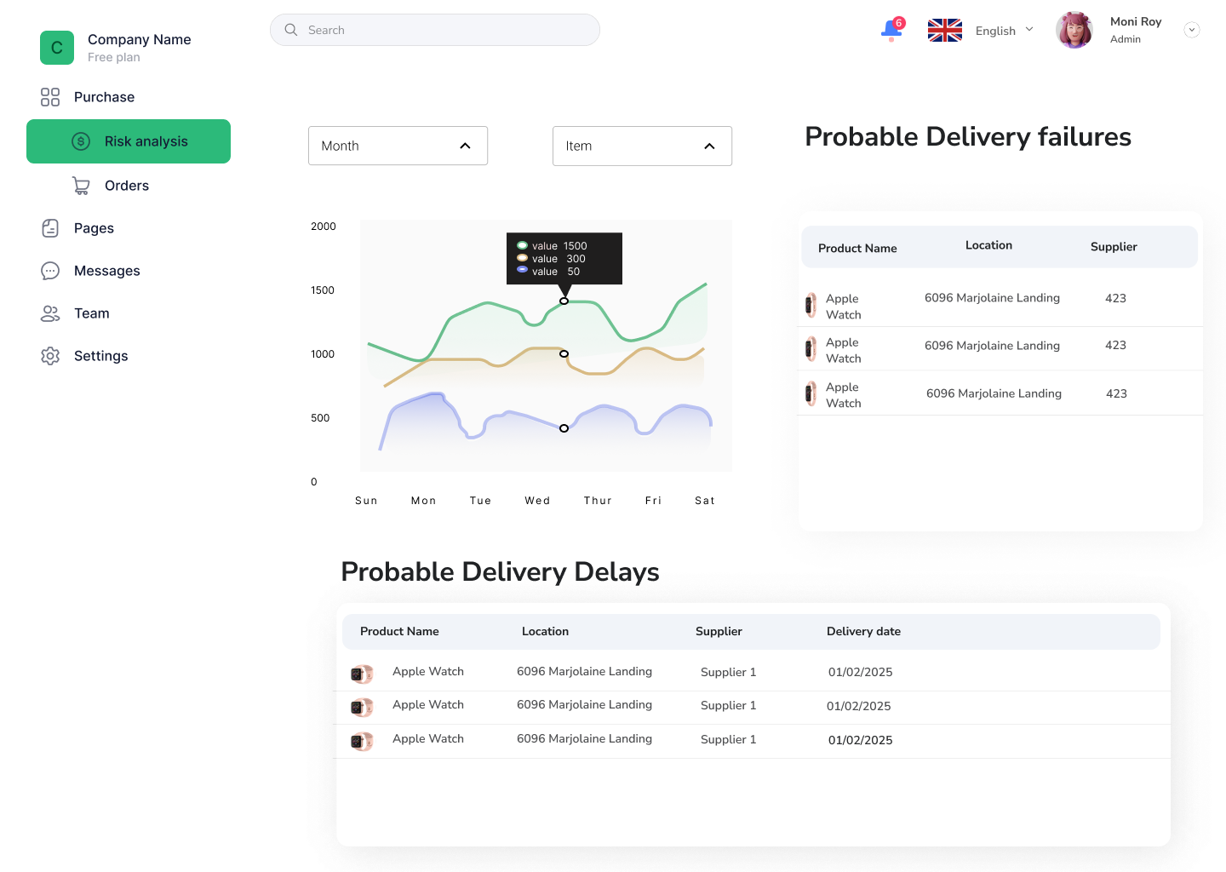

Slide 7
AI in Procurement: Mitigating Risks and Enhancing Analytics
Price Optimization
Automated RFQ suggestion
AI monitors market trends and suggests optimal pricing strategies for procurement.
AI automatically validates and approves purchase requests based on predefined rules.

Slide 8
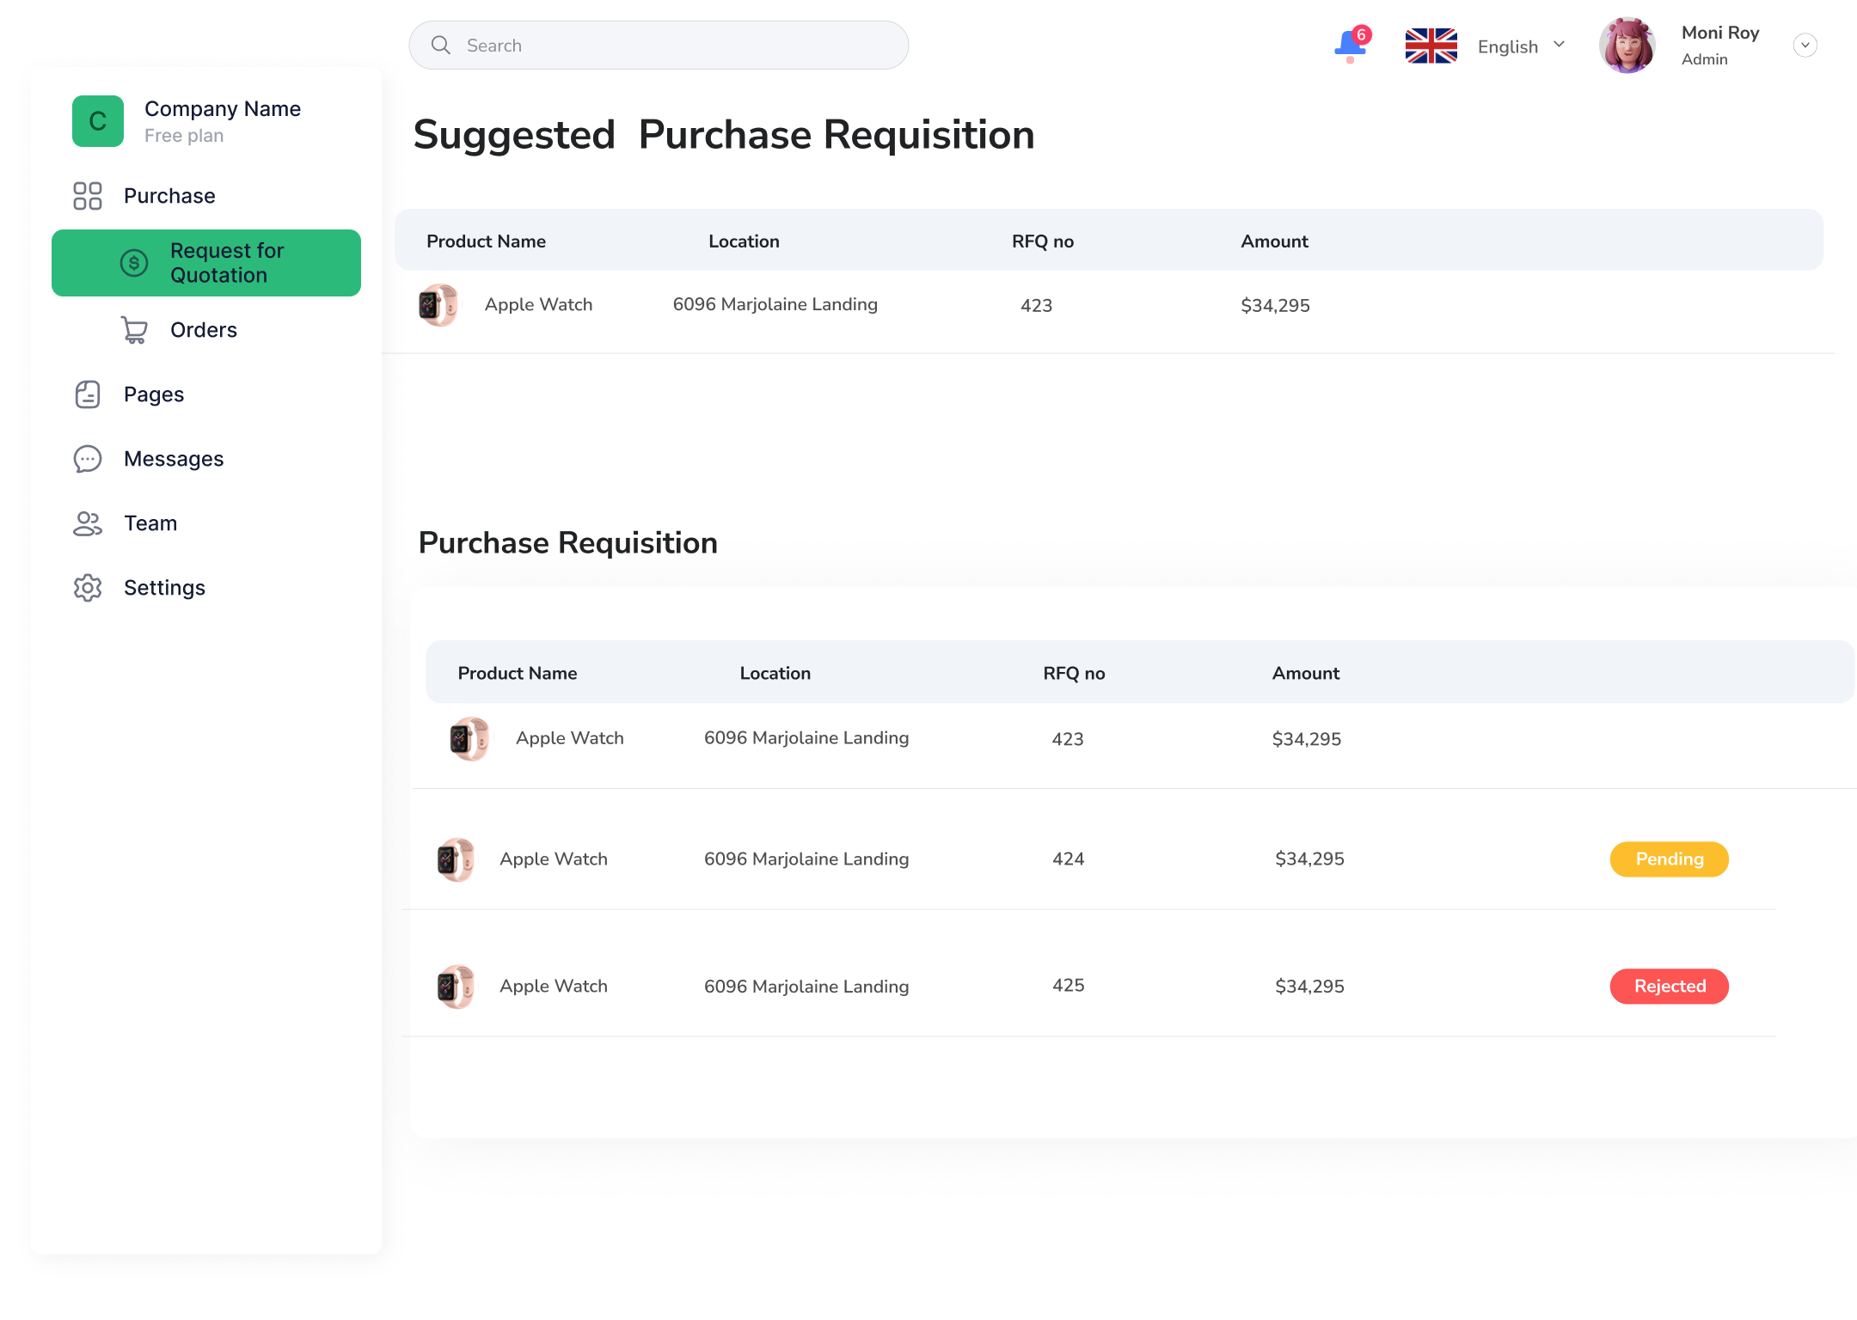

Slide 9
AI in Sales
1
Sales Forecasting
AI predicts future sales trends to set realistic sales targets.
3
Dynamic Pricing
AI adjusts prices in real-time based on demand, competition, and market factors.
2
Returned item forecasting
AI could forecast the returned item in sales process which could help the company to take necessary action

Slide 10
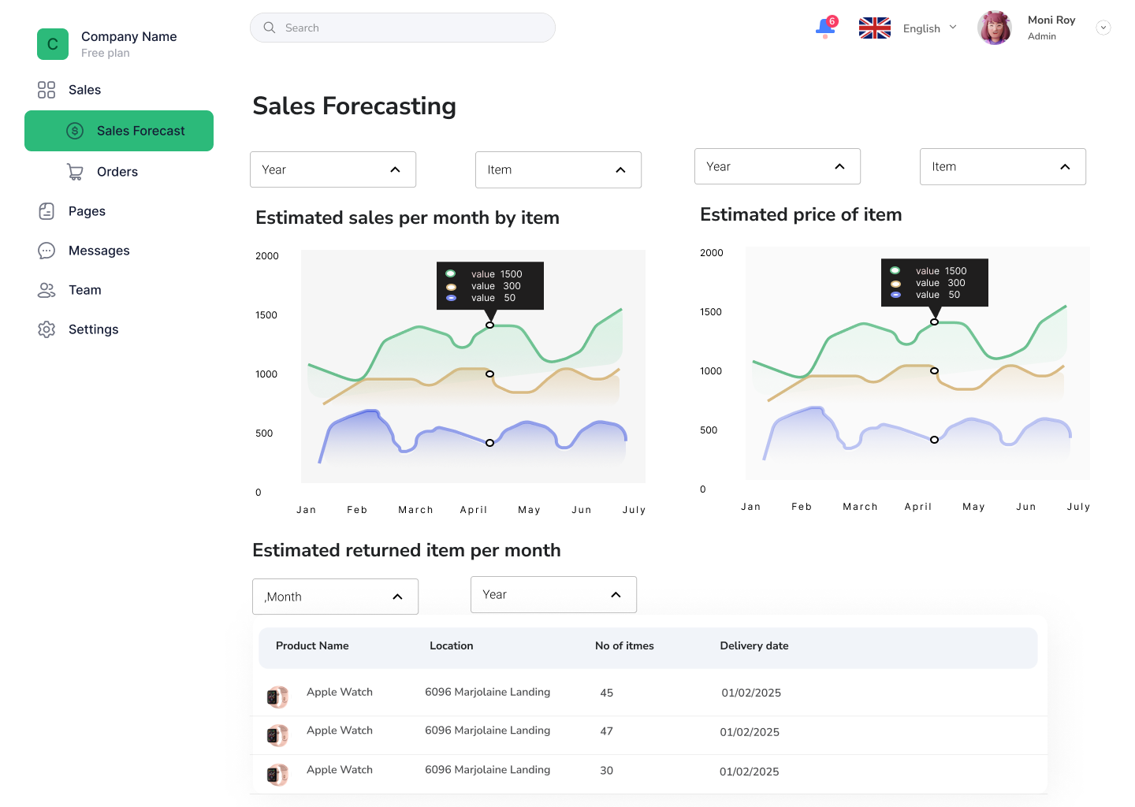

Slide 11
AI in Accounts
1
Budget prediction and Optimization
AI-driven Budget Predictions: Use machine learning algorithms to predict future budget allocations based on historical data. The AI can analyze past budget usage and identify trends to suggest adjustments.
Budget Optimization: AI can suggest optimized budget distributions across different departments or projects, aiming to reduce waste and maximize efficiency based on past spending patterns.
2
Automated Approval of Expense/advance
AI-based Approval Workflow: Automate the approval process by integrating AI that reviews the legitimacy of expenses and advances, using predefined rules or historical approval data to flag expenses that deviate from the norm.

Slide 12
AI in Inventory
1
Valuation Forecasting
Existing Feature: Valuation displays a donut chart of inventory types
AI Enhancement: Use AI to predict future inventory valuation based on historical data, trends, and demand forecasts for each item type.
2
Item Issue Allocation
Existing Feature: Item issues are manually tracked and managed based on approved requisitions.
AI Enhancement: Implement an AI algorithm that automatically assigns the most efficient allocation of items from inventory to users or departments based on urgency, availability, and historical usage.

Slide 13
AI in Inventory
3
Inventory aging analysis
Existing Feature: Coverage days and valuation display overall inventory health.
AI Enhancement: Use AI to analyze the aging of inventory items and predict which items are likely to become obsolete or unsellable soon based on usage rates and shelf life. It could also suggest optimal actions (e.g., markdowns, promotions) for slow-moving items.

Slide 14
AI in HR
1
Employee Categorization
Classifying employee based on different criteria like late entry, early leave, absent days, taken leaves etc
2
Automated leave approval
AI can analyze the leave application and after analyzing the leave application it can approve or disapprove the request which will make the process more easier.

Slide 15
AI in Asset Mgmt.
1
Asset Valuation Prediction
AI-based Valuation Models: Use machine learning algorithms to predict the future valuation of assets based on factors like depreciation, market trends, and the asset’s condition. This can assist in more accurate financial reporting.
Depreciation Prediction: AI can predict the depreciation curve of assets over time, helping with financial forecasting and asset value management.
2
AI-Powered Decision Support
Recommendation Systems for Asset Disposal: AI can suggest which assets should be sold, retired, or destroyed based on factors like depreciation rates, maintenance costs, and operational performance.

Slide 16
AI in Production
1
Production Scheduling Optimization
How AI Helps: AI can automate production scheduling by analyzing various factors such as machine capacity, labor availability, material procurement times, and past production data. AI models like genetic algorithms, reinforcement learning, or optimization algorithms can suggest the best scheduling configurations.

Slide 17
Thank you
Any Questions?

