Slide 1

ROBIL Project
OVERVIEW

Slide 2
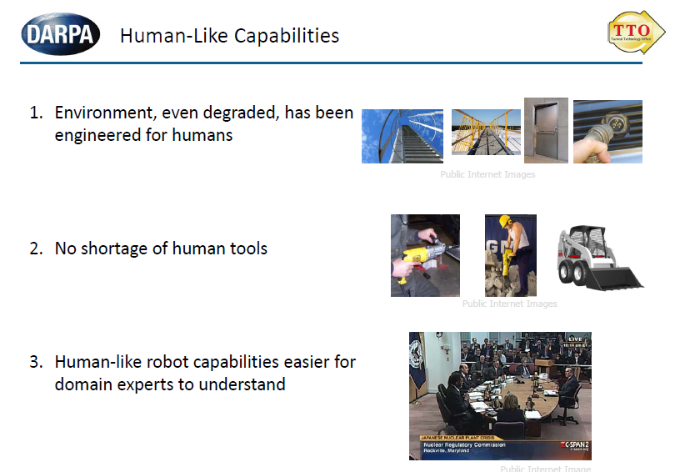
DRC - Disaster Recovery Challenge
Notes:
2

Slide 3
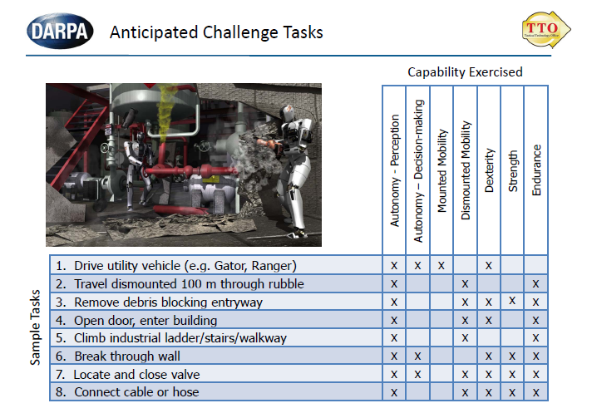
Notes:
3

Slide 4
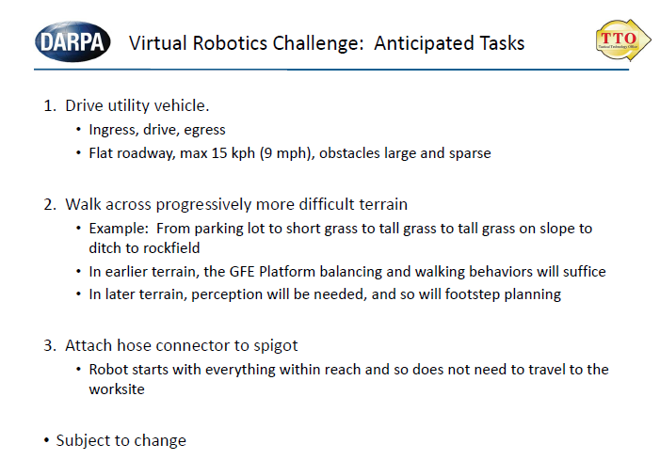
Notes:
4

Slide 5
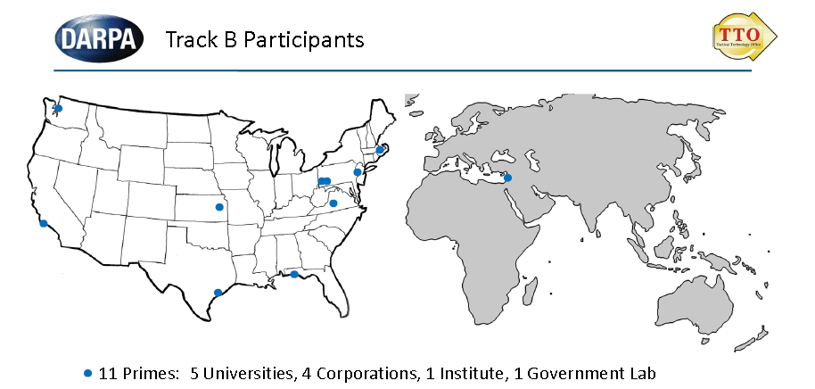
Four countries (including subcontractors) Germany, Israel, Japan, United States
ROBIL – Integration Procedures
5

Slide 6
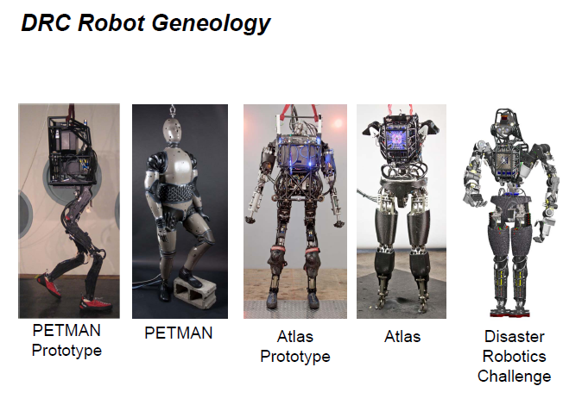
Boston Dynamics’ Robot
ROBIL – Integration Procedures
6

Slide 7
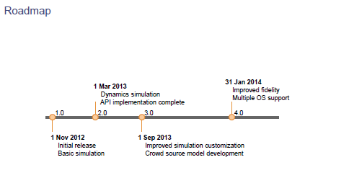
ROBIL – Integration Procedures
7

Slide 8






An ad-hoc consortium combined of the leaders in the Israeli robotics industry and
academia, includes 20 key personnel and over 40 grad students and engineers
Notes:
8

Slide 9
IAI Involvement
Light involvement in Perception (system engineering)
Human Machine Interface (called also OCU)
Integration of the work of around 20 teams
ROBIL – Integration Procedures
9

Slide 10
Environment
Operating System: Ubuntu 12.04 LTS
Open Sources Infrastructure: from OSRF (Open Source Robotic Foundation)
ROS – Robotic Operating System
Gazebo: simulator
DRC Sim : humanoid robot simulation specific to Darpa Challenge
ROBIL – Integration Procedures
10

Slide 11
INTEGRATION
Version control: git
Software repository: www.github.com
Automatic compilation and tests: Jenkins
Testing on the cloud
Bug tracking with Trac
ROBIL – Integration Procedures
11

Slide 12
Methodology-1
GIT HUB
ROBIL
Official Tree
ro
PULL REQUEST
FORK
RemoteC21
CLONE/PULL
Local Git Repository
PUSH
Local C21

Slide 13
Methodology-2
New Version!!!
GIT HUB
ROBIL
Official Tree
ro
PULL REQUEST
FORK
RemoteC21
PUSH
PULL
CLONE/PULL
Local Git Repository
PUSH
Integrator Local
RemoteC21
Integrator
Local C21

Slide 14
Methodology-3
GIT HUB
ROBIL
Official Tree
ro
RemoteC51
FORK
RemoteC21
FORK
PULL
CLONE/PULL
CLONE/PULL
Local Git Repository
PUSH
Another location
Local C51
Local C21

Slide 15
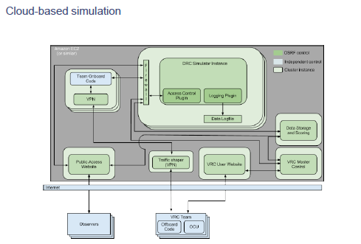
VRC Environment

Slide 16
Cloudsim
Perception
Gazebo
DRCSIM
In the cloud:
Field Computer 1 (with GPU)
Field Computer 2
Simulator
Field Computer1
Simulator
ROS
Private LAN
Field Computer2
Router
ROBIL
VPN
Msg/TCPIP
OCU – (GUI)
HMI
ROBIL – Integration
16

Slide 17
Cloudsim
FC1= Field Computer 1 (with GPU)
FC2= Field Computer 2
VPN= Virtual Private Network
OCU= Operator Console Unit (User Interface)
FC1
Local Private Network
FC2
Simulator
Router
VPN
OCU
ROBIL – Integration
17

Slide 18
Cloudsim
Field Computer
ROS
Simulator Computer
ROBIL CODE
Private Network
GAZEBO DRCSIM
ROS
Router
10.0.0.x
11.8.0.x
VPN: IP Tunnel
Local Computer
OCU – User Interface
ROBIL – Integration
18

Slide 19
Trac
Site and Bugs Tracker: www.robil.org
ROBIL – Integration
19

Slide 20
Movies
ROBIL – Integration
20

