Slide 1

ROBIL Project
OVERVIEW

Slide 2
DARPA Initiative
http://www.darpa.mil/
http://www.theroboticschallenge.com/

Slide 3
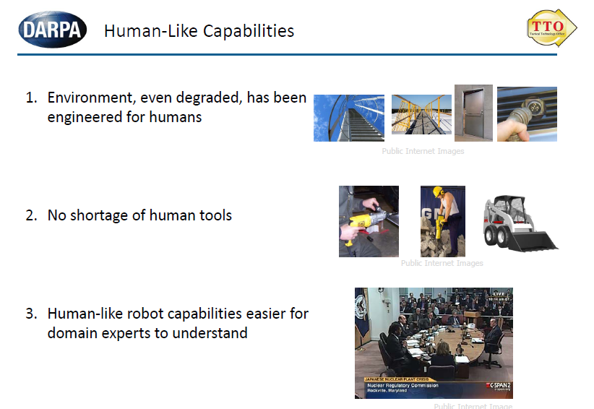
DRC - Disaster Recovery Challenge

Slide 4
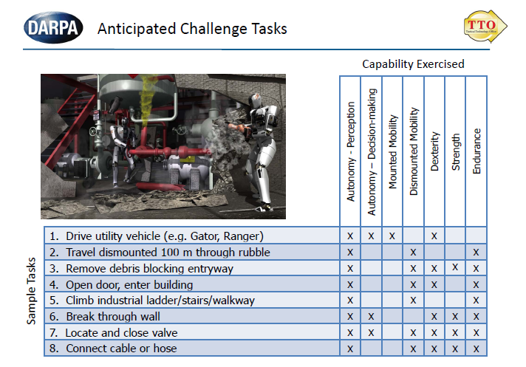

Slide 5
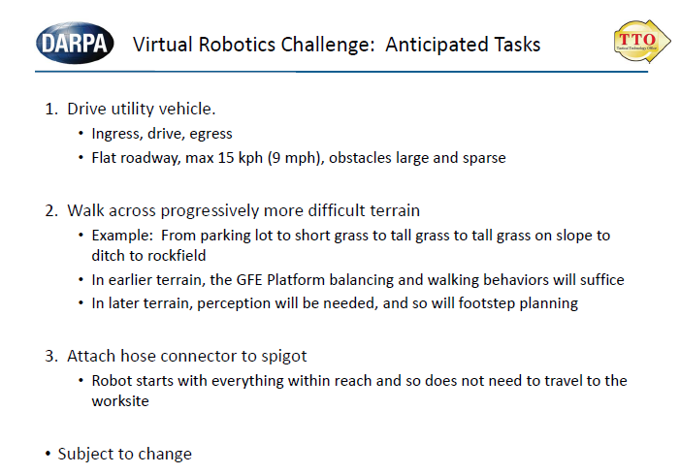

Slide 6
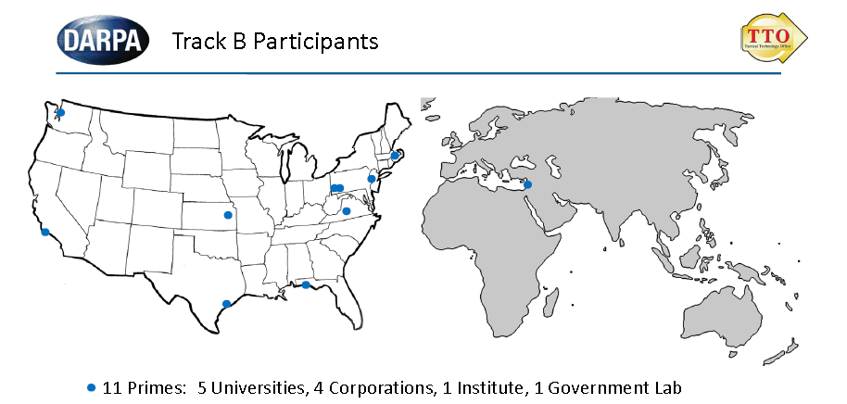
Four countries (including subcontractors) Germany, Israel, Japan, United States

Slide 7
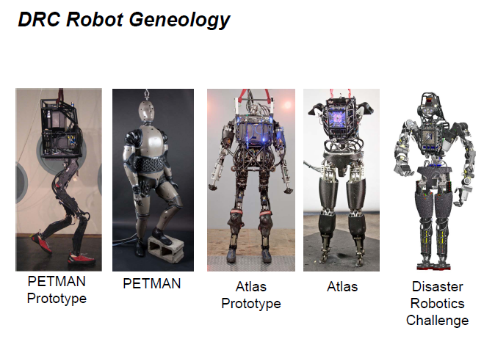
Boston Dynamics’ Robot

Slide 8
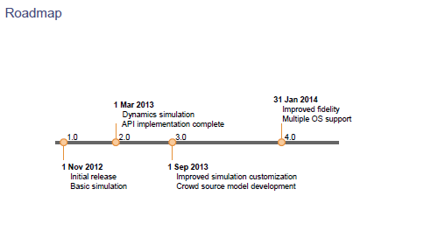

Slide 9






An ad-hoc consortium combined of the leaders in the Israeli robotics industry and academia, includes 20 key personnel and over 40 grad students and engineers

Slide 10
IAI Involvement
Light involvement in Perception (system engineering)
Human Machine Interface (called also OCU)
Integration of the work of around 20 teams

Slide 11
Environment
Operating System: Ubuntu 12.04 LTS
Open Sources Infrastructure: from OSRF (Open Source Robotic Foundation)
  ROS – Robotic Operating System
  Gazebo: simulator
  DRC Sim : humanoid robot simulation specific to Darpa Challenge

Slide 12
INTEGRATION
Version control: git
Software repository: www.github.com
Automatic compilation and tests: Jenkins
Testing on the cloud
Bug tracking with Trac

Slide 13
Git and Github(1)
GIT HUB
ROBIL
Official Tree
ro
PULL REQUEST
FORK
RemoteC21
CLONE/PULL
Local Git Repository
PUSH
Local C21

Slide 14
Git and Github(2)
New Version!!!
GIT HUB
ROBIL
Official Tree
ro
PULL REQUEST
FORK
RemoteC21
PUSH
PULL
CLONE/PULL
Local Git Repository
PUSH
Integrator Local
RemoteC21
Integrator
Local C21

Slide 15
Git and Github(3)
GIT HUB
ROBIL
Official Tree
ro
RemoteC51
FORK
RemoteC21
FORK
PULL
CLONE/PULL
CLONE/PULL
Local Git Repository
PUSH
Another location
Local C51
Local C21

Slide 16
Jenkins
PULL REQUEST
GIT HUB
Jenkins
RemoteC21
Copy Repository, Compile and
Sanity and Regression Tests
Hooks
PUSH
Local Git Repository
Local C21
Check Results

Slide 17
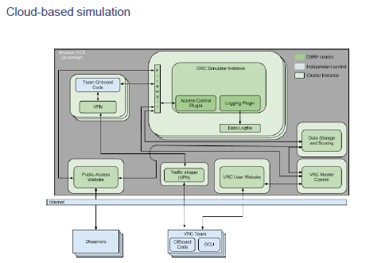
VRC Environment

Slide 18
Cloudsim
Field Computer
ROS
Simulator Computer
ROBIL CODE
Private Network
GAZEBO DRCSIM
ROS
Router
10.0.0.x
11.8.0.x
VPN: IP Tunnel
Local Computer
OCU – User Interface

Slide 19
Trac
Site and Bugs Tracker: www.robil.org

Slide 20
Movies

