Slide 1
Introduction to
Web Scraping
By: Maan Al Neami

Slide 2
Table of contents
01
What is Web Scraping
04
Beautifulsoup
02
Scraping tools
05
Other tools
03
Inspect Data
06
Ethics
Explain what is web scraping in why to use it
How to use Beautifulsoup for scraping in Python
See different tools for web scraping and the differences between them
You can describe the topic of the section here
How to use Beautifulsoup for scraping in Python
You can describe the topic of the section here

Slide 3
—SOMEONE FAMOUS
“This is a quote, words full of wisdom that someone important said and can make the reader get inspired.”

Slide 4
01.
What is Web Scraping
Username
Menu
Web Scraping is is the process of collecting data from a web page. It can be done manually or it can be automated, which we will be what talking about.
Answers
Setting

Slide 5
Why to use Web Scraping
Them
Faster
It provides us with accurate and consistent data as there is less chance of error.
Using Web Scraping tools to automate this process can help you do it in a fraction of the time.

Slide 6
Challenges of web scraping
Anti scraping
Changes
Some webpages make it harder for you to scrape them. This includes major to detect bots and block them
Webpages are updated frequently which can break your script

Slide 7
02.
Web Scraping tools
Let’s explore the tools we can use

Slide 8



What tools to use?
Beautiful soap is a Python library for pulling data out of HTML and XML files. It’s beginner friendly but need other libraries to work.
Scrapy is a web-crawling framework. Fast and can handle large data but isn’t beginner friendly
Selenium is primarily used for automating web browser interactions. It can be used with Scrapy and other tools to create a powerful web scraper.

Slide 9
03.
Inspect Your Data Source
The first step in any web scraping project is to:
Find a Website
Inspect the site structure using Developer Tools
Understand the URL
And the most important thing: Legal and Ethical Considerations

Slide 10
Our considerations
Legal
Ethical
Respect others privacy
Data collection ethics
Malicious uses
Don't break the website with too much requests.
Make sure you are not breaking any of the site rules.
Respect copyright and intellectual property

Slide 11
Inspecting the Structure
You can see the Website HTML structure using Google Chrome Inspect tool. Which you can open by right clicking the page and choose inspect, or using CTRL+Shift+C and clicking on the part you want to scrap.
Users
Prices
Likes
Followers

Slide 12
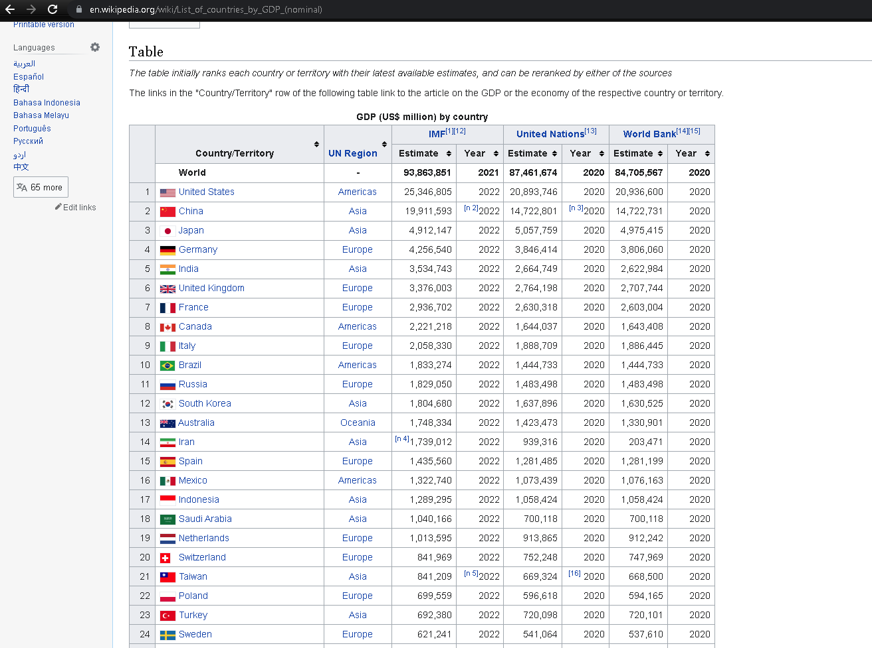
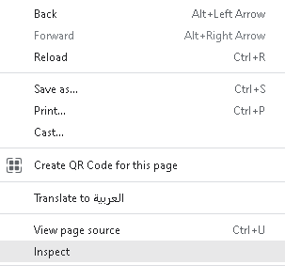
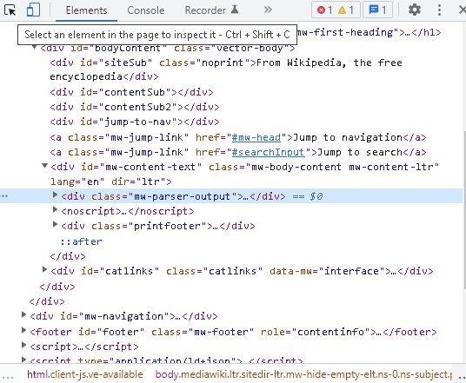
Step 1
Step 2
Step 3

Slide 13
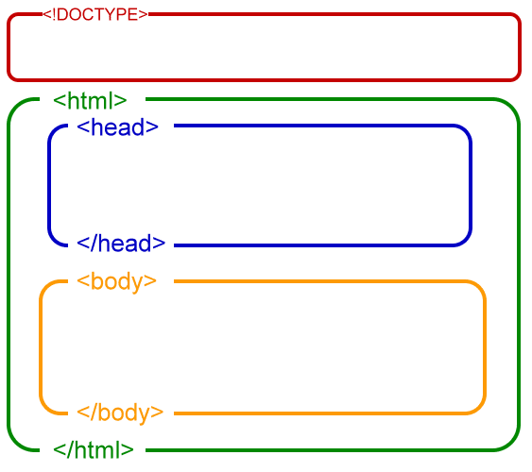
HTML Structure
In HTML, document is composed of three parts:
a line containing HTML version information,
a declarative header section (delimited by the HEAD element),
a body, which contains the document's actual content. The body may be implemented by the BODY element or the FRAMESET element.

Slide 14

HTML Elements
HTML also has many different Elements or “tags”, defined by a start tag, some content, and an end tag. Like this <div>something</div>
These tags can have different attributes inside them. Such as Class and id, which we can use to find the elements we want to scrape.

Slide 15
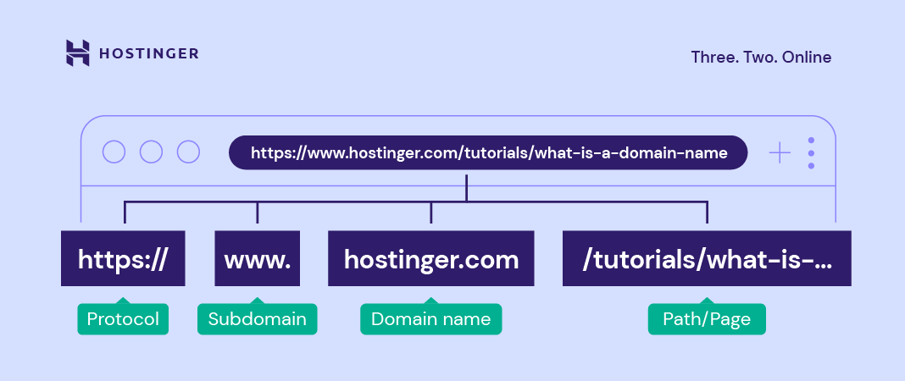

URL
URL stands for Uniform Resource Locator (URL), it refer to the web page specific location or address on a computer network.
By understanding how the the URL works you can encode a lot of useful informations, like how the pagination functions in the site.

Slide 16
04.
Starting with Beautiful soap
Using Beautiful soap to scrap real estate data

Slide 17


Installing libraries
For this demo you will need the following libraries:
BeautifulSoup
Requests
Pandas
Requests will allow us to send HTTP requests for online webpages. While BeautifulSoup allow us to parse the HTML doc to find our data. And Pandas will be used to convert the data to CSV format.

Slide 18
Writing the code
Let’s import the libraries:
import requests
from bs4 import BeautifulSoup
from pandas import DataFrame
Next we initialize the variables we need:
url = 'https://www.pararius.com/apartments/amsterdam/page-2'
title = []
loc = []
price = []
area = []
rooms = []

Slide 19
Writing the code
Now send the HTTP request than turn the result into HTML document using bs4:
result = requests.get(url)
doc = BeautifulSoup(result.content, "html.parser")
Next we use find_all() to find all the sections where our data is located:
items = doc.find_all("section",class_="listing-search-item")

Slide 20
Writing the code
Now that our data are inside items . We will loop through it to find all
the variables we need and append them to their lists:
for item in items:
title.append(item.find("a", class_="listing-search-item__link--title").text)
loc.append(item.find("div", class_="listing-search-item__location").text.strip())
price.append(item.find("div", class_="listing-search-item__price").text.strip())
area.append(item.find("li", class_="illustrated-features__item illustrated-features__item--surface-area").text)
rooms.append(item.find("li", class_="illustrated-features__item illustrated-features__item--number-of-rooms").text)

Slide 21
Writing the code
Finally, we store the the data we have in CSV format:
data = { 'Title': title, 'Loc': loc, 'Price': price, 'Area': area, 'Rooms': rooms}
df = DataFrame(data, columns = ['Title', 'Location', 'Price', 'Area', 'Rooms'])
df.to_csv(r'C:\Users\***\***\bs4data.csv')

Slide 22
05.
Other Tools
Here we will discuss other tools you can use to scrape data from the web

Slide 23



Other tools
Parsehub is a non-programing tool to web scrape.
Octoparse is similar to Parsehub so it doesn’t require programing
Google sheets can be used for light web scraping using importhtml()

Slide 24
Mix tools
BeautifulSoap
Scrapy
Selenium
Parsehub
Selenium
Parsehub
Powerful HTML parser. Beginner friendly
A very powerful web scraping tool. Hard for Beginners
Browser automation tool. Great for scraping dynamic webpages
BS4
Scrapy
Easy to use no coding web scraping tool. May require payment

Slide 25
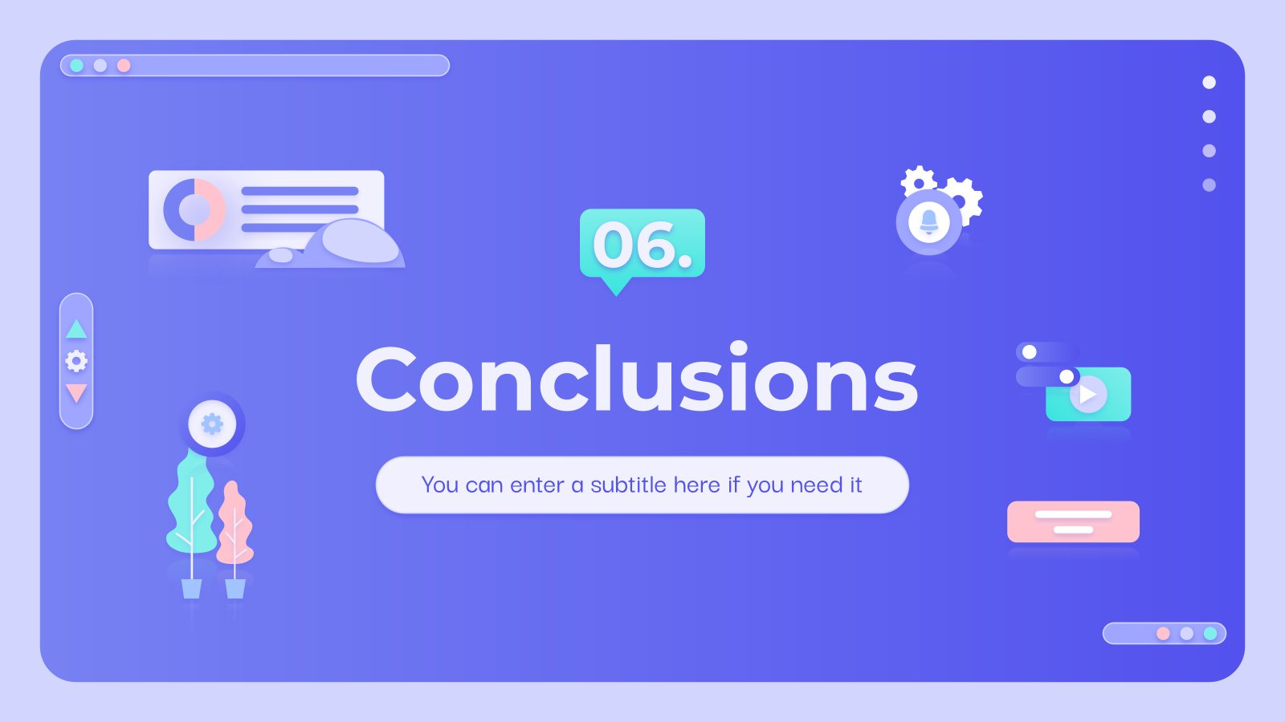

Slide 26
Conclusion
We learned the following:
Step through a web scraping lifecycle from start to finish
Inspect the HTML structure of the site with browser’s developer tools
Understand the URL
Download the page’s HTML content using requests library
Parse the downloaded HTML with BeautifulSoup to extract the wanted information
Write the code to collect the data
Turn the data into Dataframe

Slide 27
References
I used the following references:
https://www.geeksforgeeks.org/implementing-web-scraping-python-beautiful-soup/
https://opensource.com/article/21/9/web-scraping-python-beautiful-soup
https://realpython.com/beautiful-soup-web-scraper-python/
https://hevodata.com/learn/8-best-web-scraping-tools/
https://medium.com/analytics-vidhya/webscraping-a-site-with-pagination-using-beautifulsoup-fa0a09804445
https://www.storybench.org/to-scrape-or-not-to-scrape-the-technical-and-ethical-challenges-of-collecting-data-off-the-web/

Slide 28
Thanks!
Do you have any questions?
Maan Al Neami

